Slide 1
Intro to JS
Topic: Create a simple bioinformatics tool in the browser

Slide 2
TOOLS
A browser
A text editor ( my choice is VS code)

Slide 3
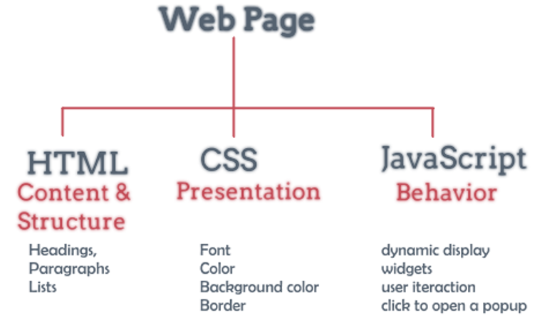

Slide 4
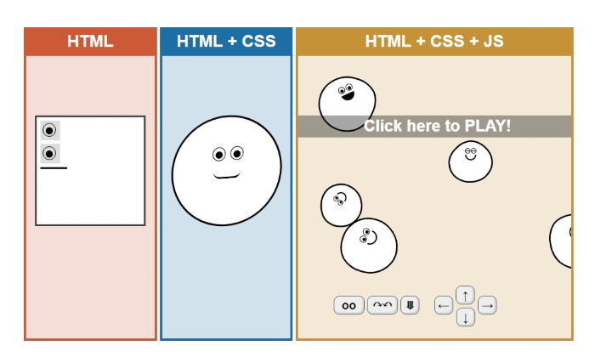

Slide 5
Common Bioinformatic Problem:
Find the mutations given the wild type and the mutant
Display it in the browser

