Slide 1
Research Summary 2013-14 Academic Year
09 May 2014

Slide 2
Overview - Pterodactyl
Pterodactyl Project Goals
Project Motivation
Background Research
Vehicle Design
Simulation and Control
Airplane Mode
Rotorcraft Mode
Design Optimization
Future Work

Slide 3
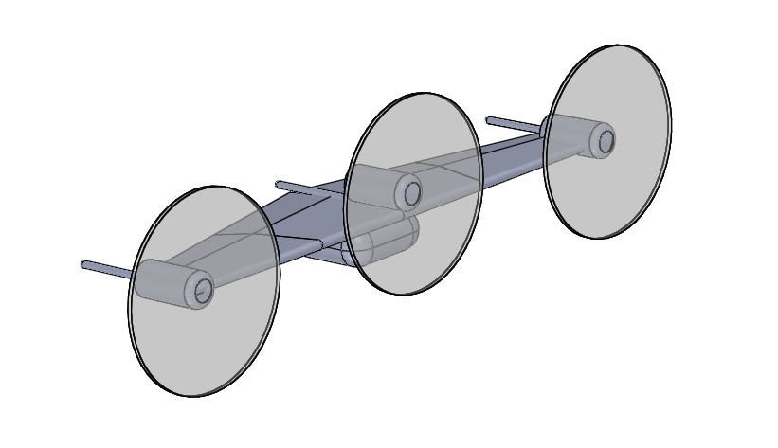
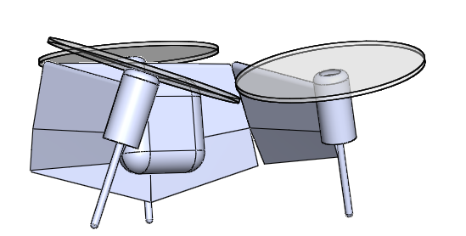
Project Goals
Design and build autonomous aircraft
Morphing design for improved versatility
Quantify performance characteristics
Optimize design geometry

Slide 4
Project Motivation
A morphing UAS can adapt to its mission
Operate as plane for covering long distances
Operate as rotorcraft for landing/loiter
Potential to use morphing as control surface
Compact design is easily deployable/retrievable
Develop techniques for quantifying performance

Slide 5
Background Research
Developed 6-DoF simulator
Good accuracy/speed trade off at 100 Hz
Can be run at 1 kHz for heightened fidelity
Implemented for Euler angles and quaternions
NACA 0012 airfoil used for body
Aerodynamic look-up tables utilized
Data compiled by Trevor Bennett
Using Strips theory for lateral/longitudinal coupling

Slide 6
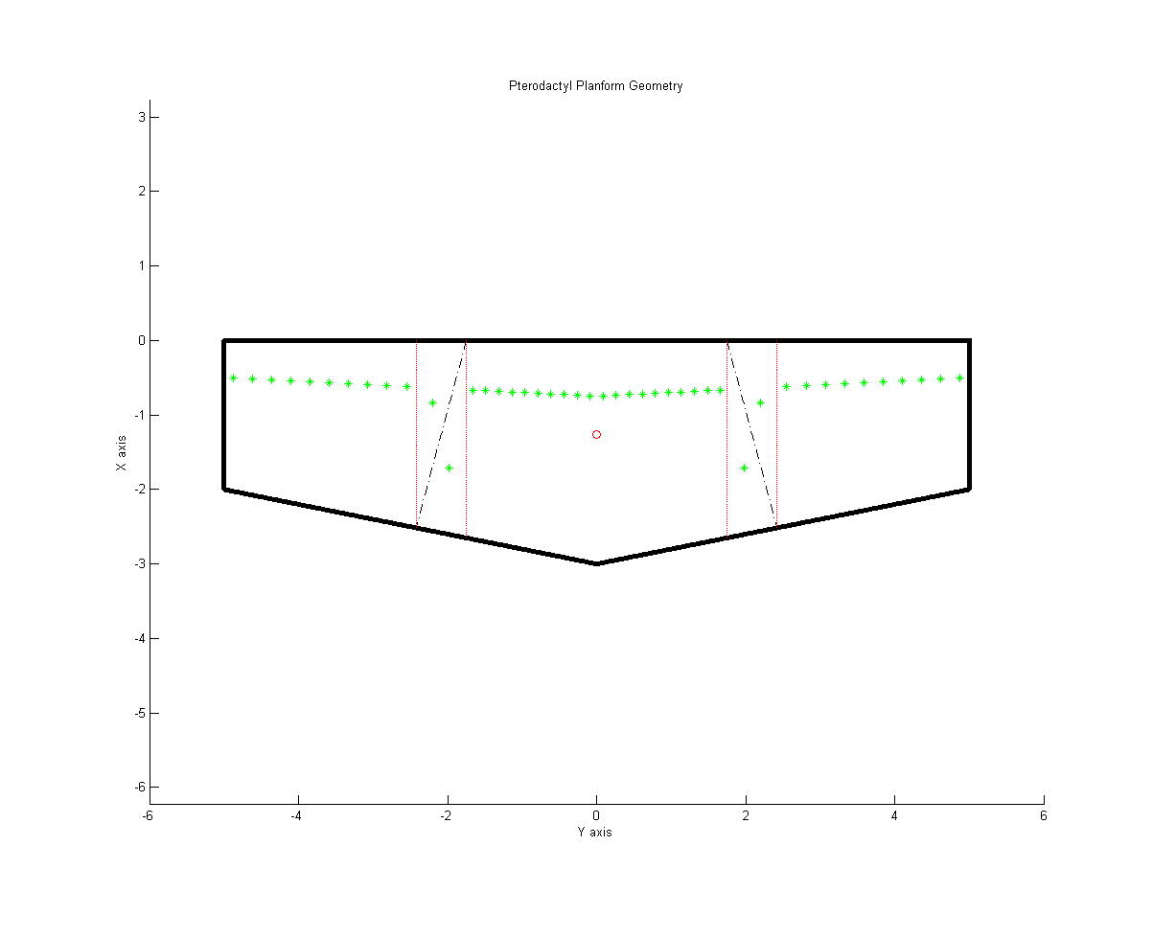
Vehicle Design

Slide 7
Vehicle Design
Planform on previous slide is dynamically generated by Matlab
Angle to leading edge and hinge positions variable
Green dots represent aerodynamic centers of strips
The 4 triangular portions are treated as flat plates
Major modification to original design
Originally to have double coaxial center propeller
Mechanically simpler to separate them
Expands the control envelope

Slide 8
Simulation and Control - Airplane
So far only have lift, drag and pitching moment
Non-dimensional terms obtained from look-up table
No control surfaces yet
Roll, yaw and sideslip accounted for

Slide 9
Simulation and Control - Rotorcraft
Forces and moments come from the propellers only
Control strategy comes from quadcopters
Yawing moment comes from rotor torque
Non-parallel axes provides additional yaw
Inner-loop, outer-loop control
Outer loop calculates heading
Inner loop calculates thrust from each propeller
Sensitive to the aircraft model

Slide 10
Design Optimization
Parameters to vary:
Hinge angle/position
Propeller position
Position of center of mass
Moment of inertia matrix
Optimization criteria
Rate of convergence to initial disturbance
Roughly equal moment arms
Control envelope size
Stability to gusts

Slide 11
Future Work
Finalize design
Generate more accurate model of the aircraft
Determine appropriate gains for rotorcraft mode
Design actuators for airplane mode
Develop control system for airplane mode
Construct and test vehicle

Slide 12
Overview – Dynamic Resource Allocation
Project Goals
Project Motivation
Methods Explored
Markov Decision Processes
Distributed Clustering
Preliminary Results
Future Work

Slide 13
Project Goals
Develop small, low-cost weapons that cooperate
Ensure full engagement of all targets
Avoid wasting weapons
Minimize communication required
Communication may be unreliable in practice
A small network may be too sparse

Slide 14
Project Motivation
Asymmetric conflict scenarios
Targets easily replaced
Targets less valuable than weapons used
Scenarios requiring precision
Targets intermixed with non-targets
Preferable to avoid unnecessary damage
Alternative applications of techniques
Selecting patients in a triage situation
Robots moving furniture

Slide 15
Markov Decision Processes
MDPs are a planning tool to generate policies
A policy maps states to one and only one action
MDPs generate optimal policies
MDPs require observable domains
List of potential states
List of possible actions in each states
State-transitions describe possible action results
Reward function for results of each action
Extensible to partially observable domains

Slide 16
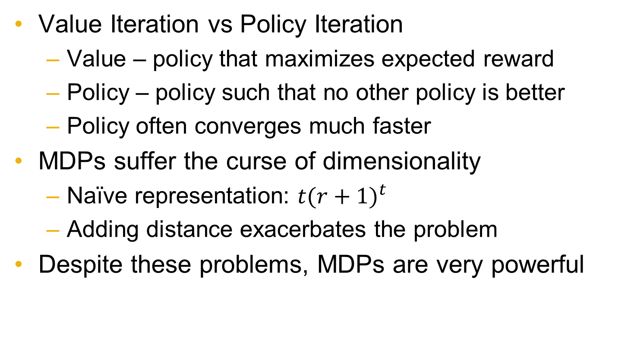
Markov Decision Processes
Value Iteration vs Policy Iteration
Value – policy that maximizes expected reward
Policy – policy such that no other policy is better
Policy often converges much faster
MDPs suffer the curse of dimensionality
Naïve representation: ${t(r+1)}^{t}$
Adding distance exacerbates the problem
Despite these problems, MDPs are very powerful

Slide 17
Distributed Clustering
Robots initially select closest target
If that target is over-engaged, chance of switching
Sigmoid threshold applied to this chance
New target is chosen randomly
Probability distribution based on distance
Requires less knowledge than MDP
Needs distance to each target
Total number targeting current target
Knowledge from sensors and local robots only

Slide 18
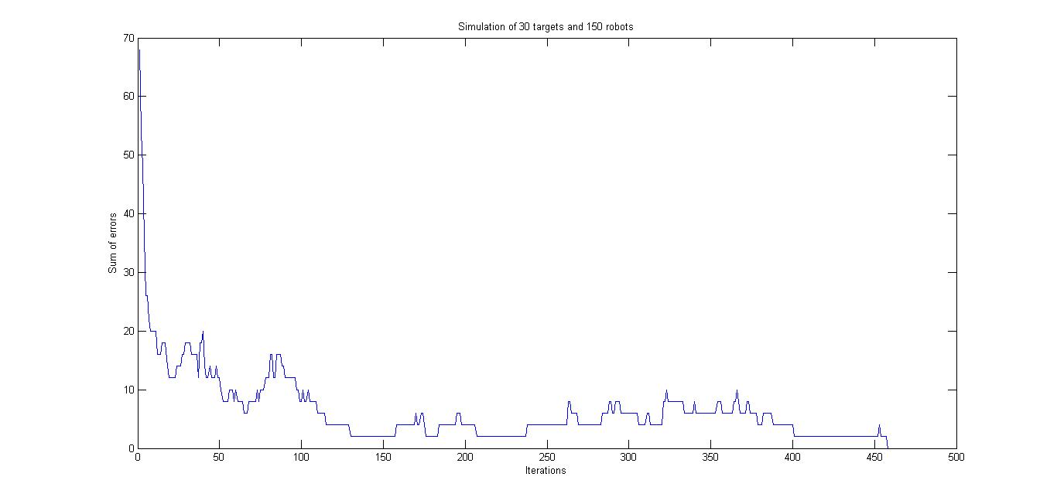
Preliminary Results

Slide 19
Future Work
Tune the sigmoid and probability functions
Improve the simulation
Incorporate altitude
Simulate communication
Simulate lossy communication
Parallelize agents (currently serial)
Test MDP policy

