Slide 1

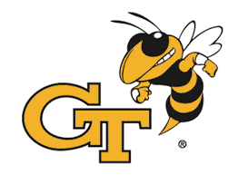
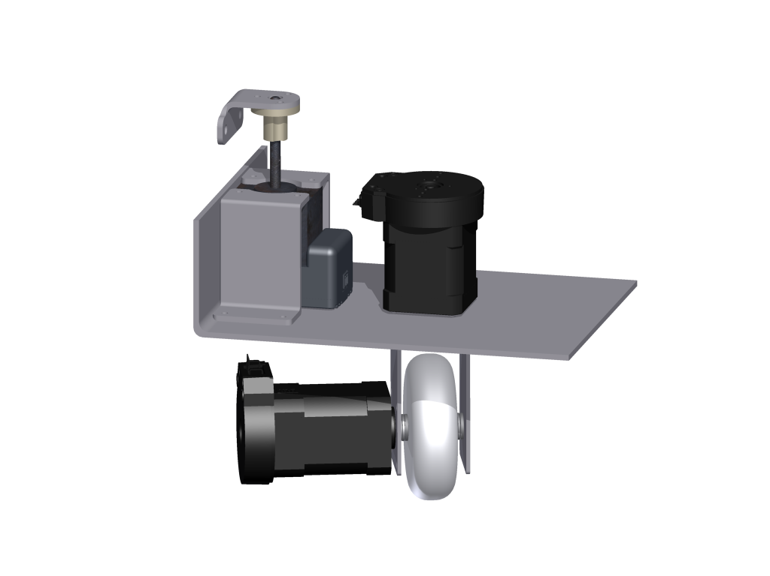
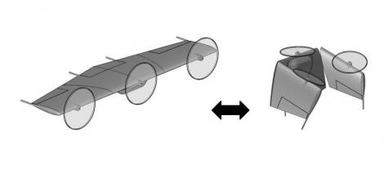
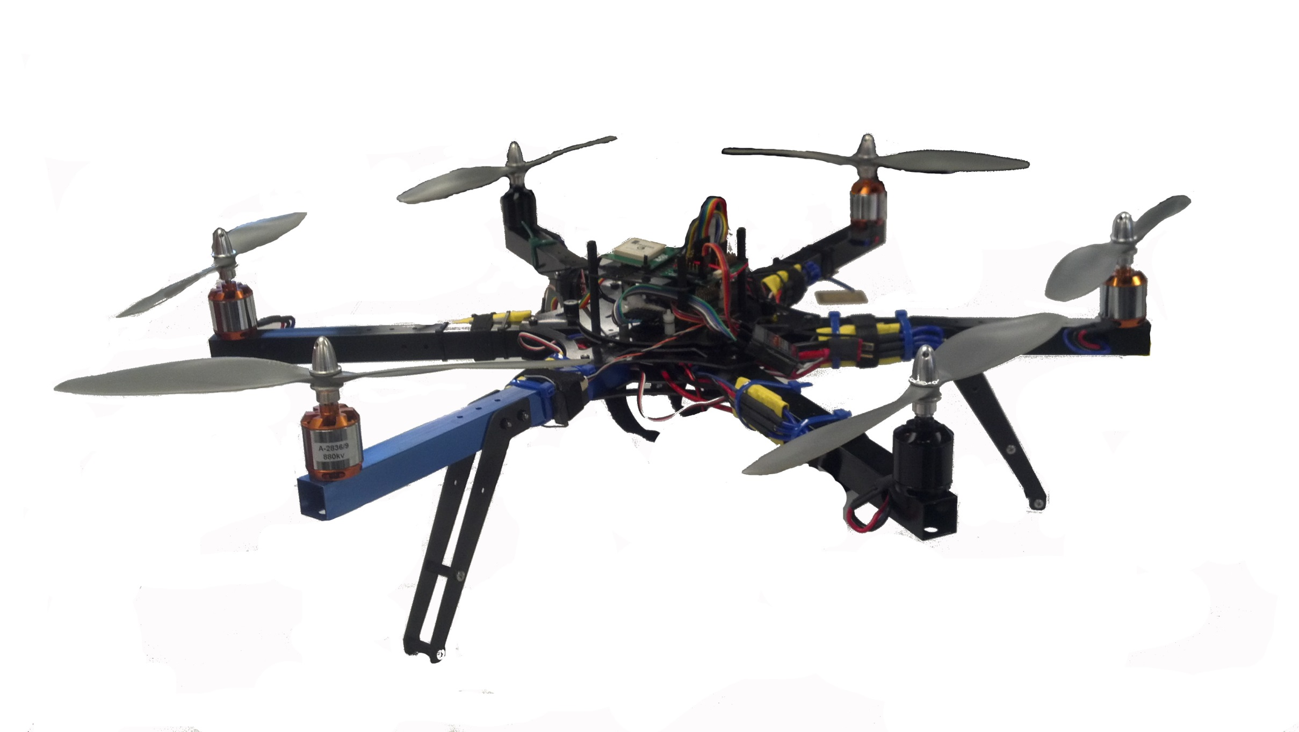
Intelligent Robotics and Emergent Automation Lab
WHAT WE DO:
Design and Control of Modular Ground and Air Robots
Massively Parallel Computational Automation
Morphing Vehicles and Hybrid Locomotion
Novel Algorithms for Nonlinear Estimation
WHAT WE ARE LOOKING FOR:
Hardware/electronics design for robotics
Help with testing & fabrication of novel devices
WHO WE ARE:
Dr. Jonathan Rogers
Laura Strickland
Andrew Brown
Jonathan Warner
Kyle Volle
Pil Eun Kim

