Slide 1
Neural Networks - a view from three sides: • PM • BA • Developer
Understanding AI
Notes:
Hello every one. My name is Konstantin Voloshenko and I’m a BA from St. Petersburg.
One of my hobbies is Neural Networks.
Today I will talk about Neural Networks from three sides: how it looks for a manager, for an analyst and for a developer.

Slide 2
Overview
AI: Data science and Neural Networks
Typical tasks
AI Project
Hardware and Frameworks
Dataset and Target Quality
Neural Network Structure and Hyperparameters
Deployment and Integration
Summary
Q&A
Notes:
You can see the Agenda.
In addition to the story, today there will be a demonstration of a simple Neural Network solution and everyone will receive a link to the source code of the examples.

Slide 3
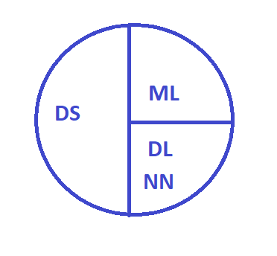
Overview
AI: Data science and Neural Networks
AI - Artificial Intelligence
DS - Data science
ML - Machine learning
DL - Deep learning
NN - Neural Networks
Notes:
Neural Networks is a part of Data science.
Neural Networks are usually considered in the context of Deep learning.
The same problem can be solved in different ways you can use Machine learning or Neural Networks.
But these are different ways. Today we are talking only about Neural Networks.

Slide 4
Overview
Typical tasks
Computer Vision (CV)
Naturel Language Processing (NLP)
Optical character recognition (OCR)
Audio and speech
Data tables (Classification, Regression)
Time series
Generative Adversarial network (GAN)
Reinforcement training
Genetic algorithms
Notes:
Where do Neural Networks work best today?
You can see a list of topics and tasks where networks really work well.
Computer Vision (CV)
Image classification
Image segmentation
Object detection
Face recognition
Naturel Language Processing (NLP)
Text classification
Handwriting text classification
Text segmentation
Chats
Optical character recognition (OCR)
Recognition of passports, documents, car license plates
Audio and speech
Speech recognition
Audio classification
Data tables
Classification
Regression (estimate)
Time series
Trading
Prediction of demand, sales
Classification
Generative Adversarial network (GAN)
Generation of pictures, texts, speech, audio, diagrams, wav2lip
Image Enhancement: Calorization, High Resolution
Reinforcement training
Robots, autopilots, drones, gaming environment
Genetic algorithms
Optimization, generation of Neural Networks architectures, tuning of hyperparameters.
Our topic for today is Regression based on Data table and we will estimate the value of Customer Credit Limit

Slide 5
AI Project
Hardware and Frameworks
GPU (CUDA, cuDNN)
Keras
TensorFlow
PyTorch
Notes:
For Neural Networks we need to use special hardware with GPU, because it works faster the CPU for Matrix multiplication.
At my home computer I use Nvidia Geforce RTX 2060 with 12 Gb
but today we will get free GPU form Google by using Colaboratory.
Colab is a cloud environment very similar to Jupiter notebook well known Python environment.
And we use only Keras framework for Neural Networks.
Keras is a really popular and simple framework for today.
Other two are TensorFlow and PyTorch.

Slide 6
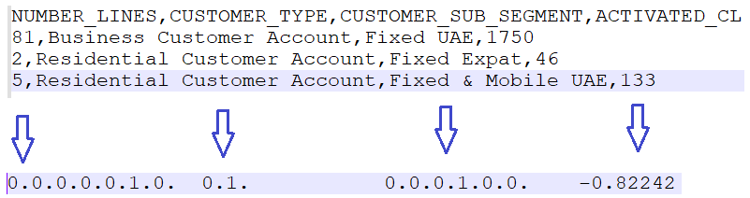
AI Project
Dataset and Target Quality
Demonstration
Exploring and Processing the Dataset:
Read and split our dataset into the input features
Analysis and selection of necessary features
Data Frame transformation:
Categorization of enumerated types
Numerical data scaling
Notes:
1 Data via db150
2 Credit Limit Object Model
3 Oracle connect via PLSQL Developer
On db150 screen we see the value of Credit Limit object type.
Let’s see the one object of Credit Limit, so we see a lot of attributes here.
On the Bass page we see Credit Limit Object Model description.
Data analyst should make decision what features from the dataset really need to use for Neural Network training.
Let’s try to make a select, so you can see a lot of gaps in the data.
Today I use simple Data Simulation, because I don't have access to the production environment.
PM Needs to agree with the Customer:
To get as big dataset as possible
The value of Target Quality for estimation predicted result on validation set.
For Target Quality will be used one of Regression losses function
Mean Squared Error (MSE) ~ 0.09 = 0.3 squaring
Dataset for Neural Network training need to be converted with using:
Numerical data scaling
Categorization of enumerated types

Slide 7
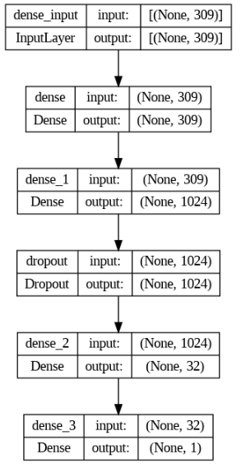
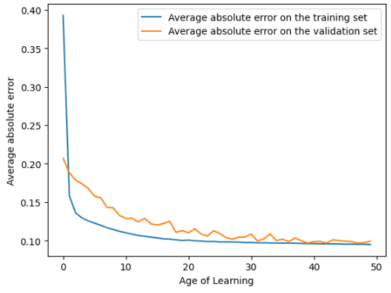
AI Project
Neural Network Structure and Hyperparameters
Number of layers in the model;
Types of layers;
Number of neurons in each layer;
Learning rate;
Batch size;
Optimizer;
Loss function.
0.091
Notes:
We need to make a lot of experiments to choose architecture of Neural Network and it's hyperparameters.
When we found the best model, we need to save it for transferring on production environment and integrate the model in to the solution.

Slide 8
AI Project
Deployment and Integration
Demonstration
Notes:
Here you can see PyCharm where is implemented a simple REST service
We moved here 3 files:
JSON with Model structure
H5 with Model’s coefficients
Standard Scaler binary file for restoring predicted value to the normal size.
Let’s try to make GET request and see the predicted result.

Slide 9
Summary
Get dataset as big as possible
Select required features
Solve problems with gaps
Transform dataset to categories and prepare data for training
Find the best model structure and values of the hyperparameters
Save the best model
Integrate model to production environment

Slide 10
Summary
Prototyping (pilot project) is really important :
Unpredictable results at the start
Impossible to work according to a preconceived project plan
Use short iterations
High importance dataset quality
Can be instability in production
GPUs are important for Deep Learning project
Notes:
Here you can see the summary with important conclusions. Yes, all this points are discussed.
Prototyping (pilot project) is really important:
Unpredictable results at the start
Repeatable CASEs with adequate datasets can fail. Specific datasets can affect the result unpredictably
Impossible to work according to a preconceived project plan
The plan can only be for separate stages. As you progress, plans need to be adjusted: often you need to sort through different hypotheses, not knowing in advance which one will work
Use short iterations
Short iterations from one week work better. You can respond quickly to emerging problems
High importance dataset quality
The quality, the size of the dataset dramatically affect the final result. If the dataset cannot be assembled, the project is failed at the start
Can be instability in production
Conditions have changed - the network has stopped working, for example, lighting, color may change for pictures
GPUs are important for Deep Learning project
Low-performance GPUs make the development process long

Slide 12


