Slide 1
Neural Networks - a view from three sides: • PM • BA • Developer
Understanding AI

Slide 2
Agenda
Overview
AI: Data science and Neural Networks
Typical tasks
AI Project
Dataset and Target Quality
Hardware and Frameworks
Prototyping
NN architecture and hyperparameters
Deployment and Integration
Q&A

Slide 3
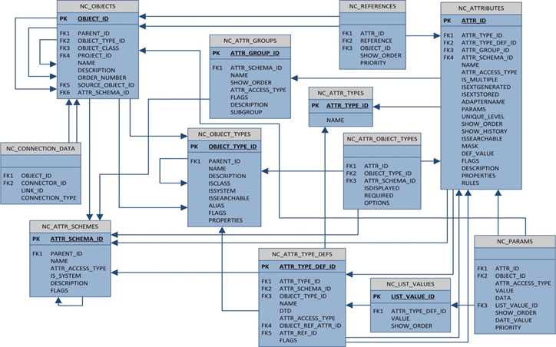
Overview
Picture from NetCracker Database Training course

Slide 4
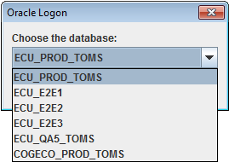
Working with many TOMS DB connections

Slide 5
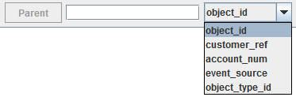
Using different IDs

Slide 6
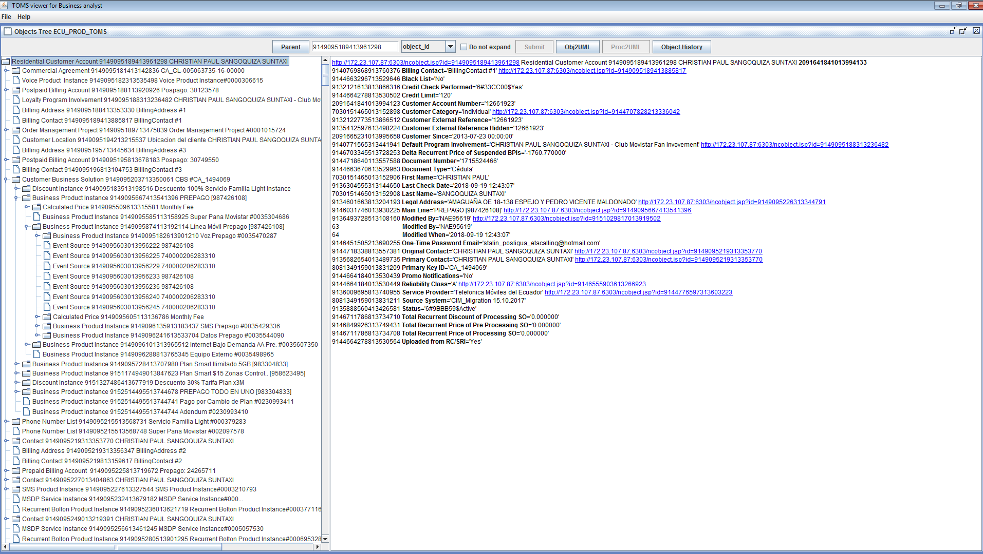
Reading Objects Tree from TOMS DB

Slide 7
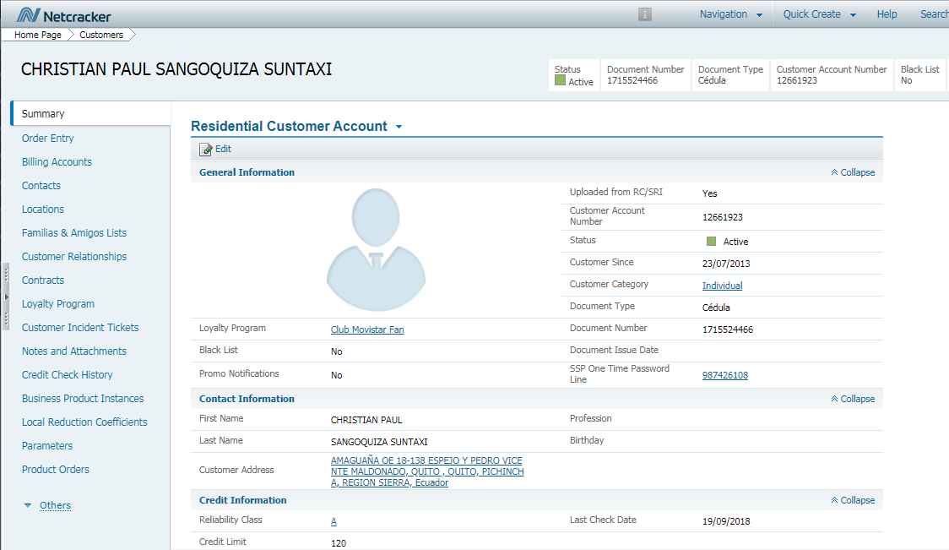
Reading Objects Tree from TOMS DB

Slide 8
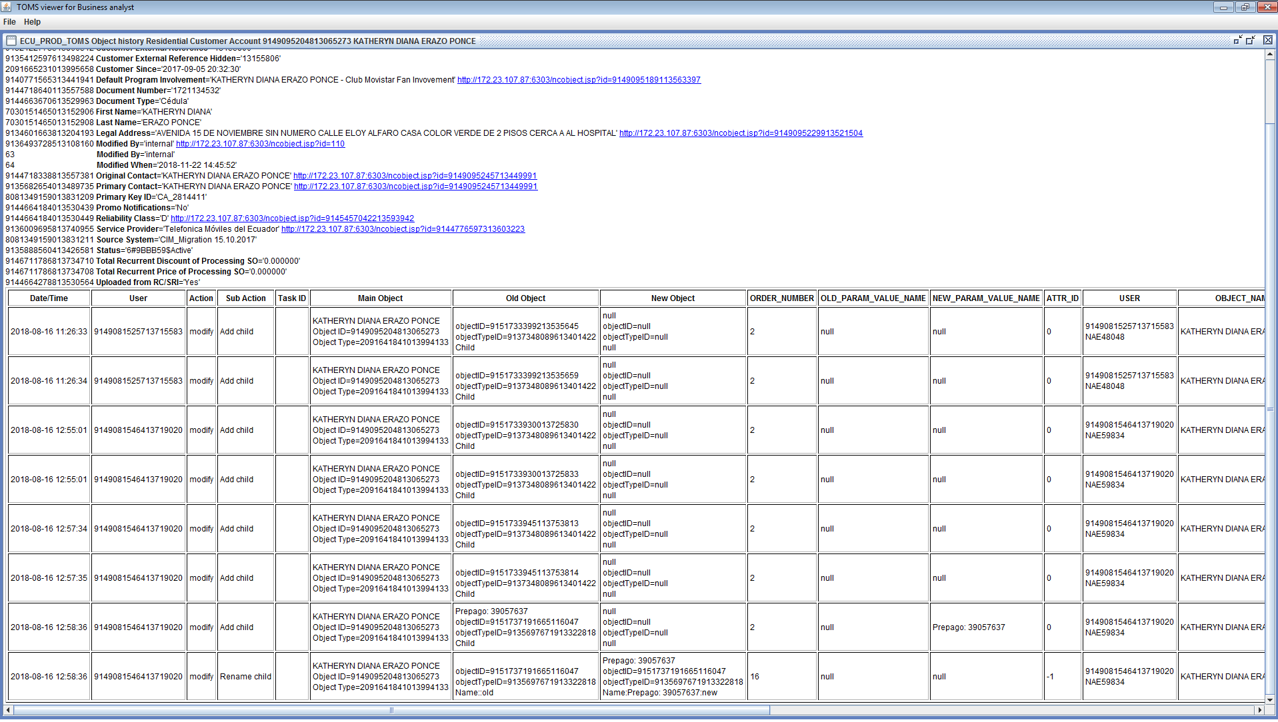
Object’s history

Slide 9
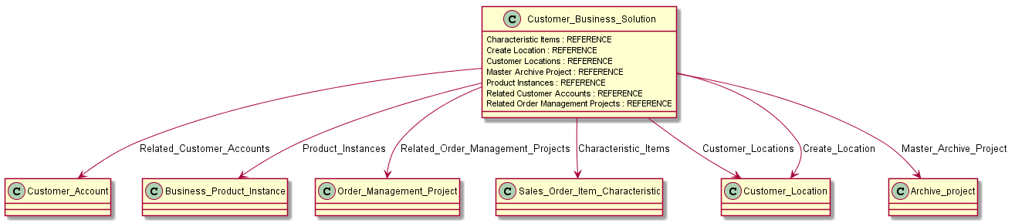
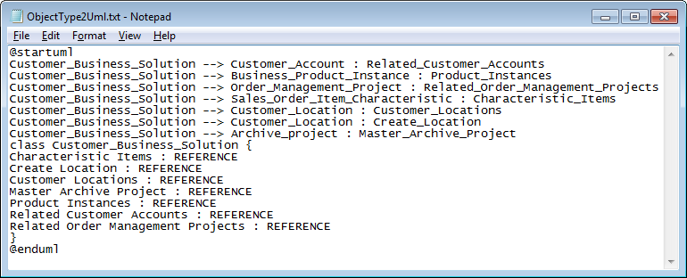
Creating UML Class diagram for the current object

Slide 10
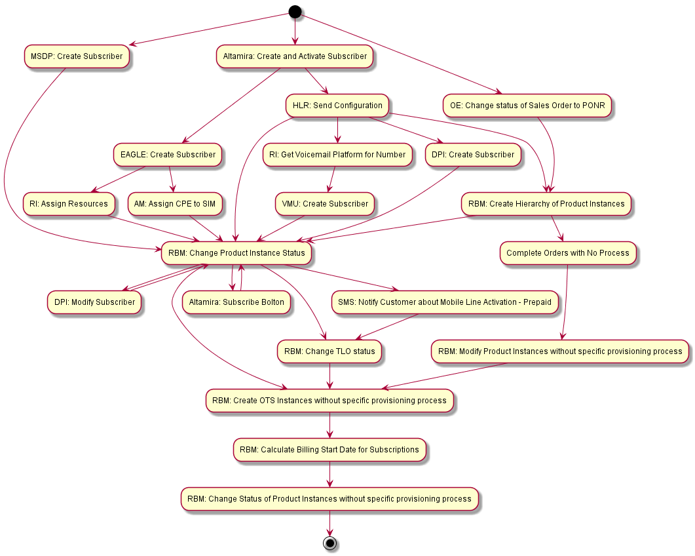
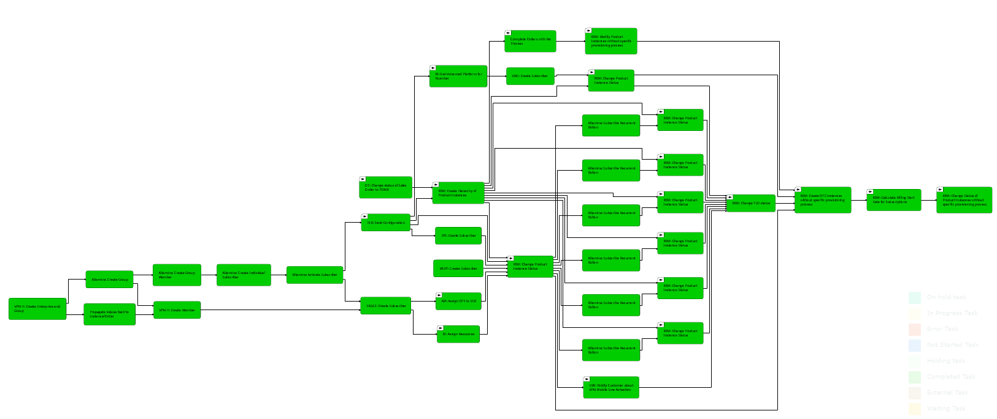
Creating UML Activity diagram for the current Execution Flow

Slide 11
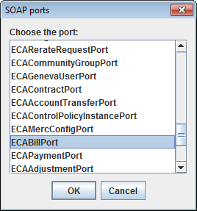
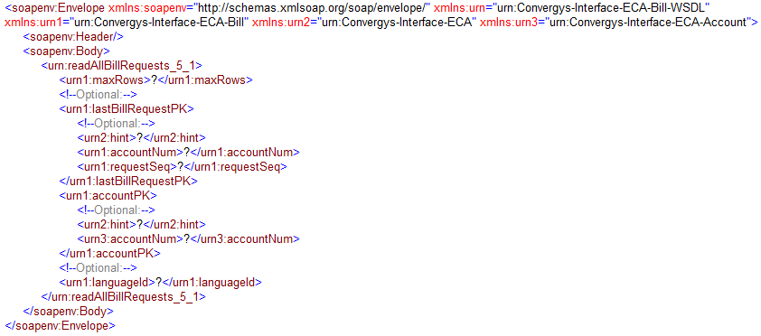
Creating SOAP examples

Slide 12
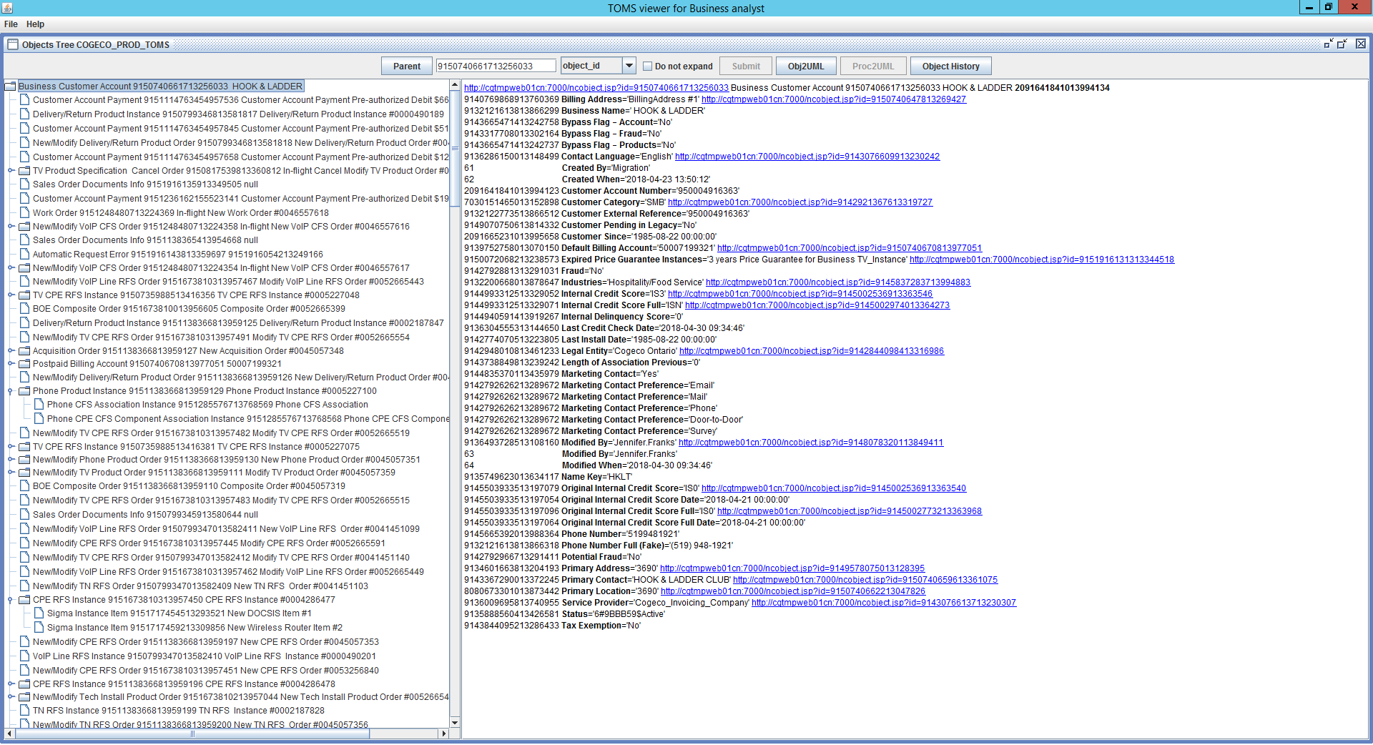
GMS + Kerberos (COGECO)

Slide 13
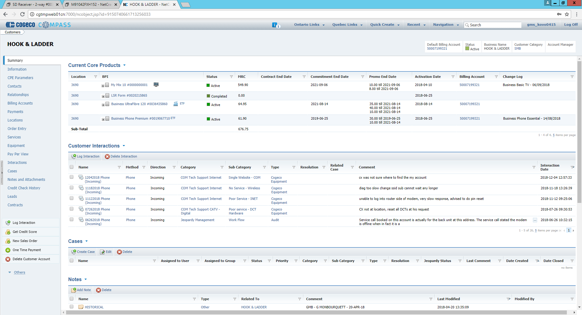
GMS + Kerberos (COGECO)

Slide 14
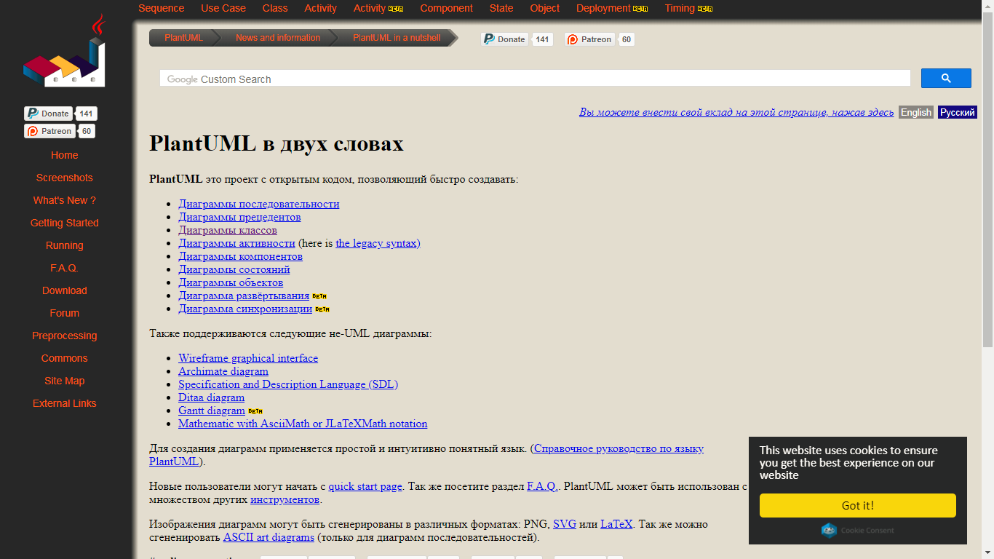
References
http://plantuml.com/

Slide 15
Known Issues

Slide 17


