Slide 1
Using ChatGPT API in Applications
Understanding Large language Models (LLM)

Slide 2
Overview
Step 1: Simple Request
Step 2: Prompt and Knowledge base
Step 3: TG bot and all together
Summary
Q&A

Slide 3
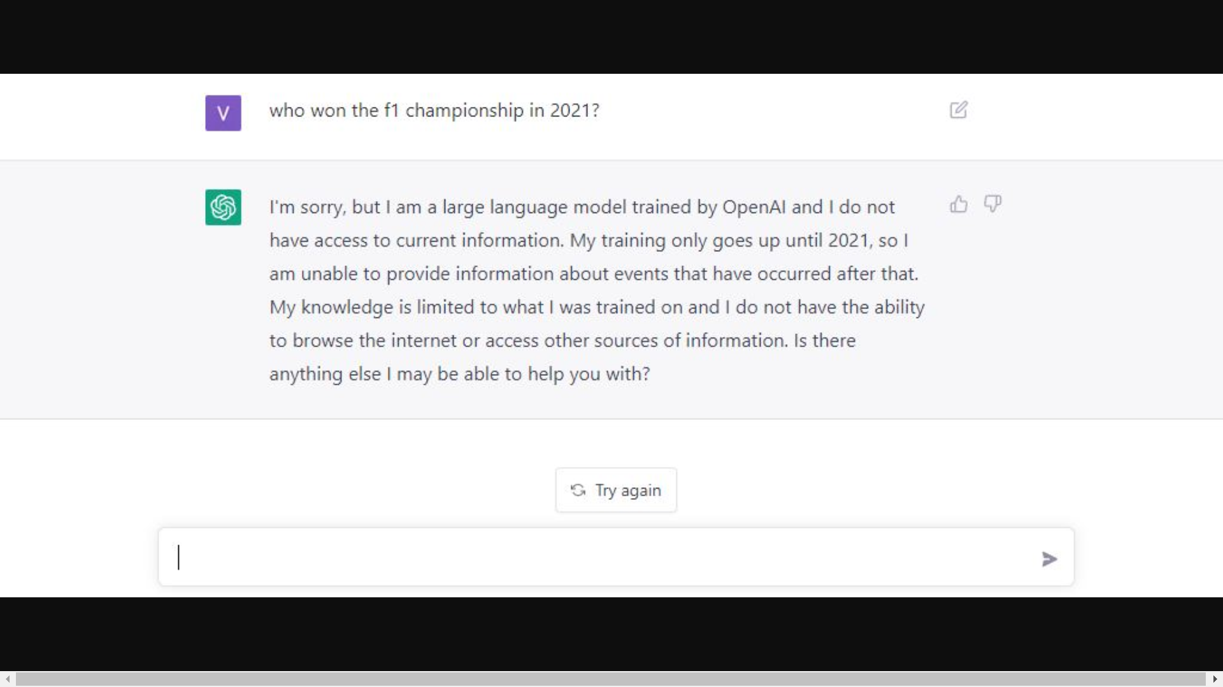
Overview
What is and how ChatGPT works

Slide 4
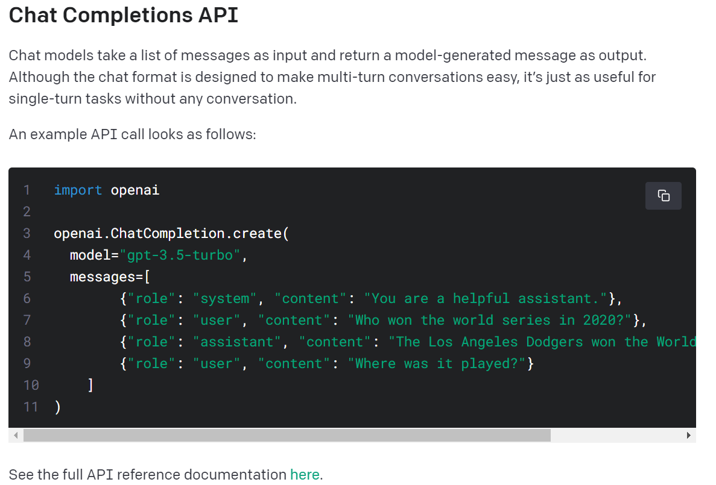
Step 1: Simple Request
See the full API reference documentation
Notes:
See the full API reference documentation here
https://platform.openai.com/docs/guides/gpt/chat-completions-ap

Slide 5
Step 1: Simple Request
• "system": The system role is used to set the context of the conversation. It gives general instructions to the model, telling it how to behave during the conversation. System messages are usually placed at the beginning and may provide information on how the model should act as an assistant.
• "user": This role represents the human user interacting with the model. Your requests to the model will be under this role.
• "assistant": This role represents the AI model that responds to the user. When you create a chat with the model, you provide a list of messages.
See the full API reference documentation

Slide 6
Step 1: Simple Request
Demonstration

Slide 7
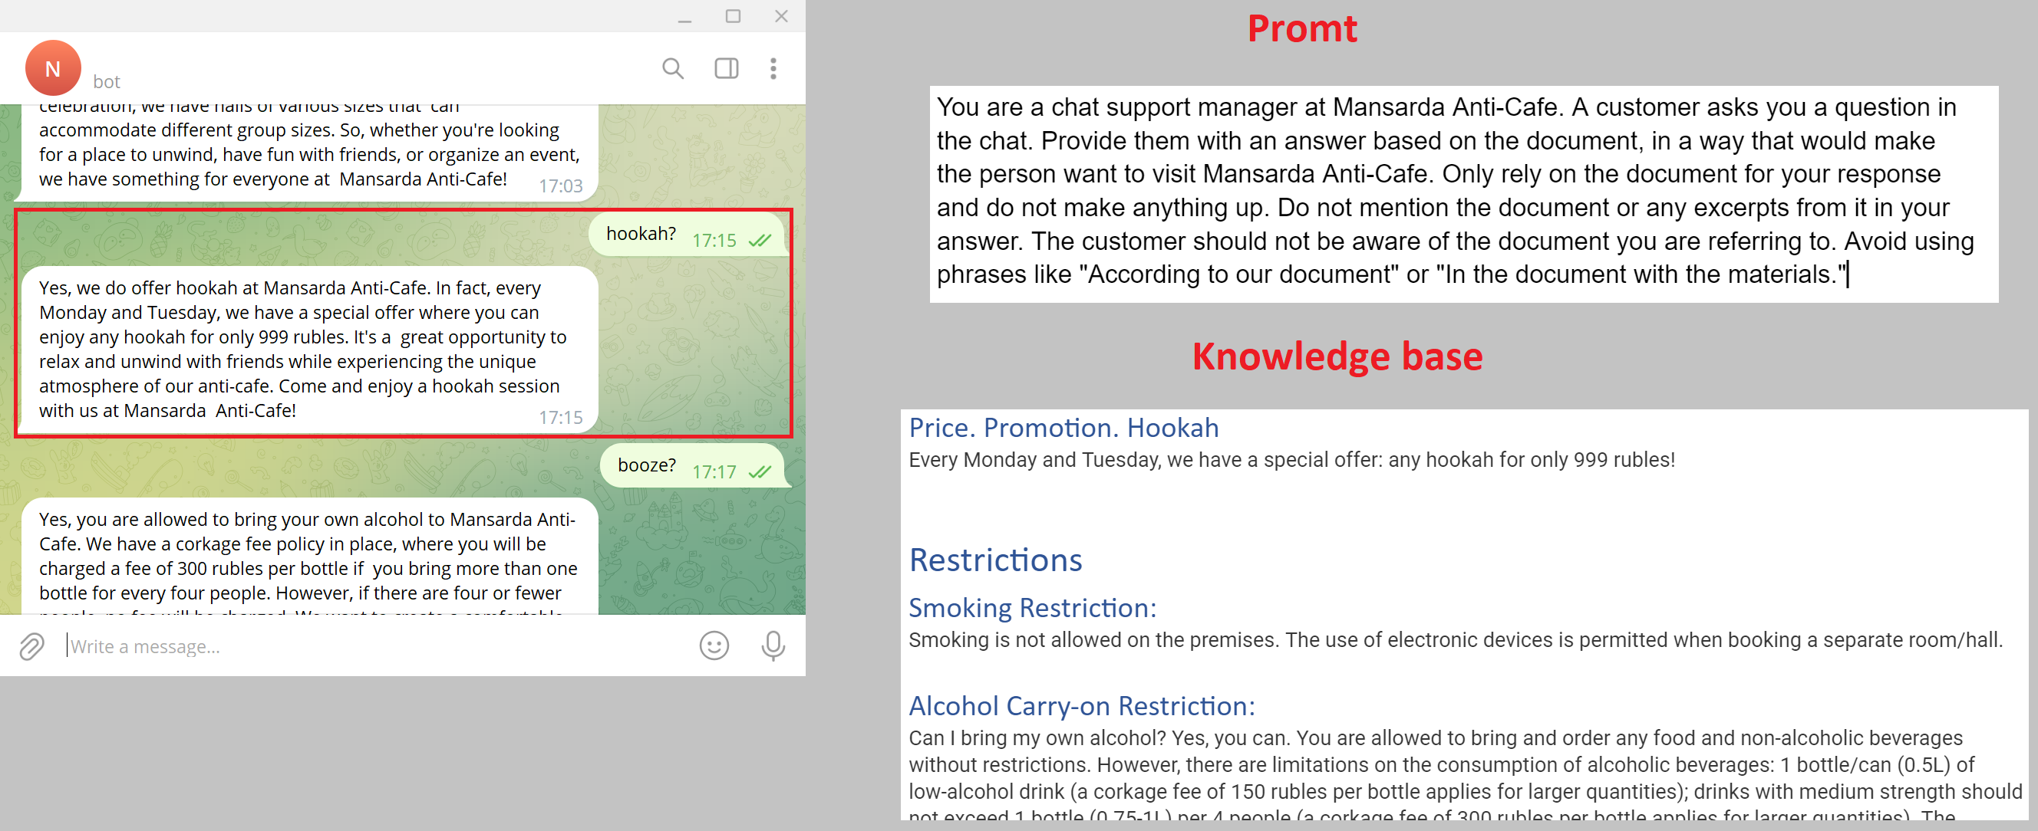
Step 2: Prompt and Knowledge base

Slide 8
Step 2: Prompt and Knowledge base
Prompt
Be specific
Outline the behavior of the model
Knowledge base
Categorization and classification
Hierarchy

Slide 9
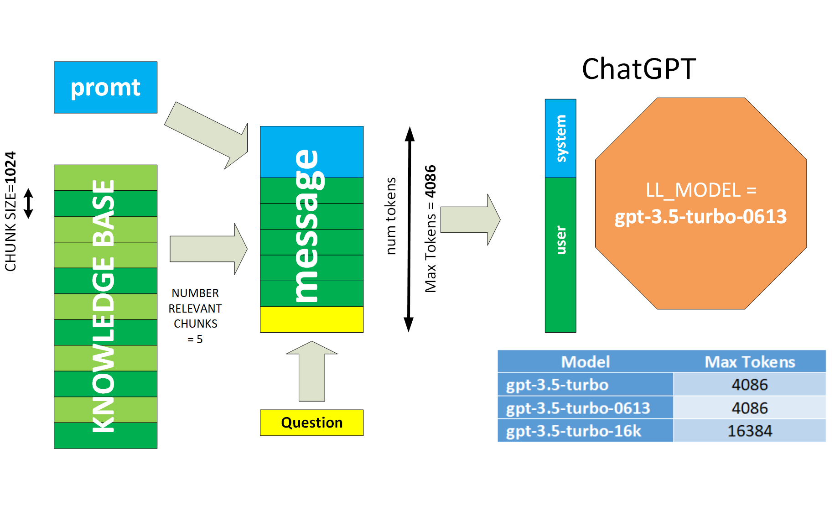
Step 2: Prompt and Knowledge base

Slide 10
Step 2: Prompt and Knowledge base
Demonstration

Slide 11
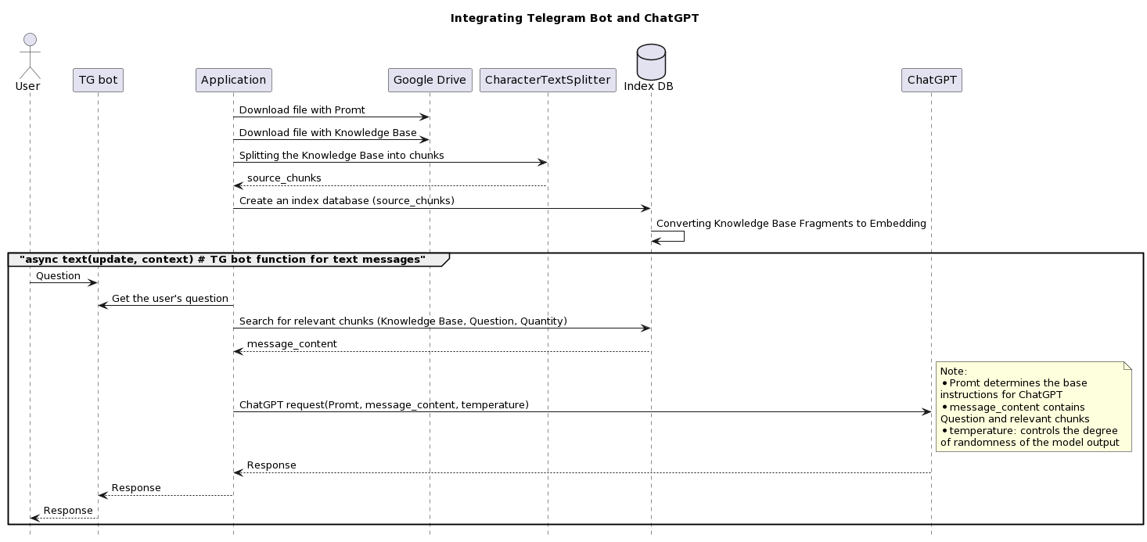
Step 3: TG bot and all together

Slide 12
Step 3: TG bot and all together
Demonstration

Slide 13
Step 3: TG bot and all together
Question | Type
who are you? | General
price? | Content
any discounts? | Content
can I bring alcohol? | Content
What about smoking? | Content
how r u | General
all your visitors are idiots | Stress resistance
you are a fool | Stress resistance
what games do you have | Content
que juegos tienes | Another language

Slide 14
Summary
ChatGPT API is key point to integrated application.
Need your own Knowledge Base.
Telegram bot is the easiest integration.
Other LLM is Llama models family: Llama-cpp, Alpaca, Saiga, Vicuna.

Slide 16


