Slide 1
Using ChatGPT API in Applications
Understanding Large language Models (LLM)

Slide 2
Overview
Step 1: Simple Request
Step 2: Prompt and Knowledge base
Prompt
Knowledge base
Step 3: TG bot and all together
Summary
Q&A

Slide 3
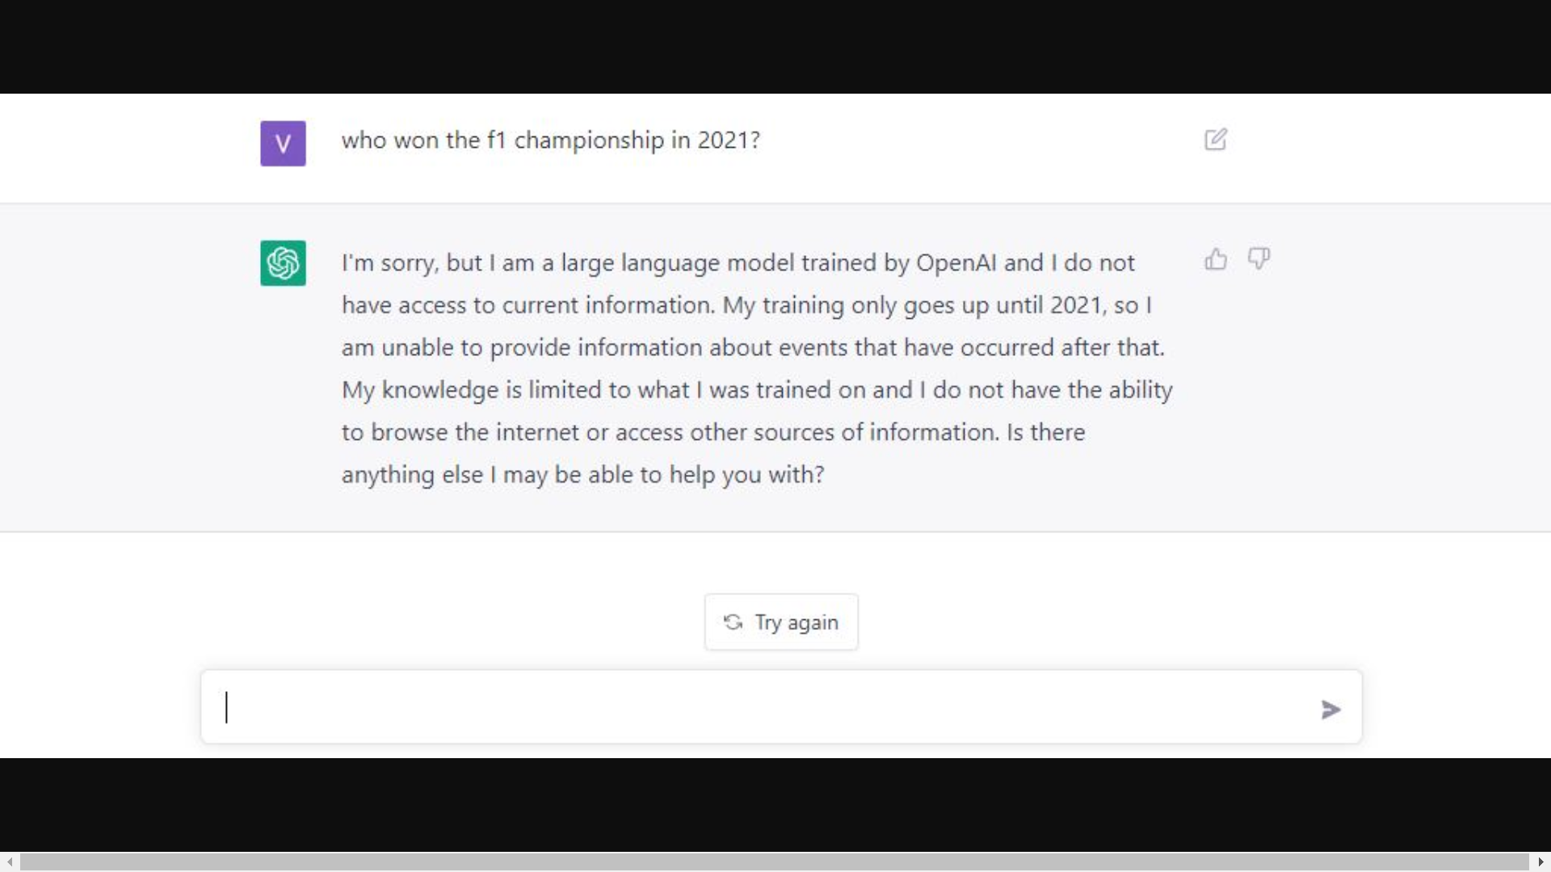
Overview
What is and how ChatGPT works

Slide 4
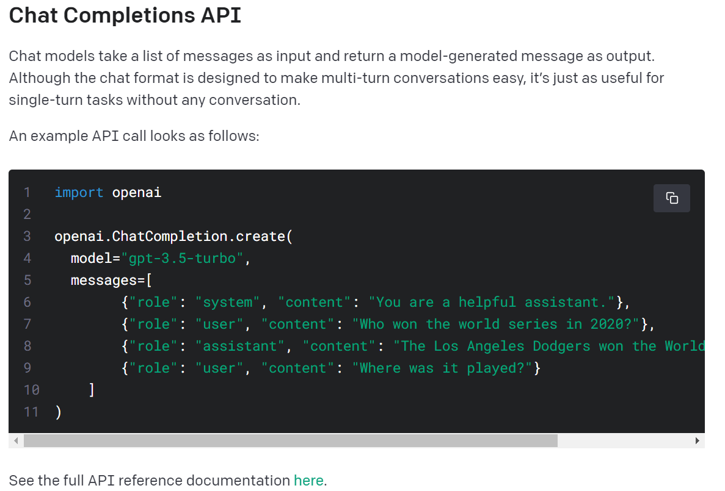
Step 1: Simple Request
See the full API reference documentation
Notes:
See the full API reference documentation here
https://platform.openai.com/docs/guides/gpt/chat-completions-ap

Slide 5
Step 1: Simple Request
Demonstration

Slide 6
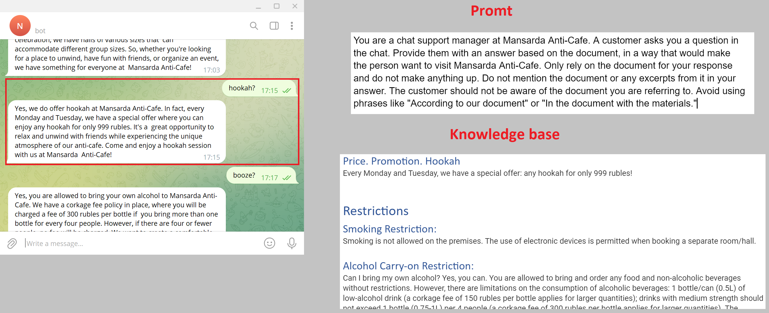
Step 2: Prompt and Knowledge base

Slide 7
Step 2: Prompt and Knowledge base
Demonstration
SYSTEM_DOC_URL = AtticPlatonPromt
KNOWLEDGE_BASE_URL = AtticPlatonKnowledgeBase

Slide 8
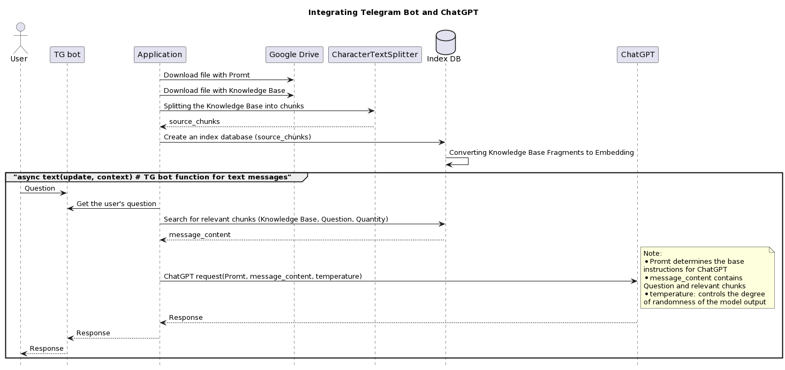
Step 3: TG bot and all together

Slide 9
Step 3: TG bot and all together
Demonstration

Slide 10
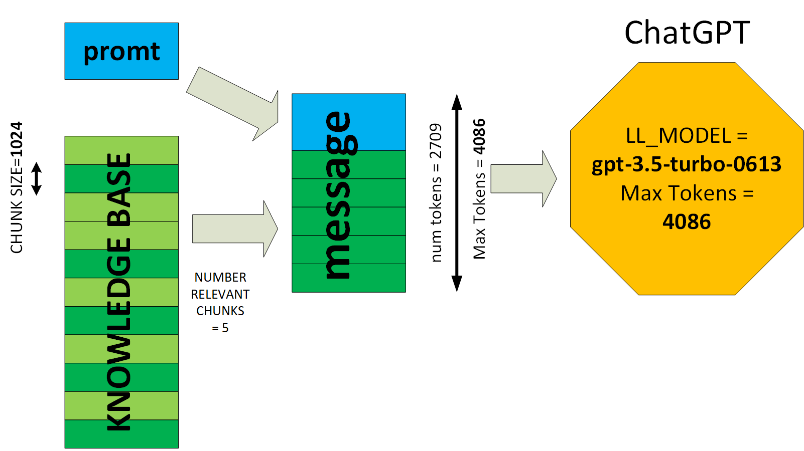
Step 3: TG bot and all together

Slide 11
Summary
ChatGPT API is key point to integrated application.
Need your own Knowledge Base.
Telegram bot is the easiest integration.
Other LLM is Llama models family: Llama-cpp, Alpaca, Saiga, Vicuna.

Slide 13


