Slide 1
Using ChatGPT API in Applications
Understanding Large language Models (LLM)
Notes:
Last time I told you about neural networks from three sides: how it looks for a PM, for a BA, and for a developer.
Today, I will talk about how you can integrate ChatGPT into your application.

Slide 2
Warning!
Overview
Step 1: Simple Request
Step 2: Prompt and Knowledge base
Step 3: TG bot and all together
Summary
Q&A
Notes:
I will provide an overview of what ChatGPT is and how it works, and then I will explain how you can use the ChatGPT API to incorporate it into your software.

Slide 3
Warning!
Please do not send our Сompany inside information to ChatGPT.
It will be a security incident!

Slide 4
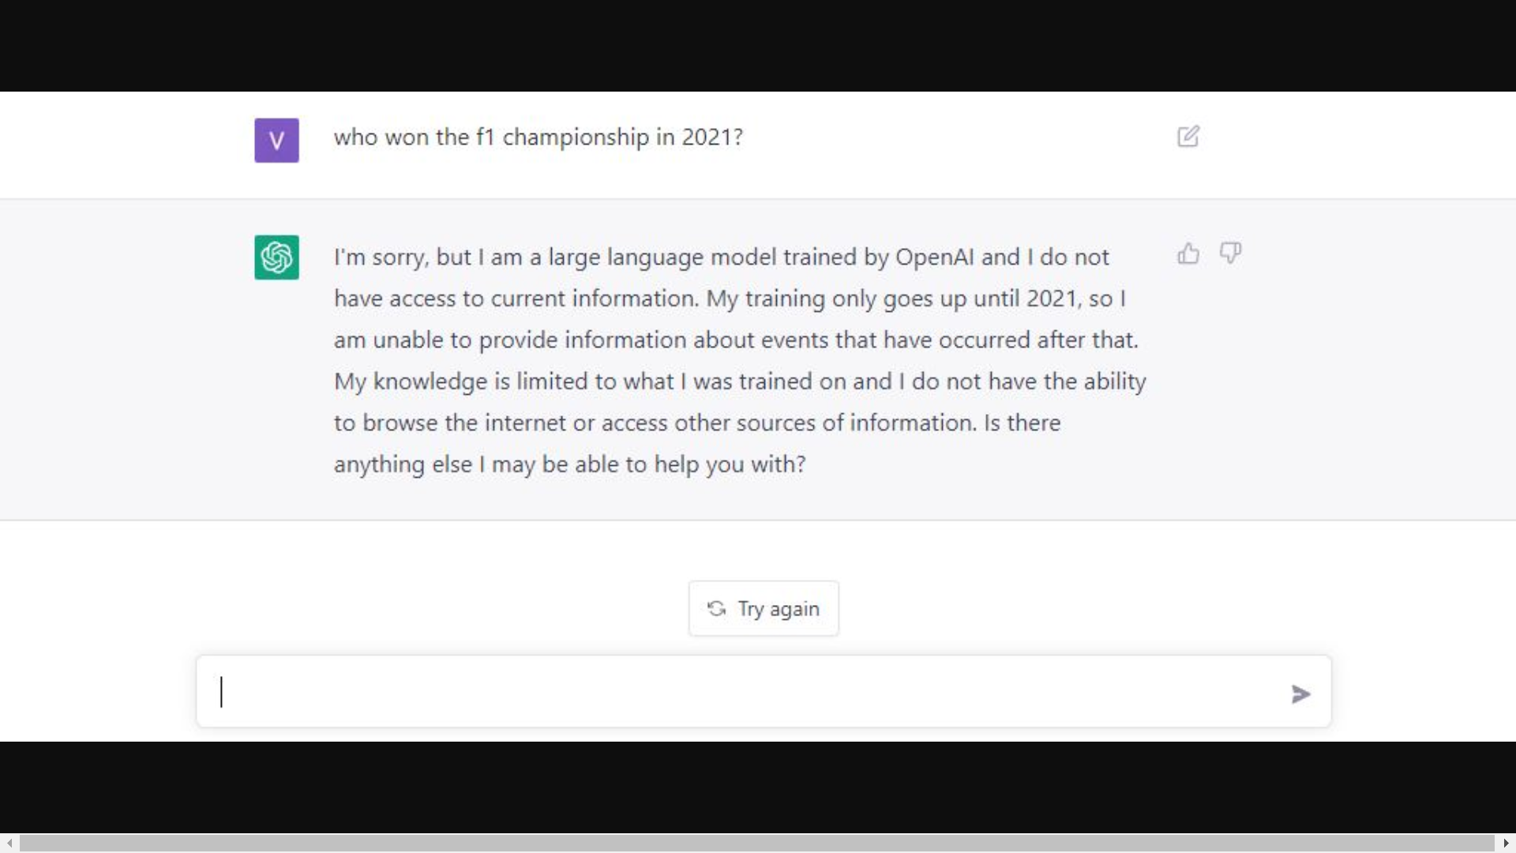
Overview
What is and how ChatGPT works
Notes:
ChatGPT is a language model developed by OpenAI. It uses a technique called Generative Pre-trained Transformer (GPT) to generate text responses that resemble human speech. This model has been trained on a large amount of text from the internet, allowing it to learn patterns, grammar, and even some understanding of various topics. It operates in a conversational way, where users can input prompts or questions, and ChatGPT generates a relevant response.

Slide 5
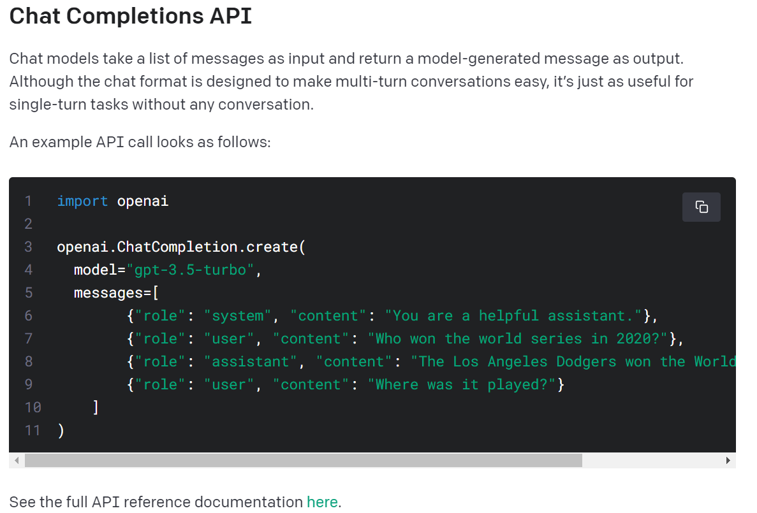
Step 1: Simple Request
See the full API reference documentation
Notes:
First of all, in order to integrate with the language model, we should find a suitable API. Yes, there is such API for ChatGPT.
See the full API reference documentation here
https://platform.openai.com/docs/guides/gpt/chat-completions-ap

Slide 6
Step 1: Simple Request
• "system": The system role is used to set the context of the conversation. It gives general instructions to the model, telling it how to behave during the conversation. System messages are usually placed at the beginning and may provide information on how the model should act as an assistant.
• "user": This role represents the human user interacting with the model. Your requests to the model will be under this role.
• "assistant": This role represents the AI model that responds to the user. When you create a chat with the model, you provide a list of messages.
See the full API reference documentation

Slide 7
Step 1: Simple Request
Demonstration

Slide 8
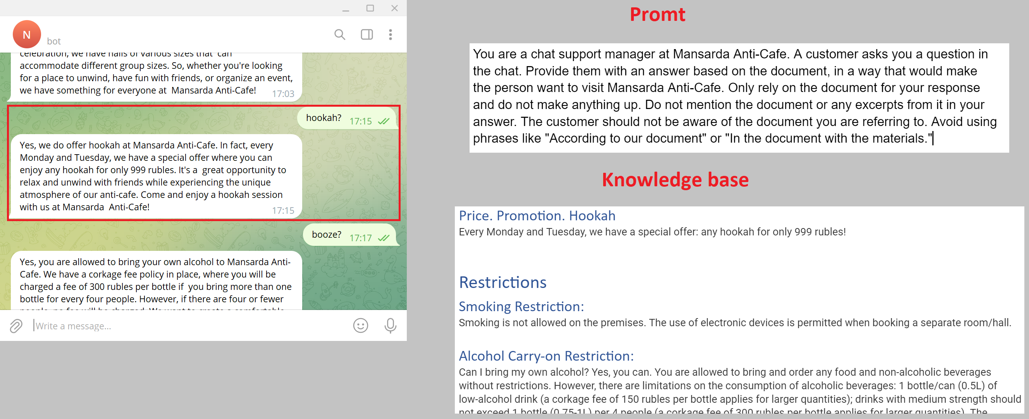
Step 2: Prompt and Knowledge base
Notes:
Secondly, we should decide how to send exactly our actual data to the language model. So, we will use the trained language model as a transformer, transforming our data into the necessary response form.
To do this, we prepare files with a prompt and a knowledge base in advance.

Slide 9
Step 2: Prompt and Knowledge base
Prompt
Be specific
Outline the behavior of the model
Knowledge base
Categorization and classification
Hierarchy
Notes:
By these principles, we can ensure that the knowledge base is designed to be organized, logical, and model - friendly.

Slide 10
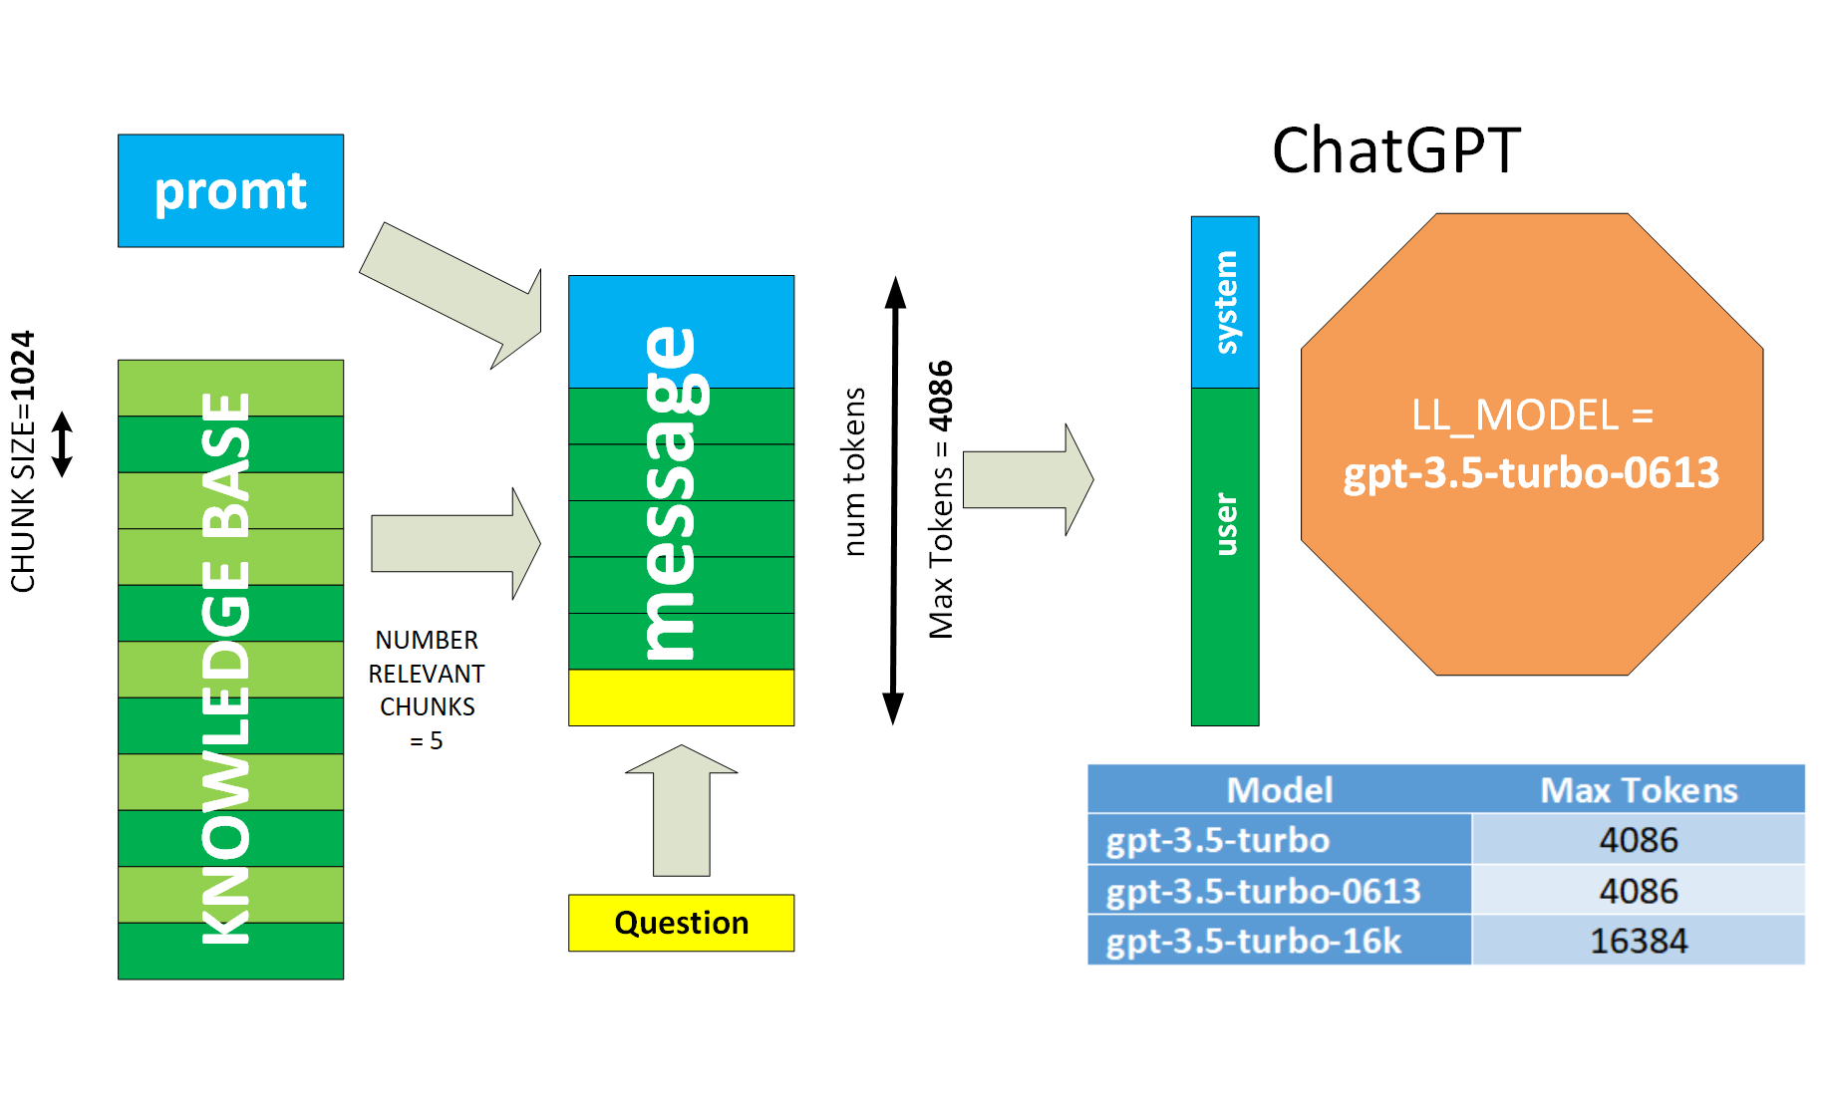
Step 2: Prompt and Knowledge base
Notes:
However, we cannot transfer a large knowledge base to the language model -
The model has restriction on the input message size.
And this model is not available to us for re-training or for fine-tuning.
So, we need to find a way to split the knowledge base into chunks, find the most relevant to the question chunks, and then submit only those relevant chunks to the language model.

Slide 11
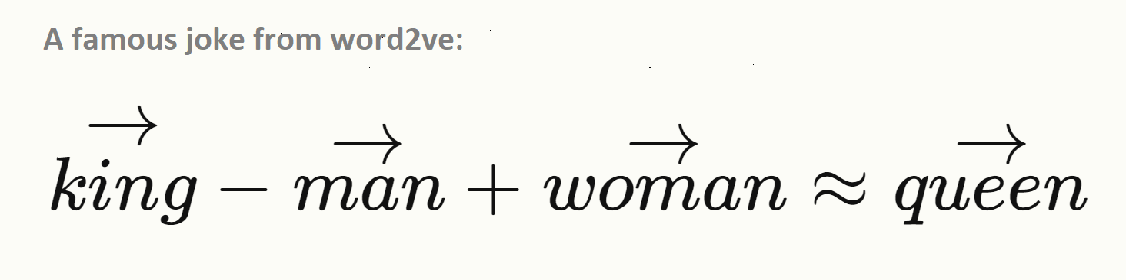
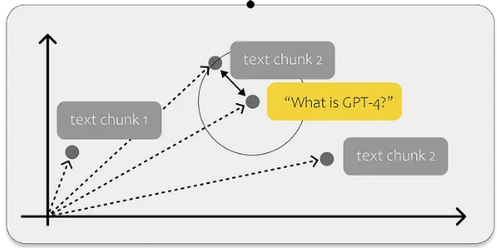
Step 2: Prompt and Knowledge base
Main Questions
How to find relevant chunks?
What is Embedding?
How does vector search work?
https://bass.netcracker.com/display/YAAIML/GenAI+Useful+Information
Notes:
Embeddings. In the context of language models, embeddings are numerical representations of words. They are created by mapping words to vectors in a mathematical space. These vectors capture the meaning or semantic relationships between words.
https://bass.netcracker.com/display/YAAIML/GenAI+Useful+Information
https://towardsdatascience.com/all-you-need-to-know-to-build-your-first-llm-app-eb982c78ffac

Slide 12
Step 2: Prompt and Knowledge base
Demonstration

Slide 13
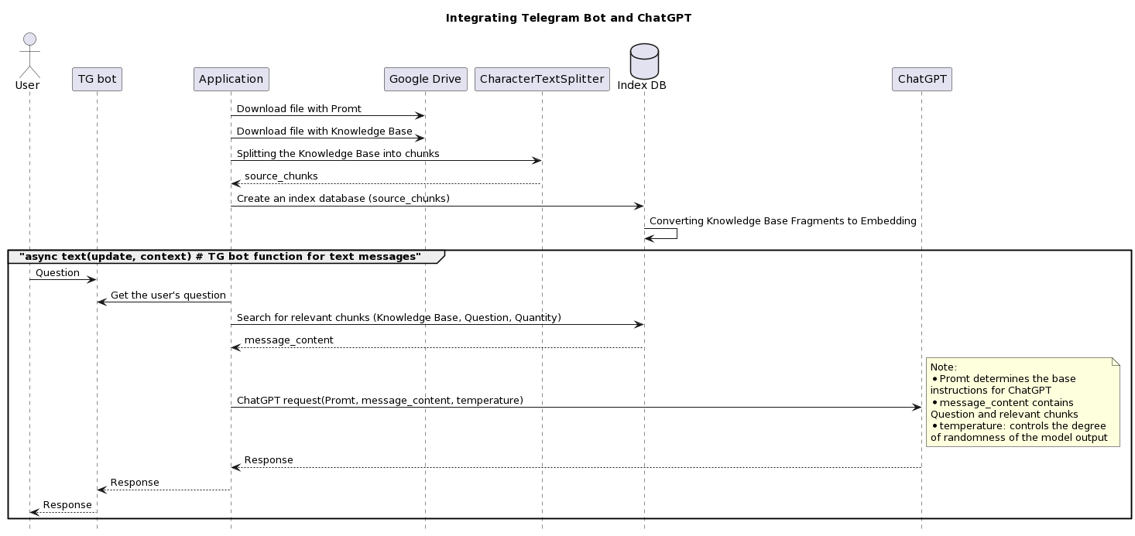
Step 3: TG bot and all together
Notes:
Thirdly, we need to integrate interaction with the language model into our application.
To do this, the easiest way is to use Telegram and create a TGbot that interacts according to our principles with ChatGPT.
The diagram shows the flow of information and the interaction of various components.

Slide 14
Step 3: TG bot and all together
Demonstration

Slide 15
Step 3: TG bot and all together
Question | Type
who are you? | General
price? | Content
any discounts? | Content
can I bring alcohol? | Content
What about smoking? | Content
how r u | General
all your visitors are idiots | Stress resistance
you are a fool | Stress resistance
what games do you have | Content
que juegos tienes | Another language

Slide 16
Summary
ChatGPT API is key point to integrated application.
Need your own Knowledge Base.
Telegram bot is the easiest integration.
Other LLM is Llama models family: Llama-cpp, Alpaca, Saiga, Vicuna.

Slide 17
Notes:
Github reference to NC_Attic branch
https://github.com/kvoloshenko/LLMT_01/tree/NC_Attic

Slide 18


