Slide 1
Using ChatGPT API in Applications
Understanding Large language Models (LLM)

Slide 2
Overview
Step 1: Simple Request
Step 2: Prompt and Knowledge base
Prompt
Knowledge base
Step 3: TG bot and all together
Summary
Q&A

Slide 3
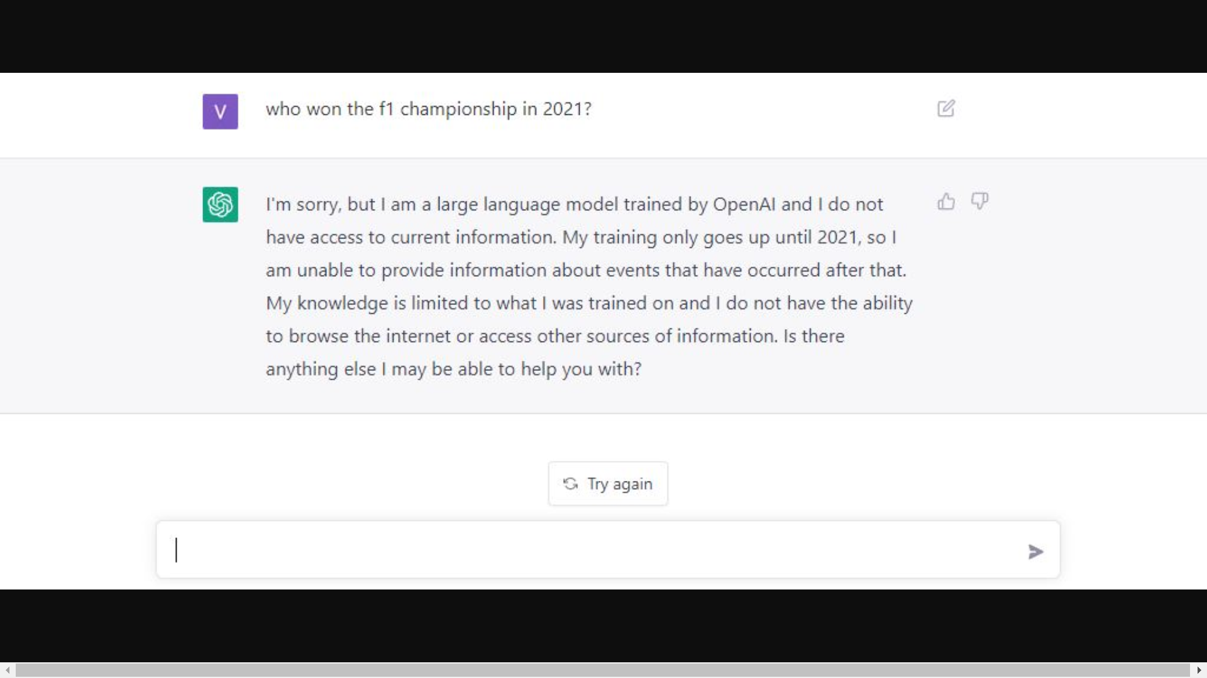
Overview
What is and how ChatGPT works

Slide 4
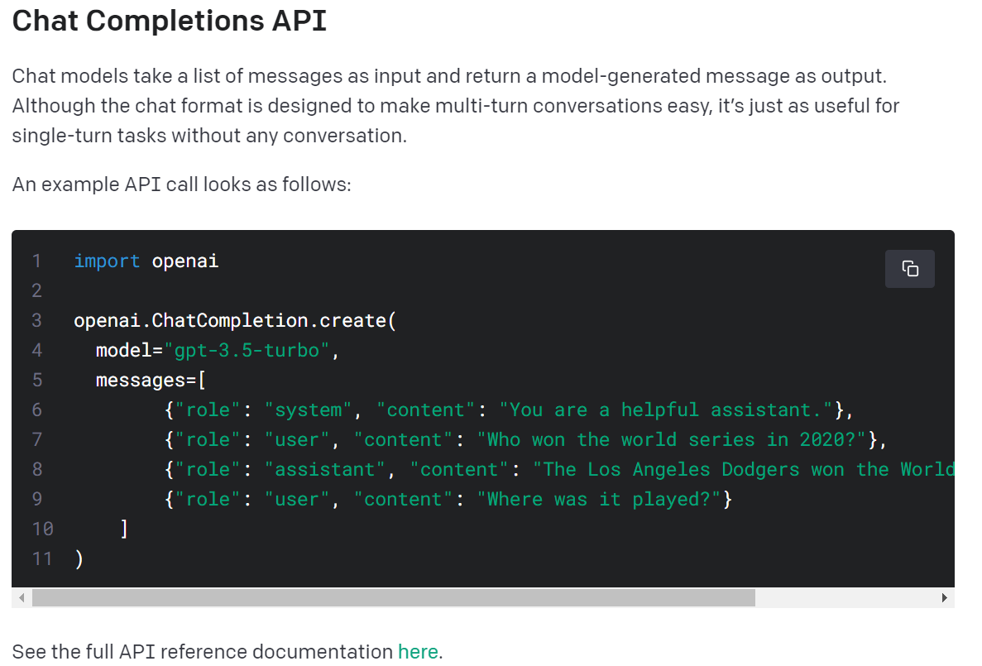
Step 1: Simple Request
See the full API reference documentation
Notes:
See the full API reference documentation here
https://platform.openai.com/docs/guides/gpt/chat-completions-ap

Slide 5
Step 1: Simple Request
Demonstration

Slide 6
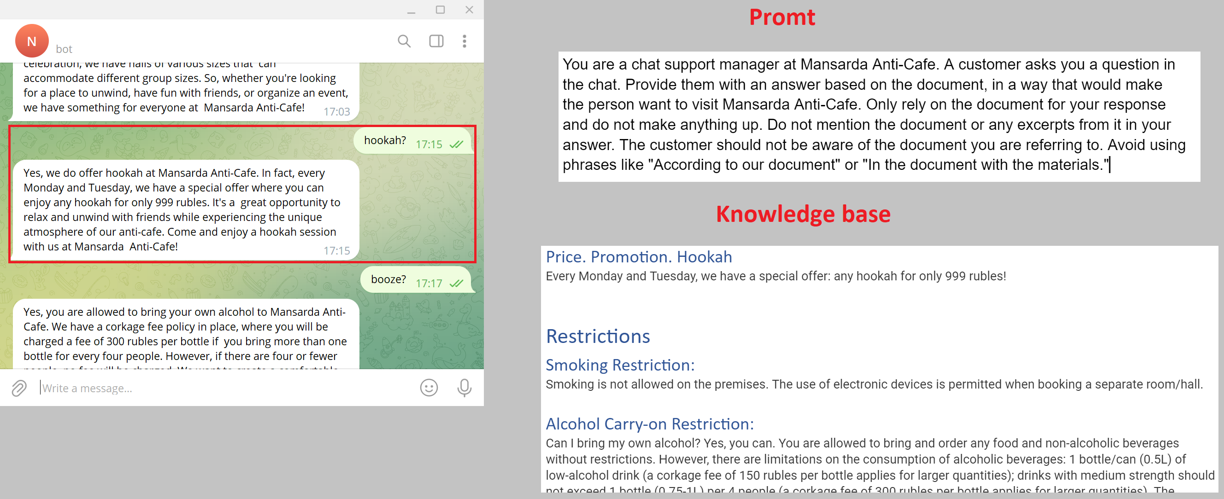
Step 2: Prompt and Knowledge base

Slide 7
Step 2: Prompt and Knowledge base
Demonstration

Slide 8
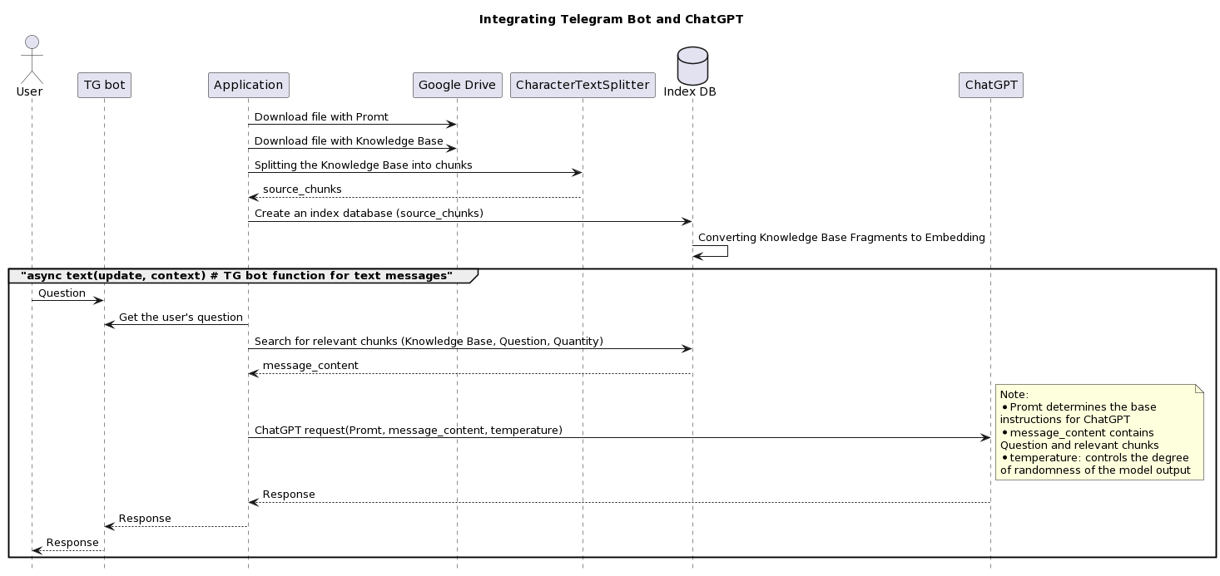
Step 3: TG bot and all together

Slide 9
Step 3: TG bot and all together
Demonstration

Slide 10
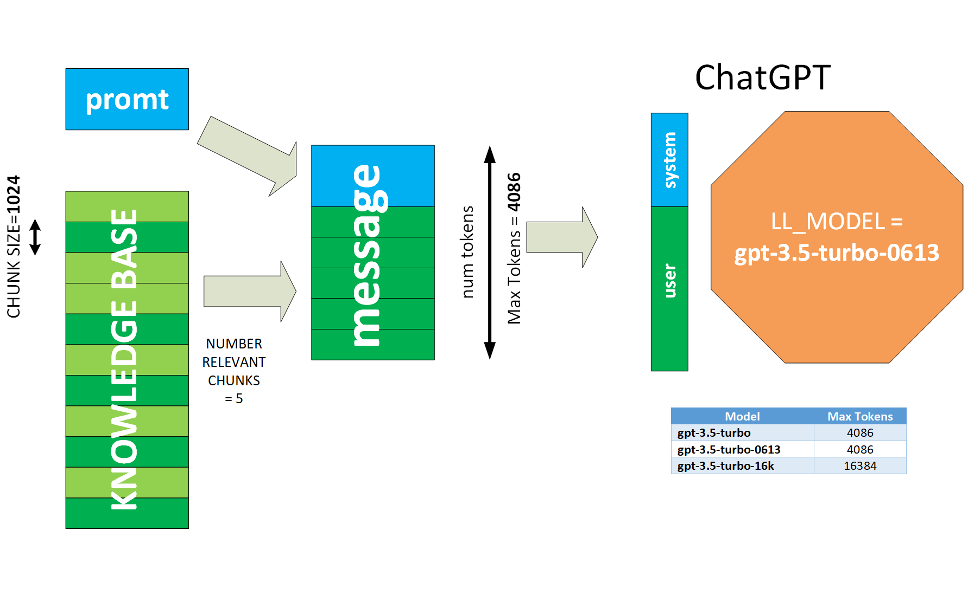
Step 3: TG bot and all together

Slide 11
Step 3: TG bot and all together
Question | Type
who are you? | General
price? | Content
any discounts? | Content
can I bring alcohol? | Content
What about smoking? | Content
how r u | General
all your visitors are idiots | Stress resistance
you are a fool | Stress resistance
what games do you have | Content
que juegos tienes | Another language

Slide 12
Summary
ChatGPT API is key point to integrated application.
Need your own Knowledge Base.
Telegram bot is the easiest integration.
Other LLM is Llama models family: Llama-cpp, Alpaca, Saiga, Vicuna.

Slide 14


