Slide 1
Using ChatGPT API in Applications
Understanding Large language Models (LLM)

Slide 2
Overview
Step 1: Simple Request
Step 2: Prompt and Knowledge base
Prompt
Knowledge base
Step 3: TG bot and all together
Summary
Q&A

Slide 3
Overview

Slide 4
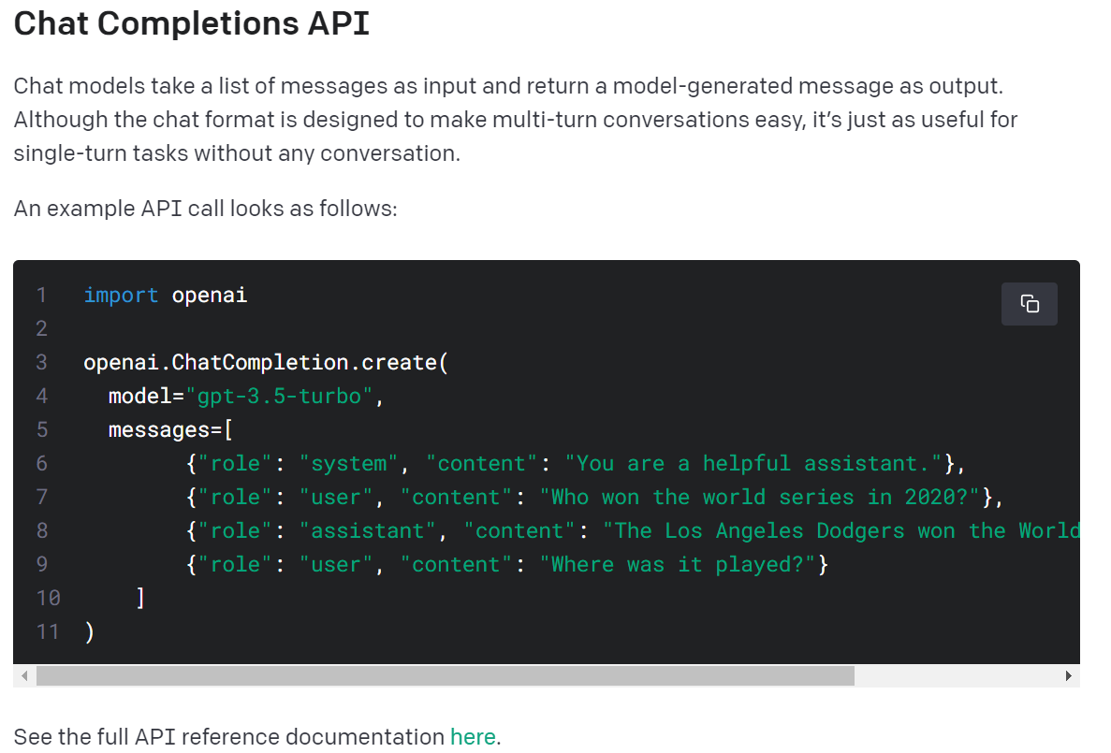
Step 1: Simple Request

Slide 5
Step 1: Simple Request
Demonstration

Slide 6
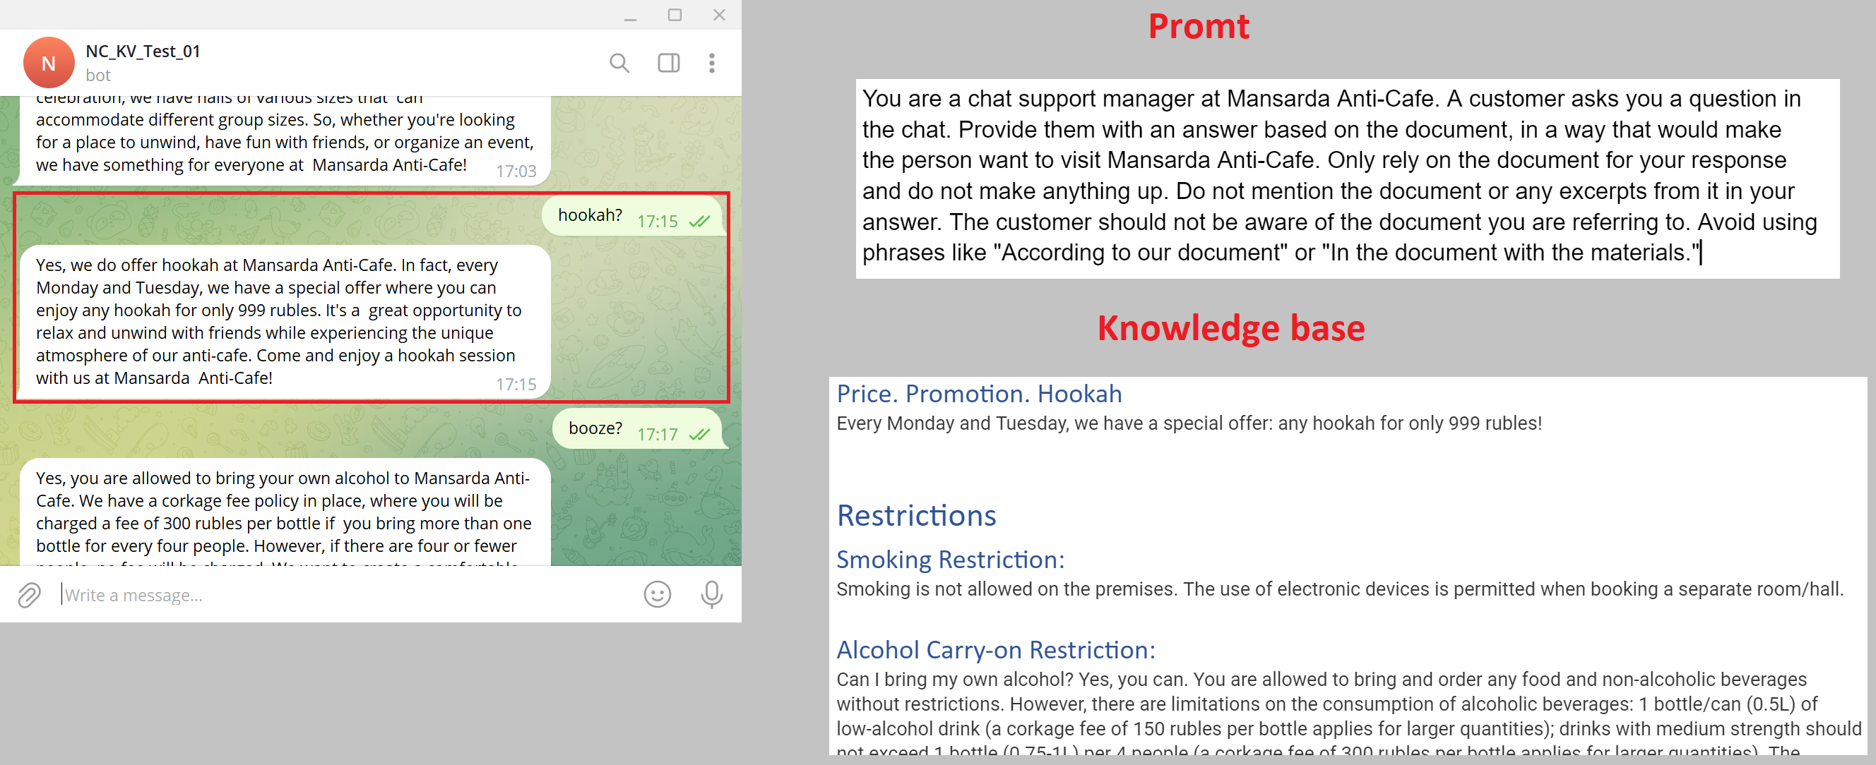
Step 2: Prompt and Knowledge base

Slide 7
Step 2: Prompt and Knowledge base
Demonstration
SYSTEM_DOC_URL = AtticPlatonPromt
KNOWLEDGE_BASE_URL = AtticPlatonKnowledgeBase

Slide 8
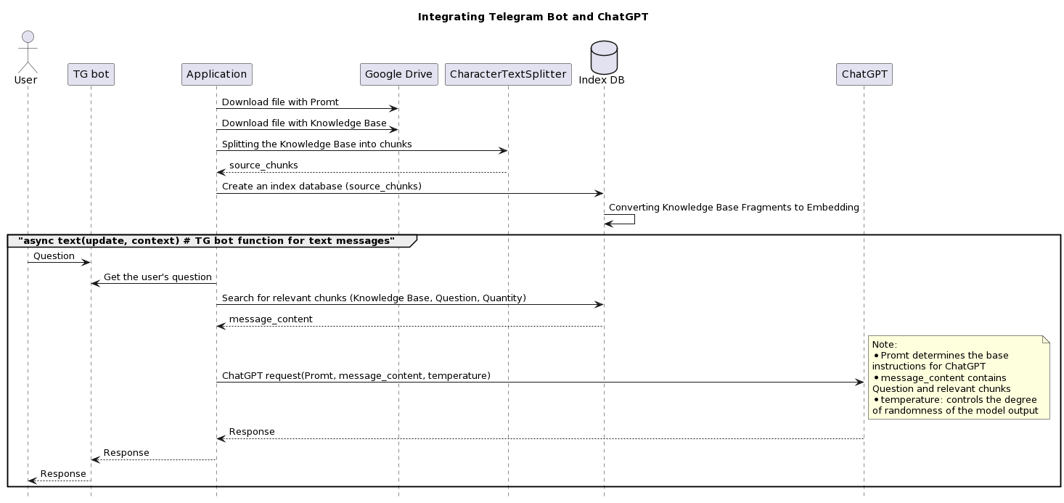
Step 3: TG bot and all together

Slide 9
Step 3: TG bot and all together
Demonstration

Slide 10
Summary

Slide 12


