Slide 1

Earthquakes
Magic Reptiles:
Kenny Vongrasamy
Suneethi Sivakumaran
Tingting

Slide 2
Overview
Dataset
Questions
Analysis
Visualization
Summary

Slide 3
Earthquake Dataset
Dataset:
World earthquake data
https://en.wikipedia.org/wiki/List_of_deadly_earthquakes_since_1900
Tennessee earthquake data
USGS's API (https://earthquake.usgs.gov/fdsnws/event/1/)
Used TN coordinates to get earthquake for tennessee
Data Cleaning:
Removed reference numbers, words and special characters to extract specific numbers (regex)

Slide 4
Questions

Slide 5
Analysis
q1

Slide 6
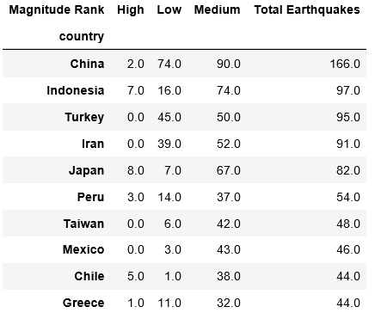
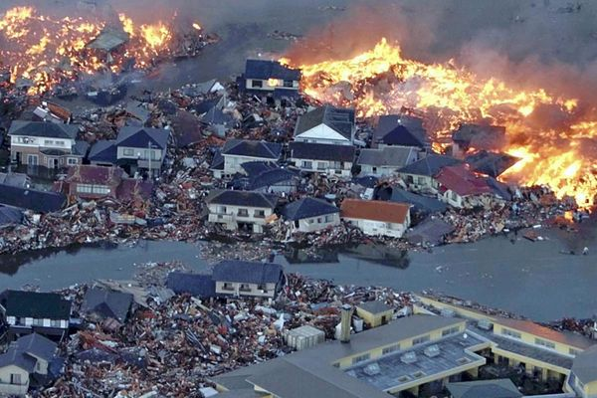
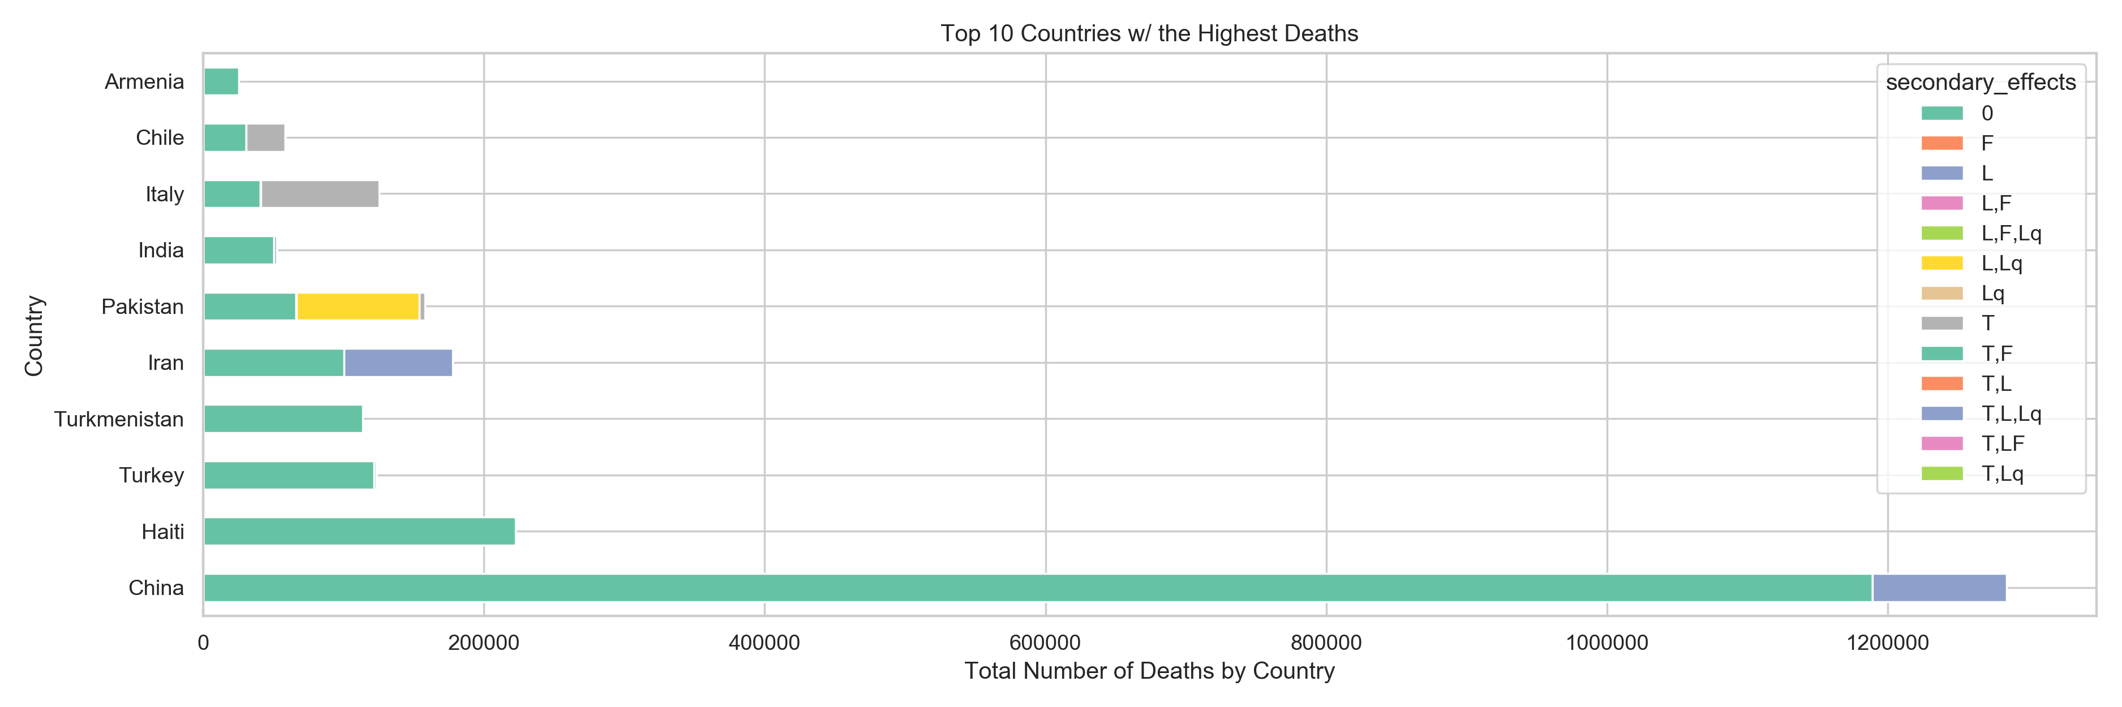
Top Number of Deaths from Earthquakes
What makes an earthquake more deadly?
Earthquakes are deadlier with infrastructure damage.
Earthquakes have killed hundreds of thousands of people even though scientists are able to make buildings much safer and stronger than in the past.
Magnitudes above 6.0 begin to have infrastructure damage.
Countries that sit on fault lines are more then likely to experience earthquakes.

Slide 7
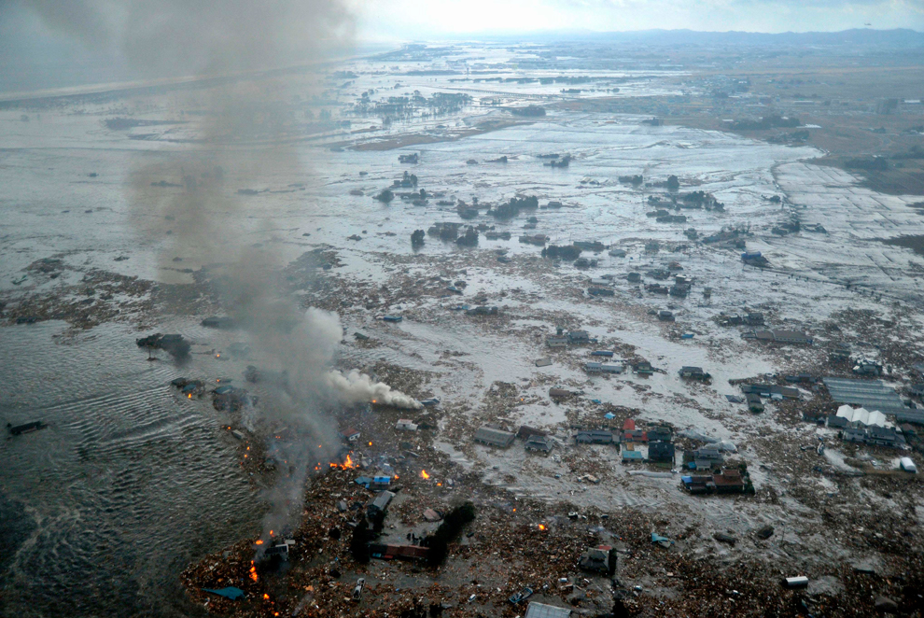
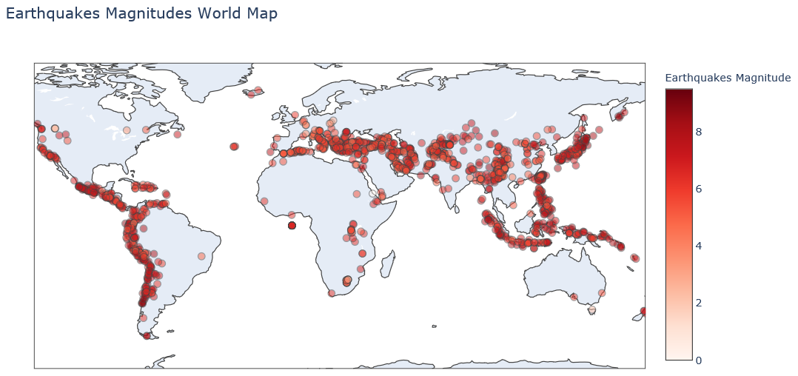
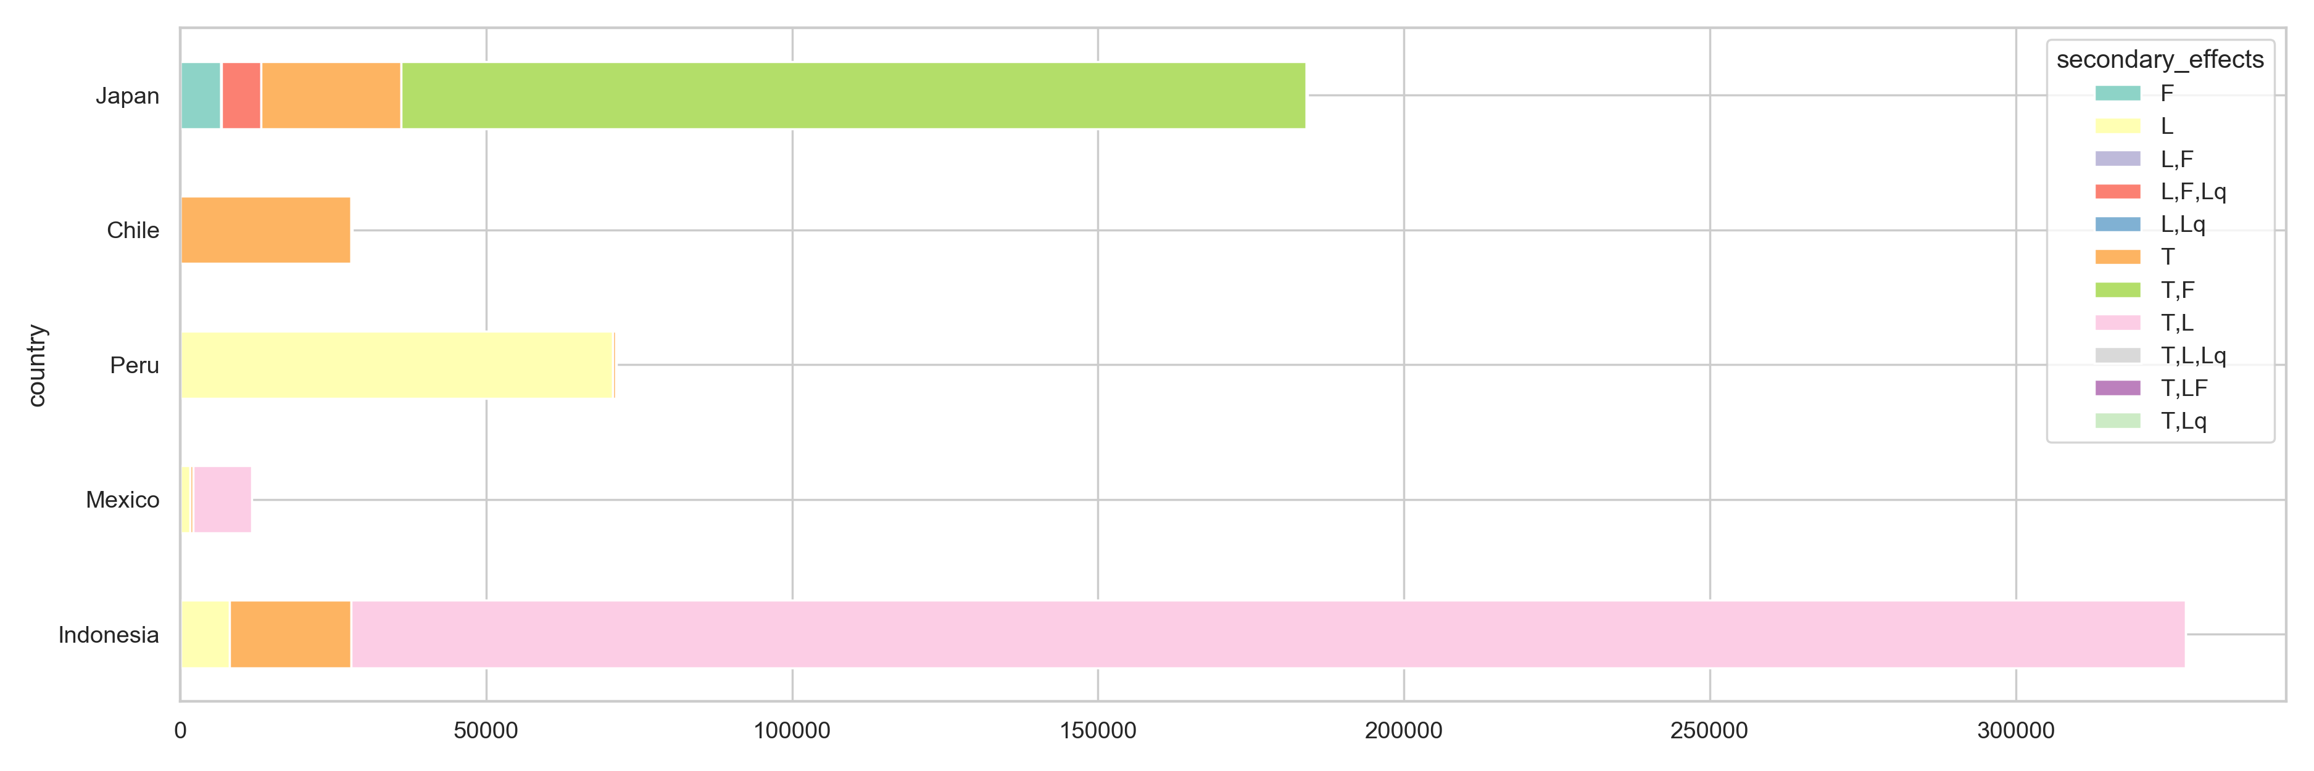
Earthquake and Secondary
What makes an earthquake more deadly?
Tsunamis and landslides causes the most death and economic cost.
Countries with coast lines and are islands face earthquake secondary effects.
These effects tend to take longer to clean up.
Japans 2011 earthquake caused a nuclear meltdown.

Slide 8
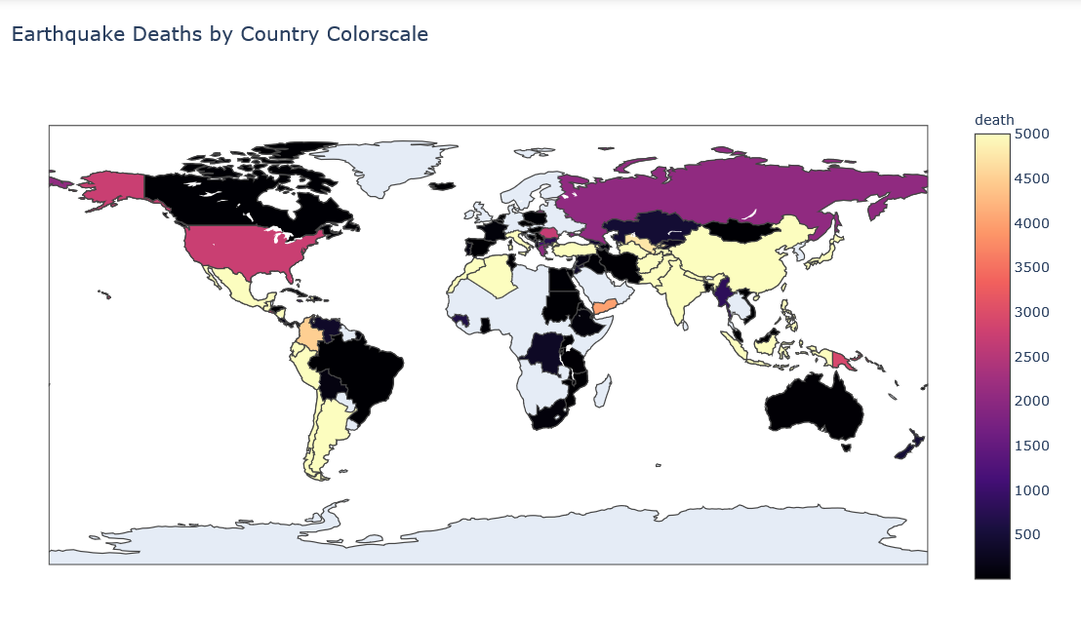
Safest Countries
Some of the safest countries are United Kingdom

