Slide 1
Business Intelligence: A Managerial Approach
Chapter 4:
Data Mining for Business Intelligence

Slide 2
Learning Objectives
Define data mining as an enabling technology for business intelligence
Understand the objectives and benefits of business analytics and data mining
Recognize the wide range of applications of data mining
Learn the standardized data mining processes
CRISP-DM
SEMMA
KDD

Slide 3
Learning Objectives
Understand the steps involved in data preprocessing for data mining
Learn different methods and algorithms of data mining
Build awareness of the existing data mining software tools
Commercial versus free/open source
Understand the pitfalls and myths of data mining

Slide 4
Opening Vignette…
Cabela’s Reels in More Customers with Advanced Analytics and Data Mining
Problem
Proposed solution
Results

Slide 5
Questions for the Opening Vignette
Why should retailers, especially omni-channel retailers, pay extra attention to advanced analytics and data mining?
What are the top challenges for multi-channel retailers? Can you think of other industry segments that face similar problems/challenges?
What are the sources of data that retailers such as Cabela’s use for their data mining projects?
What does it mean to have a “single view of the customer”? How can it be accomplished?
What type of analytics help did Cabela’s get from their efforts? Can you think of any other potential benefits of analytics for large-scale retailers like Cabela’s?

Slide 6
Data Mining Concepts and Definitions Why Data Mining?
More intense competition at the global scale.
Recognition of the value in data sources.
Availability of quality data on customers, vendors, transactions, Web, etc.
Consolidation and integration of data repositories into data warehouses.
The exponential increase in data processing and storage capabilities; and decrease in cost.
Movement toward conversion of information resources into nonphysical form.

Slide 7
Data Mining Concepts and Definitions Why Data Mining?
More intense competition at the global scale
Recognition of the value in data sources
Availability of quality data on customers, vendors, transactions, Web, etc.
Consolidation and integration of data repositories into data warehouses
The exponential increase in data processing and storage capabilities; and decrease in cost
Movement toward conversion of information resources into nonphysical form

Slide 8
Definition of Data Mining
The nontrivial process of identifying valid, novel, potentially useful, and ultimately understandable patterns in data stored in structured databases - Fayyad et al., (1996)
Keywords in this definition: Process, nontrivial, valid, novel, potentially useful, understandable
Data mining: a misnomer?
Other names: knowledge extraction, pattern analysis, knowledge discovery, information harvesting, pattern searching, data dredging

Slide 9
Data Mining at the Intersection of Many Disciplines

Slide 10
Data Mining Characteristics/Objectives
Source of data for DM is often a consolidated data warehouse (not always!).
DM environment is usually a client-server or a Web-based information systems architecture.
Data is the most critical ingredient for DM which may include soft/unstructured data.
The miner is often an end user… THAT’S YOU!!!
Striking it rich requires creative thinking.
Data mining tools’ capabilities and ease of use are essential (Web, Parallel processing, etc.).

Slide 11
Data in Data Mining
Data: a collection of facts usually obtained as the result of experiences, observations, or experiments
Data may consist of numbers, words, and images
Data: lowest level of abstraction (from which information and knowledge are derived)
DM with different data types?
- Other data types?

Slide 12
What Does DM Do? How Does it Work?
DM extracts patterns from data
Pattern?
A mathematical (numeric and/or symbolic) relationship among data items
Types of patterns
Association
Prediction
Cluster (segmentation)
Sequential (or time series) relationships

Slide 13
A Taxonomy for Data Mining Tasks

Slide 14
Other Data Mining Tasks
These are in addition to the primary DM tasks (prediction, association, clustering)
Time-series forecasting
Part of sequence or link analysis?
Visualization
Another data mining task?
Types of DM
Hypothesis-driven data mining
Discovery-driven data mining

Slide 15
Data Mining Applications
Customer Relationship Management
Maximize return on marketing campaigns
Improve customer retention (churn analysis)
Maximize customer value (cross- or up-selling)
Identify and treat most valued customers
Banking & Other Financial
Automate the loan application process
Detecting fraudulent transactions
Maximize customer value (cross- and up-selling)
Optimizing cash reserves with forecasting

Slide 16
Data Mining Applications (cont.)
Retailing and Logistics
Optimize inventory levels at different locations
Improve the store layout and sales promotions
Optimize logistics by predicting seasonal effects
Minimize losses due to limited shelf life
Manufacturing and Maintenance
Predict/prevent machinery failures
Identify anomalies in production systems to optimize manufacturing capacity
Discover novel patterns to improve product quality

Slide 17
Data Mining Applications (cont.)
Brokerage and Securities Trading
Predict changes on certain bond prices
Forecast the direction of stock fluctuations
Assess the effect of events on market movements
Identify and prevent fraudulent activities in trading
Insurance
Forecast claim costs for better business planning
Determine optimal rate plans
Optimize marketing to specific customers
Identify and prevent fraudulent claim activities

Slide 18
Data Mining Applications (cont.)
Computer hardware and software
Science and engineering
Government and defense – predict adversary’s moves
Homeland security and law enforcement
Travel industry
Healthcare
Medicine
Identify novel pattern to improve cancer survivability
Predict organ transplant success
Relationships between illnesses and successful treatments
Entertainment industry
Develop optimal pricing strategies to maximize revenues
Sports
Etc.
Highly popular application areas for data mining

Slide 19
Data Mining Process
A manifestation of best practices
A systematic way to conduct DM projects
Different groups have different versions
Most common standard processes:
CRISP-DM (Cross-Industry Standard Process for Data Mining)
SEMMA (Sample, Explore, Modify, Model, and Assess)
KDD (Knowledge Discovery in Databases)

Slide 20
Data Mining Process
Source: KDNuggets.com, August 2007

Slide 21
Data Mining Process: CRISP-DM

Slide 22
Data Mining Process: CRISP-DM
Step 1: Business Understanding
Step 2: Data Understanding
Step 3: Data Preparation (!)
Step 4: Model Building
Step 5: Testing and Evaluation
Step 6: Deployment
The process is highly repetitive and experimental (DM: art versus science?)
Accounts for ~85% of total project time

Slide 23
Data Preparation – A Critical DM Task

Slide 24
Data Mining Process: SEMMA

Slide 25
Data Mining Methods: Classification
Most frequently used DM method
Part of the machine-learning family
Employ supervised learning
Learn from past data, classify new data
The output variable is categorical (nominal or ordinal) in nature
Classification versus regression?
Classification into a category - Sunny, Rainy or Snowy day
vs. a number – what will the temperature be tomorrow
Classification versus clustering?
Supervised learning
vs. Unsupervised learning

Slide 26
Assessment Methods for Classification
Predictive accuracy
Hit rate
Speed
Model building; predicting
Robustness
Model’s ability to make reasonable accurate predictions, given noisy, missing and erroneous data
Scalability
ability to construct a prediction model efficiently given a large dataset
Interpretability
Transparency; ease of understanding

Slide 27
Estimation Methodologies for Classification
Simple split (or holdout or test sample estimation)
Split the data into 2 mutually exclusive sets training (~70%) and testing (30%)
For ANN, the data is split into three sub-sets (training [~60%], validation [~20%], testing [~20%])
Notes:
ANN = artificial neural network

Slide 28
Classification Techniques
Decision tree analysis
Statistical analysis
Neural networks
Support vector machines
Case-based reasoning
Bayesian classifiers
Genetic algorithms
Rough sets

Slide 29
Decision Trees
Employs the divide and conquer method
Recursively divides a training set until each division consists of examples from one class
Create a root node and assign all of the training data to it.
Select the best splitting attribute.
Add a branch to the root node for each value of the split. Split the data into mutually exclusive subsets along the lines of the specific split.
Repeat the steps 2 and 3 for each and every leaf node until the stopping criteria is reached.
A general algorithm for decision tree building

Slide 30
Decision Trees
DT algorithms mainly differ on
Splitting criteria
Which variable to split first?
What values to use to split?
How many splits to form for each node?
Stopping criteria
When to stop building the tree
Pruning (generalization method)
Pre-pruning versus post-pruning
Most popular DT algorithms include
ID3, C4.5, C5; CART; CHAID; M5

Slide 31
Decision Trees
Alternative splitting criteria
Gini index determines the purity of a specific class as a result of a decision to branch along a particular attribute/value
Used in CART
Information gain uses entropy to measure the extent of uncertainty or randomness of a particular attribute/value split
Used in ID3, C4.5, C5
Chi-square statistics (used in CHAID)

Slide 32
Cluster Analysis for Data Mining
A data mining method for classifying items, events, or concepts into common groupings called clusters
Part of the machine-learning family
Employ unsupervised learning
Learns the clusters of things from past data, then assigns new instances
There is no output variable
Also known as segmentation

Slide 33
Cluster Analysis for Data Mining
Clustering results may be used to
Identify natural groupings of people, things events
A high-tech Sorting Hat from Harry Potter
Identify rules for assigning new cases to classes for targeting/diagnostic purposes
Provide characterization, definition, labeling of populations
Who has done this in the past
Decrease the size and complexity of problems for other data mining methods
Identify outliers in a specific domain (e.g., rare-event detection)

Slide 34
Cluster Analysis for Data Mining
Analysis methods
Statistical methods (including both hierarchical and nonhierarchical), such as k-means, k-modes, and so on.
Neural networks (adaptive resonance theory [ART], self-organizing map [SOM])
Fuzzy logic (e.g., fuzzy c-means algorithm)
Genetic algorithms

Slide 35
Cluster Analysis for Data Mining
How many clusters?
There is no “truly optimal” way to calculate it
Heuristics are often used
Look at the sparseness of clusters
Number of clusters = (n/2)^{1/2} (n: no of data points)
Use Akaike information criterion (AIC)
Use Bayesian information criterion (BIC)
Most cluster analysis methods involve the use of a distance measure to calculate the closeness between pairs of items.

Slide 36
Cluster Analysis for Data Mining
k-Means Clustering Algorithm
k : pre-determined number of clusters
Algorithm (Step 0: determine value of k)
Step 1: Randomly generate k random points as initial cluster centers.
Step 2: Assign each point to the nearest cluster center.
Step 3: Re-compute the new cluster centers.
Repeat steps 3 and 4 until some convergence criterion is met (usually that the assignment of points to clusters becomes stable).

Slide 37
Cluster Analysis for Data Mining - k-Means Clustering Algorithm

Slide 38
Association Rule Mining
A very popular DM method in business
Finds interesting relationships (affinities) between variables (items or events)
Part of machine learning family
Employs unsupervised learning
There is no output variable
Also known as market basket analysis
Often used as an example to describe DM to ordinary people, such as the famous “relationship between diapers and beers!”

Slide 39
Association Rule Mining
Input: the simple point-of-sale transaction data
Output: Most frequent affinities among items
Example: according to the transaction data…
“Customer who bought a laptop computer and a virus protection software, also bought extended service plan 70 percent of the time"
How do you use such a pattern/knowledge?
Put the items next to each other for ease of finding
Promote the items as a package (do not put one on sale if the other(s) are on sale)
Place items far apart from each other so that the customer has to walk the aisles to search for it, and by doing so potentially see and buy other items

Slide 40
Association Rule Mining
Representative applications of association rule mining include
In business: cross-marketing, cross-selling, store design, catalog design, e-commerce site design, optimization of online advertising, product pricing, and sales/promotion configuration
In medicine: relationships between symptoms and illnesses; diagnosis and patient characteristics and treatments (to be used in medical DSS); and genes and their functions (to be used in genomics projects)

Slide 41
Association Rule Mining
Are all association rules interesting and useful?
A Generic Rule: X ⇒ Y [S%, C%]
X, Y: products and/or services
X: Left-hand-side (LHS)
Y: Right-hand-side (RHS)
S: Support: how often X and Y go together
C: Confidence: how often Y goes together with the X
L: Lift: The ratio of the observed support to the expected
Example: {Laptop Computer, Antivirus Software} ⇒ {Extended Service Plan} [30%, 70%]

Slide 42
Association Rule Mining
Algorithms are available for generating association rules
Apriori
Eclat
FP-Growth
+ Derivatives and hybrids of the three
The algorithms help identify the frequent item sets, which are, then converted to association rules

Slide 43
Association Rule Mining
Apriori Algorithm
Finds subsets that are common to at least a minimum number of the itemsets
Uses a bottom-up approach
frequent subsets are extended one item at a time (the size of frequent subsets increases from one-item subsets to two-item subsets, then three-item subsets, and so on)
groups of candidates at each level are tested against the data for minimum support
(see the figure) →

Slide 44
Association Rule Mining
Apriori Algorithm

Slide 45
Artificial Neural Networks for Data Mining
Artificial neural networks (ANN or NN) is a brain metaphor for information processing
a.k.a. Neural Computing
Very good at capturing highly complex non-linear functions!
Many uses – prediction (regression, classification), clustering/segmentation
Many application areas – finance, medicine, marketing, manufacturing, service operations, information systems, etc.

Slide 46
Biological versus Artificial Neural Networks

Slide 47
Elements/Concepts of ANN
Processing element (PE)
Information processing
Network structure
Feedforward vs. recurrent vs. multi-layer…
Learning parameters
Supervised/unsupervised, backpropagation, learning rate, momentum
ANN Software – NN shells, integrated modules in comprehensive DM software, …

Slide 48
Regression Analysis
A statistical analysis that has been around since 1805 but let’s do it on some big data anyway!
A statistical process for estimating the relationships among variables (1 dependent from 1 or many independent variables)
Regression analysis is widely used for prediction and forecasting
How much will variable “Y” change if I change variable “X” by 1?
This can lead to illusions or false relationships, so caution is advisable; for example, correlation does not imply causation.
http://www.tylervigen.com/ spurious correlations!

Slide 49
Arachnophobia???
The more spiders I throw under your chair the more scared you are!
Sample | # of Spiders | Fear Level
1 | 1 | 2
2 | 2 | 4
3 | 3 | 6
4 | 4 | 8
5 | 5 | 10
6 | 6 | 12
7 | 7 | 16
8 | 2 | 1
9 | 3 | 3
10 | 4 | 5
11 | 5 | 7
12 | 6 | 9
13 | 7 | 11
14 | 8 | 13
Notes:
R2 = coefficient of determination: a number that indicates how well data fit a statistical model
Predicting of future outcomes or testing of hypotheses.

Slide 50
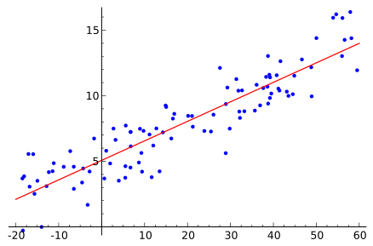
Experiment Results: Regression

Slide 51
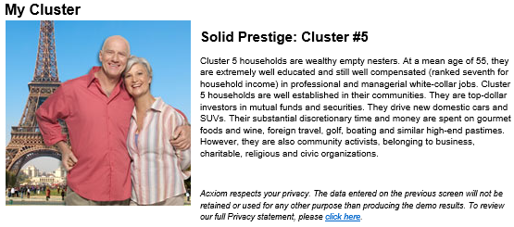
What is your PersonicX Cluster?
https://isapps.acxiom.com/personicx/personicx.aspx

Slide 52
Data Mining Software
Commercial
IBM SPSS Modeler (formerly Clementine)
SAS – Enterprise Miner
IBM – Intelligent Miner
StatSoft – Statistica Data Miner
… many more
Free and/or Open Source
RapidMiner
Weka
… many more
Source: KDNuggets.com, May 2009

Slide 53
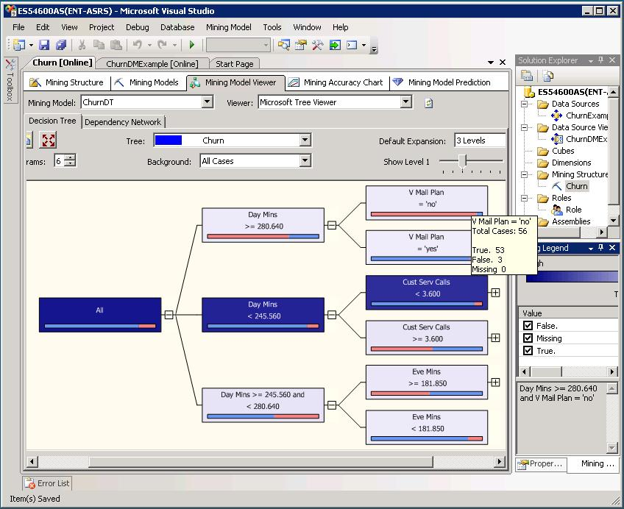
Data Mining in MS SQL Server 2008

Slide 54
Data Mining Myths
Data mining …
provides instant solutions/predictions.
is not yet viable for business applications.
requires a separate, dedicated database.
can only be done by those with advanced degrees.
is only for large firms that have lots of customer data.
is another name for good-old statistics.

Slide 55
Common Data Mining Blunders
Selecting the wrong problem for data mining
Ignoring what your sponsor thinks data mining is and what it really can/cannot do
Not leaving sufficient time for data acquisition, selection and preparation
Looking only at aggregated results and not at individual records/predictions
Being sloppy about keeping track of the data mining procedure and results

Slide 56
Common Data Mining Mistakes
Ignoring suspicious (good or bad) findings and quickly moving on
Running mining algorithms repeatedly and blindly, without thinking about the next stage
Naively believing everything you are told about the data
Naively believing everything you are told about your own data mining analysis
Measuring your results differently from the way your sponsor measures them

Slide 57
End of the Chapter
Questions, comments

Slide 58
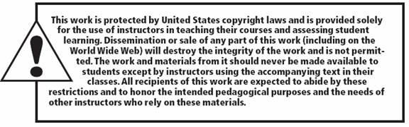
All rights reserved. No part of this publication may be reproduced, stored in a retrieval system, or transmitted, in any form or by any means, electronic, mechanical, photocopying, recording, or otherwise, without the prior written permission of the publisher. Printed in the United States of America.
Copyright © 2011 Pearson Education, Inc.
Publishing as Prentice Hall

Slide 59
Case Study 6…
“Data Mining Goes to Hollywood!”
Decision situation –
“land of hunches and wild guesses”
“No one can tell you how a movie is going to do in the marketplace… not until the film opens in darkened theater and sparks fly up between the screen and the audience.”
Problem
Proposed solution
Results
Answer & discuss the case questions

Slide 60
Case Study 6: Data Mining Goes to Hollywood!
Dependent Variable
Independent Variables
A Typical Classification Problem

Slide 61
Case Study 6 : Data Mining Goes to Hollywood!
The DM Process Map in IBM SPSS Modeler
Notes:
Support Vector Machines

Slide 62
Case Study 6 : Data Mining Goes to Hollywood!

