Slide 1
IDC3931
Data Visualization

Slide 2
What is Data Visualization?
the study of the visual representation of data, meaning "information that has been abstracted in some schematic form, including attributes or variables for the units of information. Friendly (2008)
The "main goal of data visualization is to communicate information clearly and effectively through graphical means.” Friedman (2008)

Slide 3
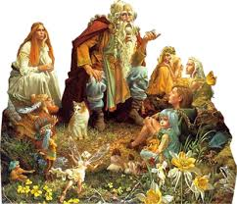
So… What Does This Mean to YOU???
Gather ‘round Students… That’s right! Story time with Uncle Ken

Slide 4
The Big Data Issue
How do we begin to comprehend a hundred rows of data, let alone a thousand or a million or a billion rows?
The answer is pictures.
Humans are fundamentally different from computers. We're wired to comprehend:
Shapes
Patterns
Colors
So technology companies are using data visualization to help companies turn large sets of data into pictures that lead people intuitively to the information that is most important to them.

Slide 5

Look at our CEO’s mesmerized by the Visualizations!!!
See Kids… the wind speed DOES affect power generated AND it increases our profits so tornadoes are actually GOOD!

Slide 6
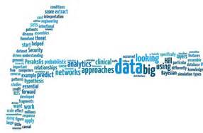
Your Imagination Is the Key
That can mean something as familiar as a color-coded map, only with lots of interactive features.
Or it can mean something unfamiliar to most people, like seemingly amorphous shapes that on closer inspection quickly yield insights into the data they portray.
Click on the link to play with Tagxedo! http://www.tagxedo.com/

Slide 7
Basics: Defining Some “Rules of Thumb”
For these basic charts, when do we use which one?
Pie Chart
Bar Chart
Column Chart
Line Chart
Scatterplot (dot) Chart

Slide 8
Pie Chart
A category comparison is best demonstrated using a pie chart
A circle give a clear impression of being total
Therefore a pie chart is ideally suited for the one and only purpose it serves:
Showing the SIZE of each part as a PERCENTAGE of some whole

Slide 9
Bar Chart
An item comparison can best be demonstrated by a bar chart
The vertical dimension is not a scale; all it is used for is labeling the measured items

Slide 10
Column Chart
A time-series comparison can best be demonstrated using either a column or line chart
Use a column chart if you have few dates (generally less than 8)

Slide 11
Line Chart
Most common chart
Clearest for determining if the trend is increasing, decreasing, fluctuating, remaining constant

Slide 12
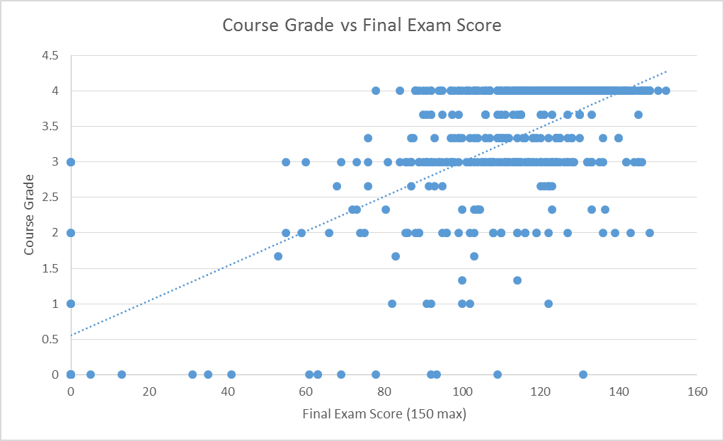
Scatter (dot) Chart
A correlation comparison shows whether the relationship between TWO variables follows, or fails to follow, a pattern or trend

Slide 13
Quick Reference Guide

Slide 14
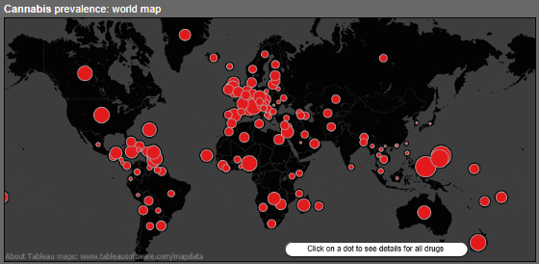

Slide 15
Bubble Maps

Slide 16
Bubble Charts

Slide 17
Line Charts

Slide 18
Tree Map

Slide 19
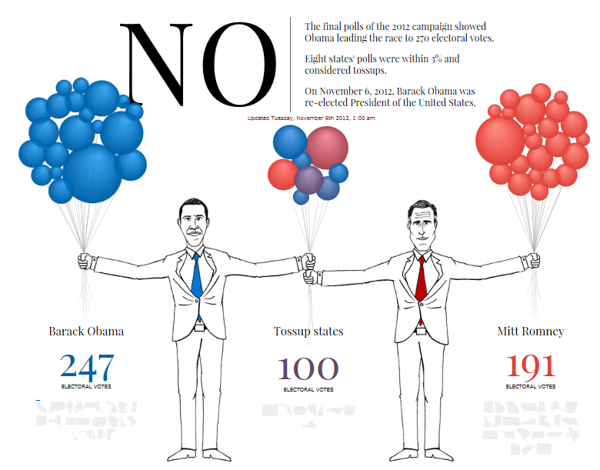
Now Let’s Let Our Imagination Run a Bit

Slide 20
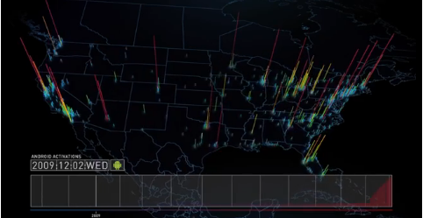

Slide 21
