Slide 1

AtomQuest Goals Portal
Enterprise HR Performance Management Platform

Slide 2
THE PROBLEM
Traditional Performance Tracking Is Broken
Enterprise HR teams are still managing goals in fragmented tools — spreadsheets, email chains, and siloed systems that create blind spots, missed deadlines, and compliance gaps.
Spreadsheet Dependency
Zero Visibility
Delayed Approvals
Goal data lives in disconnected files with no version control or single source of truth.
Managers lack real-time insight into team progress until it's too late to course-correct.
Manual sign-off chains stall goal activation, pushing timelines by days or weeks.
Disconnected Workflows
Painful Appraisals
HR, managers, and employees operate in silos with no unified approval or check-in process.
Quarterly reviews lack structured data, making fair and consistent evaluations nearly impossible.

Slide 3
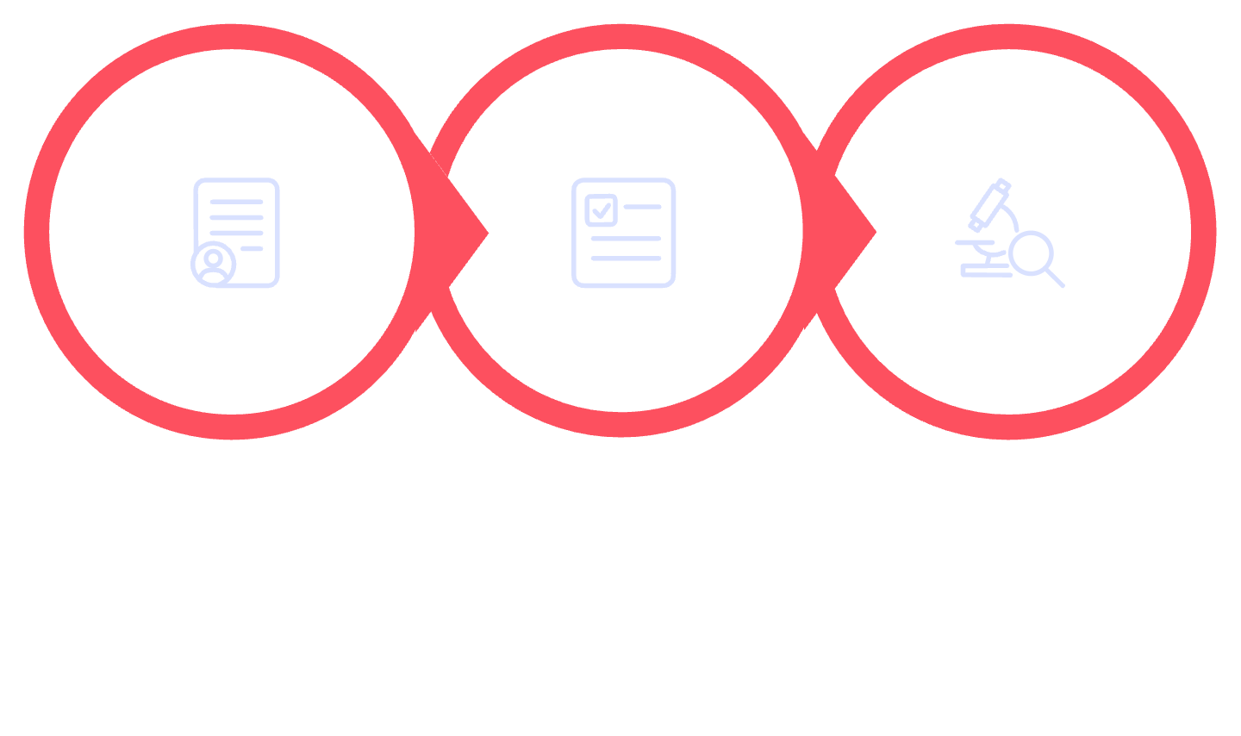
THE SOLUTION
One Centralized Platform. Every Role. Every Workflow.
Goal Management
Approval Workflows
Structured creation with weightage rules and lifecycle control.
Multi-tier sign-off with status tracking and notifications.
Employee: Submit Goals
Manager: Review & Approve
Admin: Audit & Track
Quarterly Check-ins
Analytics & Audit
Real-time dashboards, heatmaps, and immutable audit logs.
Structured mid-cycle updates with manager commentary.
AtomQuest Goals Portal unifies the entire performance cycle — from goal creation and approval to quarterly check-ins and executive reporting — in a single enterprise-grade platform.

Slide 4





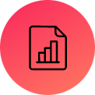


CORE FEATURES
Everything an Enterprise Needs, Out of the Box
Goal Creation
Approval Workflow
Weighted, structured goal entry with validation rules.
Multi-role review and sign-off with status visibility.
Quarterly Check-ins
Shared Goals
Periodic progress updates tied to each active goal.
Cross-functional goals visible and trackable across teams.
Analytics Dashboard
Reports & Exports
Real-time KPIs and progress metrics for every role.
CSV and PDF exports for HR compliance and audits.
Audit Logs
Role-Based Access
Immutable, timestamped change history for every action.
Granular permissions for Employee, Manager, and Admin.

Slide 5
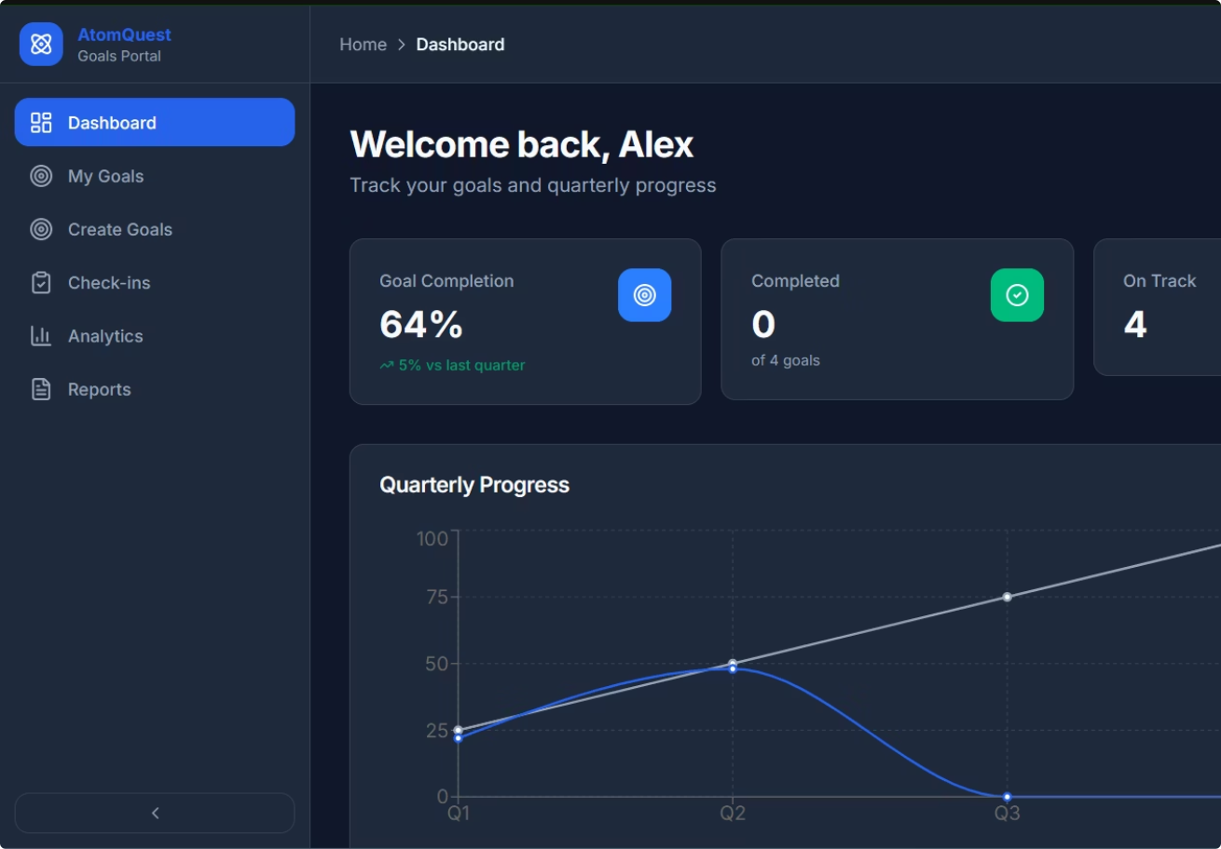
EMPLOYEE EXPERIENCE
A Dashboard Designed for Productivity
What Employees See & Do
Personal Dashboard
At-a-glance KPI widgets showing goal count, completion rate, and pending actions.
Goal Creation & Submission
Guided form with real-time weightage validation — submit for manager approval in seconds.
Progress Tracking
Visual progress bars and milestone markers keep employees focused on what matters.
Quarterly Updates
Structured check-in prompts ensure timely self-assessments every cycle.

Slide 6
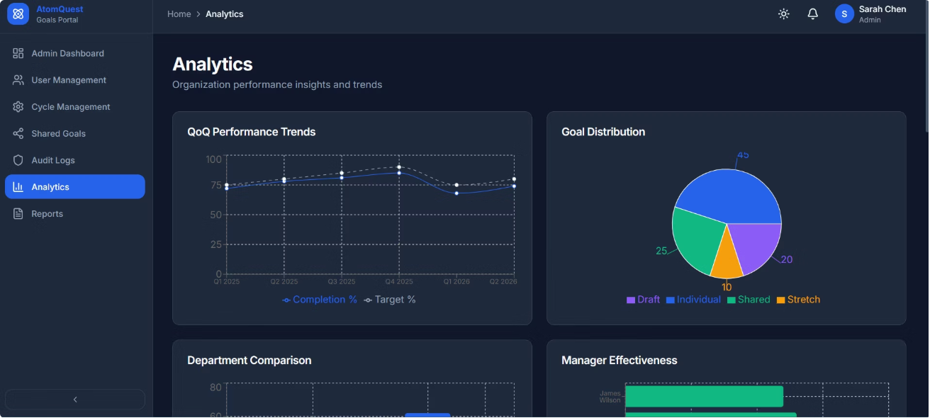
MANAGER & ADMIN EXPERIENCE
Full Organizational Visibility & Control
Manager View
Admin View
Review and approve team goals, submit check-in commentary, and unlock goal revisions when needed.
Organization-wide metrics, completion heatmaps, department rollups, and compliance audit exports.
Team Analytics
Completion Heatmaps
Aggregate goal progress by team, department, or cycle.
Identify performance patterns across the organization visually.
Unlock Controls
Audit Logs
Managers can unlock approved goals for amendment with a full audit trail.
Every state change is logged with user, timestamp, and before/after values.

Slide 7

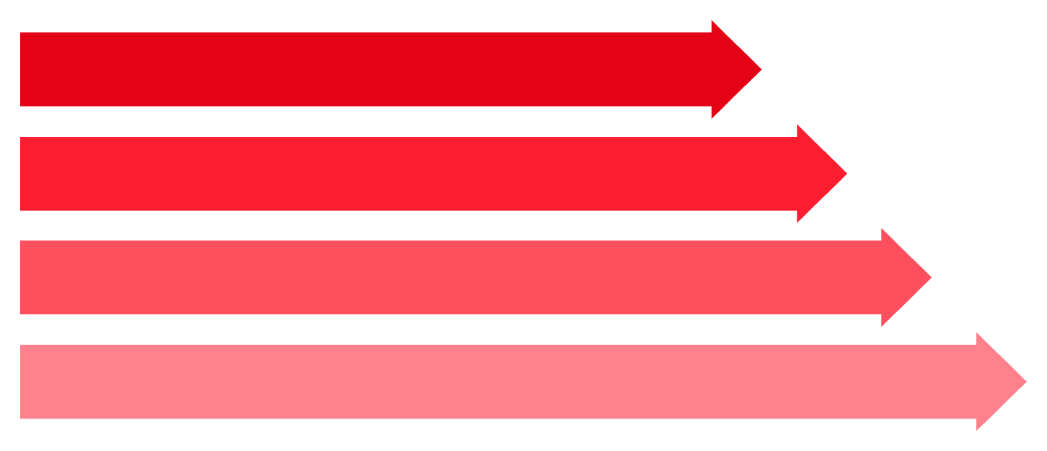
BUSINESS LOGIC
Intelligent Validation Rules Built In
1
2
100% Weightage Rule
Max 8 Goals
Draft
Total goal weights must sum exactly to 100% before submission is permitted.
Employees may define up to 8 goals per cycle — keeping focus sharp.
Submitted
Under Review
3
4
Approved
Min 10% Per Goal
Lock After Approval
Every goal passes through a governed lifecycle. Validation is enforced at every stage — no manual workarounds possible.
Each goal must carry at least 10% weightage to ensure meaningful commitment.
Approved goals are immutable. Only a manager unlock re-opens editing.

Slide 8
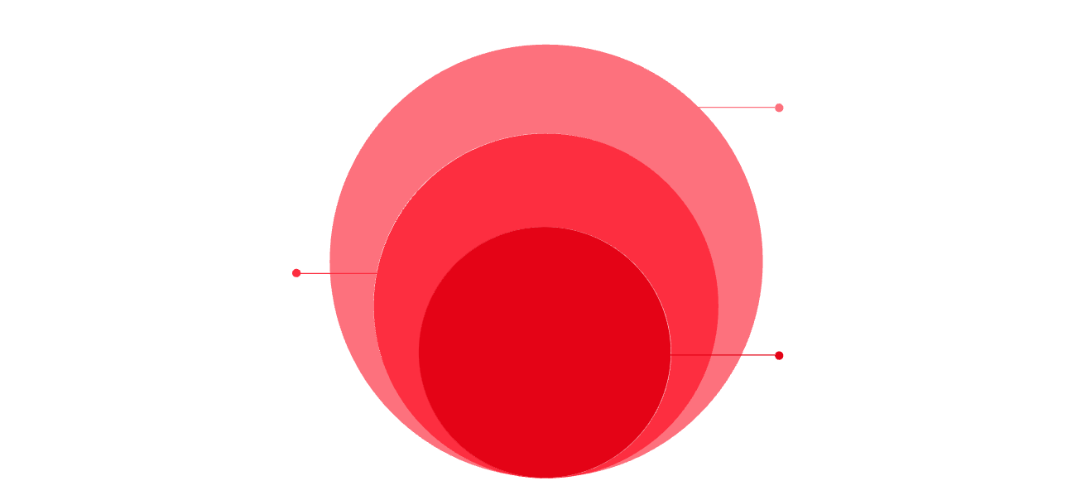
ANALYTICS & TECH STACK
Modern Architecture. Real-Time Insights.
Technology Stack
Frontend
Routing & Forms
Analytics Capabilities
React · TypeScript · Vite · Tailwind CSS
React Router · Zod Validation
Quarter-over-Quarter Analytics
KPI Dashboards
Role-specific metric cards surface what each user needs most.
Track goal completion trends across cycles with Recharts-powered visualizations.
UX & Charts
Framer Motion · Recharts
Reporting & Exports
Completion Heatmaps
Mock Database
CSV and PDF exports for HR compliance, audits, and leadership reviews.
Admin-level visual density maps for spotting organizational performance gaps.
In-memory store for fast, testable data
Service Layer
TypeScript services with Zod validation
Frontend
React + Vite UI for real-time analytics

Slide 9
LIVE DEMO
Try It Live — Right Now
🌐 Live Demo URL
atom-quest-goals-portal.vercel.app
Fully deployed, no install required.
🐙 GitHub Repository
github.com/kvr585/atom-quest_goals-portalOpen source · MIT License
🔑 Demo Credentials
Employee: employee@atomquest.com / demo123
Manager: manager@atomquest.com / demo123
Admin: admin@atomquest.com / demo123
Scan to open the live demo on your device

Slide 10
FUTURE SCOPE
What Comes Next
Azure AD Integration
SSO and identity management for seamless enterprise onboarding.
Microsoft Teams Bot
Goal nudges, approvals, and check-in reminders inside Teams.
AI Recommendations
ML-powered goal suggestions based on role, history, and org benchmarks.
Advanced Analytics
Predictive performance trends and executive-level BI dashboards.
Notification Automation
Smart deadline alerts, escalation chains, and cycle reminders.
Thank You — Built with passion by Team AtomQuest 🚀
AtomQuest Goals Portal · Hackathon Finale 2026

