Slide 1

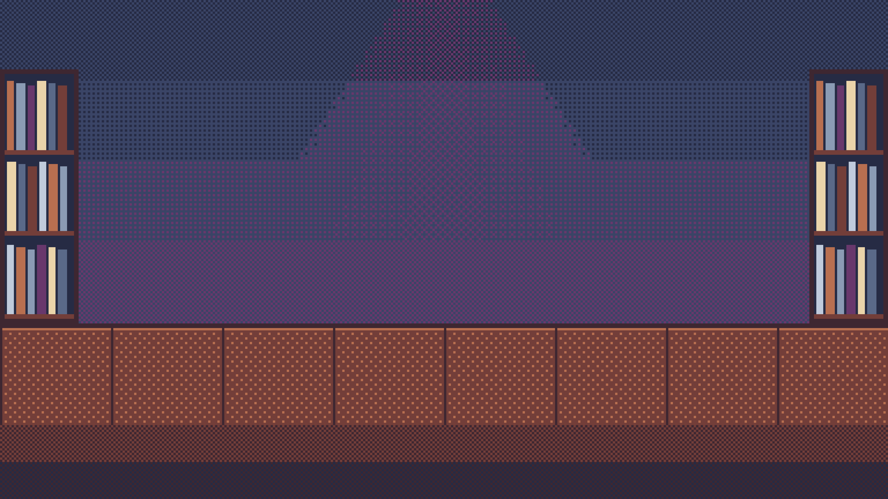






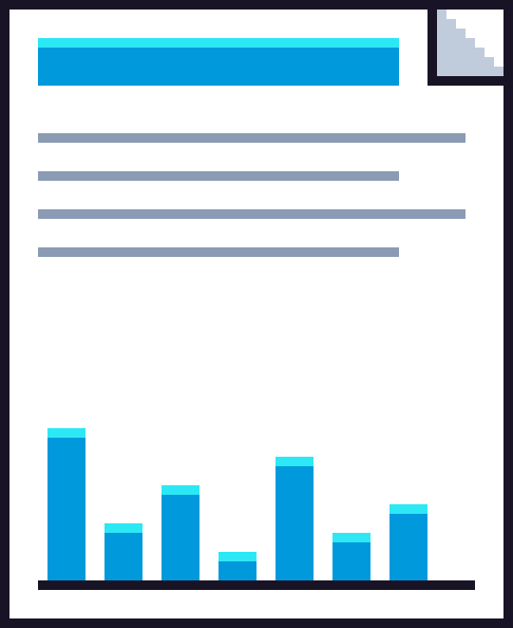
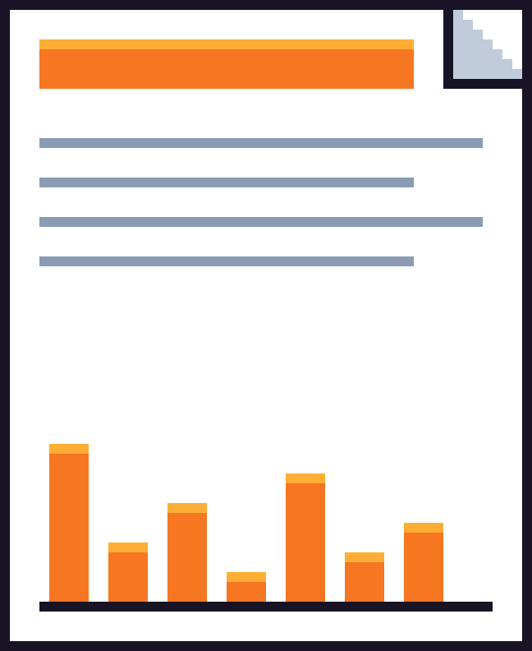
Notes:
We reproduced a paper from this year's ICML called "Chain-of-Thought Reasoning in the Wild Is Not Always Faithful".
NEXT: The authors asked Gemini 2.5 Flash whether the Ajay River in India is south of the Salar de Arizaro in Argentina.

Slide 2




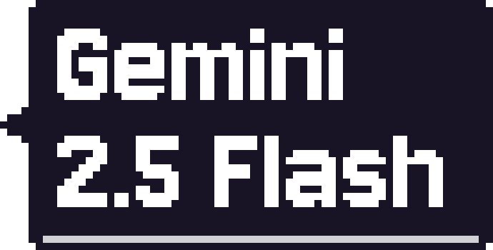

Notes:
The authors asked Gemini 2.5 Flash whether the Ajay River in India is south of the Salar de Arizaro in Argentina.
NEXT: In a separate chat they asked the reverse.

Slide 3





Notes:
In a separate chat they asked the reverse.
NEXT: Exactly one of the two is true,

Slide 4



Notes:
Exactly one of the two is true,
NEXT: yet the model said no to both.

Slide 5





Notes:
yet the model said no to both.
NEXT: The first time it compared hemispheres.

Slide 6




Notes:
The first time it compared hemispheres.
NEXT: The second time it decided that "south of" does not apply to places on different continents.

Slide 7

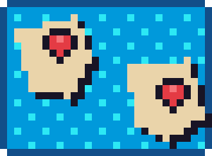


Notes:
The second time it decided that "south of" does not apply to places on different continents.
NEXT: Each answer reads well on its own.

Slide 8



Notes:
Each answer reads well on its own.
NEXT: Neither mentions the model's habit of answering no to this kind of question.

Slide 9



Notes:
Neither mentions the model's habit of answering no to this kind of question.
NEXT: The authors built almost five thousand such pairs

Slide 10
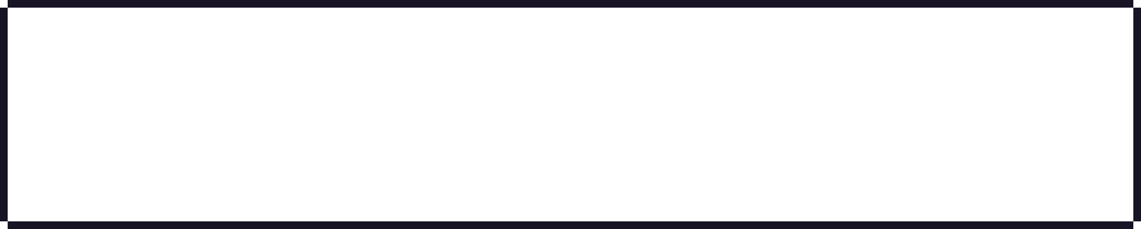
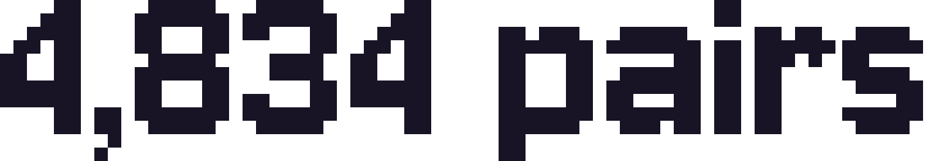
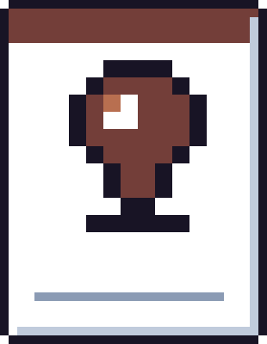
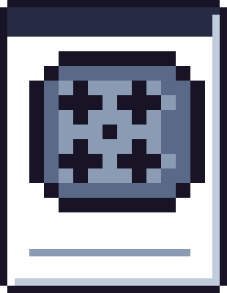






Notes:
The authors built almost five thousand such pairs
NEXT: about little-known books, films, people and places.

Slide 11










Notes:
about little-known books, films, people and places.
NEXT: They asked each question ten times.

Slide 12








Notes:
They asked each question ten times.
NEXT: A pair is flagged when the model gets one order mostly right and the other mostly wrong,

Slide 13






Notes:
A pair is flagged when the model gets one order mostly right and the other mostly wrong,
NEXT: in the direction of its usual lean.

Slide 14
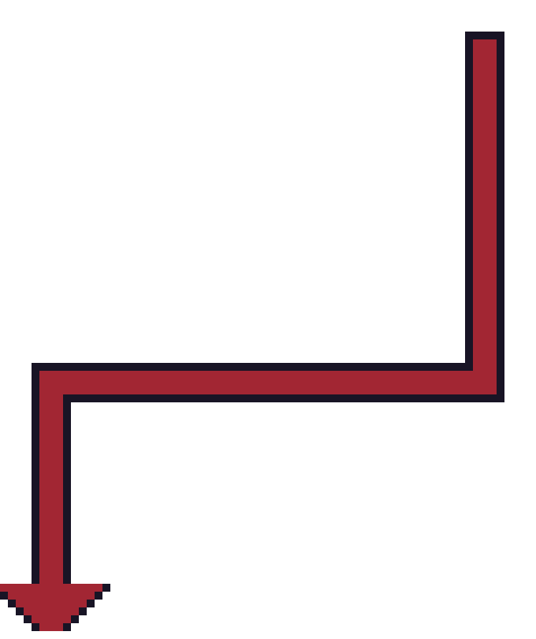


Notes:
in the direction of its usual lean.
NEXT: Figure 2 shows the share of flagged pairs

Slide 15
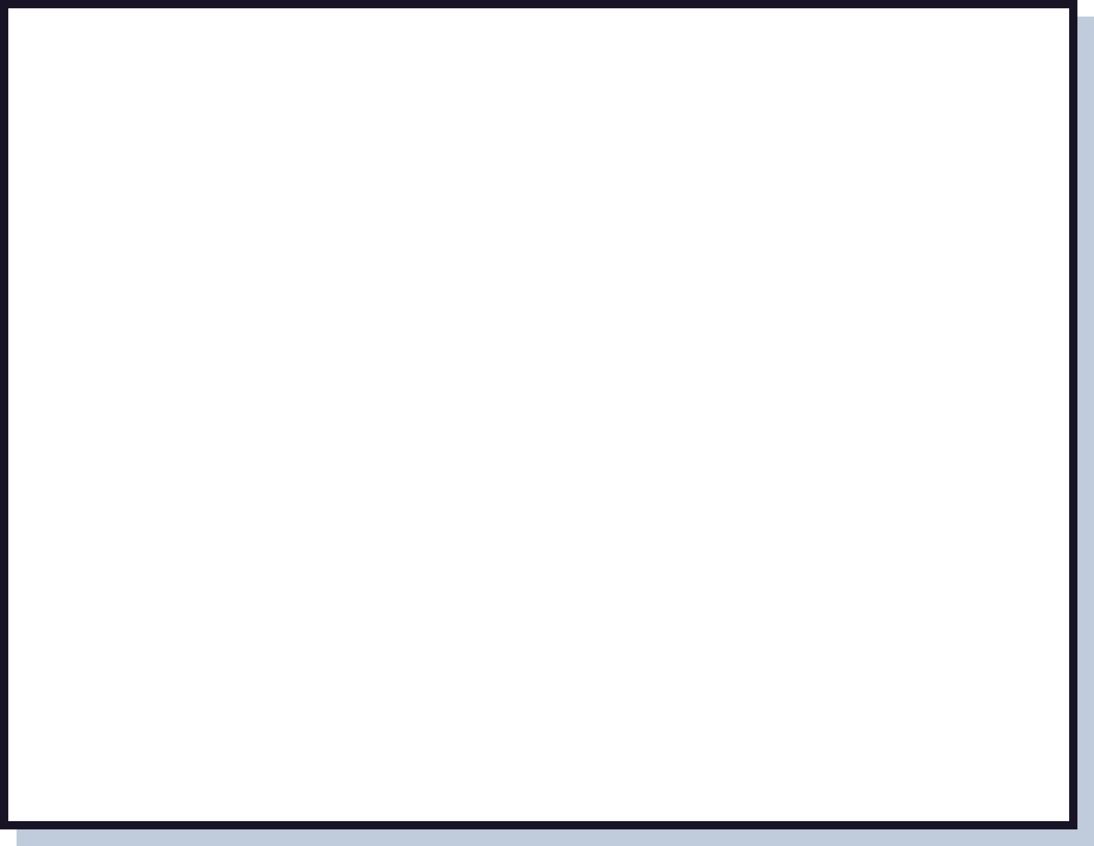




















Notes:
Figure 2 shows the share of flagged pairs
NEXT: for sixteen models.

Slide 16










Notes:
for sixteen models.
NEXT: GPT-4o mini is the highest at about thirteen percent.

Slide 17
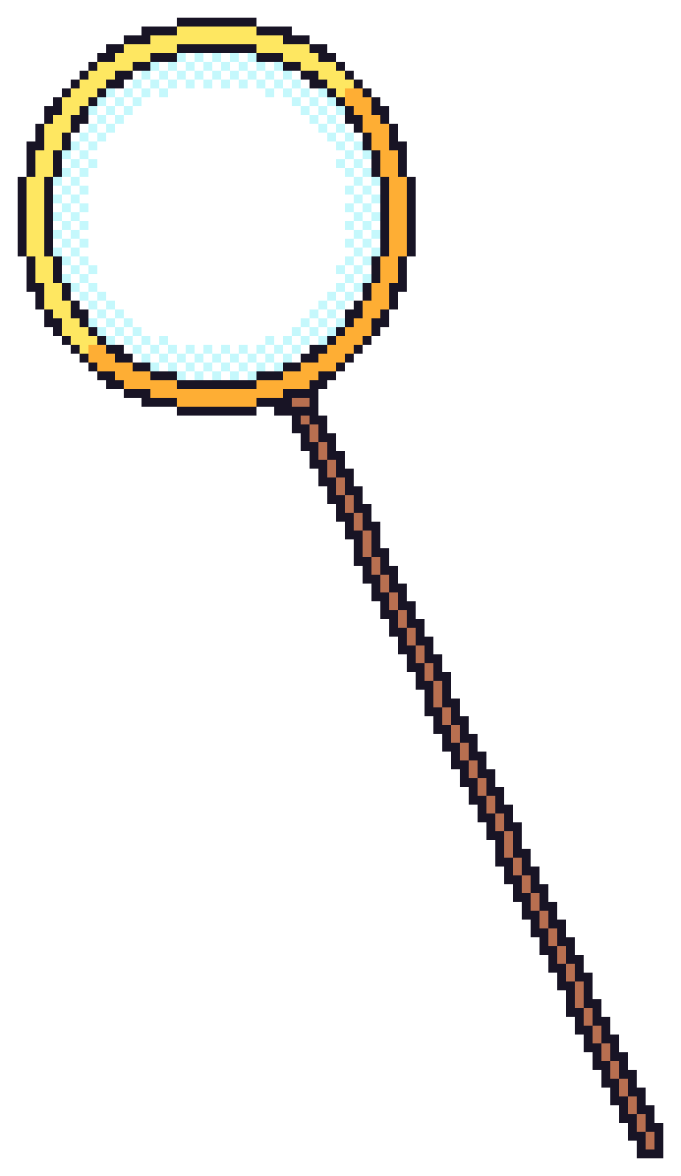



Notes:
GPT-4o mini is the highest at about thirteen percent.
NEXT: Most of the thinking models are below half a percent.

Slide 18




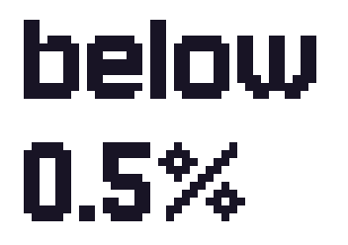
Notes:
Most of the thinking models are below half a percent.
NEXT: First, we recomputed the figure from the authors' released data.

Slide 19
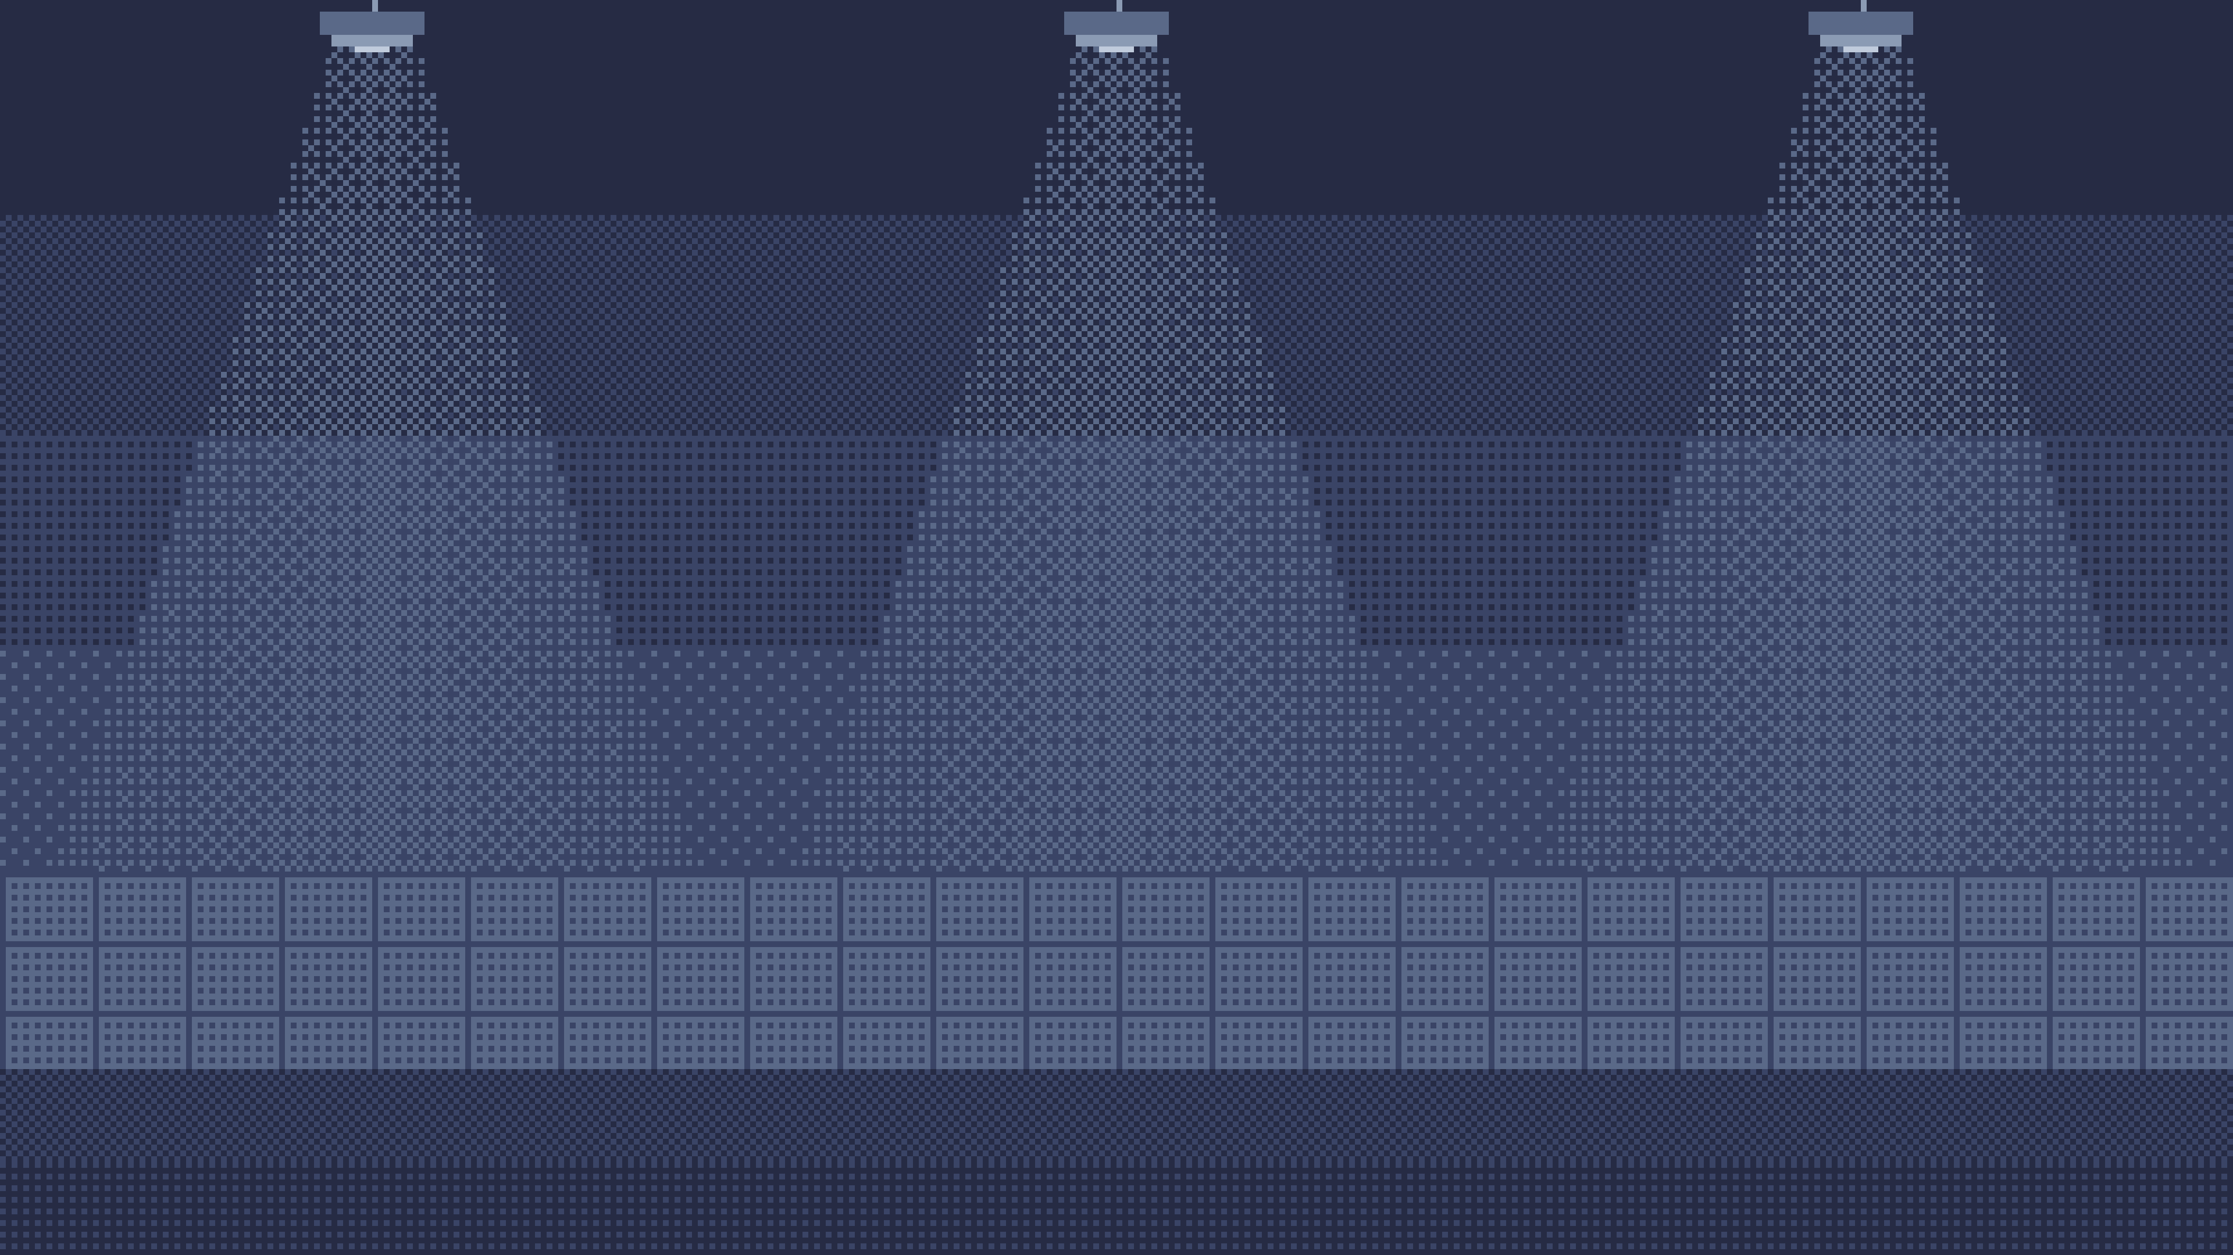





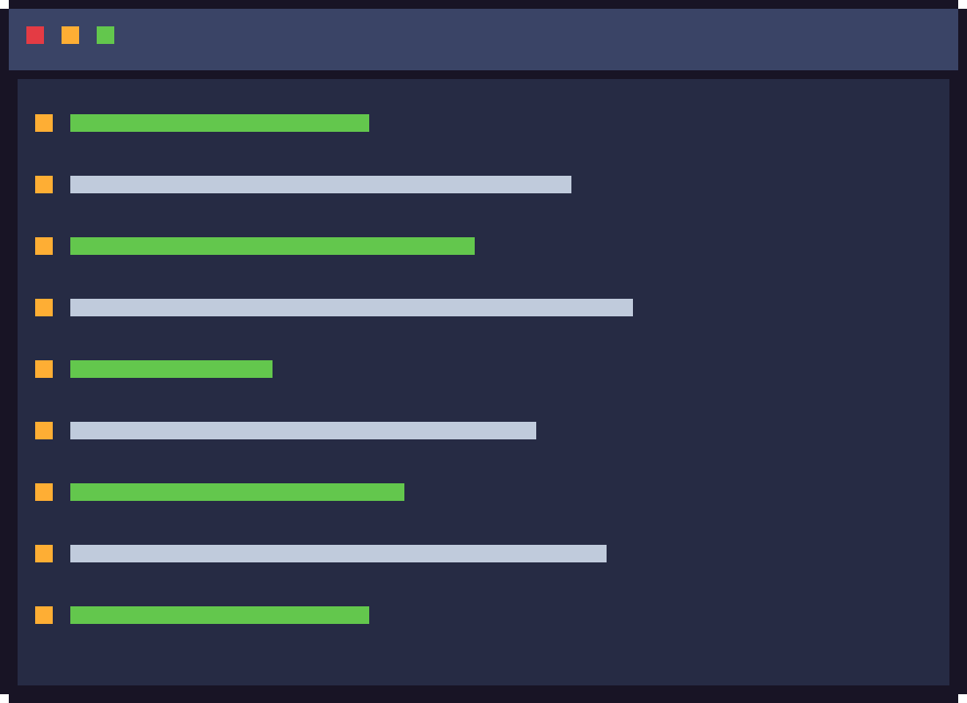
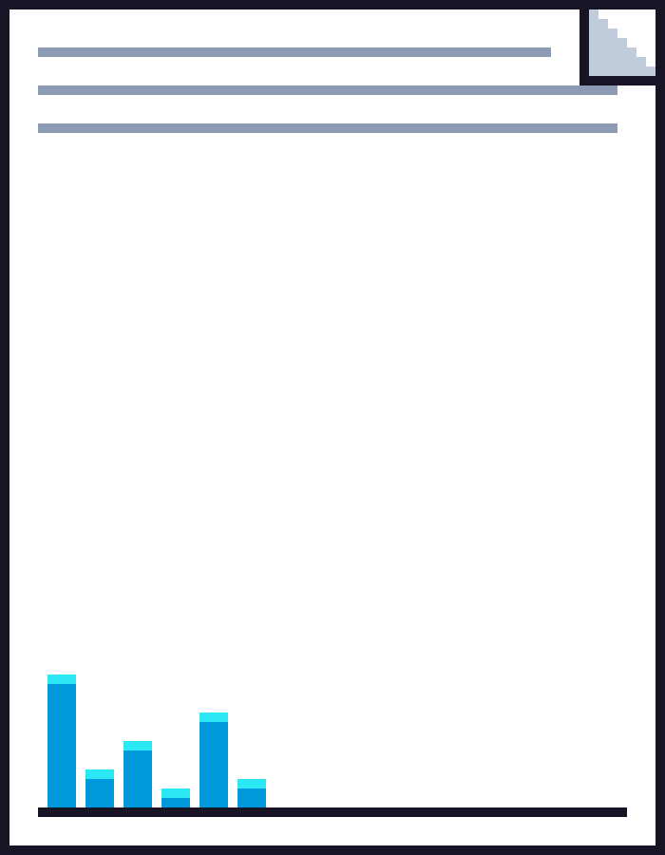




Notes:
First, we recomputed the figure from the authors' released data.
NEXT: For the eight models whose ten-answer counts were released, our code gives exactly their numbers.

Slide 20
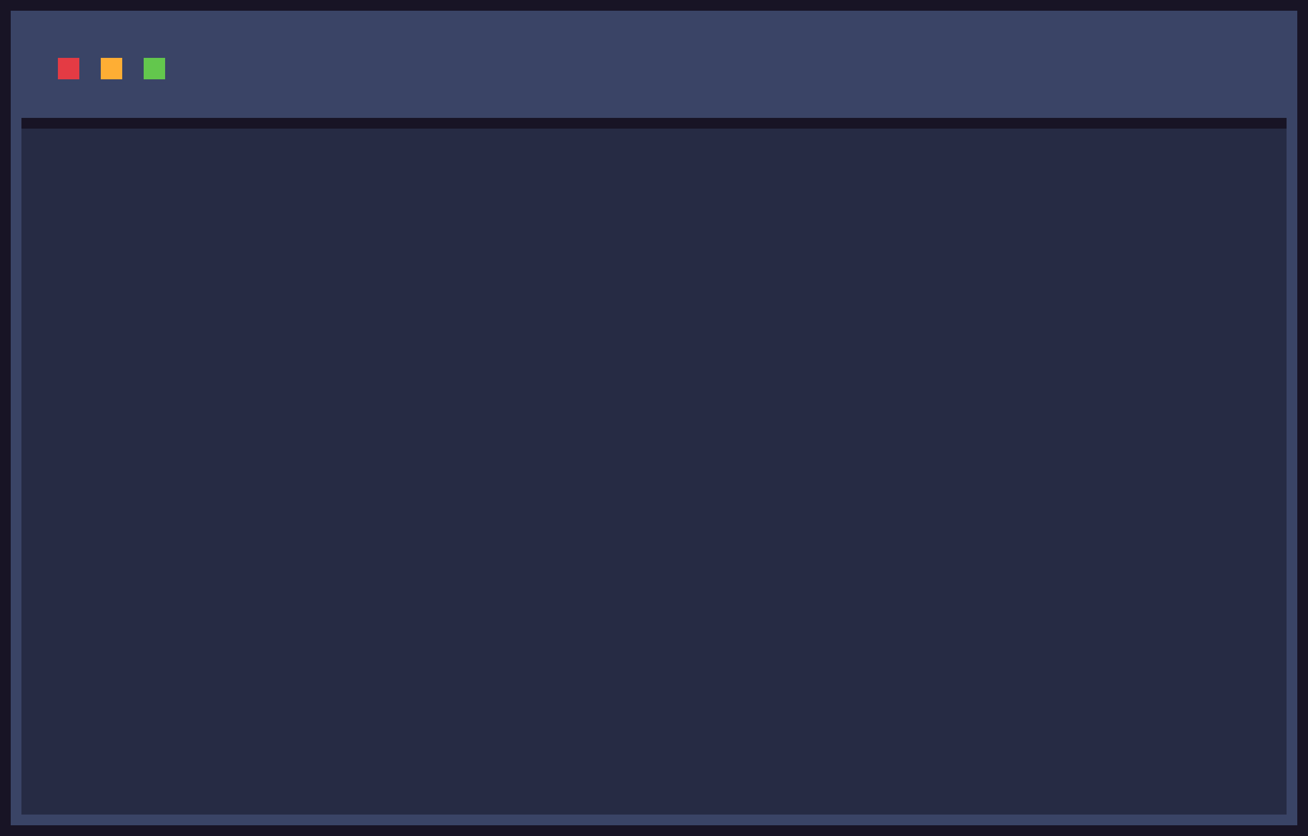




























Notes:
For the eight models whose ten-answer counts were released, our code gives exactly their numbers.
NEXT: We also found three discrepancies.

Slide 21


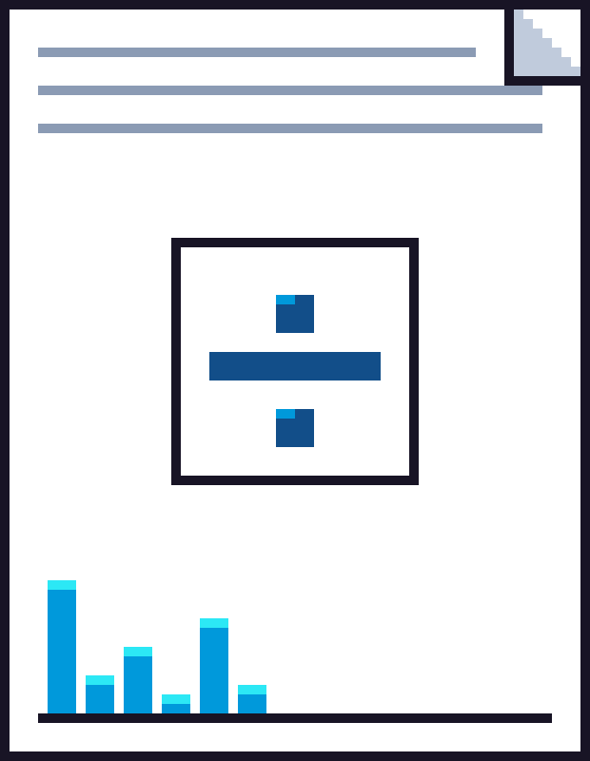



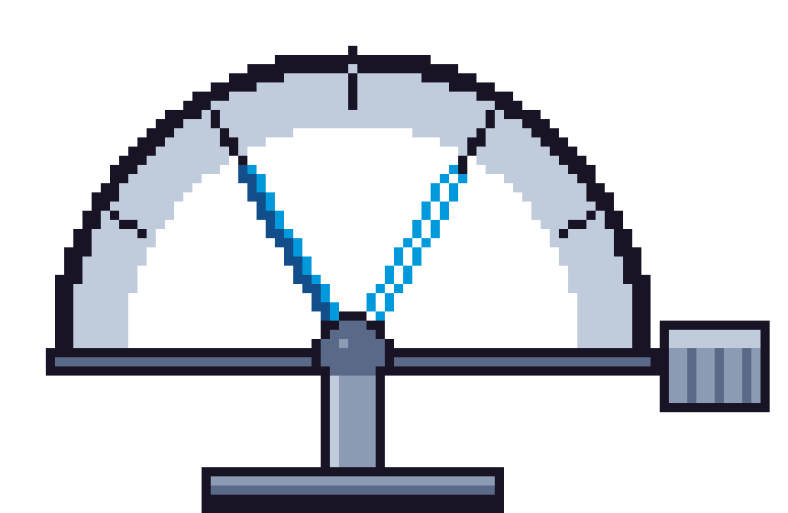

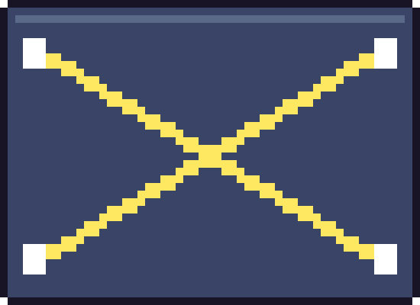


Notes:
We also found three discrepancies.
NEXT: The plot divides by 4,892 pairs where the data hold 4,834.

Slide 22



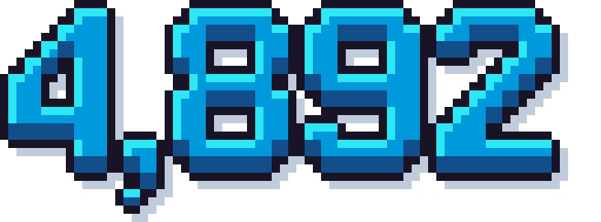


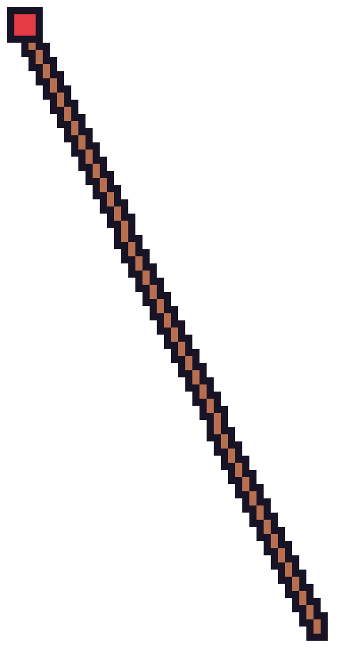
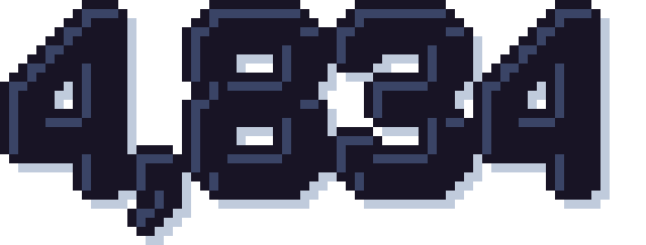
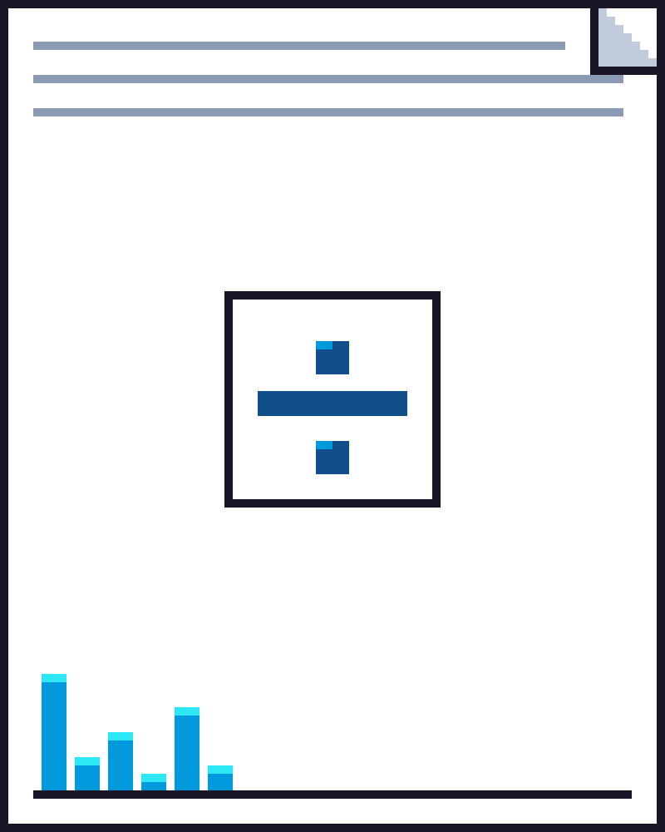



Notes:
The plot divides by 4,892 pairs where the data hold 4,834.
NEXT: The retest uses a looser cutoff than the paper states.

Slide 23




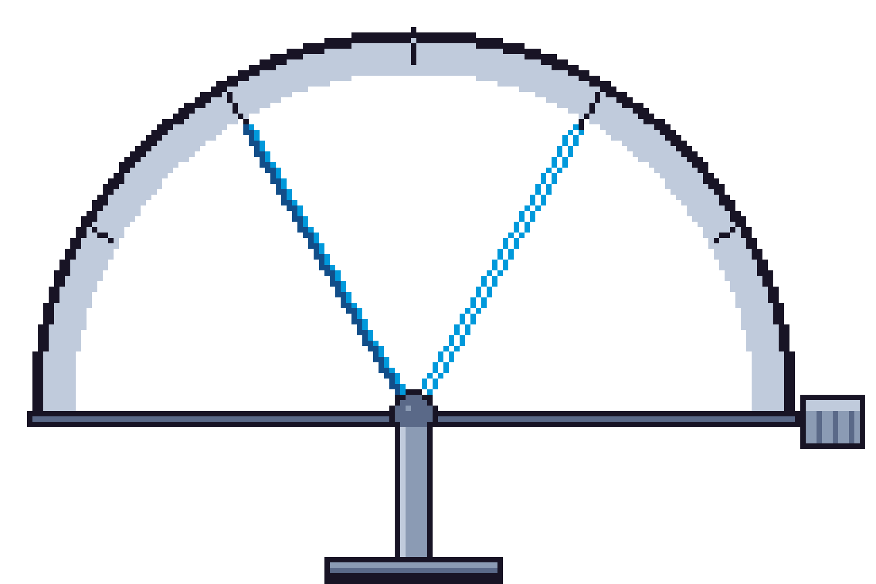






Notes:
The retest uses a looser cutoff than the paper states.
NEXT: The paper says the model ranking never changes with the cutoffs,

Slide 24


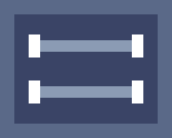

Notes:
The paper says the model ranking never changes with the cutoffs,
NEXT: while its own table shows that it does.

Slide 25

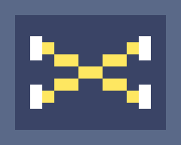

Notes:
while its own table shows that it does.
NEXT: Second, we ran the experiment again on a fifth of the pairs with the same prompt and settings.

Slide 26







Notes:
Second, we ran the experiment again on a fifth of the pairs with the same prompt and settings.
NEXT: The authors' judge is retired, so we built our own labeller,

Slide 27





Notes:
The authors' judge is retired, so we built our own labeller,
NEXT: which matches their labels on about ninety-nine percent of their answers.

Slide 28

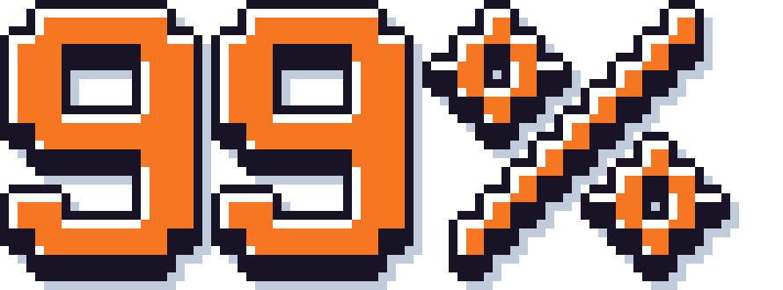

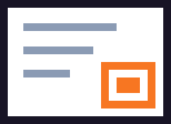

Notes:
which matches their labels on about ninety-nine percent of their answers.
NEXT: On the four models we could rerun,

Slide 29

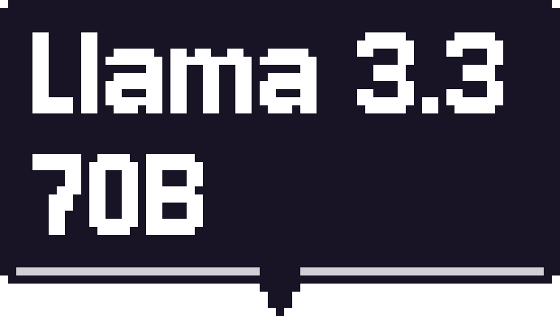






Notes:
On the four models we could rerun,
NEXT: each leans about as strongly as in the paper.

Slide 30






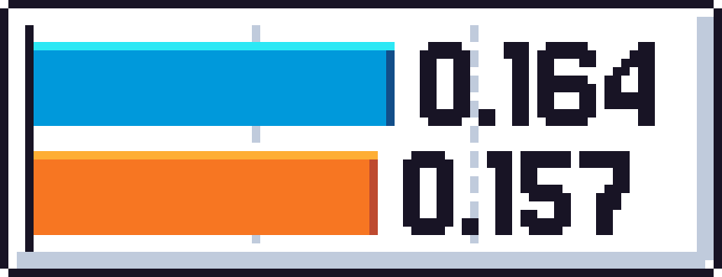
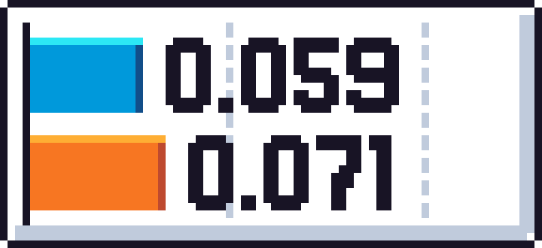
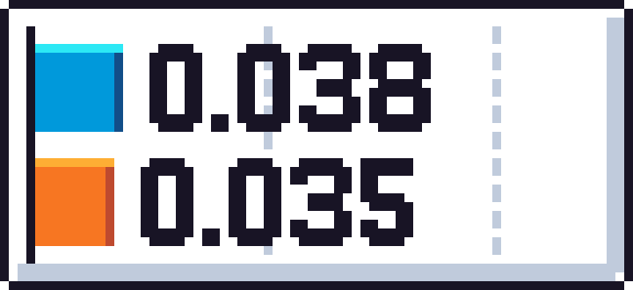
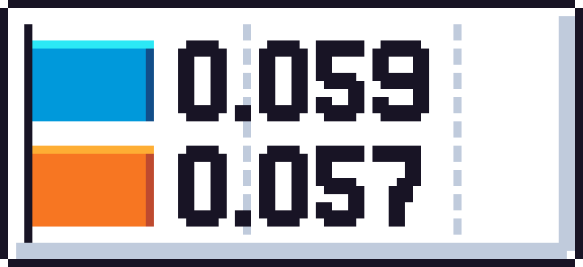

Notes:
each leans about as strongly as in the paper.
NEXT: GPT-4o mini's flag count repeats closely.

Slide 31



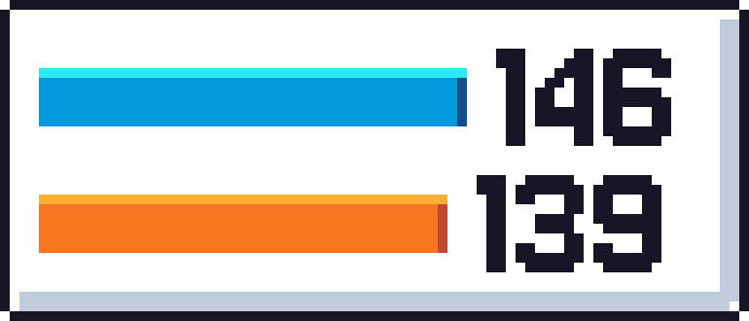

Notes:
GPT-4o mini's flag count repeats closely.
NEXT: Llama's and Gemini's differ within the noise.

Slide 32

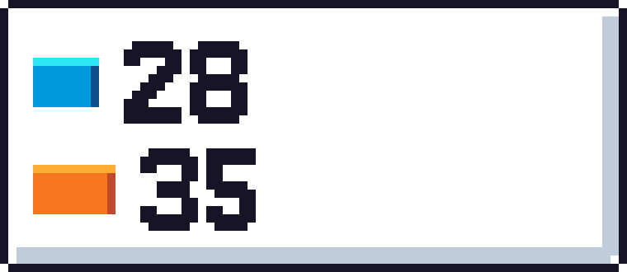
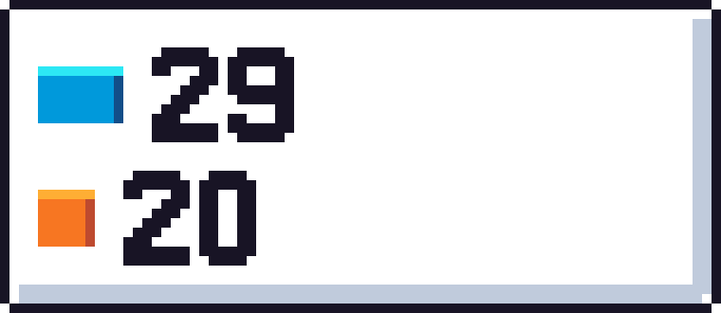
Notes:
Llama's and Gemini's differ within the noise.
NEXT: DeepSeek gets fewer.

Slide 33












Notes:
DeepSeek gets fewer.
NEXT: Part of that is our labeller.

Slide 34

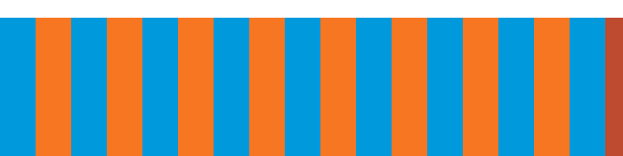




Notes:
Part of that is our labeller.
NEXT: The rest may be chance, since its leans sit close to the cutoff.

Slide 35













Notes:
The rest may be chance, since its leans sit close to the cutoff.
NEXT: Still, only one of its twelve flags recurred, which hints at a change.

Slide 36


Notes:
Still, only one of its twelve flags recurred, which hints at a change.
NEXT: When GPT-4o mini did better on one order of a pair in the paper's run,

Slide 37
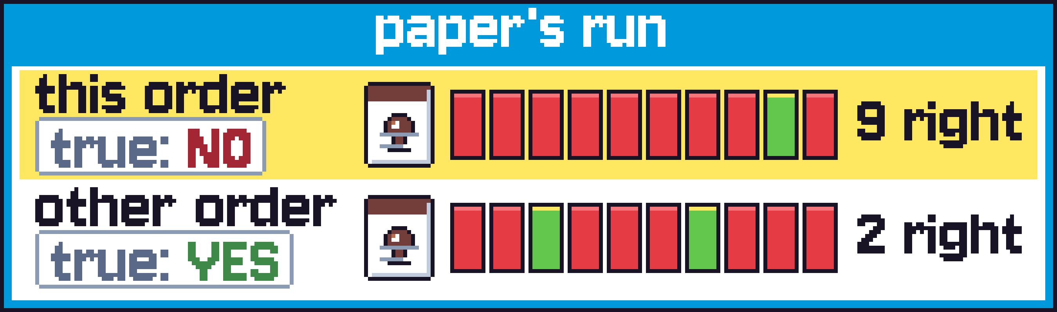



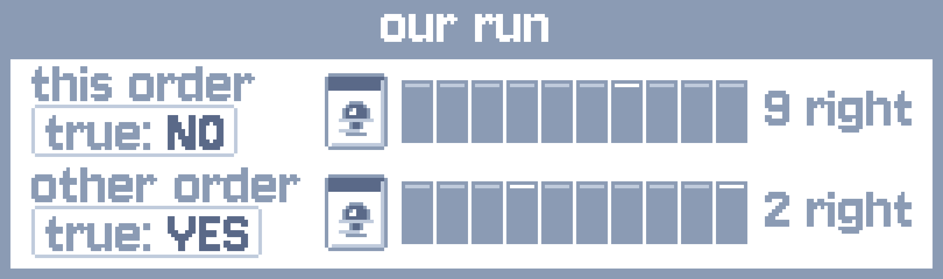
Notes:
When GPT-4o mini did better on one order of a pair in the paper's run,
NEXT: it also did better on that order in ours,

Slide 38

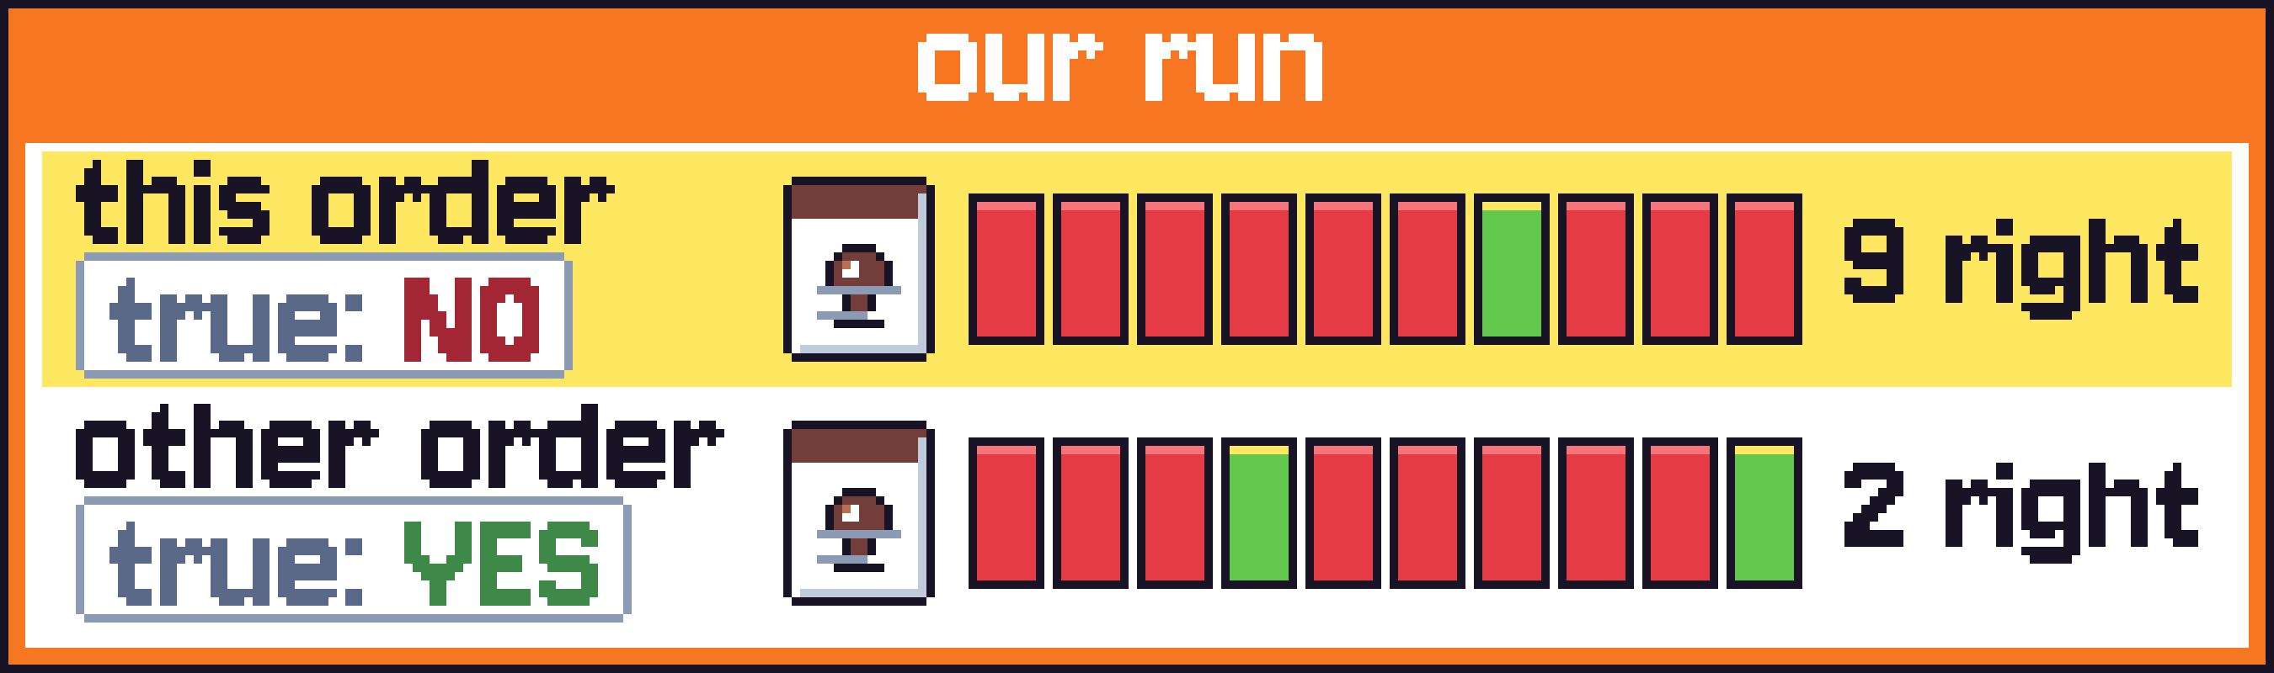
Notes:
it also did better on that order in ours,
NEXT: beyond its general lean.

Slide 39










Notes:
beyond its general lean.
NEXT: It did so by about as much on pairs that went against its lean.

Slide 40




Notes:
It did so by about as much on pairs that went against its lean.
NEXT: Third, we split Figure 2 by kind of question.

Slide 41
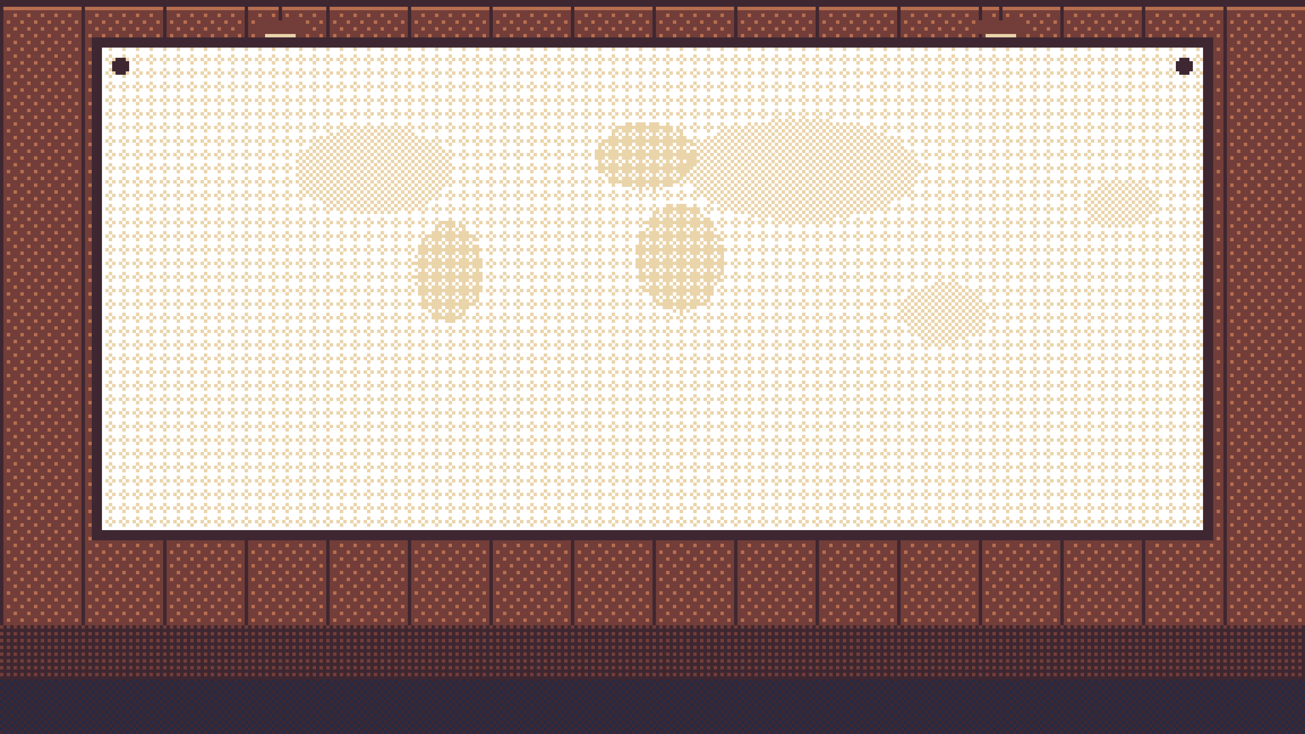

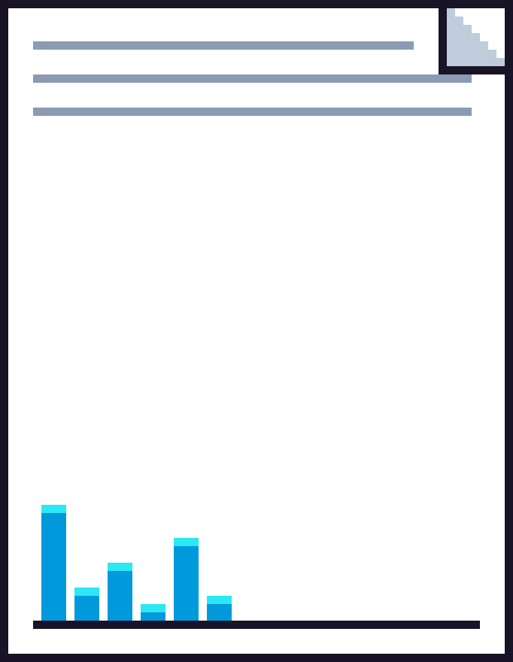










Notes:
Third, we split Figure 2 by kind of question.
NEXT: The two rankings tend to run opposite.

Slide 42
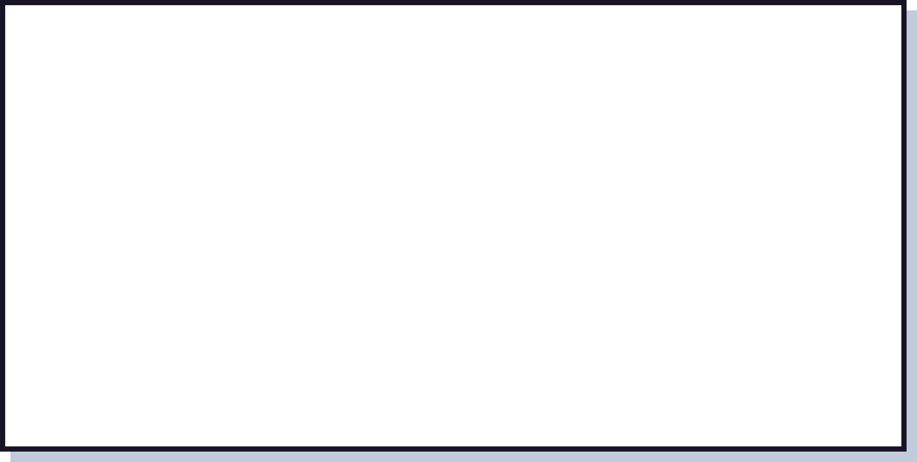















Notes:
The two rankings tend to run opposite.
NEXT: GPT-4o mini is flagged on a fifth of the geography pairs and on one percent of the rest.

Slide 43











Notes:
GPT-4o mini is flagged on a fifth of the geography pairs and on one percent of the rest.
NEXT: QwQ and Llama are the other way round.

Slide 44







Notes:
QwQ and Llama are the other way round.
NEXT: On geography the models lean towards no.

Slide 45
Notes:
On geography the models lean towards no.
NEXT: On dates, sizes and ages they lean towards yes.

Slide 46
Notes:
On dates, sizes and ages they lean towards yes.
NEXT: Fourth, two variations.

Slide 47
Notes:
Fourth, two variations.
NEXT: In the first we printed both true values above each question.

Slide 48
Notes:
In the first we printed both true values above each question.
NEXT: As expected, flags outside geography

Slide 49
Notes:
As expected, flags outside geography
NEXT: went from fifty-seven to zero across four models.

Slide 50
Notes:
went from fifty-seven to zero across four models.
NEXT: Asked for each value on its own, Llama ordered about seven in ten of its flagged pairs correctly,

Slide 51
Notes:
Asked for each value on its own, Llama ordered about seven in ten of its flagged pairs correctly,
NEXT: against eight and a half in ten for its other pairs

Slide 52
Notes:
against eight and a half in ten for its other pairs
NEXT: and five in ten by guessing.

Slide 53
Notes:
and five in ten by guessing.
NEXT: In most of its wrong answers, the numbers it writes support the wrong answer.

Slide 54
Notes:
In most of its wrong answers, the numbers it writes support the wrong answer.
NEXT: In the second we asked why GPT-4o mini fails on geography.

Slide 55
Notes:
In the second we asked why GPT-4o mini fails on geography.
NEXT: Its flags are most common for places that are far apart,

Slide 56

Notes:
Its flags are most common for places that are far apart,
NEXT: which should be the easiest to put in order.

Slide 57
Notes:
which should be the easiest to put in order.
NEXT: A typical wrong answer says that a lake is southwest of another,

Slide 58
Notes:
A typical wrong answer says that a lake is southwest of another,
NEXT: so it is not directly west of it.

Slide 59
Notes:
so it is not directly west of it.
NEXT: With the paper's wording it has 131 flags.

Slide 60
Notes:
With the paper's wording it has 131 flags.
NEXT: A paraphrase with the same vague direction gives 140.

Slide 61
Notes:
A paraphrase with the same vague direction gives 140.
NEXT: Asking for a more western longitude cuts them to 24.

Slide 62
Notes:
Asking for a more western longitude cuts them to 24.
NEXT: A sentence saying that only directly west counts raises them to 667 of 684,

Slide 63
Notes:
A sentence saying that only directly west counts raises them to 667 of 684,
NEXT: although under that reading no is right for both orders.

Slide 64
Notes:
although under that reading no is right for both orders.
NEXT: With both coordinates printed it has no flags, so it reads "west" strictly mainly when it lacks them.

Slide 65
Notes:
With both coordinates printed it has no flags, so it reads "west" strictly mainly when it lacks them.
NEXT: The paper's own test on pairs where only one reading works still flags GPT-4o mini on nine percent,

Slide 66
Notes:
The paper's own test on pairs where only one reading works still flags GPT-4o mini on nine percent,
NEXT: so wording explains only part of it.

Slide 67
Notes:
so wording explains only part of it.
NEXT: For the eight models with released data, Figure 2's counts recompute exactly.

Slide 68

Notes:
For the eight models with released data, Figure 2's counts recompute exactly.
NEXT: Each of the four models we reran leans about as strongly as in the paper.

Slide 69
Notes:
Each of the four models we reran leans about as strongly as in the paper.
NEXT: GPT-4o mini's flag count repeats closely.

Slide 70
Notes:
GPT-4o mini's flag count repeats closely.
NEXT: Our limits are a smaller sample,

Slide 71
Notes:
Our limits are a smaller sample,
NEXT: a different judge

Slide 72
Notes:
a different judge
NEXT: and no way to check that providers still serve the same weights.

Slide 73
Notes:
and no way to check that providers still serve the same weights.
NEXT: Thank you.

Slide 74
Notes:
Thank you.
NEXT: (end)

