Slide 1
STAT 175 · FINAL PROJECT · SPRING 2026
STAT 175 · FINAL PROJECT · SPRING 2026
Cost-Constrained
Edge Removal
for Epidemic Containment.
Learning the cost of breaking a friendship.
Karlo Vrančić
Alec Leprevotte
coord
model
Jackson Webster
Ryan Jiang
policy
results
Harvard · Prof. Austern · 28 April 2026
KARLO
Notes:
Hey everyone. We're working on epidemic containment on social networks, but with a twist: the cost of breaking a friendship matters. I'm Karlo, and the team is Alec, Jackson, and Ryan.

Slide 2
STAT 175 · cost-aware edge removal
WHAT INTERVENTIONS LOOK LIKE
You can't remove people.
Public-health policy is, structurally, edge cuts on a graph.
Real interventions don't isolate individuals, instead they restrict who is allowed to meet whom:
INTERVENTION · EDGE-SET · COST
Dorm reassignment
within-dorm ties
high
school closures
Class cancellation
classmate ties
med
dorm reassignments
contact-tracing isolation
Travel ban
between-campus ties
varies
travel restrictions
Quarantine cluster
one node's full nbhd
v.high
gathering size limits
the cost depends on which ties you break — that's the framing this project starts from.
02 / 17
KARLO
Notes:
Here's the setup. Suppose a disease is spreading through a college's friendship graph. You can't remove people from society — that's not how real interventions work. What public-health policy actually does is restrict who's allowed to meet whom. Closing a school, reassigning a dorm, banning a gathering — all of those are edge cuts. And every cut has a cost. Severing a roommate tie is socially expensive, but severing a casual acquaintance is cheap.

Slide 3
STAT 175 · cost-aware edge removal
THE FORMAL PROBLEM
What is the cheapest cut that keeps the disease subcritical?
ANNOTATIONS
OBJECTIVE
minimize
Σ c(e)
c(e)
cost proxy = σ(⟨xᵤ, x_v⟩) → defined slide 6
e ∈ E_cut
prev_∞
steady-state SIS infected fraction
SUBJECT TO
θ
public-health tolerance
prevalence_∞ ( G ∖ E_cut ) ≤ θ
G ∖ E_cut
residual graph after cuts
E_cut ⊆ E
equivalently: a cost-weighted variant of the immunization problem · Tong et al. 2012, Saha et al. 2015
03 / 17
KARLO
Notes:
So the question is: **what's the lowest-cost set of edges to cut so the epidemic stays under control?** That's a constrained optimization on a weighted graph, with a learned component sitting inside it. Alec, take it from the math.

Slide 4
STAT 175 · cost-aware edge removal
DYNAMICS
Susceptible → Infected → Susceptible.
Endemic respiratory diseases don't grant immunity. SIS lets you ask about steady state.
WHY SIS, NOT SIR
S
β · k
I
MIMICS
endemic respiratory diseases without permanent immunity
susceptible
infected
ADMITS
γ
a non-trivial steady-state — our primary outcome
PER STEP · DISCRETE TIME
MATCHES
I → S γ
the theoretical scaffold around λ₁(A) — see slide 5
S → I 1 − (1 − β)ᵏ k = # infected nbrs
RUN ON · 5 FACEBOOK100 CAMPUSES
Caltech36 · Bowdoin47 · Harvard1 · Penn94 · Tennessee9
04 / 17
ALEC
Notes:
We use the SIS model — Susceptible–Infected–Susceptible — because COVID-style diseases don't give permanent immunity. People recover, then catch it again. We run everything on five Facebook100 campuses, picked for diversity in clustering coefficient.

Slide 5
STAT 175 · cost-aware edge removal
WHEN DOES IT DIE OUT?
τ_c = 1 / λ₁(A).
Cut edges → shrink λ₁ → raise τ_c → contain. · Wang, Chakrabarti, Wang & Faloutsos 2003
steady-state prevalence
τ_c
EPIDEMIC THRESHOLD
endemic
τ_c = 1 / λ₁(A)
our headline R₀
the SIS process dies out iff β/γ < τ_c
R₀ WE SWEEP
0.8
1.5
3.0
6.0
dies out
the 1.5 regime is the headline → slide 10
0
1
2
3
4
R₀ = β · λ₁(A) / γ
05 / 17
ALEC
Notes:
There's a clean threshold for whether an SIS epidemic dies out or persists: τ_c = 1 over the leading eigenvalue of the adjacency matrix. Below τ_c, the disease dies. Above, it goes endemic. Edge removal directly raises this threshold — cutting bridges shrinks lambda_1, which raises τ_c, which shrinks the endemic region.

Slide 6
STAT 175 · cost-aware edge removal
COST = SIMILARITY
Similar people share expensive ties.
Cost is sigmoid of feature dot product. Cheap edges to cut = strangers.
WORKED EXAMPLE
DEFINITION
c(u, v) = σ ( ⟨ x_u , x_v ⟩ )
ALICE ↔ BOB
freshmen · Adams Hall · CS → 4 / 6 attributes shared
⟨x_A, x_B⟩ ≈ 0.67 → c ≈ 0.66
EXPENSIVE
FEATURE VECTOR x_u ∈ ℝ⁵⁹⁸
one-hot over 6 attributes, L2-normalized:
ALICE ↔ CAROL
dorm
year
major
freshman vs senior · diff dorm · diff major → 0 / 6 shared
⟨x_A, x_C⟩ ≈ 0.0 → c = 0.50
gender
status
high-school
CHEAPER
missing values are their own category.
observed band on Facebook100: c ∈ [0.50, 0.73] → motivates the cost-function ablation (slide 13).
06 / 17
ALEC
Notes:
Now the cost function. We follow our advisor's suggestion: each node has feature data — dorm, year, major, gender. We L2-normalize the one-hot encoding and define cost as **sigmoid of the dot product** of two endpoint feature vectors. Similar features means socially close, means an expensive edge to cut. J

Slide 7
STAT 175 · cost-aware edge removal
FOUR POLICIES
Random. Centrality. Bubble. Learned.
Naive → classical → realistic → novel. Every policy must beat the floor.
01
BASELINE
02
CLASSICAL
Random
Edge betweenness ÷ cost
Sample edges uniformly without replacement until the cost budget is exhausted. The floor every policy has to beat.
score(e) = betweenness(e) / c(e), greedy. Sampled with k=300 pivots on Penn94/Tennessee95 (Brandes 2008). Bang-for-buck.
03
REALISTIC
04
NOVEL
Distance Threshold
GNN-learned
Louvain communities → meta-graph → cut edges between communities far apart. The kind of policy a government can actually enforce.
2-layer GraphSAGE → 16-d embeddings → cost = σ(⟨z_u, z_v⟩) → score = NetMelt eigenscore / learned cost. Detailed slide 9.
all four implement the same Policy interface in src/stat175/policies/. locked by Project Outline §3.
07 / 17
JACKSON
Notes:
We compare four policies, ordered from naive to learned. **Random edge removal** — the trivial baseline. Every other policy has to beat it. **Edge betweenness centrality, divided by cost** — bottleneck edges divided by what they cost to cut. The classical bang-for-buck baseline. And then two more interesting ones.

Slide 8
STAT 175 · cost-aware edge removal
POLICY · 03
Stay in your bubble.
The realistic baseline. One threshold knob, no per-edge optimization.
ALGORITHM
1.
Run Louvain on residual graph → community labels.
2.
Build the meta-graph (one node per community).
3.
For threshold X, cut edges (u, v) with d_meta(c_u, c_v) > X.
4.
X is the budget knob — sweep it.
WHY IT MATTERS
"you may interact within your dorm-and-class bubble; not across."
intra-bubble · keep
d = 1 · keep
d ≥ 2 · cut
08 / 17
JACKSON
Notes:
**Distance Threshold** — the realistic, implementable one — the kind of policy a government can actually enforce. We partition the graph into communities, build a community meta-graph, and cut edges between communities that are far apart in that meta-graph. Equivalent to "stay within your friend bubble."

Slide 9
STAT 175 · cost-aware edge removal
POLICY · 04 · THE NOVEL PIECE
Learn the cost end-to-end.
Architecture is a means. The cost function is what's learned.
X
SVD
SAGE×2
z
c(u,v)
ℝⁿˣ⁵⁹⁸
→ ℝⁿˣ⁶⁴
graph encoder
ℝⁿˣ¹⁶
σ(⟨z_u, z_v⟩)
hidden_dim=32 · embed_dim=16 · dropout=0.5
analog of slide 6's hand-designed σ(⟨x,x⟩)
TRAINING · SELF-SUPERVISED LINK PREDICTION
EDGE SCORE · NETMELT
+ real edges as positive pairs
score(e) = ( u_i · v_j + u_j · v_i ) / c(u, v)
− sampled non-edges as negatives
ℒ BCE on σ(⟨z_u, z_v⟩)
u, v → leading eigenvectors of A
⚙ 40 epochs · Adam · lr 1e-3 · per-campus encoder
greedy fill until budget exhausted.
Tong et al. 2012
the cost function itself is what's learned end-to-end. the architecture is a means.
09 / 17
JACKSON
Notes:
And **the novel piece — a GNN-learned policy.** A 2-layer GraphSAGE encoder learns node embeddings z_v from a self-supervised link-prediction task. The cost of an edge is sigmoid(<z_u, z_v>) — basically, the probability the GNN thinks two nodes "should" be connected. Then we score each edge by eigenvector product divided by that learned cost. The point isn't that we invented a new architecture. The point is the cost function itself is learned end-to-end from the graph, instead of being hand-designed. Ryan, results.

Slide 10
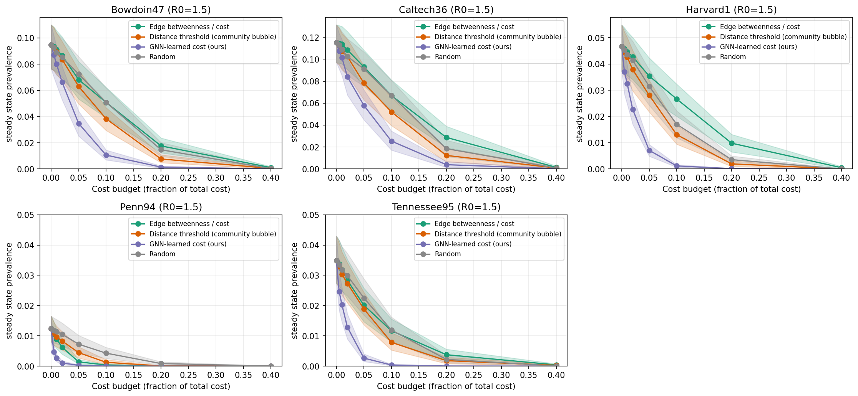
STAT 175 · cost-aware edge removal
HEADLINE · R₀ = 1.5 · NEAR THE THRESHOLD
GNN ≈ 2× the next-best policy.
R₀ = 1.5
FIGURE
AT 5% BUDGET
steady-state prevalence reduction
GNN
−4.0
pp
main_pareto_R0_1.5.png
Distance
−2.2
pp
Betweenness
−1.7
pp
Random
−1.6
pp
10 / 17
RYAN
Notes:
This is the headline. Across all five campuses, near the epidemic threshold — that's R0 around 1.5 — the GNN policy is the clear winner. At a 5% cost budget, it cuts steady-state prevalence by **4.0 percentage points**; the next-best classical baseline only achieves **2.2**. The learned cost is roughly twice as efficient where it matters most: when the disease is barely sustaining itself.

Slide 11
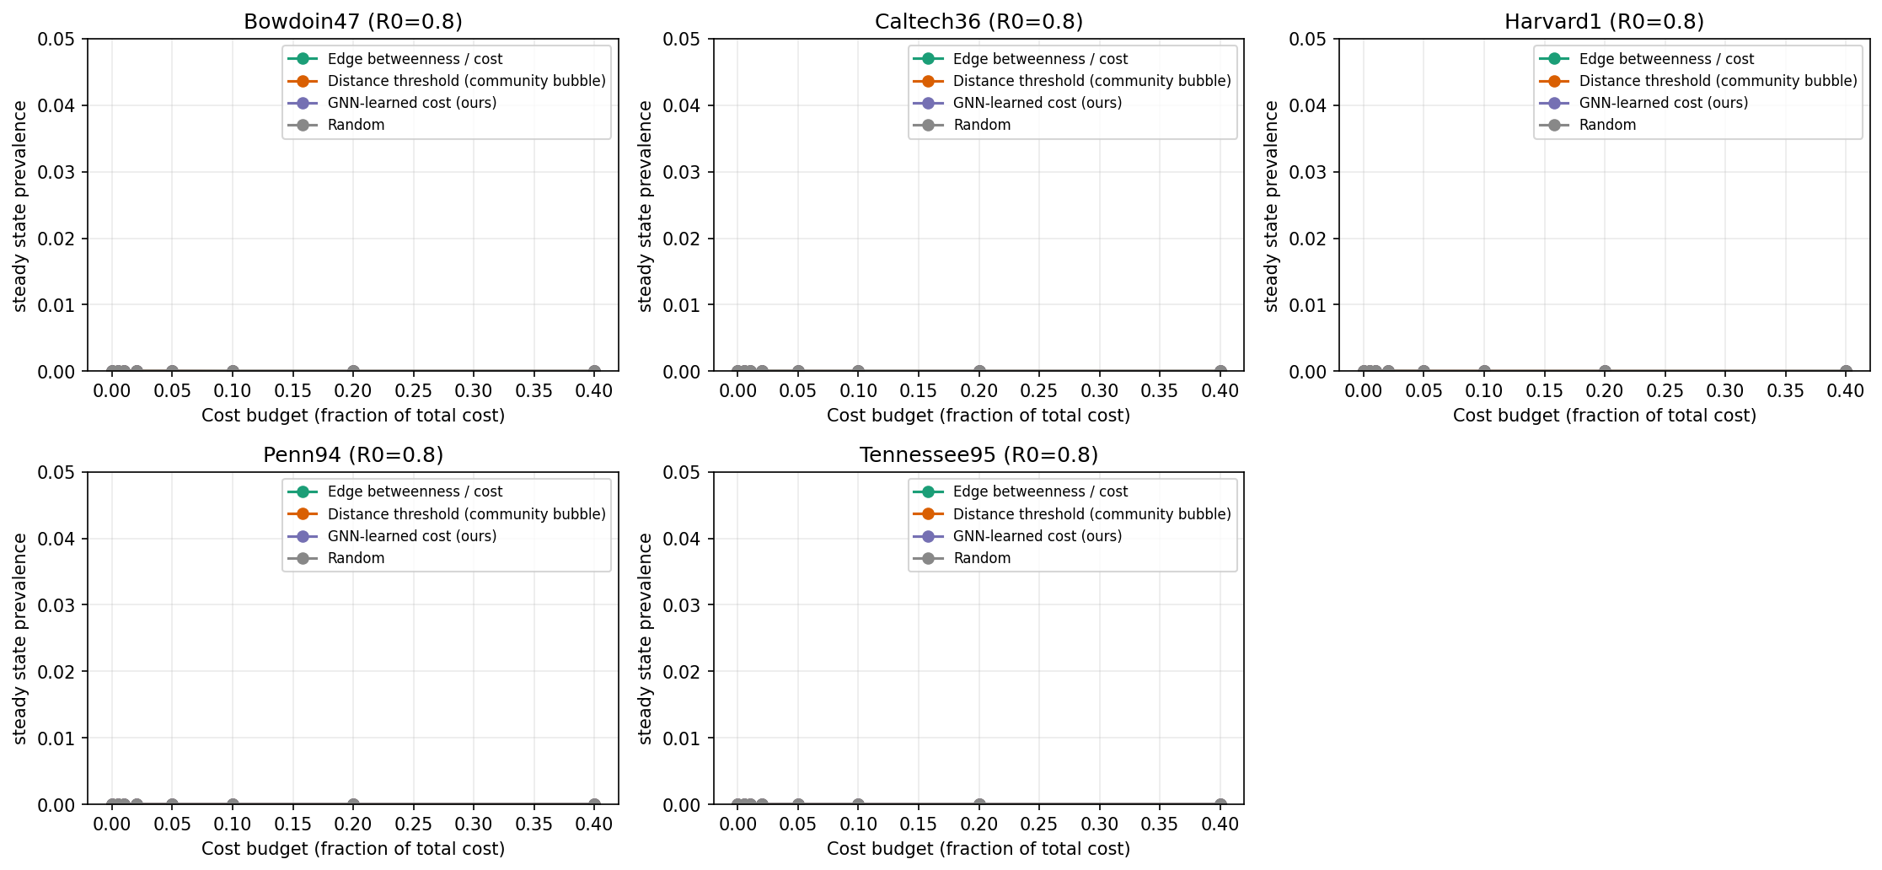
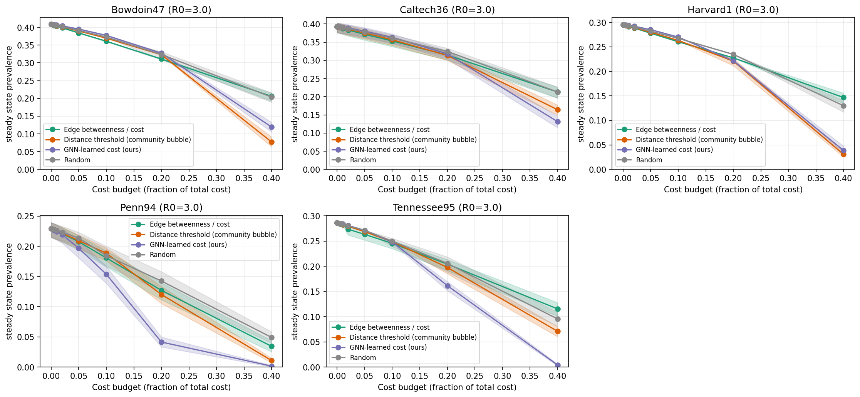
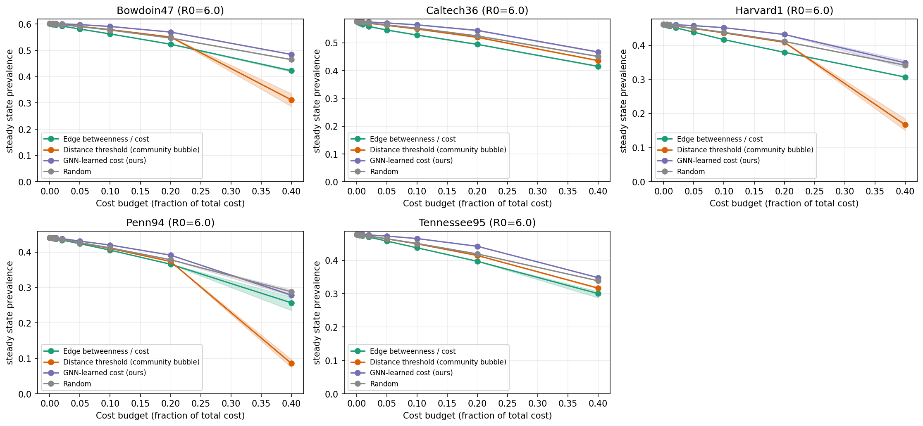
STAT 175 · cost-aware edge removal
AS R₀ GROWS
The picture flips.
cost-aware learning helps most where the disease is barely sustaining itself. brute-force structural cuts dominate when every path overflows.
R₀ = 0.8 · SUBCRITICAL
R₀ = 3.0 · MID
R₀ = 6.0 · ENDEMIC
IGURE
FIGURE
FIGURE
main_pareto_R0_0.8.png
below threshold; all policies → 0
GNN advantage shrinks
Distance & Betweenness now match
11 / 17
RYAN
Notes:
But the picture flips at R0 = 6. In a heavily endemic regime, distance-threshold and edge-betweenness take over — there's nothing subtle to optimize once the graph is saturated.

Slide 12
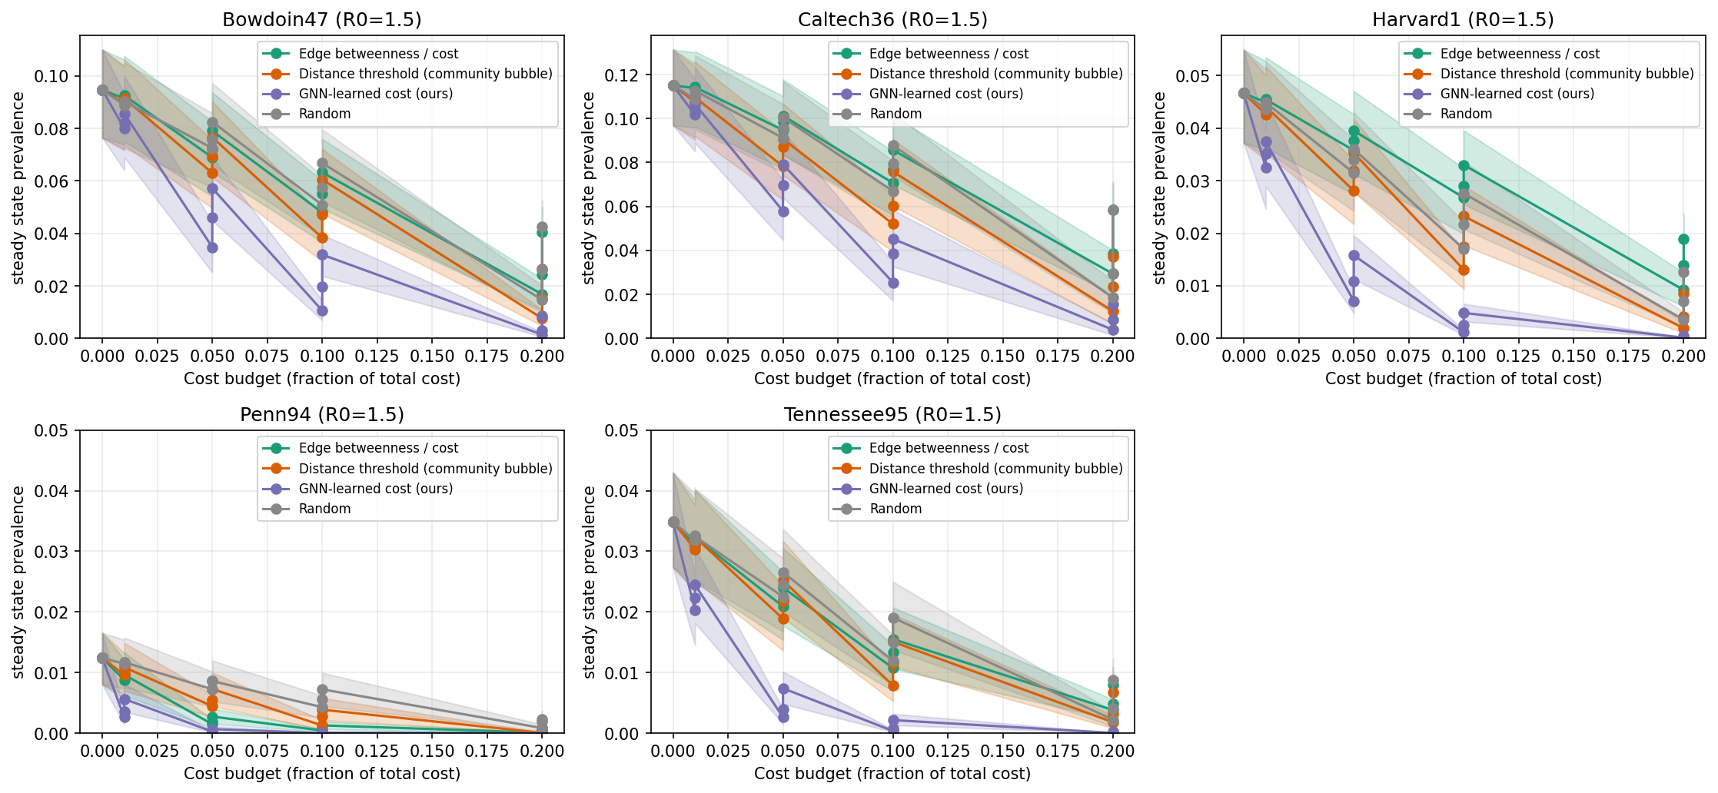
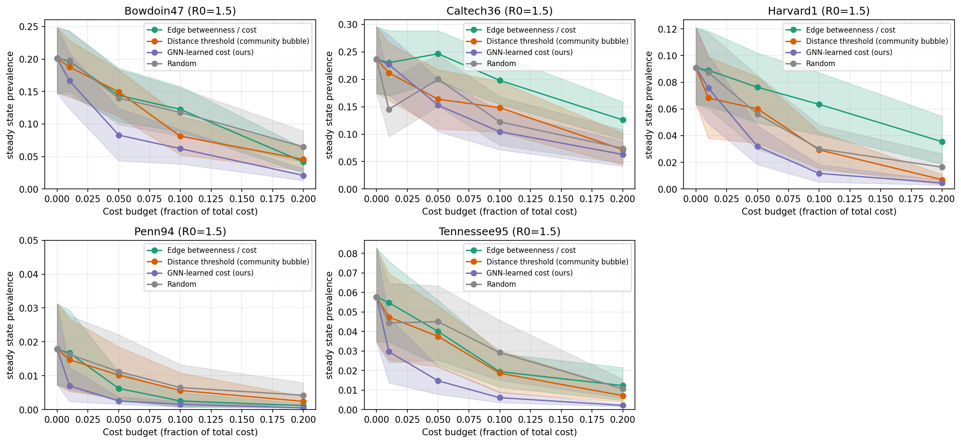
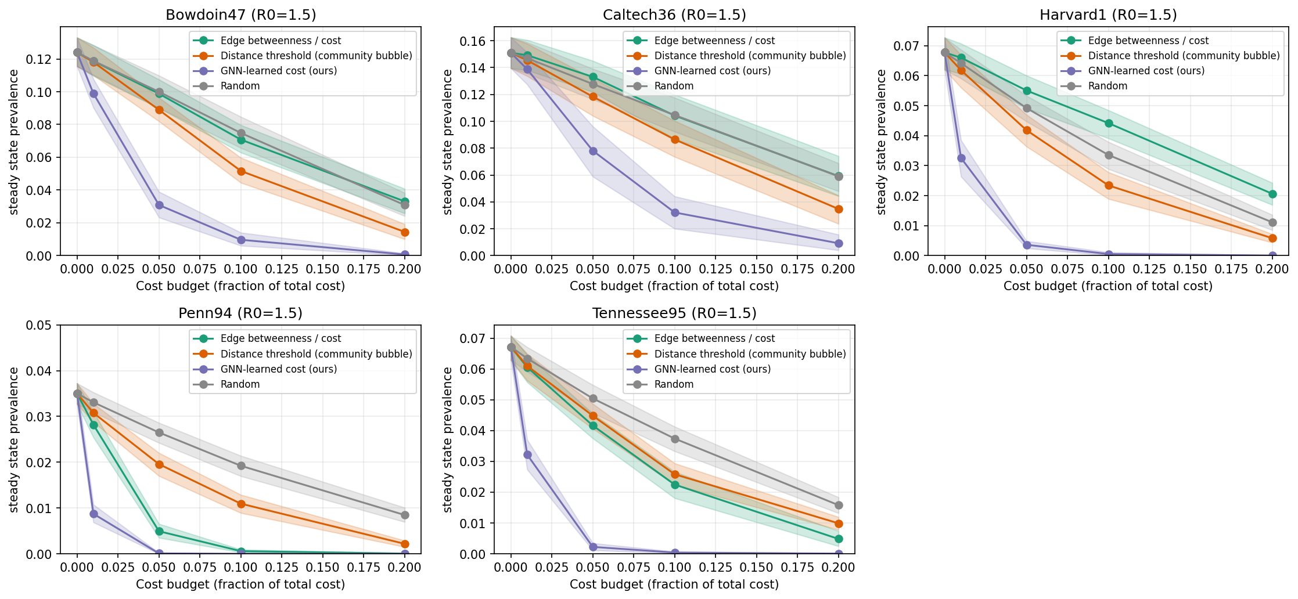
STAT 175 · cost-aware edge removal
ROBUSTNESS · R₀ = 1.5
Three ways to break the headline (none of them do)
COMPLIANCE
GNN at 60% compliance still beats every other policy at 100%.
SIR ALTERNATIVE
the cost-aware ranking is not an SIS artifact.
ADVERSARIAL SEEDING
GNN now wins both regimes — including R₀ = 6 where it had been third.
reduced sim budget on these panels (n_realizations = 20) is documented in WARNINGS.md.
12 / 17
RYAN
Notes:
Three robustness panels. **Compliance:** the GNN at 60% non-compliance still beats every other policy at full compliance. **SIR alternative:** same regime split, even sharper. **Adversarial seeding** — start the disease at the eigenvector backbone — the GNN now wins both regimes including R0=6 where it had been third under random seeding.

Slide 13
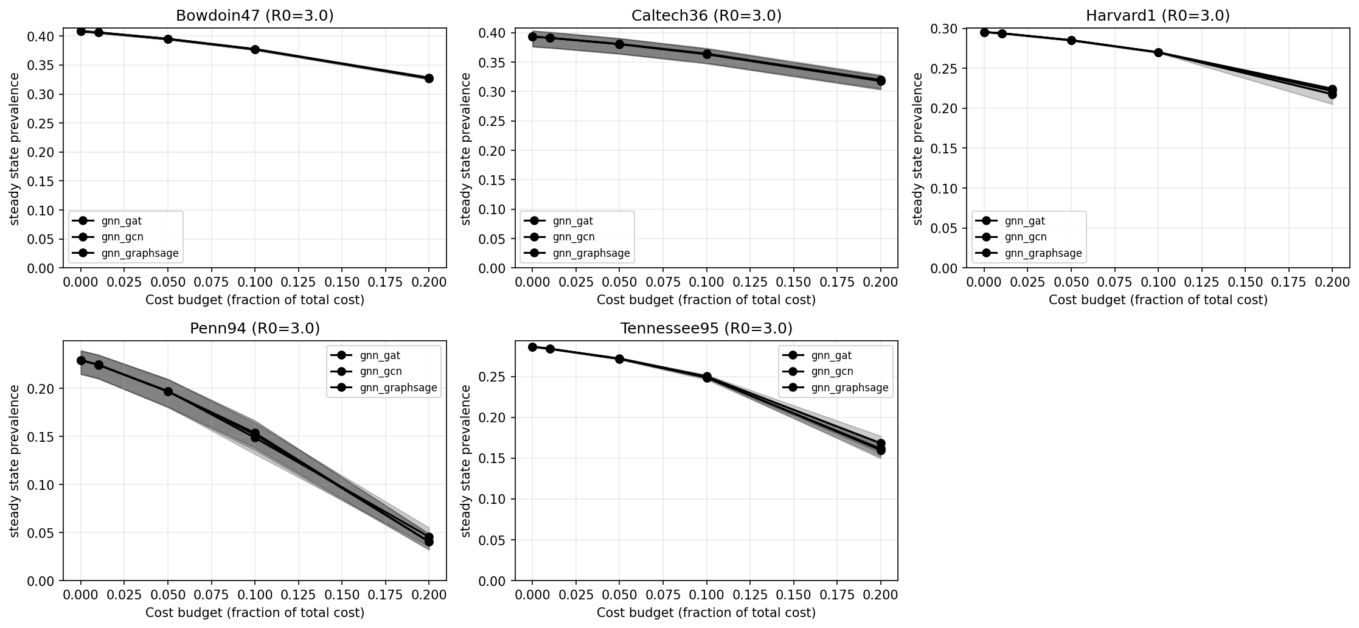
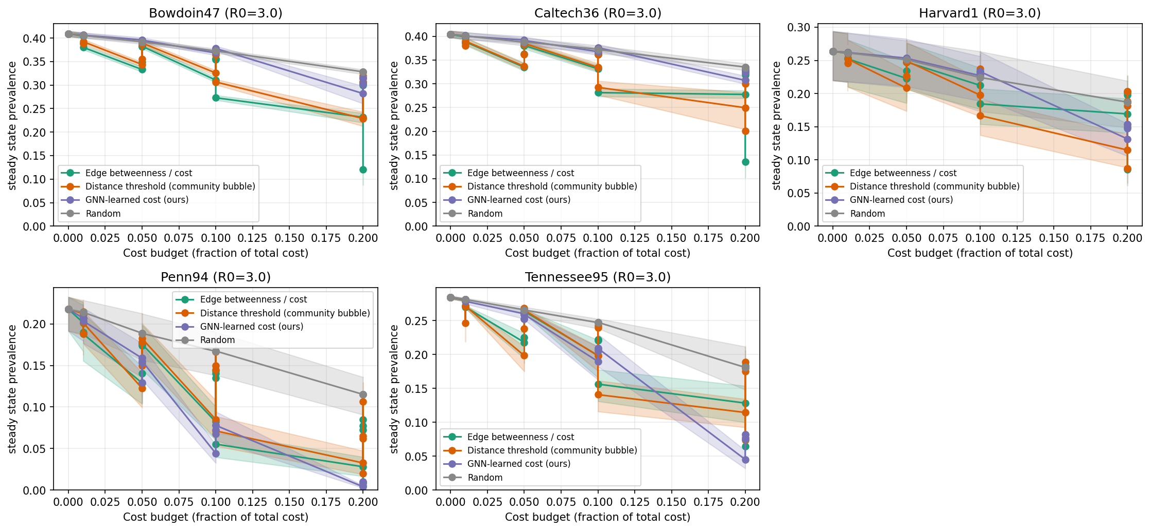
STAT 175 · cost-aware edge removal
TWO ABLATIONS
Operator doesn't matter, but cost variance does.
ARCHITECTURE
COST FUNCTION
FIGURE
FGURE
ablation_gnn_arch_R0_3.0.png
ablation_cost_function_R0_3.0.png
paper/figures/
GraphSAGE = GAT = GCN within bootstrap CI.
under oracle_lognormal (high variance), the GNN advantage widens. under uniform, it shrinks.
the framework is what matters; the operator doesn't.
the cost-aware framing depends on cost actually varying.
synthetic-topology + cross-campus regression deferred to the appendix and the paper.
13 / 17
RYAN
Notes:
The architecture ablation says GraphSAGE, GAT, and GCN are indistinguishable — the cost-learning framework matters, not the message-passing operator. And the cost-function ablation says the GNN advantage widens when cost has more dynamic range.

Slide 14
STAT 175 · cost-aware edge removal
WHAT WE ARE NOT CLAIMING
Friendship ≠ contact.
WHAT WE ARE NOT SOLVING
WHERE WE CUT CORNERS
Friendship ≠ contact.
Reduced GNN encoder.
Facebook100 is stable friendships; epidemics spread on transient contact graphs.
TruncatedSVD pre-projection · hidden=32 · embed=16 · 40 epochs. Full retrain script in notebooks/.
SIS is a simplification.
Sampled betweenness.
Real respiratory pathogens have latency, age structure, behavior change.
k = 300 pivots on Penn94 / Tennessee95 (Brandes 2008).
Cost is a proxy.
Smaller robustness sim.
σ(⟨x, x⟩) stands in for social distance — not the dollar cost of a school closure.
n_realizations = 20 vs 50 in main results — see WARNINGS.md.
the contribution is the framing — that cost-awareness reorders policy rankings — not a deployable COVID intervention.
14 / 17
RYAN
Notes:
The honest caveat: Facebook100 is a friendship graph, not a contact graph. We're not solving COVID. We're showing that the cost-aware framing changes which policies look "best" — and the gap between the mathematically optimal GNN and the enforceable distance threshold is the interesting part.

Slide 15
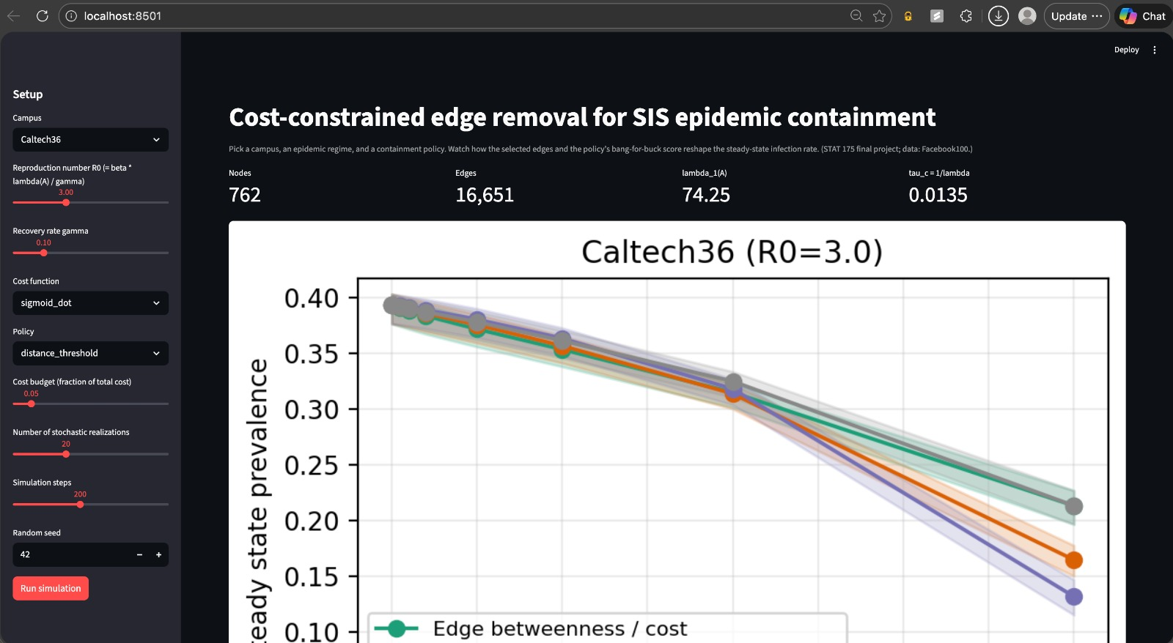
STAT 175 · cost-aware edge removal
WEB APP
Run it yourself.
Streamlit + pyvis · live SIS spread on the residual graph · five campuses pre-loaded.
FEATURES
5 campuses pre-loaded
switch SIS ↔ SIR
compare policies side-by-side
animated infection curve
removed edges greyed out
no GPU required for inference
source: webapp/app.py
15 / 17
RYAN
Notes:
We also built a Streamlit app where you can pick a campus, dial R0 and the budget, and watch SIS spread on the residual graph. Let me show you.

Slide 16
STAT 175 · cost-aware edge removal
DEMO
→ webapp/app.py
R₀ = 1.5 · 5% budget · Caltech36 · GNN
16 / 17
RYAN

Slide 17
STAT 175 · cost-aware edge removal
THANK YOU
Questions?
REPRODUCE THE HEADLINE
python scripts/04_run_pareto.py && python scripts/08_make_figures.py
Karlo Vrančić · Alec Leprevotte · Jackson Webster · Ryan Jiang
(graph, minus_edges, contained)
17 / 17
ALL

