Slide 1
Group 3
Budget Optimization and Profit Maximization
Group members:
Kondapally Venkata Rishwanth, Karkuzhali Selvendran, Reshmaa Vasudevan, Jayakumar Nevedita, Linus Koh Zhijie
Notes:
Good Morning all!
We are Group 3 and today we will be presenting our project titled ‘Which Spending Drives Profit? – A Budget Optimization Analysis.’
We are focusing on one key business question, Where should a company invest its money to maximize profit?
Throughout this presentation, we will walk you through the business problem, the dataset, our analytical approach, and finally, our recommendations based on the results.
Let’s get started.

Slide 2
Business Challenge
Companies invest heavily in R&D, Administration, and Marketing, but many lack clarity on which of these spending categories drives higher profits.
This ambiguity leads to inefficient budget allocation and missed opportunities for maximizing returns.
Our aim is to uncover the true profit drivers using data analysis, enabling companies to make smarter, evidence-based investment decisions.
Notes:
Companies typically spend across three main areas namely Research and Development, Marketing, and Administration. But not all spending contributes equally to profit.
Many organizations still lack clarity on a critical question, which of these investments actually drives higher profit?
Without this understanding, companies often rely on assumptions or past practices when allocating their budgets.
This uncertainty leads to inefficient spending, where money may be directed into areas that generate low returns, while high-impact areas remain underfunded.
As a result, businesses miss opportunities to maximize profit and improve performance.
Our goal was to use data analysis and statistical modeling to identify:
which department has the strongest impact on profit
where businesses should prioritize their budget for the best returns.
To turn this challenge into actionable insights, we applied data-driven techniques. Let’s move on to see how we conducted our analysis

Slide 3
Objective
Using data from 1000 companies, the goal is to determine the type of investment most strongly
influence profit and build a data-driven model for optimal budgeting decisions.
Strategy
1. Problem Recognition
Companies lack clarity on which spending category (R&D, Administration, Marketing) drives profit.
2. Analytical Approach
Clean and prepare financial data from 1,000 companies.
Apply regression and correlation analysis to quantify impact of each spending type.
Handle outliers and missing values to ensure model credibility.
3. Model Development
Build a predictive model to estimate profit based on spending inputs.
Validate model performance using R², RMSE, and business interpretability.
4. Insight Translation
Convert statistical findings into clear, actionable business recommendations.
Identify high-impact investment areas for profit maximization
Notes:
Our objective is rather than relying on intuition or industry assumptions, our goal is to develop a data-driven model that helps companies make smarter budgeting decisions and allocate resources more effectively.
To do this, we cleaned and analyzed the data, applied regression and correlation analysis and built a predictive model to estimate profit based on spending patterns.
Most importantly, we translated our findings into practical business insights, helping companies invest in the areas that deliver the highest returns rather than relying on assumptions.

Slide 4
Concepts
Data Cleaning: Applied techniques to handle missing data and correct inconsistencies, deduplicated within the dataset for our model.
Exploratory Data Analysis (EDA): Analyze initial relationships between spending categories and profit, forming early hypotheses about which factors are most influential.
Data Transformation: Standardizing data formats, Scaling and Normalizing, Encoding categorical variables (State) and creating derived features for analysis.
Predictive Modelling: Utilized an Ordinary Least Squares Regression model in python to analyze the relationships between multiple factors versus profit.
Notes:
To ensure reliable and meaningful results, we followed a structures data analysis process.
In data cleaning, we handled missing values, corrected inconsistencies and removed duplicate records to ensure the quality and integrity of our dataset.
Next, we performed Exploratory Data Analysis (EDA), to understand initial patterns and relationships between spending categories and profit allowing us to form early data-driven hypotheses.
We then applied data transformation techniques, including scaling to standardize spending amounts, encoding categorical variables such as state and engineering additional features to improve model performance.
Finally, we built a OLS Regression model in Python to quantify the impact of each spending category on profit and identify the strongest predictors for business decision-making

Slide 5
Initial Data Observations
CSV file of 1000 companies
There are 1002 rows, 5 columns (features).
Numeric and text datatypes found.
Values are missing in some rows.
State names are inconsistently formatted (e.g., capitalization issues).
Three duplicate values are found.
Some companies report zero R&D or Marketing spend, which may represent outliers or special cases.
Profit generally increases with R&D spend, but the relationship with Marketing and Administration is less clear.
Notes:
We started by reviewing the raw dataset to understand its structure and quality.
The data was provided as a CSV file containing financial information from approximately 1,000 companies.
We observed that the dataset contained 1,002 rows and 5 columns with a mix of numerical values and text-based variables.
During inspection, we found that some values were missing and several state names were inconsistently formatted, such as differences in capitalization and spelling.
We also identified three duplicate records which required removal to prevent skewing the results.
In addition, some companies reported zero spending on R&D or Marketing. These may represent either data entry issues or special business cases, so they were reviewed carefully during cleaning.
An early pattern emerged showing that profit generally increases with R&D investment, while the relationship with Marketing and Administration was less immediately clear.
These observations guided our data cleaning and modeling strategy for more accurate analysis late

Slide 6

Data Cleaning
1.Missing Values
Profit column: At least one row has missing profit values
e.g., row with 101381,125429.5035,264393.9555,California, → Profit is blank).
Impact: Missing target variable values reduce the dataset’s usability for regression modeling. So, we removed these rows.
R&D Spend column: Found empty rows in R&D Spend column. Filled them with Mean values.
Marketing column: Filled the empty cells with Mean value.
Administration column: Filled the empty cells with Median value.
2. Data Type Consistency
Numeric columns (R&D Spend, Administration, Marketing Spend, Profit) are floats but need verification for consistent formatting.
Impact: Ensures smooth processing in modelling and avoids type conversion errors.
Notes:
“Let’s begin with the crucial step of data cleaning, starting with how we handled missing values.
First, in the Profit column, we identified rows with completely blank profit values. For example, one record had all other financial data and a state listed, but the profit field was empty. Since profit is our target variable for regression modelling, these missing entries significantly reduce the dataset’s usability. Therefore, we decided to remove these rows entirely to ensure the integrity of our predictive modelling.
Next, we addressed missing values in our spending columns using imputation:
For R&D Spend and Marketing Spend, we filled the empty cells with the mean value of each respective column.
For the Administration column, we used the median value for imputation, as it is less sensitive to outliers.
Finally, we checked for Data Type Consistency. All key numeric columns—R&D Spend, Administration, Marketing Spend, and Profit—are correctly formatted as floats.
The Profit column was converted to numeric format, and invalid values were safely handled as missing data. This verification is essential to ensure smooth data processing in our models and to avoid any potential type conversion errors later on.

Slide 7
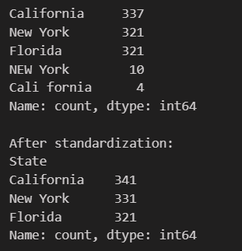
Data Cleaning
3. Inconsistent Categorical Values
State column: Inconsistencies in capitalization and spelling:
"NEW York", "New York", "NEW York" → same state but different formats.
Impact: Causes duplication in grouping/aggregation and misleads state-level analysis. Requires standardization (e.g., all to "New York").
4. Zero Spending
R&D Spend: Some companies report 0 (e.g.,0,135426.92,0,California,42559.73).
Marketing Spend: Several rows show 0 (e.g., 86419.7,153514.11,0,New York,122776.86).
These may represent genuine business strategies (no R&D/Marketing).
Notes:
Moving on to the second phase of cleaning, we tackled inconsistencies and examined unusual data points.
We found Inconsistent Categorical Values in the ‘State’ column. For instance, ‘NEW York’, ‘New York’, and ‘NEW York’ appeared as different entries but refer to the same state. This kind of inconsistency causes duplication during grouping or state-level analysis, which can mislead our insights. The solution was standardization—converting all entries to a consistent format, like ‘New York’.
We also noted the presence of Zero Spending in the data.
Some records show $0 in R&D Spend.
Similarly, several rows report $0 in Marketing Spend.
It’s important to highlight that these zeros are not necessarily errors. They could represent legitimate business strategies where a company, in a given period, chose not to invest in R&D or marketing. We have kept these entries in the dataset but will need to consider their potential impact when interpreting our models, as they may represent distinct operational profiles.
Now that the data is prepared, let’s explore what insights it reveals

Slide 8
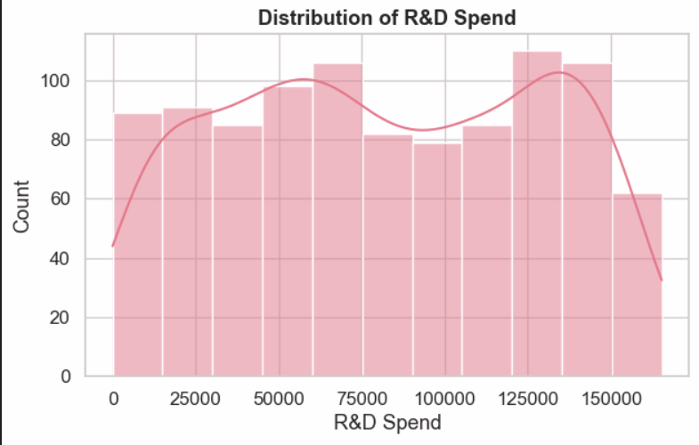
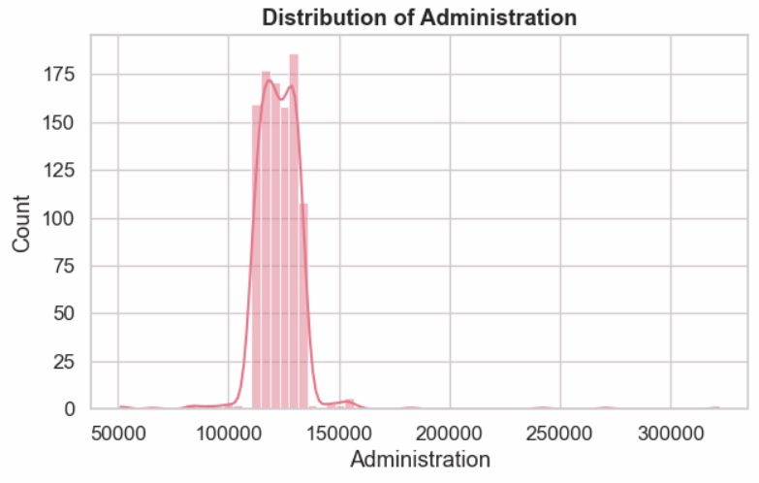
Exploratory Data Analysis (EDA)
Distribution: Bimodal distribution with peaks around $50K and $120K
Range: $0 - $165,349
Pattern: Two distinct spending strategies visible.
Outliers: 12 extreme high-value outliers detected
Business Insight: Companies cluster into two groups: conservative R&D investors and aggressive R&D spenders
Distribution: Near-normal distribution (bell curve)
Central tendency: Tightly clustered around $122,000
Range: $51,283 - $321,652
Consistency: Lowest variability among all spending categories
Business Insight: Administration costs are relatively standardized across companies, with most maintaining similar overhead levels
Notes:
Distribution Analysis - R&D Spend:"The R&D spending distribution reveals a fascinating bimodal pattern. Companies fall into two distinct camps: those investing around $50,000 and those investing closer to $120,000. This suggests two different business models at play. We also identified 12 outlier companies with exceptionally high R&D budgets, which warrant further investigation."
Distribution Analysis - Administration Costs:Next, when we look at Administration spending, we see a very different pattern.
The distribution is near-normal,a bell-shaped curve with values tightly clustered around one hundred twenty-two thousand dollars.
Although the overall range stretches from about fifty-one thousand to over three hundred twenty thousand, the majority of companies fall within a narrow band.
This category shows the lowest variability among all spending types.
The business insight here is that administration costs tend to be relatively standardized across companies.

Slide 9
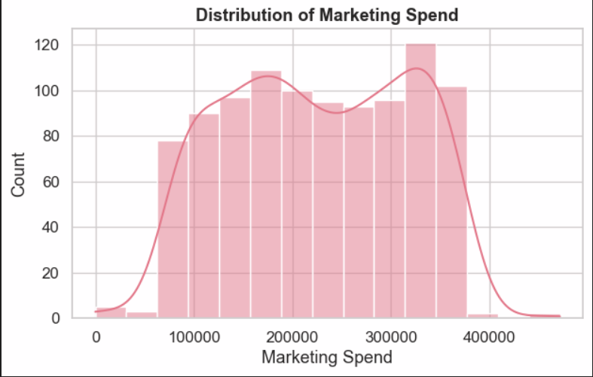
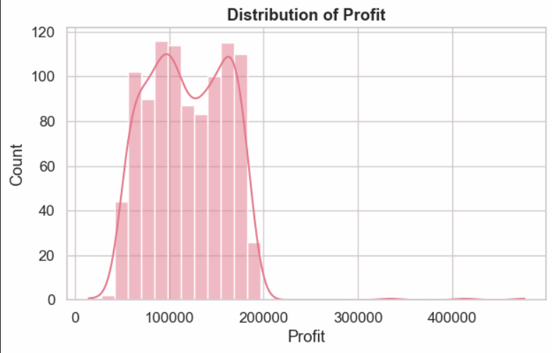
Exploratory Data Analysis (EDA)​
​
Distribution: Right-skewed with widespread Range: $0 - $471,784 (widest range)
Peak: Around $200K with long tail
Variability: Highest standard deviation ($91,698)
Business Insight: Marketing budgets vary dramatically, indicating diverse market strategies from minimal to aggressive spending
Distribution: Slightly bimodal, roughly normal
Mean Profit: $119,530
Range: $14,681 - $476,485
Spread: Wide variance in profitability outcomes
Business Insight: Profit distribution suggests spending decisions create winners and losers, with some companies achieving 30x the profit of others
Notes:
Distribution Analysis - Marketing Spend:"Marketing spend shows the most diversity of all categories, ranging from zero to nearly $472,000. The right-skewed distribution tells us most companies invest moderately, but there's a significant subset pursuing aggressive marketing strategies. This variability makes marketing a prime candidate for optimization analysis."
Distribution Analysis – Profit:"The profit distribution reveals significant disparities in company performance. While the average profit is around $120,000, we see some companies earning just $15,000 while others exceed $476,000. This massive range over 30 times difference underscores how critical effective budget allocation is to business success."

Slide 10
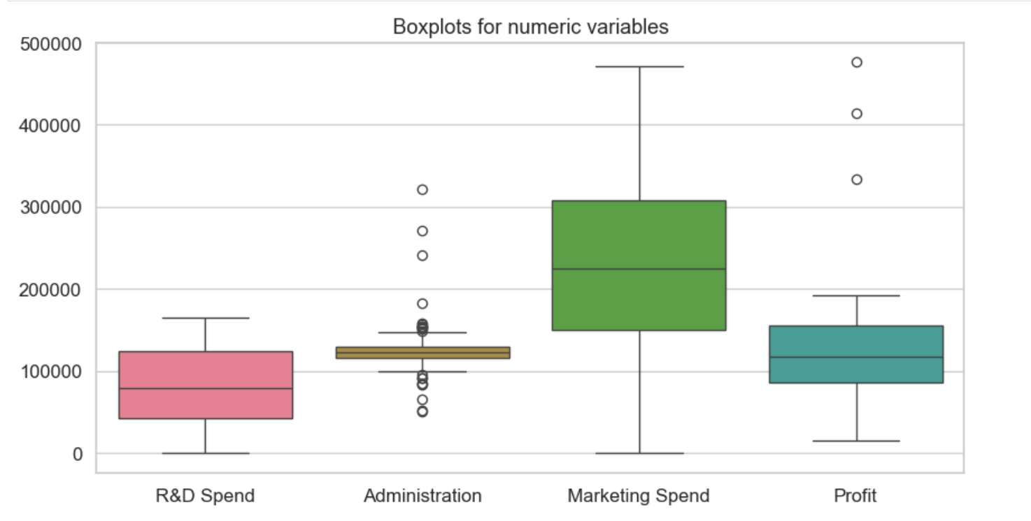
Comparative Boxplot Analysis
Key Findings:
R&D: Moderate spread with several high outliers
Administration: Tight distribution, few outliers
Marketing: Widest spread with extreme outliers
Profit: Substantial outliers on high end
Outlier Detection:
12 extreme outliers identified in each category
Same companies appear as outliers across multiple dimensions
High spenders tend to be high earners
Notes:
This comparative boxplot gives us a bird's-eye view of all our variables. Notice how Administration has the tightest distribution while Marketing shows the most extreme variations. The 12 outliers we detected are particularly interesting as these are companies that spend and earn at exceptional levels, representing potential case studies for best practices.

Slide 11
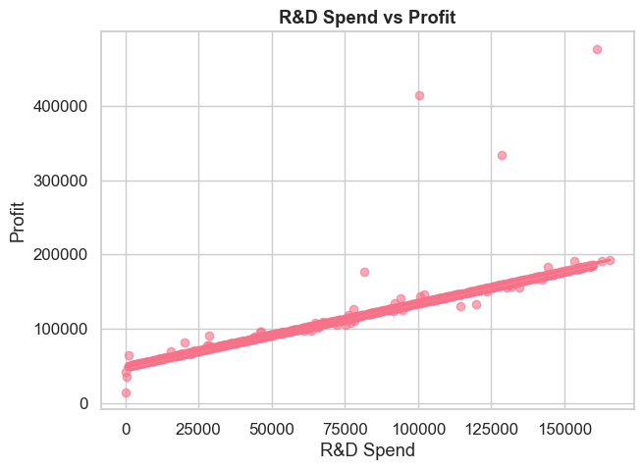
Exploratory Data Analysis (EDA)
Correlation Analysis
Profit vs. R&D Spend
Clear upward trend, suggesting R&D is a major driver.
Profit ↔ R&D Spend: 0.94 (Very strong positive)
R&D investment is the most consistent predictor of higher profits.
Each dollar in R&D correlates with substantial profit gains, higher R&D spending is strongly associated with higher profits.
Notes:
As you can see from the scatter plot, there is a clear upward trend, which shows that companies investing more in R&D generally achieve higher profits. This upward slope indicates that R&D is a major driver of company performance.
The correlation coefficient between Profit and R&D Spend is 0.94, which is extremely strong and positive. This means increases in R&D spending are very closely associated with increases in profit.
Among all spending factors, R&D investment shows the most consistent relationship with profitability. This suggests that innovation and product development activities significantly contribute to business growth.
Overall, the key takeaway is that every dollar spent on R&D tends to generate substantial returns, and companies that invest heavily in R&D typically experience higher profit outcomes.

Slide 12
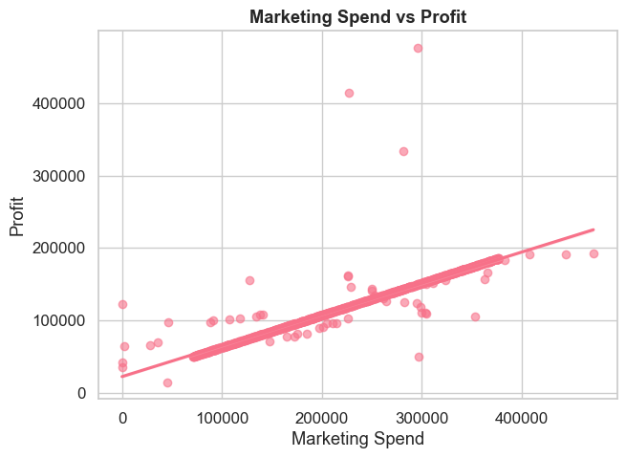
Exploratory Data Analysis (EDA)​
​
Correlation Analysis
Critical Finding - Marketing Spend vs Profit Relationship
Some positive relationship, but more scattered.
Profit ↔ Marketing Spend: 0.92 (Very strong positive)
Marketing contributes but with more variability, meaning effectiveness may depend on execution.
Second-most important profit driver after R&D
Notes:
From the scatter plot on the right, we can see there is a positive upward trend, but the data points are more scattered compared to R&D. This tells us that while marketing does influence profit, its impact tends to vary more from company to company.
The correlation between Profit and Marketing Spend is 0.92, which is still very strong and positive. This means higher marketing investment is generally associated with higher profitability.
However, the greater spread in the points indicates that marketing effectiveness depends heavily on execution. In other words, marketing can be a powerful driver, but it doesn’t guarantee consistent results the way R&D spending does.
Overall, this makes marketing the second-most important profit driver after R&D. It clearly contributes to profit growth but with more variability in outcomes.

Slide 13
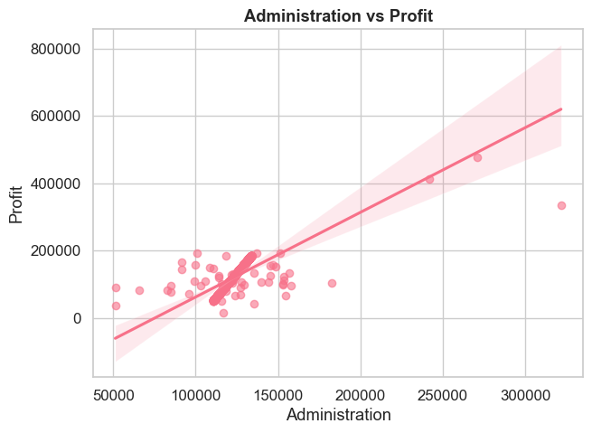
Exploratory Data Analysis (EDA)​
​
Correlation Analysis
Profit vs. Administration
No strong pattern, indicating limited impact.
Profit ↔ Administration: 0.74 (positive)
Administration spending does not appear to drive profit directly, suggesting it should be optimized rather than expanded.
Operational efficiency matters but is less critical than growth spending
Notes:
Here we are looking at the relationship between Administration spending and Profit.
From the scatter plot on the right, we can see that there is no clear or strong visual pattern. The points are fairly scattered, indicating that administrative expenses do not strongly explain variations in profit.
When we calculate the correlation value, we get 0.74, which is technically a positive correlation. However, based on the distribution of the points, this correlation appears to be influenced by a few higher-profit observations rather than a consistent trend across the data.
This suggests that increasing administrative spending does not directly lead to higher profit. Instead, it’s more likely that companies that are already performing well tend to have higher administrative budgets not that admin spending causes the profit.
The key takeaway here is:
Administration cost should be optimized, not expanded as a strategy to increase profit.
Operational efficiency is important, but compared to other growth-focused expenses, administration has a weaker impact on profitability.
Overall, this plot tells us that administrative spending plays more of a supporting role rather than being a major profit driver.

Slide 14
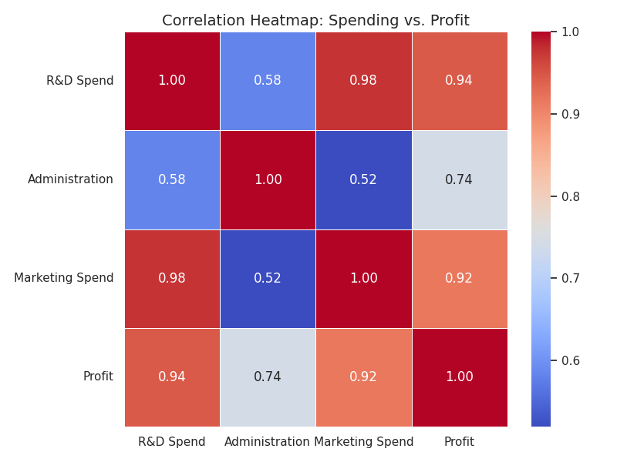
Exploratory Data Analysis (EDA)​
​
Correlation Heatmap
  R&D Spend shows the strongest positive correlation with Profit, the clearest driver of profitability.
  Marketing Spend has a moderate correlation which means contributes, but less consistently.
  Administration appears to have weak or negligible correlation with Profit, means little direct impact on profit
Notes:
Now let’s look at the correlation heatmap, which helps us understand how different types of spending relate to Profit.
Starting with R&D Spend, we can see it has the strongest positive correlation with Profit. This makes R&D the clearest and most consistent driver of profitability. Companies that invest more in research and development tend to achieve significantly higher profits.
Next, Marketing Spend shows a moderate to strong correlation with Profit. This means marketing definitely contributes to profitability, but it is not as consistently impactful as R&D. The relationship is positive, but the effect varies more across companies.
Finally, Administration Spend has the weakest correlation with Profit compared to the other two spending categories. This tells us that administrative expenses have little direct impact on profitability. Increasing admin budgets doesn’t necessarily translate into higher profit.
Overall, this heatmap helps us clearly identify spending priorities .R&D creates the strongest profit impact, marketing helps but less reliably, and administration should be optimized rather than expanded.

Slide 15
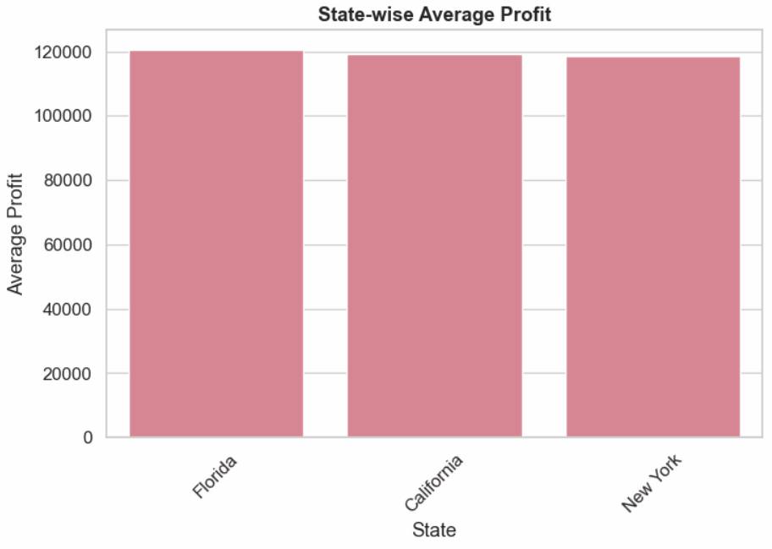
Exploratory Data Analysis (EDA)
State-wise Average Profit Rankings
Florida: ~$120,000 (Highest)
California: ~$118,500 (Mid)
New York: ~$118,000 (Lowest)
Insights:
Profit differences across states are minimal (~2% variance)
Location is NOT a significant profit driver in this dataset
Business model and spending strategy matter more than geography
Suggests market conditions are relatively uniform across these states
Notes:
Next, let’s look at the state-wise average profit comparison.
From the bar chart, we can see that the differences in average profit across the three states are actually quite small. Florida has the highest average profit at around $120,000, followed by California at about $118,500, and New York at roughly $118,000, which is the lowest.
Even though Florida technically ranks highest, the gap between the states is extremely small — roughly a 2% difference. This tells us that location is not a major driver of profit in this dataset.
Instead, what this suggests is that business performance is influenced far more by internal factors like spending strategy and business model rather than geography. It also implies that market conditions across these three states are relatively uniform, meaning no state provides a strong advantage or disadvantage in terms of profit.
So overall, the key takeaway is that state location has very minimal impact on profitability for these companies.

Slide 16
Data Quality & Transformation Pipeline
Step 1: Load & Normalize - Standardized column names and data types.
Step 2: One-Hot Encoding - State_California, State_Florida, State_New York.
Step 3: VIF Analysis - Validate multicollinearity before and after fix.
Step 4: Feature Engineering - Created Total_Spend = R_D_Spend +Marketing_Spend.
Step 5: Scaling - z-score standardization for Total_Spend and Administration.
Step 6: Final Schema - Model-ready BCS dataset.

Slide 17
Load and Normalize – Standardized column names and datatypes
Standardizing column names with underscores and correcting data types ensures consistency and reproducibility, reduces errors, and simplifies collaboration.
Data Normalization stabilizes schemas, prevents errors, and enables faster, reliable analytics with high stakeholder confidence, while Feature Engineering with derived metrics improves model performance for accurate, traceable strategic decisions.
Columns Before | Columns After
R&D Spend | R_D_Spend
Marketing Spend | Marketing_Spend
Administration | Administration
Notes:
Purpose:
Standardizing Column Names
Normalize column names by replacing spaces and specialcharacters with underscores for consistency.
Correct Data Types
Convert numeric columns to correct data types to avoiderrors during calculations and modeling.
Benefits of Normalization
Normalization ensures reproducibility, reduces risk, andsimplifies collaboration across teams.
Business Impact:
Data Normalization Benefits
Normalization stabilizes data schemas and prevents costly errors, ensuring reliableanalytics outcomes.
Business Value of Normalization
It enables faster analytics turnaround and increases stakeholder confidence in dataintegrity.
Feature Engineering Next Steps
Derived metrics like Total_Spend help address multicollinearity and improve modelperformance.
Strategic Decision-Making
Traceable transformations aligned with business goals enable accurate forecasting anddecisions.

Slide 18
One Hot Encoding
Purpose of One-Hot Encoding
  Converts categorical data into numerical format to enable machine learning algorithm processing effectively.
Schema Stability Importance
  Maintains fixed data structure during updates, preventing model disruptions from new or missing categories.
Business Impact and Efficiency
  Enhances operational efficiency and reduces risk with stable models, supporting confident deployments.
Improved Interpretability and Analytics
  Makes regional effects explicit, aiding strategic decision-making and enabling advanced modeling techniques.
State_California | State_Florida | State_New York
0 | 0 | 1
1 | 0 | 0
0 | 1 | 0
0 | 0 | 1
Notes:
One-hot encoding transforms categories — such as different states — into numerical values so that machine learning algorithms can process the information correctly

Slide 19
Fixing Multicollinearity- Variance Inflation Factor
Original Schema VIF Analysis
Reduced Schema VIF Analysis
Feature | VIF Score
R_D_Spend | 25.16
Administration | 1.63
Marketing_Spend | 22.80
FEATURE | VIF SCORE
Total_Spend | 1.42
Administration | 1.42
VIF ≈ 1 → No multicollinearity (safe)
VIF ≥ 5 → High concern
VIF ≥ 10 → Severe problem
Engineered Total_Spend by combining R_D_Spend + Marketing_Spend to reduce redundancy.
Reduced VIF scores enhances model stability and forecasting accuracy by removing redundant variables.
Notes:
What is VIF?
Variance Inflation Factor (VIF) measures how much a predictor’s variance is inflated due to correlation with other predictors:
VIFj=11−Rj2\text{VIF}_j = \frac{1}{1 - R^2_j}VIFj =1−Rj2 1
Where Rj2R^2_jRj2 is the coefficient of determination when regressing predictor XjX_jXj on all other predictors.
VIF ≈ 1 → No multicollinearity (safe)
VIF ≥ 5 → High concern
VIF ≥ 10 → Severe problem
Our transformation reduced VIF from 25+ and 22+ (R&D and Marketing) to ~1.42 for Total_Spend and Administration — a dramatic improvement in model stability.
Why It Matters
Multicollinearity inflates variance in model coefficients, leading to:
Unpredictable forecasts
Poor interpretability
Risky business decisions
By reducing multicollinearity, models become stable, interpretable, and trustworthy, enabling confident budget planning and forecasting.
Why We Did This
Our original dataset had R&D Spend and Marketing Spend highly correlated. This caused multicollinearity, making models unstable and coefficients unreliable. To fix this, we engineered Total_Spend (combining R&D + Marketing) and kept Administration as a separate feature.
What We Did
Normalized columns for consistency.
Engineered Total_Spend by combining R_D_Spend + Marketing_Spend to reduce redundancy.
One-hot encoded states (California, Florida, New York) as 0/1 flags for regional effects.
ORIGINAL VS REDUCED SCHEMA VIF ANALYSIS
Understanding VIF
Variance Inflation Factor detects multicollinearity affecting stability of regression coefficient estimates.
Original Schema Issues
Original schema showed high VIF for R&D and Marketing, indicating severe multicollinearity problems.
Reduced Schema Benefits
Consolidating features into Total_Spend lowered VIF values, improving model stability and reliability.
Future Modeling Impact
Reduced multicollinearity leads to better forecasting, interpretability, and compliance in models.

Slide 20
Feature Engineering - Created Total Spend to capture aggregate investment
Total_Spend | Administration | Profit
637133.3 | 136897.8 | 192261.8
606496.2 | 151377.6 | 191792.1
561376.1 | 101145.6 | 191050.4
527572 | 118671.9 | 182902
508275.8 | 91391.77 | 166187.9

Slide 21
​
Scaling
Total_Spend_scaled | Administration_scaled
2.397005 | 1.101437
2.174171 | 2.246297
1.845998 | -1.72535
1.60013 | -0.33962
Before Scaling (Raw Values):
Total_Spend (R&D + Marketing)Administration have very different ranges (hundreds of thousands vs. tens of thousands).
After Scaling (Standardization):
All predictors are on the same scale (e.g., mean = 0, std = 1).
Easier to compare the impact of R&D vs. Marketing vs. Administration.
Notes:
What We Did (Scaling)
Applied z-score standardization to Total_Spend and Administration.
Formula:
z=x−meanstdz = \frac{x - \text{mean}}{\text{std}}z=stdx−mean
This ensures both features have mean = 0 and standard deviation = 1.
Business Impact
Scaled features allow fair comparison of predictors.
Enables advanced models like Ridge/Lasso and tree-based ensembles without bias toward high-magnitude features.
Supports consistent performance across different datasets and time periods.
Why It Matters
Many algorithms (e.g., linear regression, regularization methods, distance-based models) are scale-sensitive.
Without scaling, features with large numeric ranges dominate the model, skewing coefficients and predictions.
Standardization improves:
Model stability
Convergence speed
Interpretability of coefficients
Review:
What: Apply z‑score scaling to Total_Spend (R&D + Marketing) and Administration so each feature has mean=0 and std=1.
Formula:
z=x−meanstdz = \frac{x - \text{mean}}{\text{std}}z=stdx−mean
Why: Removes magnitude bias so large-value features don’t dominate models and comparisons.
How: Compute z = (x − mean)/std using population std (ddof=0), persist means/stds in scale_stats, and save Total_Spend_scaled and Administration_scaled.
Business impact: Improves model stability, interpretability, and fairness; reduces risk of biased or unstable decisions caused by scale differences.

Slide 22
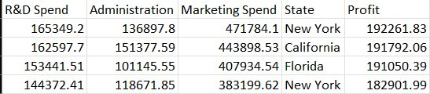
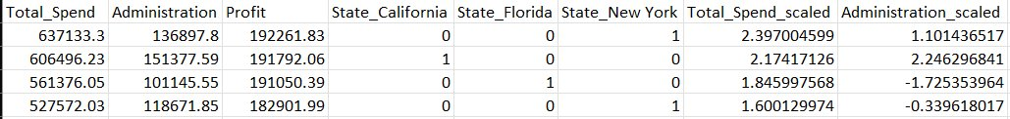
Before Transformation
After Transformation
Notes:
So this is a sample of our dataset before and after transformation

Slide 23

Key Takeaways from Transformation
Problem Solved
Multicollinearity in budget data has been eliminated through smart feature engineering. Models are now stable and predictable.
Quality Assured
A rigorous 6-step transformation pipeline ensures data integrity, compliance, and auditability.
Ready for Action
The Budget Core Schema is production-ready and can be deployed immediately for forecasting and planning.

Slide 24
Modeling
Profit Prediction Using Linear Regression
Objective:
Build a model using selected features to predict profit and identify which factor influences profit most.
Companies spend heavily on administration, R&D, and marketing — but which one truly increases profit?
Manual analysis doesn’t show impact clearly. We need a model that can:
Quantify impact of each variable
Predict future profits from spending behavior
Identify the highest profit yielding pattern
Notes:
Today I am presenting my project titled Profit Prediction Using Linear Regression.
This study is based on a dataset containing 993 companies, where all variables are cleaned, transformed and scaled for model efficiency. The purpose of this work is not just to predict profit, but to understand why profit increases — what actually drives it, and which business factor contributes the most.
My objective in this project is simple but powerful:
1.Build a prediction model using selected features
2.Analyse how each variable influences company profit
3.Identify the strongest profit-generating factor mathematically
By the end of this presentation, you will clearly see which business investment yields the highest return.
Companies spend a lot on administration, R&D, and marketing — but we don’t know which one truly boosts profit.
Just looking at numbers isn’t enough.
So we built a model that can:
Measure the impact of each spend
Predict profit accurately
Identify which investment gives the highest return

Slide 25
Dataset Features Used
Only 5 predictor variables were included:
Administration _ scaled
R&D _ Marketing _ Spend_ scaled
State _ California
State _ Florida
State _ New York
Notes:
In this model, we focused only on 5 key variables:
Administration _ scaled, Total_Spend_scaled, and the State dummies — California, Florida, New York.
Instead of guessing manually, the model helps us:
Measure how each of these 5 features affects profit
Predict future profit based on spending
Identify which variable gives the highest return

Slide 26
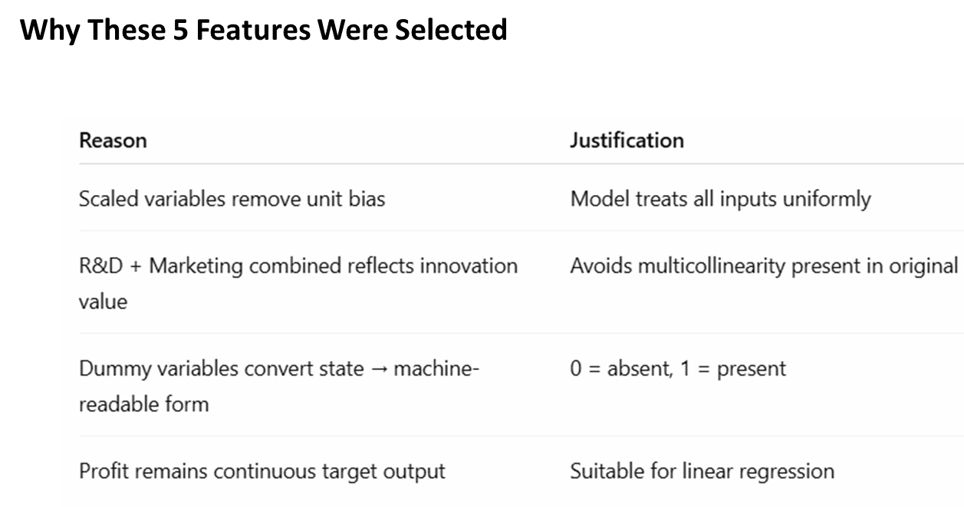
Notes:
I selected only five features because they directly influence profit and work cleanly with linear regression.
The spend values were scaled so that all inputs are treated equally without unit dominance.
I combined R&D and Marketing as one feature to reflect innovation value and to avoid multicollinearity from the original dataset.
The state columns were converted into dummy values —
1 means present and 0 means absent — making them machine-readable.
And finally, profit is a continuous output, which is perfect for regression-based prediction.

Slide 27
Model Approach
Imported & cleaned dataset
Selected only 5 independent variables
One-Hot Encoding applied (State 0/1 format)
Train/Test Split → 80% training, 20% testing
Built OLS Linear Regression Model
Evaluated using R² + RMSE
Predicted profit across full dataset
Identified the most profitable record
Notes:
To build this model, I first imported and cleaned the dataset, and then filtered it down to only the five independent variables relevant for prediction.
Next, I applied One-Hot Encoding to convert the states into machine-readable 0 and 1 format.
The data was split into 80% for training and 20% for testing, so the model learns and is also evaluated fairly.
I then built an OLS Linear Regression model and evaluated its performance using R² and RMSE.
After training, I predicted profit for the entire dataset and identified the most profitable combination of features.

Slide 28
Key Results from OLS Model
Model explains how much of profit is predictable
Lower RMSE → better accuracy
Higher R² → stronger model fit
Metrics:
R² Score 0.9214
RMSE 12988.02
Notes:
Here are the key results from the OLS model.
The R² score is 0.9214, which means the model explains about 92% of the variation in profit.
This indicates that the selected five features have very strong predictive power.
The RMSE value is 12988.02, which means on average the prediction error is around eleven to twelve thousand units — fairly low compared to overall profit values.
So overall:
The model explains how much profit is predictable
A lower RMSE means better prediction accuracy
And the high R² confirms a strong model fit"

Slide 29
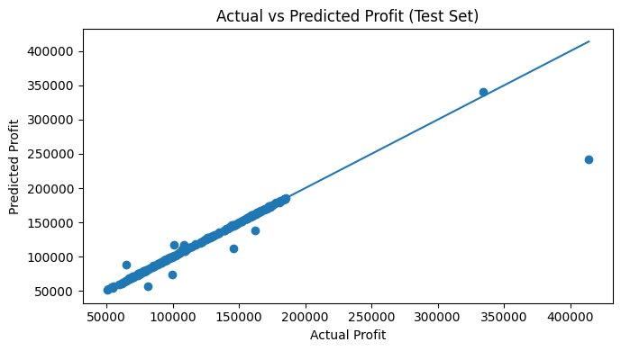
Visualizations
Points closer to diagonal line → model accuracy is good
Small spread = reliable prediction capability
No large deviations = model learned pattern well
Notes:
Here, each point represents a company's real profit compared to the model’s prediction.
Most of the points fall very close to the diagonal line, which means the model is able to predict profit with strong accuracy.
There is only a small spread, which shows stable and consistent prediction performance.
Since there are no large deviations from the line, we can conclude that the model has learned the underlying pattern very well

Slide 30
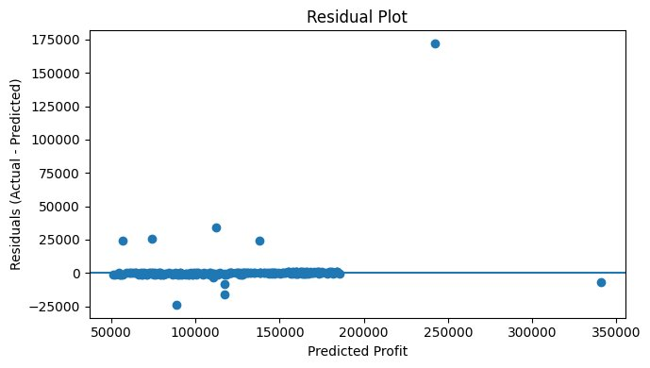
Visualizations ​
Residuals randomly scattered around zero → no systematic bias
Model assumptions hold
Indicates no serious over-fitting
​So, to conclude
Highest impact variable = R&D _ Marketing _ Spend_ scaled​
Administration contributes moderately​
State variables contribute very little​
Notes:
This is the residual plot, where residuals are simply the difference between actual and predicted profit values.
Here, we can see that the points are randomly scattered around the zero line.
This is a very good sign — it means the model has no systematic bias and is not favouring any particular range of values.
Since the distribution is random and not forming any curve or trend, the model assumptions are satisfied and it indicates no serious overfitting.
In simple words — the model is consistent, balanced, and generalizes well.
From the analysis, we found that the R&D + Marketing Spend is the strongest driver of profit.
Increasing investment in this area shows the highest positive impact.
Administration has a moderate effect — it supports growth but not as aggressively.
And lastly, the state-based dummy variables contribute very little, which means location does not decide profitability — spending strategy does.

Slide 31
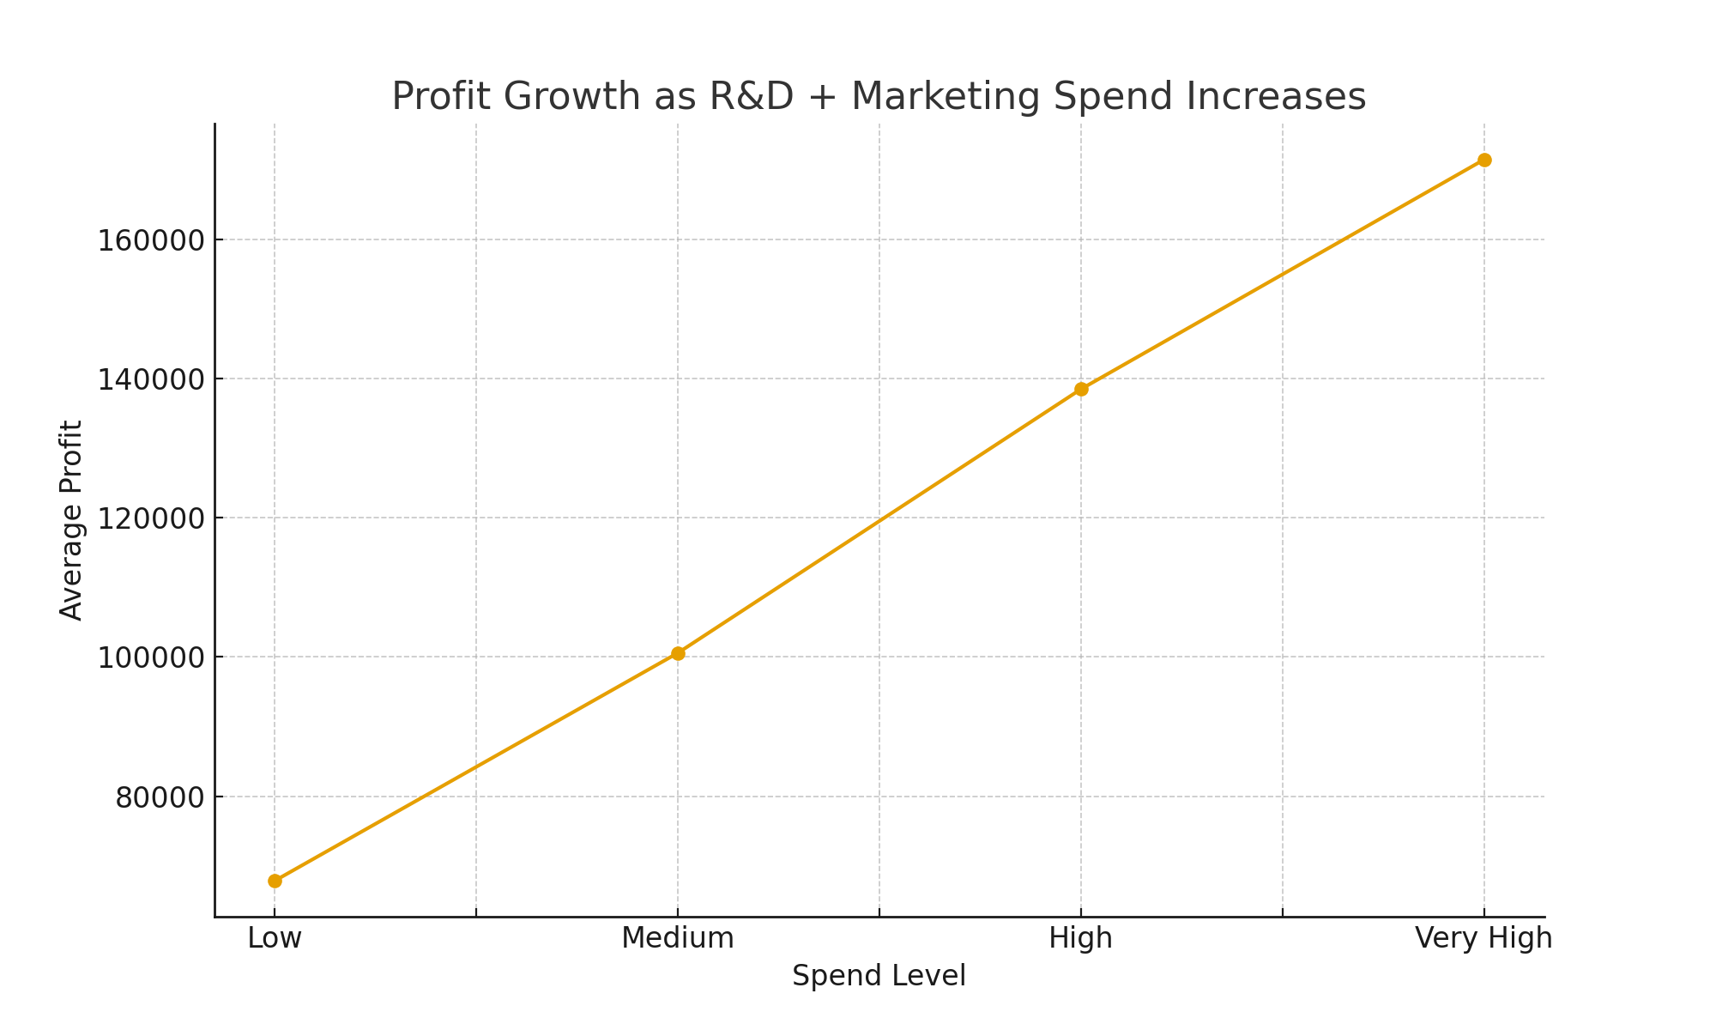
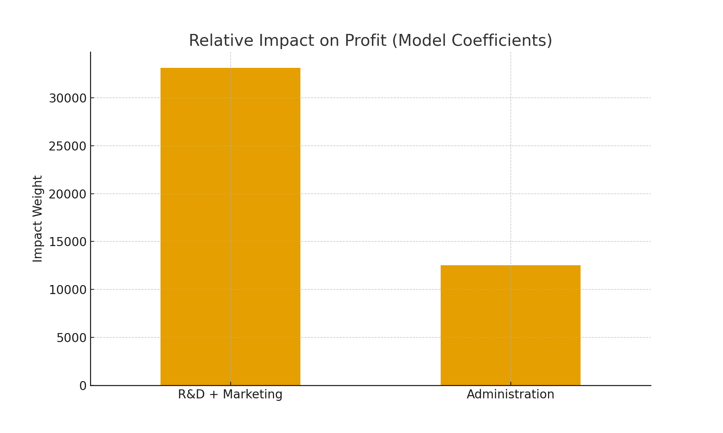
Recommendations
1.Profit consistently rises with higher R&D + Marketing investment — this is our strongest growth engine.
2. R&D + Marketing delivers over 2× the profit impact compared to Administration.
Notes:
The chart shows a strong upward pattern. As R&D and Marketing spend rise, profit increases in a consistent, predictable way.
This confirms these are the strongest profit drivers in the business.
Model coefficient chart
R&D and Marketing combined generate over two times more profit impact than administration.
This directly tells us where investment works hardest

Slide 32
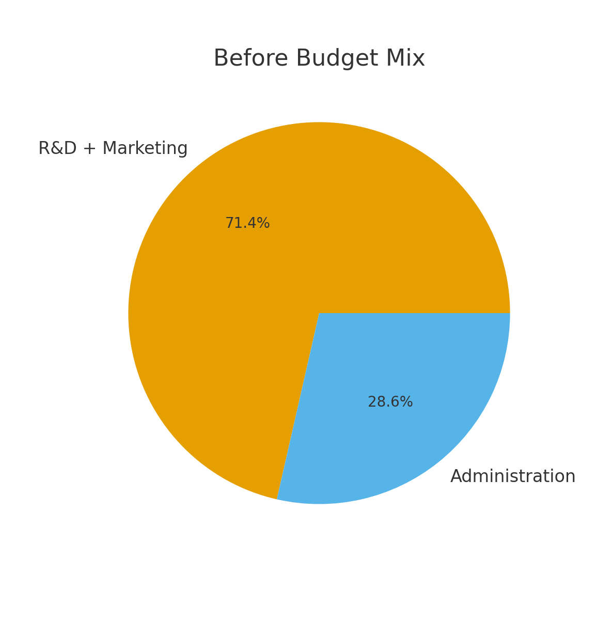
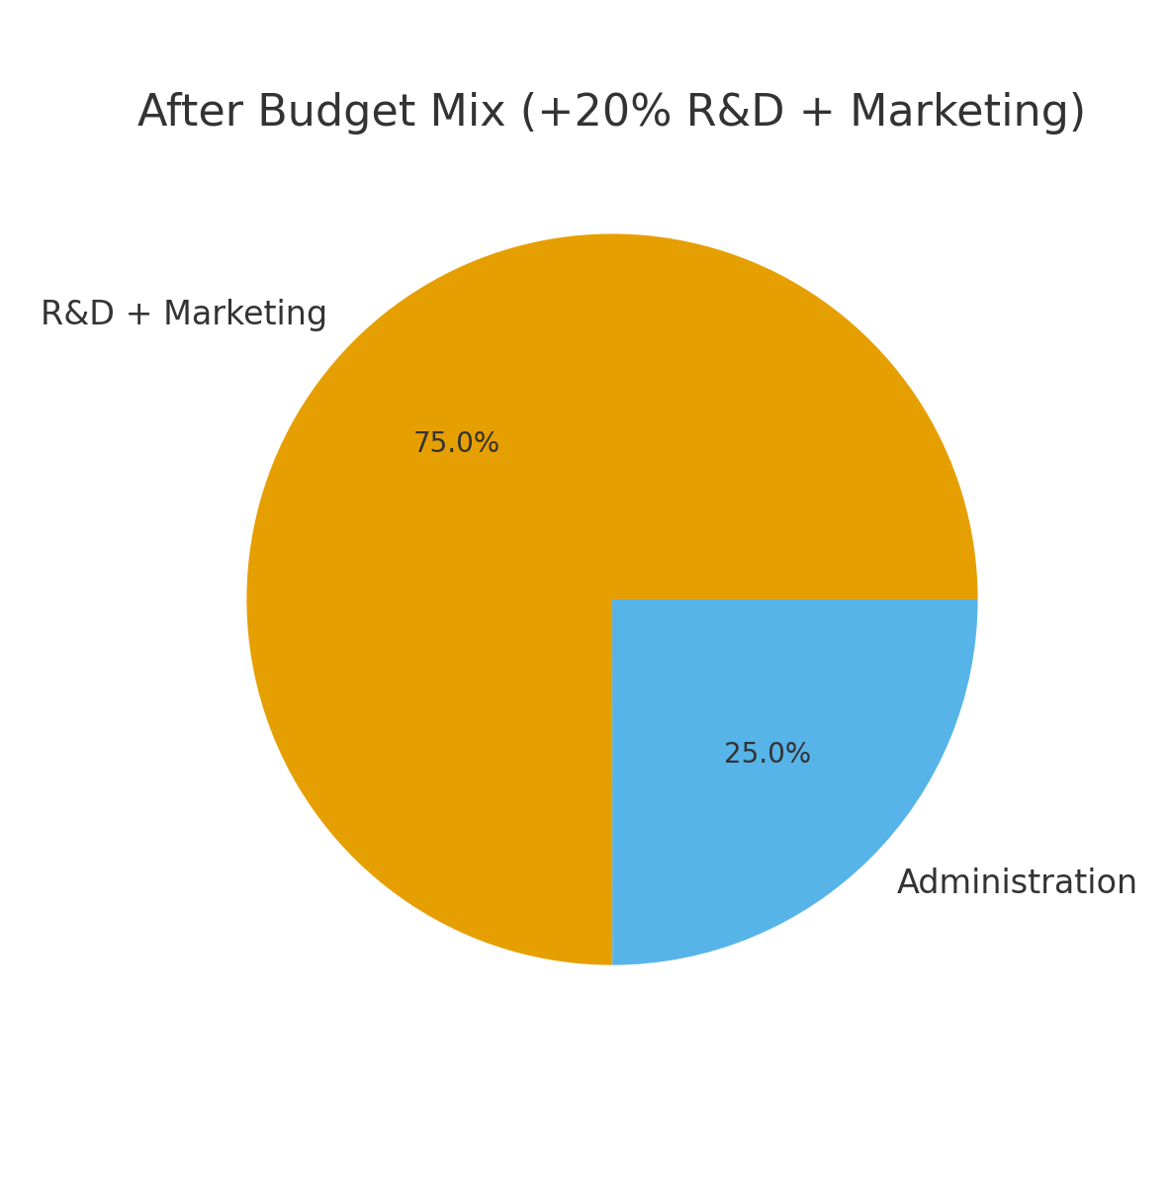
Notes:
On the left is our current spending mix.
On the right, we simulate a 20% increase in R&D + Marketing while keeping Administration stable.
The mix clearly tilts toward growth activities that our model shows have the strongest association with profit.
This is a strategic shift from cost-center spending to revenue-generating investment

Slide 33
Recommendations
1. Prioritize Investment in R&D + Marketing
Every increase in combined R&D + Marketing leads to much higher profit growth than other expenses.
2. Control Administration Costs
Administration:
Positively affects profit
But impact is much smaller than R&D + Marketing
Keep Admin spending efficient, not excessive
Notes:
So, based on our analysis, we recommend two key actions for organisations
First, companies should prioritize spending on R&D and Marketing.
Our model shows that increases in combined R&D and Marketing investment drive significantly higher profit growth compared to other types of spending.
This suggests that innovation and market reach are the strongest engines of revenue and profitability.
Second, Administration costs should be carefully managed.
While Administrative spending does contribute positively to profit, its impact is much smaller compared to R&D and Marketing.
Therefore, organizations should focus on keeping Administration lean and efficient — not excessive — ensuring resources are concentrated in high-return investment areas.
In summary, the fatest path to profit growth is not simply spendig more, it is spending smartly in the right areas
To maximize profit, the company should prioritize investment in R&D and Marketing as a combined strategy. These two departments contribute the most to profit growth. While Administration spending has a positive effect, it should be kept efficient. Geographic location does not significantly influence profit — spending strategy matters more than location. The prediction model is accurate (R² ≈ 92%) and reliable enough for financial planning. ROI should not be used as an input but as a performance metric after profits are earned.

Slide 34
REFERENCES
Data Cleaning – Session 2, Understanding data wrangling [Lecture slides]
Exploratory Data Analysis (EDA) - Session 1 [Lecture slides]
Data transformation: Session 3, Data Transformation: Normalization, Scaling, Encoding [Lecture slides]
Predictive Modelling – Session 4, Airline case study [Lecture slides], Statistical Aid, a school of statistics.
Tools used: Python, Excel
Notes:
References used for our project

Slide 35
THANK YOU

Slide 36
Recommendations
We built a statistical model to identify what drives profit. The model explains over 92% of profit variation, which makes it highly reliable.
The biggest finding: R&D and Marketing spending have more than double the impact on profit compared to Administration.
This shows that growth comes primarily from innovation and market expansion, not overhead operations.
We also tested geography and found that location does not materially change profitability. Therefore, our recommendation is simple:
Increase investment in R&D and Marketing
Optimize Administration spend
Stop allocating budget based on state
If executed, this strategy will maximize profitability and capital efficiency
Notes:
Using a statistical model that explains over 92% of profit variation, we identified the strongest drivers of financial performance.
The message is clear:
R&D and Marketing deliver more than twice the profit impact compared to Administration spending.
This tells us that growth comes from innovation and market expansion — not from increasing overhead.
We also tested the impact of geography and found that location does not materially affect profitability.
So our recommendations are straightforward,
Increase investment in R&D and Marketing
Tightly manage Administration costs
Stop allocating budget based on state

Slide 37
APPENDIX

Slide 38
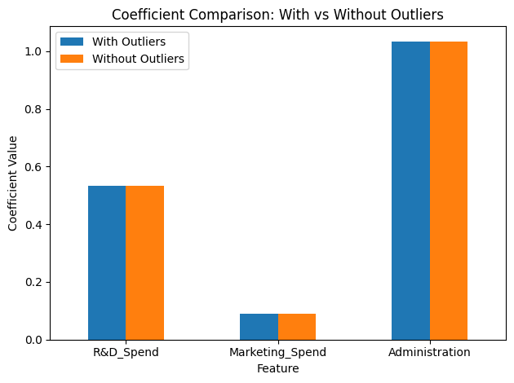
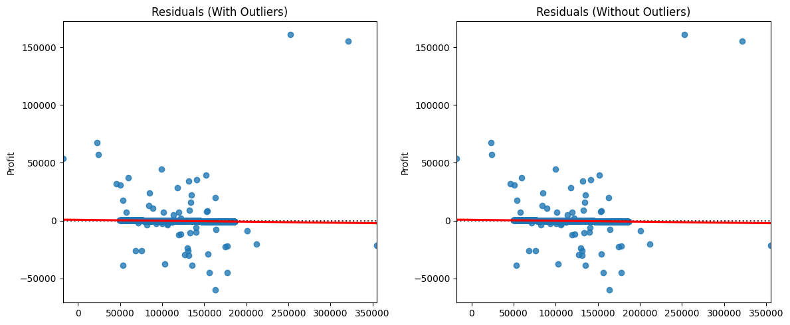
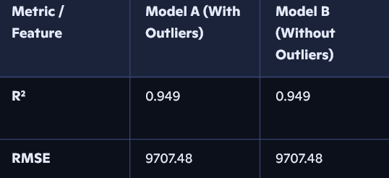
Tested for outliers
We tested models both with and without extreme spend cases. Results were consistent, confirming that our recommendations are robust. Outlier handling was applied only to data-entry errors or unrealistic values, not genuine business events.
Outliers aren’t influential: R² and RMSE are almost identical, so the flagged outliers likely don’t have leverage on the regression line, removing extreme values doesn’t change fit or error metrics.

Slide 39
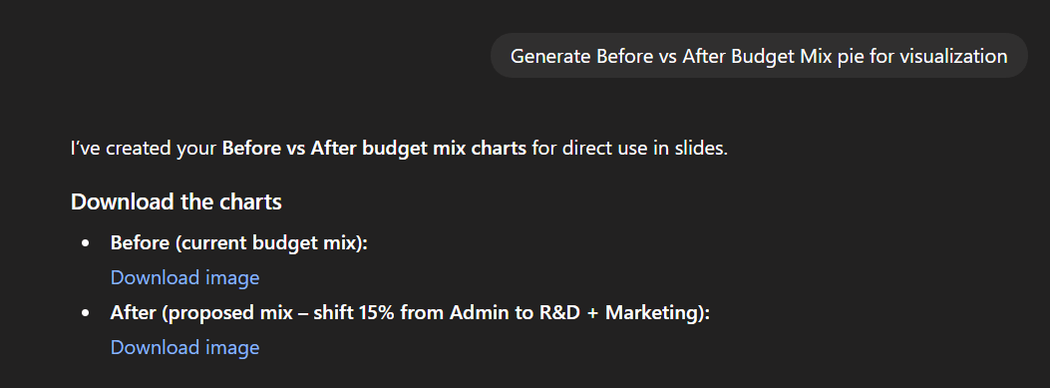
Reference
Prompt used to generate the recommendation pie chart

