Slide 1
Agenda
Capstone Title & team coordinates
Problem/Challenge statement
Business case/Market opportunity
Solution overview
Existing solutions and Challenges
AI role in solving the Challenges (phase wise)
Capstone scope
Capstone scope Iteration – 1
Capstone scope Iteration – 2
Capstone scope Iteration – 3
Capstone conclusion for Phase – 1 (Iteration 1, 2 & 3)
Q & A
Acknowledgements

Slide 2
AI role in Unlocking the Interconnection Queue to power grids
Team# 16 Capstone Project Member(s):
Alejandro Duque (aduquego55@gmail.com)
Junia Compostella (jcompostella@ucdavis.edu)
K.V. Ramakrishna Rao (kvrkr866@gmail.com)

Slide 3
Problem / Challenge statement
TBD

Slide 4
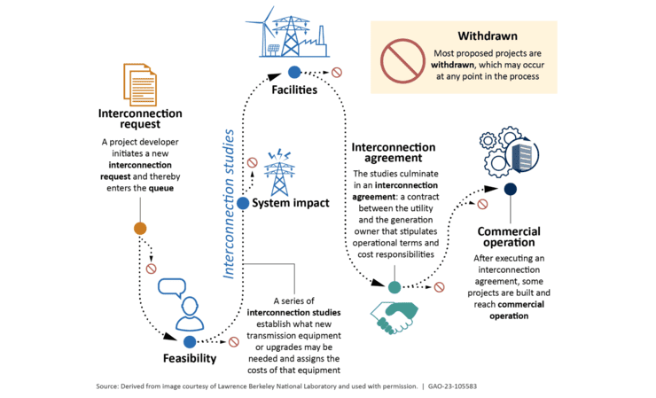
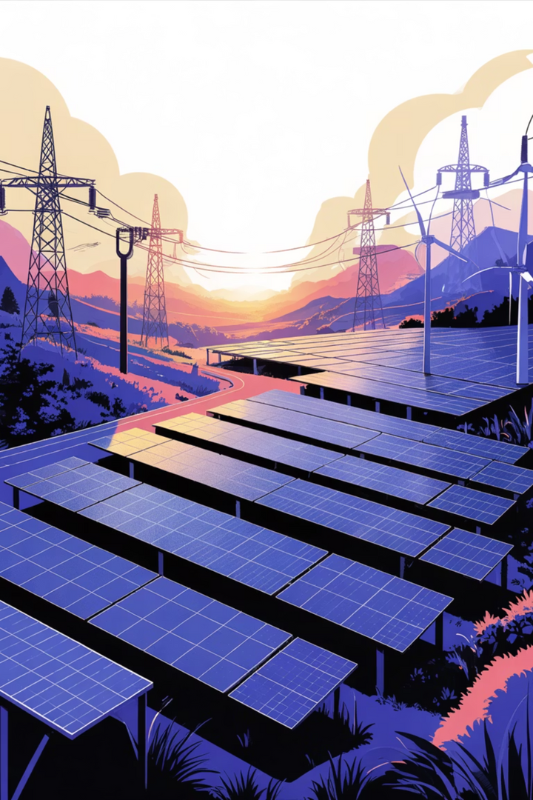
Unlocking the Interconnection Queue
Leveraging AI, LLMs, RAG & Agents to
Transform Grid Modernisation

Slide 5
The Interconnection Queue Crisis
The Challenge
Critical Impact
Over 6 terawatts of renewable energy projects—enough to power 145 million customers—are trapped in interconnection queues across the grid. The median wait time has ballooned to five years from initial request to operation.
This bottleneck involves complex approval processes with manual reviews, lengthy technical studies for grid impact evaluation, and administrative procedures that can't keep pace with demand.
💰 Economic Loss
Delays cost billions in lost investment and stalled infrastructure development
🌍 Climate Goals
Slows clean energy transition and renewable adoption targets
⚡ Grid Expansion
Prevents capacity growth for AI data centres and emerging technologies

Slide 6
Business case / Market opportunity
TBD

Slide 7
Solution Overview
TBD

Slide 8
Existing Solutions & Their Limitations
Traditional approaches to interconnection processing face fundamental constraints that prevent scalability and efficiency.
1
2
Manual Processing
Static Grid Models
Approach: Human review of applications and technical studies
Approach: Fixed capacity ratings and assessments
Limitation: Conservative estimates that underutilize actual grid capacity
Limitation: Slow, error-prone, and inconsistent across projects
3
4
Traditional Software
Batch Studies
Approach: Basic automation and database management
Approach: Sequential project evaluations
Limitation: Cannot handle complexity and scale of modern requirements
Limitation: Creates cascading backlogs across the entire queue

Slide 9
AI role in solving the Challenges phase wise

Slide 10
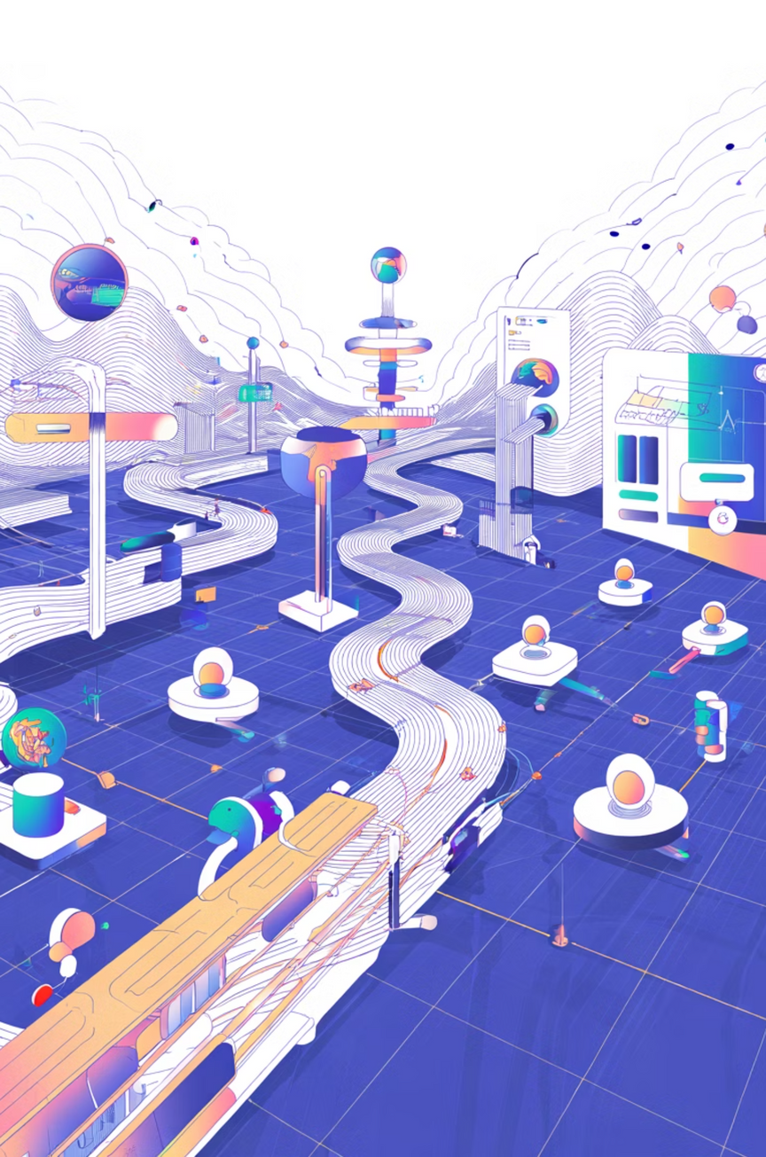





AI-Solvable Challenges in Interconnection
Artificial intelligence offers targeted solutions across four critical domains, each with defined implementation timelines and proven methodologies.
Phase 1
Document Processing
Challenge: Application review & validation
Potential AI Solution: LLM + RAG
Phase 2
Technical Studies
Challenge: Grid impact analysis & modeling
Potential AI Solution: ML Models + Agents
Phase 3
Capacity Planning
Challenge: Dynamic line rating & optimization
Potential AI Solution: predictive ML & Real-time Analytics
Phase 4
Decision Support
Challenge: Multi-stakeholder coordination
Potential AI Solution: Multi-Agent Systems

Slide 11
Capstone Scope
Minimal implementation of Phase – 1 is considered as scope of the capstone project by considering 08th Nov 2025 timeline.

Slide 12
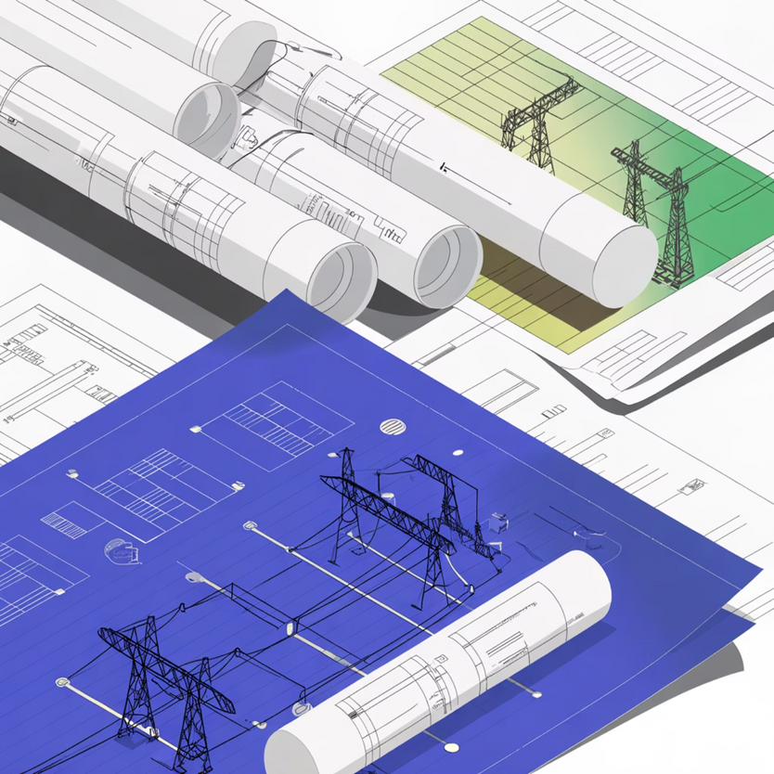


Challenge 1: Application Document Processing
The Problem
Manual review of thousands of pages including technical specifications, grid studies, environmental reports, and compliance documentation creates severe processing delays.
Current State
Applications take weeks to months per review with high error rates, inconsistent standards across reviewers, and frequent rework cycles.
Foundation LLMs
RAG System
GPT-4 and Claude for deep document understanding and context extraction
Regulatory knowledge base with historical precedents and compliance rules
Automated Validation
Smart Extraction
Real-time verification against regulatory requirements and technical standards
Intelligent parsing of technical specifications and key data points
Expected Impact: 70-80% reduction in review time with 90%+ accuracy rates, achievable within 6-12 months of implementation.

Slide 13




AI Approach: Intelligent Document Processing
RAG-Powered Application Review System
Document Ingestion
RAG Knowledge Base
PDF and Word parsing, OCR for scanned documents, automated metadata extraction
Regulatory standards (FERC, NERC), historical applications, grid codes and requirements
Tech: LangChain, PyPDF
Tech: Vector DB (Chroma)
LLM Analysis
Automated Report
Completeness verification, compliance validation, technical specification extraction, flag missing information
Validation summary, required corrections, risk assessment, approval recommendation
Tech: Open AI
Tech: Structured Outputs
Key Benefit: Applications processed in hours instead of weeks, with consistent quality and comprehensive audit trails

Slide 14
Iteration-1: Architecture - Data/Control flow

Slide 15
Iteration-1: Design elements

Slide 16
Iteration-1: Evals & Operational Metrics

Slide 17
Iteration-2: Architecture - Data/Control flow

Slide 18
Iteration-2: Design elements

Slide 19
Iteration-2: Evals & Operational Metrics

Slide 20
Iteration-3: Architecture - Data/Control flow

Slide 21
Iteration-3: Design elements

Slide 22
Iteration-3: Evals & Operational Metrics

Slide 23
Conclusion

Slide 24
Q & A; Acknowledgement
Capstone Project Team #16 - would like to sincerely thank all the participants, Instructors, learning partners and the supporting team during this course. Their help was invaluable to its completion. Thank you
- Alejo, Junia & RK

Slide 25
Acknowledgement

Slide 26
Additional Information slides / Bakcup
Additional Information
/
Backup slides

Slide 27
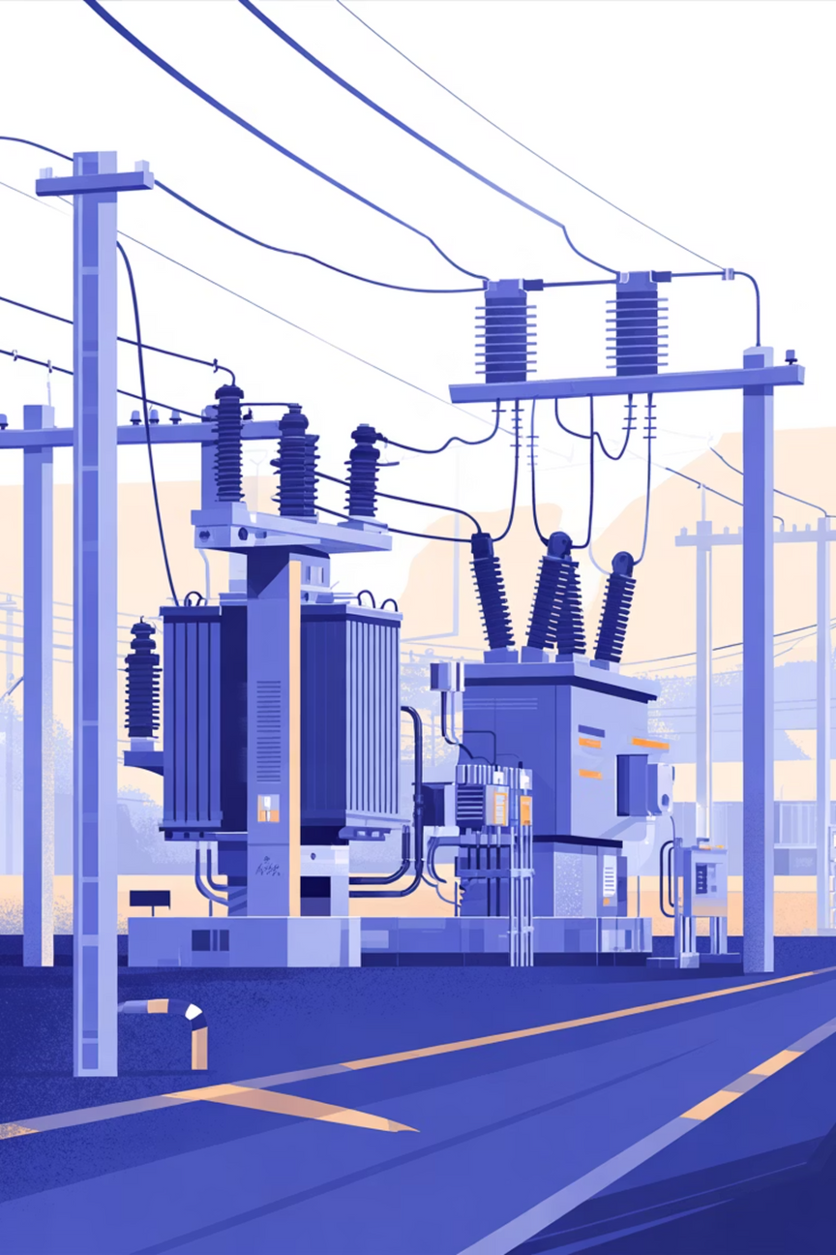
Challenge 2: Grid Impact Studies
The Problem
Multi-Agent System
Complex simulations required to assess voltage stability, fault analysis, power flow dynamics, and overall system reliability before approving new connections.
Specialised agents for each study type—voltage analysis, fault assessment, and power flow modelling
Current State
Studies take months per project, require specialised engineers with deep expertise, and involve manual scenario modelling that's difficult to scale.
ML Models
Trained on historical grid data to predict outcomes and identify patterns
Automated Scenarios
Intelligent generation and simulation of edge cases and typical conditions
Predictive Optimisation
Models identify optimal interconnection points and configurations
Timeline: 12-18 months | Impact: 60-70% faster studies with better solution identification

Slide 28
AI Approach: Multi-Agent Study System
Agentic Workflow for Grid Studies
01
02
Manager Agent
Specialist Agents
Analyses project requirements, decomposes into specific study tasks, coordinates specialist agents throughout workflow
Voltage Stability Agent utilises ML models and power flow simulations
Fault Analysis Agent leverages historical data with predictive models
Tech: LangGraph orchestration
Capacity Agent applies dynamic line rating algorithms
Tech: ReAct Agents + Tools
03
04
Synthesis Agent
Human Review
Combines all study results, identifies conflicts and dependencies, recommends optimal configuration, generates comprehensive report
Engineer validates AI findings, approves recommendations, provides final sign-off via intuitive dashboard interface
Tech: LLM with structured output
Tech: Interactive dashboard
This approach enables parallel processing, ensures consistent methodology across projects, and allows for faster iteration cycles when refinements are needed.

Slide 29





Challenge 3: Dynamic Capacity & Planning
The Problem
Predictive ML + Agentic Control Solution
Static ratings severely underutilise grid capacity. Weather conditions, load patterns, and renewable generation create opportunities for dynamic optimisation that traditional systems cannot exploit.
Current State
Weather Forecasting
Conservative static limits, manual adjustments requiring human intervention, and reactive planning that responds to problems rather than preventing them.
ML models predict capacity based on temperature, wind, and precipitation patterns
Load Prediction
Transformer models with attention mechanisms forecast demand patterns
RL Optimisation
Reinforcement learning algorithms optimise dispatch decisions in real-time
VPP Coordination
Agent-based systems coordinate distributed energy resources efficiently
Timeline: 12-24 months
Impact: 20-40% capacity increase, reducing congestion costs by over $20 billion annually

Slide 30
Implementation Roadmap & Expected Outcomes
Phase 1:
Phase 3:
Focus: Document Processing
Focus: Real-time Optimisation
RAG system for application review
Dynamic line rating system
LLM-powered compliance checker
VPP coordination agents
Automated reporting pipeline
Predictive capacity planning
Outcome: 70% faster initial review
Outcome: 30% capacity increase
1
2
3
Phase 2:
Focus: Technical Studies Automation
Multi-agent study system
ML models for impact analysis
Scenario generation engine
Outcome: 60% reduction in study time
Overall Impact
80%
$20B+
6TW
Time Reduction
Cost Savings
Clean Energy
Queue time drops from 5 years to 1-2 years
Annual reduction in delays and congestion costs
Accelerated deployment of renewable projects

