Slide 1

Unlocking the Grid Interconnection Queue with AI
Alejo, Junia, RK
Team 16
Notes:
Hello everyone, my name is Junia, and with Alejo and RK we’ve tackled the queue challenge that is affecting the power grid interconnection of electricity loads and generation, especially in the U.S.

Slide 2
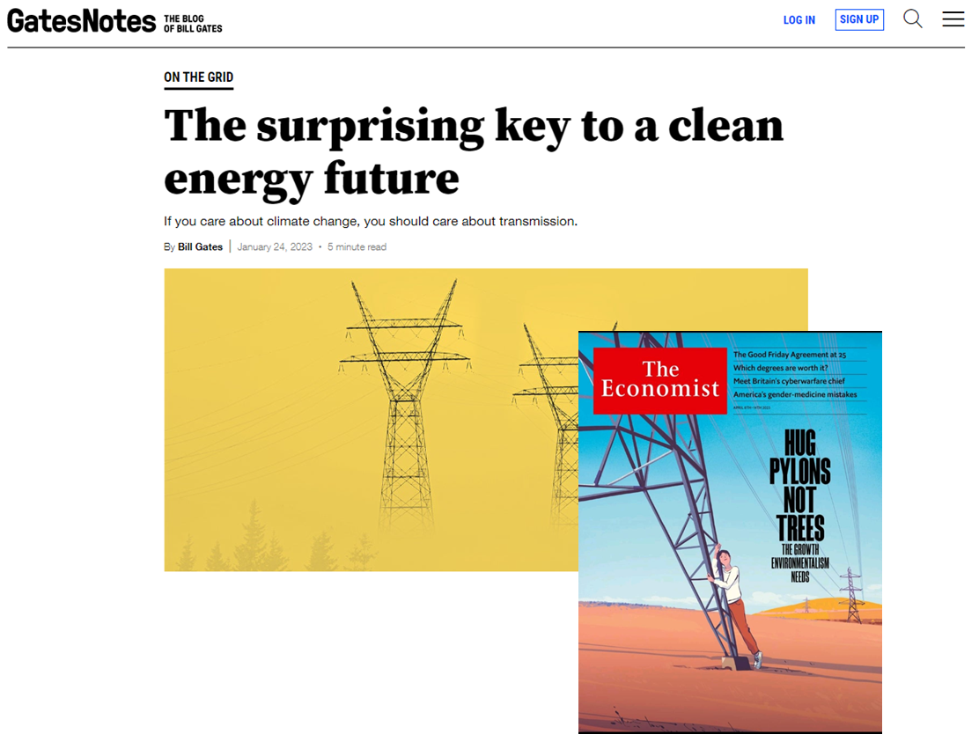
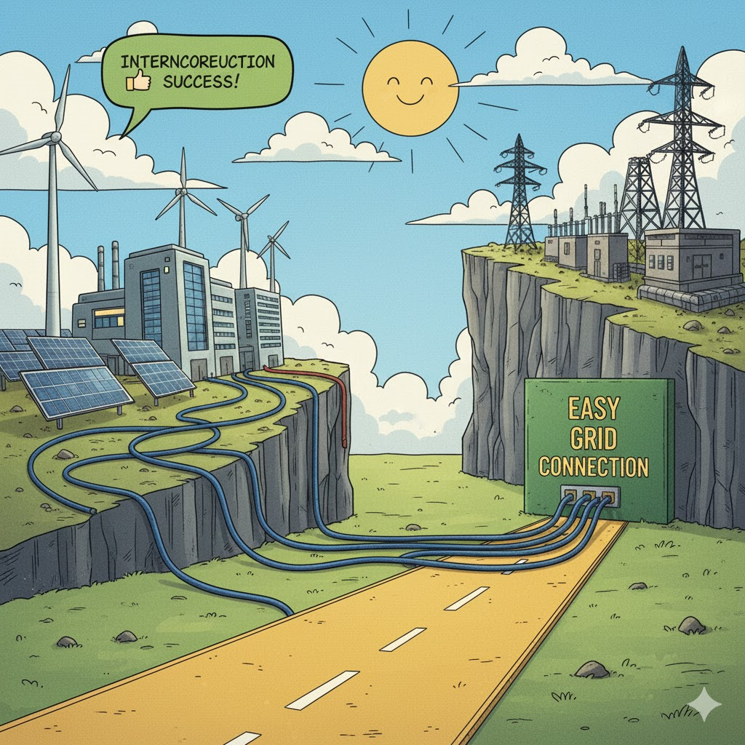

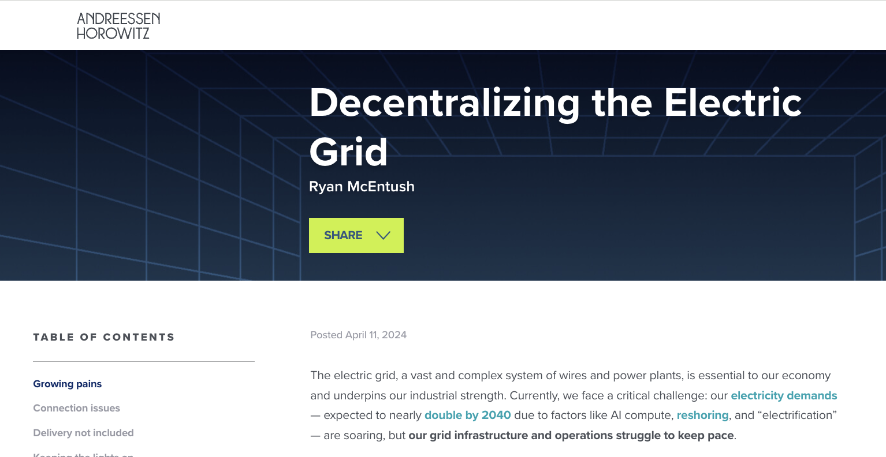
Boost of Interconnection Requests to the Power Grid
Expectation:
Team 16
Notes:
Extreme weather events have really woken people up to power grids—and how they can fail when we need them most. Meanwhile, we're seeing this huge surge in energy demand coming from AI data centers, mining, metal industries, electrolysis, and more. Plus, we're racing to add new electricity supply from solar plants, gas plants, and other sources.
Now, you expect all these new loads and generation sources would just plug into the grid.

Slide 3
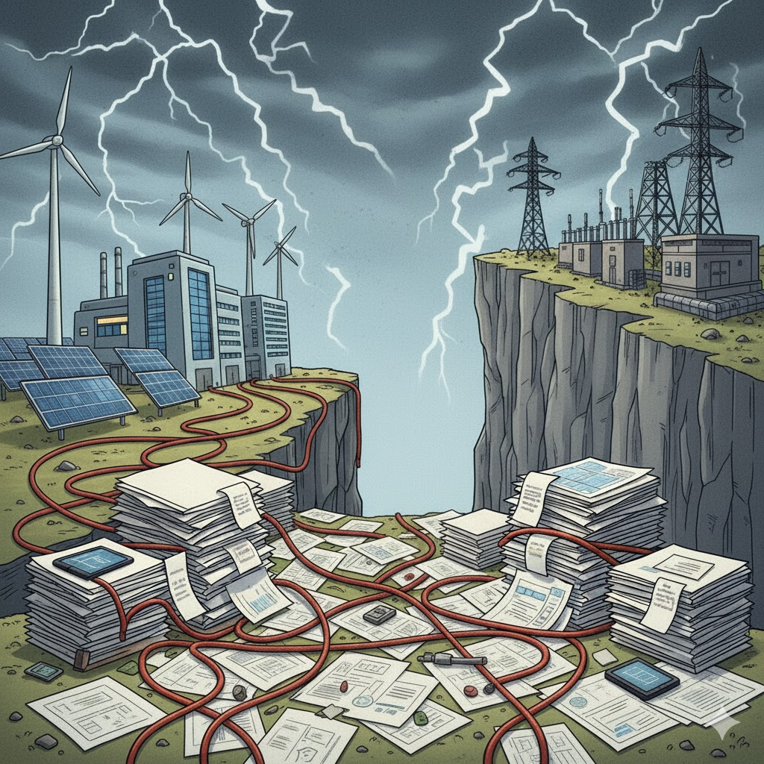
Interconnection Queue Costs the Global Economy $50-80B per Year
Reality:
$2-3B*addressable business potential
The annual global revenue opportunity for providers of interconnection-specific services and tools (e.g., feasibility studies, system impact analyses, compliance modeling, queue management platforms)
U.S. $800-900M*
80% of projects withdraw during 3–5-year queue process
Team 16
Notes:
But here's the reality check—that's not what's happening. Why? Because our grid infrastructure is simply too outdated to connect loads and generation fast enough to satisfy this surge in electricity demand. This is creating massive interconnection delays and forcing projects to withdraw, which is costing developers billions in lost revenue and exposing utilities to serious operational risks.
Now, as with any crisis, there's opportunity. The opportunity here is modernizing grid management with interconnection-specific tools—and we're looking at a total addressable market of 2 to 3 billion dollars globally, with about a billion in the U.S. alone.
* $50-80B: The annual estimate starts at the U.S.-level based on 2023-2024 data and derived from two separate components: (a) developers' lost revenue from delayed or withdrawn projects in interconnection queues, and (b) utilities' operational risks from grid instability (e.g., outages tied to poor interconnections).
The focus on renewables and storage (95% of the U.S. interconnection queue) is based on LBNL data, which shows that as of end-2023, the queue totaled 2,600 GW, with solar (1,086 GW), battery storage (947 GW), wind (300 GW), and hybrids (675 GW) comprising over 95% of capacity, while gas (74 GW) and other non-renewables are minor (<5%) (https://emp.lbl.gov/queues). This justifies the emphasis, as the queue is overwhelmingly renewables/storage-driven, with loads like data centers adding similar but smaller impacts (e.g., data centers projected at 50-130 GW cumulative demand by 2030, often handled via separate utility processes rather than main queues) (https://emp.lbl.gov/queues, https://www.latitudemedia.com/news/the-us-interconnection-queue-is-twice-its-installed-capacity/). Loads are not ignored but treated additively in calculations below, as they exacerbate delays but represent <5% of current queue volume (https://emp.lbl.gov/queues). This avoids overestimation while capturing the dominant driver of lost revenue and risks.
Part A: Developers' Lost Revenue ($10-15B Annually)
Determine Queue Size and Withdrawal Rate
The U.S. queue is 2,600 GW (end-2023; latest LBL data, projected steady to 2024 as queues grew 27% in 2023) (https://emp.lbl.gov/queues). Withdrawal rate 80% (cumulative; 2,080 GW unbuilt). Average delay 3-5 years (midpoint 4 years for operational projects) (https://emp.lbl.gov/queues). Annual effective lost capacity: 2,080 GW / 4 years = 520 GW/year.
(No miss: Includes delays for completers; loads additive below.).
Estimate Forgone Generation per GW
Average renewable LCOE (levelized cost of energy, proxy for revenue potential) is $30-50/MWh for solar/wind average. Capacity factor 20-30% (e.g., solar 24.9%, wind 35.4% average) (https://emp.lbl.gov/cost-power-interruptions). Annual generation per GW: 8,760 hours/year * 20-30% = 1,752-2,628 effective full-load hours per year. For a 1 GW plant, the annual energy output is those effective hours * 1 GW = 1,752 GWh to 2,628 GWh. Revenue per GW/year: 1,752-2,628 GWh * $30-50/MWh = $52.56-131.4 M/GW/year. LCOE approximates wholesale revenue; capacity factor adjusts for real output. Delays (3-5 years) multiply this forgone amount. Per GW lost over 4 years average: $210-525M/GW total, or $52-131M/GW/year annualized.
Scale to Total Lost Revenue:
Annual lost capacity ~520 GW/year * $52-131M/GW/year = $27-68B/year base. Conservative adjustment: Attribute 50% (standard reasoning step in market impact calculations when reports provide qualitative emphasis like “most consequential” “major bottleneck” to interconnection delays in this case) (https://www.cfr.org/article/us-interconnection-challenge-why-renewables-are-stuck-line). Result: $13.65-34.15B/year; midpoint $10-15B.
Additive for AI/Data Center Loads:
Projected 50 GW new capacity (mid-range to 2030; not in main queue). 2-year delay (typical for large loads). Revenue loss/site (100 MW): $50/MWh 8,322 hours/year (95% utilization) * 2 years = $83.22M/site (rounded $100M). Scaled: 500 sites (50 GW / 100 MW) * $100M = $50B total; annualized ~$5B/year. Origin of 50 GW: DOE says that EPRI estimates that data centers could grow to consume up to 9% of U.S. electricity generation annually by 2030, up from 4% of total load in 2023 (https://www.energy.gov/gdo/clean-energy-resources-meet-data-center-electricity-demand). So I calculated that data center annual consumption is 9% of U.S. annual electricity generation 4,243 TWh (EIA 2023 data) ~382 TWh/year. Data centers operate at high utilization (95% capacity factor), so equivalent average load is ~382 TWh / (8,760 hours/year * 0.95) ≈ 46 GW >> 50 GW.
Part B: Utilities' Operational Risks ($5-10B Annually)
Identify Outage Frequency and Cost per Event
U.S. has 5-10 major power outages/year causing sustained interruptions (e.g., >1 hour, affecting >100,000 customers). Attribute to Interconnection Risks
Annual total outage costs: 5-10 major events * $500M-1B = $2.5-10B base.
Total Combined Estimate: Developers $10-15B (core queue-based) + $5B (AI additive) + utilities $5-10B = $15-25B annually U.S.
$2-3B: Quantification of the 'Niche' (Power Grid Interconnection Market) in Dollars
Global smart grid market: $73.8B (MarketsandMarkets 2024 forecast from 2023 $61.6B at 20% CAGR)
Software/services share: 28% ($20.66B; MarketsandMarkets average for analytics/consulting).
Interconnection subset: 12% of software/services ($2.48B; MarketsandMarkets allocation for "transmission optimization/renewable integration").
U.S. share: 32% of global ($794M; MarketsandMarkets geographic split).
“Step-by-Step Reasoning for U.S. Smart Grid Software Market Size ($3.5-4.5B in 2024) and Interconnection Niche Subset ($800-900M)”
Notes:
The 80% withdrawal rate is cumulative over a project's life cycle (3-5 years average duration in queue), not annual. Annually, withdrawals represent ~8-27% of the queue it's the total dropout over the full lifespan of a project in the queue, which typically lasts 3-5 years from entry to decision.
The addressable business potential refers to the annual revenue opportunity for providers of interconnection-specific services, software, tools, and consulting (e.g., feasibility studies, system impact analyses, compliance modeling, queue management platforms). This is equivalently the annual spend by customers (developers, utilities, RTOs/ISOs) on these items. It excludes physical grid upgrades (e.g., new lines or substations) and post-interconnection operations.
Turnover is the annual rate (45%) of change or activity in the queue, calculated as (annual GW of additions + advancements + withdrawals + completions) / total end-of-year queue GW * 100%

Slide 4

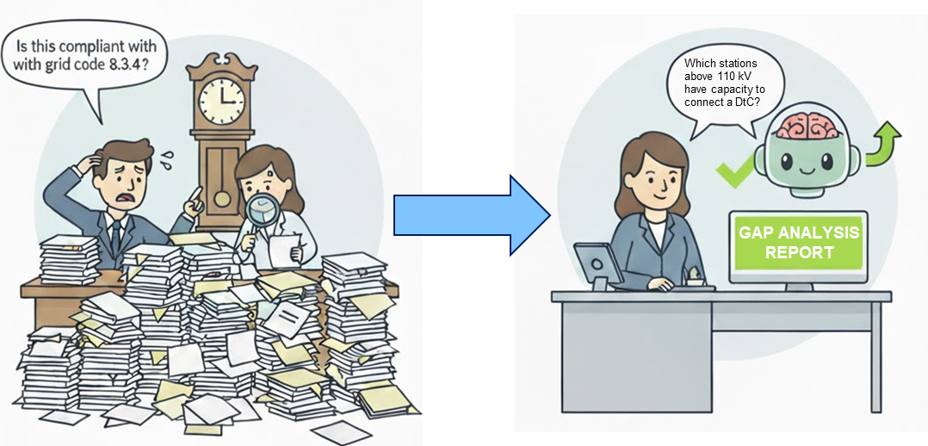



AI-solvable challenges in the grid interconnection process
AI enables targeted solutions across four critical domains, each with defined implementation timelines and proven methodologies.
Document Processing
Challenge: Application review & validation
CAPSTONE SCOPE
Technical Studies
Challenge: Grid impact analysis & modeling
Grid Expansion Planning
Challenge: Optimal grid expansion
Decision Support
Challenge: Coordination between stakeholders
Team 16

Slide 5
Power Grids Interconnection Queue: Compliance AI Agent
Problem-First based Capstone Iterations:
Iteration 1
Grid diagnostics
Iteration 2 Iteration 1 + Grid interconnection process analyzer
Iteration 3 Iteration 2 + Gap analysis of interconnection requests
Team 16

Slide 6
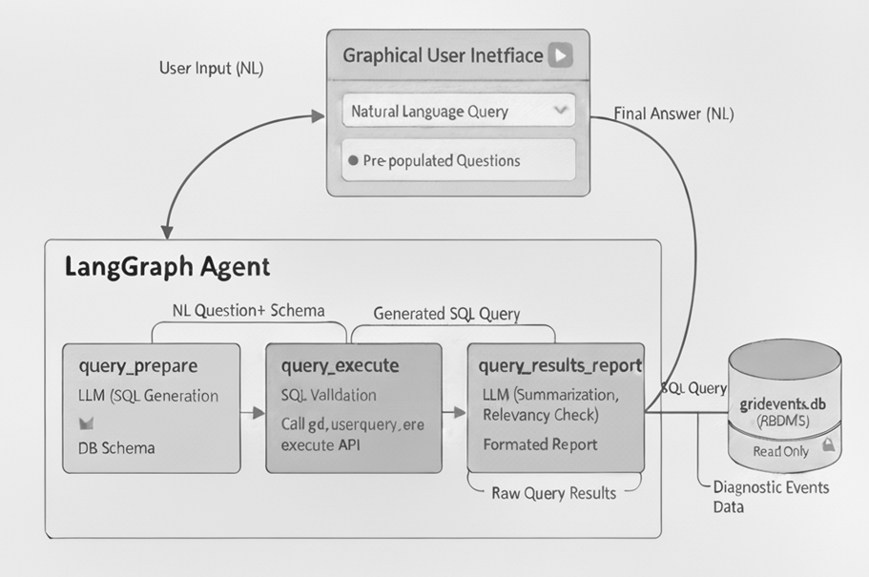
Compliance AI agent Iteration 1: Grid Diagnostics
OpenAI gpt-5-mini
Streamlit
LangGraph
SQLite3
Comet Opik
Team 16

Slide 7
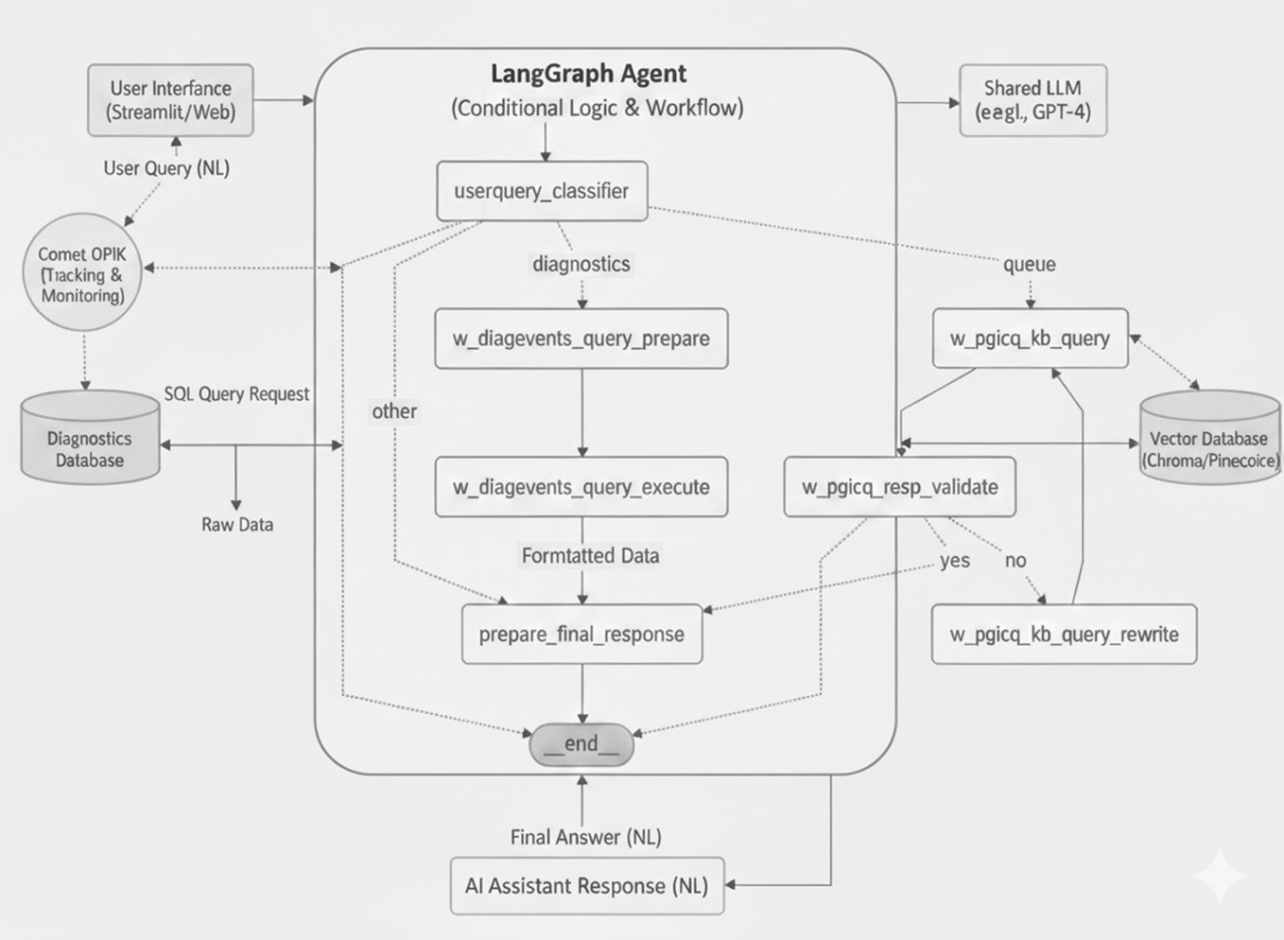
Compliance AI agent Iteration 2: Grid Interconnection Process Analyzer
OpenAI gpt-5-mini
Streamlit
LangGraph
SQLite3
Comet Opik
Chroma DB
OpenAI Embeddings
Team 16

Slide 8
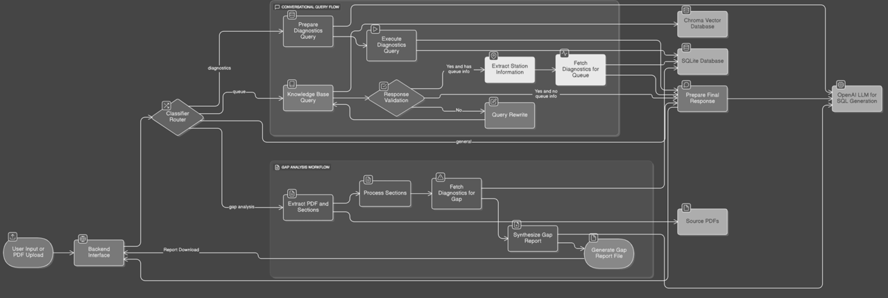
Compliance AI agent Iteration 3: Gap Analysis of Interconnection Requests
Tech stack as Iteration 2
Team 16

Slide 9
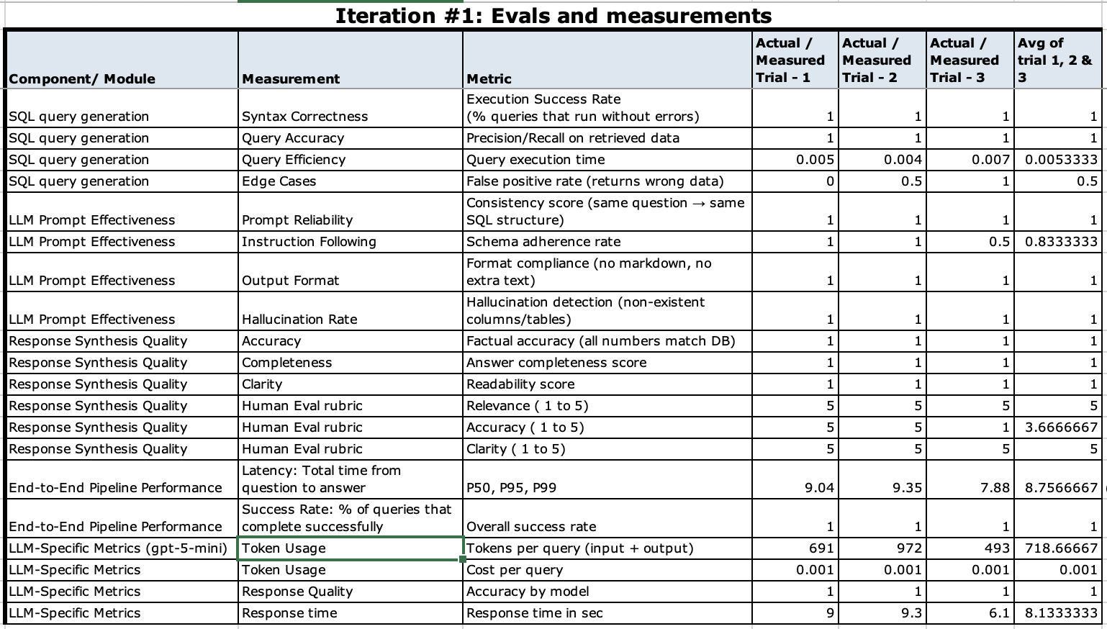
Evals & Measures for Compliance AI agent: Iteration 1
Team 16

Slide 10
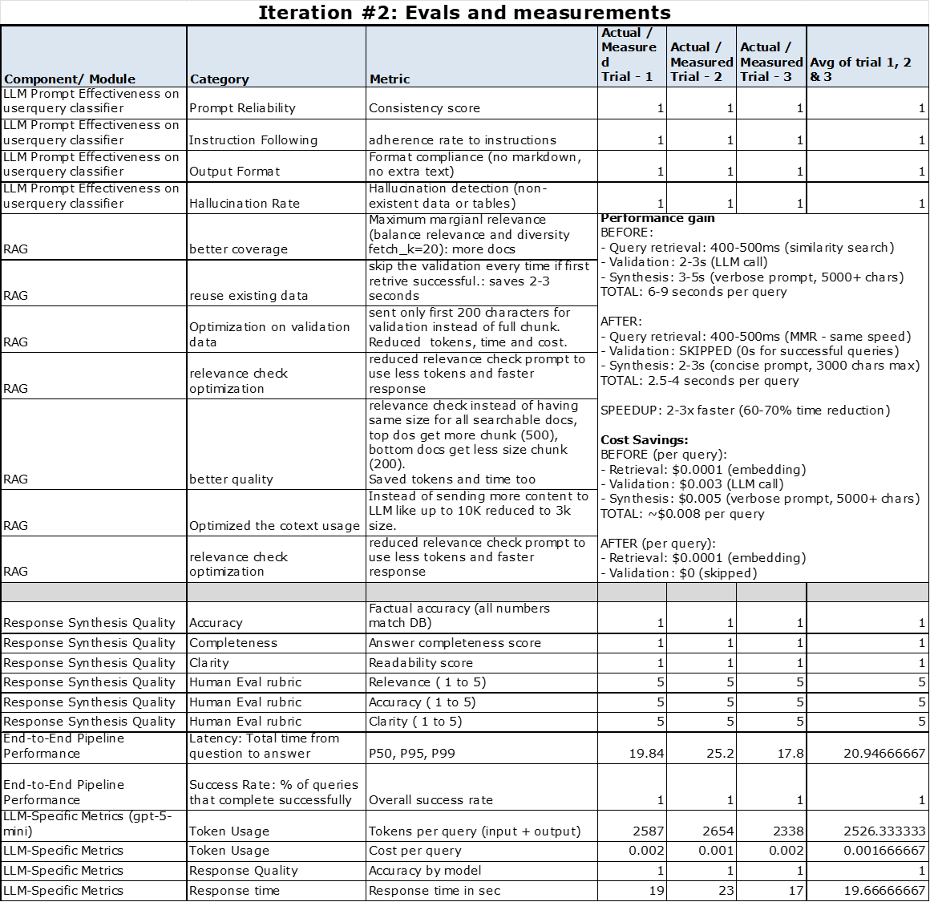
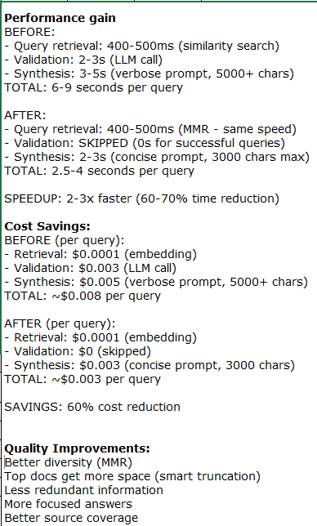
Evals & Measures for Compliance AI agent: Iteration 2 & 3
Team 16
https://github.com/kvrkr866/unblocking_icq_phase1/blob/main/capstone16_evals_n_metrics.xlsx

Slide 11
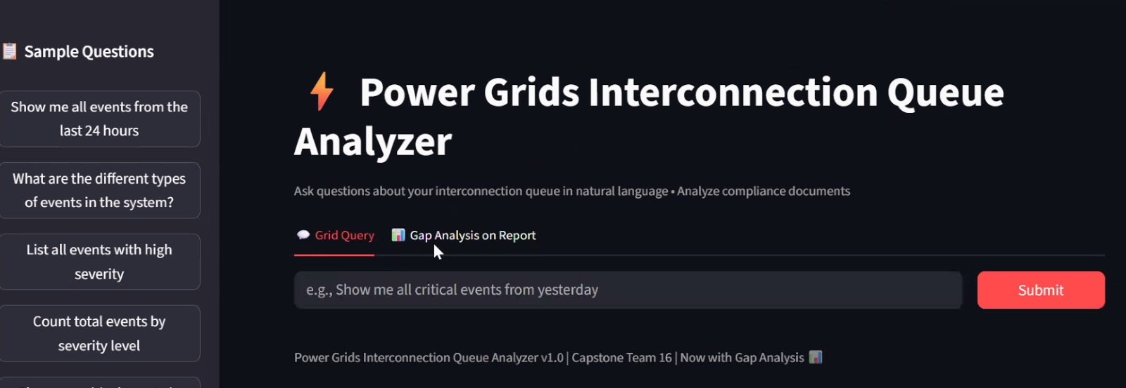
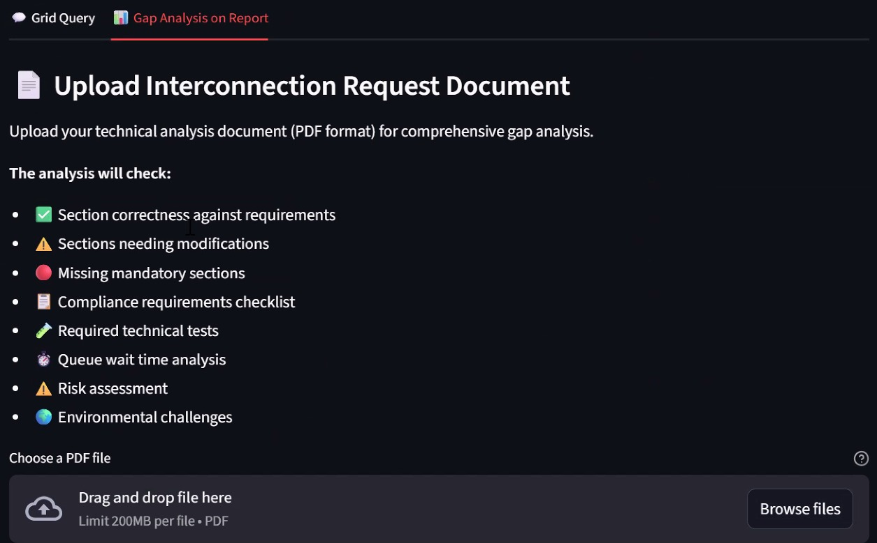
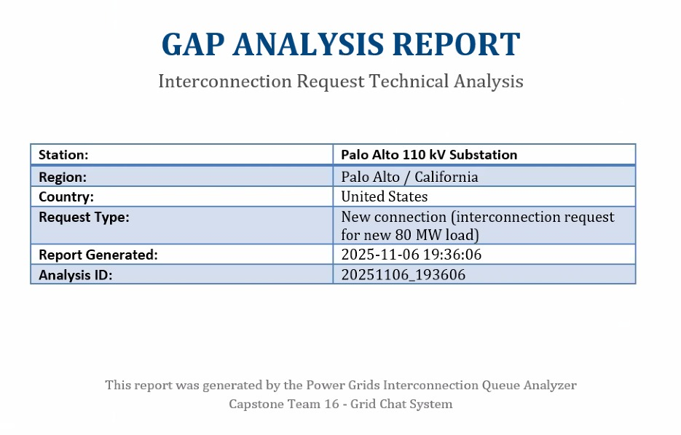
Demo
Team 16

Slide 12
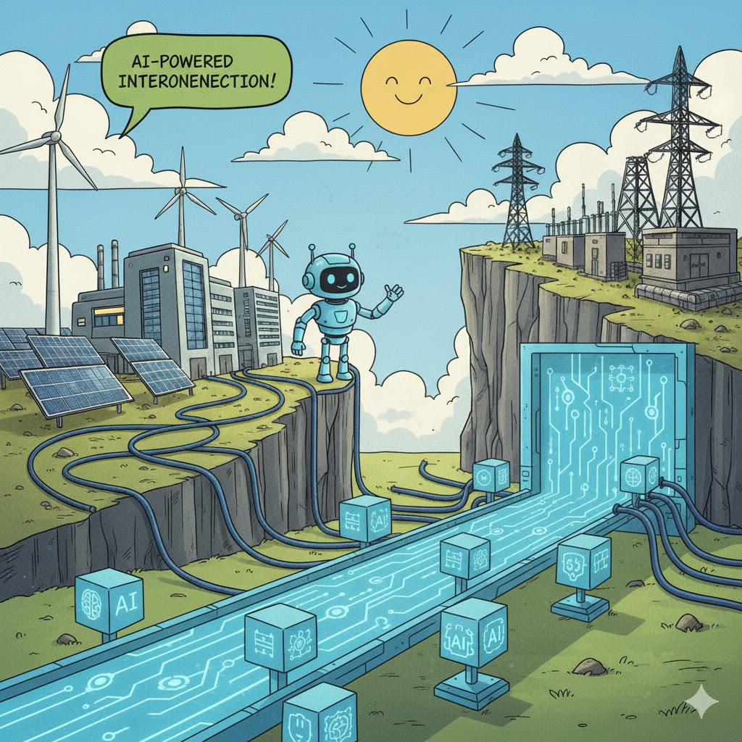
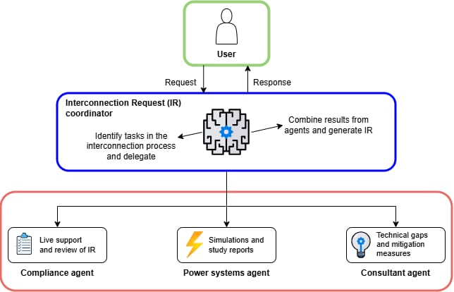
Our Idea: An AI Turnkey Solution to Run the Interconnection Process End to End
Goal:
Capstone project!
Team 16

Slide 13






Thank You for Your Attention!
RK
K.V. Ramakrishna Rao
kvrkr866@gmail.com
Junia
Junia Compostella
jcompostella@ucdavis.edu
Alejo
Alejandro Duque
aduquego55@gmail.com
Any questions?
Team 16

