Slide 1
My3Tech
Notes:
https://chatgpt.com/
https://docs.oracle.com/javase/tutorial/
https://www.javatpoint.com/history-of-java

Slide 2
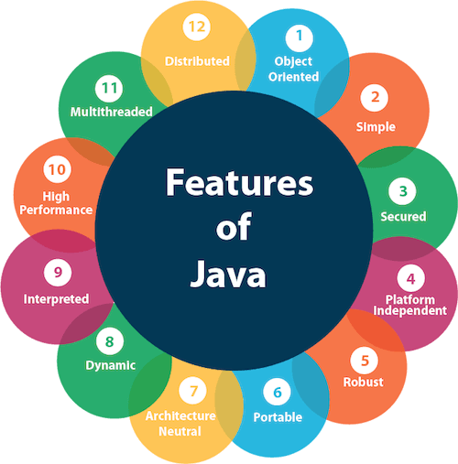
Welcome 2 Java
Notes:
https://chatgpt.com/
https://docs.oracle.com/javase/tutorial/
https://www.javatpoint.com/history-of-java

Slide 3
Agenda
What/why is Java?
Setting up the environment
A First Java Program
Java Naming Conventions/Java Identifiers
Differences between JDK, JRE and JVM
Notes:
Homework: Download and install JDK, Write a simple java program to print Hello World/something
https://docs.oracle.com/javase/tutorial/getStarted/application/index.html
https://docs.oracle.com/javase/tutorial/getStarted/QandE/questions.html
https://docs.oracle.com/javase/tutorial/getStarted/problems/index.html

Slide 4
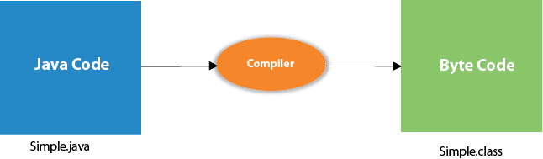
Notes:
Homework: Download and install JDK, Write a simple java program to print Hello World/something
https://docs.oracle.com/javase/tutorial/getStarted/application/index.html
https://docs.oracle.com/javase/tutorial/getStarted/QandE/questions.html
https://docs.oracle.com/javase/tutorial/getStarted/problems/index.html

Slide 5
Agenda – Session 2
Data types
Variable & Declarations of Variable
Enum
Arrays
Notes:
Homework: 1) Download and Install Eclipse 1) Download and Install Eclipse 2) Create a Java Project in Eclipse 3) create 2 packages inside the src 4) create 2(one default class, one public class) classes (one in each package) 5) create a class and methods with all Access Modifiers inside the class 6) create a parameterized constructor and add method in a class and call it from another class 7) create all types of variables and initialize from main method

Slide 6
Agenda – Session 3
Arithmetic Operators
Relational Operators
Logical Operators
Increment and Decrement Operators
The Conditional Operator
Notes:
Homework:
1) Write a program with all types of Primitive Datatypes and print 2) Write a simple program to do implicit & explicit conversions 3) Write a program with all types of operators(at least one example for each type

Slide 7
Agenda – Session 4
Selection Statement (if , Switch)
Iteration Statements (while, do-while , for , Nested Loop)
Jump Statements (break , Continue, Return)
Notes:
Homework:
1) Write a program to print given month by using Switch statement 2) write a program which contains a method with return statement 3) write a sample program on do-while

Slide 8
Agenda – Session 5
List of all Java Keywords
Important Keywords in Java
Notes:
Homework:
Write a program to print given month by using Switch statement 2) write a program which contains a method with return statement 3) write a sample program on do-while

Slide 9
Agenda – Session 6
Array
Notes:
Homework:
1) we have an array of 5 elements {2,4,6,8,10}. Write a program to access element at specific index 2) we have multi-dimensional array. Write a program with multi-dimensional array and find the length of row 2 3) write a program to copy values from one array into another array. 4) write a program to delete one element from an array

Slide 10
Agenda – Session 7
String Class
StringBuffer Class
StringBuilder Class
Notes:
https://www.digitalocean.com/community/tutorials/string-vs-stringbuffer-vs-stringbuilder
Homework:
1) we have an array of 5 elements {2,4,6,8,10}. Write a program to access element at specific index 2) we have multi-dimensional array. Write a program with multi-dimensional array and find the length of row 2 3) write a program to copy values from one array into another array. 4) write a program to delete one element from an array

Slide 11
Agenda – Session 8
Constructor
Static method
Notes:
Homework:
1) we have an array of 5 elements {2,4,6,8,10}. Write a program to access element at specific index 2) we have multi-dimensional array. Write a program with multi-dimensional array and find the length of row 2 3) write a program to copy values from one array into another array. 4) write a program to delete one element from an array

Slide 12
Agenda – Session 9
Classes and Objects
Different ways to create objects in Java
Association, Composition and Aggregation
Access and Non-Access Modifiers in Java
this reference
Object class
Static class in Java
Notes:
https://www.geeksforgeeks.org/different-ways-create-objects-java/
https://www.geeksforgeeks.org/association-composition-aggregation-java/
Homework:
Write a sample program with static block and a constructor
Sample programs to show association, aggregation, composition
Non-access modifiers
This reference
Object class
Static class

Slide 13
Agenda – Session 10
OOPs concepts
Introduction to OOP Concept
Inheritance in Java
Encapsulation in Java
Abstraction in Java
Polymorphism in Java
Why Java is not a purely Object-Oriented Language?
Notes:
Homework:
1)Write a example program for Single inheritance 2)Write a example program for Hierarchical inheritance 3)Write a example program for Multi-level inheritance 4)Write a example program for Has-a relationship
Java is not considered a "purely object-oriented programming language" because it includes primitive data types like "int", "float", and "char", which are not objects themselves, unlike in a truly pure OOP language where everything would be an object; this means you can perform operations directly on these primitive types without wrapping them in object classes, which deviates from the strict definition of pure OOP.

Slide 14
Agenda – Session 11
Inheritance in Java
Multiple Inheritance
Why Java doesn't support Multiple Inheritance – The Diamond Problem
Java Object Creation of Inherited Class
Inheritance and constructors
Interfaces and Inheritance
Using final with Inheritance
Override private methods
Parent and Child classes having same data member
Notes:
Homework:

Slide 15
Agenda – Session 12
Polymorphism in Java
Method Overloading
Method Overriding
Overloading or Overriding static methods
Shadowing of static methods(Also called Method Hiding)
Static methods vs Instance methods in Java
Assigning values to static final variables in Java
Static blocks in Java
Notes:
Homework:
1) Write one example program for Method Overloading 2) Write one example program for Method Overriding 3) Write a sample program with super keyword

Slide 16
Agenda – Session 13
Constructor in Java
Default constructor
Assigning values to static final variables
Private Constructors and Singleton Classes
Constructor Overloading
Notes:
Homework:

Slide 17
Agenda – Session 14
Packages
Packages Introduction
Notes:
Homework:

Slide 18
Agenda – Session 15
Interfaces and Abstract Classes
Access specifier for methods in interfaces
Access specifiers for classes or interfaces
Abstract Classes
Difference between Abstract Class and Interface in Java
Comparator Interface
Java Interface methods
Functional Interfaces
Static method in Interface in Java
Notes:
Homework:

Slide 19
Agenda – Session 16
Exceptions
OutOfMemoryError Exception
Different ways to print Exception messages in Java
flow control in try-catch-finally
Types of Exceptions
Checked vs Unchecked Exceptions
Throw and Throws
Multicatch
Chained Exceptions
Null Pointer Exception
Notes:
Homework:

Slide 20
Agenda – Session 17
Input/output Streams
Scanner Class
Scanner and nextChar()
Scanner vs BufferReader Class
Reading input from console
Notes:
Homework:

Slide 21
Agenda – Session 18
Threads
Lifecycle and states of a thread
Methods to prevent thread execution
Callable and Future in Java
Notes:
Homework:

Slide 22
Agenda – Session 19
File Handling in Java
File class
Ways of Reading a text file in Java
Notes:
Homework:

Slide 23
Agenda – Session 20
Java 8
The Collections Framework
The Set Interface
Set Implementation Classes
The List Interface
List Implementation Classes
The Map Interface
Map Implementation Classes
Notes:
Homework:
Create github account:
https://github.com/kvrmurthysrcm/3T-Infotech-Training.git

Slide 24
Agenda – Session 21
JDBC
Introduction to JDBC
Architecture of JDBC
Statement Ojects
Resultset
Transaction Processing
Notes:
Homework:
https://github.com/kvrmurthysrcm/3T-Infotech-Training.git

Slide 25
Agenda – Session 22
Notes:
Homework:

Slide 26
Agenda – Session 23
Notes:
Homework:

Slide 27
Agenda – Session 24
Notes:
Homework:

Slide 28
Agenda – Session 25
Notes:
Homework:

