Slide 1
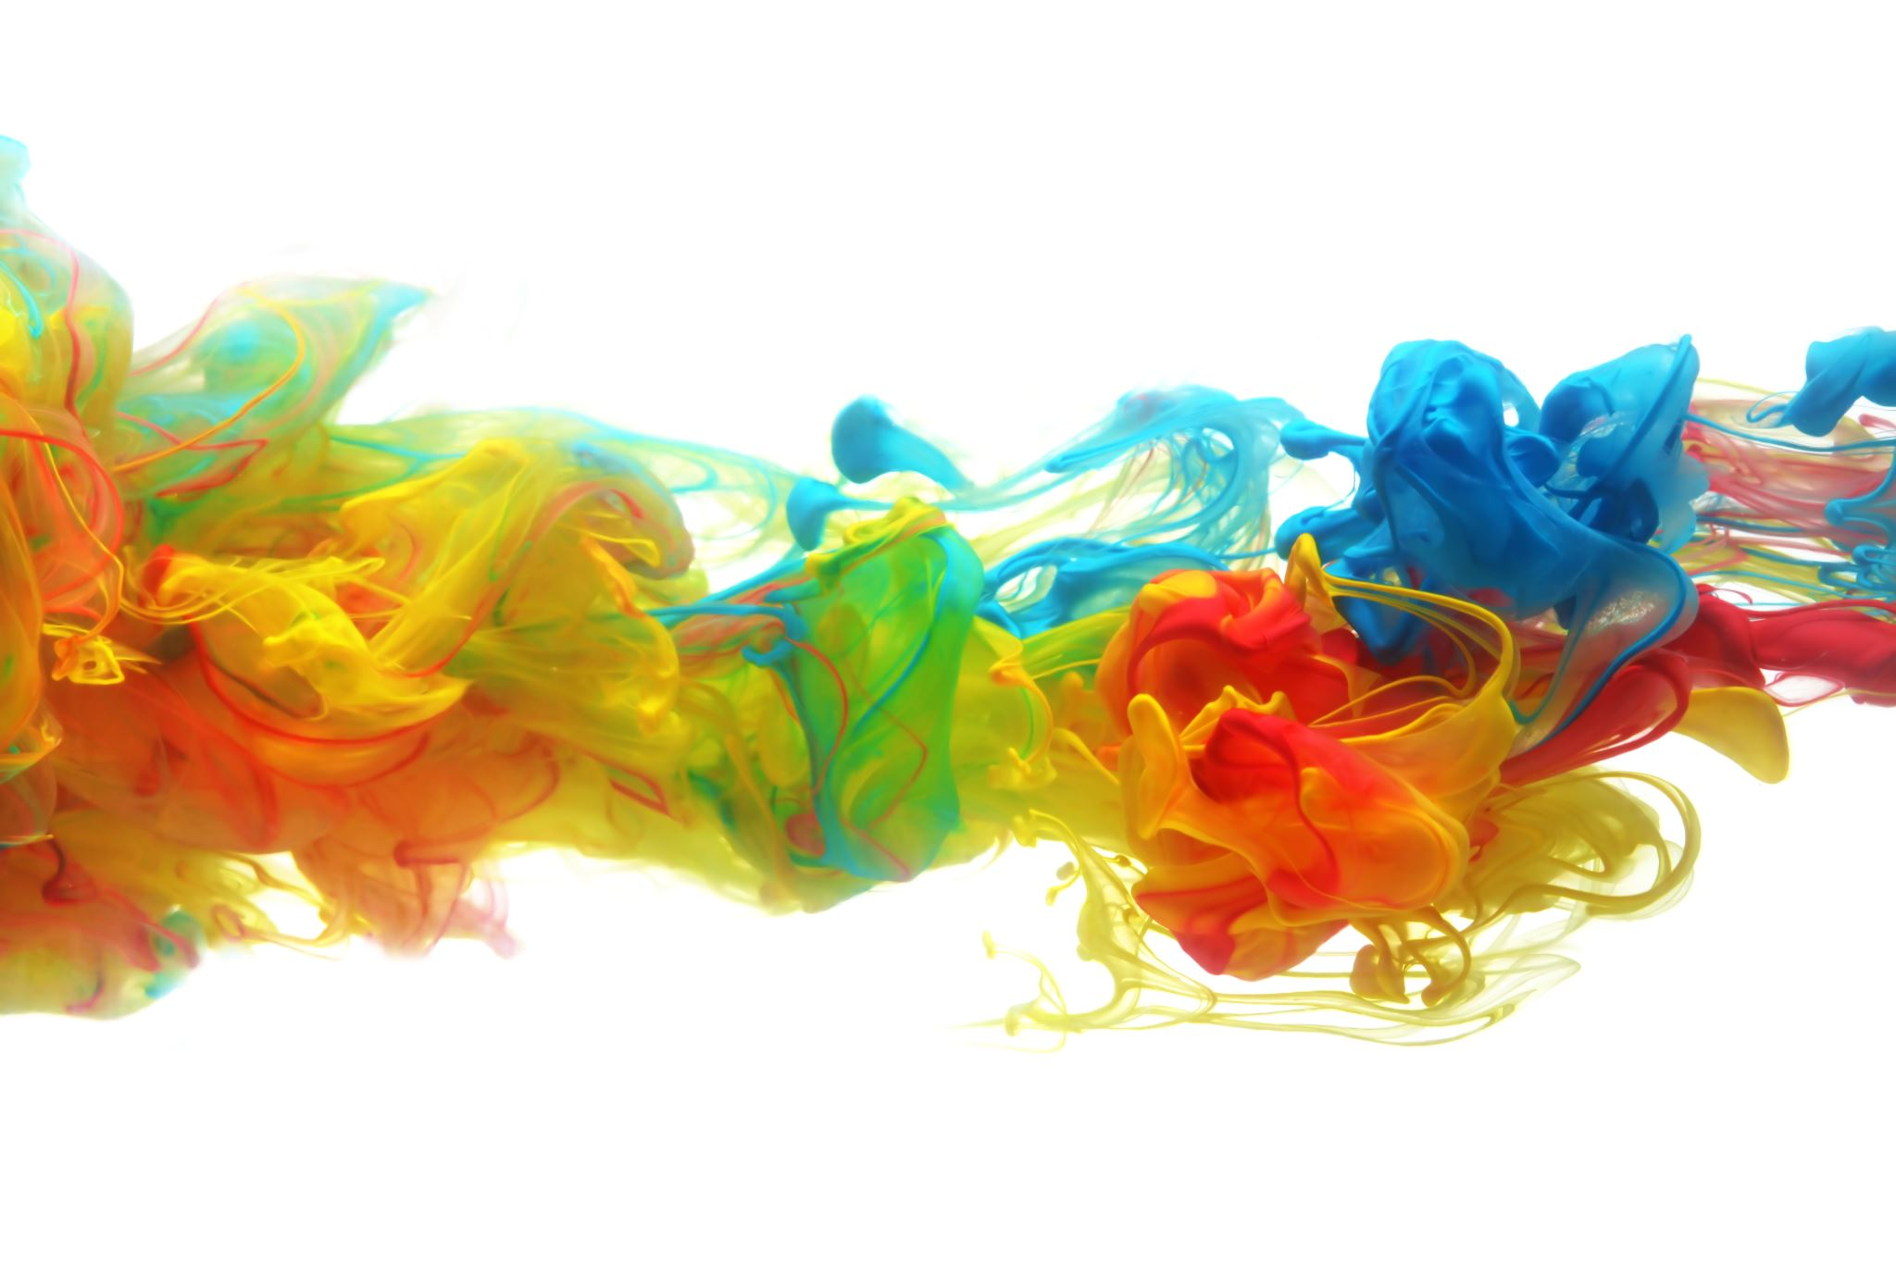

Generation of client puzzles and bitcoin for resolution of flooding(ddos) attack
Kaza Venkata sai madhav
Itc520-foundations of computer security
Research project

Slide 2


overview
Week 6- Generation of Client puzzles using CAPTCHA’s
Week 7- Website building using HTML and CSS
Week 8- Embedding Django for the website.
Week 9- Testing for Website built.

Slide 3
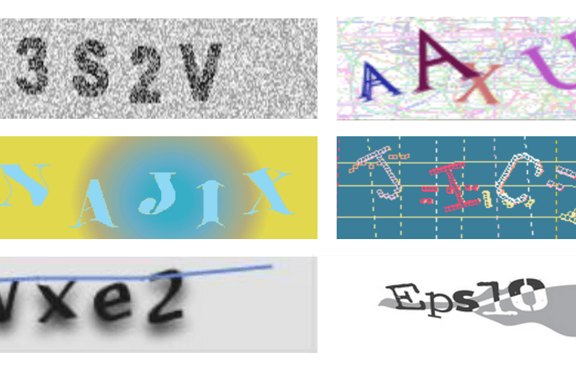
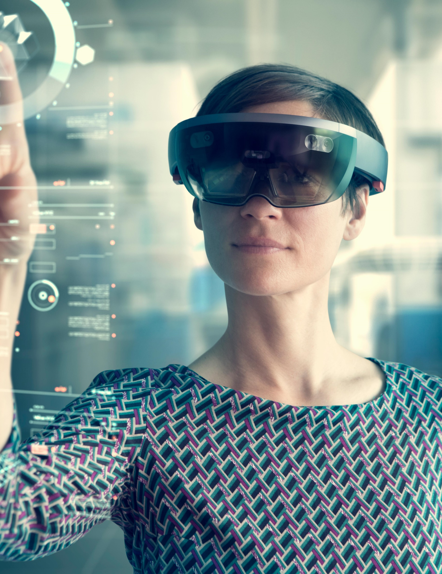
Week6-Generation of client puzzles

Slide 4
Week7&8- website building using html and css, and embedding Django for the website

Slide 5
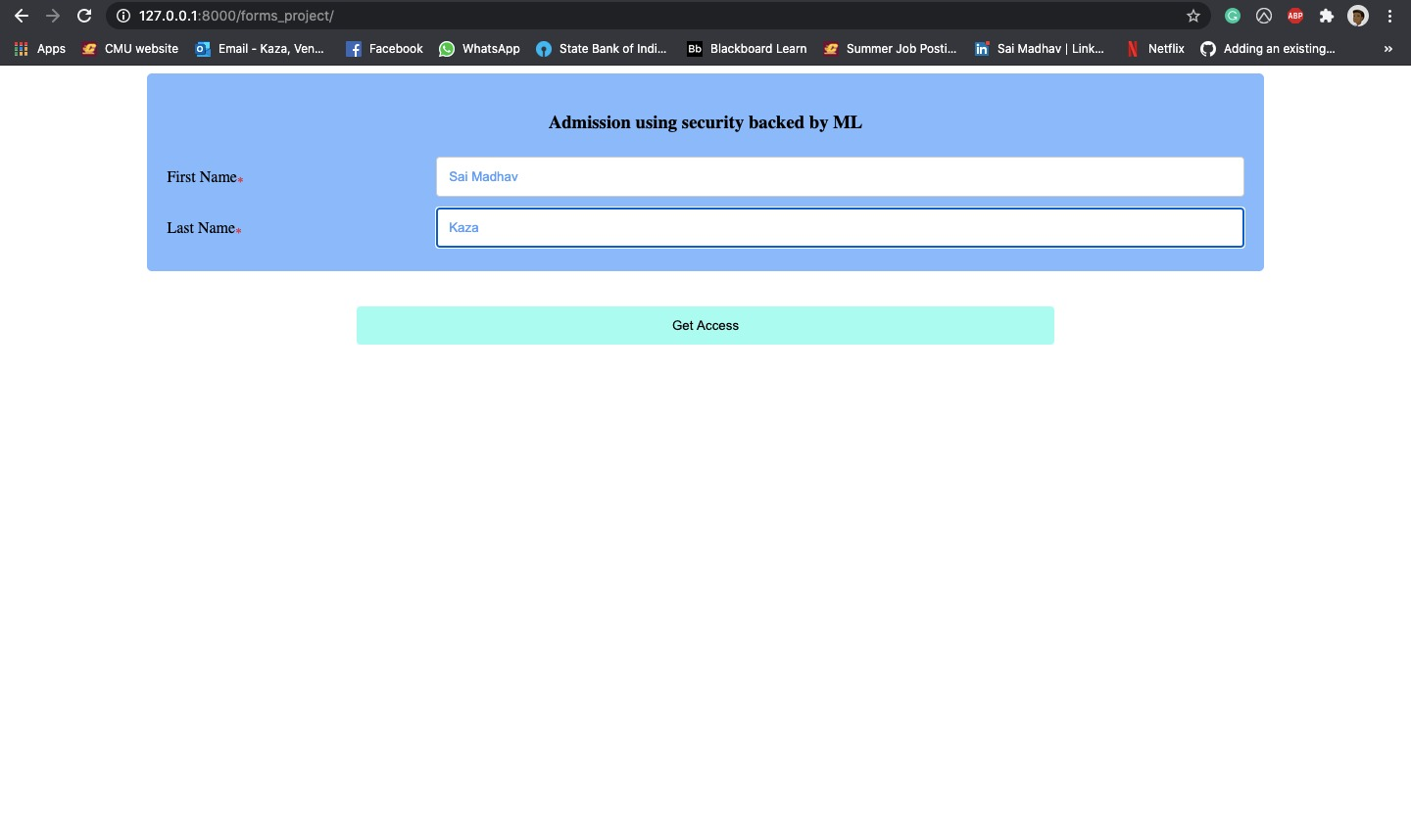
Initial page of the website

Slide 6
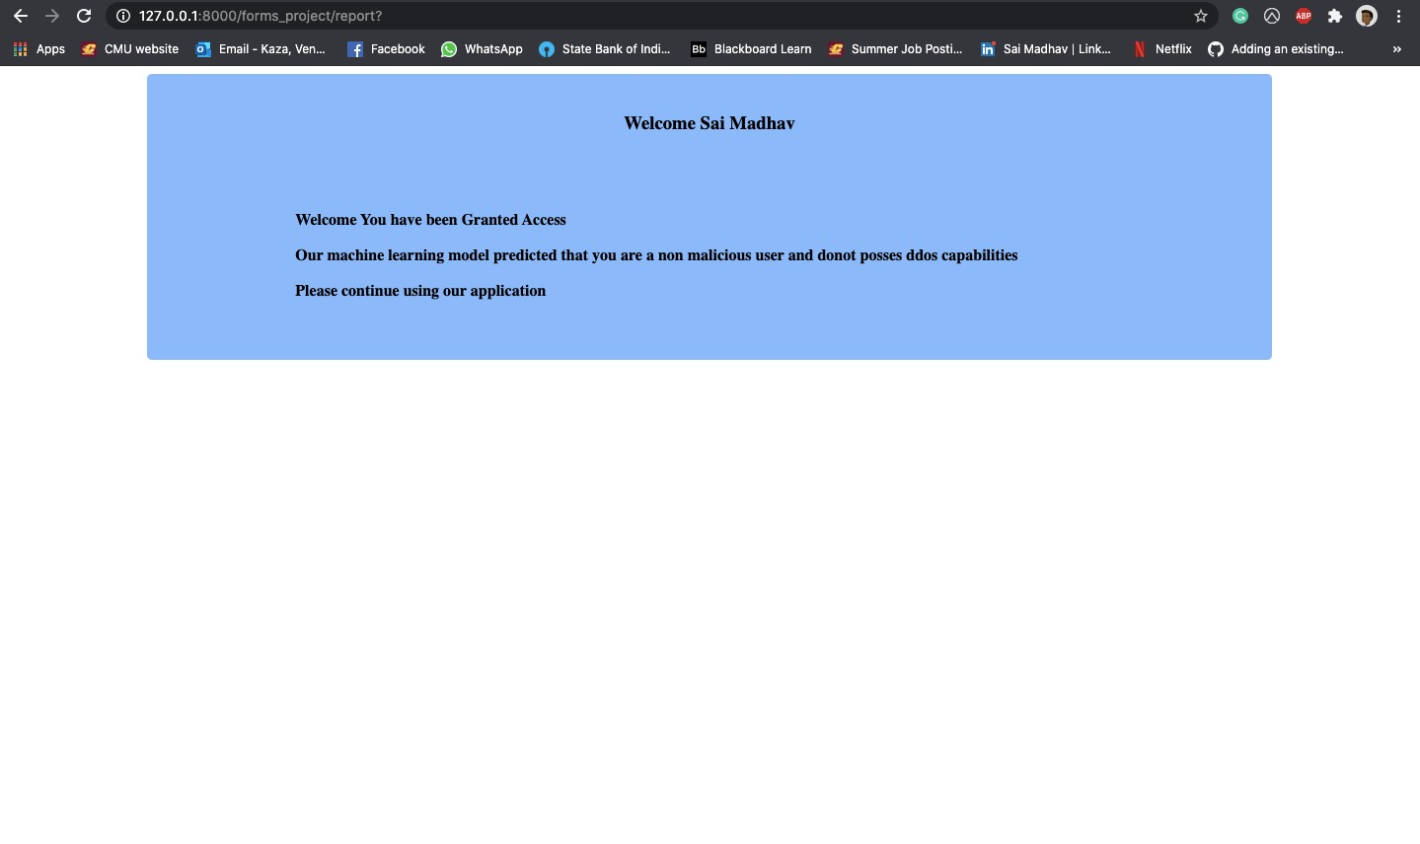
Final page of the website

Slide 7
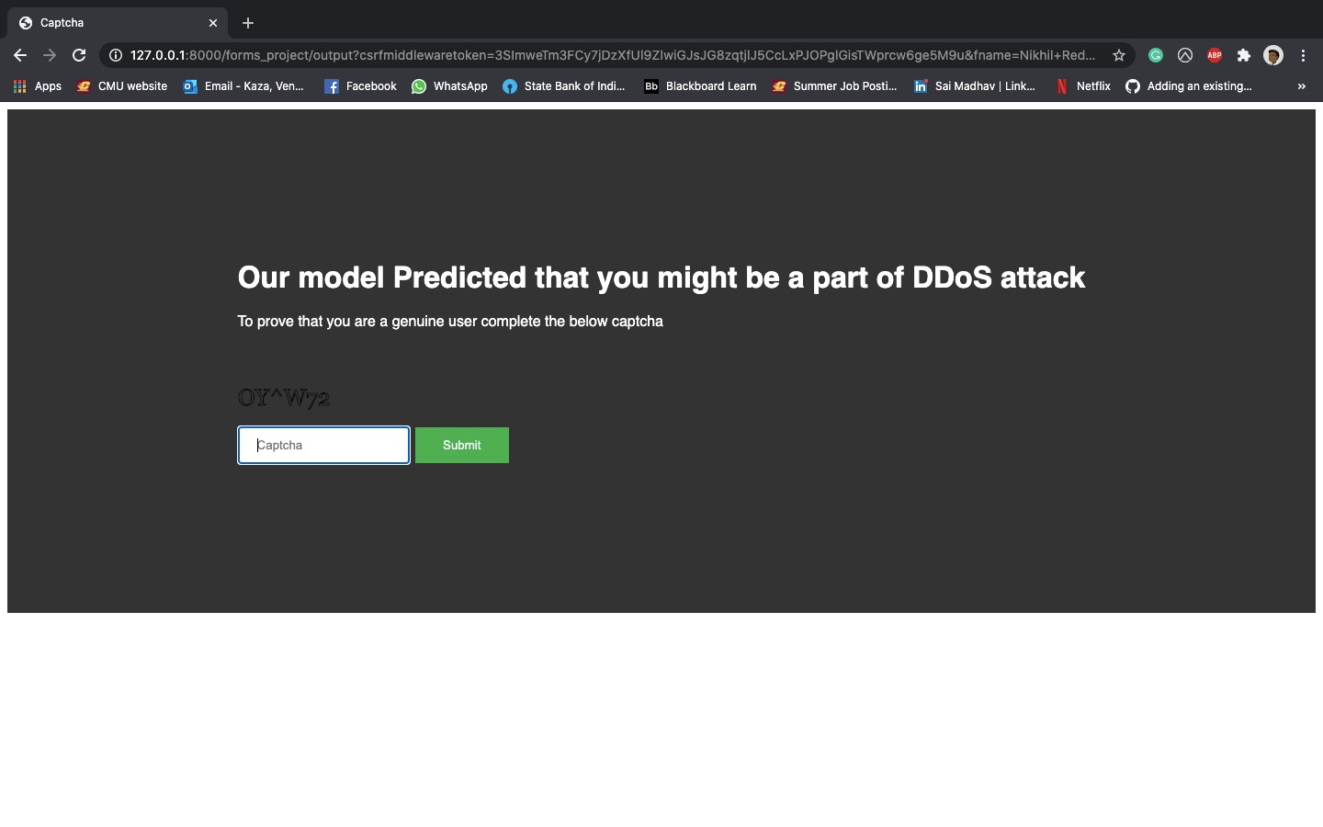
New captcha page of the website

Slide 8
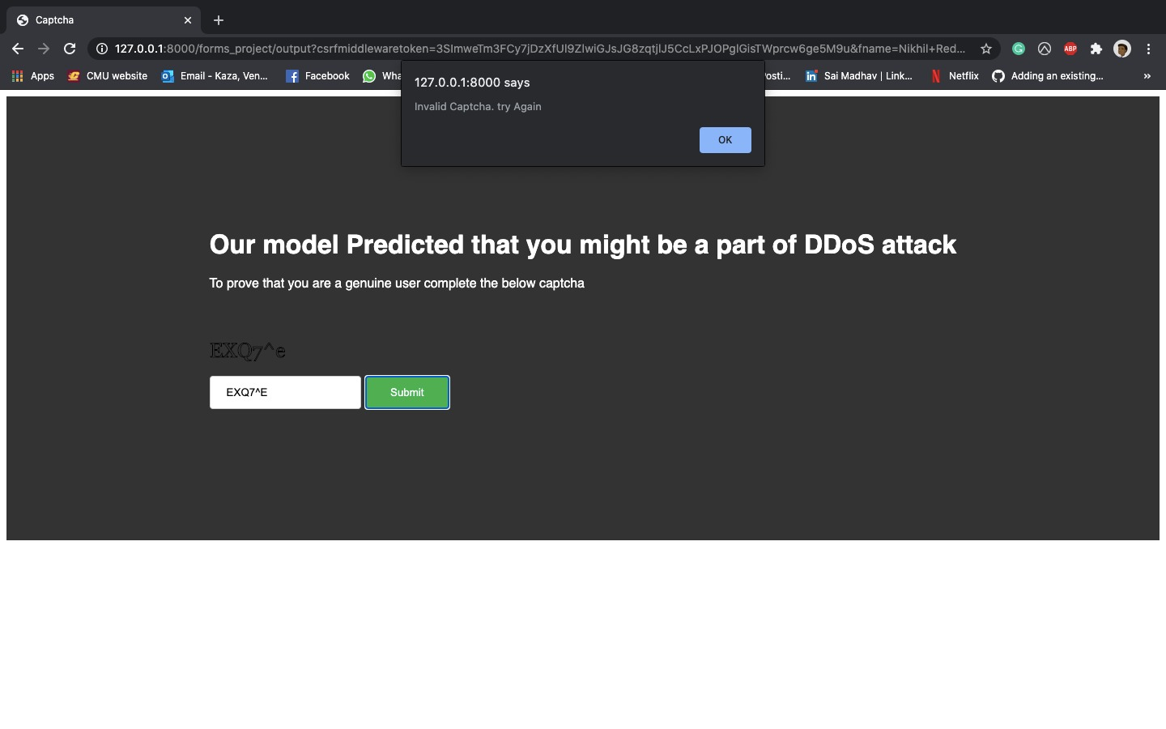
inValid captcha page of the website

Slide 9

Valid captcha page of the website

Slide 10
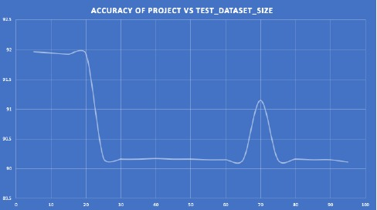
Week 9- testing for the website

Slide 11

Q&A

Slide 12
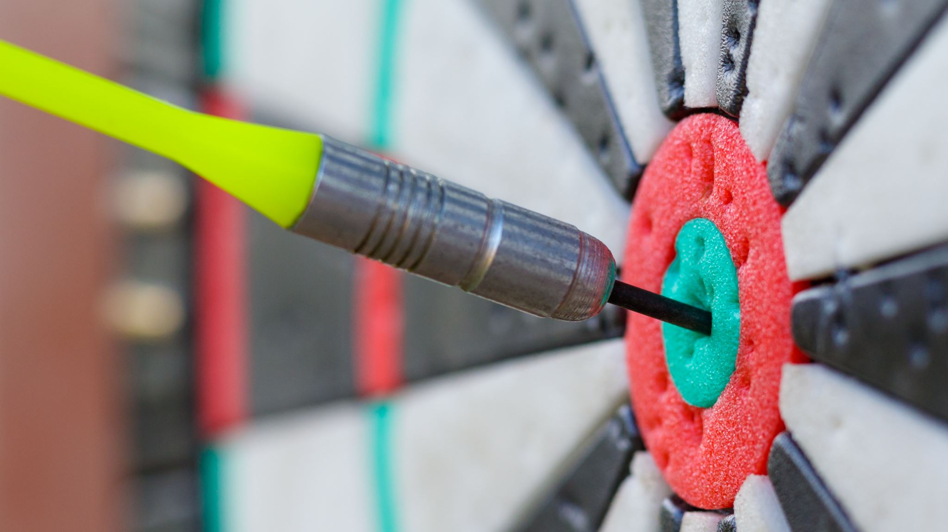
Thank you

