Slide 1


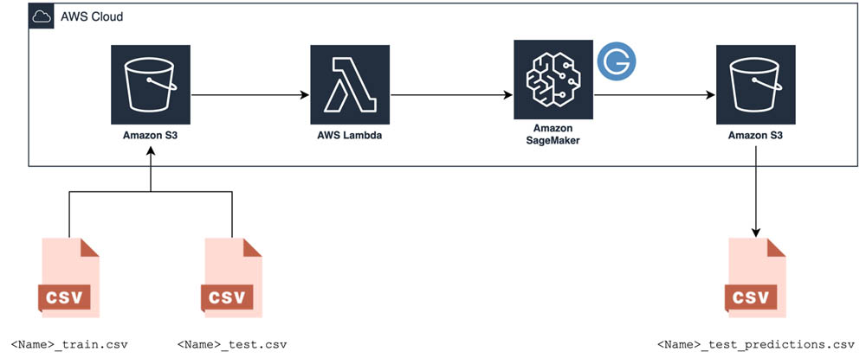
Credit Card Fraud Detection
Priyadarshini (balaj2p)
Vijaya (nanna1v)
Venkata Kaza (kaza2v)

Slide 2
Overview
Introduction
Methods
Results
Conclusion
Future Work

Slide 3


Introduction to Credit Card Fraud
“ Credit card fraud occurs when an unauthorized person gains access to genuine persons information and uses it to make purchases “
Popular Ways Credit Card Fraud can happen:
Lost or stolen credit cards
Calling about fake prizes or wire transfers
Skimming your credit card, such as at a gas station

Slide 4



Current ways to protect Credit Card Fraud
Choose a credit card with $0 liability on unauthorized charges
Monitor your credit accounts
Sign up for transaction alerts
Secure your information

Slide 5
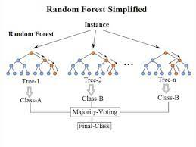
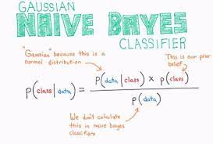
Project Outline
We have used two approaches to solve the credit card fraud detection problem in our project.
Naïve Bayes Approach
Random Forest Approach

Slide 6
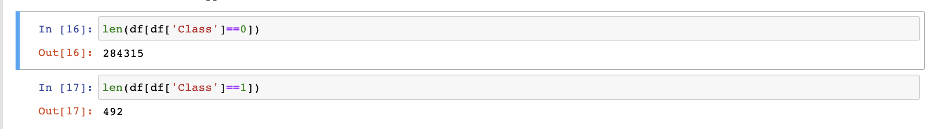
Dataset
Source: Kaggle Community
URL: https://www.kaggle.com/mlg-ulb/creditcardfraud
The datasets contains transactions made by credit cards in September 2013 by European cardholders.
Dataset has 492 frauds and 284315 normals

Slide 7
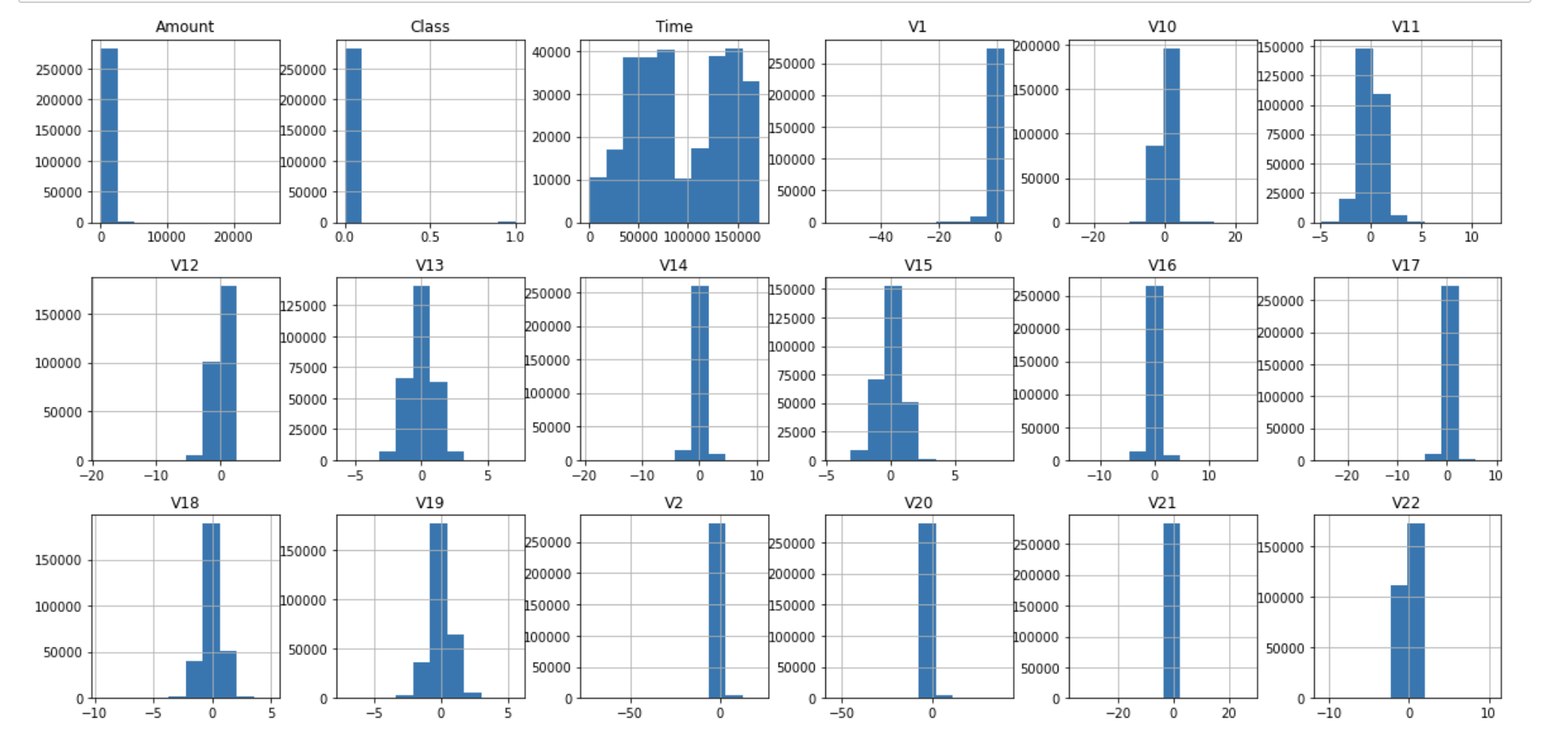
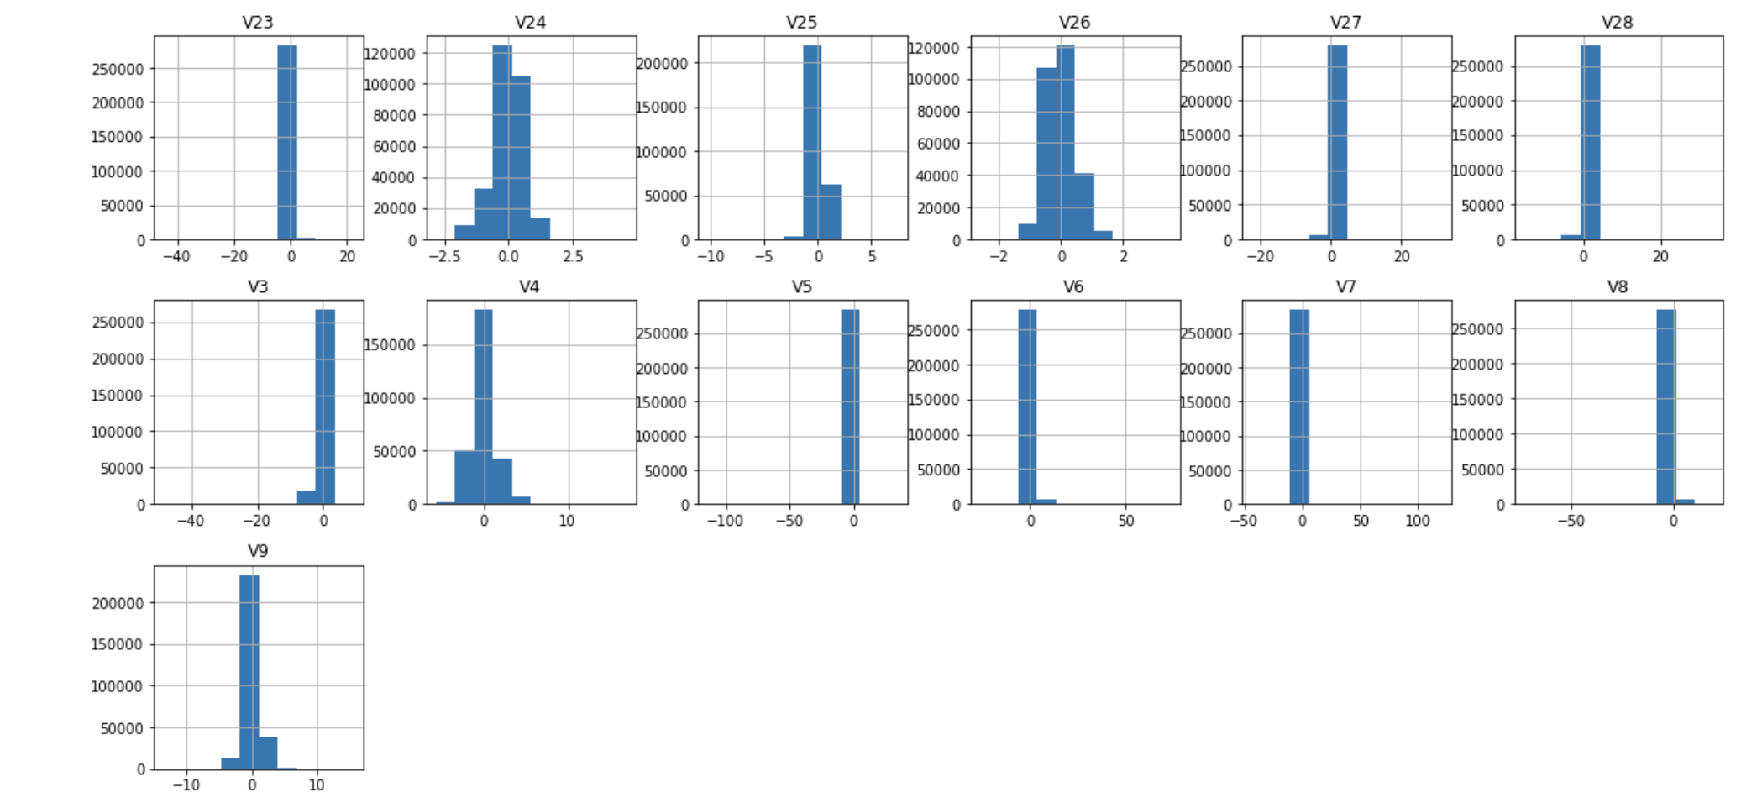
Dataset

Slide 8
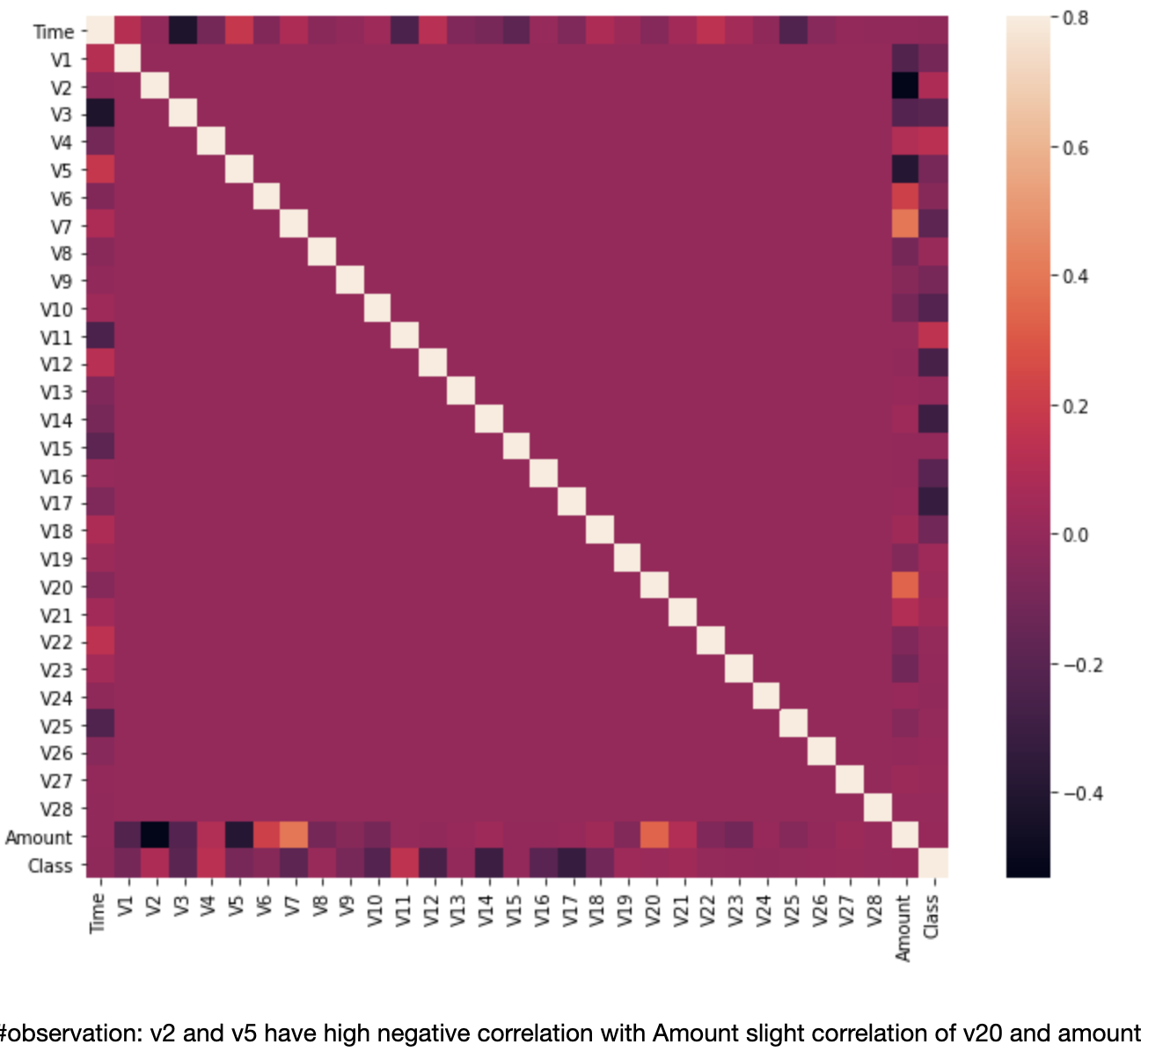
Dataset
99.83% transactions are genuine, and 0.17% transactions are fraud.
The dataset is imbalanced. So, there is requirement of balancing the dataset by taking 500 transactions randomly from the 284,315 transactions to make the overall processed dataset as 50-50 of fraud and genuine transactions for better performance of ML Algorithms.

Slide 9
Methods
Naïve Bayes Approach
Naive Bayes classifiers are a family of simple "probabilistic classifiers" based on applying Bayes' theorem with strong (naïve) independence assumptions between the features.
Naïve Bayes classifiers are highly scalable, requiring a number of parameters linear in the number of variables (features/predictors) in a learning problem.
Random Forest Approach
Random forests or random decision forests are an ensemble learning method for classification, regression and other tasks that operates by constructing a multitude of decision trees at training time and outputting the class that is the mode of the classes (classification) or mean/average prediction (regression) of the individual trees.
Random forests are frequently used as "black box" models in businesses, as they generate reasonable predictions across a wide range of data while requiring little configuration.

Slide 10
Results

Slide 11

Naïve Bayes Accuracy and ROC Curve

Slide 12
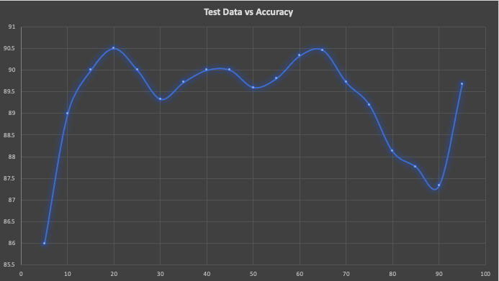
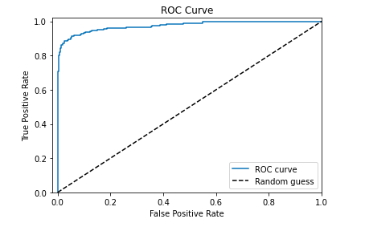
Accuracy and ROC Curve
According to the accuracy results on the variation of test split data, the highest accuracy is obtained at 65% test split data with the value of 90.46% and the lowest accuracy is obtained at 5% test split data with the value of 86%.
The ROC curve mentioned is for the test split data of 65% which also includes the accuracy results to be 90.46%.

Slide 13

Random Forest Results

Slide 14
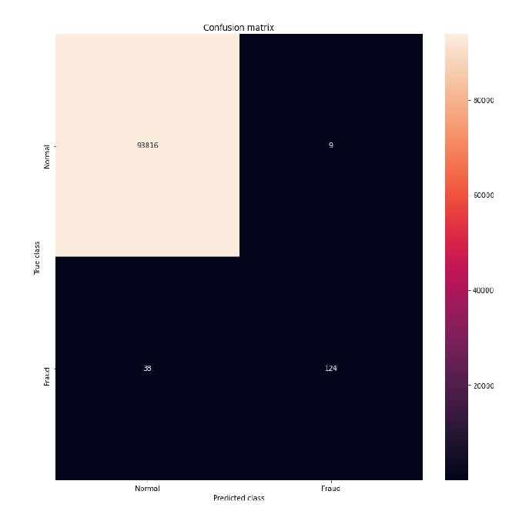
Confusion Matrix
The test split data is for 33% and the confusion matrix obtained is shown on the left.
Here, we can see that are total of 47 data points which are classified wrong from a total transactions of 93,987 (33% of 284,807 transactions).

Slide 15
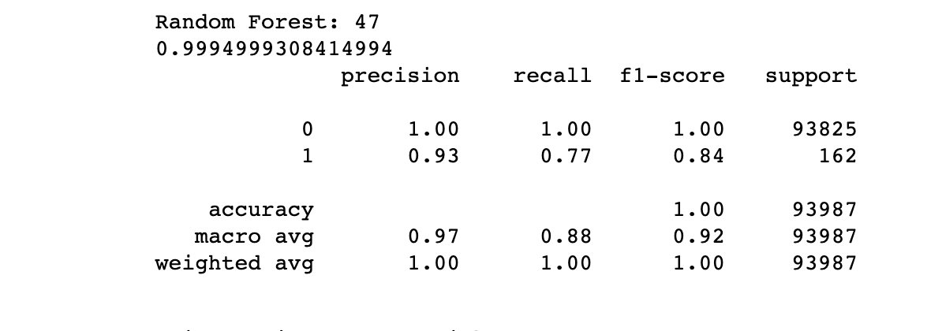
Accuracy for 33% test split data

Slide 16
Conclusion
Naïve bayes ML algo has given an accuracy of 90.46% for a test split data of 65% from the 1000 transactions having balanced dataset of fraud and genuine transactions.
Random forest ML algo has given an accuracy of 99% overall.

Slide 17
Future Work
The further opportunity might be regarding building up the application using the model tested and resulted in higher accuracy to give out the real-time analysis of credit card fraud.
The application built must address how credit card fraud detection will help banks to gain the publicity of the customers as more and more credit cards will be purchased.

Slide 18

Any Questions

Slide 19

Thank You

