Slide 1
Analytics Training
Analytics Training Institute

Slide 2
Table of Contents
Evolution of Outsourcing
Typical organization structure of a business KPO
Key ‘Soft Skills’ for succeeding in a business KPO
Hard skills for succeeding in a business KPO
Your growth over the next 5 years ( Career Path)
Flavor of your work in the analytics industry

Slide 3
Evolution of Outsourcing
Knowledge Based
2007 and beyond
Non Voice Based- Rules
DrivenEarly 2000
Voice Based Outsourcing – Rule’s Driven
Late 1990’s

Slide 4
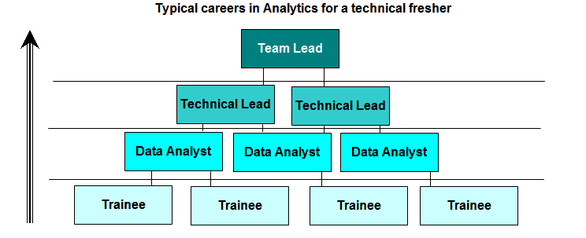
Typical organization structure of a KPO

Slide 5
Key Soft-skills for succeeding in a KPO
Orientation to client delight
Empathy with the client
Not getting disturbed by brutal clients
First listen then talk
Ability to write emails
Ability to make good presentation decks

Slide 6
Hard Skills and Growth over the 5 years
1. Knowledge of SAS
2. Ability to understand and prepare data as per requirements
3. Ability to manipulate large and complex data with SAS
4. Ability to apply knowledge gained by experience in structuring analysis
5. Conceptual knowledge of statistics
6. Ability to understand a business problem and converting to a statistical problem
7. Applying analytics to solve business problems

Slide 7
Growth over 5 years - Managerial - Statisticians
Track | Profile | Account/Role | Time | Designation | Skills
Managerial | Statistician | All | <0 months | Internship | Tie up with statistical/2nd Tier MBA colleges across the country for internship programs for quantitatively oriented students - Idnetify resources at lower costs
Managerial | Statistician | Individual Contributor | 0-12 Months | Jr. Statistical Analyst | Individual Contributor for Modeling Quality Control Orientation Gain expertise in SAS/ Applied Statistical Techniques
Managerial | Statistician | Team Lead | 12-18 Months | Team - Lead | Team Management Successfully delivering a set of 3-4 models simultaneously
Managerial | Statistician | Managerial | 18- 24 Months | Manager (equivalent to an MBA from a premier institute) | Successfully delivering a suite of 8-12 models Client Management and Communication If a resource has aspired to this track he should be enrolled for a executive MBA program with a bond so that by this (18-24) time he woould be having Management skills
Managerial | Statistician -Managerial | Small Account Managememt - Account TL | gt 24 Months | Account Manager | This could be equivalent to a TL position

Slide 8
Growth over 5 years - Managerial – Tools experts
Track | Profile | Account/ Role | Time | Designation | Skills
Managerial | Tools Experts | Individual Contributor | 0-12 Months | Tools Expert | Individual Contributor for Reporting /Automation Individual Contributor for modeling Gain expertise in SAS/ Standardised Dataset creation / automation techniques / IBM database expertise
Managerial | Tools Experts | Team Lead | 12-18 Months | Team - Lead | Independently leading a team for multiple reporting tasks Individually executing automation/reporting projects with 2-3 team members Test out execution of a a set of 2-3 models
Managerial | Tools Experts | Managerial | 18-24 Months | Manager (equivalent to an MBA from a premier institute) | Client Management and Communication If a resource has aspired to this track he should be enrolled for a executive MBA program with a bond so that by this (18-24) time he woould be having Management skills
Managerial | Tools Experts Managerial | Small Account Managememt Account TL | gt 24 Months | Account Manager | Succesfully managing a client relationship with a team whether it is modeling , reporting or automation This could be equivalent to an IBM TL position like the 5 TL's

Slide 9
Growth over 5 years -Technical – Statistician
Track | Profile | Account/Role | Time | Designation | Skills
Technical | Statistician | All | <0 months | Internship | Tie up with statistical/2nd Tier MBA colleges across the country for internship programs for quantitatively oriented students - Idnetify resources at lower costs
Technical | Statistician - Learning Phase | Individual Contributor | 0-12 Months | Jr. Statistical Analyst | Individual Contributor for Modeling Quality Control Orientation Gain expertise in SAS/ Applied Statistical Techniques
Technical | Statistician - Expertise Buildup | Project Accounts | 12- 24 Months | Statistical Analyst | Exposure to projects in segmentation , SEM / other techniques across accounts and domains
Technical | Statistician - Expertise Deployment | TL - accounts | 24 - 36 Months | Lead - Statistical Solutions | Set up processes/ provide statistical solutions to new projects / accounts
Technical | Statistician - Evangalist | TL - Multiple accounts | gt 36 months | Statistical Evangalist | Take on lead training role/ lead role in multiple accounts

Slide 10
Growth over 5 years - Technical – Tools experts
Track | Profile | Account/Role | Time | Designation | Skills
Technical | Tools Experts - Learning Phase | Individual Contributor | 0-12 Months | Tools Expert | Individual Contributor for Reporting /Automation Individual Contributor for modeling Gain expertise in SAS/ Standardised Dataset creation / automation techniques / IBM database expertise
Technical | Tools Experts - Expertise buildup | Project Accounts | 12- 24 Months | Data and Reporting Strategist | Independently provide optimal solutions across multiple platforms / databases to clients reporting needs
Technical | Tools Experts - Expertise Deployment | TL - accounts | 24-36 Months | Lead - Analytics Support | Independently provide optimal solutions across multiple platforms / databases across multiple clients in an account or across 2-3 accounts
Technical | Tools Experts -Evangalist | TL - Multiple accounts | gt 36 months | Analytics Tools and Technologies Evangalist | Take on lead training role/ lead role of dveloping solutions / best practices across multiple accounts

Slide 11
Analytics - Using data to make accurate business decisions
Flavor of work in analytics
Informational
Predictive
Which region, dealer and product has the highest sales.
In the credit cards business which segment of customers is the most profitable
Who is the most successful sales person in the organization
Which competitor is gaining in market share
How is the profitability of my bank going to get impacted if more younger profile of people are targeted
What will be the increase in sales for Liril if a ‘fairness’ feature is added to the campaign
How many mailers need to be sent for a new life insurance product to get 1000 new insurance applications
What are the factors which need to be focused on to maximize sales of credit cards.

Slide 12
Answering these questions requires
Sales
CRM/SFA
Finance
GL
Production
Inventory/SCM
Marketing
MR/CRM
Human Resources
Payroll /performance
Customer Service
CRM
Tool to integrate and merge large databases
Power to run basic and advanced mathematical / statistical functions
Functionality to automatically create customized / standard decision making reports / dashboards
SAS has the functionality to do all the above and more

Slide 13
Course Contents
Week | Course | Application
1 | Basics of Statistics and Descriptive Statistics | Applications of statistics and basic knowledge of your customers ( ex: what is the average spends on jewelry in North India vs South India )
1 | Probability and Distribution | Understanding Samples of your customers
2 | Hypothesis Testing, Correlation and Regression | Making conclusions of the overall population based on sample data Understanding some key relationships within the data
3 | OLS regression – Introduction to Data modeling | Based on previous years spends of customers on credit cards , predicting the spends of each customers for the next 5 years

Slide 14
Course Contents (continued…)
Week | Course | Application
4 | Logistic regression – Advanced Data modeling | Ranking customers in order of propensity to purchase for the next year based on pervious years data
5 | Discriminant, Factor and Cluster | Developing segments in the customer based ( Rich, Middle class , Poor )
6 | Predictive modeling – Challenges and Tests and Evaluation | Challenges in executing real life projects in analytics

Slide 15
UNIT I
Statistics – Basics

Slide 16
Table of Contents
What is Statistics ?
Data
  Data Sets
  Data and Variables
  Types of data
Scale of Measurements
  Nominal Scale
  Ordinal Scale
  Interval Scale
  Ratio Scale
Descriptive Statistics
  Tabular and Graphical Methods
  Summarization Methods
    Qualitative
    Quantitative

Slide 17
Statistics - Definition
Statistics is a Mathematical Science pertaining to the
    Collection
    Classification
    Analysis
    Interpretation or explanation
    Presentation of data

Slide 18
Data and Variables
Data are pieces of information
Data are made up of the objects that have been measured (eg people, trees, rats) and attributes that were recorded (age, size, ph, cost, weight, etc)
  objects are subjects, cases, entities, etc
  Observations are details about the object
  attributes are characteristics, variables, factors, etc

Slide 19
Data and Variables
When we measure the attributes of an object, we obtain a value that varies between objects.
  consider the people in this class as objects and their height as the attribute.
The attribute varies between objects, hence attributes are more collectively known as variables
  Variables are the things we measure, control or manipulate in research
  Variables differ in “how well” they can be measured. Amount of information that can be provided by a variable is determined by it’s type of measurement scale.

Slide 20
Types of Data
Variables can be measured on four different scales
It is essential that we know the four different scales of measurement and examples of each
    Nominal scale of Measurement
    Ordinal scale of Measurement
    Interval scale of Measurement
    Ratio scale of Measurement

Slide 21
Nominal scale of Measurement
Data are measured at the nominal level when each case is classified into one of a number of discrete categories
  Eg: Colour, Political party, Gender, Jersey number etc

Slide 22
Ordinal scale of Measurement
Data are measured on an ordinal scale if the categories imply order
Eg: Military rank, Clothing size, etc
The difference between ranks is consistent in direction, but not magnitude

Slide 23
Interval scale of Measurement
If the differences between values have meanings, the data are measured at the Interval scale
Temperature and IQ rating are examples

Slide 24
Ratio scale of Measurement – with example
Data measured on a ratio scale have differences that are meaningful, and relate to some true zero point
Eg. Weight, Height, Age, etc
This is the most common scale of measurement

Slide 25
Comparison of the different scales of Measurement
Scales of measurement
 | Nominal | Ordinal | Interval | Ratio
Properties | Identity | Identity Magnitude | Identity Magnitude Equal interval | Identity Magnitude Equal interval True zero
Mathematical operations | Count | Rank Order | Addition Subtraction | Addition Subtraction Multiplication Division
Descriptive statistics | Mode | Mode Median Range Statistics | Mode Median Mean Range statistics Variance Standard deviation | Mode Median Mean Range statistics Variance Standard deviation

Slide 26
Descriptive Statistics:
Tabular and Graphical Methods

Slide 27
Summarizing Data
Qualitative
  Frequency Distribution
  Relative Frequency and Percent Frequency Distribution
  Bar Graph
  Pie Chart
Quantitative:
  Frequency Distribution
  Relative Frequency and Percent Frequency Distributions
  Dot Plot
  Histogram
  Cumulative Distributions
  Ogive

Slide 28
Frequency Distribution
A frequency distribution is a tabular summary of data showing the frequency (or number) of items in each of several nonoverlapping classes.
The objective is to provide insights about the data that cannot be quickly obtained by looking only at the original data.
Notes:
Page 14 – marked in red – this is examples

Slide 29
Relative Frequency Distribution
The relative frequency of a class is the fraction or proportion of the total number of data items belonging to the class.
A relative frequency distribution is a tabular summary of a set of data showing the relative frequency for each class.
The percent frequency of a class is the relative frequency multiplied by 100.
A percent frequency distribution is a tabular summary of a set of data showing the percent frequency for each class.
Notes:
Page 16 – marked in red / Pick up 2 more examples from levin and rubin – page 14 ( freq distribution )and page 16 ( relative frequency distribution)

Slide 30
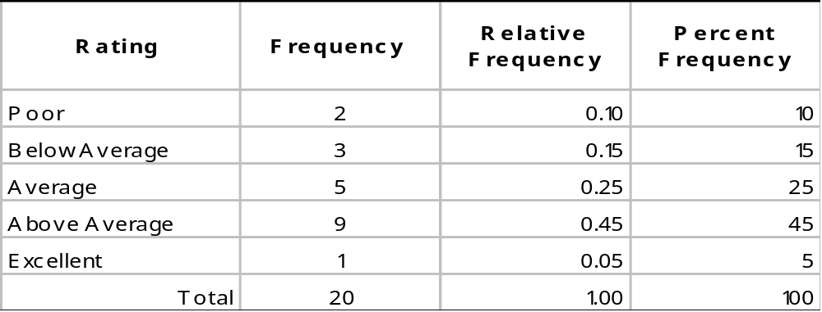
Relative Frequency Distribution - Example

Slide 31
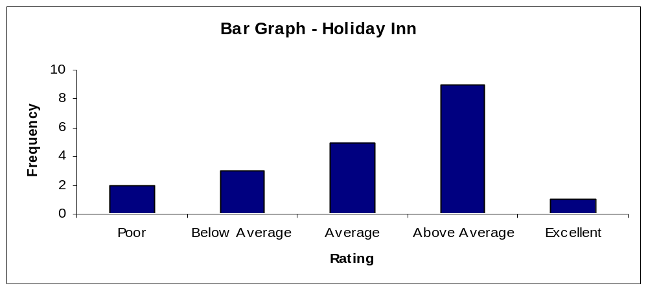
Bar Graph
A bar graph is a graphical device for depicting qualitative data.
On the horizontal axis we specify the labels that are used for each of the classes.
A frequency, relative frequency, or percent frequency scale can be used for the vertical axis.
Notes:
Use credit card example to create 3 examples of bar graph – use repayment data

Slide 32
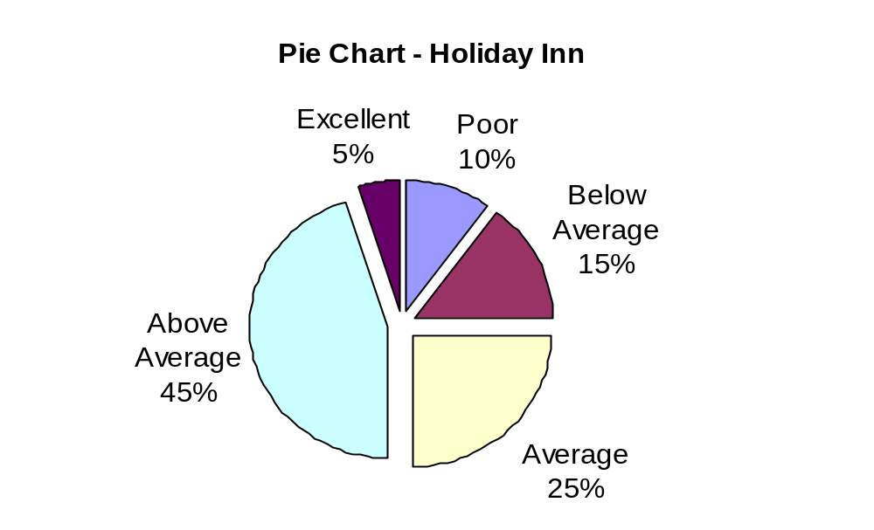
Pie Chart
The pie chart is a commonly used graphical device for presenting relative frequency distributions for qualitative data. Example -
Notes:
Use repayment data to create pie chart for share of category spent – also use – use levin and rubin – page 17-20 to create three more example – make sure that all foreign names are converted to indian names

Slide 33
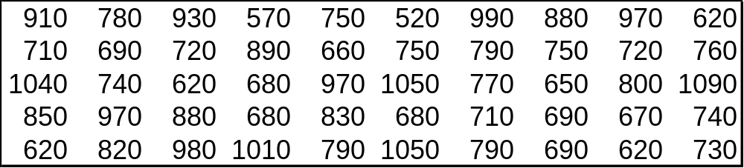
Quantitative data representation: example
The manager of Bimal Auto Repair would like to get a better picture of the distribution of costs for engine tune-up parts. A sample of 50 customer invoices has been taken and the costs of parts, rounded to the nearest ten Rupees, are listed below.

Slide 34

Frequency Distribution
Guidelines for Selecting Number of Classes
  Use between 5 and 10 classes.
  Data sets with a larger number of elements usually require a larger number of classes.
  Smaller data sets usually require fewer classes.
Guidelines for Selecting Width of Classes
  Use classes of equal width.
  Approximate Class Width
Notes:
Page 22 is the sample example – pg 26 and 28 for 2 more examples

Slide 35
Frequency Distribution- Example: Bimal Auto Repair
If we choose six classes:
  Approximate Class Width = (1090 - 520)/6 = 95 ≈ 100
Cost (Rupees) | Frequency | Relative frequency | Percent frequency
500-590 | 2 | .04 | 4
600-690 | 13 | .26 | 26
700-790 | 16 | .32 | 32
800-890 | 7 | .14 | 14
900-990 | 7 | .14 | 14
1000-1090 | 5 | .10 | 10
Total | 50 | 1.00 | 100

Slide 36
Frequency Distribution- Example: Bimal Auto Repair
Insights gained from the Percent Frequency Distribution
    Only 4% of the parts costs are in the Rs.500-590 class.
    30% of the parts costs are under Rs.700.
    The greatest percentage (32% or almost one-third) of the parts costs are in the Rs.700-790 class.
    10% of the parts costs are Rs.1000 or more.

Slide 37
Dot Plot - with Example
    One of the simplest graphical summaries of data is a dot plot.
    A horizontal axis shows the range of data values.
    Then each data value is represented by a dot placed above the axis.
.
. .. . . .
. .. .. .. .. . .
. . . ..... .......... .. . .. . . ... . .. .
500 600 700 800 900 1000 1100
Cost (Rs)

Slide 38
Histogram
Another common graphical presentation of quantitative data is a histogram.
The variable of interest is placed on the horizontal axis.
A rectangle is drawn above each class interval with its height corresponding to the interval’s frequency, relative frequency, or percent frequency.
Unlike a bar graph, a histogram has no natural separation between rectangles of adjacent classes.

Slide 39
Histogram – example
18
16
14
12
Frequency
10
8
6
4
2
Parts
Cost (Rs)
500 600 700 800 900 1000 1100

Slide 40
Cumulative Distributions
Cumulative frequency distribution -- shows the number of items with values less than or equal to the upper limit of each class.
Cumulative relative frequency distribution -- shows the proportion of items with values less than or equal to the upper limit of each class.
Cumulative percent frequency distribution -- shows the percentage of items with values less than or equal to the upper limit of each class.

Slide 41
Cumulative Distributions - example
Cost (Rupees) | Cum. frequency | Cum. Relative frequency
<=590 | 2 | .04
<=690 | 15 | .30
<=790 | 31 | .62
<=890 | 38 | .76
<=990 | 45 | .90
<=1090 | 50 | 1.00

Slide 42
Ogive
An ogive is a graph of a cumulative distribution.
The data values are shown on the horizontal axis.
Shown on the vertical axis are the:
  cumulative frequencies, or
  cumulative relative frequencies, or
  cumulative percent frequencies
The frequency (one of the above) of each class is plotted as a point.
The plotted points are connected by straight lines.
  Because the class limits for the parts-cost data are 500-590, 600-690, and so on, there appear to be one-unit gaps from 590 to 600, 690 to 700, and so on.
  These gaps are eliminated by plotting points halfway between the class limits.
  Thus, 595 is used for the 500-590 class, 695 is used for the 600-690 class, and so on.

Slide 43
Ogive Example: Bimal Auto Repair
Ogive with Cumulative Percent Frequencies
100
80
60
Cumulative Percent Frequency
40
20
500 600 700 800 900 1000 1100
Parts Cost (Rs)

Slide 44
Cross tabulation
Crosstabulation is a tabular method for summarizing the data for two variables simultaneously.
Crosstabulation can be used when:
  One variable is qualitative and the other is quantitative
  Both variables are qualitative
  Both variables are quantitative
The left and top margin labels define the classes for the two variables.
Notes:
Use credit banking to create 3 relevant examples of cross tab – pivot tablesfrom credit card acquisition data – all these need to be done in SAS using proc freq

Slide 45
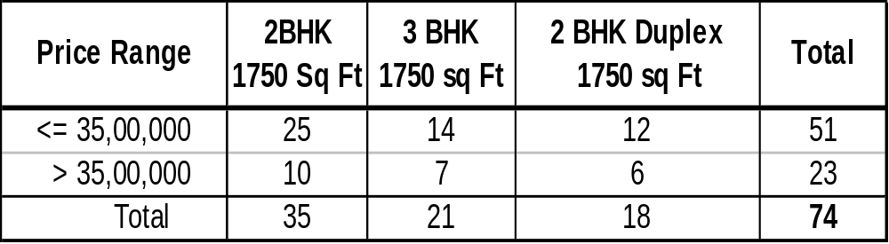
Cross Tabulations - Example: Sobha Homes
The number of Sobha homes sold for each style and price for the past two years is shown below.
Insights:
  Houses less than 35,00,000 rupees are sold about 100% more than the ones above 35,00,000.
  Only 6 sold houses were duplex.

Slide 46
Scatter Diagram
A scatter diagram is a graphical presentation of the relationship between two quantitative variables.
One variable is shown on the horizontal axis and the other variable is shown on the vertical axis.
The general pattern of the plotted points suggests the overall relationship between the variables.
y
y
x
x

Slide 47
Summary: Tabular and Graphical Procedures
Data
Qualitative Data
Quantitative Data
Tabular
Methods
Graphical
Methods
Tabular
Methods
Graphical
Methods
Bar Graph
Pie Chart
Dot Plot
Histogram
Ogive
Scatter Diagram
Frequency Distribution
Relative Freq. Distribution
% Freq. Distribution
Crosstabulation
Frequency Distribution
Relative Freq. Distribution
Cumulative Freq. Distribution
Cumulative Relative Freq. Distribution
Crosstabulation

Slide 48
Descriptive Statistics
So far we constructed Tables and Graphs using raw data.
Resulting frequency distributions illustrated trends and patterns.
For more exact measurements we define and study the following terms and definitions in describing data
Summary Statistics
    Central tendency
    Dispersion
    Skewness
    Kurtosis

Slide 49
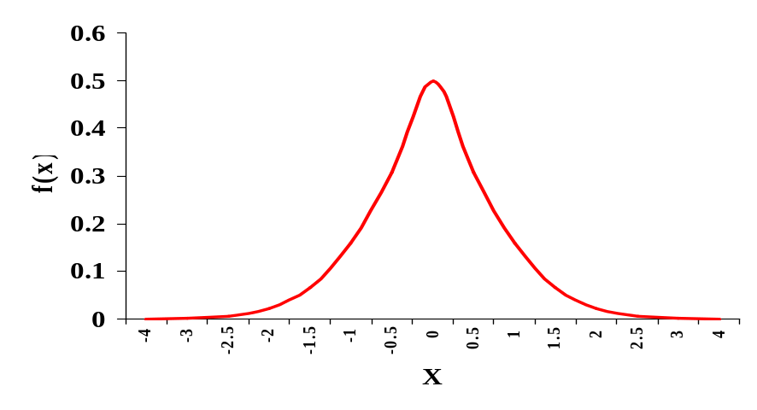
Descriptive statistics – Central Tendency
Central Tendency:
  Central Tendency is the middle point of distribution
  Measures of Central Tendency are also called Measures of Location
Dispersion:
  Dispersion is the spread of the data in a distribution
  That is the extent to which the observations are scattered

Slide 50
Descriptive Statistics – Dispersion Continued ….
Dispersion – Why it is Important?
  It gives additional information that enables to judge the reliability of the measure of central tendency
  If data are widely spread the central location is less representative of data as a whole than it would be for data more closely centered around mean
  Since problems are peculiar to widely dispersed data, dispersion enables to identify and tackle problems accordingly
  This enables to compare dispersions of various samples
  For eg. If a wide spread of values are away from center, this may be undesirable or presents a risk, one may avoid choosing that distribution

Slide 51
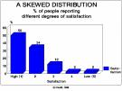



Descriptive Statistics – Skewness
Skewness:
  Curves representing data set either symmetrical (around the central point) or skewed towards one side
  Values in the frequency distribution may be concentrated ether on low end or on high end of the scale on horizontal axis
  The values are not distributed equally on both sides
Positively Skewed
Negatively Skewed

Slide 52
Descriptive Statistics – Skewness
Skewed to right called positively skewed and to left called negatively skewed.
Is an asymmetrical frequency distribution in which the values are concentrated on one side of the central tendency and trail out on the other side.
If the trail is to the right or positive end of the scale, the distribution is said to be positively skewed. If the distribution trails off to the left or negative side of the scale, it is said to be negatively skewed.

Slide 53

Descriptive Statistics – Kurtosis
Kurtosis
  Kurtosis of a frequency distribution is a measure of its peakedness
  For example curve A and curve B differ only in that one is more peaked than the other.
  Both have same central location and dispersion and both are symmetrical.
  They are set to have different degrees of kurtosis.

Slide 54
SAS code – Descriptive Statistics
Proc freq – Frequency
Percent
Cumulative Frequency
Cumulative Percent
Syntax:
Proc Freq data = <Dataset-name>;
tables <variable name>;
run;
Note: To create a Cross-tab use
tables <variable name> * <variable name>;

Slide 55
SAS code – Descriptive Statistics
Proc means - Number of observations
Mean
Standard Deviation
Minimum / Maximum
Syntax:
Proc means data = <Dataset-name>;
var <variable name>;
run;
Note : For Median, Skewness, Kurtosis etc., mention them as a option.
By default

Slide 56
SAS code – Descriptive Statistics
Proc univariate – Measures Of Central Tendency
Measures Of Dispertion
Skewness
Kurtosis
Highest / Lowest Observations
Syntax:
Proc Univariate data = <Dataset-name>;
var <variable name>;
run;

Slide 57
SAS code – Descriptive Statistics
Proc Summary – Number of observations
Mean
Standard Deviation
Minimum / Maximum
Syntax:
Proc Summary data = <Dataset-name> print;
var <variable name>;
run;
Note : For Median, Skewness, Kurtosis etc., mention them as a option.
By default

Slide 58
Probability And Probability Distribution

Slide 59
Probability Distributions
In this topic, we extend the principles of probability to selecting data consisting of one or more observations on some variable
For example, we may survey a large number of consumers (say 1000) and ask for their preference of brand of computer. We then record the number (x) who prefer a particular brand. Since we don’t know the number we will record for x before the experiment, it is called a random variable

Slide 60
Random Variables
A random variable is a variable that assumes numerical values associated with an experiment
It’s value cannot be predicted before the experiment
Random variables are usually assigned the capital letters X, Y or Z
Random variables can be either discrete or continuous

Slide 61
Discrete Random Variables
A discrete random variable is one that can assume only a countable number of values
Example –
A multiple choice exam of 20 questions. The random variable X is the number of correct answers.
Possible values for X are 0, 1, 2, 3, 4, 5, ……. 20.
In general, with Discrete Random Variables, we are concerned with counting something

Slide 62
Continuous Random Variables
A Continuous Random Variable can assume any value in one or more intervals on a line
With a Continuous Random Variable, we are generally concerned with measuring something
Example
  The time spent studying for a course per week could be the measurement variable X.
  It could be measured in days, hours, minutes, seconds, etc… (say 600 minutes/week, or 591 minutes/week, or 590 minutes and 45 seconds, and so on)

Slide 63
Discrete probability distributions
Once we know all the possible values and the probabilities associated with those values for a Discrete Random Variable, we can construct a Discrete Probability Distribution
A Discrete Probability Distribution describes how the probabilities are distributed over the various values that the discrete random variable can take

Slide 64
Discrete probability distributions (Cont.)
The probability distribution for the discrete random variable X, is a table, graph or formula that gives the probability of observing each value of x
We denote the probability of each x by the symbol p(x)
2 important rules for probability distributions;
0 ≤ p(x) ≤ 1 for all values of x
Σp(x) = 1

Slide 65
Discrete probability distributions (Cont.)
Example: Toss two coins…….Let X be defined as the number of heads occurring in the two tosses
Simple Events # of heads
TT 0
TH 1
HT 1
HH 2
T
P(TT)=0.25
T
H
P(TH)=0.25
H
T
P(HT)=0.25
P(HH)=0.25
H

Slide 66
Discrete probability distributions (Cont.)
P(x=0) = P(TT) = 0.25
P(x=1) = P(TH or HT) = 0.25+ 0.25 = 0.5
P(x=2) = P(HH) =0.25
Therefore, the probability distribution of X is;
x 0 1 2
p(x) 0.25 0.5 0.25

Slide 67
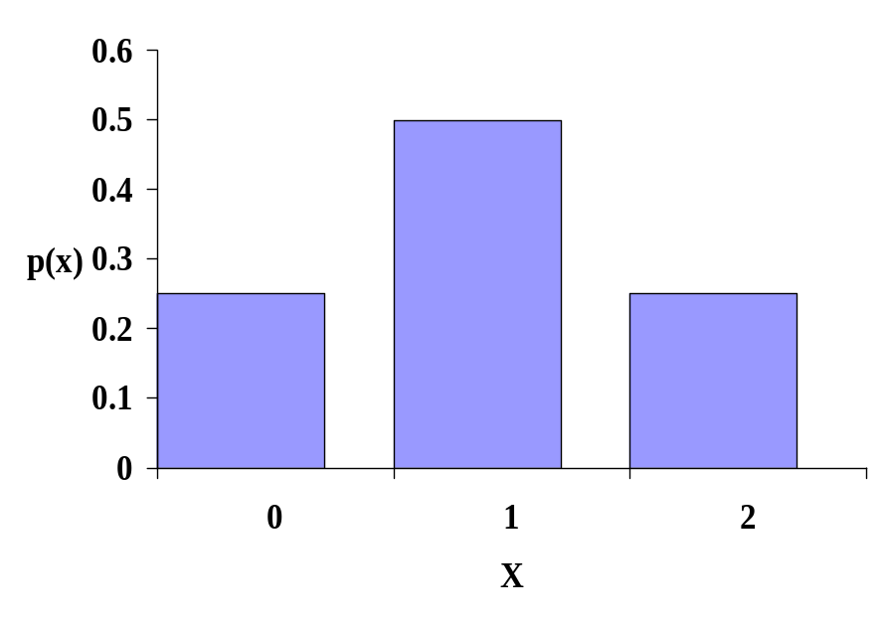
Discrete probability distributions (Cont.)
Alternatively, this is simply displayed by a bar chart;

Slide 68
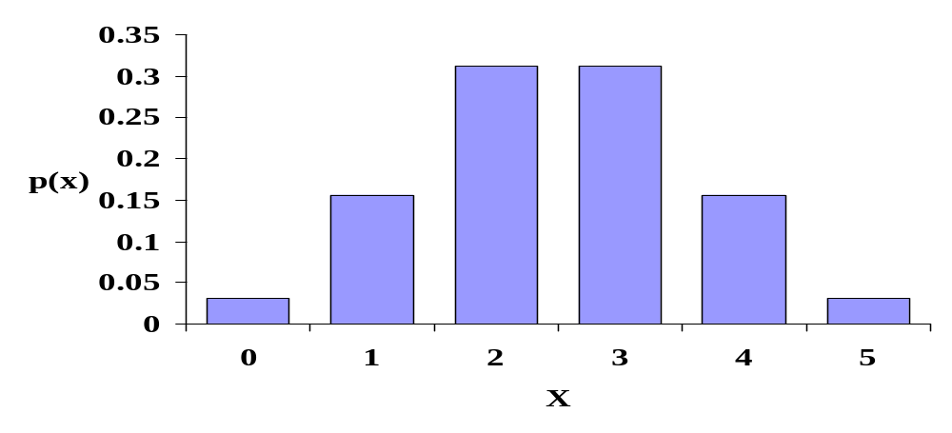
Discrete probability distributions (Cont.)
Another example; 5 rolls of a dice.
X = number of odd numbers
x p(x)
0 1/32
1 5/32
2 10/32
3 10/32
4 5/32
5 1/32

Slide 69
Discrete probability distributions (Cont.)
Lets check the validity of the distribution;
x 0 1 2
p(x) 0.25 0.5 0.25
0 ≤ p(x) ≤ 1 for all values of x; ✓ OK
Σp(x) = 1; 0.25 + 0.5 + 0.25 = 1 ✓ OK

Slide 70
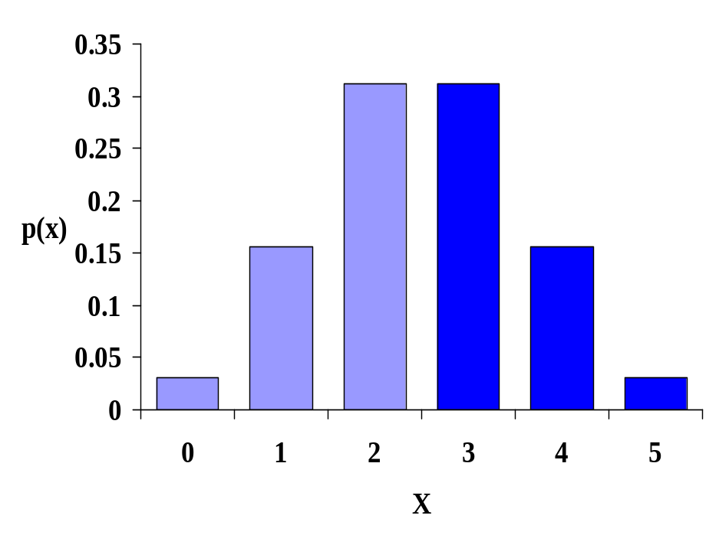
Discrete probability distributions (Cont.)
Probability distributions can also be used to calculate probabilities associated with a range of events.
Example:
What is the probability that more than half the 5 rolls of the dice will be odd?
Ans:
P(x > 2.5)
= P(x=3)+P(x=4) +P(x=5)
= [10 + 5 + 1] /32
= 0.5

Slide 71
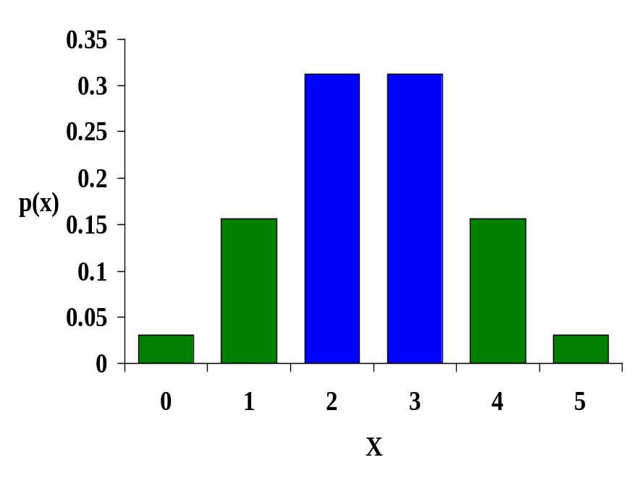
Discrete probability distributions (Cont.)
Example2 : What is the probability that there will be more than 1 and less than 4 odd numbers?
Ans:
P(1 < x < 4)
= P(x=2)+P(x=3)
= [10 + 10] /32
= 0.625

Slide 72
Expected value of X
If we repeat an experiment a number of times, we are unlikely to get the same answer. Imagine rolling a dice twice, the probability of getting the same number twice is 1/6th. Rolling a dice 3 times, the probability of getting the same number 3 times is 1/36th. In fact this is the reason why the variable X is called a random variable, it’s value is somewhat random between repeated experiments

Slide 73
Expected value of X (Cont.)
One question that we may ask however, is “ if we repeated the experiment N times, what will the average value of X be?”
This is known as the mean of X, or the expected value of X. It is denoted as E(X) and calculated as the weighted average of all possible values X can take

Slide 74
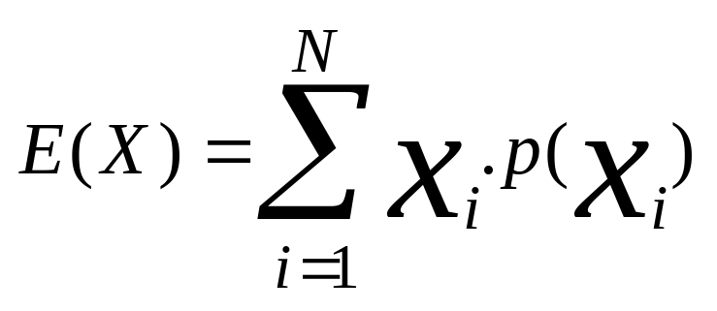
Expected value of X (Cont.)
The formula is logical, because it is really saying that if we conducted the experiment a large number of times, we would expect values of X to occur in proportion to their assigned probabilities

Slide 75

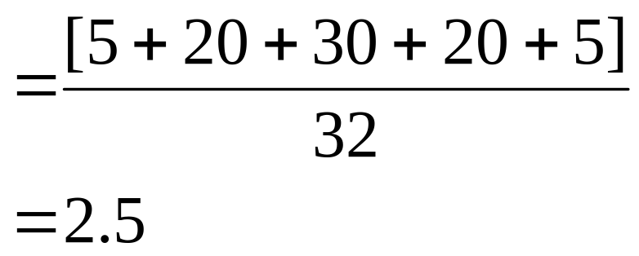
Expected value of X (Cont.)
Example:
What is the expected value of X for the probability distribution of number of odd dice in 5 rolls?
x p(x) x.p(x)
0 1/32 0
1 5/32 5/32
2 10/32 20/32
3 10/32 30/32
4 5/32 20/32
5 1/32 5/32

Slide 76
Expected value of X (Cont.)
μ = 2.5
Note that E(X) does not have to be one of the values of X in the distribution (as above)

Slide 77
Variance of X
The mean or expected value of any variable does not in itself tell us enough about the variable. We also need some measure of the dispersion of the variable
The variance of X is the expected value of (X-μ)²

Slide 78
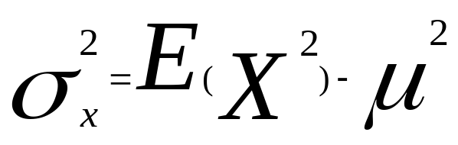
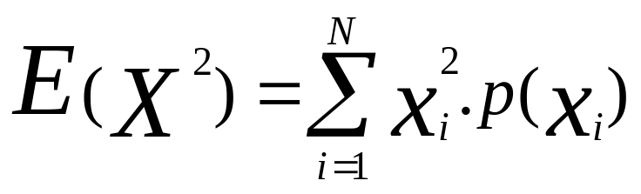
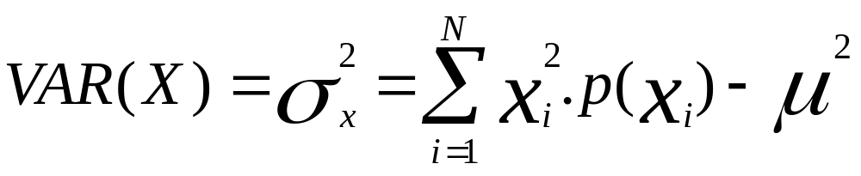
Variance of X (Cont.)

Slide 79
Variance of X (Cont.)
Example:
what is the variance of the number of odd numbers in 5 rolls of a dice?
x p(x) x.p(x) x² x².p(x)
0 1/32 0 0 0
1 5/32 5/32 1 5/32
2 10/32 20/32 4 40/32
3 10/32 30/32 9 90/32
4 5/32 20/32 16 80/32
5 1/32 5/32 25 25/32
E(X) = 2.5 = 7.5

Slide 80
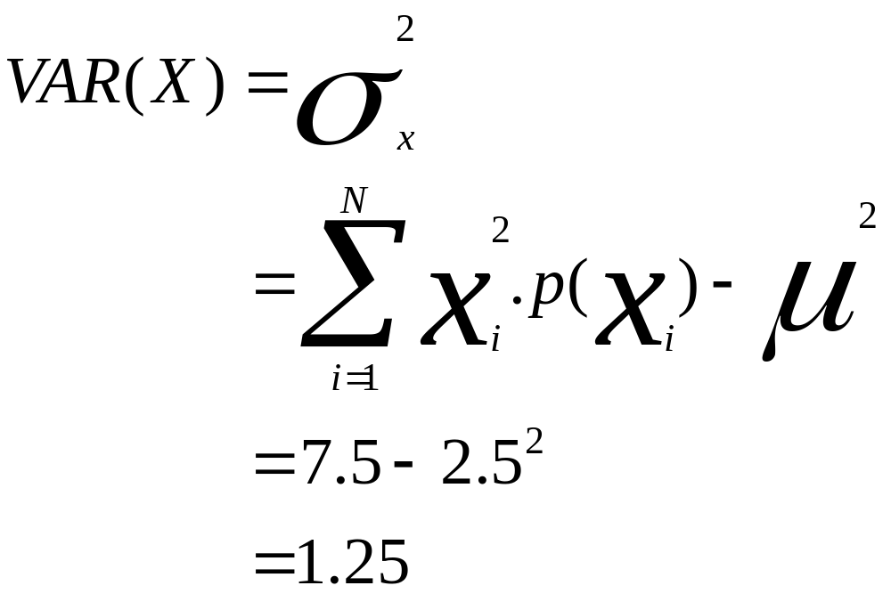
Variance of X (Cont.)
The standard deviation is the positive square root of the variance;
σ = √ σ² = √1.25 = 1.118

Slide 81
The Binomial Distribution
The Binomial Distribution is used to describe the response from a Binomial Experiment
In a Binomial Experiment there are only two possible outcomes. Example: Yes/no, for/against, present/absent, +/-, will buy/will not etc. These outcomes are usually referred to as success/failure
A Binomial Experiment usually consists of a number of repeated trials

Slide 82
Conditions required for a Binomial Experiment
A sample of n experimental units is selected from a population
Each experimental unit can take only one of two possible outcomes. Conventionally these are either called success or failure
The probability that a single experimental unit possesses a success is equal to p. The probability is the same for all experimental units
The outcome for any one experimental unit is independent of the outcome of any other experimental unit
The binomial random variable x counts the number of successes in the n trials

Slide 83

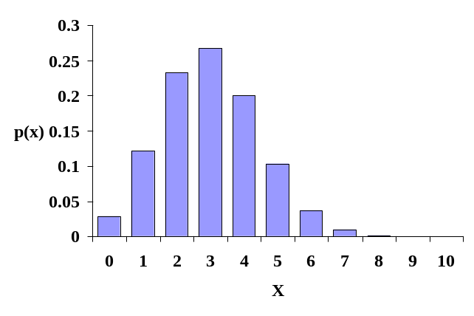
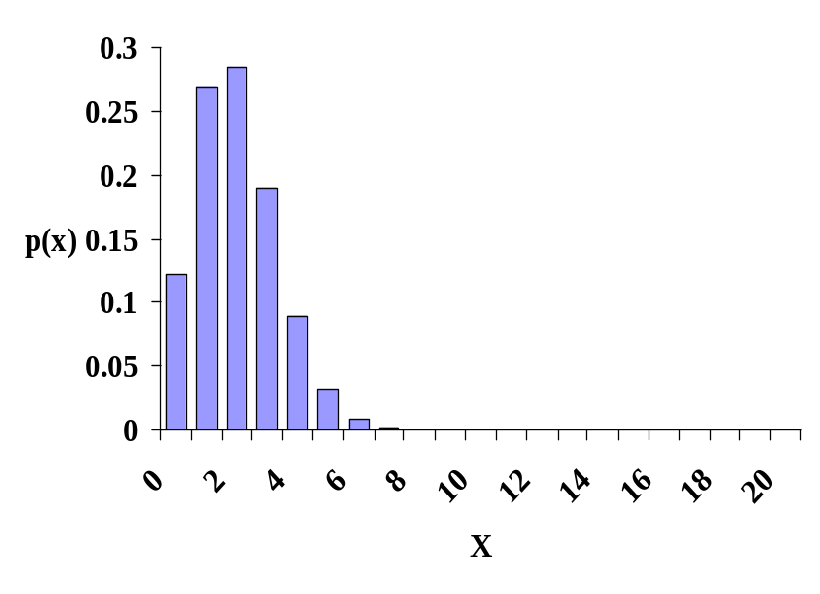
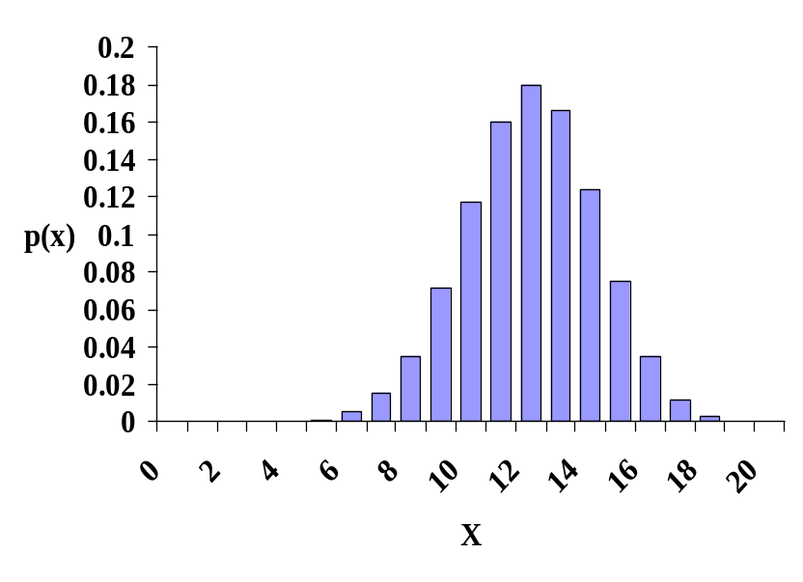
Sample Binomial distributions
P=0.5, n=5
P=0.3, n=10
P=0.6, n=20
P=0.1, n=20

Slide 84
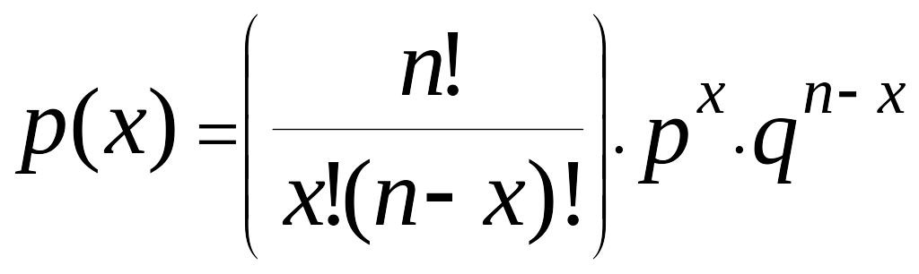
Formula for a Binomial Distribution
The probability of obtaining x successes in n trials with a probability p of success in each trial can be calculated using the formula;
(where q = 1 - p)

Slide 85
The Poisson Distribution
It is a Discrete Probability Distribution
The Poisson distribution is used to model the number of events occurring within a given time interval.
In other words, it refers to the problem in which occurrence of an event and counting the number of times the event occurs during a given period of time or space.
Poisson random variable X may take any value 0, 1, 2,…….∞.
The mean and variance are both equal to λ.
Example:
a) The number of spelling mistakes one makes while typing a single page b) The number of phone calls at a call centre per minute.

Slide 86
Conditions required for a Poisson Experiment
The Poisson distribution provides an approximation for the Binomial Distribution.
It is the number of occurrences of an event, and not the non-occurrences in a given situation.
Events takes place randomly and independently over a certain time or space.
Events being random means the probability of more than one occurrences during the same time interval is very small
Occurrences of events is independent means that its occurrence in a given time interval is not affected by the occurrence of that event during any previous or future time interval (or region of space)

Slide 87
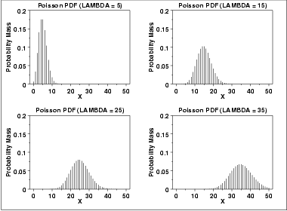
Example of Poisson Distribution

Slide 88
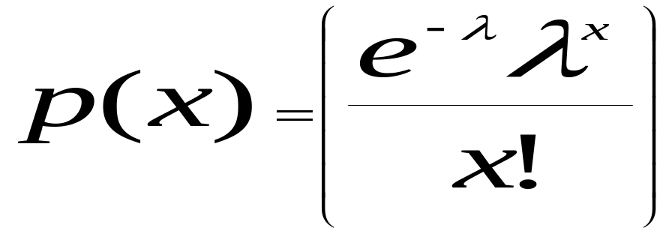
Formula for a Poisson Distribution
A number of discrete occurrences (sometimes called "arrivals") that take place during a time-interval of given length. If the expected number of occurrences in this interval is λ, then the probability that there are exactly k occurrences (k being a non-negative integer, k = 0, 1, 2, ...) is equal to
Where,
λ : Mean number of successes in a given time period, λ>0
x : Number of successes we are interested in, where x = 0,1,2…n
e : Base of natural logarithm in function ln(≈ 2.71828)

Slide 89
Continuous Probability Distributions
In discrete random variable distributions, there is always a gap between the points of a distribution. i.e.. the number of odd dice in five rolls can only be 0, 1, 2, 3, 4 or 5, not 4.2 or 3.5, etc.
In a continuous distribution, there are no gaps between values
The distribution of a curve is characterised by a probability density function, f(x)

Slide 90

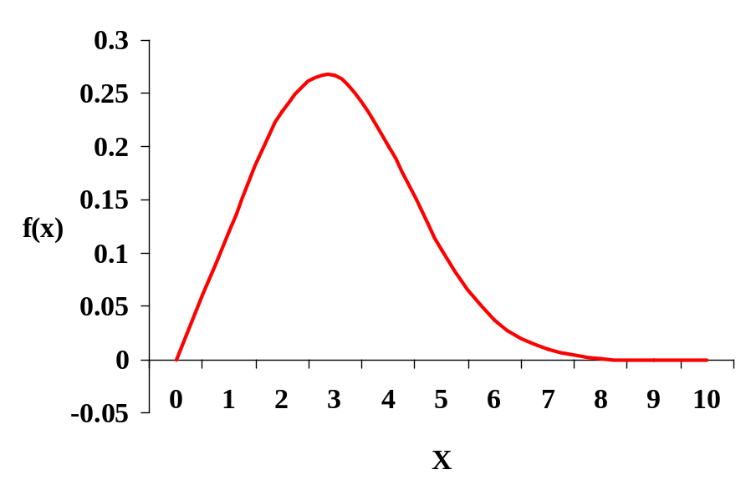
Continuous Probability Distributions
Discrete Continuous

Slide 91
Continuous Probability Distributions
The probability density function f(x) must satisfy two conditions;
a) f(x) ≥ 0, (ie non negative
b) The total area under the curve is 1
As the area of a line is zero, the specific value of any x value is always 0

Slide 92
The Normal Distribution
The most important continuous probability distribution is the Normal Distribution.
The reason is that it has a very important use in the statistical theory of drawing conclusions from sample data about the populations from which the samples are drawn, and in Statistical Process Control.
There are several characteristics that make the normal distribution very important for statisticians:
a) It is bell shaped
b) Symmetrical about Mean which is also Median and Mode
c) Most observations in the distribution are close to the mean, with
gradually fewer observations further away

Slide 93
The Normal Distribution (Cont..)
d) It can be determined entirely by the values of µ and σ.
e) The spread of the distribution is measured by the standard distribution,
may be large or small but in every case approximately
  68.3 % of all observations lie within µ+σ, (i.e 1 standard deviations of
  the mean) approximately two thirds observations
  95.4 % of all observations lie within µ+2σ
  99.7 % of all observations lie within µ+3σ

Slide 94
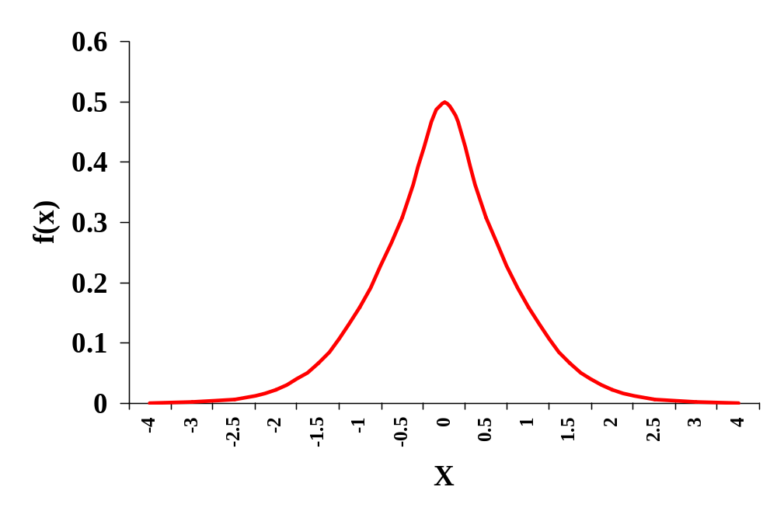
The Normal Distribution (Cont)
A typical normal distribution;
X∼N(μ,σ²)

Slide 95
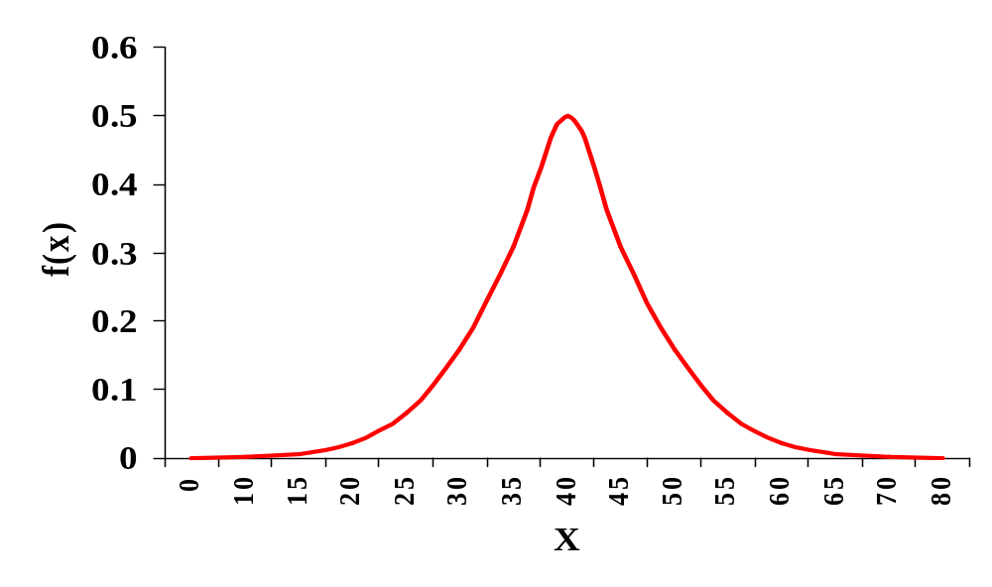
The Normal Distribution (Cont)
P(μ-σ < X < μ+σ) = 0.683
μ
X∼N(40,10)
μ - σ
μ + σ

Slide 96

The Standard Normal Distribution
A special case of the normal distribution, the standard normal distribution has a mean of 0 and a standard deviation of 1
The corresponding standard random variable is denoted by Z

Slide 97
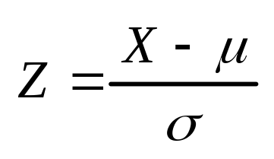
The Standard Normal Distribution (Cont)
Any normal distribution can be converted to the Standard Normal Distribution, simply by converting it’s mean to 0 and it’s standard deviation to 1.
i.e. Subtracting μ from each observation and dividing by σ.

Slide 98

Standard Normal Distribution Tables
A) As the data are symmetrical, then we know that 50% of observations lie above and below the mean. If the mean is zero, then there are 50% of observations above and below zero
i.e. if Z∼N(0,1)
P(z<0) = 0.5

Slide 99
Standard Normal Distribution
Example: If X is a continuous random variable with a mean of 40 and a standard deviation of 10, what proportion of observations are a) less than 50 b) < 20, c) between 20 and 50
X∼N(40,10)

Slide 100

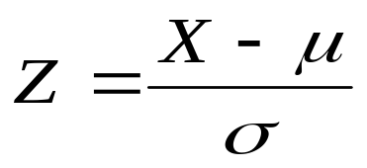
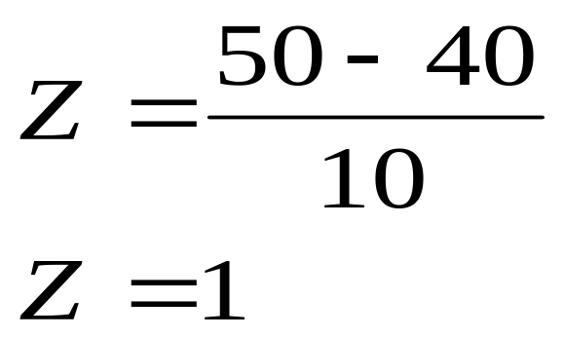
Normal Distribution (Cont.)
A) P(x < 50)?
P(x < 50) = P(z < 1) = 0.8413
X∼N(40,100)

Slide 101
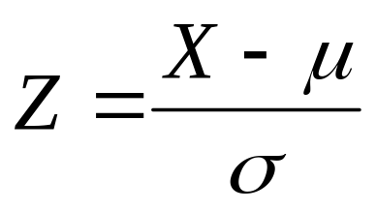
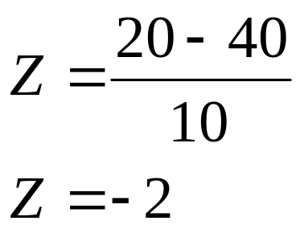
Normal Distribution (Cont.)
B) P(x < 20)?
P(x < 20) = P(z < -2) = 0.0228
X∼N(40,10)

Slide 102
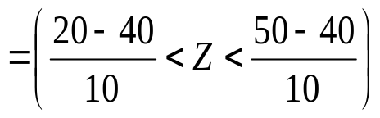
Normal Distribution (Cont.)
P(20 < x < 50)?
P(20 < x < 50)
= P(-2 < z < 1)
= 0.8413 - 0.0228
= 0.8185
X∼N(40,10)

Slide 103
Sampling & Sampling Distribution

Slide 104
Sampling and Sampling Distributions
We have previously learnt that for a given distribution, we can calculate the probability of an individual observation lying within a certain range
In the real world, we don’t know the exact population parameters and we use a sample to make inference about the population
Sample
Because it is seldom possible to measure all the individuals in a population, researchers use samples and infer their results to the population of interest
Example: Election polls, consumer preference surveys, etc.

Slide 105
Samples (Cont.)
To be valid, samples must be representative of the population
A Simple Random Sample is one in which every member of the population is equally likely to be measured
Example:
Allocate a number to each member of the population and use a random number generator to determine which individuals will be measured

Slide 106
Sampling (Cont.)
A Stratified Random Sample separates the population into mutually
exclusive groups and randomly samples within the groups
Example: Randomly select a number of people from within each state in an election pole
Note: The number of people selected within each group is proportional to
the group size

Slide 107
Sampling (Cont.)
Example : A Physician wants to find out how many hours his patients sleep
Age Group | Percentage of total
Birth – 19 years | 30
20 – 39 years | 40
40 – 59 years | 20
60 yrs and older | 10

Slide 108
Cluster Sampling
In Cluster sampling, we divide the population into groups, or clusters, and then select a random sample of these clusters. We assumed that these individual clusters are representative of the population as a whole.
For example:
If a market research team is attempting to determine by sampling the average number of television sets per household in a large city.
They could use a city map to divide the territory into blocks and then choose a certain number of blocks (clusters) for interviewing. Every household in each of these blocks would be interviewed.

Slide 109
Comparison of Stratified and Cluster Sampling
With both cluster and stratified sampling, the population is divided into well-defined groups.
We use ---
a) stratified sampling when each group has small variation within itself
but there is a wide variation between the groups.
b) cluster sampling in the opposite case---when there is a considerable
variation within each group but the groups are essentially similar to
each other.

Slide 110

Sampling Distributions
Consider a population where it is very difficult to measure all individuals, say the population of all Australians
If we take a representative sample of say 100 individuals and calculate their average annual income, we will obtain an estimate of the true average annual income for all Australians.
It will however not be the actual average μ, rather an estimate
If we took another sample of 100 Individuals from the same population, we would obtain another estimate of the annual average income for Australians.

Slide 111
Sampling Distributions (Cont.)
It is extremely unlikely that the average calculated for the second sample will be the same as the average calculated for the first sample
In fact, statisticians know that repeated samples from the same population give different sample means
They have also proven that the distribution of these sample means will always be normally distributed, regardless of the shape of the parent population. This is known as the Central Limit Theorem

Slide 112
The Central Limit Theorem
STATEMENT: A distribution with a mean μ and variance σ², the sampling distribution of the mean approaches a normal distribution with a mean (μ) and a variance σ²/N as N, the sample size increases.
The amazing and counter-intuitive thing about the central limit theorem is that The distribution of an average tends to be Normal, even when the distribution from which the average is computed is decidedly non-Normal
If enough samples are taken repeatedly from a population, the centre of the distribution of the sample means, is μ, the population mean
The spread of the distribution of the sample means is dependent on two quantities, σ² (the variance) and n (the sample size)

Slide 113
Distribution of sample means
If the underlying population has a large variance, then naturally the sample means will also have a large variance
As the sample size n increases, the variance of the sampling distribution decreases. This is logical, because the larger the sample size, the closer we are to measuring the true population parameters

Slide 114
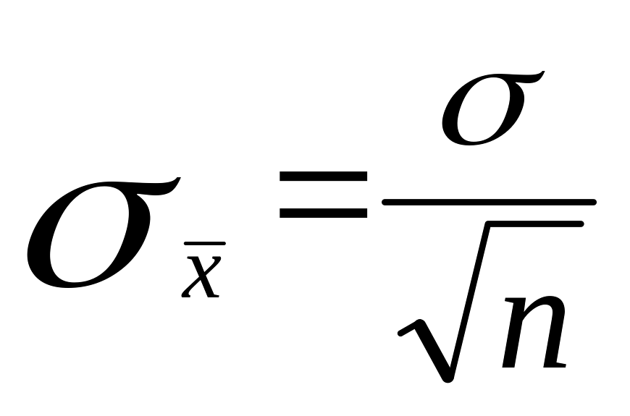
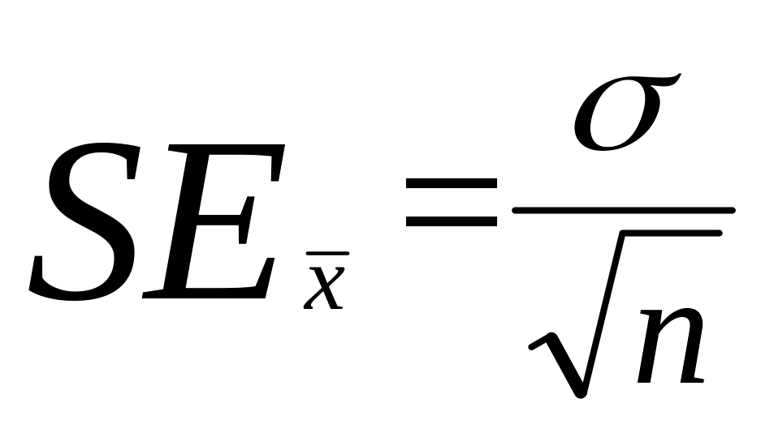
Variance of the sample means
The standard deviation of the sample means is called the standard error, and can be calculated by the formula;
to avoid confusion, write it as SE,
Because we know that the distribution of sample means is normal and we now have a formula for the spread of sample means from the true mean. We can now use a sample to make inference about the true population parameters

