Slide 1
Correlation and Regression

Slide 2
Correlation and Regression
  In the previous session we discussed :
    Z and t statistic
    Approximation of t to z
    Test of hypothesis
  Now relationship (intuitive and calculated) between, what is already
  known, what is to be estimated will be discussed.
  If decision makers can determine how the known is related to the
  future event, they can aid the decision making process considerably.
  How to we determine the relationship between variables?

Slide 3
Simple linear Correlation and Regression
Regression
  Quantifying the relationship between two continuous variables
  Predict (or forecast) the value of one variable from knowledge of the value of another variable
  That is an estimating equation - a mathematical formula - will be developed
Correlation
  When the pattern of relationship is known, Correlation analysis can be applied to determine the degree to which the variables are related
  Correlation analysis informs how well the estimating equation actually describes the relationship

Slide 4
Correlation - Strength of a relationship
The strength of the relationship between two variables is measured by the coefficient of correlation ρ, ‘rho’. For a sample we estimate rho using Pearson’s correlation coefficient r
Correlation coefficients range between -1 and +1

Slide 5
Correlation coefficients
-ve correlation coefficients indicate negative relationships.
i.e. as one variable increases, the other decreases
Stronger relationships have values closer to ± 1, weaker relationships have values closer to 0.
0 indicates no relationship at all
± 1 indicates a perfect relationship
Eg: Income and expenditure is positive
    Price and demand of commodity is negative

Slide 6
Correlation and causation
Correlation analysis helps determine degree of relationship between two or more variables
It does not tell about cause and effect relationship
Even high degree of correlation does not necessarily mean a relationship of cause and effect exists between variables
Correlation does not imply causation though the existence of causation always imply correlation

Slide 7
Correlation and causation
The significant degree of correlation may due to
  The correlation may be due to pure chance especially in small samples
  Both the correlated variables may be influenced by one or more other variables
  Both the variables may be influencing each other so that neither can be designated as the cause and the other the effect

Slide 8
Method of studying correlation
Scatter Diagram Method
Graphic Method
Karl Pearson’s Coefficient of correlation
Rank correlation method

Slide 9
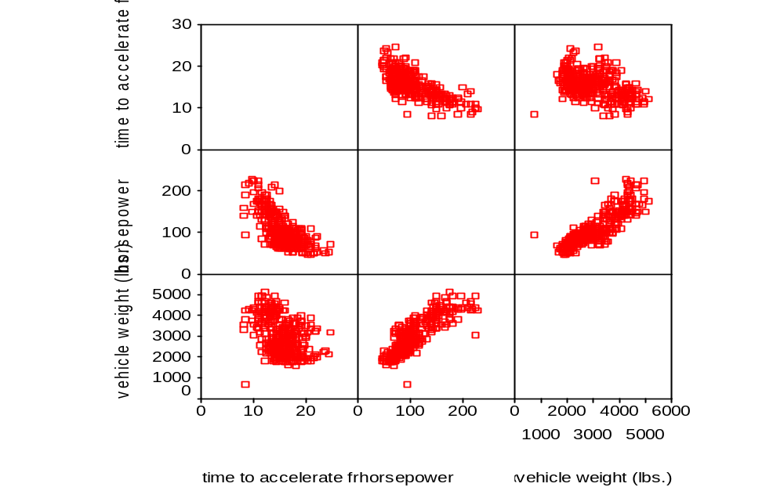
Method of studying correlation – Scatter diagram Method

Slide 10
Correlation coefficients
The significance of a correlation is test using the same method as for the slope of the regression line.
i.e. if the slope is significant, then so is the correlation, and vice versa
It is possible to test
Ho: ρ = 0 against Ha: ρ ≠ 0 [or <,>]
Using the sample correlation coefficient r, against critical values of r from a table.

Slide 11
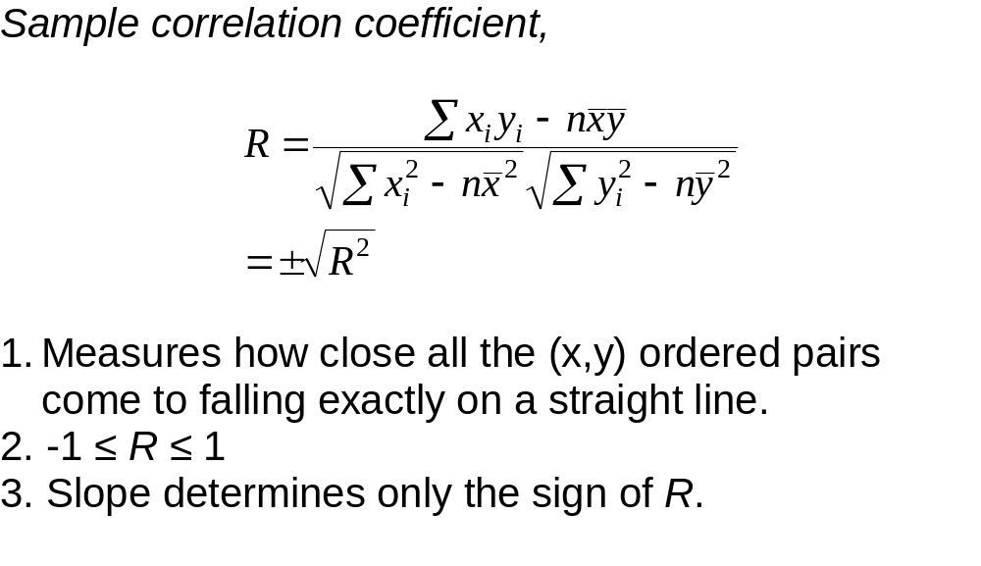
Coefficient of correlation

Slide 12

Coefficient of Determination
The coefficient of determination r² measures how well the line fits the data
It tells us how much of the variation in Y is explained by the relationship with X
Consider the Y variable alone. It has some total variation calculated using

Slide 13
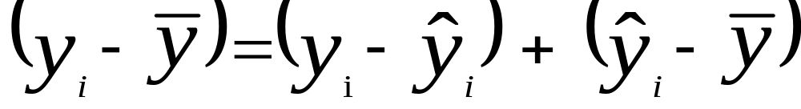
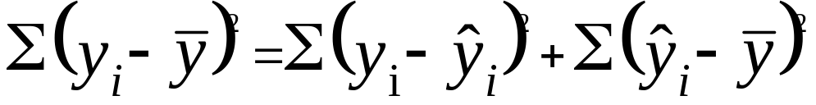
Coefficient of Determination
This variation can be partitioned into a part explained by the regression line and the residual
The equation can be converted to squared terms, which are
squared deviations
Total sum of squared
deviations in y
sum of squared
deviations of residuals
sum of squared
deviations of regression line
=
+

Slide 14
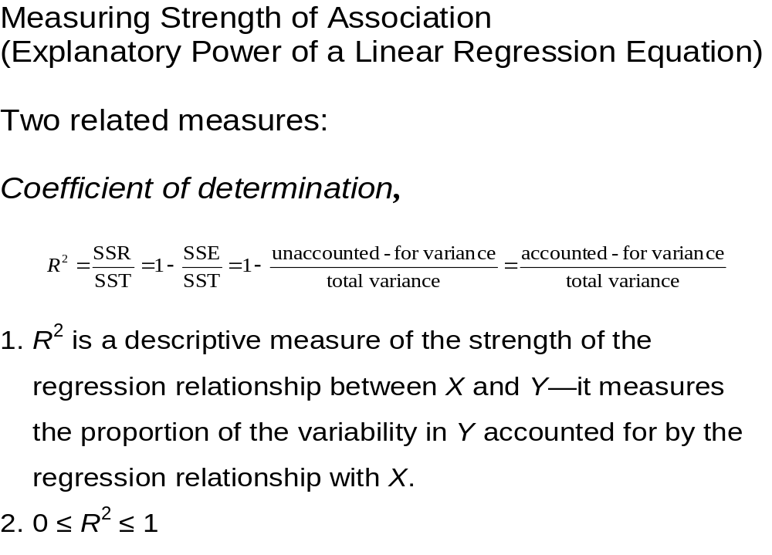
Strength of association

Slide 15
Deterministic/Stochastic
Deterministic Relationship
  Lease of SUV over the weekend:
    Fixed Cost $250.00
    Plus $0.40/mile.
    X = # of miles you drive SUV
    Y = total lease cost
    Y = 250 + 0.40 X (slope? intercept?)
  No work for a statistician to do here—there’s nothing random (stochastic) about them.
Stochastic Relationship
  Where there is a random element—where you can’t predict with absolute certainty Y for a given X.

Slide 16
Simple linear regression
Definitions:
Regression is a measure of the average relationship between two or more variables in terms of the original units of the data
-Samuel B. Richmore
One of the most frequently used techniques in economics and business research, to find a relation between two or more variables that are related casually, is regression analysis
-Taro Yamne
Independent variable: Called Regressor or Predictor or Explanatory
Dependant Variable: Called Regressed or Explained variable

Slide 17
Simple linear regression (cont..)
Example: Importance of regression analysis in Business Decisions
  In Bond/Stock market relationship between bond interest rate to prime Interest rate
  Relationship between advertising to sales in a Company
  Which relationship best suited for predicting unemployment rate? Is it minimum hourly rates, or inflation rates or wholesale price index?
In simple linear regression we generate an equation to calculate the value of a dependent variable (Y) from an independent variable (X).
Example: Time taken to get to work (Y) is a function of the distance travelled (X)

Slide 18
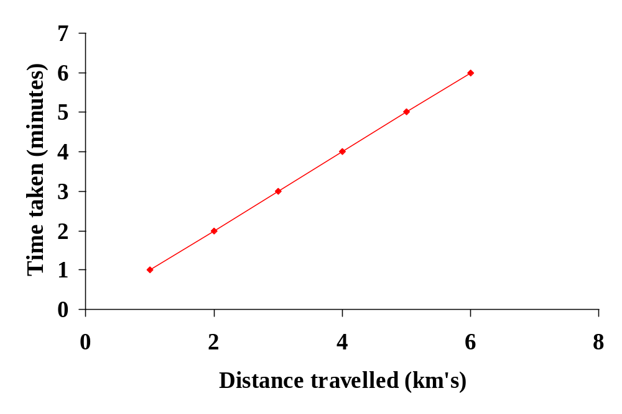
The regression model
Let us develop a simple regression model with an example:
  Say you drive to work at an average of 60 kms/hour. It takes about 1 minute for every kilometre travelled…
  Travel time = 1 minute × kilometres travelled
  This is a mathematical model that represents the relationship between the two variables
  Representing in a linear scale

Slide 19
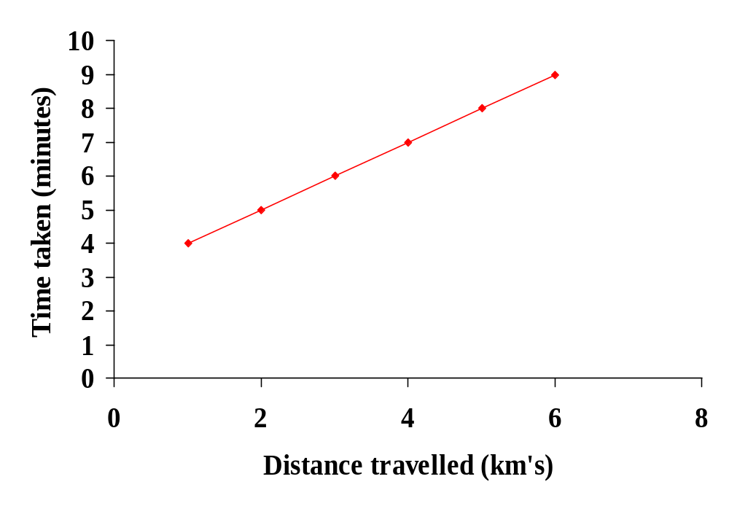
The regression model (Cont..)
Actually, it won’t be that simple, because there will some time taken to walk to your car and then walk from the car to work. Say this takes an extra 3 minutes per day

Slide 20
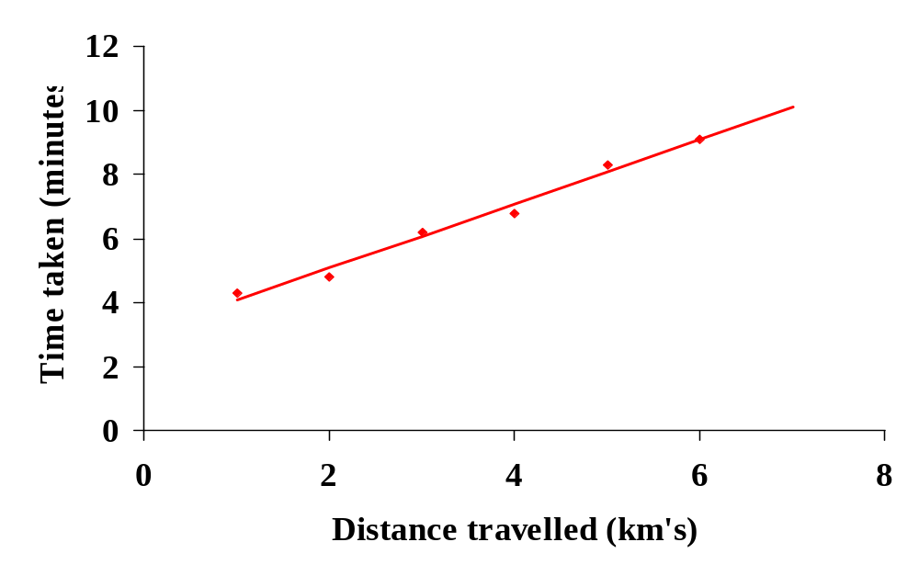
The regression model (Cont..)
It also won’t be that precise because there will be slight variations in time taken because of traffic, road works, etc

Slide 21
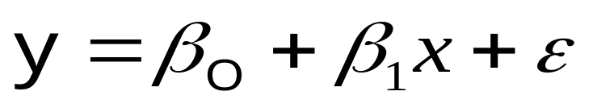
The regression model (Cont..)
In general, the regression equation takes the form;
y = the dependent variable
x = the independent variable
β_{o} = The y-intercept
β₁ = The slope of the line
ε = random error term ~N(0, σ²)

Slide 22
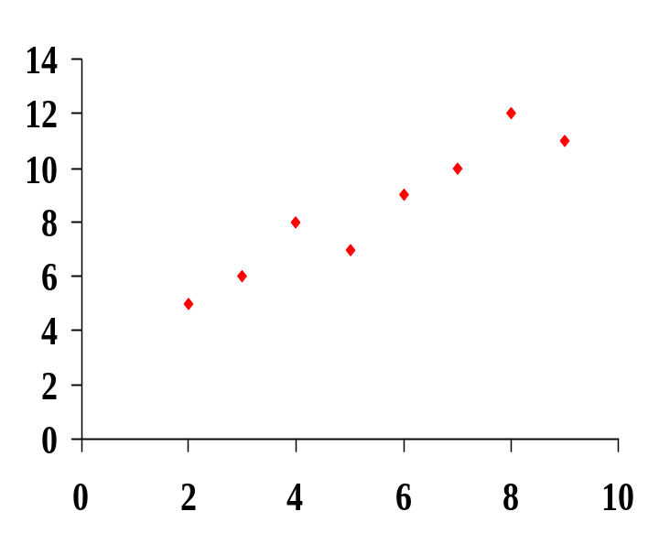
The regression model (Cont..)– Line of best fit
Given a data set, we need to find a way of calculating the parameters of the equation
We need to fit a line of best fit
?
?
?

Slide 23
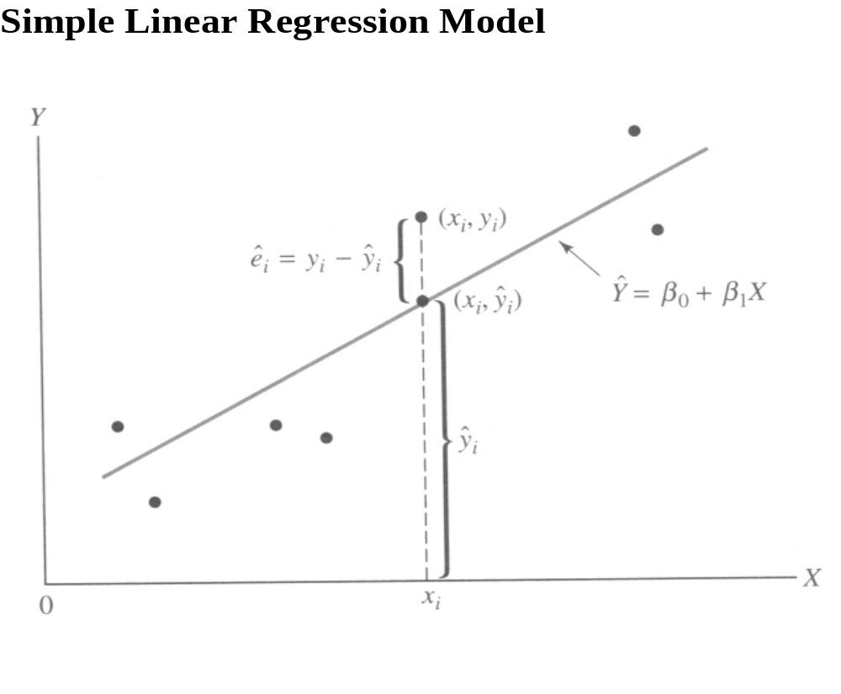
The regression model (Cont..)– Line of best fit

Slide 24
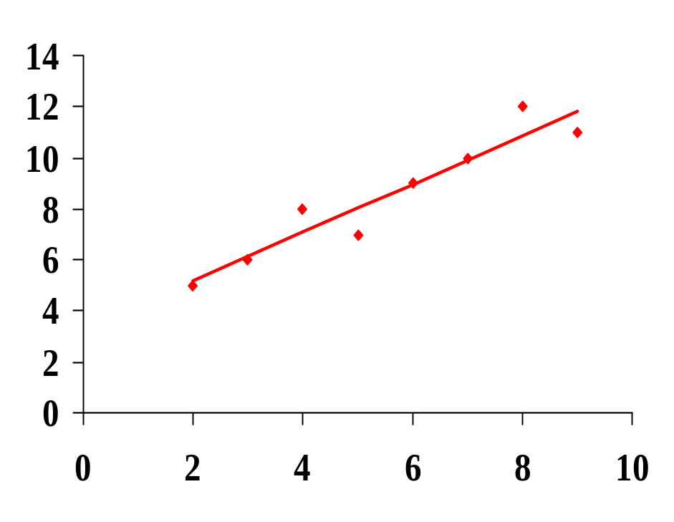


The regression model (Cont..)– Line of best fit
Because the line will seldom fit the data precisely, there is always some error associated with our line
The line of best fit is the line that minimises the spread of these errors
(y_{i} - )

Slide 25
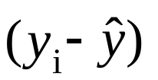
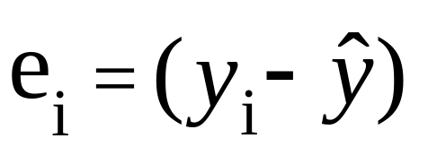
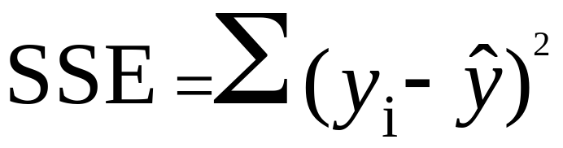
The regression model (Cont..) – Error Term
The term is known as the error or residual
The line of best fit occurs when the Sum of the Squared Errors is minimised

Slide 26
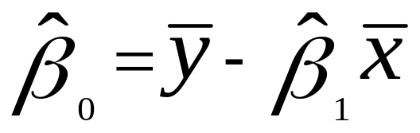
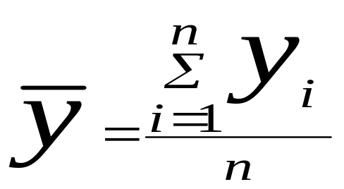
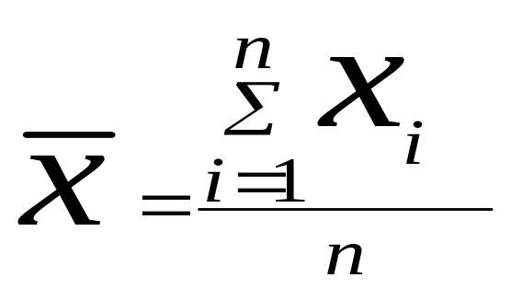
The regression model (Cont..) - Estimating of parameters
Y intercept :
where
and,

Slide 27
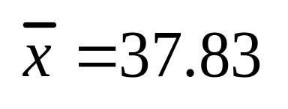
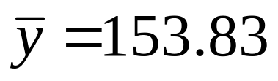
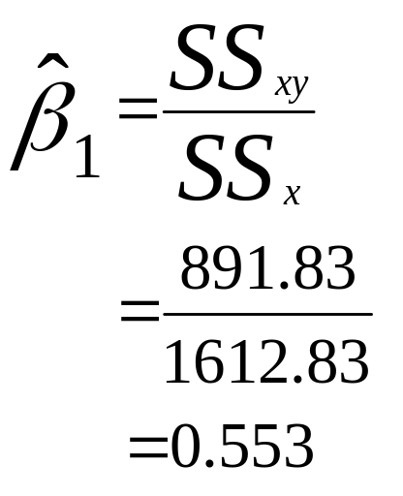
The regression model (Cont..) - Example
X (kilos) | Y (cost, $)
17 | 132
21 | 150
35 | 160
39 | 162
50 | 149
65 | 170
ΣXY - nXY
ΣX² – nX²

Slide 28
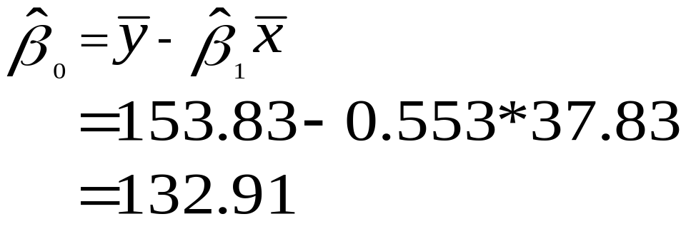

The regression model – Example (Cont.)
And the equation is

Slide 29

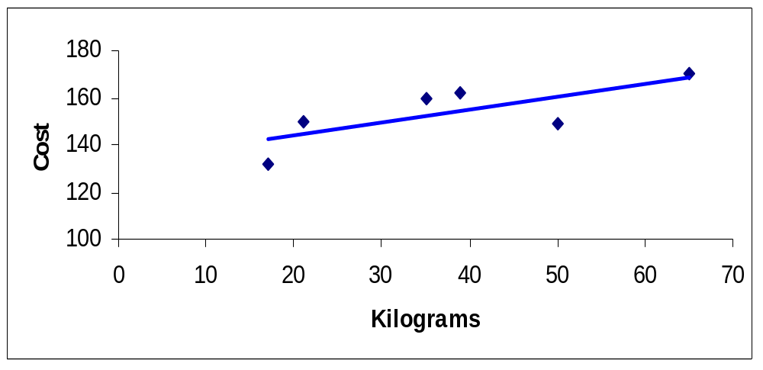
The regression model – Example
Interpreting the parameter estimates
In the previous example, the estimate of the slope was 0.553.This means that for every change in X of 1 kg, there will be a change in Y of 0.553 $

Slide 30

Interpreting the parameter estimates
is the y intercept. IE the point at which the line crosses the y
axis. In this case $132.91
$132.91
It is the value of Y when X = 0

Slide 31
Assumptions of the error term
OLS method for estimating regression equation parameters are only valid if certain conditions are met:
  The error variable is normally distributed
  The expected value of the error variable is zero
  The variance of the error is constant over the entire range of X values
  The errors associated with any two Y values are independent

Slide 32
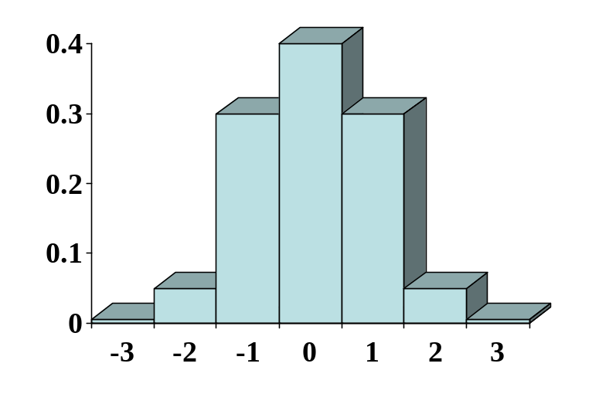

Assessing assumptions
Graphical methods are particularly useful for studying potential violations of these assumptions
The simplest way to assess whether or not the residuals are normal is to draw a histogram and visually inspect the distribution
e

Slide 33
Assessing assumptions (Cont.)
Using least squares regression method ensures that the expected value of the error variable is zero
Homoscedasticity or constant variance is best evaluated by plotting the residuals against the predicted value of the Y variable

Slide 34
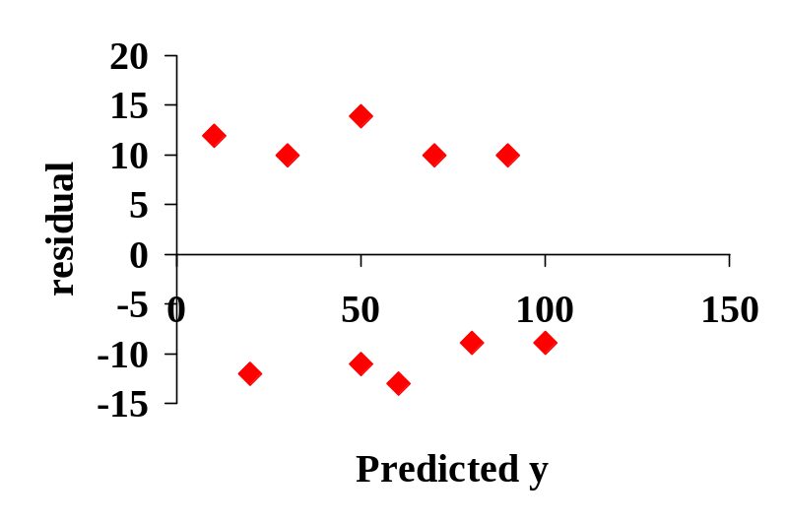
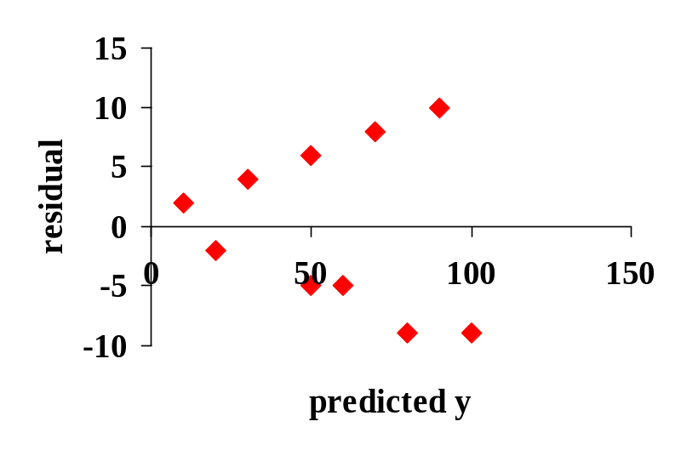
Homoscedasticity
Homoscedasticity
Heteroscedasticity

Slide 35
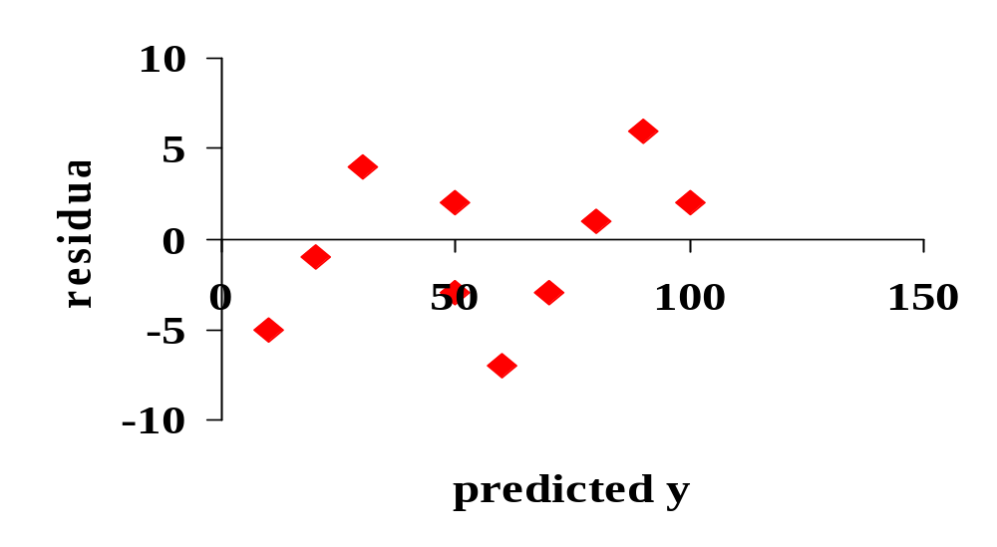
Independent errors
When observations are recorded in adjacent time periods or geographical locations, the residuals can show a non random scatter

Slide 36
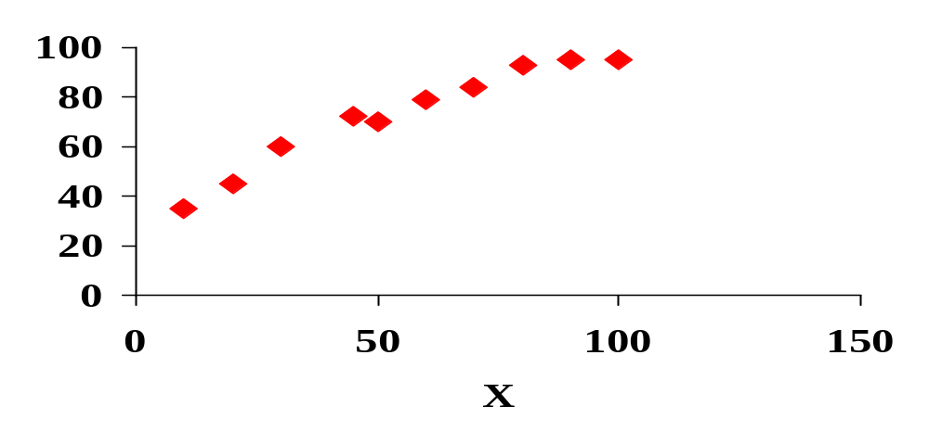
Appropriateness of model
Residual plots against the X variable can also help us determine whether or not the simple linear model is the most appropriate for the data at hand
Whilst a straight line looks appropriate for these data;
residual

Slide 37
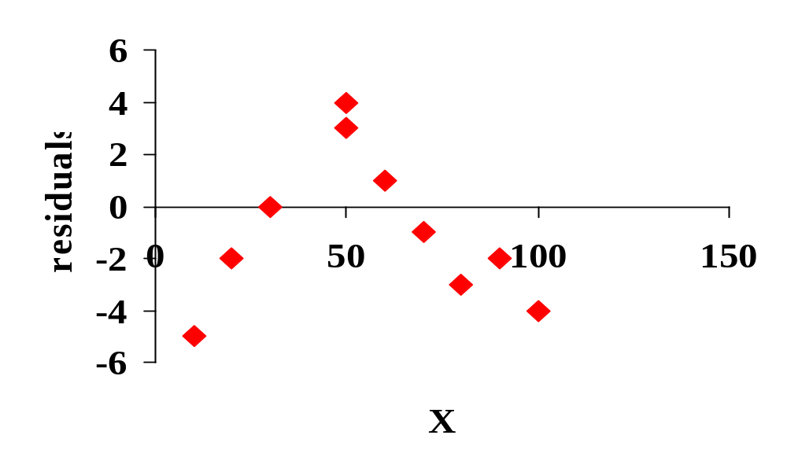
Independence
A residual plot can sometimes reveal a curvilinear relationship would give a better fit
A non - random scatter can also suggest non independence between adjacent observations

Slide 38
Assessing Model fit
Is a linear model appropriate?
Does a linear relationship actually exist between the two variables?
What is the strength of the relationship between the two variables?

Slide 39
Is the linear model appropriate?
Inspection of a scatterplot of X and Y initially reveals whether the trend is linear
Inspection of the residual plot also indicates whether the trend is linear
We can also look at the error variables themselves

Slide 40
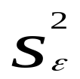
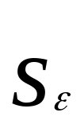
Residuals
When the line fits the data well, the residuals are small and hence their variance is also small
The variance of the residual can be estimated from the sample by
is known as the standard error of the estimate and is given by the computer

Slide 41
Residual Standard Error
The size of the residual standard error is however dependent on the sampling units and really only useful for comparing between models

Slide 42
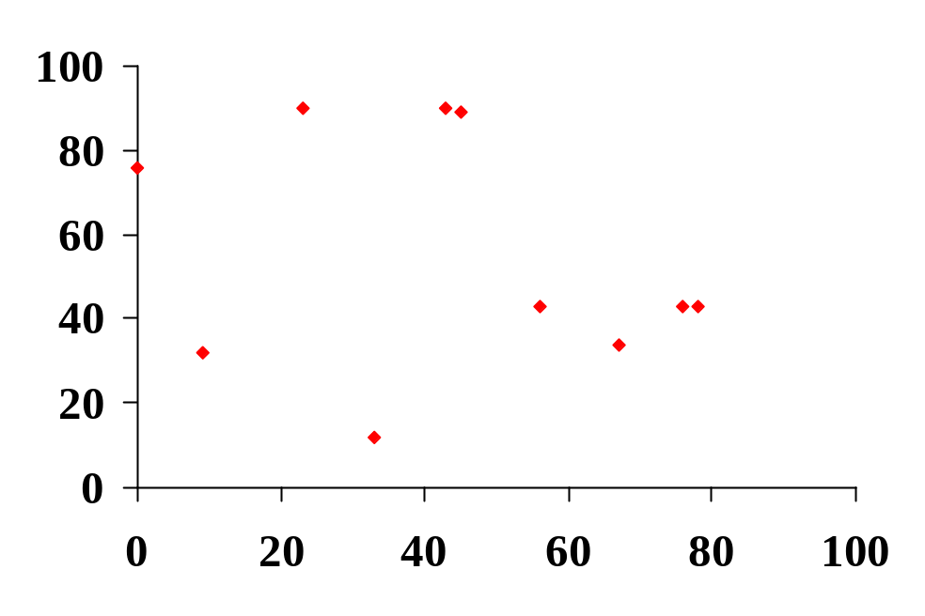
Significance of the relationship
Consider two random variables with no relationship at all
When we try to fit a regression line, it is extremely unlikely that the parameter estimate of the slope will be zero
Is there a way to assess whether the slope is not very different from zero

Slide 43
Significance of the relationship
i.e. will always have some value
We can use hypothesis testing to determine whether or not parameter estimate is significantly different from zero
i.e. whether or not the slope is significant
i.e. whether or not the linear relationship is significant

Slide 44

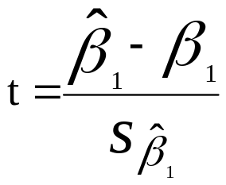
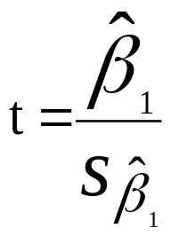
Significance of the relationship
Ho: = 0
Ha: ≠ 0
test :
which, if the null hypothesis is true is the same as

Slide 45
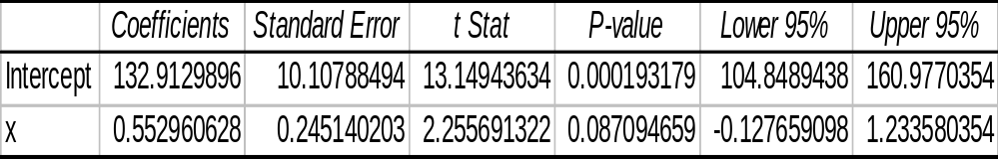
Regression using computers
We can obtain all the parameter estimates simply using many computer programs
Parameter estimates
T value for Ho: β=0
Exact probability of t
Standard error of the parameter estimates
Confidence interval of parameter estimates

Slide 46
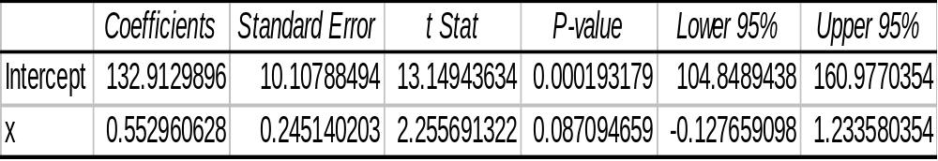
Significance of the relationship
Significance level: say 0.01
Decision rule: Reject Ho if p value is < 0.01
Test statistic: t = 2.26, P(>t) = 0.087
T_{0.01}=2.62(critical value of t)
as P(>T) is > 0.01, do not reject Ho. Relationship is not significant

Slide 47
Multiple Regression
The objective of multiple regression analysis is to predict the single dependent variable by a set of independent variables.
Both independent and dependent variables should be metric (interval or ratio data). However, under certain conditions, dummy-coded independent variables are used.
There are some assumptions in using this statistics –
(a) the criterion variable is assumed to be a random variable
(b) there would be statistical relationship (estimating the average value) rather functional relationship (calculating an exact value)
(c) there should be linear relationship among the predictors and between the predictors and criterion variable.

Slide 48
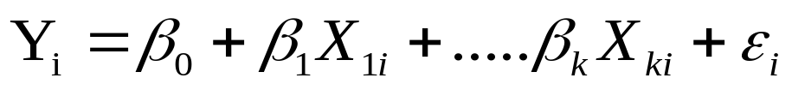
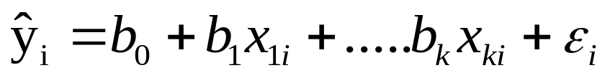
Multiple Regression
Multiple regression analysis provides a population model as:
Where,
x₁, x₂, . . . , x_{k} (k of them) are Independent variables
Data is of type:
(y₁, x₁, x₂, . . . , x_{k} ), . . . , (y_{n}, x_{1n}, x_{2n}, . . . , x_{kn})
And same analysis provides a predictive equation as:
Regression coefficients: b₀, b₁,…, b_{k} are estimates of β₀, β₁,…, β_{k} .
      Where,
      β_{o} = intercept of the line
      β_{k} = partial regression coefficients
      e = error term associated

Slide 49
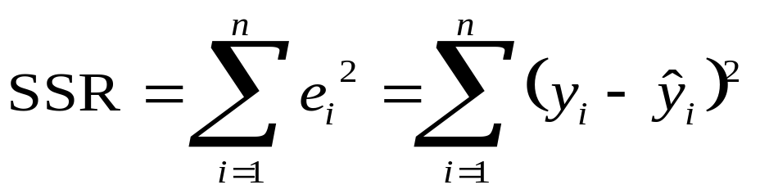
Multiple Regression
Goal:
Here our goal is to choose b₀, b₁, ... , b_{k} to minimize the residual sum of squares.
i.e., minimize:

Slide 50
Multiple Regression - Example
If you want to predict rent (in dollars per month) based on the size of the apartment (number of rooms). You would collect data by recording the size and rent and fit a model.
The following information has been gathered from a random sample of apartment renters in a city.
Rent, $ | 360 | 1000 | 450 | 525 | 350 | 300
No. of rooms | 2 | 6 | 3 | 4 | 2 | 1

Slide 51
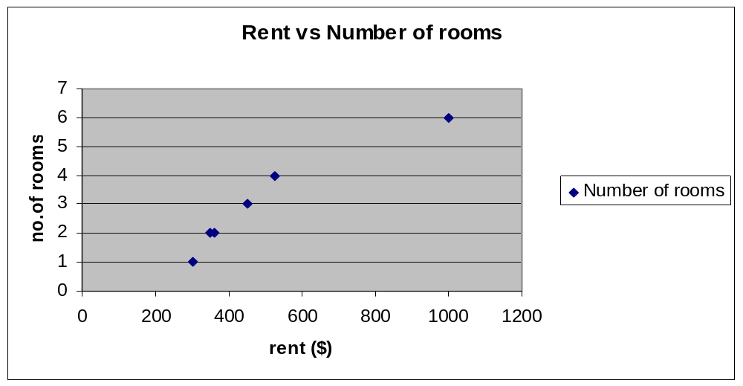
Multiple Regression - Example
Next we graph the data…...
And because the data looks linear, fit an LSR line…

Slide 52

Multiple Regression - Example

Slide 53
Multiple Regression - Example
But ‘number of rooms’ isn’t the only factor that has an impact on ‘Rent’.
The ‘Distance from Downtown’ may be another predictor.
With multiple regression you may have more then one independent variable, so you could use number of rooms and Distance from Downtown to predict Rent.
Our new table, with the data, the Distance from Downtown, looks like this…
Rent, $ | 360 | 1000 | 450 | 525 | 350 | 300
No. of rooms | 2 | 6 | 3 | 4 | 2 | 1
Distance from Downtown (in miles) | 1 | 1 | 2 | 3 | 10 | 4

Slide 54
Multiple Regression - Example
This data can’t be graphed like simple linear regression, because there are two independent variables.
SAS can analyze data with multiple independent variable.
Lets take a look at a SAS output for our data…
No. of observations read | 6
No. of observations used | 6
Cont….

Slide 55
Multiple Regression - Example
Analysis Of Variance
Source | DF | SS | MS | F value | Pr>F
Model | 2 | 306910 | 153455 | 16.28 | 0.0245
Error | 3 | 28277 | 9425.76565
Corrected total | 5 | 335188
Root MSE | 97.08638 | R-Square | 0.9156
Dependent Mean | 497.5 | Adj R-Sq | 0.8594
Coeff Var | 19.51485
Cont….

Slide 56
Multiple Regression - Example
Parameter Estimates
Variable | Label | DF | Parameter Estimate | Standard Error | t Value | Pr > |t| | Standar- dized Estimate | Variance Inflation
Intercept | Intercept | 1 | 96.458 | 118.12 | 0.82 | 0.47 | 0 | 0
Number_of_ rooms | Number_of_rooms | 1 | 136.48 | 26.864 | 5.08 | 0.01 | 0.94297 | 1.23
dis_downtown | Distance_ from_ Downtown | 1 | -2.4035 | 14.171 | -0.17 | 0.88 | -0.0315 | 1.23
What does all this mean?

Slide 57
Multiple Regression - Example
Just like linear regression, when you fit a multiple regression to data, the terms in the model equation are statistics not parameters.
The multiple regression model for our data is…
We get the coefficient values from the SAS output…
Parameter Estimates

Slide 58
Multiple Regression - Example
Once the regression is fitted, we need to know how
well the model fits the data…
First, we check and see if there is a good overall fit.
Then, we test the significance of each independent variable.
Note: You will notice that this is the same way we test for significance in a simple linear regression.

Slide 59
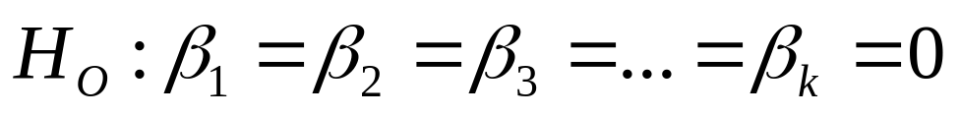
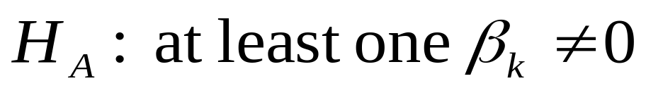
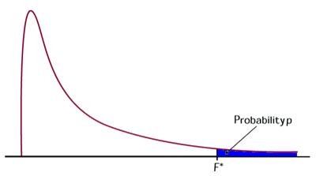
Hypotheses:
Multiple Regression - Example
All independent variables are unimportant for predicting y
At least one independent variable is useful for predicting y
What type of test should be used?
The distribution used is called the Fischer distribution. The F-Statistic is used with this distribution.

Slide 60
Multiple Regression - Example
How do you calculate the F-statistic?
It can easily be found in the SAS output, along with the p-value…
Or you can calculate it by hand…
But, before you can calculate the F-statistic, you need to be introduced to
some other terms.
Regression sum of squares (regression SS) - the variation in Y accounted for by the regression model with respect to the mean model
Error sum of squares (error SS) - the variation in Y not accounted for by the regression model.
Total sum of squares (total SS) - the total variation in Y

Slide 61
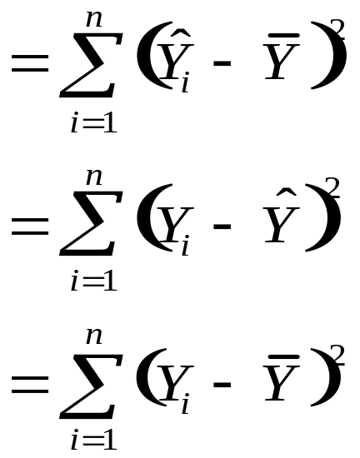
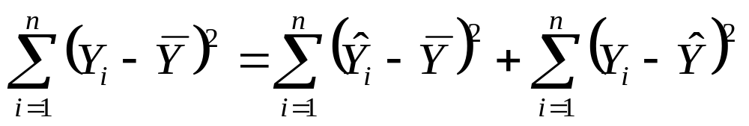
Multiple Regression - Example
Now that we understand these terms we need to know how to calculate them…
Regression SS
Error SS
Total SS
Total SS = Regression SS + Error SS

Slide 62
Multiple Regression - Example
There are also regression mean of squares, error mean of squares, and total mean of squares (abbreviated MS).
To calculate these terms, you divide the sum of squares by its respective degrees of freedom…
Regression d.f. = k
Error d.f. = n-k-1
Total d.f. = n-1
Where k is the number of independent variables and n is the total number of observations used to calculate the regression
Now we can calculate the F-statistic.
F= model mean square
error mean square

Slide 63
Multiple Regression - Example
The p-value for the F-statistic is then found in a F-Distribution Table. As you saw before, it can also be easily calculated by software.
A small p-value rejects the null hypothesis that none of the independent variables are significant. i.e., at least one of the independent variables are significant.
The conclusion in the context of our example is:
We have strong evidence (p is approx. 0) to reject the null hypothesis.
i.e. either ‘No. of rooms’ or ‘Distance from downtown’ is significant in predicting ‘Rent’.
Once you know that at least one independent variable is significant, you can go on to test each independent variable separately.

Slide 64
Multiple Regression - Example
Testing Individual Terms:
If an independent variable does not contribute significantly to predicting the value of Y, the coefficient of that variable will be 0.
The test of the these hypotheses determines whether the estimated coefficient is significantly different from 0.
From this, we can tell whether an independent variable is important for predicting the dependent variable.

Slide 65
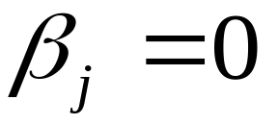
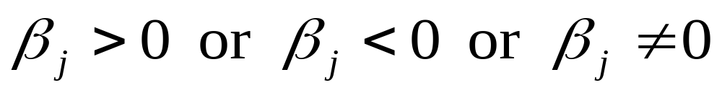
Multiple Regression - Example
Test for Individual Terms:
HO:
The independent variable, xj, is not important for predicting y
HA:
The independent variable, x _{j}, is important for predicting y
where j represents a specified random variable

Slide 66
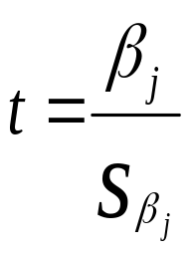
Multiple Regression - Example
Test Statistic:
d.f. = n-k-1
Remember, this test is only to be performed, if the overall model of the test is significant.
Tests of individual terms for significance are the same as a test of significance in simple linear regression
A small p-value in Parameter estimates table means that the independent variable is significant.
This test of significance shows that ‘No. of rooms’ is a significant independent variable for predicting ‘Rent’, but average ‘Distance from Downtown’ is not.

Slide 67
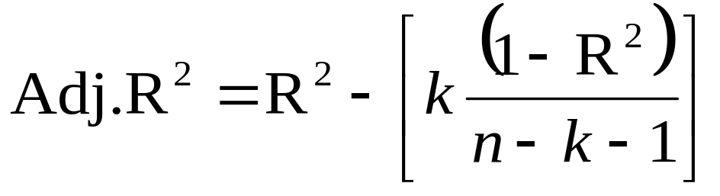
Multiple Regression
  Some more evaluations:
  Strength of association is measured using coefficient of multiple determination (R²).
  Residual Analysis – to check appropriateness of the model
  Histogram - Normal distribution assumption. Can also be checked with K-S one sample test
  Plotting residuals against predicted values – Assumption of constant
  variance of the error term.

Slide 68
Multiple Regression
    Plotting residuals against time/sequence of observations –assumption
    of non correlation across error terms (Durbin Watson test provides a formal
    analysis of same)
    Plotting residuals against independent variables – appropriateness of
    model
    Multiple regression is sometimes done stepwise - Each predictor
    variable is included/removed one at a time which helps in cases of
    multicollinearity
      Forward inclusion
      Backward elimination
      Stepwise solution

Slide 69
Multiple Regression
  Necessary to understand relative importance of predictors
    Statistical significance – partial F test or t-test
    r²
    R² - between the independent and dependent variable controlling for effect of other independent variables
    R² – changes in R² when variable is entered into an equation
Cross validation
    Regression estimated using entire data set
    Data Split into estimation and validation sample
    Regression on estimation sample alone - compared with the model done on entire sample on partial regression coefficients
    This model is applied to validation sample
    The observed and predicted values are correlated to get an r²
Dummy variable regression
    To use nominal/categorical variables as predictor/independent variables
    Class data (High, medium, Low or Old, middle age and young) is converted into binary variables(1,0)

Slide 70
Post Regression check list
Statistics checklist:
a) Calculate the correlation between pairs of x variables
b) Watch for evidence of multicollinearity
c) Check signs of coefficients – do they make sense?
d) Check 95% C.I. (use t-statistics as quick scan) – are coefficients
significantly different from zero?
e) R² :overall quality of the regression, but not the only measure
Residual checklist:
Normality – look at histogram of residuals
Heteroscedasticity – plot residuals with each x variable
Autocorrelation – if data has a natural order, plot residuals in
order and check for a pattern

Slide 71
Final check list
Linearity : scatter plot, common sense, and knowing your problem,transform including interactions if useful
t-statistics: are the coefficients significantly different from zero? Look at width of confidence intervals
F-tests : for subsets, equality of coefficients
R²: is it reasonably high in the context?
Influential observations, outliers in predictor space, dependent variable space
Normality : plot histogram of the residuals - Studentized residuals
Heteroscedasticity: Plot residuals with each x variable, transform if necessary, Box-Cox transformations
Autocorrelation: ”time series plot”
Multicollinearity: compute correlations of the x variables, do signs of coefficients agree with intuition? - Principal Components
Missing Values

Slide 72
Multiple Regression – Steps in SAS
Divide dataset into training & validation
Take training dataset.
Identify dependent and independent variables
Understand the relation between dependent and independent variables
Establish best linear relationship between dependent and independent variables.
Use Stepwise to reduce variables
Remove Outliers
Check for Multicollinearity
Check for Significance of variables
Check for Closeness of R² and Adjusted R²
Use model to score validation
Compare performance

Slide 73
Multiple Regression – Steps in SAS
Step 1 : Divide dataset into training & validation
data libref.train libref.valid;
set libref.<dataset name>;
if ranuni(0)<=0.60 then output libref.train;
else output libref.valid;
run;
Step 2 : Find missing values
proc means data=libref.train nmiss; run;
Step 3 : Check variable data types
proc contents data = libref.train; run;

Slide 74
Multiple Regression – Steps in SAS
Step 4 : Get the categories of the character variable (if any)
proc freq data=libref.train;
tables <variable name> / norow nocol nopercent;
run;
Step 5 : Check linearity between dependent vs. independent & indep. Vs. indep.. Here variable having character data type is not included.
proc corr data = libref.train;
run;

Slide 75
Multiple Regression – Steps in SAS
Step 6 : Create dummy variable (if any).
For example, variable ‘charles’ is a character variable with categories ‘far’ and ‘near’
data <dataset>;
set libref.train;
if charles = 'Far' then charles_far = 1;
else charles_far = 0;
drop charles;
run;

Slide 76
Multiple Regression – Steps in SAS
Step 7 : Check existence of Multicollinearity
proc reg data = libref.<datasetname>;
model <Dependent variable> =
<list of Independent variables> / stb vif dw
;
run;
where,
stb = Standardized estimate
vif = Variance inflation Factor
dw = Durbin Watson statistics.

Slide 77
Multiple Regression – Steps in SAS
Step 8(a) : OUTLIERS: Finding Outliers in the given data & remove them. Also check the value of R² for remaining data.
proc reg data = <libref.dataset name>;
model <Dependent variables> =
<list of Independent variables>;
output out = libref.train_residuals
predicted = pred_medianvalue
residual = res
cookd = cd;
run;
Step 8(b) : Find the number of outliers present in the data by cook's value
[4/(n-k-1)].
where n = number of observation
k = number of variables

Slide 78
Multiple Regression – Steps in SAS
Step 8(b) : Cont..
proc sql;
select count(*) from libref.train_residuals
where cd > 4/(506-10-1);
quit;
Delete the outliers from the data
data <libref.dataset name>;
set exer1.train_residuals;
if cd > 4/(506-10-1) then delete;
run;
Check the value of R-square after removing outliers
proc reg data = <libref.dataset name>;
model <Dependent variables> =
<list of Independent variables> / stb vif dw; run;

Slide 79
Multiple Regression – Steps in SAS
Step 8(b) : Alternative method
Find the number of outliers present in the data by standardizing the residuals
proc means data = libref.train_residuals;
var res;
run;
data <libref.dataset name>;
set <libref.dataset name>;
<new var> = (res-3.120311E-14)/4.3338348 ;
run;
proc sql;
select count(*) from <libref.dataset name>
where res_std>3.5 or res_std<-3.5 ;
quit;

Slide 80
Multiple Regression – Steps in SAS
data <libref.dataset name>;
set <libref.dataset name>;
if res_std>3.5 or res_std<-3.5 then delete;
run;
proc reg data = <libref.dataset name>;
model <Dependent variables> =
<list of Independent variables> / stb vif dw;
run;

Slide 81
Multiple Regression – Steps in SAS
Step 9 : We can do multiple regression with Stepwise / Backward / Forward / selection
proc reg data = <libref.dataset name>;
model <Dependent variables> =
<list of Independent variables> / selection = rsquare start=2
stop = 10 best = 1;
run;
Note : Instead of Selection, you can use Stepwise / Backward / Forward
options

Slide 82
Multiple Regression – Steps in SAS
Step 10 : Score Validation for train
proc reg data = <libref.dataset name>; model <Dependent variables> =
<list of Independent variables> ;
output out = <libref.dataset name>;
predicted = predicted;
run;
Step 11 : Score Validation for valid
data <libref.dataset name>;
set <libref.dataset name>;
if charles = 'Far' then charles_far = 1;
else charles_far = 0;
drop charles;
run;

Slide 83
Multiple Regression – Steps in SAS
Step 12 : Calculate the predictive value for valid dataset.
data <libref.dataset name>;
set <libref.dataset name>; ;
predicted y = β_{o} + β₁x ₁+……….+ β _{k} x_{k};
run;
Step 13 : Check consistency
proc corr data = <libref.dataset name>; /*train*/
var <original dependent var> <predicted dependent var.>;
run;
proc corr data = <libref.dataset name>; /*valid*/
var <original dependent var> <predicted dependent var.>;
run;

Slide 84
Multiple Regression – Steps in SAS
Step 14 : Find Absolute value
data <libref.dataset name>; /*train*/
set <libref.dataset name>;
<new variable> = abs(<original dependent var> - <predicted dependent var.>);
run;
data <libref.dataset name>; /*train*/
set <libref.dataset name>;
<new variable> = abs(<original dependent var> - <predicted dependent var.>);
run;

Slide 85
Multiple Regression – Steps in SAS
Step 14 : Compare Performances
proc means data = <libref.dataset name>; /*train*/
var absolute;
run;
proc means data = <libref.dataset name>; /*valid*/
var absolute;
run;

