Slide 1
Linux useful cmds

Slide 2
/ Top level root directory
/root: home directory for /user
/home: it is users home directory
/boot: it is have bootable file
/etc: it is have configuration file
/usr: by defaltly packages install here
/bin: commands defind here
/opt: reserved for the installation of add ans of package
ls --list of file or dir
ls -l long list
ls -la long list all
ctrl+c use to come out form any unexcicuted comand
to create files:
cat > filename, to come out from file ctrl+d.
touch filename to create empty file
nano > filename to create file, to come out ctrl+x, to save Y, dont save N
vi filename to create file, to come out esc :wq!

Slide 3
mkdir -p dir/dir1/dir2/dir3 to create directory in dirs
hostname -- to check hostname
hostname -i -- to check ip address
which packagename --- to know package is installed or not
yum list installed --- to see installed package in server
packagename --version to know version of package
cat /etc/os-release --- to see the os details
find -type f -- to see all file only in dir
find -type d -- to see all dir only in dir
find -type f -name ssfile1 to find file path
sudo useradd -m olivia -p PASSWORD to create user and passwd
gpasswd -a shekar developers to add user into group
gpasswd -M shekar,geetha developers to add multiple users in the group
usermod -a -G groupsname1,groupname2 usename to add user into multiple group
gpasswd -d shekar developers to remove theuser from group
useradd –G new_group new_user to create user and group
usermod –g new_group user_name change user primary group
Groupdel groupname to delete group
ln –s filename softlinkename to create softlink
ln filename hordlinkfilename to create hardlink

Slide 4
Permissions
Chmod to change permission
Chown to change ownership
Chgrp to change groupe permission
Read=4 write=1 xcute=1
Tar or zip
Tar –cvf dirname.tar dirname to create tar file
Tar –cvzf dirname.tar.gz dirname to create zip file
Tar –xvf dirname.tar dirname to create extract file
Tar –xvzf dirname.tar.gz dirname to extract zip file
Tar –cvzf dirname.tar.gz dirname to create tar.zip file
To create multiple users
uname1:passwd:UID:GID:COMMENT:/home/uname1:/bin/bash
uname3:x:2112:3525:backend:/home/uname3:/bin/bash
uname4:x:9002:4721:HR:/home/uname4:/bin/bash

Slide 5
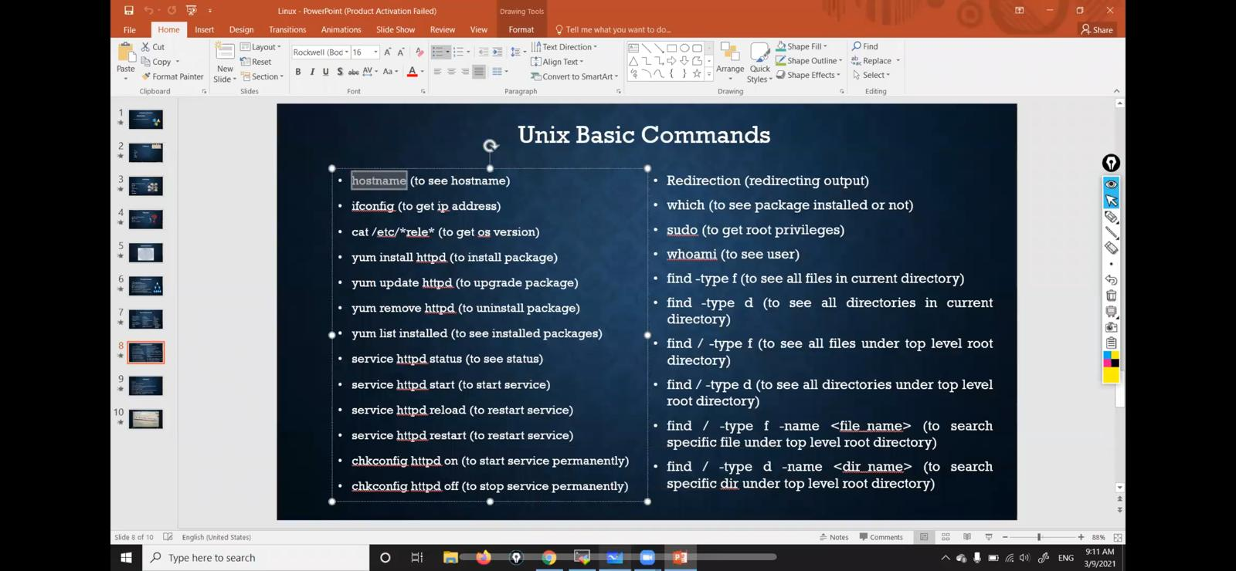

Slide 6
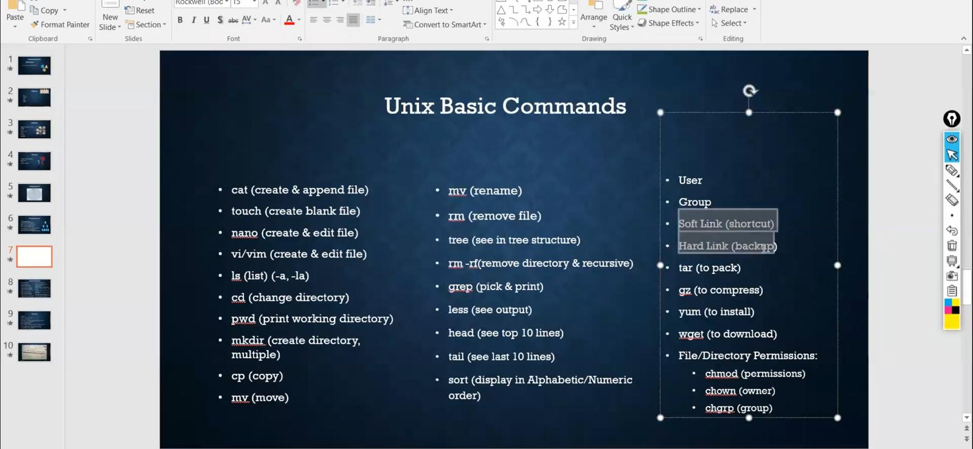

Slide 7
