Slide 1
Neighborhood selection for relocation
Ketan shende

Slide 2
introduction
Business problem
datasets
$25 billion relocation industry moves ~10% of US citizens every year
Job related relocation process is time sensitive: ~2-4 weeks for relocation
Data science tools to explore neighborhoods can greatly expedite the process
Neighborhood selection focused on:
Safety measure
Neighborhood facilities
Sample state: Minnesota, MN
List of cities – Wikipedia (here)
Crime Statistics – Article (here)
Incomplete crime statistics dataset led to a reduced overall dataset for analysis (79 cities)
Neighborhood info – Foursquare API

Slide 3
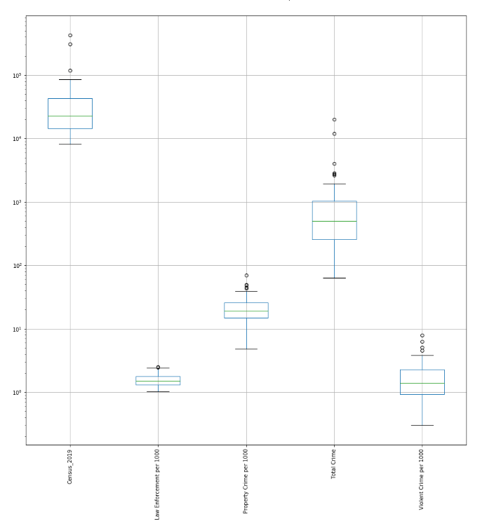
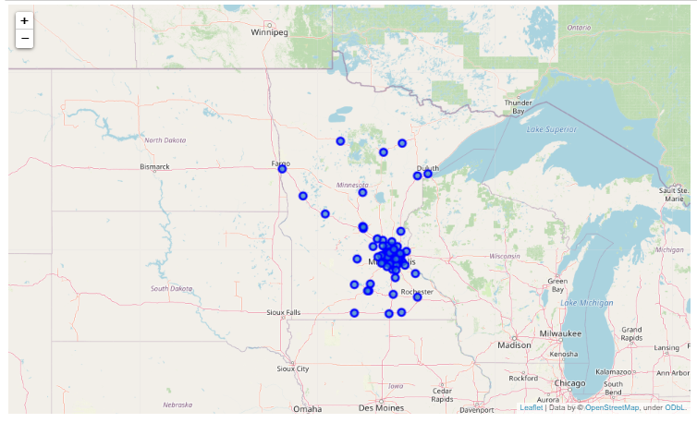
Exploratory analysis (1/2)
Most of the cities in Minnesota are closer to the southern border of the state
Three most populous cities account for 27% of total population

Slide 4
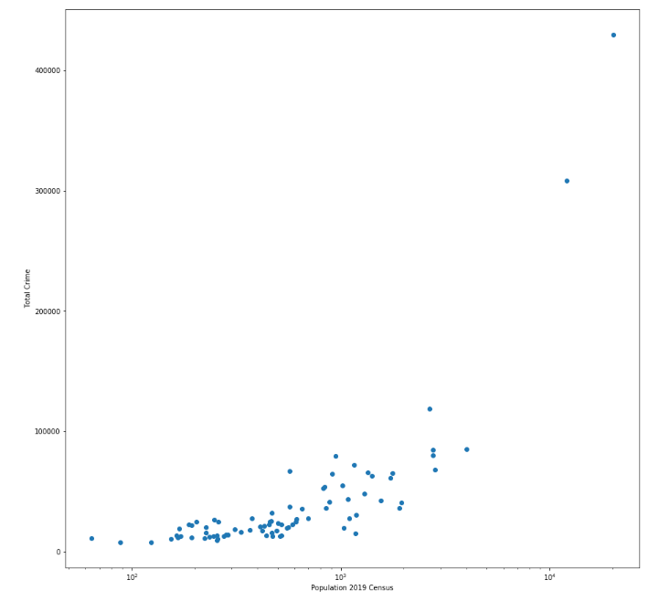
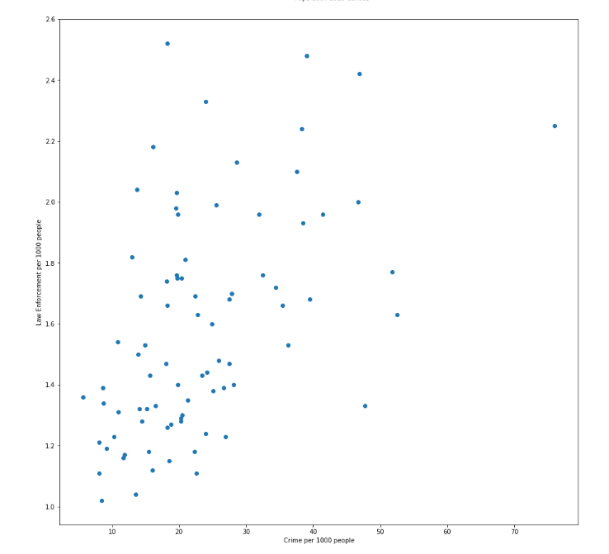
Exploratory analysis (2/2)
Total crime and law enforcement presence follow population size almost logarithmically
Interestingly, their ratio indicates that per 1000 people a small city of Bemidji (pop ~ 12k) has the highest crime rate

Slide 5
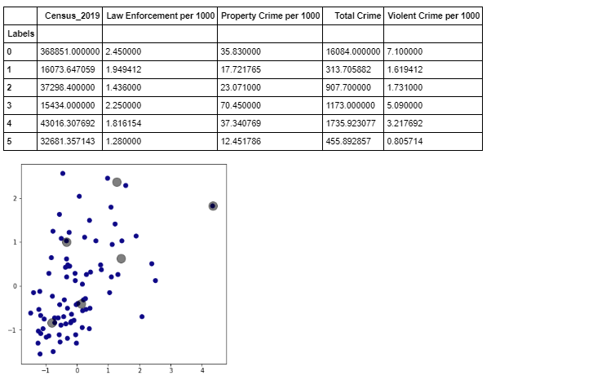
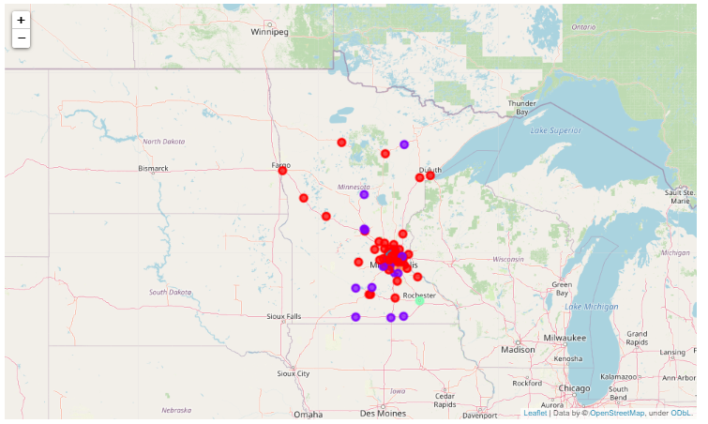
Neighborhood classification Results
Neighborhood clustering based on crime statistics
Map of Neighborhood clustering based on all parameters

Slide 6
Findings:
Population density decreases as we go northwards in Minnesota – the top 3 most populous cities of Minneapolis, St. Paul and Rochester are within 20 miles of each other
Clustering cities based on crime statistics show a few outliers - wide range of population skews the results – some clusters only contain 1 city.
Increasing number of clusters would help to address this problem
Most common neighborhood facilities include restaurants, parks and gym.
Some cities don’t have schools within 1 mile radius

Slide 7
conclusion
Analysis highlights neighborhood characteristics that can help in selecting potential neighborhoods for migration
Wide range of population skews the results – normalizing the parameters helps to discern neighborhood advantages
Analysis was limited by data availability – additional parameters of interest need to be added in future iterations:
Walkability / Local transportation score
City safety rankings based on nationwide comparison

