Slide 1

High Performance Computing
Performance profiling report
ASSIGNMENT_01

Slide 2
INTRODUCTION:
Application Overview:
A Flask application for Information Retrieval.
Utilizes TF-IDF vectorization for document similarity.
Implements feedback-based evaluation for performance improvement.

Slide 3
Objective:
Understand the importance of runtime information retrieval in a Flask application.
Utilize profiling tools to analyze and optimize the application's performance.
Implement feedback-based evaluation to enhance the relevance of search results.

Slide 4
Profiling Tools Selection:
Choice of Profiler:
Selection of Gprof for C profiling.
Gprof helps identify time-consuming functions.
Application Profiling:
Application uses cProfile to profile Python code.
Gprof analyzes C functions during runtime.

Slide 5
Implementation of Profiling:
Code Profiling:
Integarte ‘cprofile’ or Python code profiling.
Example: Profiling the Flask application.
Gprof Integration:
Profile C code for detailed function-level analysis.
Use Gprof to identify performance bottlenecks.

Slide 6
Analysis of Performance Issues:
Feedback Evaluation:
Implement a feedback-based evaluation function.
Analyze recall and precision for relevance.
Cosine Similarity Computation:
Analyze the computation of cosine similarity.
Identify areas for potential optimization.

Slide 7
Recommendations for Optimization:
Optimization Strategies:
Apply algorithmic and code-level optimizations.
Refactor time-consuming functions.
Profiler Insights:
Utilize Gprof insights to pinpoint areas for improvement.
Address performance bottlenecks based on feedback analysis.

Slide 8
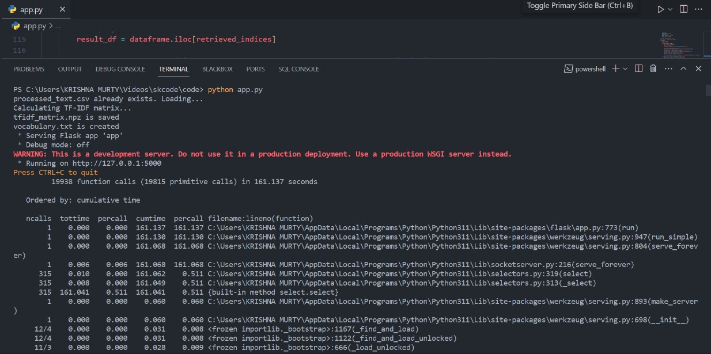
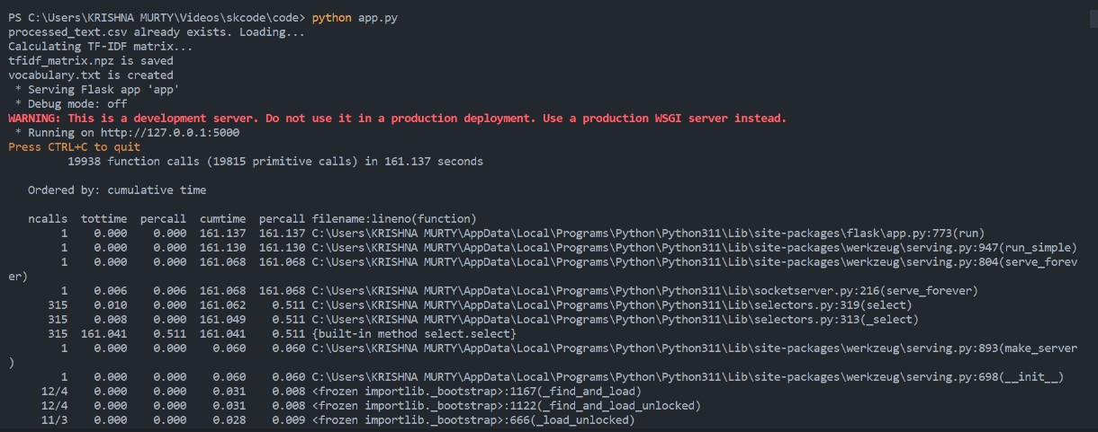
Appendies:

Slide 9
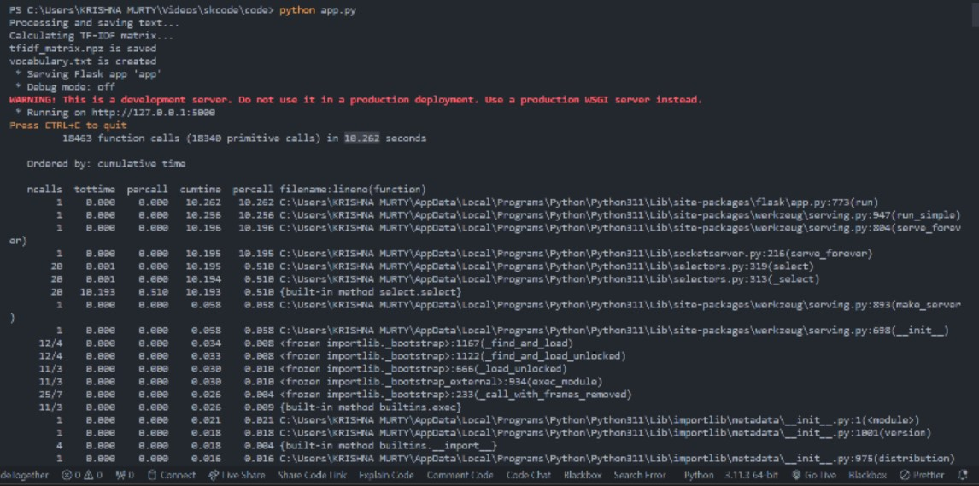
Include any additional code snippets, screenshots, or graphs generated during the profiling process:

Slide 10
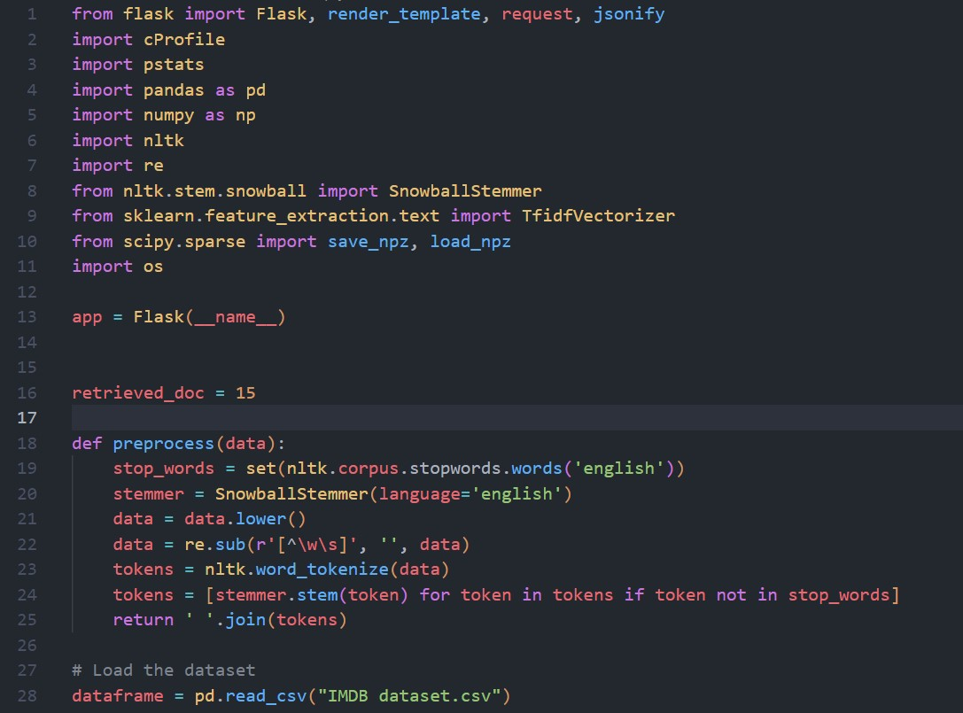
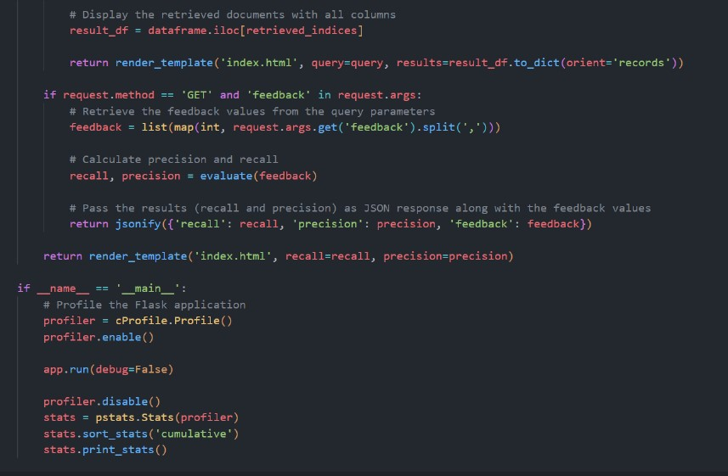
Code:

Slide 11
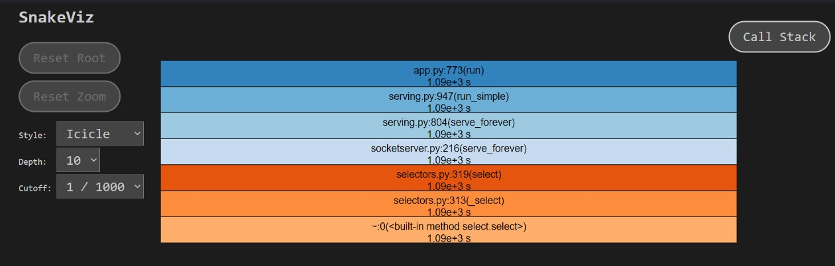
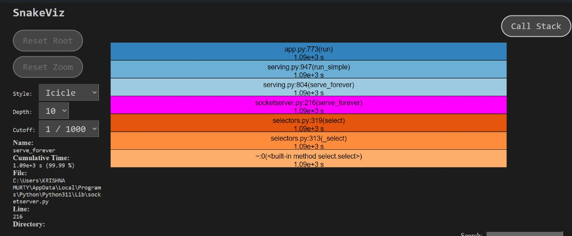
Profile analysis in Graphs visualization:

Slide 12
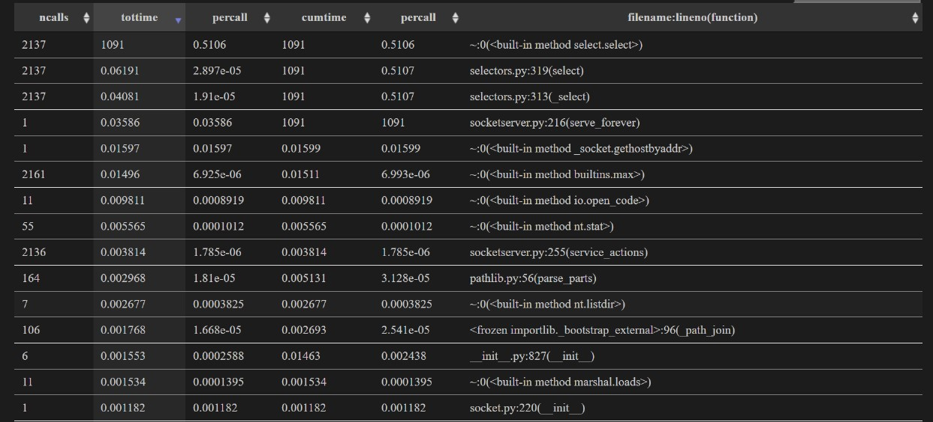
Profile Analysis:

Slide 13
Conclusion:
Key Takeaways:
Profiling is essential for identifying and addressing performance issues.
Gprof provides valuable insights into C code runtime.
Feedback-based evaluation improves relevance.
Next Steps:
Implement recommended optimizations.
Continuously monitor and profile the application for ongoing improvements.

Slide 14
Your best quote that reflects your approach… “It’s one small step for man, one giant leap for mankind.”
- Neil Armstrong

