Slide 1
AtliQ Sales Memory Assistant
An AI assistant that remembers every client promise, so busy founders don't have to
Venkat · Codebasics AI PM Capstone · October 2026
Notes:
AtliQ is a small data and AI services company where the founders do the selling. This deck walks through the problem we found, the opportunity we chose, the prototype we built, how we will measure success, and the risks and guardrails.

Slide 2




The story in one slide
Problem
Opportunity
Solution
Result
Follow-ups live in founders' heads and inboxes. Only about 1 in 6 happens on time, and USD 405k of deals has stalled.
AtliQ already has the answers in its email and notes. AI can read them and turn them into dated, owned tasks.
A daily brief of at most 7 items per person. Each item shows its source sentence and comes with a draft reply.
A working prototype with 12 of 12 checks passing. It costs about USD 455 a month to run, and AI is only USD 6.5 of that.
Notes:
If you remember one slide, it is this one. The rest of the deck backs up each of these four boxes.

Slide 3



Leads and promises are leaking out of the pipeline
0 of 40
USD 405k
CRM records have a follow-up date, so nobody is reminded of anything
sits in 7 valued deals that have stalled or been forgotten
21 days
4 leads
FinEdge, the biggest deal at USD 95k, waited for a reply to its email
wrote in (Harbor & Finch, Nimbus, Lumino, PixelWorks) and never reached the CRM
Source: the provided CRM export (40 records) and 50 emails and meeting notes. Dataset date: Friday 10 July 2026.
Notes:
These numbers come straight from the dataset. The CRM is empty where it matters most: not one record has a follow-up date. The founders said it themselves: we find out what's urgent by accident.

Slide 4

Who we built for: the founder-seller
Goals
Pains
Success looks like
Close the right deals fast, without letting a warm lead go cold
Grow revenue from happy clients
Spend less time on CRM admin
Calls and replies happen on the phone and never reach the CRM
Promises slip: ByteBridge case studies are 56 days late
Jay spends about 2 hours rebuilding the CRM before each review
Every open deal has a next step, a date and an owner
Clients get a reply within 2 working days
Every new lead is in the CRM within 24 hours
Bhavin, Dhaval, Karandeep
Founders who sell, deliver and run the company. Jay supports sales and keeps the CRM.
“We find out what's urgent by accident.”
Notes:
The persona is a composite of the three founders. Their behaviour is the key: they answer email on the phone between meetings and plan to update the CRM later, which rarely happens.

Slide 5
Discovery: the pipeline leaks at seven points
1
2
3
4
5
6
7
Capture
Log
Follow up
Propose
Close
Grow
Revisit
Never entered
Thin records
Promises slip
Questions wait
CRM is wrong
Cross-sells lost
Lost stays lost
4 inbound leads not in the CRM
MedTrack: “dashboards? or LIMS? both?”
ByteBridge case studies, 56 days late
Meridian waiting 24 days
Trustline said yes; CRM says Proposal Sent
Acme asked about forecasting
Quantia: “check back Q2 2026”
Insight: every leak has the same shape. The facts are already written down in an email or note, but nothing turns them into a task with a date and an owner.
Notes:
We walked one deal at a time through the sales journey and asked where it leaks. Seven stages, seven leaks, each with a real example from the dataset.

Slide 6
Root cause: the CRM depends on memory
1
Why did FinEdge (USD 95k) wait 3 weeks? Nobody noticed its email needed action.
Problem statement
AtliQ's founder-sellers need a way to capture and act on every sales conversation without extra effort. Today the CRM depends on them remembering and retyping what was said, so promises slip, referrals go cold, cross-sells go unnoticed and lost deals are never revisited.
2
Why didn't the CRM flag it? It only knows what someone types in.
3
Why isn't it updated? Updating is a separate step, done later at a laptop.
4
Why didn't “update the CRM same day” work? Founders have no spare time. It failed in April and again in July.
5
Why is there no safety net? The CRM is passive storage. It never reads email or reminds anyone.
Notes:
Five whys, starting from the most expensive symptom: FinEdge. The answer isn't more discipline. The team already tried that twice. The fix has to remove the retyping step.

Slide 7
We scored 16 ideas and chose five to build
Build now
Park for version 2
Lead catcher
Spots new leads in email and drafts the CRM record
Business card and voice note capture: no samples to test with
Proposal and questionnaire writer: a wrong answer is a legal risk
Objection helper: needs a case-study library first
F1
F2
Promise and deadline tracker
Turns “by Friday” into a dated task with an owner
F3
Waiting-on-us radar
Flags unanswered client emails and fixes stale statuses
Don't build
Win-probability score: 40 records is too little history
AI that emails clients itself: one wrong email costs a deal
Meeting bot: consent and privacy, and many calls are by phone
F4
Cross-sell and revisit spotter
Catches new needs and “try again later” dates
F5
Daily brief with draft replies
One short list each morning; a person sends
Notes:
Each idea was scored on impact and feasibility from 1 to 5. The rejected ideas matter as much as the chosen ones: we deliberately said no to an AI that emails clients on its own, because founder-led sales runs on personal trust.

Slide 8




How it works: AI reads, rules decide, people approve
1. Read
2. Verify
3. Rank
4. Approve
Claude Haiku 5.5 reads each email and note and lists promises, questions, deadlines and leads, each with the exact sentence it came from.
A plain checker looks for every quote word-for-word in the source. No match means the item is hidden. Unknown values say “Not stated”.
Simple rules set due dates (client questions: 2 working days) and order the list by days overdue, deadline and deal value. At most 7 per person.
Claude Sonnet 5.5 drafts replies. A person edits and sends them, and approves every CRM change. Every click is logged.
Why this split: AI does the reading, which it is good at. The decisions that must be predictable and explainable (what is due, what comes first) stay in plain rules anyone can check.
Notes:
Example: Karandeep wrote 'I'll send both, plus a reference, by Friday' to ByteBridge on Tuesday 12 May. The AI pulls out that promise with the quote. The checker confirms the quote is in the email. The rules work out the due date, 15 May, and that it is 56 days overdue.

Slide 9
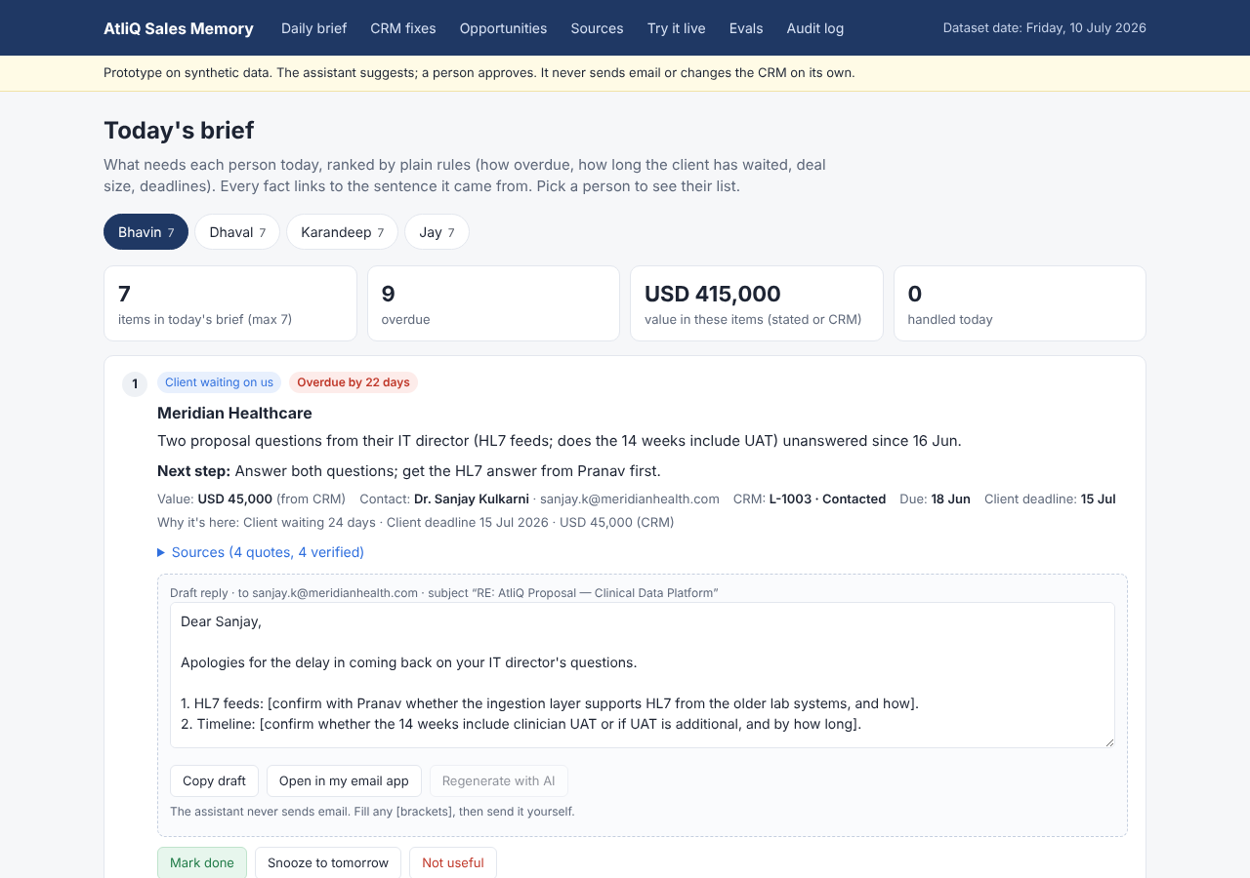
Walkthrough: each founder's daily brief
1
Pick a person
Bhavin, Dhaval, Karandeep or Jay. Each sees at most 7 items.
2
See why it's here
Meridian: client waiting 24 days, deadline 15 July, USD 45k.
3
Check the source
Every fact opens to the sentence it came from, marked verified.
4
Send the reply yourself
Edit the draft and copy it. Unknown facts stay as [brackets].
5
Mark done, snooze or “not useful”
Each choice is logged and tunes the list.
Notes:
Live demo: open the Daily brief, switch to Bhavin, open Sources on Meridian, then mark it done and show the next item move up.

Slide 10
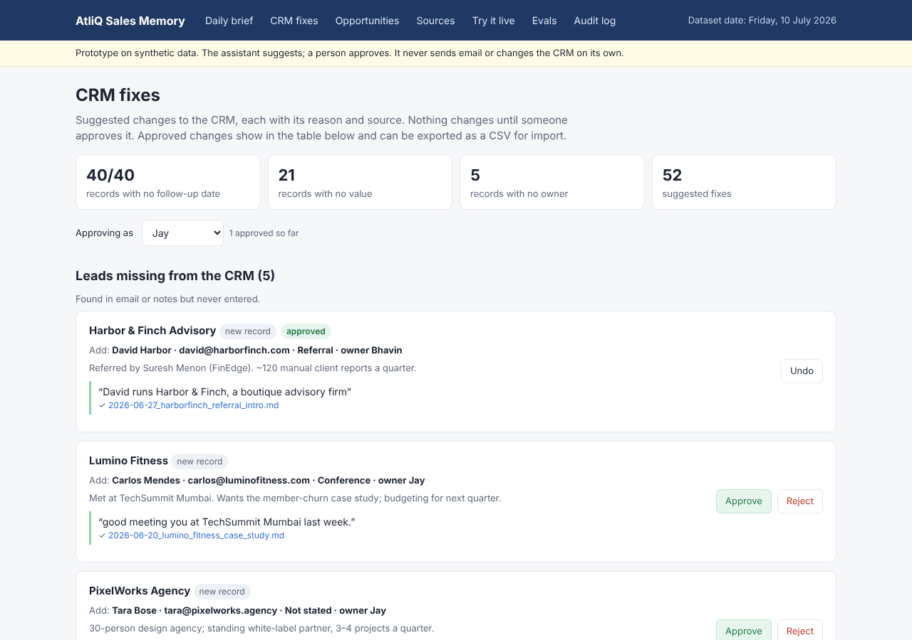
Walkthrough: CRM fixes need a person's click
1
Missing leads
Harbor & Finch, Lumino, PixelWorks, Nimbus and Ridgeline, drafted from their emails.
2
Duplicates
Meridian (L-1003 and L-1027) and GlobalMart are flagged, not merged.
3
Wrong statuses
Trustline is won and Kaveri is live again, so status changes are suggested.
4
Approve, reject or undo
Nothing changes until someone approves. The result exports as a CSV.
Notes:
The CRM page shows 52 suggested fixes. Here Harbor & Finch has been approved, and the audit log records who approved it and when.

Slide 11
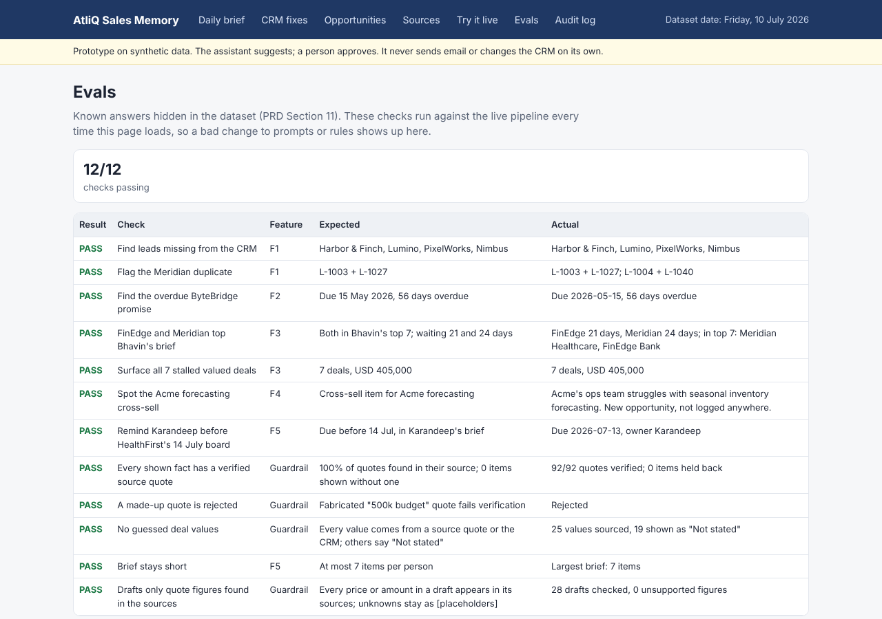
Walkthrough: proof that it can be trusted
1
12 of 12 checks pass
Known answers hidden in the dataset are re-checked every time the page loads.
2
92 of 92 quotes verified
A made-up “500k budget” quote is caught and rejected.
3
No guessed values
25 values are sourced, and the other 19 say “Not stated”.
4
Try it live
Paste a new email and the same checks run on what the AI finds.
Notes:
Evals are the PM's safety net. If someone changes a prompt or a rule and breaks a known answer, this page turns red.

Slide 12

North Star: follow-ups done on time
Supporting metrics
On-time follow-up rate
Deals with a next step and date
0 of 40 → 90%
New lead in CRM
within 24 hours
Client questions, our promises and new leads acted on by their due date, divided by all that were due.
Median client wait
2 working days or less
CRM admin time
2 hours → 20 minutes
~17%
today (about 1 in 6)
Facts backed by a source
95% or more
Stalled pipeline revived
USD 200k of 405k in 90 days
80%
in 8 weeks
Guardrail metrics (must hold)
90%
in 6 months
0 emails sent or CRM changes made without a person · at most 7 items per brief · under 30% of suggestions rejected
Notes:
The North Star captures the whole problem in one number: did the thing that was due get done on time? Today it is about 6 of 36. The supporting metrics explain why it moves, and the guardrail metrics make sure we don't buy speed with risk.

Slide 13
It costs about USD 455 a month to run
USD 6.5
a month for AI: Haiku 5.5 reads, Sonnet 5.5 drafts
USD 7,200
one-time build cost
~9 months
to pay back from founder time saved
USD 31
a month even if we used the top model (Opus 5.5) everywhere
Notes:
Volumes: about 60 emails and 4 notes a day, and 15 draft replies a day. The AI is about 1% of the cost, so the model choice is about quality, not money. We use the cheap model for high-volume reading and the stronger model for the client-facing drafts.

Slide 14
Risks, and the guardrails that handle them
Risk | Guardrail in the product | How we check it
AI makes up a fact or a number | An item is shown only if its quote is found word-for-word; unknown values say “Not stated” | 95% or more of facts backed by a source; fake-quote eval
A wrong email reaches a client | There is no send button. The person edits and sends the draft from their own email | 0 emails sent without a person
A bad suggestion corrupts the CRM | Every change needs Approve, can be undone, and is logged with who and when | 0 CRM changes without a person
Too many alerts, so people stop reading | At most 7 items per person, ranked by plain rules; the rest sit under “See all” | Brief open rate; under 30% rejected
AI misses a promise | Known-answer evals run on every change; “Not useful” feedback is reviewed weekly | Under 10% of promises missed
Client data goes where it shouldn't | Only the email being read and matching CRM rows are sent to the model; sales mail only | Monthly access review
Notes:
Every guardrail from the Step 2 opportunity map is built into the prototype, not just written down. The third column is how we would know if it stopped working.

Slide 15
Rollout plan and next steps
Alpha
Beta
Phased rollout
Full release
13–24 Jul
27 Jul–21 Aug
24 Aug–18 Sep
30 Sep
Run on the sample dataset; tune prompts and rules against the evals
Dhaval uses the brief, promise tracker and radar (F2, F3, F5) daily
All founders; adds the lead catcher (F1) and CRM write-back
Everyone; the cross-sell spotter (F4) follows after version 1
Before a real launch
Connect live Gmail and the CRM instead of the frozen sample files
Move decisions and the audit log to a server, with sign-in for each founder
Review real “Not useful” feedback weekly and grow the eval set from it
Notes:
The rollout starts small on purpose: one founder, three features, and the North Star tracked weekly before anyone else is added.

Slide 16


Thank you
Nothing slips, the CRM stays right, and a person always presses Send.
Code and README: github.com/kvsmisc96-cloud/atliq-sales-memory
Also delivered: problem discovery worksheet, opportunity map, AI PRD, cost estimate

