Slide 1

UNIVERSITY MANAGEMENT SYSTEM

Slide 2
Why this project?
Introduction
The system was designed as a role-based offline prototype for a university environment.
Problem
Goal
Success criteria
Manual student management causes repeated data entry, unclear ownership, slow updates for attendance and marks, and no single place for students to check their status.
Build one management system where Admin manages records, Staff updates academic data, and Student views only their own information and takes exams.
Separate logins, generated credentials, file-based persistence, exam publishing control, timed student exam, and dashboards that mirror real university workflows.
Designed in Eclipse WindowBuilder so the UI can be visually built and then connected to code logic.
Every critical action shows feedback through pop-up messages for better usability.
Logic was prioritized over decoration: role security, flow correctness and data persistence were the main focus.

Slide 3
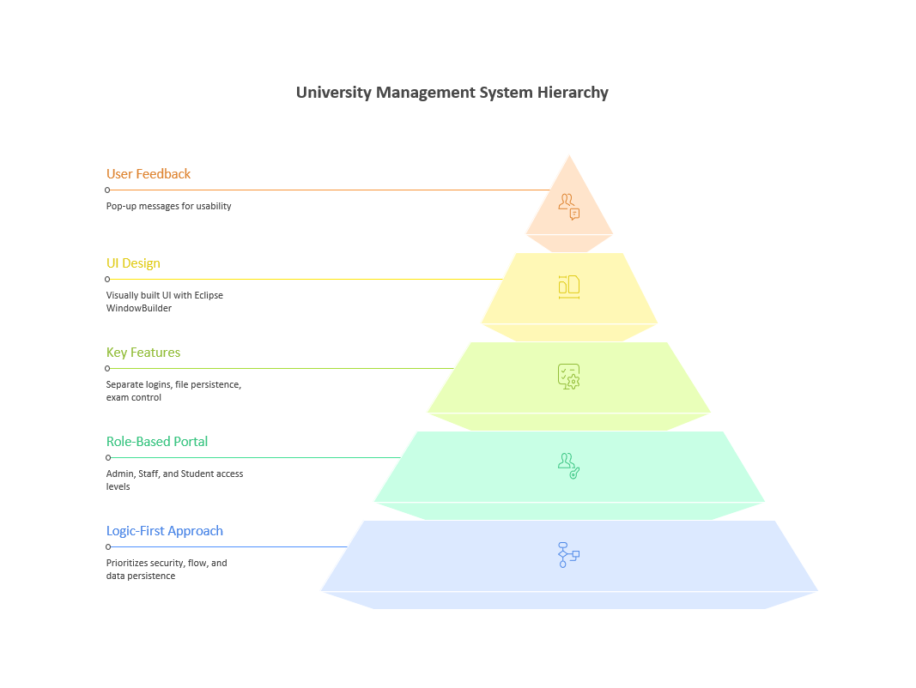

Slide 4
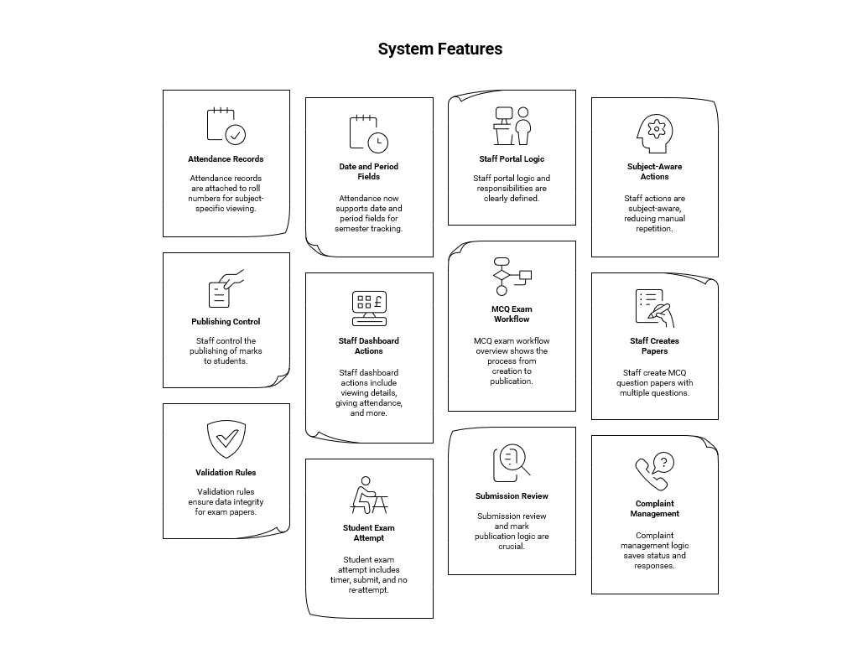

Slide 5
Key insights and design decisions
Insights
Role separation
Generated identity
Admin creates student accounts and payments; Staff controls attendance, exams, complaints; Student only views personal data and attempts exams.
Roll number, username and password are generated to reduce manual errors and to make student login practical.
Publish-before-view marks
Students do not see immediate marks; staff must publish them. This matches real exam governance.
Logic lens
Project principle:
UI is visual, but logic is rule-driven.
Every feature answers one question:
who can create it?
who can update it?
who can only view it?
This is the rule that makes the portal realistic.
3
Offline first
Text files were used as a simple local data layer to keep the prototype runnable without a server or database.

Slide 6
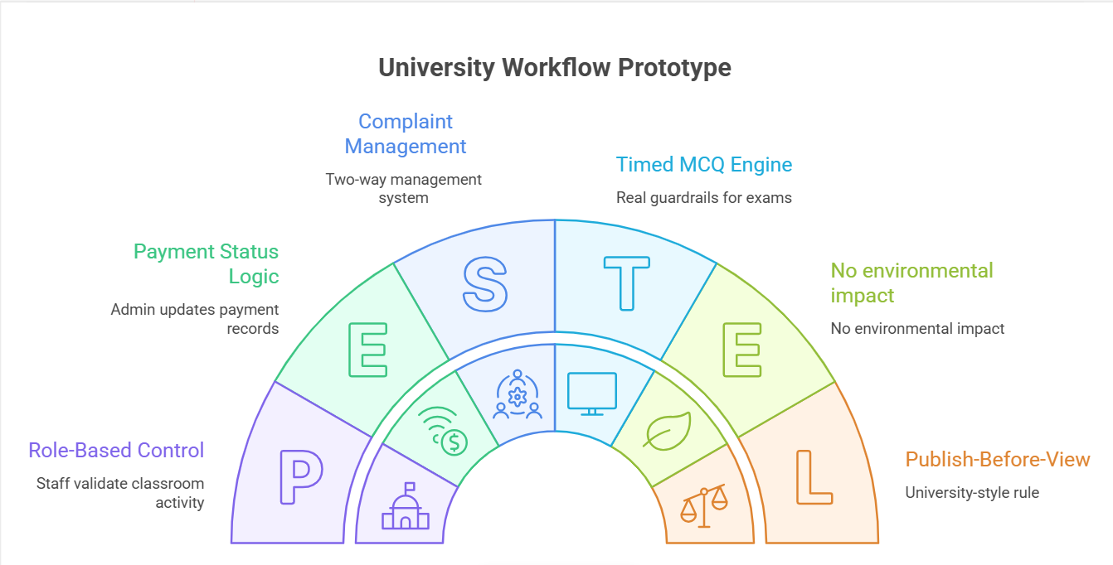

Slide 7
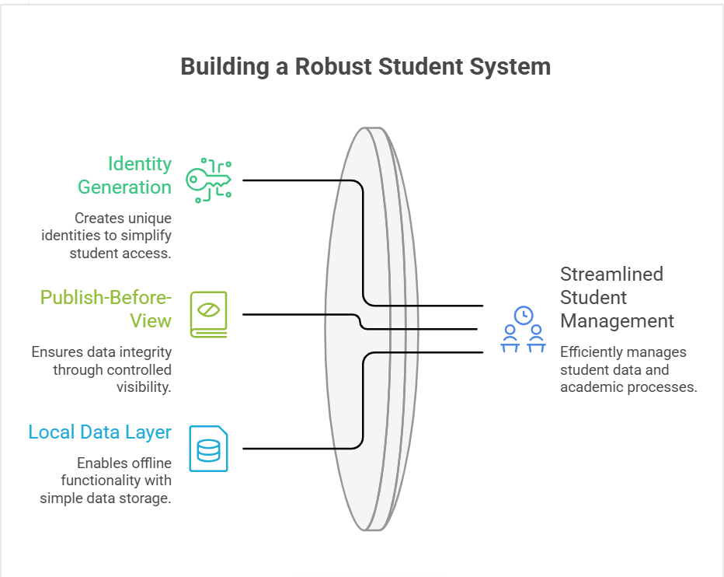
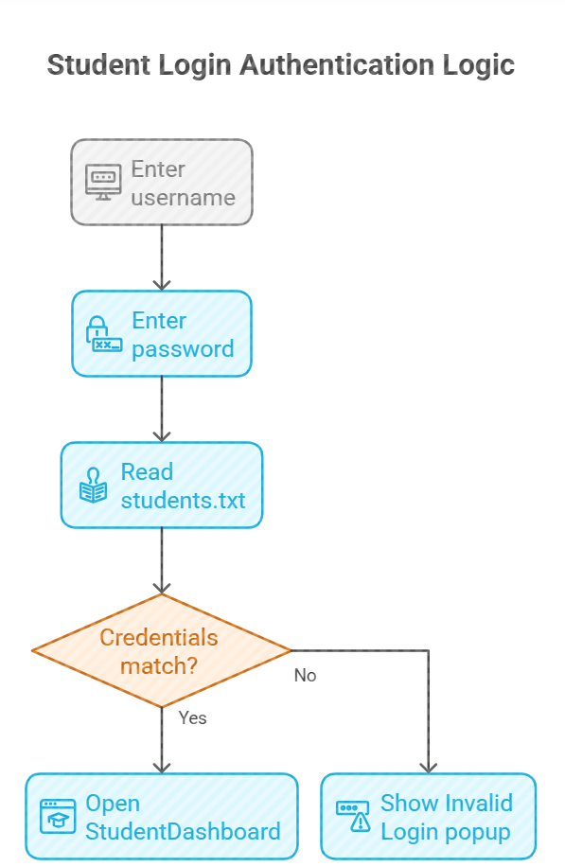

Slide 8
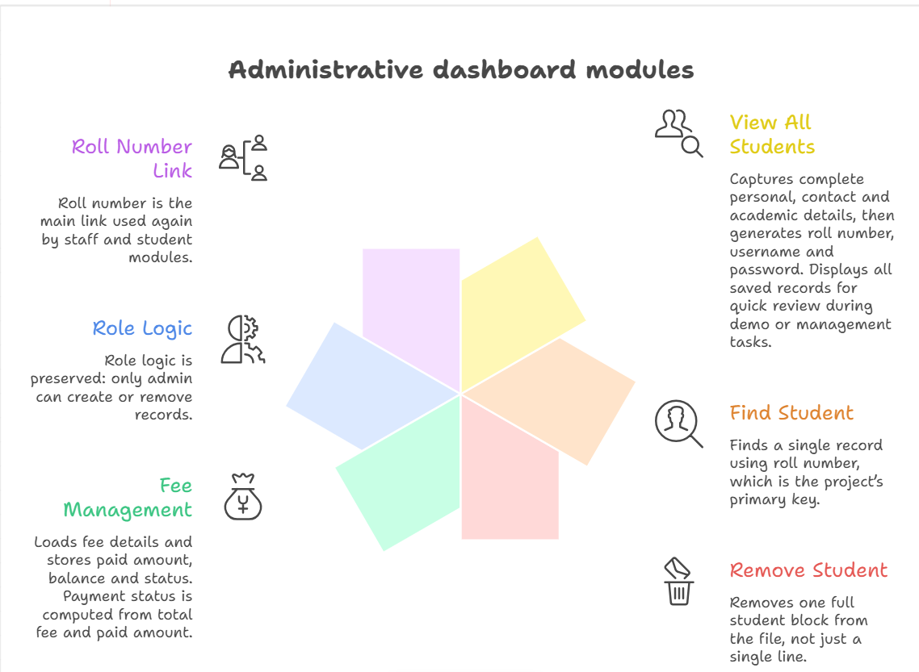
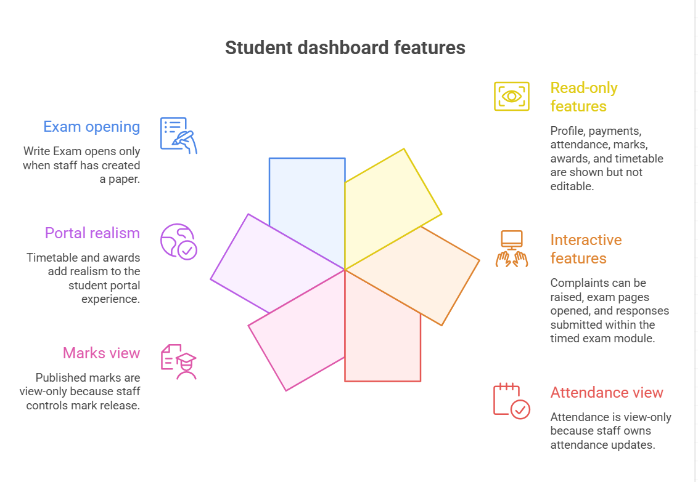

Slide 9
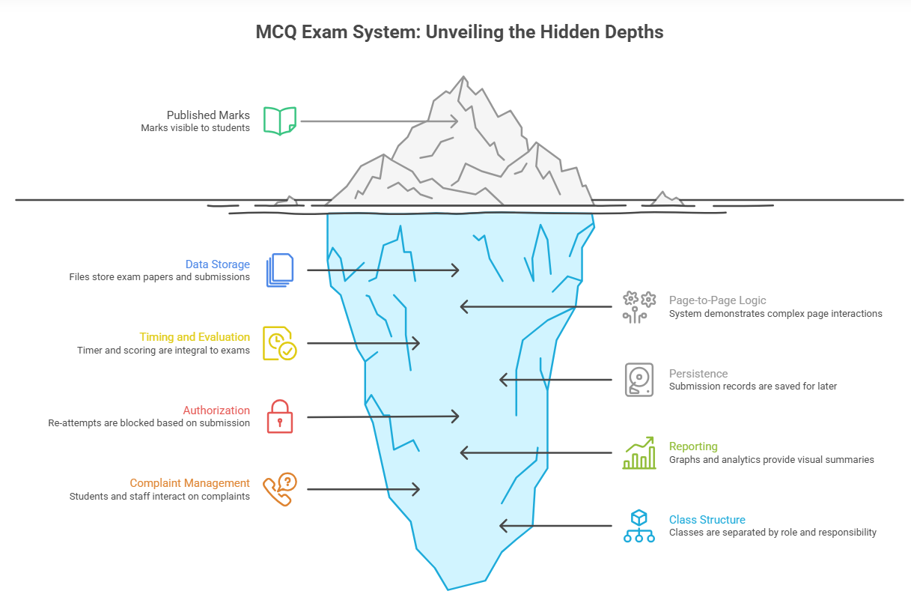
Methodology
Methodology and development environment
WindowBuilder workflow
Design the JFrame visually → place components like labels, fields and buttons → assign names/events → connect event handlers to business logic. This reduced layout friction and kept the focus on application flow.
Technology stack
Process used
Java
Swing
Eclipse IDE
WindowBuilder
Text-file persistence
1. Build UI shell
2. Connect login logic
3. Add file persistence
4. Add role-specific modules
5. Add exam engine
6. Add analytics
6
Started with page navigation first so the whole system could be demonstrated end-to-end.
Then added persistence and control rules so each role had correct permissions.
Finally added advanced features: timed exams, publish marks, complaint status and graphs.

Slide 10
Why each Java Swing component was used
Main modules
• Entry point: MainPage
• Login pages: AdministrativeLoginPage, StaffLoginPage, StudentLoginPage
• Dashboards: AdministrativeDashboardPage, StaffDashboardPage, StudentDashboard
• Specialized pages: attendance, marks, payments, complaints, exam creation and exam writing
JFrame
JTable + DefaultTableModel
Main window for each portal or submodule like login, dashboard, attendance, and exam pages.
Used to show structured data like attendance, marks, analytics, complaints, and student lists.
JTextField
JRadioButton + ButtonGroup
Used for username, roll number, marks, amounts, dates, and general input.
Used in MCQ exams so the student can choose only one option per question.
JButton
JLabel
Triggers all actions through event listeners: login, save, search, generate, publish, refresh, and logout.
Used for titles, field names, instructions, timer text, and welcome messages.
Component flow
JScrollPane
JComboBox
Example UI logic
create JFrame
add JPanel
add JLabel title
add JTextField username
add JPasswordField password
add JButton login
on click -> validate -> navigate
Wraps tables and text areas so large content stays readable and scrollable.
Used where the user must pick from fixed options such as course/branch instead of typing random text.
JPanel
JTextArea
Used to group controls and keep screen layout organized.
Used where longer text is needed, like complaints and multi-line guidance.
JPasswordField
Timer
Used in login pages to hide password characters.
Used in the exam module to enforce 35 minutes and auto-submit when time is over.

Slide 11
Complaint management logic
MCQ exam workflow overview
Status + response saved in complaint_status.txt
Staff
creates
paper
Student
submits
complaint
Stored in
complaints.txt
Staff
reviews
Submission review and mark publication logic
Paper
saved
Write final mark into exams.txt and mark Published = Yes
Student
submission
View in
submissions
Select
row +
publish
Student
opens
Exam & Student
submits
Attendance management: from staff entry to student view
Staff enters
roll + subject
Add date,
period, total,
present
Save to
attendance.txt
Student dashboard reads by roll and computes percentage
Staff publishes marks

Slide 12
Admin dashboard pseudo code
Student registration Pseudo code
if admin login succeeds:
open AdministrativeDashboardPage
choose module
perform save / search / delete / update
show pop-up feedback
Input: personal details + contact details + academic details + course
fees = courseFeeMap[course]
roll = generateRoll(course, year, sequence)
username = normalize(studentName)
password = defaultPassword or generated token
save block to students.txt
Name / Roll / Course / Contacts / Fees / Username / Password
show popup("Student data saved successfully")
Payment Status logic
balance = totalFees - paidAmount
if paidAmount <= 0: status = "Pending"
else if balance == 0: status = "Completed"
else: status = "Partial"

Slide 13
Student Pseudo code
enter subject + exam title
repeat for any number of questions:
enter question
enter option A / B / C / D
enter correct answer
click ADD QUESTION
click FINISH PAPER
write END_EXAM marker
for each student block in students.txt:
read Name, Roll, Username, Password
if username == inputUser and password == inputPass:
open StudentDashboard(name, roll)
stop
Staff creates MCQ question papers Pseudo code
Attendance formula
percentage = (present * 100.0) / total
store as subject,total,present,date,period
student view filters only matching roll

Slide 14
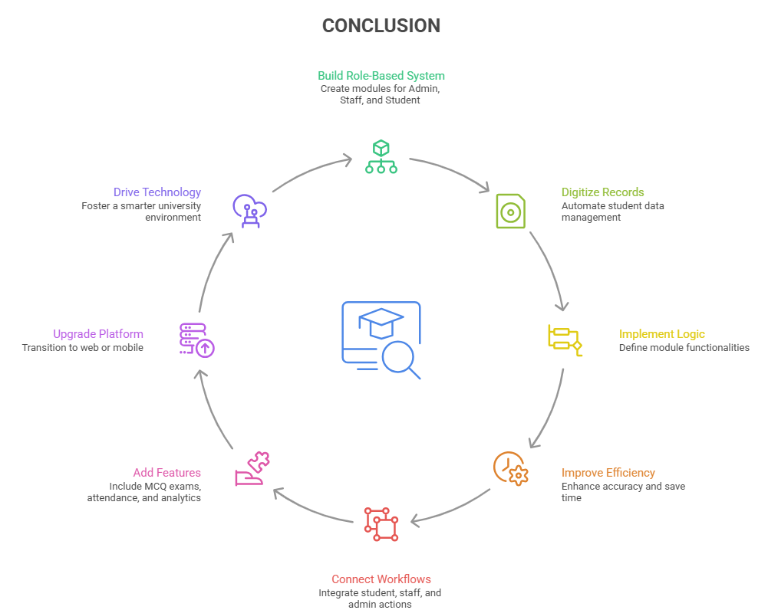

Slide 15

THANK
YOU.

