Slide 1


Microservices
By Ravindra

Slide 2
Agenda
Distributed log tracing with Zipkin and Sleuth

Slide 3
Challenges in Microservices
Log tracing is the major challenge in microservices distributed applications.
Distributed service calls can be traced using zipkin server.
Sleuth is the client application (Microservice applications)
Zipking is the server and it provides default UI to trace the logs and log latency.
Once the hits the any microservice application we can see the application name, trace id span id and exportable in logs.
Create a new Zipkin server application or Pull the Zipkin docker image and run it in server.
Add sleuth dependency to all the Microservice applications to trace the logs in Zipkin server.
Store all the trace id with any external data base or use ELK stack to store and track the logs.
Pull and Run Zipkin from docker image.
>docker run -d -p 9411:9411 openzipkin/zipkin

Slide 4
Lets here Service-2 is taking more time to respond to the service -1. We can use the Zipkin server to trace the logs by using trace id.
Sleuth will produce the logger as a [applicationName, spanId, traceId,exportable]
Here the same trace id can be seen all the Microservices for the same request.
If it is exportable true means, trace id can be seen in Zipkin server.
[SpringBootRedisCache,ec2645a7be17ce31,ec2645a7be17ce31,true]
Eureka
Service-1
Service-2
Service-3

Slide 5
Step 1: Latest spring cloud versions no need to write our own Zipkin server. Just pull the docker image and run it.
Step 2: If you want to write your own zipkin server add the zipkin related dependencies to your application and write @EnableZipkinServer to the application class.
<dependency>
<groupId>io.zipkin.java</groupId>
<artifactId>zipkin-autoconfigure-ui</artifactId>
<version>2.11.6</version>
</dependency>
<dependency>
<groupId>io.zipkin.java</groupId>
<artifactId>zipkin-server</artifactId>
<version>2.11.6</version>
</dependency>
@SpringBootApplication
@EnableDiscoveryClient
@EnableZipkinServer
public class Application {
public static void main(String[] args) {
SpringApplication.run(Application.class, args);
}
}

Slide 6
Step 3: Add the below properties in Zipkin server application.properties file.
management.metrics.web.server.auto-time-requests=false
spring.main.allow-bean-definition-overriding=true
Step 4 : Add the Sleuth(Zipkin client) dependencies in the all the Microservice applications.
<dependency>
<groupId>org.springframework.cloud</groupId>
<artifactId>spring-cloud-starter-sleuth</artifactId>
</dependency>
<dependency>
<groupId>org.springframework.cloud</groupId>
<artifactId>spring-cloud-starter-zipkin</artifactId>
</dependency>
<dependency>
<groupId>org.springframework.cloud</groupId>
<artifactId>spring-cloud-sleuth-zipkin</artifactId>
</dependency>
Step 5 : Add the below properties in all the client applications.
spring.zipkin.base-url=http://localhost:9411/
spring.zipkin.sender.type=web
spring.sleuth.sampler.probability=100
management.endpoints.web.exposure.include=*

Slide 7
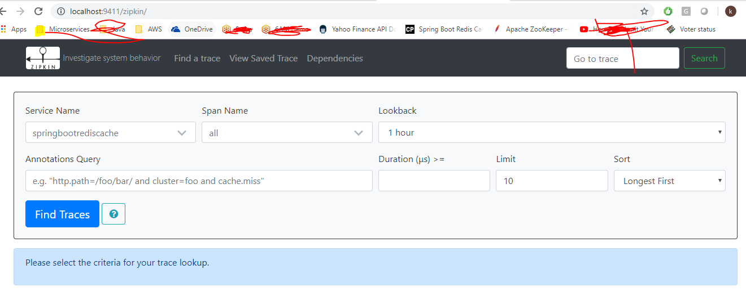
Step 6 : Start Zipkin server and Seluth application(Microservice application) and open the Zipkin server URL
http://localhost:9411
Here 9411 is the Zipkin server default port.

Slide 8
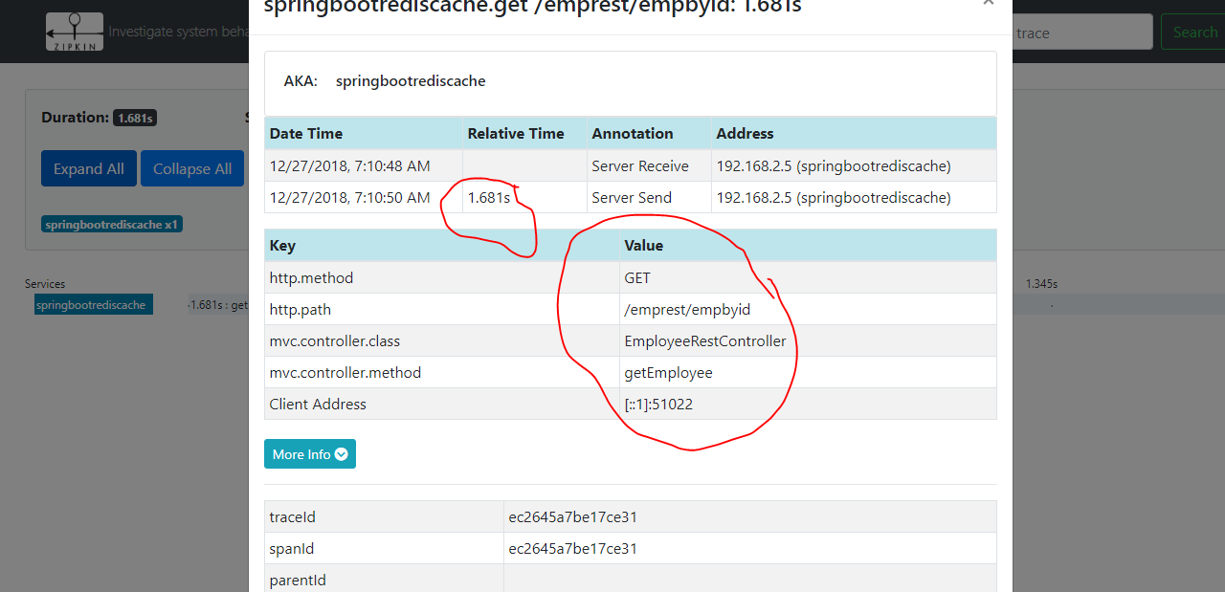
Step 7: Search the trace id in the Zipkin server UI. It gives all the endpoint execution details and how much time it has taken for the service execution.

Slide 9
Interview Questions
How do you trace the logs in Distributed environment?
What is Zipkin and Sleuth
Have you implemented your own Zipkin server or used the docker image?
How do you check the Microservice application latency.
What is the Zipkin server default port.
Where do you store the Zipkin trace id’s.

Slide 10
Questions
?

Slide 11
Thank you

