Slide 1
STYLE-X PROTOTYPE
TEAM 1

Slide 2
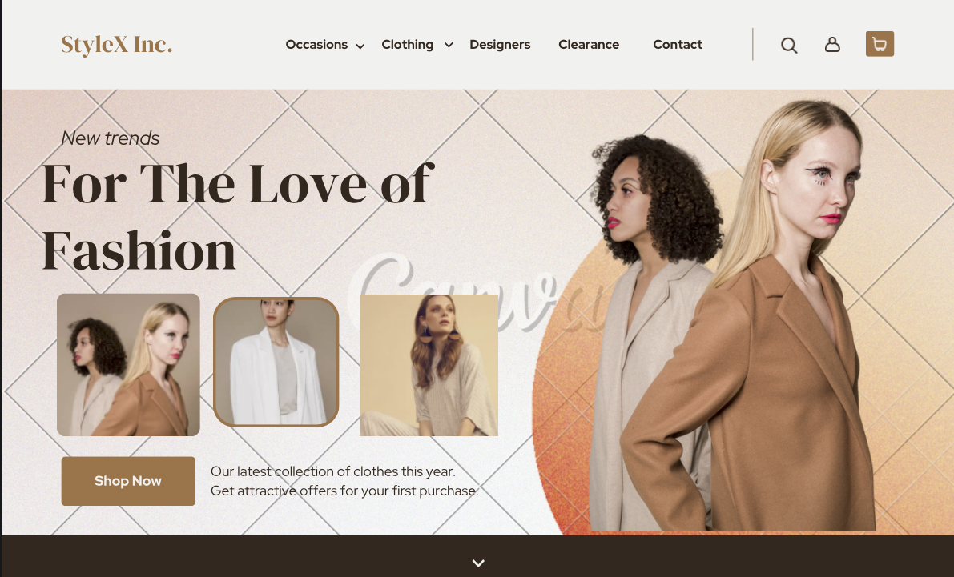
LANDING PAGE

Slide 3
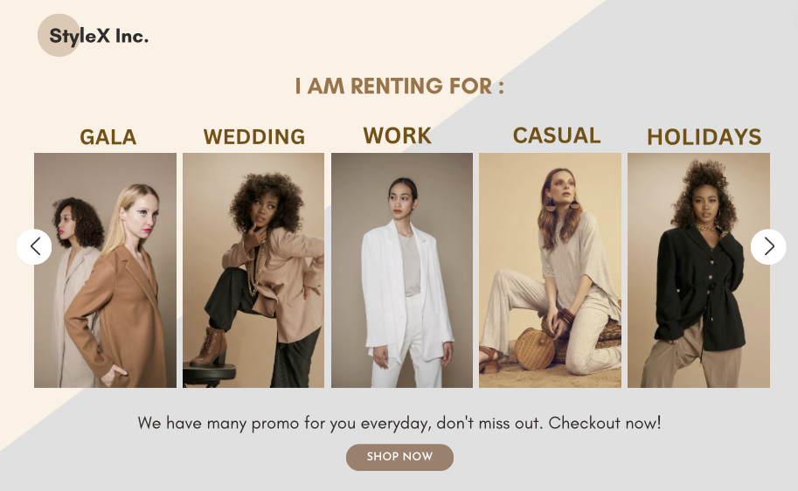

Slide 4
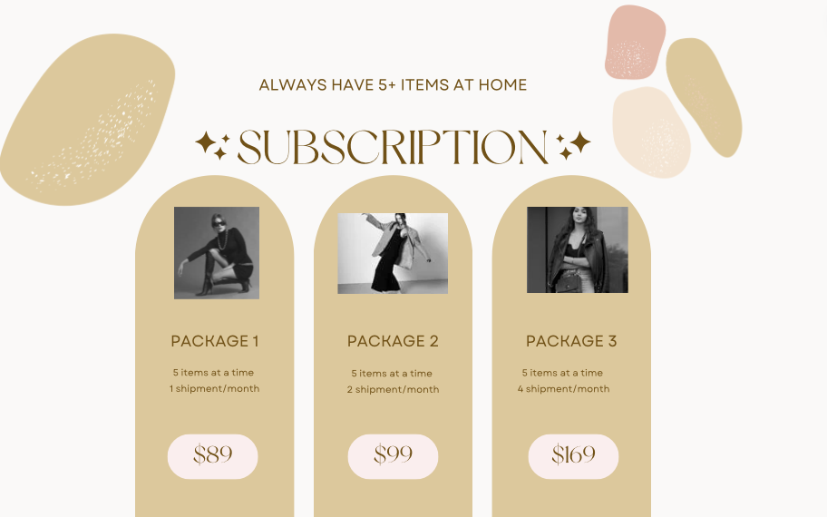

Slide 5
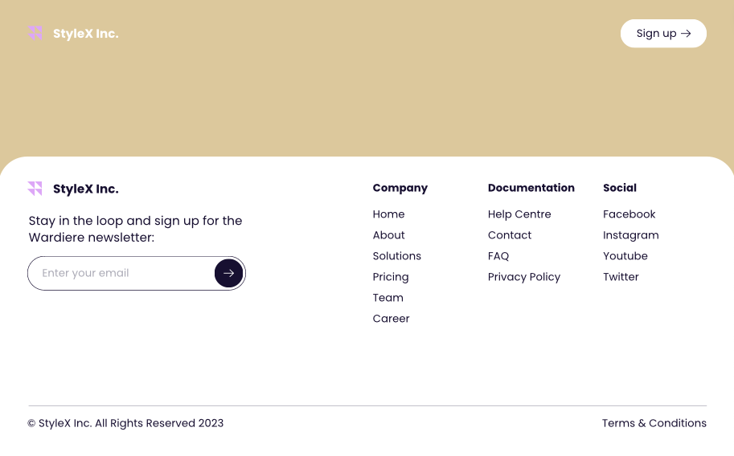

Slide 6
DESIGN INSPIRATION : NUULY
REFERENCE : https://www.nuuly.com
Diverse Selection: Nuuly offers a wide range of designer brands and styles to cater to various tastes and occasions.
Flexible Rental Options: Providing both one-time rentals and subscription models to suit different customer needs and preferences.
Personalization: Offering recommendations based on user preferences and past rentals.

