Slide 1

BRM AND SIPOC DIAGRAMS AND USER ROLES
TEAM 1 CAPSTONE PROJECT CRN 21180

Slide 2
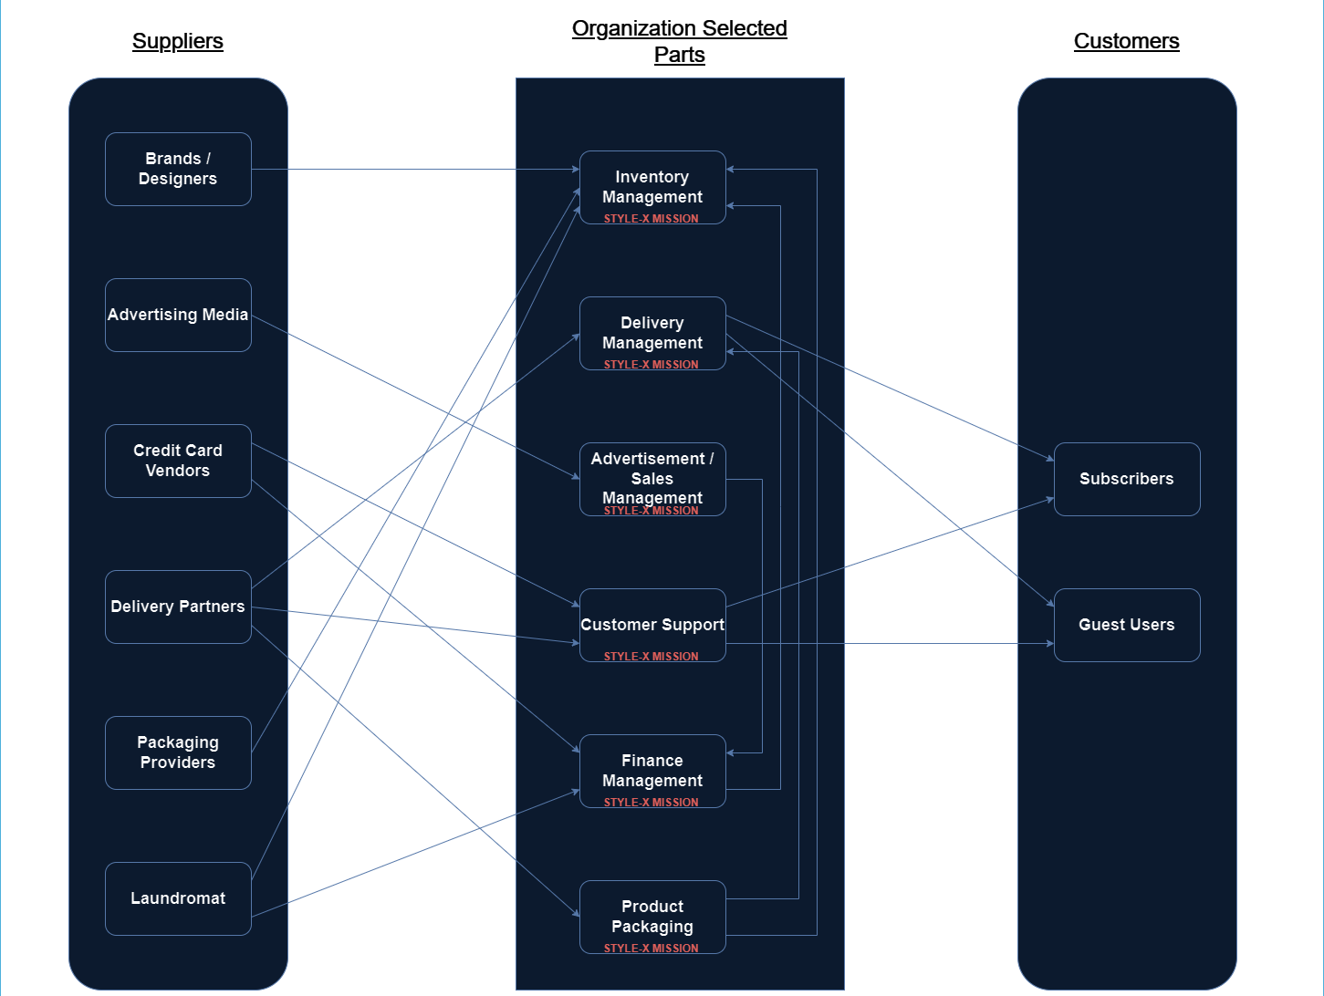

B
R
M
StyleX Mission
StyleX Mission

Slide 3
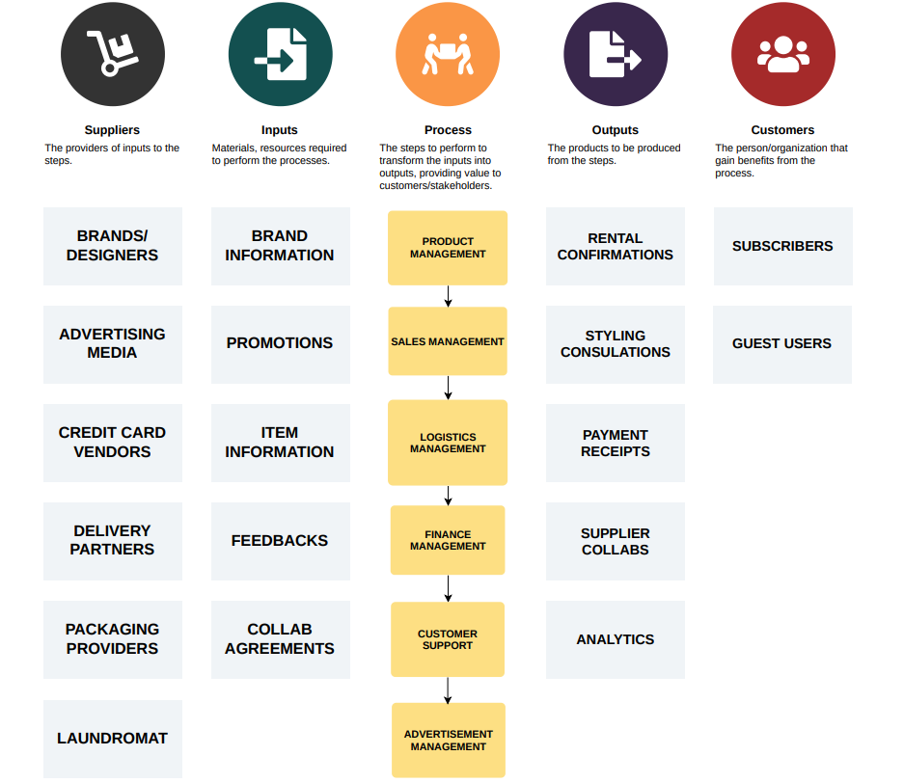
SIPOC MODEL

Slide 4
USER ROLES BY BUSINESS GROUPS
EXTERNAL USERS:
USER ROLES | TEAM MEMBERS
Subscribed Users | Sharath, Vineet
Guest Users | Rohith, Kalpana
INTERNAL USERS :
INTERNAL USERS:
BUSINESS GROUP | USER ROLES | TEAM MEMBERS
Inventory Management | Inventory Analyst Inventory Coordinator | Anirudh , Nikhil
Delivery Management | Logistics Manager Delivery Operations Specialist | Sakshi , Dhivya
Sales Management | Sales Strategist Account Manager | Anirudh, Ram Prakash
Customer Support | Customer Service Representative Support Team Lead | Aisha , Honghao
Finance Management | Financial Analyst Financial Transactions Coordinator | Somil , Nikhil
Product Packaging | Packaging Designer Packaging Operations Manager | Sivasai, Gauri

