Slide 1
Elastic
Aug 7th, 2017

Slide 2
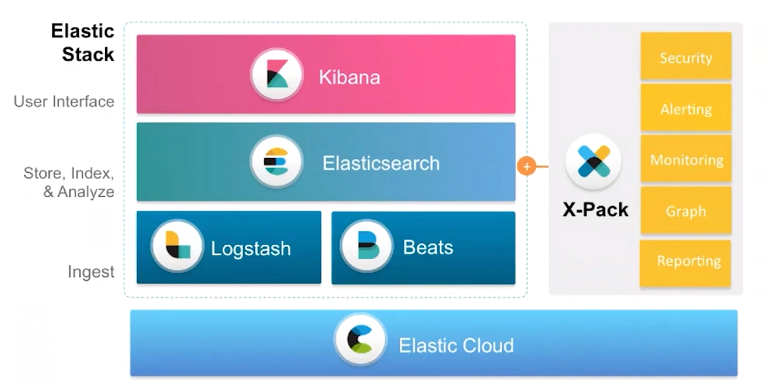
Elastic Stack & Extra Pack

Slide 3
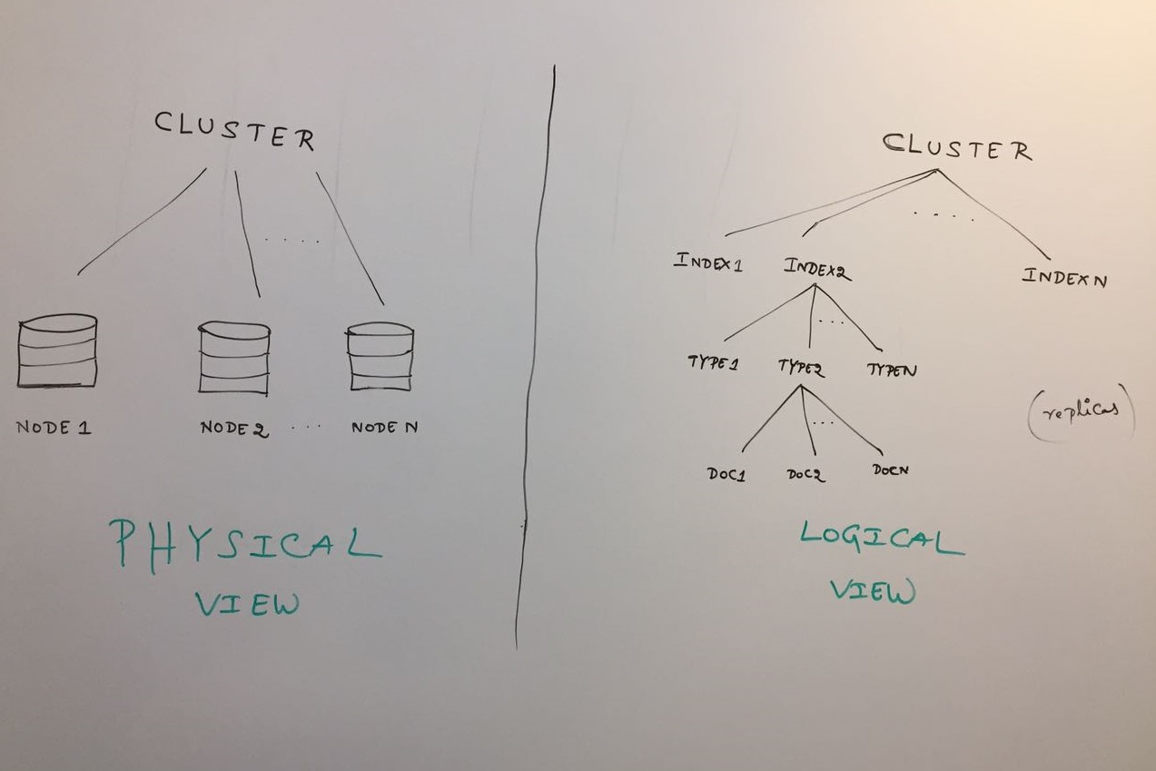
Elastic Search Cluster

Slide 4
Thank You!

