Slide 2
AWS & Impetus GenAI Hackathon

Slide 3
AI-driven live call insights
Team Name: Sahre
Team Members: Sankar, Siddarth
Note: All solutions submitted during the event will become the property of Impetus Technologies. Impetus reserves the right to use, develop, and extend the submitted ideas further. Participants will not retain ownership rights or control over the idea or its future use by Impetus.

Slide 4
Introduction
Team Members:
Sankar Role: Team Leader, Architect & Frontend Developer Responsibilities: System architecture design, frontend development, UI/UX integration, and overall project coordination.
Siddarth Role: Backend Developer Responsibilities: API development, database design, server-side logic, and integrations.
Team Leader Contact Information
Name: Sankar Email: kvs.sankar001@gmail.com Phone: +91 9347994869

Slide 5
Problem ​statement​
Modern sales and support teams struggle to keep up with the pace of live customer conversations. Representatives often miss opportunities or give incomplete answers due to lack of real-time contextual information. The goal is to develop a GenAI-powered solution that provides real-time, speech-to-text-based insights and actionable suggestions during live calls, using pre-trained company knowledge.
Scope of the Solution
The solution will:
• Accept pre-call documents or contextual materials (e.g., meeting agenda, CRM data, past tickets).
• Perform real-time speech-to-text conversion of the ongoing conversation.
• Use GenAI with pre-trained domain-specific data to identify key moments during the call.
•Trigger smart information cards based on:
o Detected topics or keywords
o Customer tone/emotion
o Gaps in the agent’s response
o Follow-up prompts or closing questions
• Help users ask better questions, give more accurate answers, and close calls efficiently.

Slide 6
Solution approach​
React frontend streams audio via WebSocket to backend. Speech is transcribed in real time using Amazon Transcribe. Text is passed through RAG with OpenSearch to extract insights. Smart cards pop up based on tone, keywords & pre-call material.
Key Features
🔊 Live transcription
📌 Context-aware suggestion cards
🧠 Pre-meeting knowledge integration
🔍 Real-time agent search tools
Scalability Runs fully serverless on AWS Fargate — scalable in all directions.

Slide 7
Tech-stack selection​
Language & Frameworks
React (frontend) and Node.js (backend with WebSockets)
Models & Tools
Bedrock Titan Embeddings + Anthropic Claude with Web Search & RAG tools
AWS Services
Fargate, API Gateway, Lambda, S3, Transcribe, CloudWatch (for logs & monitoring)
Vector Database
Amazon OpenSearch Serverless for semantic document retrieval
Why This Stack? Serverless, scalable, GenAI-ready — tight AWS integration ensures low ops, real-time insights, and observability.

Slide 8
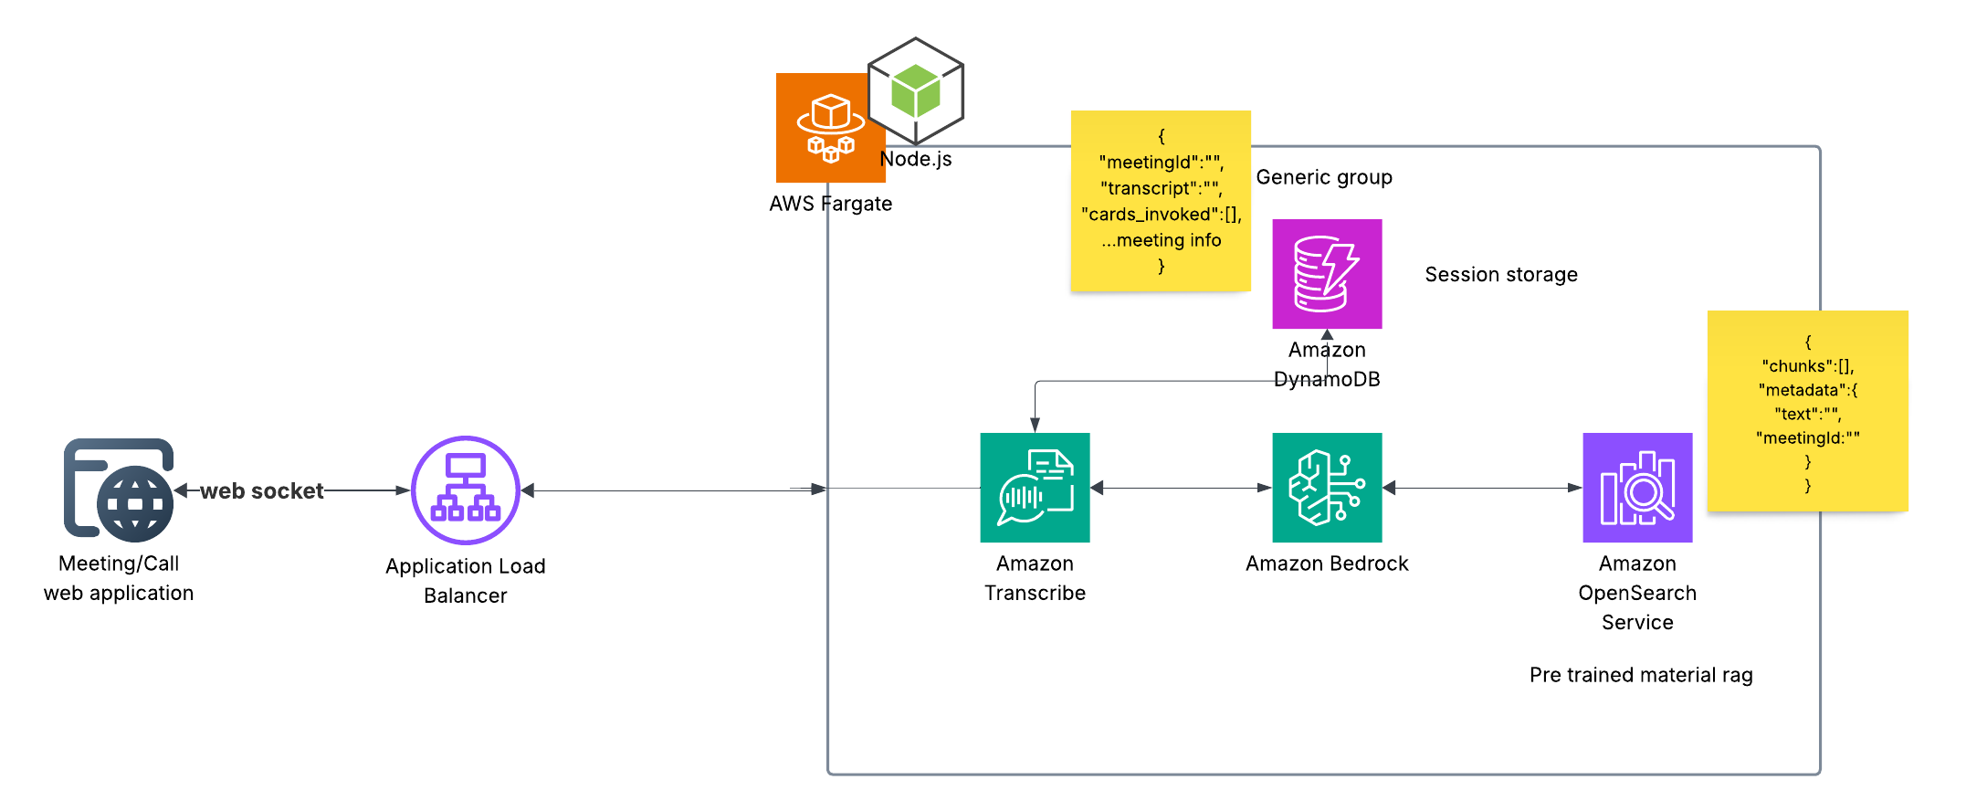
Architecture design/diagram

Slide 9
Implementation plan​
Week 1 (June 10–16) Understand problem, research competitors, finalize key features
Week 2 (June 17–23) Build PoC for voice-to-text using Amazon Transcribe
Week 3 Start Integrate Bedrock (Claude/Titan) with RAG setup
Week 3 Mid Define card types, user intents, and set up basic React + Node backend
Week 3 End Connect WebSocket flow and prepare OpenSearch vector store
Week 4 (July 1–7) Do complete end-to-end testing of call → card flow
Week 4 Mid Test session tracking, DynamoDB storage, and card accuracy
Week 4 End Polish UI, handle edge cases, optimize flow
Final Days (July 8–9) Host application, dry-run demo, and finalize content
Deadline (July 10) Submit final build and present the working demo

Slide 10
Cost estimates​
Total estimate for 2 months : $120 - $150
Service | Usage | Monthly Cost (USD)
Fargate (Node.js backend) | ~15 tasks/month, small vCPU/memory (spot) | $8 – $15
Application Load Balancer | Light WebSocket traffic | $18 – $22
Amazon Transcribe | 20 mins/day (0.0066/min) | ~$4
Amazon Bedrock (Claude) | Few thousand tokens/day via Claude v2 | $10 – $15
OpenSearch Serverless | ~10K vector docs + light queries | $12 – $18
DynamoDB | 25K reads/writes/month | ~$1
S3 (pre-call files) | < 5 GB storage + minimal transfer | <$1
CloudWatch Logs | Basic logging (under free tier) | $0 – $1

Slide 11
Impact potential & limitations​
🔮 Potential Impact
• Transforms live meetings with real-time GenAI assistance
• Boosts productivity by helping users ask better questions and close faster
• Can be extended to sales, support, hiring, healthcare, and more
✅ Benefits
• Real-time transcription and contextual insights
• Seamless agent support without tool-switching
• Serverless, low-maintenance, scalable setup
🔗 Dependencies
• Relies on AWS services (Transcribe, Bedrock, OpenSearch)
• Uses Anthropic Claude + Titan (via Bedrock) for RAG + GenAI reasoning
⚠️ Limitations
• Latency may occur with large documents or weak internet
• Real-time card accuracy depends on prompt tuning and RAG quality

Slide 12
Ethical & security considerations​
🔐 User Privacy
Conversations may contain sensitive info — we ensure data is not stored permanently unless required for debugging or feedback.
🔍 Transparency
Users are notified when transcription or AI-based suggestions are active during calls.
🔏 Data Security
All data transmission is encrypted (HTTPS, WSS).
Stored metadata (e.g., in DynamoDB/S3) follows AWS IAM and encryption best practices.
⚖️ Ethical Use
System is intended for consensual, professional use only (e.g., meetings, support).
Clear usage policies prevent misuse like surveillance or manipulation.
🛡️ Mitigation
Admins can review logs, set data retention rules, and opt out of logging.

Slide 13
Video pitch & demo
https://youtu.be/rQgK0tD1xTA

