Slide 1
LLM_Pc_Bench
LLM Benchmarks for your GPU
--Balakrishna Thati

Slide 2
Overview
Add your first bullet point here
Add your second bullet point here
Add your third bullet point here

Slide 3
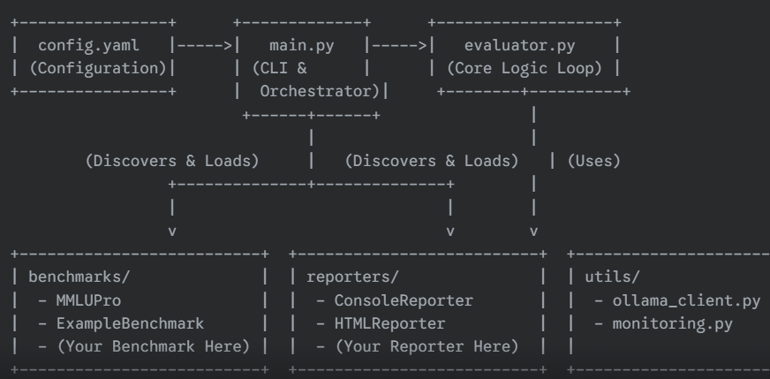
Architecture & Design

Slide 4
Core Module – main.py
The Orchestrator
primary entry point for the application
Command-Line Interface (CLI): Parses command-line arguments using argparse to allow users to specify a configuration file or override settings like the list of models to test
Configuration Loading: Reads and parses the config.yaml file to get settings for the evaluation run, including models, benchmarks, reporters, and model generation options.
Dynamic Module Discovery: Implements the load_modules_from_path function, which automatically scans the benchmarks/ and reporters/ directories. It dynamically imports Python modules and discovers classes that are subclasses of BaseBenchmark and BaseReporter, respectively. This makes the framework highly extensible.
Orchestration: Initializes the configured benchmarks and reporters, calls the run_evaluation function from the evaluator module, and then passes the results to each active reporter.
Startup Checks: Calls check_ollama_connection to ensure the Ollama server is running before starting a potentially long evaluation run

Slide 5
Config.yaml – The configuration hub
Models: Defines the list of Ollama model tags to be evaluated (e.g., llama3:8b, qwen2:14b).
Model Options: Specifies generation parameters like temperature and seed that are passed to the Ollama API to ensure consistent and reproducible results.
Benchmarks: A dictionary where users can enable or disable specific benchmarks and provide parameters for them (e.g., percentage_per_subject for MMLUPro). The keys in this section must exactly match the class names of the benchmarks.
Reporters: A dictionary to enable or disable different reporting formats, such as the console table and the HTML report.

Slide 6
Evaluator.py – The core evaluation engine
This module contains the primary business logic for running the benchmarks.
run_evaluation function: This is the heart of the framework. It takes the list of models, benchmarks, and model options as input and performs the following actions in nested loops
Iterates through each benchmark.
Iterates through each model.
Initializes and starts the SystemMonitor from utils/monitoring.py.
Retrieves all questions for the current benchmark.
Iterates through each question, sending the prompt to the ollama_client.
Receives the response and passes it to the benchmark's evaluate method.
Stops the system monitor and aggregates the results, including the score, performance (tokens/sec), and system resource metrics.
Returns a list of dictionaries, with each dictionary containing the complete results for one model-benchmark pair.

Slide 7
Utility Module – ollama_client.py – API Communicator
This module manages all communication with the Ollama server API.
check_ollama_connection function: Pings the Ollama server to ensure it is running and accessible before any work begins.
get_ollama_response function:
Constructs the JSON payload for the /api/generate endpoint.
It includes the system prompt and options (like temperature and seed) passed down from the configuration.
Sends the request using the requests library and handles potential timeout errors.
Returns the model's response string, tokens per second, and any errors.

Slide 8
Utility Module – monitoring.py – Resource Monitor
This module provides the functionality to track system resource usage during a benchmark run.
SystemMonitor class:
When start() is called, it launches a separate thread that runs in the background.
This thread wakes up at a set interval (e.g., every second) and records a "snapshot" of the system's state using the psutil and pynvml libraries. This includes CPU percentage, RAM percentage, GPU utilization, and GPU power draw.
When stop() is called, the thread is terminated, and the collected data is processed to calculate averages, maximums, and total energy consumption (for NVIDIA GPUs).

Slide 9
Pluggable Modules – Benchmark system
base_benchmark.py: Defines the abstract base class BaseBenchmark. It serves as a contract, requiring any new benchmark to implement two methods
get_questions(): Must return a list of question data.
evaluate(model_response, question_data): Must take a model's response and the original question data and return a score (typically a float).
Mmlu_pro.py: A concrete implementation for the MMLU-Pro benchmark.
It uses the datasets library to download and process data from the Hugging Face Hub.
The _format_prompt method implements the one-shot prompting technique to ensure reliable responses from various models.
The _extract_choice method reliably parses the JSON object from the model's response.

Slide 10
Pluggable Modules – Reporting system
base_reporter.py: Defines the abstract base class BaseReporter. Any new reporter must implement one method:
report(results_data): Takes the final list of results from the evaluator and processes it (e.g., prints it to the console, writes it to a file)
console_reporter.py: A concrete implementation that uses the tabulate library to print a clean, formatted table of the results to the console.
html_reporter.py: A concrete implementation that generates an HTML report. It appends the results of each new run to the same file, creating a cumulative log that can be viewed in a web browser

Slide 11
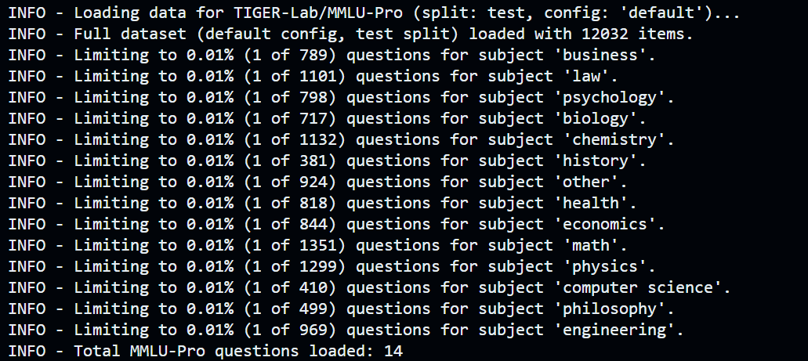
Quick Test

Slide 12
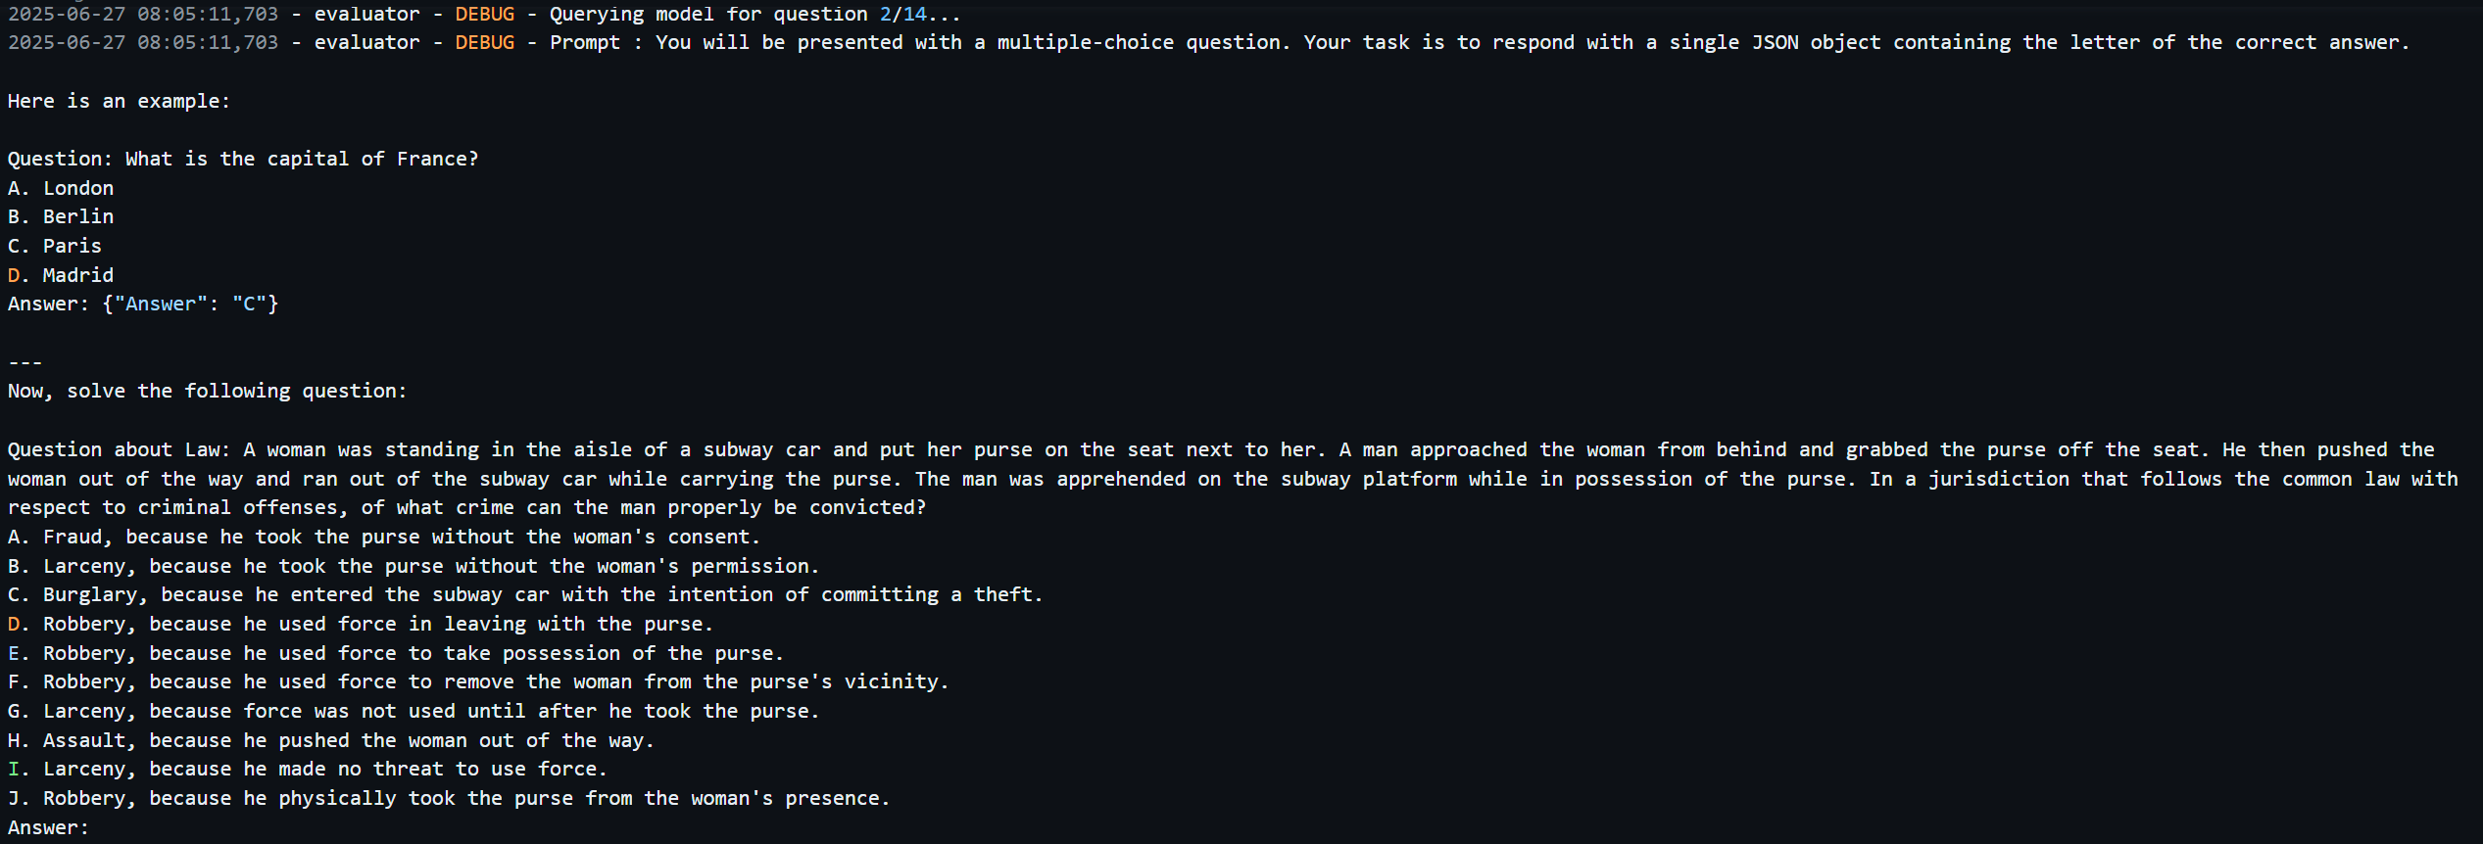
Sample prompt

Slide 13
Sample response

Slide 14
Lessons learned
As LLMs becoming commodity, keep project LLM agnostic
Use LLM abstractors like LiteLLM, which offers unified interface to call various LLMs
Prompt engineering is vital for optimal utilization of LLMs
Always assume LLM’s response isn’t consistent and have alternative ways to handle it.
To avoid vulnerabilities, limit number of external libraries
Moving all moving parts to a configuration file

