Slide 1
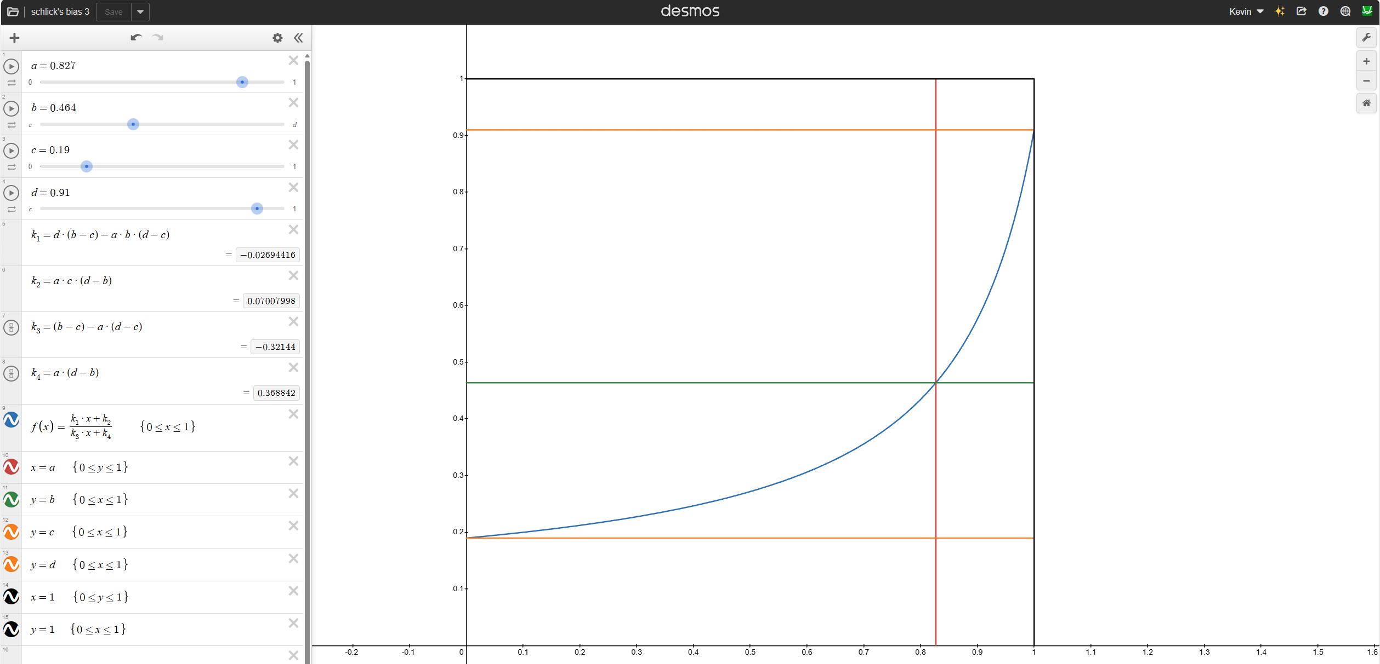
Input color is mixed between black and white by a factor
Then we have light, color, dark values for each channel
For this example, we’ll work with red channel only
So we have r_light, r_color, r_dark
Also we have FacingRatio which is same for all channels
“a” is mapped to an input called “BaseColorPoint”
“b” = r_color
“c” = r_dark
“d” = r_light
“f(x)” computes the value for the red channel
Resulting color is < f_r(x), f_g(x), f_b(x) >

