Slide 1

Project Title
AI-POWERED ADAPTIVE MULTI-FACTOR AUTHENTICATION AND ACCESS CONTROL SYSTEM
SOA PROJECT REVIEW-1
 | Under the Guidance of Venkateswari Ketineni Assistant Professor, Department of Computer Science and Engineering, KLH CSE Bowrampet Campus
Team Members Kvv Ganesh-2420030650 Nabi Rasool- 2420030408 Sai Teja-2420030008

Slide 2
OUTLINE OF PROJECT WORK
1. Introduction and Project Focus
2. Problem Statement and Security Need
3. Research Objectives
4. Literature Survey and Existing Approaches
5. Problem Gap Identification
6. Innovation, Creativity, and Novelty
7. Feasibility, Architecture, and Project Plan
8. Challenges and Risk Mitigation
9. Conclusion and Future Work
10. References and Publication Details

Slide 3
Problem Statement
• Traditional authentication mechanisms generally depend on fixed credentials and static access policies and do not sufficiently distinguish between normal and suspicious login contexts.
• An attacker using valid or stolen credentials may access an account from a new device, unfamiliar location, unusual login time, or after repeated failed password attempts. A password-only decision may therefore be insufficient.
• Applying MFA to every login can improve security but may introduce unnecessary friction for legitimate low-risk users. The system therefore requires a mechanism that dynamically increases authentication strength according to observed risk.
• The proposed project combines credential verification, device trust, location risk, login-time analysis, failed-attempt tracking, adaptive risk scoring, step-up MFA, access decisions, and persistent audit logging.
• The architecture further provides an extension point for AI/ML anomaly detection and DevSecOps automation so that the authentication system can evolve into an intelligent, testable, and securely delivered cybersecurity solution.

Slide 4
Objectives
• Develop a secure authentication workflow using username and password verification.
• Evaluate contextual security signals including failed attempts, device trust, location trust, and unusual login time.
• Implement an adaptive risk-assessment engine that calculates a transparent risk score and classifies requests as LOW, MEDIUM, or HIGH.
• Implement adaptive access decisions: allow low-risk authentication, require MFA for medium-risk authentication, and deny high-risk authentication.
• Implement OTP-based MFA with expiry and limited verification attempts.
• Persist authentication and security events in PostgreSQL using Spring Data JPA for long-term auditability.
• Provide investigation-oriented APIs for all logs, risk-specific logs, user-specific logs, denied events, and failed-attempt counts.
• Prepare the architecture for an AI/ML anomaly-detection layer and secure DevSecOps-based CI/CD pipeline.

Slide 5
Literature Survey
Authors | Title of the Paper | Methodology | Inferences | Limitation/Future work
Singh, Patel & Chaudhary [1] | Resilient Risk based Adaptive Authentication and Authorization (RAD-AA) Framework, 2022 | Risk scores and trust profiles for adaptive authentication and authorization; discusses OAuth 2.0, OpenID Connect, SAML 2.0, STRIDE and PASTA. | Shows that authentication and authorization can adapt to transaction risk and trust context. Discusses ML as a future adaptive-engine approach. | Primarily a design/research framework; the proposed project focuses on a working service implementation with device, location, time, MFA and audit components.
Chauhan, Kumar & Komal [2] | Adaptive Authentication Using Machine Learning, ICICC 2024 | Uses historical user-login data to train a machine-learning model and evaluates new login attempts to select an appropriate authentication method. | Demonstrates the relevance of historical login behavior for adaptive authentication and dynamic security decisions. | The paper emphasizes ML-driven authentication; our implementation first establishes a transparent rule-based baseline with persistent auditability and explicit step-up MFA before ML integration.
Sasikumar & Nagarajan [3] | A Hybrid Machine Learning and Explainable AI Framework for Optimizing Risk-Based Authentication, PLOS ONE, 2026 | Combines machine-learning ensemble methods, fuzzy logic, clustering and optimization for dynamic risk assessment and account-takeover detection. | Shows the value of hybrid ML and explainable-AI methods for contextual risk scoring and interpretable authentication decisions. | More complex than the current academic scope; our system uses an explainable rule-based score initially and keeps a clear extension point for a future ML/XAI risk layer.

Slide 6
Problem Gap Identification
• Many conventional systems use static authentication policies and do not continuously adapt authentication strength to contextual risk.
• Research on adaptive authentication demonstrates the value of behavioral and contextual signals, but complex ML approaches can be difficult to explain, reproduce, and integrate into a small service-oriented academic implementation.
• Security logs are often treated as operational records rather than as persistent evidence that can support investigation and future behavioral modeling.
• There is a gap between a risk-scoring research model and a complete implementation combining credential authentication, contextual risk assessment, step-up MFA, access decisions, persistent audit storage, investigation APIs, and secure software delivery.
• The proposed project addresses this gap by implementing a transparent and testable risk-based authentication foundation first, while maintaining a clear extension point for AI/ML anomaly detection and DevSecOps automation.

Slide 7
Innovation, Creativity, and Novelty
• Adaptive step-up authentication: authentication strength changes according to calculated risk rather than applying the same challenge to every login.
• Multi-signal risk model: failed attempts, device trust, location trust, and unusual login time are combined into one transparent risk score.
• Separation of current state and audit history: consecutive failed attempts can be reset without deleting permanent PostgreSQL audit evidence.
• Security-focused audit APIs: logs can be filtered by risk level, username, decision, and failed-attempt count for investigation.
• Explainable-AI-ready architecture: the current rule-based score provides a transparent baseline and a future ML/XAI component can contribute an additional anomaly signal.
• DevSecOps-ready security pipeline: automated tests, static analysis, secret scanning, dependency scanning, container scanning, and controlled deployment can be integrated.
• Service-oriented design: authentication, risk assessment, trust evaluation, MFA, access decisions, and auditing are separated into maintainable Spring Boot service components.

Slide 8
Feasibility and Project Plan
Feasibility: Java 21 + Spring Boot + PostgreSQL + Spring Data JPA + REST APIs; future integration with AI/ML and DevSecOps tools.
Phase | W1 | W2 | W3 | W4 | W5 | W6 | W7+
Foundation | ● | ●
Adaptive Risk |  | ● | ● | ●
MFA & Access |  |  | ● | ● | ●
Audit + DB |  |  |  | ● | ● | ●
AI/ML Layer |  |  |  |  | ● | ● | ●
Testing + DevSecOps |  |  |  |  |  | ● | ●
• Technical: widely adopted Java/Spring technologies and relational persistence.
• Operational: modular services allow security features to be tested independently.
• Security: MFA, risk scoring, audit persistence and investigation APIs provide measurable controls.
• Scalability: service/repository separation supports future growth and decomposition.
• AI feasibility: existing audit telemetry can supply features for anomaly-detection experiments.
• DevSecOps feasibility: the application can be containerized and integrated into GitHub Actions.

Slide 9
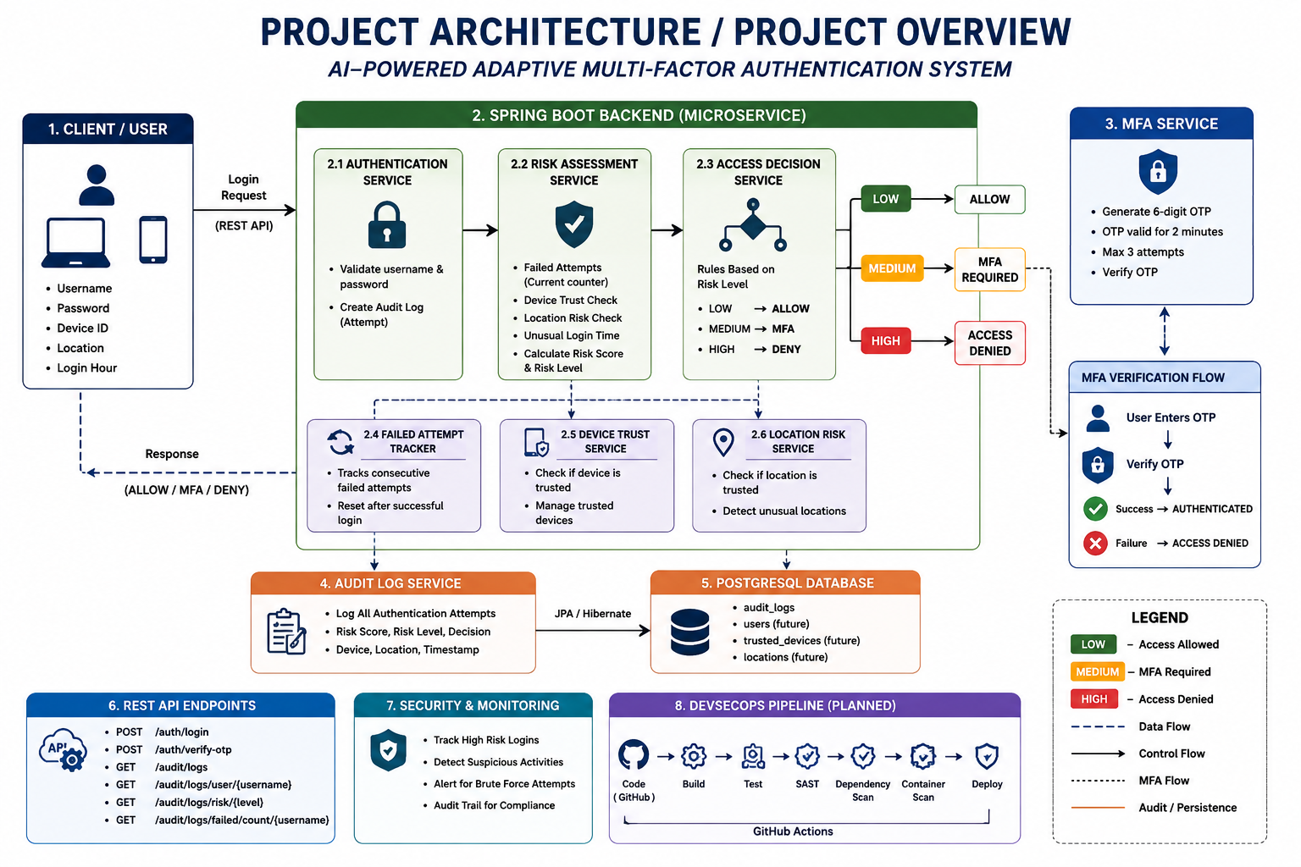

Slide 10
Challenges, Conclusion and Future Work
Challenges
• Keeping current failed-attempt state separate from permanent audit history.
• Designing risk thresholds that are transparent and easy to validate.
• Managing OTP expiry and maximum verification attempts securely.
• Preparing high-quality authentication telemetry for future AI/ML modeling.
• Preventing security tooling and CI/CD automation from becoming a source of new vulnerabilities.
Conclusion & Future Work
• The current implementation demonstrates adaptive authentication with contextual risk scoring, MFA, access decisions and persistent audit logging.
• Future work will integrate AI/ML anomaly detection using historical authentication behavior.
• Password hashing, user/device persistence, account lockout and API authorization will strengthen production security.
• Automated JUnit/Mockito/Spring tests will validate the risk engine, MFA and audit components.
• DevSecOps CI/CD will add SAST, secret scanning, dependency scanning, container scanning and controlled deployment.
• A security dashboard will provide visibility into risk levels, failed attempts and suspicious authentication events.
SOA Project Review-1

Slide 11
References and Publications Details
[1] J. Singh, C. Patel, N. K. Chaudhary, “Resilient Risk based Adaptive Authentication and Authorization (RAD-AA) Framework,” arXiv:2208.02592, 2022.
[2] A. Singh Chauhan, D. Kumar, K. Komal, “Adaptive Authentication Using Machine Learning,” Proceedings of ICICC 2024, 2024.
[3] K. Sasikumar, S. Nagarajan, “A Hybrid Machine Learning and Explainable AI Framework for Optimizing Risk-Based Authentication,” PLOS ONE, 21(5), 2026. DOI: 10.1371/journal.pone.0349095.
[4] NIST, “Digital Identity Guidelines: Authentication and Authenticator Management,” SP 800-63B-4, July 2025.
Publications Details
Current status: Project under development; no publication has been submitted at the time of Review-1. The above references form the literature and standards basis for the proposed adaptive authentication, risk assessment, MFA, and AI-assisted security approach.
SOA Project Review-1

