Slide 1
AI-POWERED ADAPTIVE
MULTI-FACTOR AUTHENTICATION
AND ACCESS CONTROL SYSTEM
SOA PROJECT REVIEW – 2
Team Members: Kvv Ganesh – 2420030650
Nabi Rasool – 2420030408
Sai Teja – 2420030008
Under the Guidance of Venkateswari Ketineni, Assistant Professor
SOA Project Review – 2 | AI-Powered Adaptive MFA & Access Control System | 1

Slide 2
Project Overview
What has been implemented since Review-1
Credential Authentication
Contextual Risk
Adaptive Decision
Username/password verification with password hashing and account-security controls.
Device trust, location trust, login-time behavior and failed-attempt history.
LOW → allow, MEDIUM → step-up MFA, HIGH → deny.
AI Risk Layer
Persistence & Audit
React Frontend
Spring Boot communicates with a FastAPI Random Forest service for AI risk prediction.
PostgreSQL stores users/security state and authentication/audit evidence.
Login, MFA verification, security dashboard and trusted-factor management.
SOA Project Review – 2 | AI-Powered Adaptive MFA & Access Control System | 2

Slide 3
Review-1 → Review-2 Progress
Feature / Module
Review-1
Review-2 status
Architecture
Design
Implemented
Spring Boot backend
Planned
Implemented
Adaptive risk engine
Proposed
Implemented
MFA + access decisions
Planned
Implemented
PostgreSQL persistence
Planned
Implemented
Audit logging
Planned
Implemented
React frontend
Future
Implemented
Security dashboard
Future
Implemented
Random Forest AI
Future
Integrated / in progress
DevSecOps CI/CD
Future
Pending
SOA Project Review – 2 | AI-Powered Adaptive MFA & Access Control System | 3

Slide 4
Updated System Architecture
React Frontend
Spring Boot Backend
FastAPI + Random Forest
AuthenticationService
RiskAssessmentService
MFAService
AuditLogService
PostgreSQL Database
SOA Project Review – 2 | AI-Powered Adaptive MFA & Access Control System | 4

Slide 5
Dataset & Feature Schema
AI model input schema used by the FastAPI prediction service
Dataset purpose
Input features
Target
Authentication-login records are used to learn a mapping from security context to a risk class. The available project materials document the feature schema, but do not provide a verified dataset source, row count or class distribution.
• failed_attempts
• trusted_device
• trusted_location
• unusual_time
• password_failed
Risk class / AI risk output
LOW
MEDIUM
HIGH
The exact training-label distribution should be reported from the actual training dataset.
Dataset
Feature Preparation
Train / Test
Random Forest
Risk
SOA Project Review – 2 | AI-Powered Adaptive MFA & Access Control System | 5

Slide 6
AI/ML Methodology
Random Forest model exposed through FastAPI
Input
Preprocess
Train
Predict
Integrate
5 security features
Prepare numeric features
Random Forest classifier
Risk + probabilities
Spring Boot AIService
Current Java integration
AIService serializes AIPredictionRequest → POST http://127.0.0.1:8000/predict → reads the FastAPI response → returns AI prediction data to the risk layer.
SOA Project Review – 2 | AI-Powered Adaptive MFA & Access Control System | 6

Slide 7
Adaptive Risk Engine
Transparent rule score + AI risk are available to the decision layer
Failed attempts
LOW
ALLOW
Trusted device
Trusted location
Rule-Based
Risk Score
AI Risk
(Random Forest)
Hybrid Risk
Level
MEDIUM
MFA
Unusual login time
HIGH
DENY
Password failure
SOA Project Review – 2 | AI-Powered Adaptive MFA & Access Control System | 7

Slide 8
Authentication & MFA Flow
Login
Context
Risk
Decision
Username + password
Device + location + time
Rule + AI
LOW / MEDIUM / HIGH
MFA implementation
LOW → ALLOW
MEDIUM → OTP
When the access decision requires step-up authentication, an OTP is generated, expiry/attempt limits are enforced, and successful verification creates the authenticated session.
HIGH → DENY
SOA Project Review – 2 | AI-Powered Adaptive MFA & Access Control System | 8

Slide 9
Backend Implementation – Spring Boot
Core services
Technology stack
• AuthenticationService – login and MFA workflow
• RiskAssessmentService – hybrid risk assessment
• DeviceTrustService – trusted-device checks
• LocationRiskService – coordinate/radius checks
• LoginBehaviorService – login-time risk
• MFAService – OTP generation/verification
• AccessDecisionService – ALLOW / MFA / DENY
• AuditLogService – persistent security evidence
• AccountSecurityService – failed attempts / lockout
• AIService – FastAPI communication
Java 21
Spring Boot 4.1.0
Spring Security
Spring Data JPA
PostgreSQL
REST APIs
BCrypt password hashing
FastAPI Random Forest AI service
The service-oriented design keeps authentication, risk, MFA and auditing modular.
SOA Project Review – 2 | AI-Powered Adaptive MFA & Access Control System | 9

Slide 10
Frontend Implementation – React + Vite
Component structure
Services
Frontend behavior
LoginForm.jsx
MFAVerification.jsx
SecurityDashboard.jsx
RiskSummary.jsx
SecuritySuggestions.jsx
SecurityFactors.jsx
TrustedDevices.jsx
TrustedLocations.jsx
TrustedLoginTimes.jsx
authService.js
• login()
• verifyMFA()
• rememberDevice()
• rememberLocation()
• rememberLoginTime()
deviceService.js
locationService.js
• Captures browser device ID
• Requests browser geolocation
• Sends login context to backend
• Displays risk + AI output
• Shows MFA challenge
• Manages trusted factors
• Loads/removes saved factors
• Presents security suggestions
SOA Project Review – 2 | AI-Powered Adaptive MFA & Access Control System | 10

Slide 11
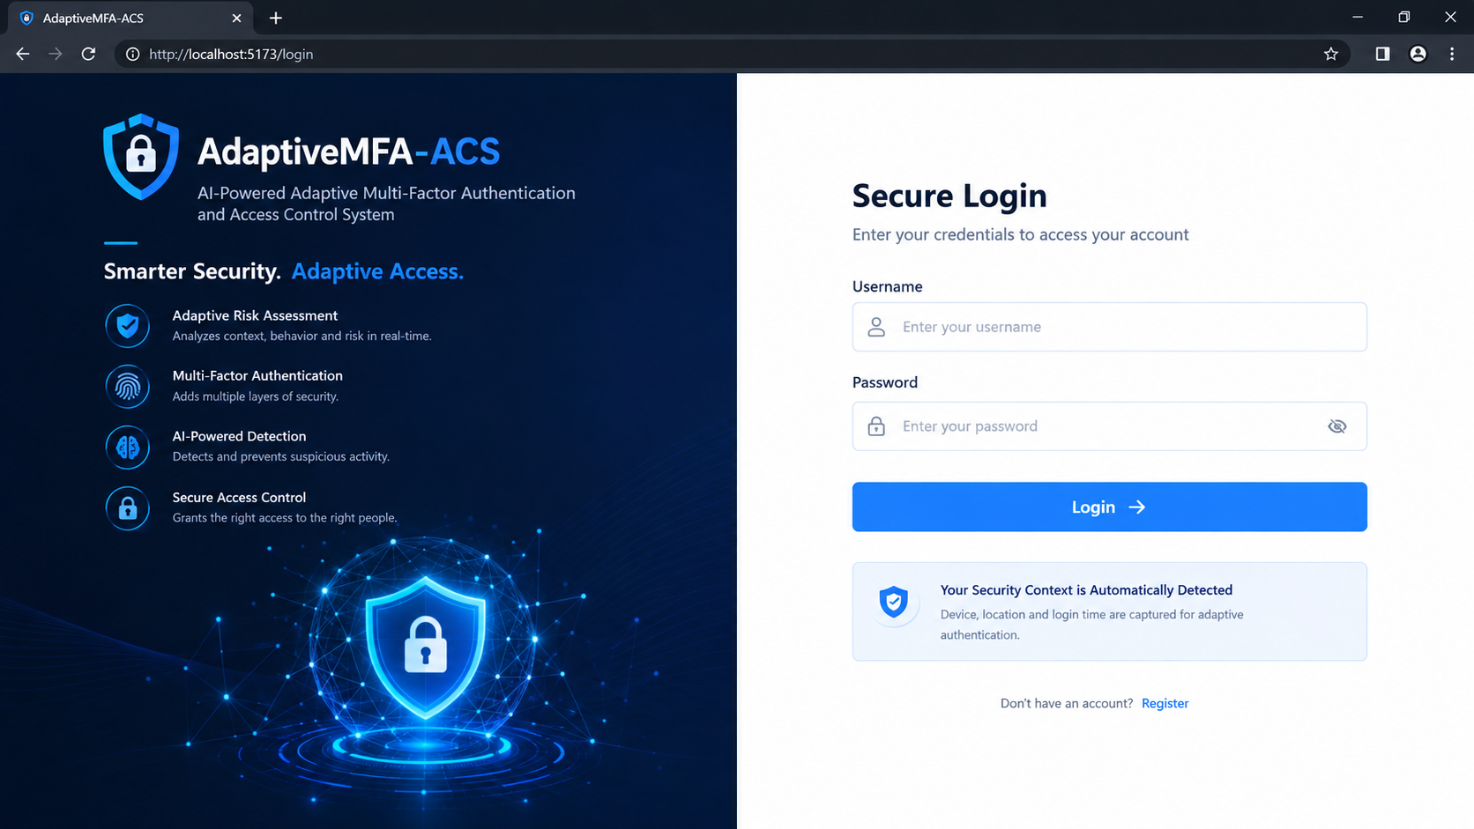
Frontend Execution – Login Page
SOA Project Review – 2 | AI-Powered Adaptive MFA & Access Control System | 11

Slide 12
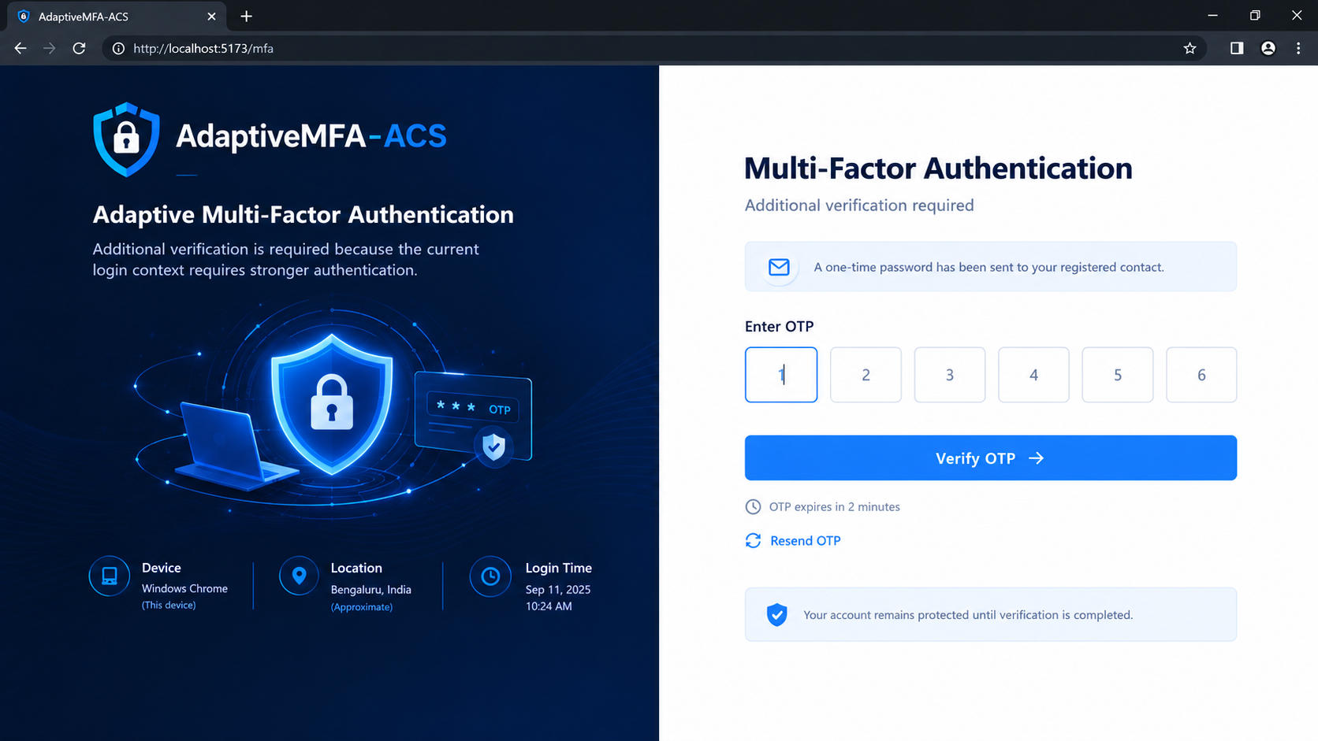
Frontend Execution – MFA Verification
Execution sequence
MFA_REQUIRED response → OTP entry → /auth/verify-mfa → AUTHENTICATED → authenticated session
SOA Project Review – 2 | AI-Powered Adaptive MFA & Access Control System | 12

Slide 13
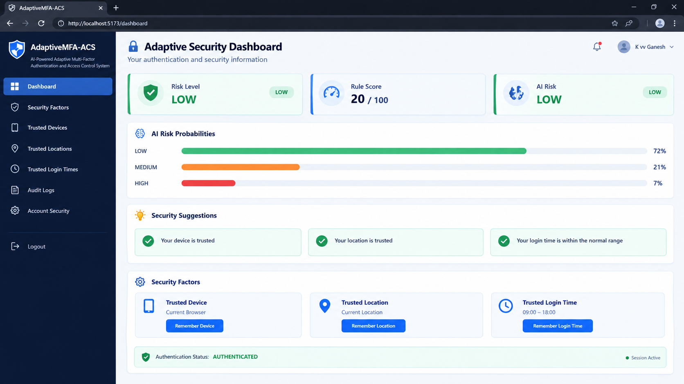
Frontend Execution – Security Dashboard
SOA Project Review – 2 | AI-Powered Adaptive MFA & Access Control System | 13

Slide 14
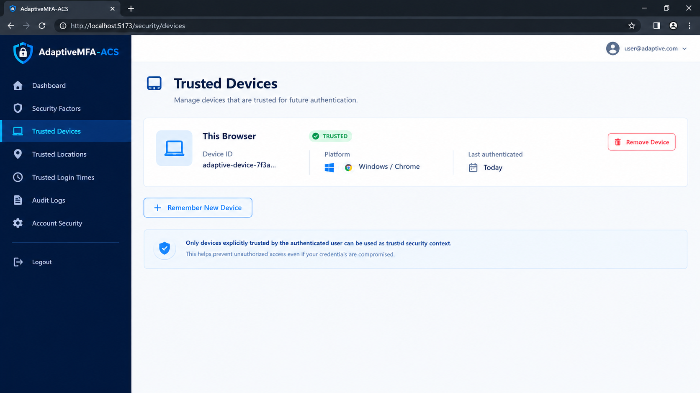
Trusted Security Factors
Security rule
Adding a new trusted factor is protected by recent authentication / MFA verification in the intended secure design.
SOA Project Review – 2 | AI-Powered Adaptive MFA & Access Control System | 14

Slide 15
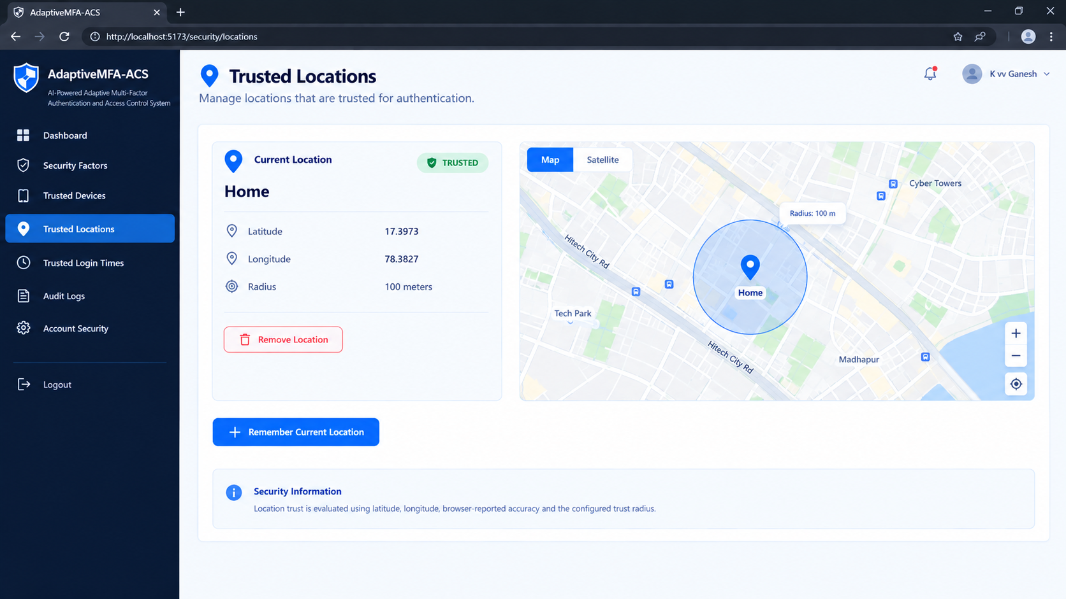

Slide 16
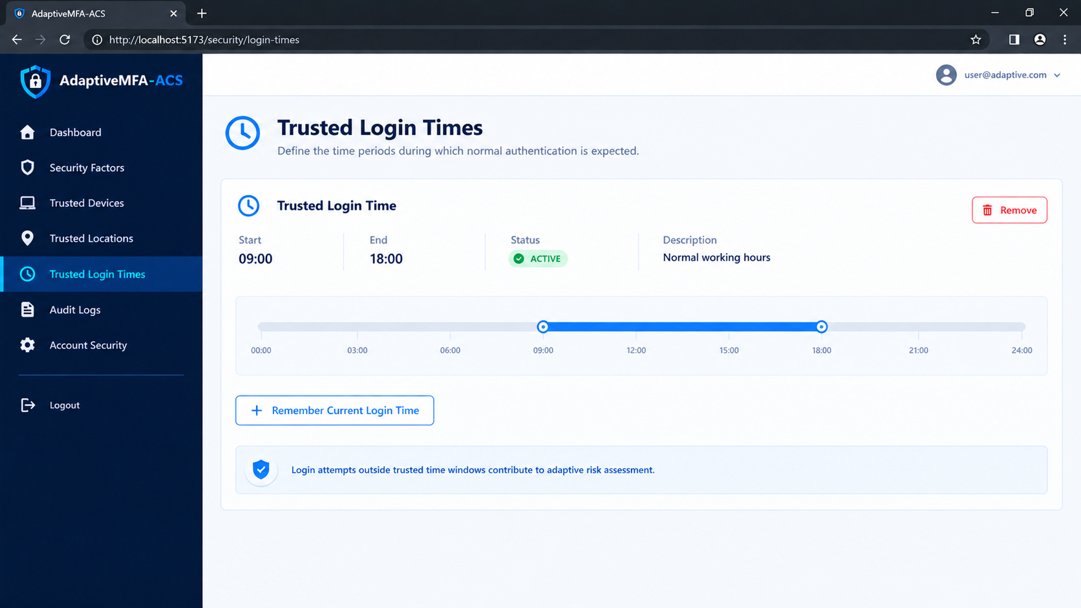

Slide 17
PostgreSQL Persistence & Audit Logging
Persistence
Audit evidence
Spring Data JPA is used to persist security state and audit evidence.
Examples:
• users
• trusted devices
• trusted locations
• trusted login times
• authentication / audit records
• failed-attempt / account-security state
Authentication events capture security-relevant context such as:
• username
• device identifier
• location / accuracy where available
• failed-attempt count
• rule score
• risk level
• final decision / event type
Audit history remains separate from the resettable failed-attempt state.
SOA Project Review – 2 | AI-Powered Adaptive MFA & Access Control System | 15

Slide 18
API / System Execution
Authentication APIs
Security-factor APIs
AI API
POST /auth/login
POST /auth/verify-mfa
POST /auth/change-password
POST /auth/forgot-password
POST /auth/reset-password
POST /security/devices/remember
GET /security/devices
DELETE /security/devices/{id}
POST /security/locations
GET /security/locations
DELETE /security/locations/{lat}/{lon}
POST /security/login-times/remember
GET /security/login-times
DELETE /security/login-times/{id}
POST http://127.0.0.1:8000/predict
Spring Boot AIService:
1. Builds AIPredictionRequest
2. Serializes JSON
3. Sends HTTP POST
4. Reads response
5. Passes AI risk/probabilities to the risk layer
SOA Project Review – 2 | AI-Powered Adaptive MFA & Access Control System | 16

Slide 19
Current Project Progress
Authentication & password policy
Failed-attempt tracking / lockout
Completed
Completed
Adaptive rule-based risk
Device / location / login-time trust
Completed
Completed
OTP MFA + access decisions
PostgreSQL persistence + audit
Completed
Completed
React login / MFA / dashboard
AI FastAPI + Random Forest
Implemented
Integrated / in progress
Password reset UI
Admin dashboard + audit UI
Next
Next
DevSecOps CI/CD
End-to-end security testing
Pending
In progress
SOA Project Review – 2 | AI-Powered Adaptive MFA & Access Control System | 17

Slide 20
Testing & Demonstration Plan
Valid credentials + trusted context
Valid credentials + medium-risk context
Expected: LOW / authentication allowed
Expected: MFA_REQUIRED
High-risk context
Wrong password
Expected: ACCESS DENIED
Expected: failed attempt recorded; no direct authentication
Correct OTP
Wrong / expired OTP
Expected: authenticated session
Expected: access denied
Trusted device / location / time APIs
Audit logging
Expected: add, list and remove operations
Expected: authentication events persisted for investigation
SOA Project Review – 2 | AI-Powered Adaptive MFA & Access Control System | 18

Slide 21
Challenges & Solutions
AI/backend integration
Risk transparency
Dedicated AIService and DTO contract between Spring Boot and FastAPI.
Rule-based scoring remains explainable while AI provides an additional signal.
MFA state management
Location trust
OTP expiry, verification limits and authentication-session handling.
Coordinate + radius comparison with browser-provided accuracy.
Persistent security evidence
Frontend/backend integration
Audit history stored separately from resettable failed-attempt state.
React services send credentials and contextual security signals to REST APIs.
SOA Project Review – 2 | AI-Powered Adaptive MFA & Access Control System | 19

Slide 22
Conclusion & Future Work
Review-2 achievements
Remaining work
✓ Adaptive authentication workflow
✓ Contextual rule-based risk assessment
✓ Device, location and login-time trust
✓ OTP-based step-up MFA
✓ PostgreSQL persistence and audit logging
✓ React security dashboard
✓ FastAPI AI integration
✓ Trusted-factor management
→ Finalize AI/rule integration and validate model results
→ Add password change / reset UI
→ Build admin and audit dashboards
→ Improve OTP delivery
→ Complete automated and security testing
→ Add DevSecOps CI/CD, scanning and containerization
→ Prepare final deployment and demonstration
Thank You
SOA Project Review – 2 | AI-Powered Adaptive MFA & Access Control System | 20

