Slide 1
WELCOME

Slide 2

ADITYA COLLEGE OF ENGINEERING
DISASTER MANAGEMENT
PROJECT GUIDE: V. ANANTHA LAKSHMI Asst.Prof
TEAM MEMBERS:
M. DURGAPRASAD (16MH1A0596)
P. TEJASWINI VENKATA SAI (16MH1A05A5)
K. V. V. SATYA RAVI (16MH1A0587)
ACHUER AYUEL AJAK BOL (16MH1A05C9)
G. HARSHA VARDHAN (16MH1A0580)

Slide 3
ABSTRACT
For any person who is in danger due to flood in unknown area will be difficult for him/her to find safe places nearby but with the help of our project he/she can easily find safe places in their location. We will be maintaining a database consisting of several frequently flooded areas with safe zones near to them, transport details to that safe places and the rescue team details.

Slide 4
DISASTER MANAGEMENT
Definition:
Disaster Management can be defined as the organization and management of resources and responsibilities for dealing with all humanitarian aspects of emergencies, in particular preparedness, response and recovery in order to lessen the impact of disasters.

Slide 5
PROJECT REQUIREMENTS
HARDWARE REQUIREMENTS:
MONITOR
1TB HARD DISK
I5 BASED COMPUTER
16 GB RAM
SOFTWARE REQUIREMENTS:
PYTHON WITH DJANGO FRAMEWORK
PYTHON INTERPRETER

Slide 6
What is Django?
Django is a high-level Python Web framework that encourages rapid development and clean. Built by experienced developers, it takes care of much of the hassle of Web development, so you can focus on writing your app without needing to reinvent the wheel. It’s free and open source.

Slide 7
Features of Django
don't repeat yourself
unbelievably fast
tons of packages
highly secure
widely scalable

Slide 8
PROPOSED SYSTEM
The data in this system exists in the digital format.
Warnings or alerts will be informed before occurrence of disaster.
With the help of our project, information about safeplaces and other important contacts will be known to all users.

Slide 9
EXISTING SYSTEM
In the existing system there is no alert or warning before disaster.
The data like safe places and important contact details are available manually.
Lack of transparency in data distribution.
It requires paper work, large amount of laborious work.

Slide 10
Modules and their Description
The website is having 3 major modules with their sub-modules:
1. Admin Module: The authorized person need to input the login credentials to access the below given sub-modules.
Add govt official: Can add government officials to system.
Delete govt official: Can delete government officials to system.
2. Govt Official Module: After logged-in to website he/she will do the following actions.
Add details : Can add details of new safe place to database.
Delete/Update details : Can delete/update details of new safe place to database.
Give Alerts: Can give alerts to the user regarding the areas which are going to be effected by floods.
3. User Modules: There is no login credentials to user, he can enter his location and get results from website.

Slide 11

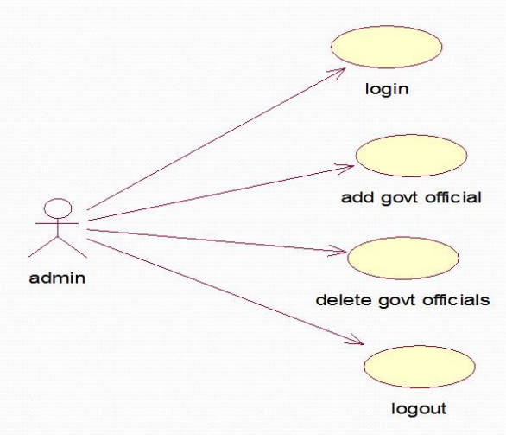
Usecase diagram for Admin

Slide 12


Usecase diagram for govt official
login
add details of safe place
govt official
delete details of safe place
give alerts
logout

Slide 13
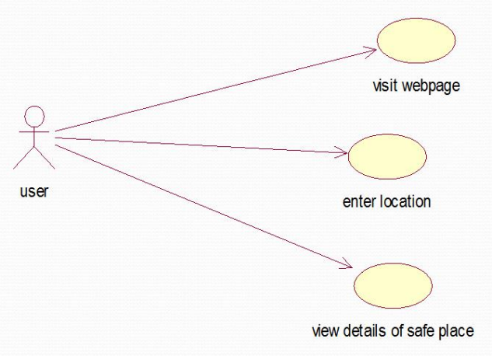
Use case diagram for User

Slide 14

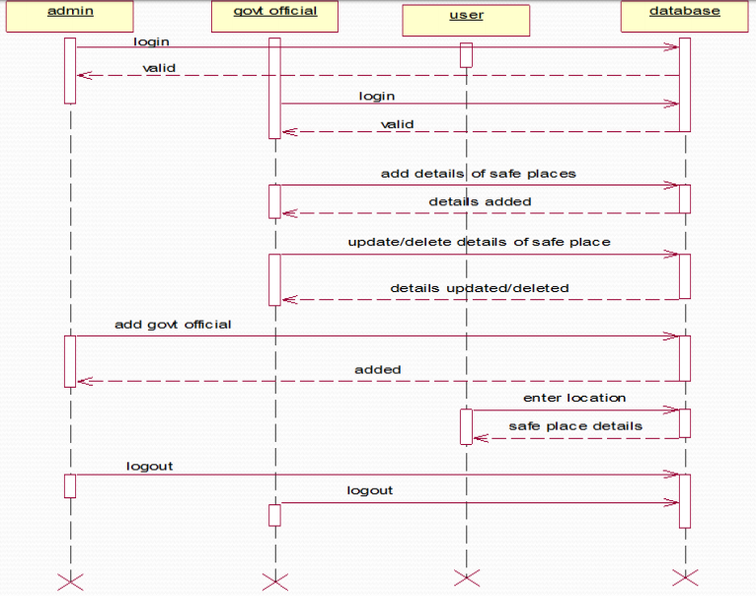
Sequence diagram

Slide 15
Activity diagram for Admin

Slide 16
Activity diagram for govt official

Slide 17
Activity diagram for User

Slide 18
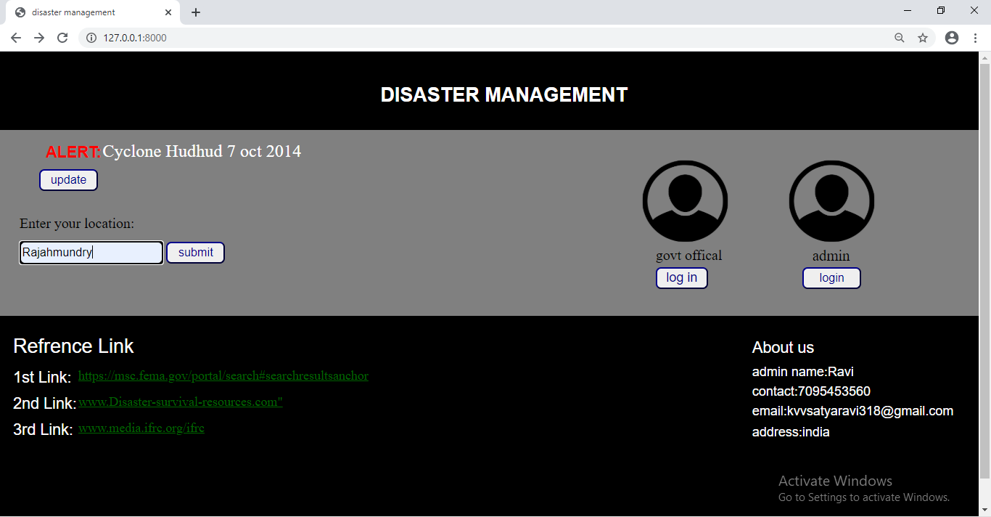
Output screens
Main page:-

Slide 19
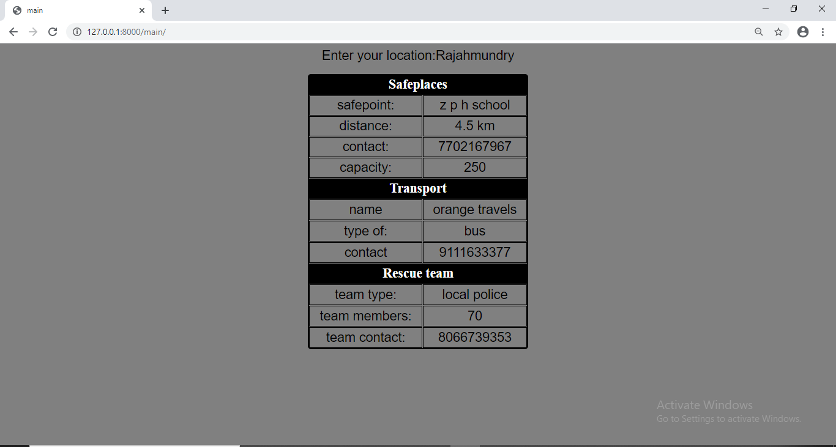
Output:-

Slide 20
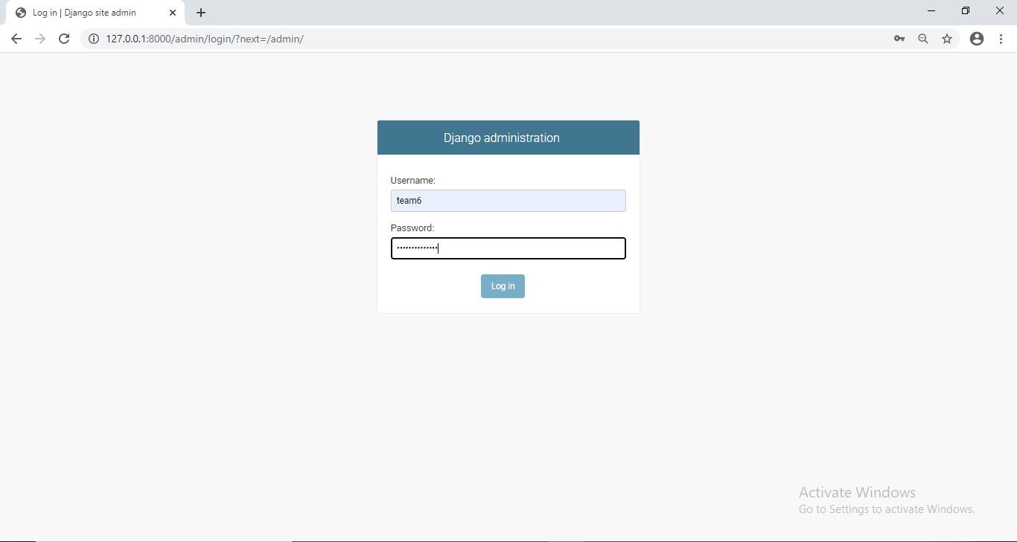
Super Admin

Slide 21
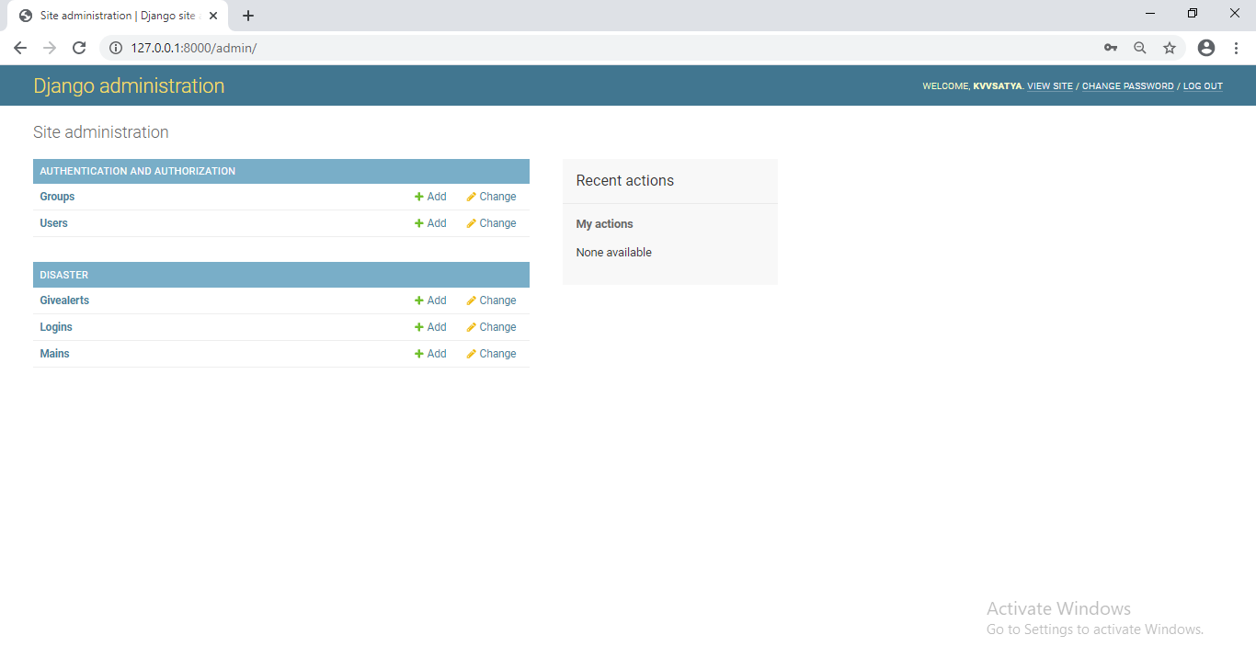
Django administration

Slide 22
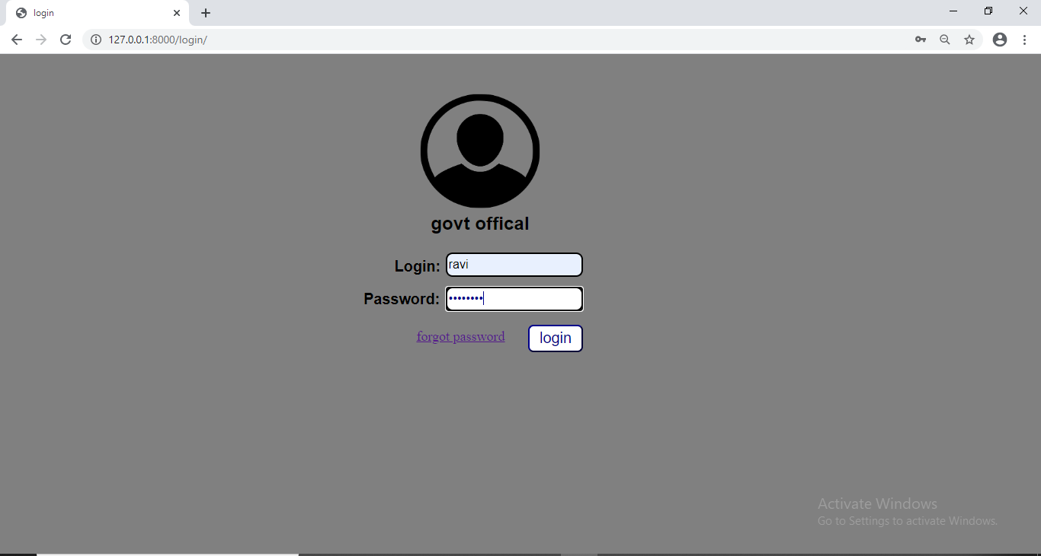
Govt login page

Slide 23
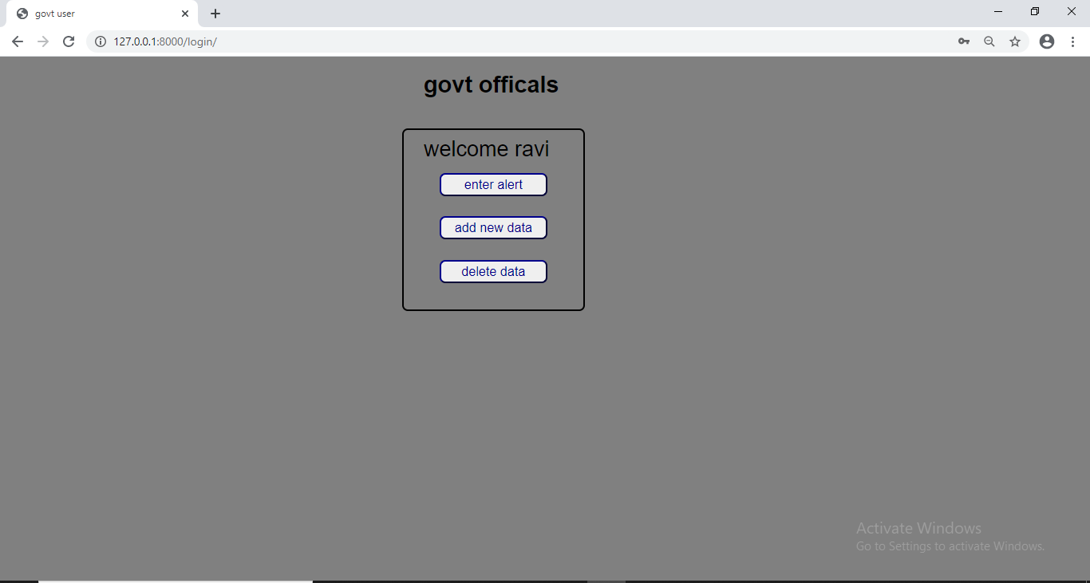
Govt officals

Slide 24
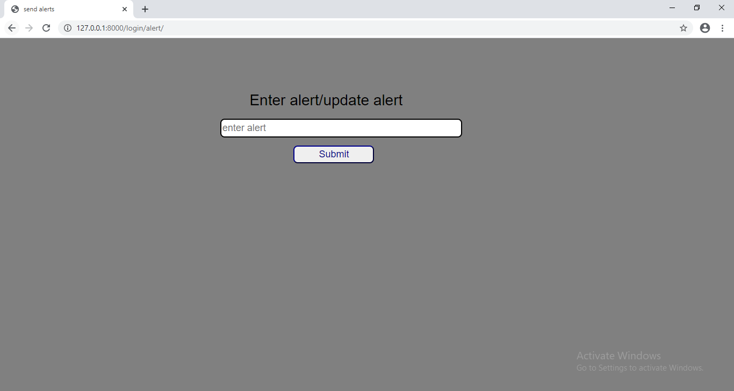
Govt officals adding/updating alerts

Slide 25
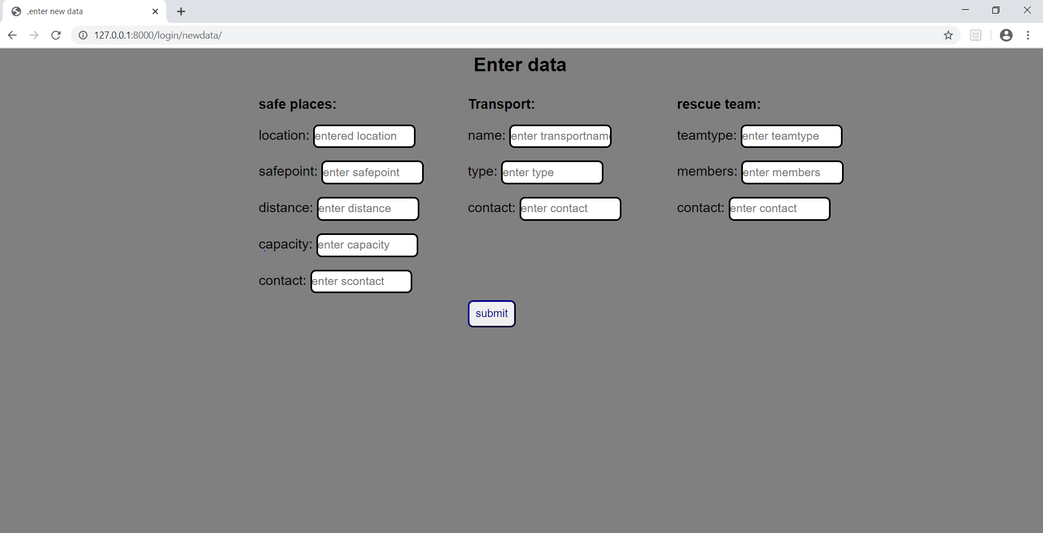
Govt offical data entry

Slide 26
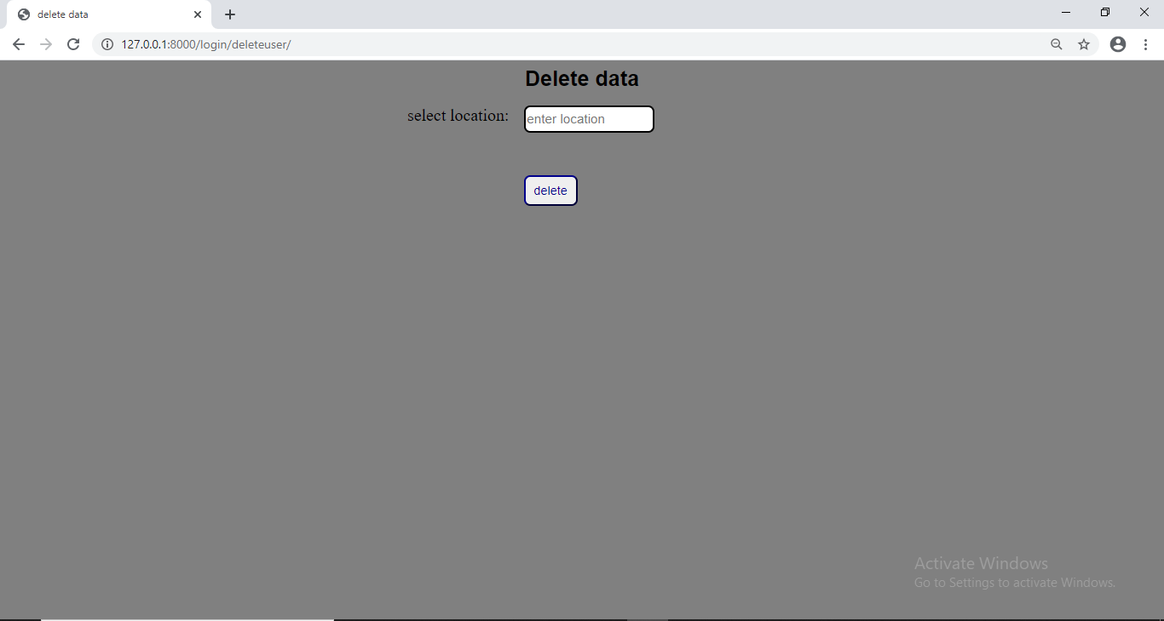
Govt delete

Slide 27
Conclusion
Our project on being implemented shows the nearby available safe places in flooded areas so that user can find those safe places easily.
This project is good in saving the time for finding the safe places. It will be more useful when you visit the place which you don't know previously. We know that nothing is more precious than life of us, this project helps in finding those safe places for people in the above situation. We used Django technology in it for building this website. It contains inbuilt database named sql lite3, so we can use that database for database needs. In this website we have not given login credentials to the user because in flood situation, if user forgot his password it may take time to generate new password and user will lose his very precious time in that time which could increase danger rate. So, we don't given any login credentials to him.

Slide 28
THANK YOU

