Slide 1

Bank CRM Analysis -Krishi Raj

Slide 2

Welcome to the presentation on customer relationship management in the banking sector. As the analytical CRM specialist for the bank, I've been tasked with extracting insights from diverse customer datasets to reduce churn, improve service, and boost satisfaction.
The project utilizes a robust dataset encompassing customer information, transaction details, credit scores, and demographic profiles. Through advanced analytics and visualization techniques, I have uncovered valuable insights that will guide in making data-driven decisions to optimize customer satisfaction and business growth.

Slide 3

You are an analytical CRM (Customer Relationship Management) specialist hired by a bank to extract meaningful insights from various customer-related datasets.
The bank aims to reduce customer churn, improve service delivery, and enhance customer satisfaction. They have provided you with datasets including customer demographics, transaction details, customer exit information, and active customer profiles

Slide 4
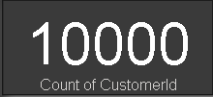
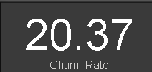
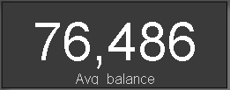
TOTAL CUSTOMERS
Overview of the Customers
CHURN RATE
AVERAGE BALANCE

Slide 5
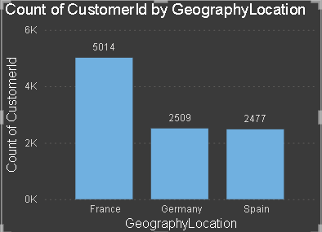
Total Customers by Countries
France has highest customers.
Germany and Spain almost have same number of customers and share 2nd ,3rd spots respectively.

Slide 6
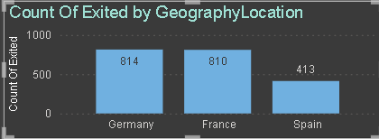
Churned Customers by Countries
Germany has highest exited customers.
France follows Germany to the second spot.
Spain has the least exited customers.

Slide 7
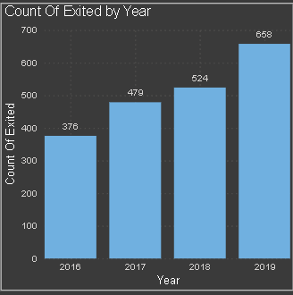
Churned Customers by Year
There is increase of exited customers every year.
In 2019 customers exited the most.
2016 has least exited customers.

Slide 8
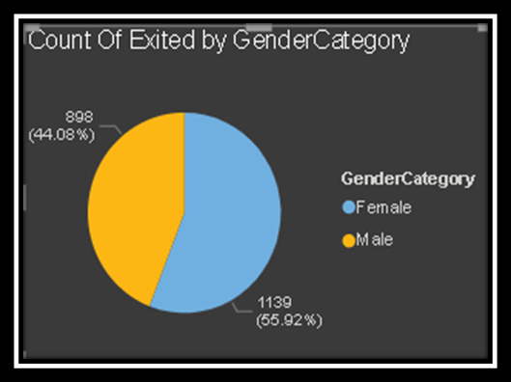
Churned Customers by Gender
Female tend to exit the most contributing around 56% of total.
Male exit less compared to females and have a minor share of 44%.

Slide 9
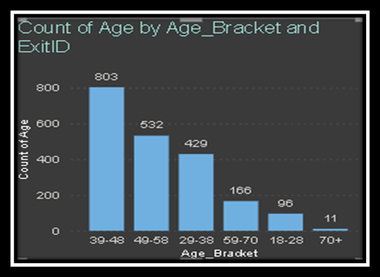
Churned Customers by Age Group
The age group 39-48 tend to exit the most with the highest count of 803.
Age group 70+ exit the least .Only 11 people of age 70+ have exited the bank.

Slide 10

Churned Customers by Number of Products
Majority of the exited customers use only 1 product.
Customers using 4 products exit the least.
We must create awareness about the diversified range of products being offered.

Slide 11
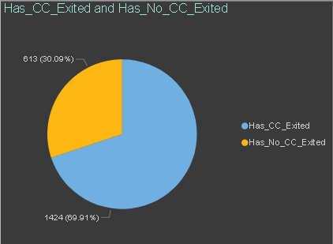
Churned Customers by Credit Card Usage
1424 of the exited customers used credit card services.
613 exited customers did not use credit card.
Majority were using credit card so we must account the risk involved as well.

Slide 12
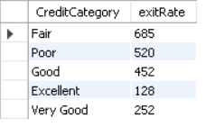
Churned Customers by Credit Category
Fair and Poor credit score customers exit the most.
Customers having higher credit score do not exit more.
Impact of credit score must be made understood by all to reduce the exit rate.

Slide 13
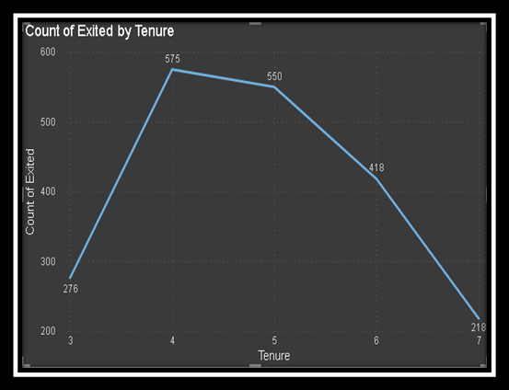
Churned Customers by Tenure
Customers having higher tenure exit the most.
The outliers are 3 and 7 years as these have less exited customers.
Some benefits must be given to old customers to retain them.

Slide 14

Customer Growth and Churn Rate Trends: Customer numbers have risen yearly, peaking in 2019, while churn rates hit a high in 2017 but declined thereafter, suggesting improved retention efforts.
Geographical Insights: Germany has the highest churn rate, while France boasts the most customers, underlining regional differences in customer behavior.
Credit Card Ownership Trends: Credit card ownership is highest among 30-50-year-olds, with notable variations across age groups, necessitating targeted strategies.

Slide 15
Correlation Analysis: A slight correlation exists between salary and customer balance, with slightly higher balances among churned customers. No significant correlation exists between salary and credit score.
Gender-Based Analysis: Female customers have slightly higher average salaries but fewer active accounts compared to males, suggesting a negative correlation between gender, active accounts, and salary.

Slide 16


