Slide 1
COLUMBIA ASIA HOSPITAL ANALYSIS
-KRISHI RAJ

Slide 2
ABOUT COLUMBIA ASIA
Columbia Asia Hospital, part of the Columbia Asia group founded in 1996, is a private healthcare provider operating hospitals across Asia, including in Malaysia, India, Indonesia, and Vietnam. Headquartered in Kuala Lumpur, the hospitals offer a wide range of medical services encompassing primary, secondary, and tertiary care, with modern facilities for inpatient and outpatient services, diagnostic imaging, and emergency care. Known for its patient-centric approach, Columbia Asia emphasizes quality care, patient safety, and affordability, employing skilled medical professionals and advanced technologies. Many of its hospitals are accredited by national and international bodies, reflecting high standards of healthcare delivery. The group continues to expand, making quality healthcare accessible to more communities.

Slide 3
PROBLEM STATEMENT
To understand patient demographics and their healthcare utilization patterns to optimize services and improve patient outcomes.
To understand how wait times and satisfaction levels relate to one another, how departmental visits are affected by demographics, and how to handle discrimination complaints.
Also understand daily revenue ,departmental wise revenue and is the hospital profitable as a whole or not.
wait times and satisfaction levels relate to one another, how departmental visits are affected by demographics, and how to handle discrimination complaints

Slide 4
DATA CLEANING AND VALIDATION
Inconsistent Date Format: The date format in the dataset was inconsistent,. To ensure consistency for easier processing and analysis, all dates were converted to the "dd-mmmm-yyyy" format.
Combining Patient First Initial and Last Name: The dataset contained separate columns for Patient First Initial and Patient Last Name. these two columns were combined into a single column named "Patient Full Name".
Null Values : Null values in the "Patient Sat Score" column were retained. Retaining null values ensures that no data is lost and allows for accurate representation of the dataset. Instead, SAT_Imputed column was created .
wait times and satisfaction levels relate to one another, how departmental visits are affected by demographics, and how to handle discrimination complaints

Slide 5
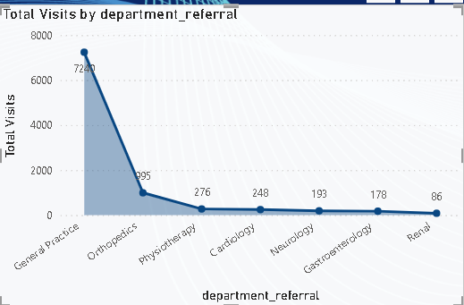
Total Visits by Department
General Practice department has highest total visits (7240) followed by the rest departments.
Renal is the least referred department.
The line chart clearly visualizes the relative popularity among the departments referred.

Slide 6
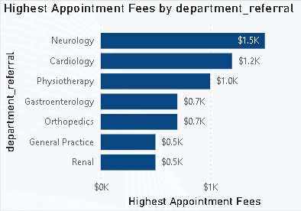
APPOINTMENT FEES
The appointment fees is unique w.r.t doctor and department referred to.
Neurology department charges the highest appointment fees.
General practice and Renal have lowest appointment fees.
The fees can be randomized and fix a common appointment fee if possible for easier financial transactions.

Slide 7
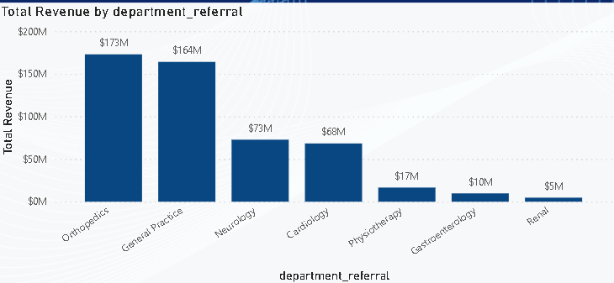
TOTAL REVENUE
The total revenue of the hospital is around $509M.
Orthopedics and general practice departments contribute a major share.
Renal contributes the least to the Total revenue.
The column chart visualizes the different contributors to the revenue.

Slide 8
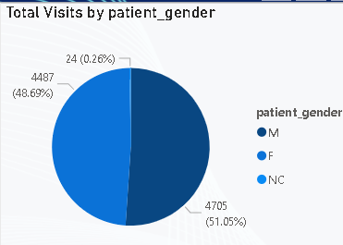
GENDER PREFERENCE
The Pie chart resembles the hospital is neutral towards Gender of the patient.
Both Men and Women are almost same in contribution to the total percentage.
This also shows there is no gender discrimination and everyone is treated equal professionally.

Slide 9
KEY FINDINGS
Demographic Diversity: The patient population demonstrates diversity across gender, age, and racial backgrounds, highlighting the importance of culturally sensitive healthcare practices.
“General Practice” is the primary point of contact for patients, emphasizing the importance of primary care services in the healthcare facility.
“Dr. Smith” emerges as a prominent physician, demonstrating expertise and popularity among patients seeking primary care services.

Slide 10
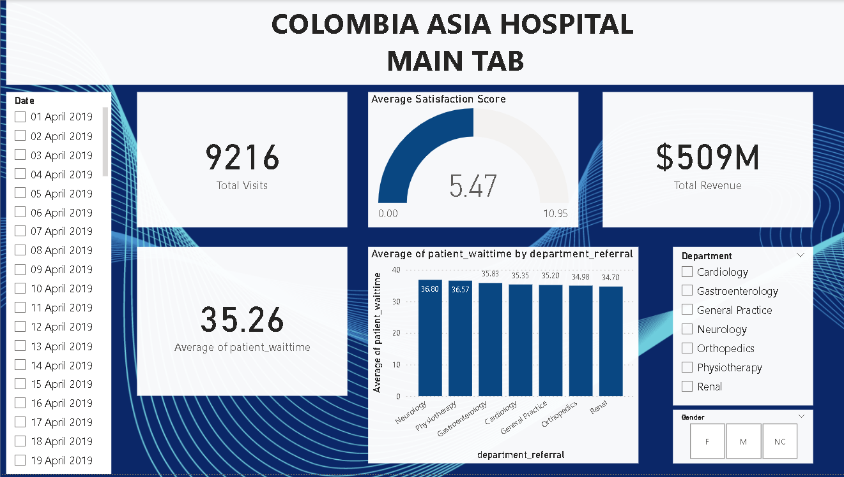

Slide 11
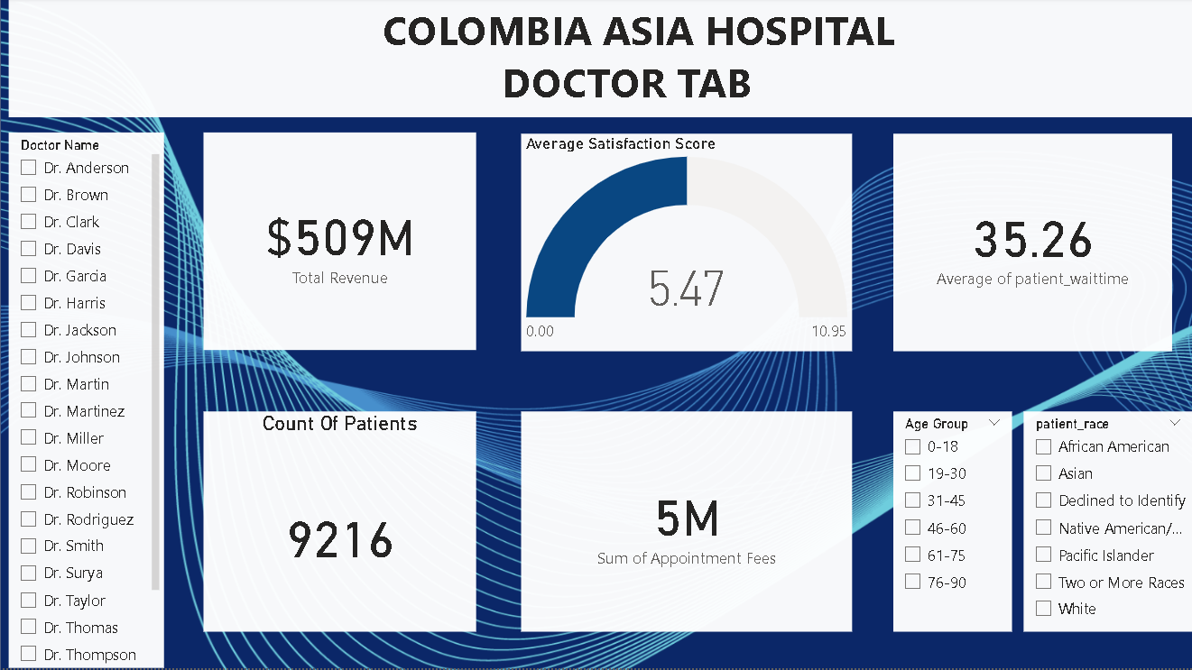

Slide 12
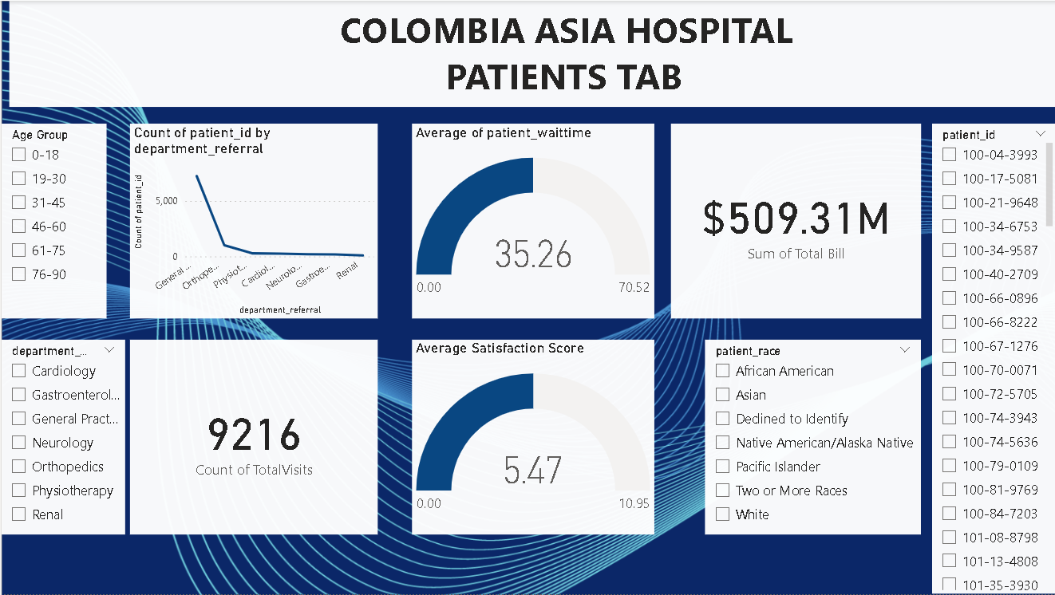

Slide 13
CONCLUSIONS
Understanding patient demographics, healthcare utilization patterns, physician billing trends is crucial for optimizing healthcare delivery and enhancing patient satisfaction.
Further research and analysis are warranted to identify areas for improvement and implement targeted interventions to meet the diverse needs of the patient population.

Slide 14
THANK YOU

