Slide 1
Zomato Restaurants
SUBMITTED BY- KRISHI RAJ

Slide 2
PROBLEM STATEMENT
As a consultant data analyst for Zomato, the task involved creating a comprehensive Excel-based data analysis dashboard. This dashboard provides key insights and strategies for Zomato's expansion and the opening of new restaurants. The analysis focuses on identifying optimal locations, understanding market demands, and leveraging data-driven decisions to enhance growth.

Slide 3
DATA OVERVIEW
Restaurant ID: It is a Unique identifier assigned to each restaurant to differentiate amongst same other franchise.
Restaurant Name: This column has the name of the restaurant.
Country Code: It represents the Country code of the location where the restaurant is located.
City: It represents the city where the restaurant is located.
Cuisines: This column depicts the type of cuisine offered by the restaurant.
Currency: The currency used for transactions in the restaurant is indicated in this column.

Slide 4
DATA OVERVIEW
Has_Table_booking:This column has Yes/No values that the restaurant offers table booking or not.
Has_Online_delivery: This column has Yes/No values that the restaurant offers Online Delivery or not.
Price_range:This column indicates the price range for the restaurant.
Votes: The number of feedbacks/votes received by the restaurant is shown in this column.
Average_Cost_for_two: It showst the average cost for two people dining at the restaurant.
Rating: The overall rating of the restaurant is based on user reviews is depicted by this column.

Slide 5
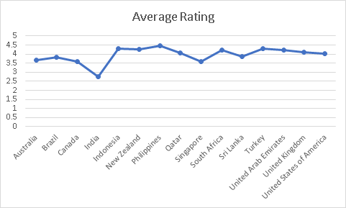
COUNTRIES Restaurant Count & Avg Rating
India has the highest number of restaurants , followed by United States of America.
Canada has least number of restaurants with 4 restaurants.
Philippines has the highest average rating followed by Indonesia, New Zealand.

Slide 6
SUGGESTED COUNTRIES
CANADA
AUSTRALIA
SINGAPORE
The suggested countries have low restraint count as well as low rating.
These suggestions were made keeping in mind to grab our market share for the new restaurant.

Slide 7
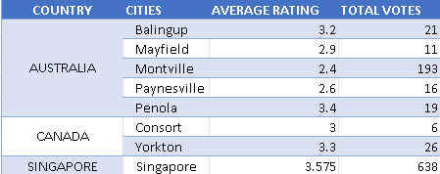
SUGGESTED CITIES
The cities are suggested that the average rating of city is less than that of the country.
The votes were also considered to suggest the cities with almost same average.
Singapore has only one city option available ,Australia has 5 and Canada has 2.

Slide 8
LESSER COMPETITION
I found that Australia, Canada and Singapore are having a smaller number of restaurants are having lesser competition as compared to the countries having a greater number of restaurants.

Slide 9
Ratings Of Suggested Countries
The Column Chart indicates Average rating of the suggested countries, and it is observed that Indonesia has highest average followed by Qatar, Australia, Canada and Singapore respectively.

Slide 10
AVERAGE VOTES
The Line Chart clearly indicates Average votes of the countries
It is observed that Indonesia has highest average votes followed by Turkey , UAE and USA respectively.
The votes of suggested countries are on the lower side.

Slide 11
Total Expenditure on Foods
Singapore Country has the highest expenditure on foods followed by Qatar , Australia , Singapore and Canada.
Considering only expenditure Canada can be the best option as it has the lowest Expenditure amongst suggested countries.

Slide 12
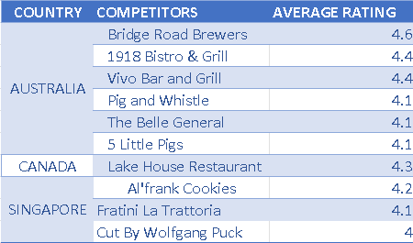
COMPETITORS
The competitors were recognized as restaurants with rating greater than 4.
Australia has 6 competitors , Singapore with 3 and Canada with 1.
Dealing with 3 competitors in the same city of Singapore would be challenging and interesting as well.

Slide 13
TECH AVAILABILITY
Majority of existing Restaurants lack the features like Table booking , Online delivery.
Only 12% restaurants offer table booking service available.
Online Delivery is also offered only by 26% of the Restaurants overall.
Suggested countries and cities don’t have any of these features.

Slide 14
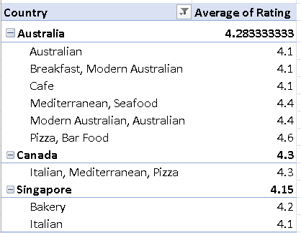
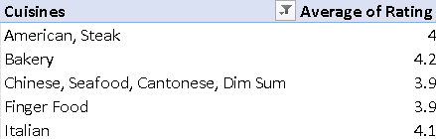
TOP CUISINES
SUGGESTED COUNTRIES
The cuisines are very diversified for every country and Italian food is found to be commonly liked.
Australians are observed to prefer Australian food a bit over the rest cuisines.
Bakery and Chinese can be interesting options to go with.
SUGGESTED CITIES

Slide 15
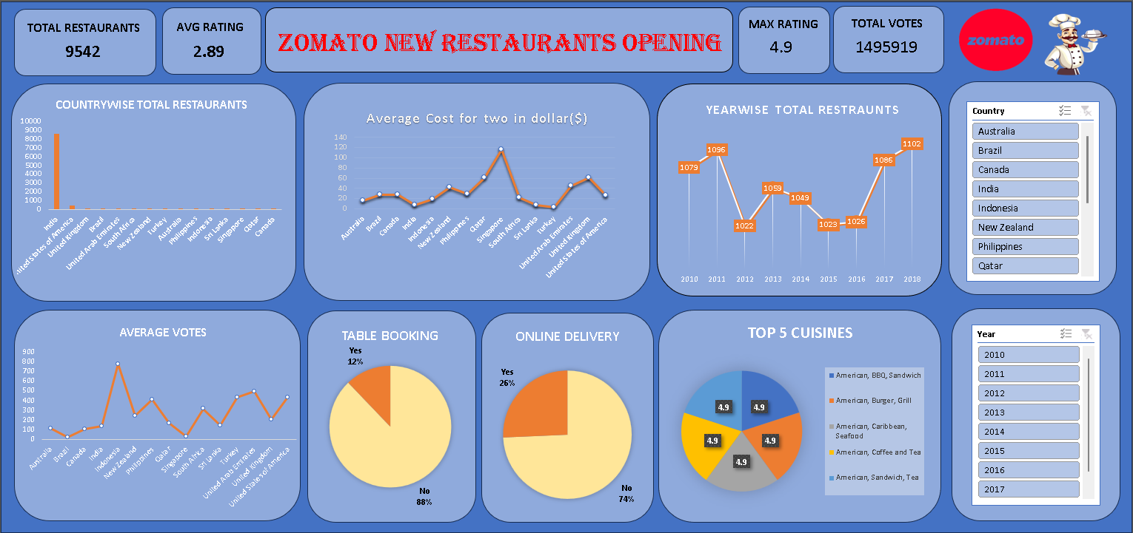
DASHBOARD

Slide 16
CONCLUSIONS
SUGGESTED COUNTRIES :CANADA, AUSTRALIA, SINGAPORE are Suggested.
Tech Availability : Inclusion of facilities like table booking and online delivery are recommended for better ratings and repeat rate.
Price Range : Price range of 2,3 is recommended initially to disrupt the existing market.
Cuisines : The cuisines offered must be diversified can include Italian , Chinese but with local cuisines to offer seamless experience.
Rating: The rating is being affected with a lot of factors and availability of services . Additional experience of ambience , music/concert might help achieve a higher rating.

Slide 17
THANK YOU

