Slide 1
Wavelet Application
Speaker : Zhao Kai-Wen
Advisor : Chang Ren-Jung
NCKU-ME

Slide 2
Outline
Why we use WP?
Tree Algorithm and Threshold Selection
Results
Can we find the best basis?

Slide 3
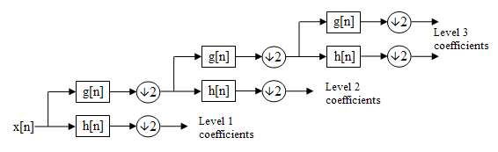
Why we use Wavelet Packet?
DWT – decompose low frequency parts
It’s called Mallat’s Algorithm
A theory for multiresoltion signal decomposition, 1989

Slide 4
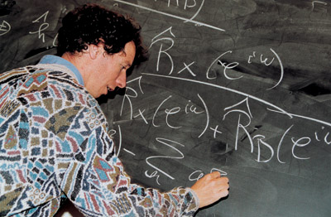

Why we use Wavelet Packet?
Stéphane Mallat
A French, an author, a MIT professor

Slide 5
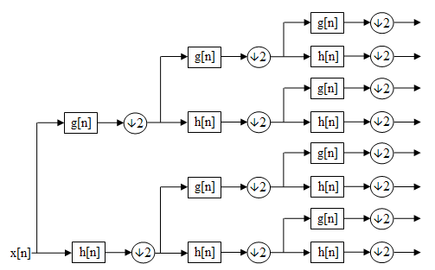
Why we use Wavelet Packet?
Wavelet Packet
Full filter banks
Energy Conservation
Higher Resolution

Slide 6
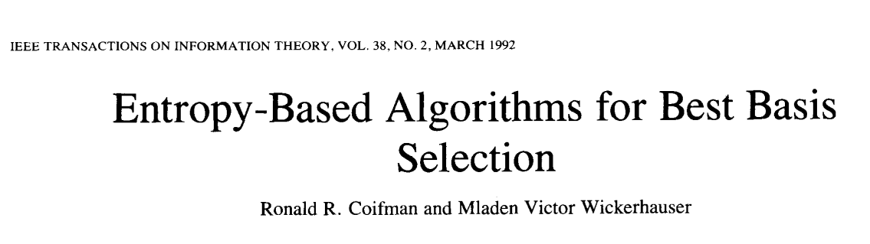
Best Tree Algorithm
Efficient Reconstruction and Compression
On 1992, Ronald Coifman
Coiflet name after him

Slide 7
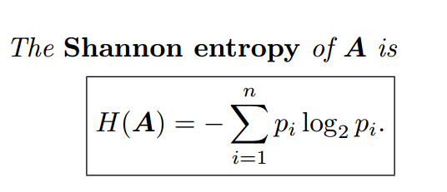
Best Tree Algorithm
The idea is minimize the Entropy (Information size)
It is so efficient, O(NlogN)

Slide 8
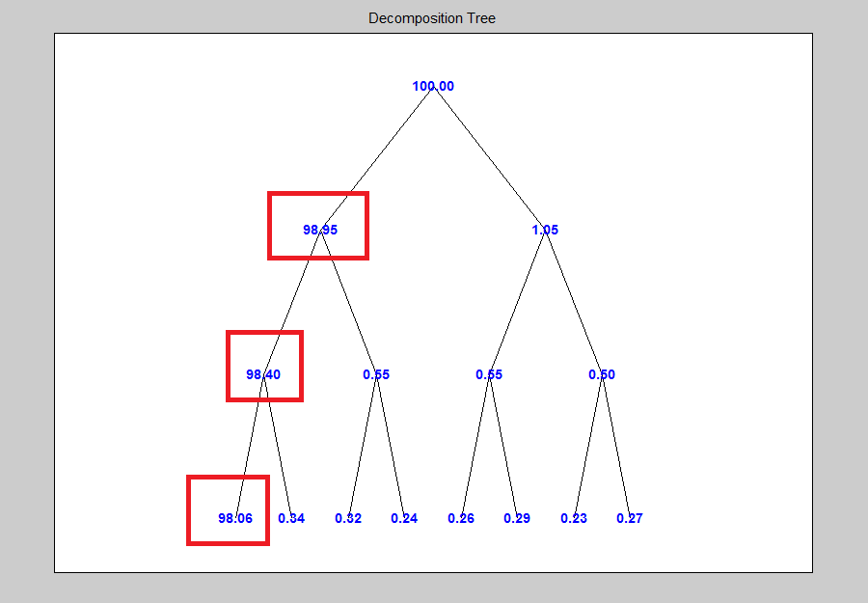
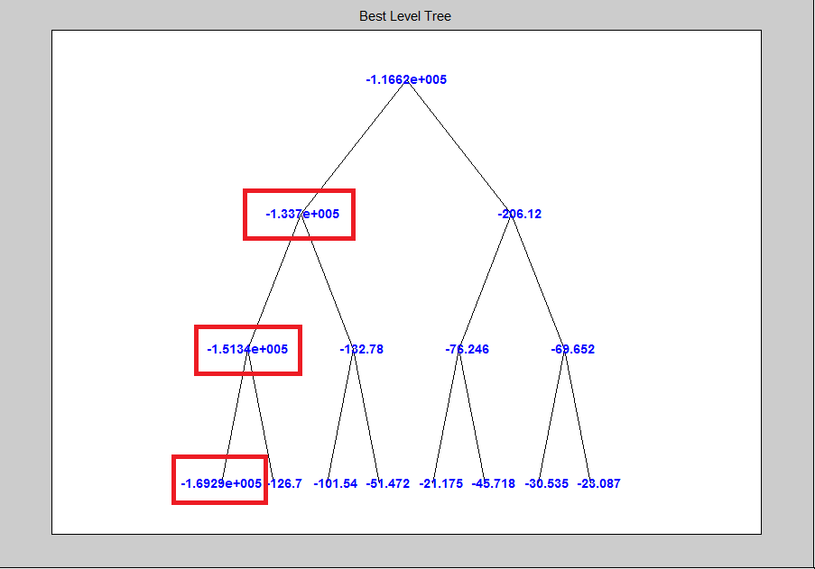
Best Tree Algorithm
Energy and Entropy

Slide 9
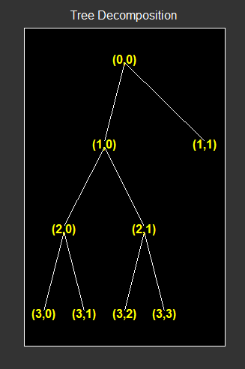
Best Tree Algorithm
Best Tree

Slide 10
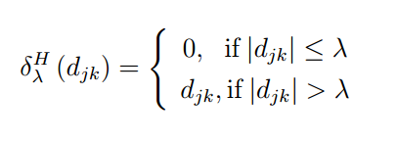
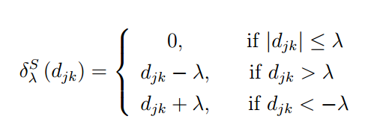
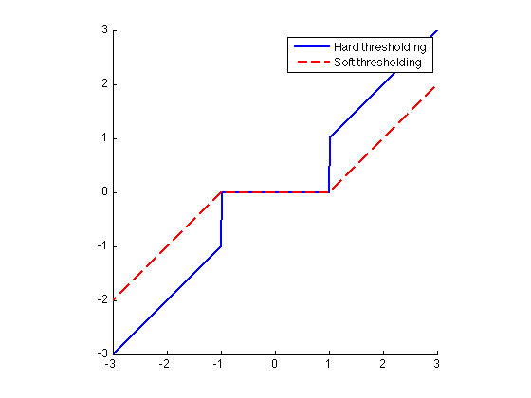
Threshold Selection
Hard or Soft ?
Illustration

Slide 11
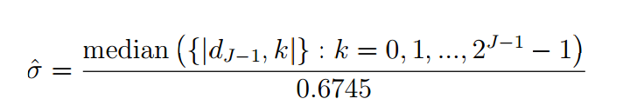
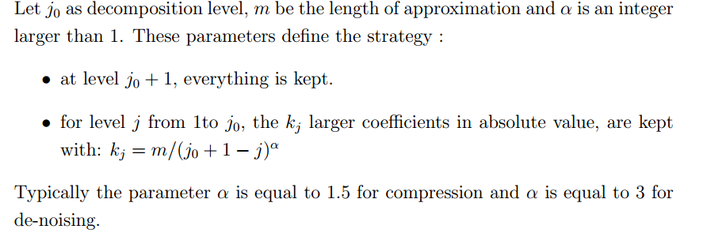
Threshold Selection
Matlab function : wpbmpen(alpha,sigma)
Median absolute deviation, Donoho and Johnston
Birge-Massart Strategy

Slide 12
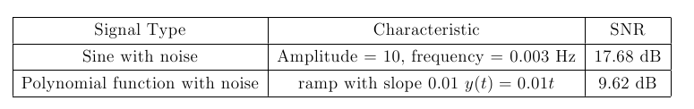
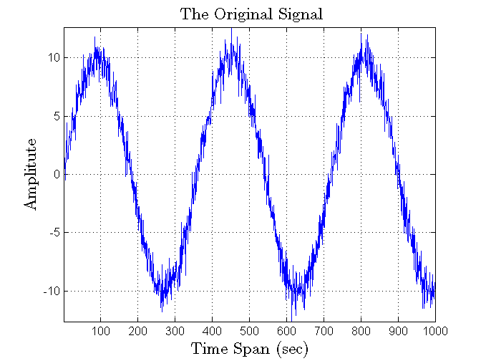
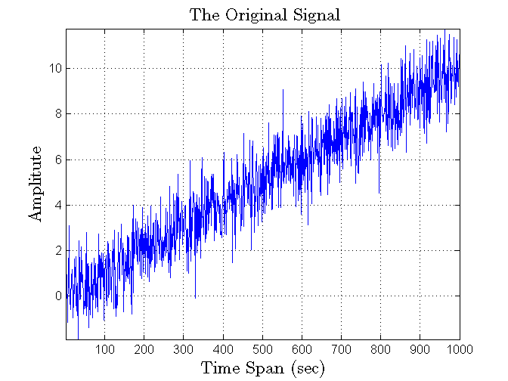
Results – sine + noise
Data Specifications

Slide 13
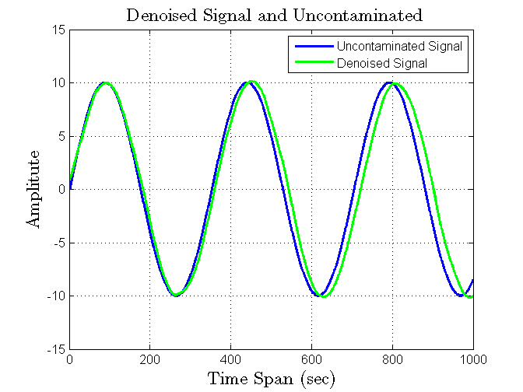
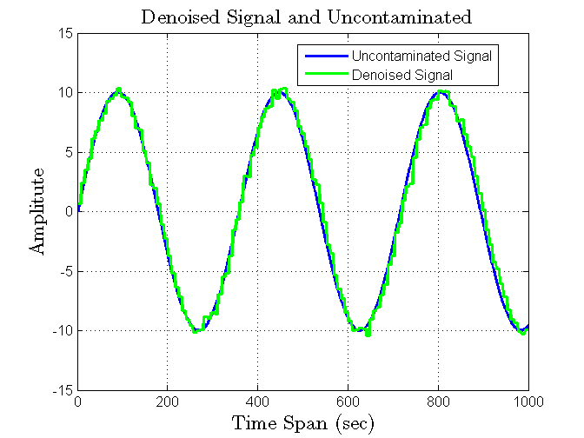
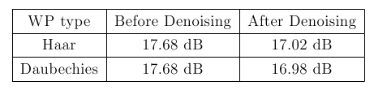
Results – sine + noise
Pick Daubechies level 5, Haar level 7
Denoised Sine Signal

Slide 14
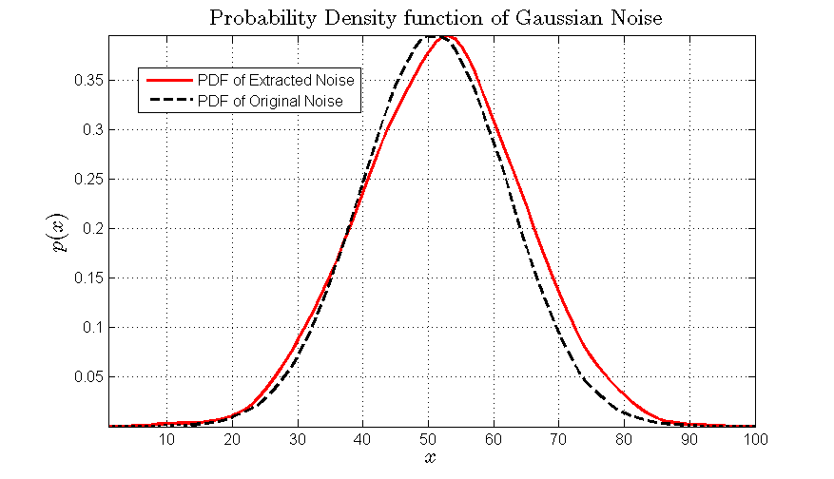
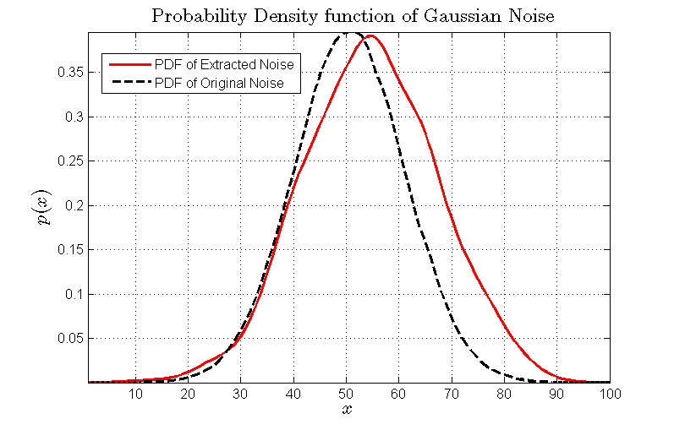
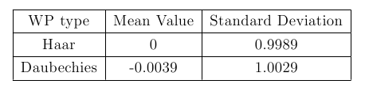
Results – sine + noise
Extracted Noise
Daubechies Level 5,5
Haar Level 7

Slide 15
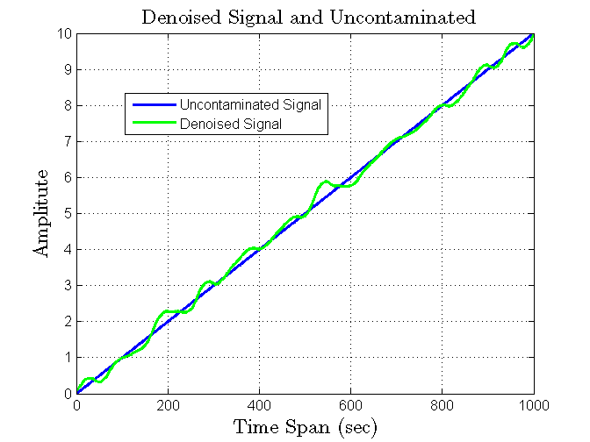
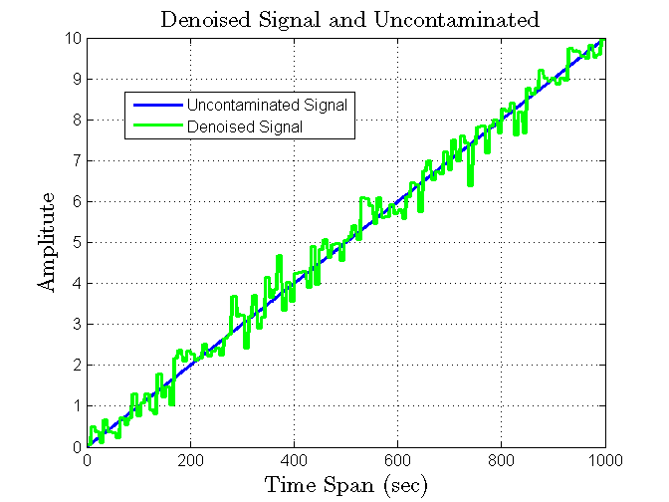
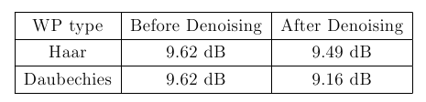
Results – ramp + noise
Denoised Signal
Daubechies Level 5,5
Haar Level 7

Slide 16
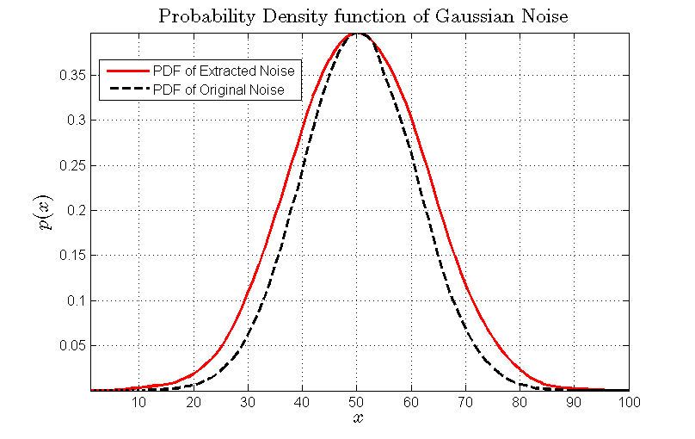
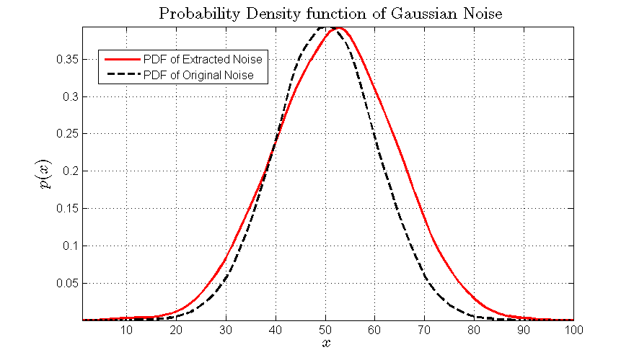
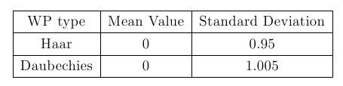
Results – ramp + noise
Extracted Noise
Daubechies Level 5,5
Haar Level 7

Slide 17
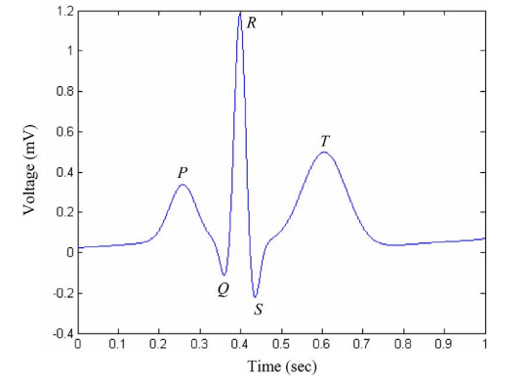
Find the Best basis?
Optimal selection of wavelet basis function applied to ECG signal denoising, 2006, ELSEVIER
ECG signal

Slide 18
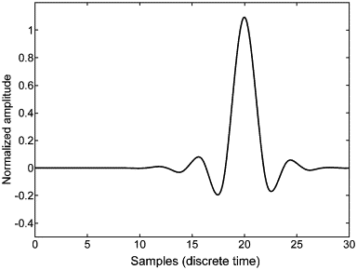
Find the Best basis?
First come to my mind is …
Coiflet looks so similar

Slide 19
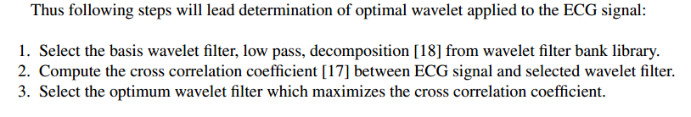
Find the Best basis?
How to define Best?
Their Strategy
Easy to say, signal and filter are related
It implies that error is relatively low

Slide 20
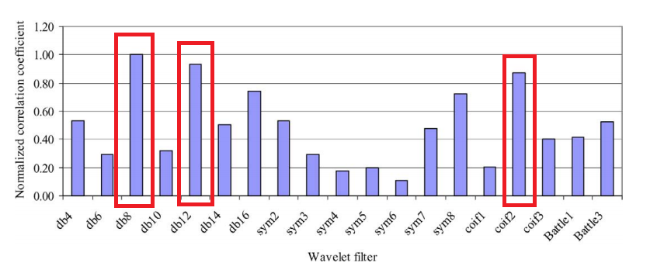
Find the Best basis?
Correlation Coefficient (large as possible)
Db8,db12,coif2

Slide 21
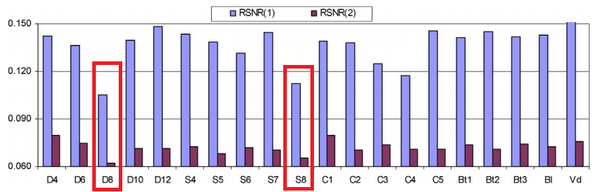
Find the Best basis?
SNR( less as possible )
Db8,S8

Slide 22
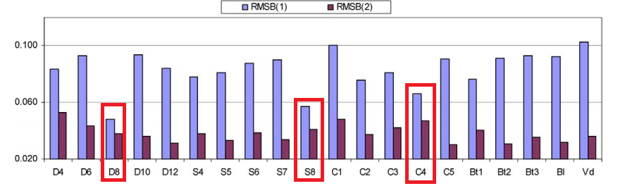
Find the Best basis?
Root Mean Square Error( less as possible )
Db8,S8,Coif4
They conclude Daubechies level 8
And they say it is not easy

Slide 23
End
Thanks for your attention!
Any Questions?

