Slide 1
Wavelet Application
Speaker : Zhao Kai-Wen
Advisor : Chang Ren-Jung
NCKU-ME

Slide 2
Outline
Sin wave + Gaussian Noise case
Benefits of Wavelet and Problems
Useful Internet Resources

Slide 3
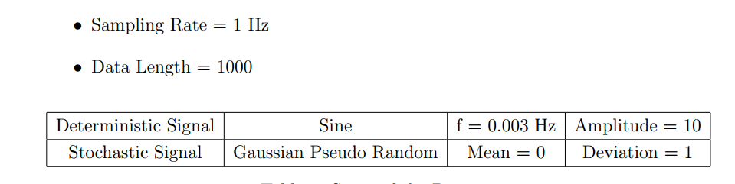
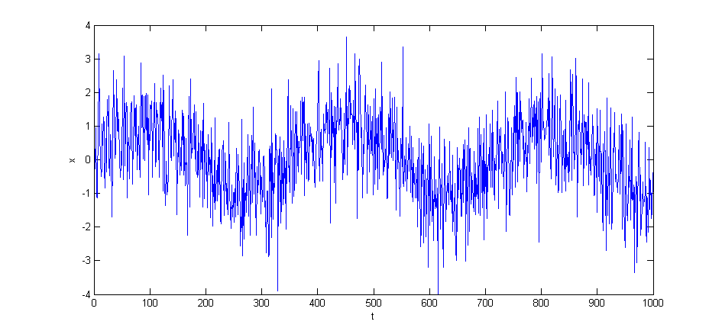
Sin + Gaussian Noise
Data specs
Time Series

Slide 4
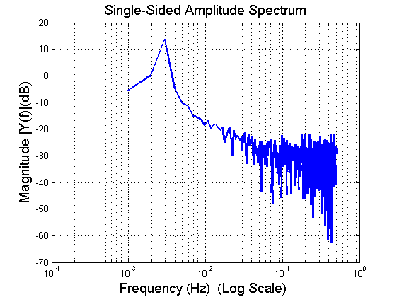
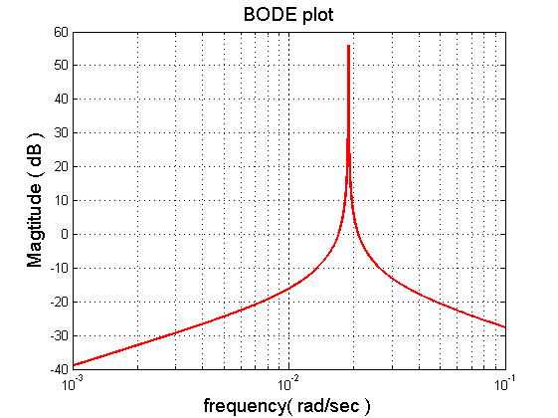
Signal Denosing
NBP Filter : f = 0.003 Hz, B = 0.001, k = 4

Slide 5
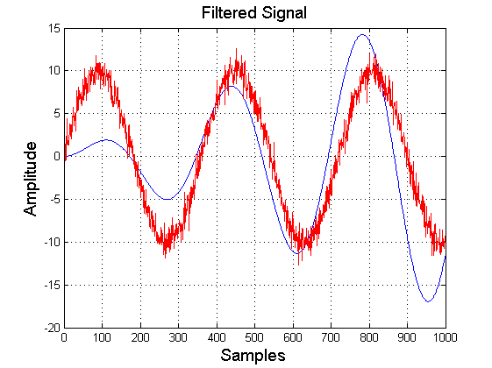
Signal Denosing
Result of Filtering - Drifting

Slide 6
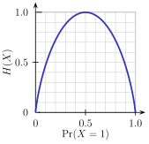
Signal Denosing
Wavelet - Benefits
Low information entropy
Multiresolution, multi-choices
Reduce correlation – whiten the noise
Binary entropy plot

Slide 7
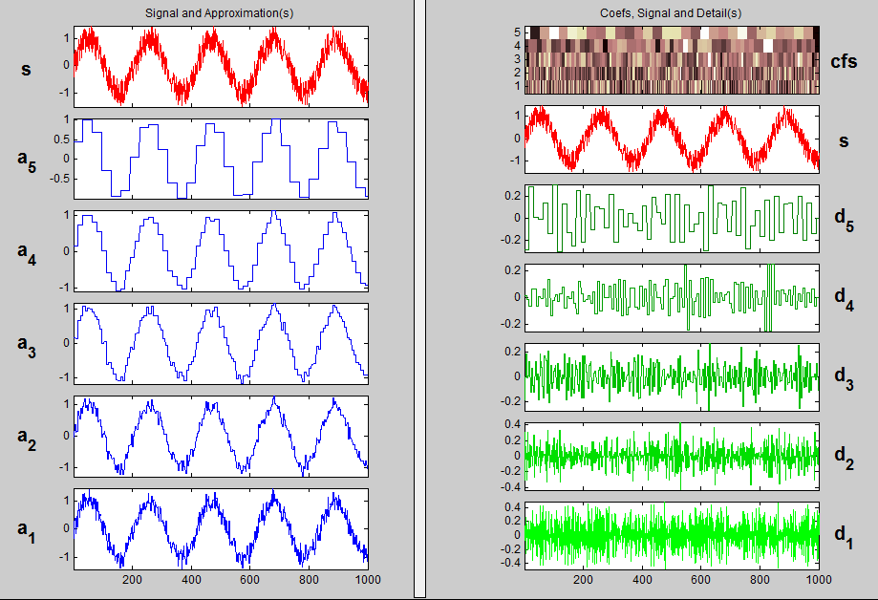
Decomposition

Slide 8
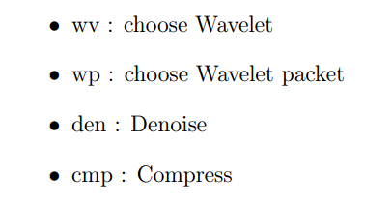
Denoise function
Matlab function
I use wden()
threshold selection rule
soft or hard thresholding
threshold rescaling

Slide 9
Thresholding Rule
Stein‘s unbiased risk estimate ( SURE )
choose a parametric form for an estimator, and then optimize the values of the parameters to minimize the risk estimate
Heuristic SURE

Slide 10
Thresholding Rule
Stein‘s unbiased risk estimate ( SURE )
choose a parametric form for an estimator, and then optimize the values (MSE) of the parameters to minimize the risk estimate (Unbiased)
Heuristic SURE

Slide 11
Thresholding Rule
Stein‘s unbiased risk estimate ( SURE )
choose a parametric form for an estimator, and then optimize the values (MSE) of the parameters to minimize the risk estimate (Unbiased)
Heuristic SURE
Next time we can try function thselect()

Slide 12
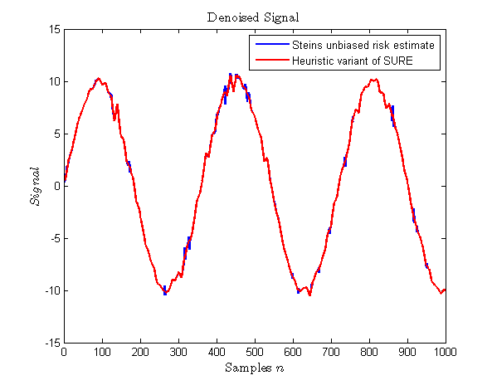
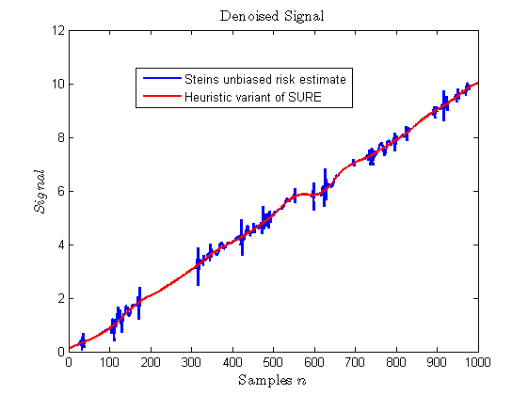
Thresholding Rule
Results
Haar Wave, level 6
Daubechies wavelet Level 6, 6

Slide 13
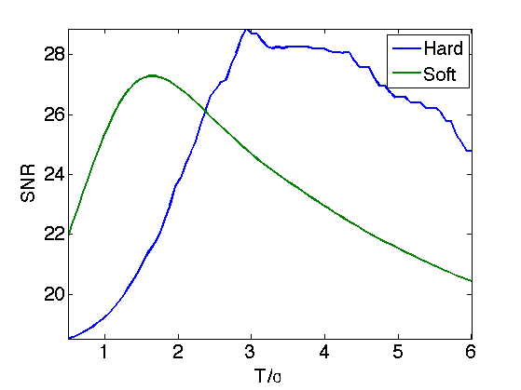
Soft or Hard ?
Steal from Internet
So, I always choose soft

Slide 14
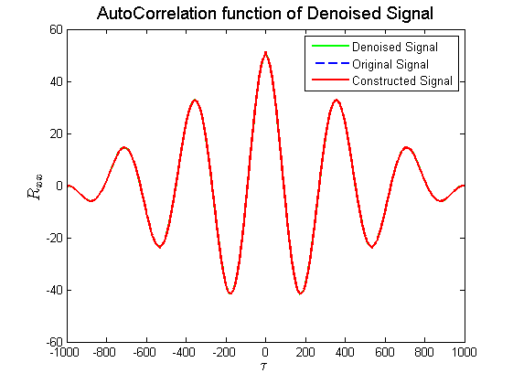
Autocorrelation Estimation
It overlaps ?!

Slide 15
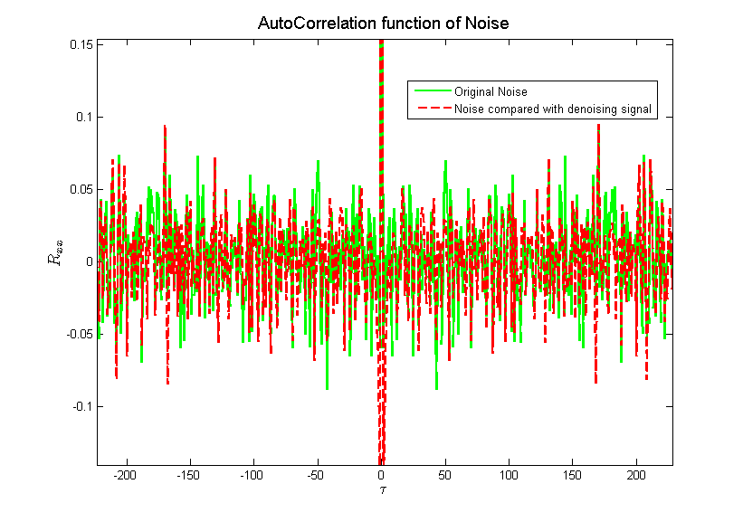
Whitened Noise
Autocorrelation decays

Slide 16
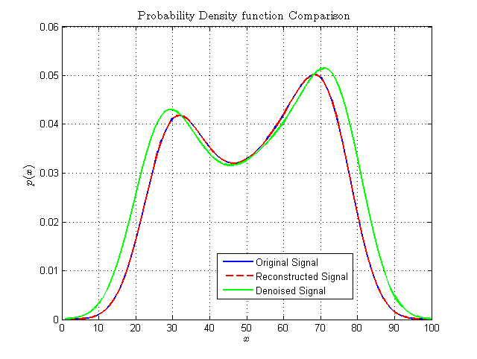
PDF Estimation
Maybe something hikes inside?

Slide 17
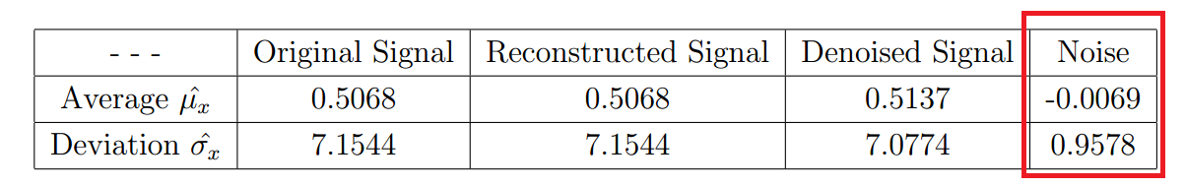
Basic Estimation
It looks reasonable.

Slide 18
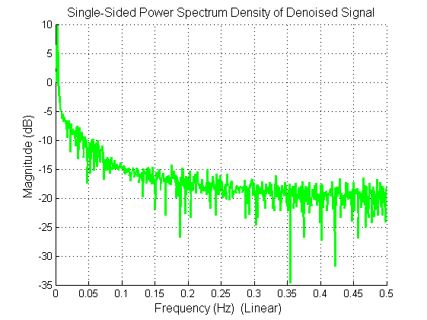
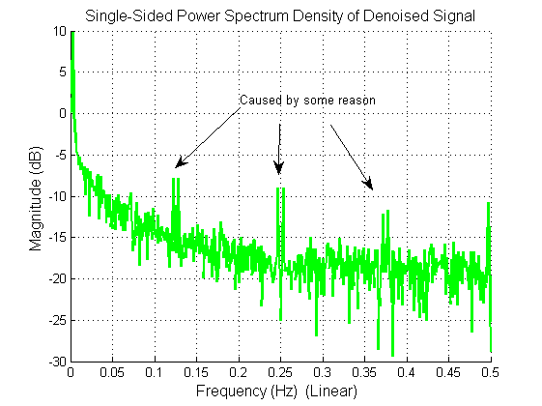
Power Spectrum Density Estimation
Sometimes, it dosen’t work well
Daubechies wavelet Level 6, 6
Haar Wavelet, Level = 1

Slide 19
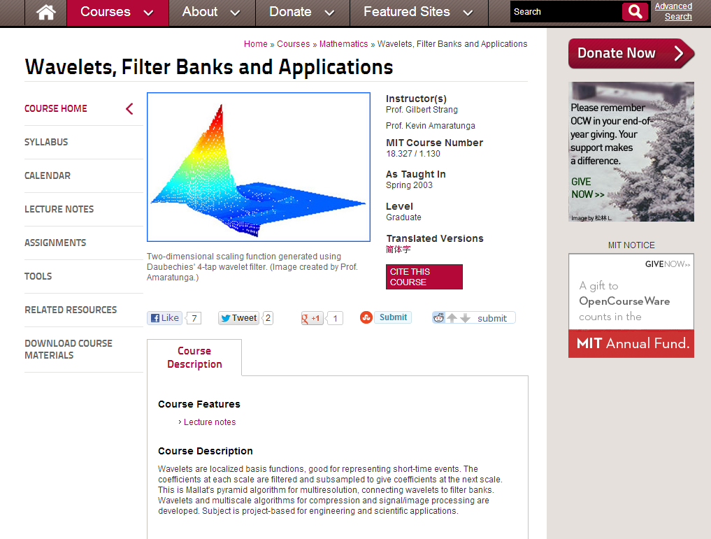
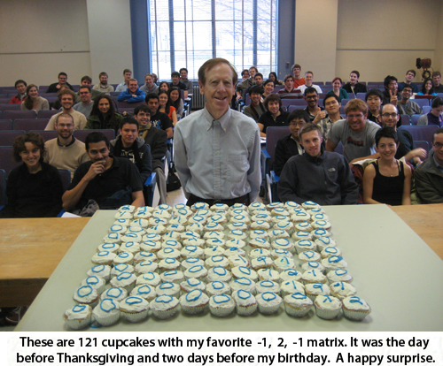
Learn from MIT!
Open Ware Course
Gilbert Strang

Slide 20
End
Thanks for your attention!
Any Questions?

