Slide 1
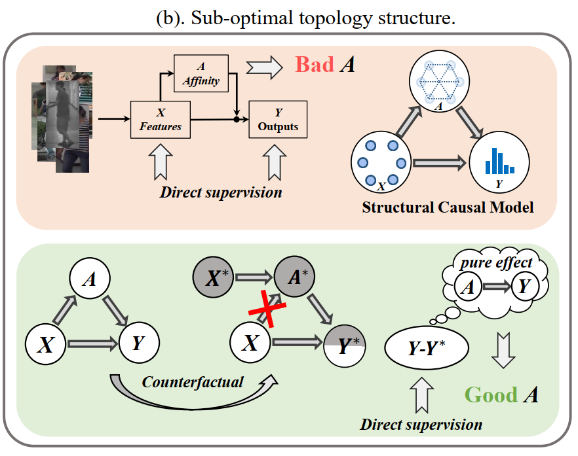
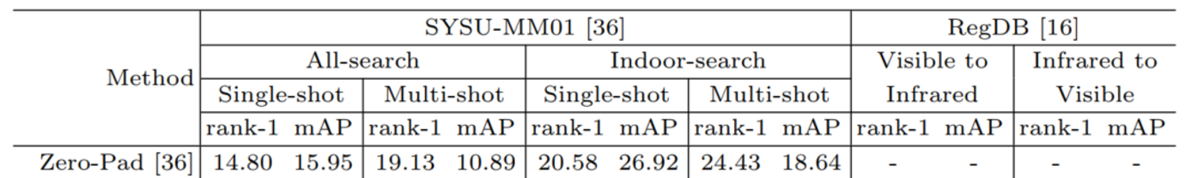
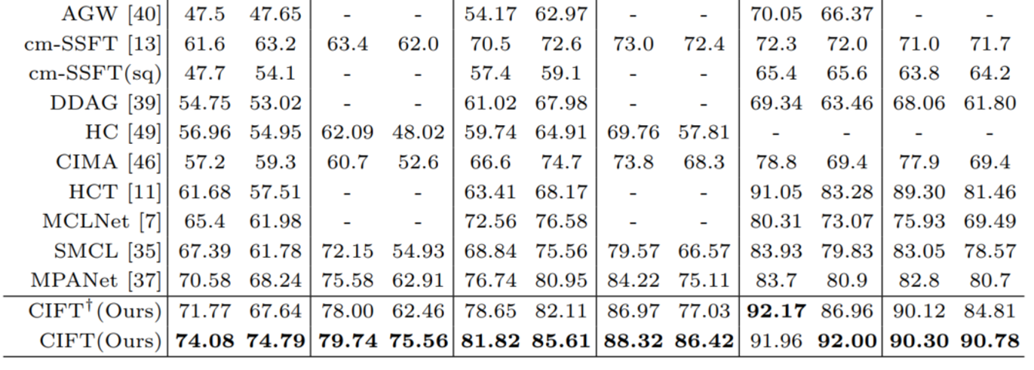
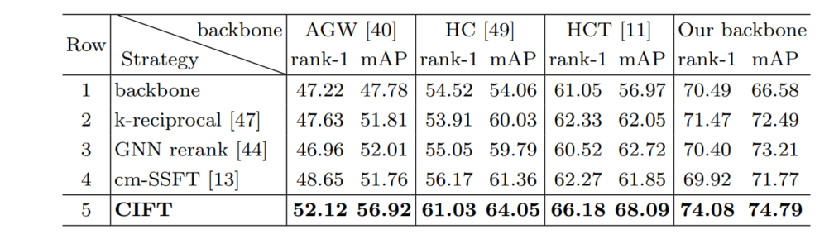
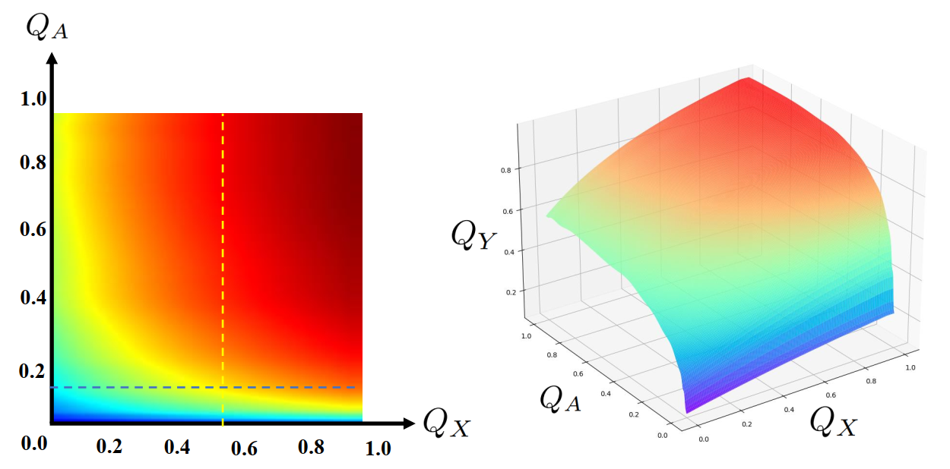
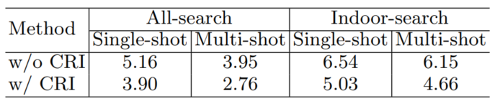
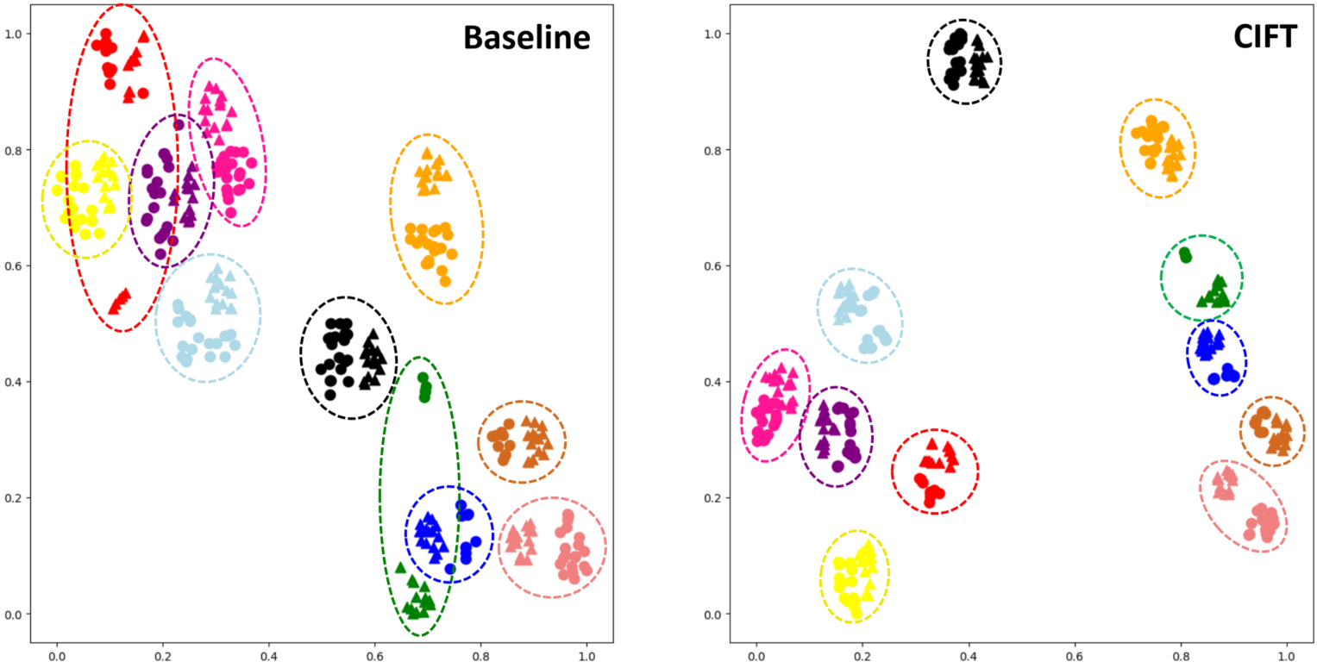
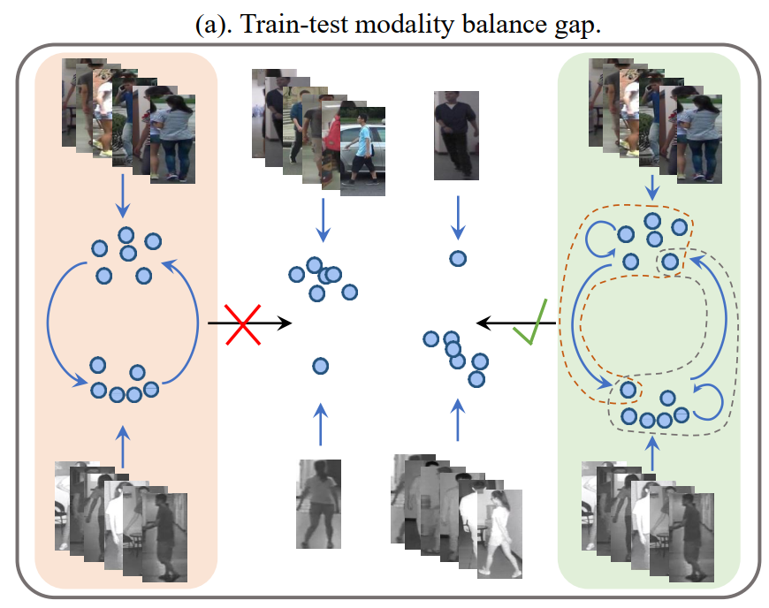
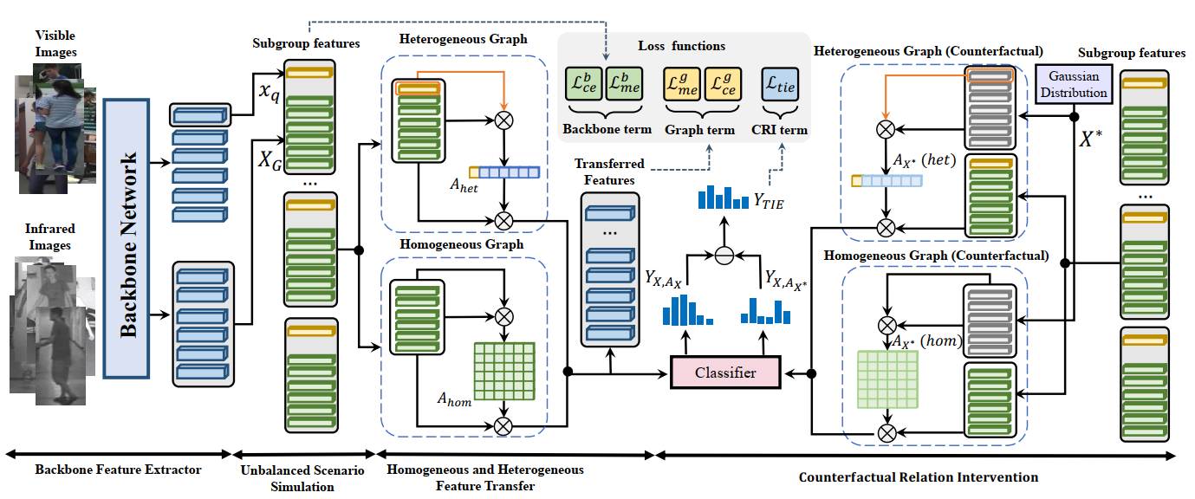
Counterfactual Intervention Feature Transfer for Visible-Infrared Person Re-identification
Xulin Li, Yan Lu, Bin Liu, Yating Liu, Guojun Yin, Qi Chu, Jinyang Huang, Feng Zhu, Rui Zhao, and Nenghai Yu
Background
Counterfactual Relation Intervention
Experiment & Visualization
Visible-infrared person re-identification (VI-ReID) aims to match pedestrian images of the same identity captured by different modality cameras.
Graph-based methods achieve excellent performance because they can spread information between different modality data.
Comparison with State-of-the-art Methods
Existing Problem
we find existing graph-based methods in VI-ReID task suffer from bad generalization because of two issues:
Train-test modality balance gap, which is a property of VI-ReID task. The number of two modalities data are balanced in the training stage but extremely unbalanced in inference, causing the low generalization of graph-based VI-ReID methods.
Sub-optimal topology structure caused by the end-to-end learning manner to the graph module. We analyze that the joint learning of backbone features and graph features weaken the learning of graph topology, making it not generalized enough during the inference process.
Our method uses a counterfactual intervention tool to calculate the pure effect contributed by the affinity changes only, making the model perceive the role of graph topology more direly.
Comparison with Multi-gallery Matching Methods
The average error ratio (%) of the affinity matrix.
Homogeneous and Heterogeneous Feature Transfer
The relationship between the quality of backbone feature QX, affinity QA, and output prediction QY
t-SNE results
Overall Framework Design
Conclusion
We delve into the existing VI-ReID graph model and find two main reasons for their low generalization.
We introduce a Homogeneous and Heterogeneous Feature Transfer module including two independent types of well-designed graph module and an unbalanced scenario simulation.
We propose a Counterfactual Relation Intervention algorithm, which utilizes causal effect tools to highlight the role of the topology in the feature transfer module.
Our method overcomes modality balance gap by unbalanced scenarios simulation and a novel graph module design.

