Slide 1

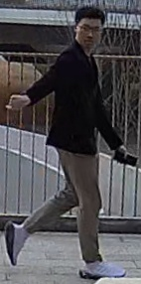
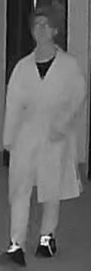
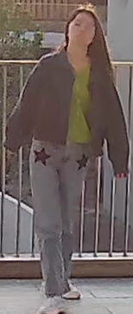
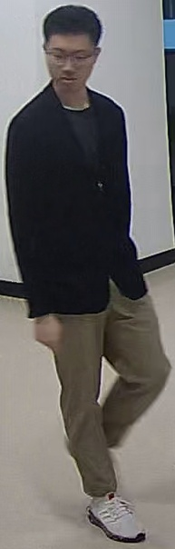
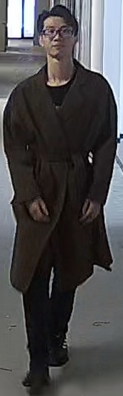
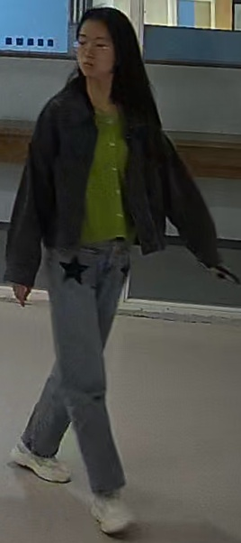
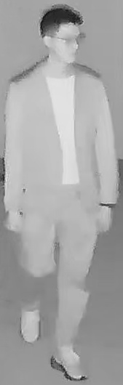
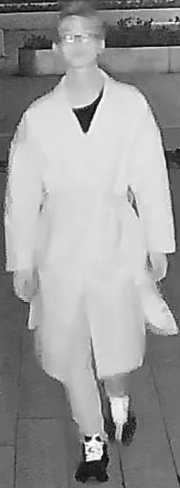
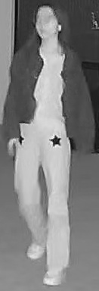
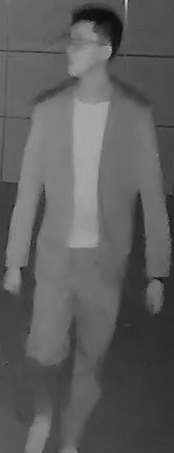
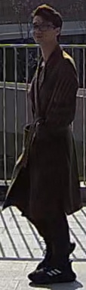
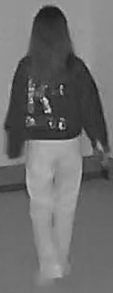
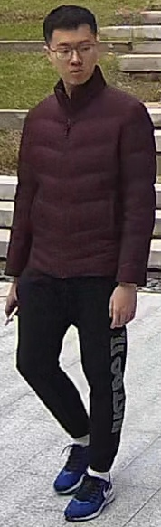
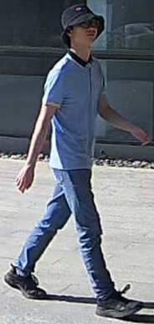
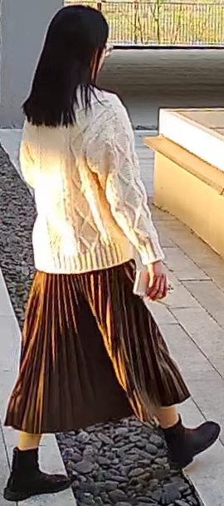
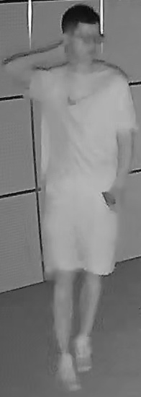
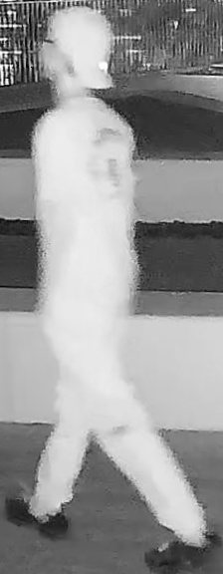
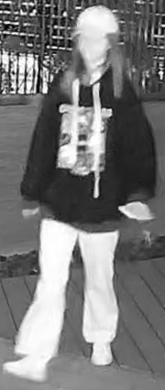
Query images
RGB camera
in the day
IR camera
in the night
Short-term
Long-term

Slide 2

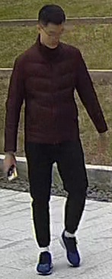
Daytime RGB camera
Nighttime IR camera
Short-term
Long-term
Scenario : DT-ST
Daytime Short-term ( Tr-ReID )
Scenario : NT-ST
Nighttime Short-term
Scenario : DT-LT
Daytime Long-term ( CC-ReID )
Scenario : NT-LT
Nighttime Long-term
Anytime ReID (AT-ReID)
Scenario : AD-ST
All-day Short-term ( CM-ReID )
Scenario : AD-LT
All-day Long-term

Slide 3
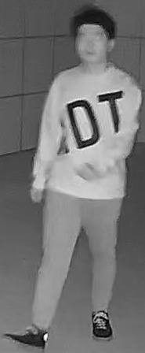
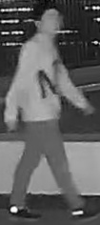
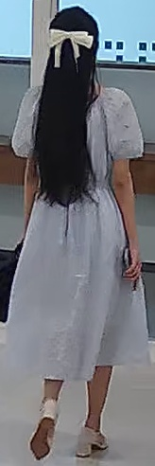
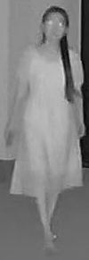
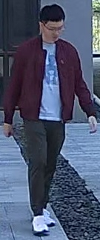
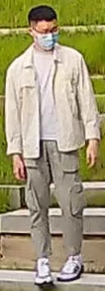
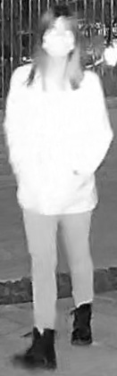
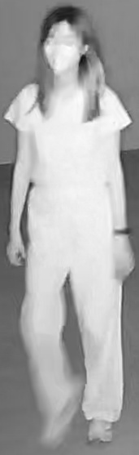
AT-ReID
Daytime
Nighttime
All-day
RGB camera
IR camera
RGB IR
Scenario : DT-ST
Scenario : NT-ST
Scenario : AD-ST
anytime retrieval
AT-ReID
Short-
term
multi-scenario learning
Same clothes
Uni-AT Model
covers all scenarios
Scenario : DT-LT
Scenario : NT-LT
Scenario : AD-LT
AT-100K Dataset
Long-
term
Clothes
changes
(a) Six scenarios of AT-ReID
Tr-ReID
Lack
CM-ReID
CC-ReID
Lack
Lack
DT-ST
NT-ST
AD-ST
Any time
DT-LT
NT-LT
AD-LT
AT-100K Dataset
AT-ReID
Uni-AT Model
(b) The solution of AT-ReID

Slide 4
AT-ReID
Daytime
Nighttime
All-day
anytime retrieval
RGB camera
IR camera
RGB IR
AT-ReID
Scenario : DT-ST
Scenario : NT-ST
Scenario : AD-ST
multi-scenario learning
anytime retrieval
Uni-AT Model
AT-ReID
Short-
term
multi-scenario learning
covers all scenarios
Same clothes
AT-100K Dataset
Uni-AT Model
covers all scenarios
Scenario : DT-LT
Scenario : NT-LT
Scenario : AD-LT
AT-100K Dataset
Long-
term
Clothes
changes
(a) Six scenarios of AT-ReID
anytime retrieval
N/A
N/A
AT-
ReID
Tr-ReID
N/A
CM-ReID
CC-ReID
multi-scenario learning
Uni-AT
covers all scenarios
AT-100K
DT-ST
NT-ST
AD-ST
DT-LT
NT-LT
AD-LT
(b) The solution of AT-ReID

Slide 5
AT-ReID
Daytime
Nighttime
All-day
anytime retrieval
RGB camera
IR camera
RGB IR
AT-ReID
Scenario : DT-ST
Scenario : NT-ST
Scenario : AD-ST
multi-scenario learning
anytime retrieval
Uni-AT Model
AT-ReID
Short-
term
multi-scenario learning
covers all scenarios
Same clothes
AT-100K Dataset
Uni-AT Model
covers all scenarios
Scenario : DT-LT
Scenario : NT-LT
Scenario : AD-LT
AT-100K Dataset
Long-
term
Clothes
changes
(a) Six scenarios of AT-ReID
AT-ReID
anytime retrieval
Tr-ReID
New
CM-ReID
CC-ReID
New
New
Uni-AT
multi-scenario learning
AT-100K
cover all scenarios
DT-ST
NT-ST
AD-ST
DT-LT
NT-LT
AD-LT
(b) The solution of AT-ReID

Slide 6
AT-ReID
Daytime
Nighttime
All-day
anytime retrieval
RGB camera
IR camera
RGB IR
AT-ReID
Scenario : DT-ST
Scenario : NT-ST
Scenario : AD-ST
multi-scenario learning
anytime retrieval
Uni-AT Model
AT-ReID
Short-
term
multi-scenario learning
covers all scenarios
Same clothes
AT-100K Dataset
Uni-AT Model
covers all scenarios
Scenario : DT-LT
Scenario : NT-LT
Scenario : AD-LT
AT-100K Dataset
Long-
term
Clothes
changes
(a) Six scenarios of AT-ReID
AT-ReID
anytime retrieval
Tr-ReID
New
CM-ReID
CC-ReID
New
New
Uni-AT
multi-scenario learning
AT-100K
cover all scenarios
DT-ST
NT-ST
AD-ST
DT-LT
NT-LT
AD-LT
(b) The solution of AT-ReID

Slide 7
AT-ReID
Daytime
Nighttime
All-day
RGB camera
IR camera
RGB IR
Scenario : DT-ST Tr-ReID
Scenario : NT-ST
New
Scenario : AD-ST
CM-ReID
Short-
term
Same clothes
Scenario : DT-LT
CC-ReID
Scenario : NT-LT
New
Scenario : AD-LT
New
Long-
term
Clothes
changes
(a) Six scenarios of AT-ReID
AT-ReID
anytime retrieval
Tr-ReID
New
CM-ReID
CC-ReID
New
New
Uni-AT
multi-scenario learning
AT-100K
cover all scenarios
DT-ST
NT-ST
AD-ST
DT-LT
NT-LT
AD-LT
(b) The solution of AT-ReID

Slide 8
AT-ReID
Daytime
Nighttime
All-day
RGB camera
IR camera
RGB IR
Scenario : DT-ST Tr-ReID
Scenario : NT-ST
New
Scenario : AD-ST
CM-ReID
Short-
term
Same clothes
Scenario : DT-LT
CC-ReID
Scenario : NT-LT
New
Scenario : AD-LT
New
Long-
term
Clothes
changes
(a) Six scenarios of AT-ReID
AT-ReID
anytime retrieval
Tr-ReID
New
CM-ReID
CC-ReID
New
New
Uni-AT
multi-scenario learning
AT-100K
cover all scenarios
DT-ST
NT-ST
AD-ST
DT-LT
NT-LT
AD-LT
(b) The solution of AT-ReID

Slide 9
AT-ReID
Daytime
All-day
Nighttime
RGB camera
RGB IR
IR camera
Scenario : DT-ST
Tr-ReID
Scenario : AD-ST
CM-ReID
Scenario : NT-ST
New
Short-
term
Same clothes
Scenario : DT-LT
CC-ReID
Scenario : AD-LT
New
Scenario : NT-LT
New
Long-
term
Clothes
changes
(a)
AT-ReID
anytime retrieval
Tr-ReID
CC-ReID
CM-ReID
New
New
New
Uni-AT
multi-scenario learning
AT-100K
cover all scenarios
DT-ST
DT-LT
AD-ST
AD-LT
NT-ST
NT-LT
(b)

Slide 10
(a)
AT-ReID
Daytime
All-day
Nighttime
RGB camera
RGB IR
IR camera
Scenario : DT-ST
Tr-ReID
Scenario : AD-ST
CM-ReID
Scenario : NT-ST
New
Short-
term
Same clothes
Scenario : DT-LT
CC-ReID
Scenario : AD-LT
New
Scenario : NT-LT
New
Long-
term
Clothes
changes
(b)
AT-ReID
anytime retrieval
Tr-ReID
CC-ReID
CM-ReID
New
New
New
Uni-AT
multi-scenario learning
AT-100K
cover all scenarios
DT-ST
DT-LT
AD-ST
AD-LT
NT-ST
NT-LT

Slide 11
(a)
Daytime
All-day
Nighttime
RGB camera
RGB IR
IR camera
Scenario : DT-ST
Tr-ReID
Scenario : AD-ST
CM-ReID
Scenario : NT-ST
New
Short-
term
Same clothes
Scenario : DT-LT
CC-ReID
Scenario : AD-LT
New
Scenario : NT-LT
New
Long-
term
Clothes
changes
(b)
AT-ReID
Anytime retrieval
Tr-ReID
CC-ReID
CM-ReID
New
New
New
Uni-AT
Multi-scenario learning
AT-100K
Cover all scenarios
DT-ST
DT-LT
AD-ST
AD-LT
NT-ST
NT-LT

Slide 12
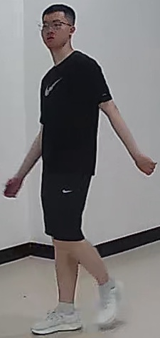
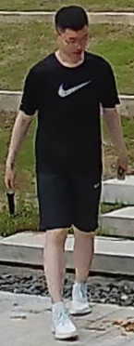
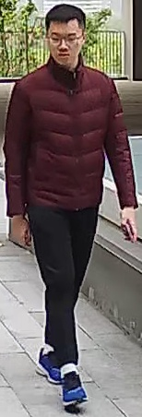
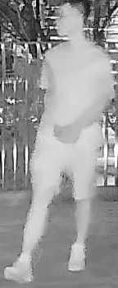
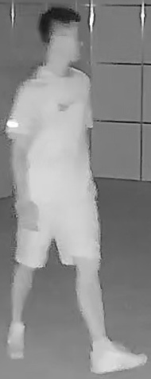
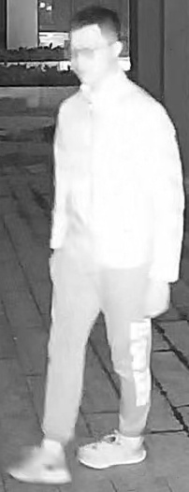
DT: Daytime
RGB Camera
NT: Nighttime
IR Camera
AD: All-day
RGB IR
ST: Short-term
Same clothes
LT: Long-term Clothes changes
Day
DT-ST
Tr-ReID
DT-LT
CC-ReID
AD-ST
CM-ReID
(a)
Spring
Summer
Winter
AD-LT
NT-ST
NT-LT
Night
AT-ReID
Anytime retrieval
Tr-ReID
CC-ReID
CM-ReID
New
New
New
(b)
Uni-AT
Multi-scenario learning
AT-135K
Cover all scenarios
DT-ST
DT-LT
AD-ST
AD-LT
NT-ST
NT-LT

Slide 13
DT: Daytime
RGB Camera
NT: Nighttime
IR Camera
AD: All-day
RGB IR
ST: Short-term
Same clothes
LT: Long-term Clothes changes
Day
DT-ST
Tr-ReID
DT-LT
CC-ReID
AD-ST
CM-ReID
Spring
Summer
Winter
AD-LT
NT-ST
NT-LT
Night
(a)
AT-ReID task
Anytime retrieval
Tr-ReID
CC-ReID
CM-ReID
New
New
New
Uni-AT method
Multi-scenario learning
AT-135K dataset
Cover all scenarios
DT-ST
DT-LT
AD-ST
AD-LT
NT-ST
NT-LT
(b)

Slide 14
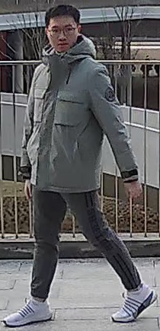
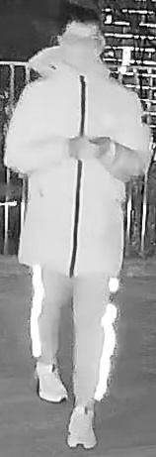
DT
Daytime
RGB Camera
Day
DT-LT
CC-ReID
NT
DT-ST
Tr-ReID
Nighttime
IR Camera
AD
AD-ST
CM-ReID
AD-LT
All-day
RGB IR
Spring
Winter
ST
Short-term
Same clothes
NT-ST
LT
NT-LT
Long-term Clothes changes
Night
(a)
AT-ReID task
Anytime retrieval
Tr-ReID
CC-ReID
CM-ReID
New
New
New
Uni-AT method
Multi-scenario learning
AT-135K dataset
Cover all scenarios
DT-ST
DT-LT
AD-ST
AD-LT
NT-ST
NT-LT
(b)

Slide 15
DT
DT-ST
Tr-ReID
Daytime
RGB Camera
Day
DT-LT
CC-ReID
NT
Nighttime
IR Camera
AD
AD-ST
CM-ReID
AD-LT
All-day
RGB IR
Spring
Winter
ST
Short-term
Same clothes
LT
NT-LT
Long-term Clothes changes
Night
NT-ST
(a)
AT-ReID task
Anytime retrieval
Tr-ReID
CC-ReID
CM-ReID
New
New
New
Uni-AT method
Multi-scenario learning
AT-135K dataset
Cover all scenarios
DT-ST
DT-LT
AD-ST
AD-LT
NT-ST
NT-LT
(b)

Slide 16
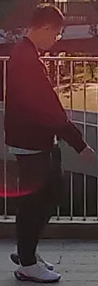
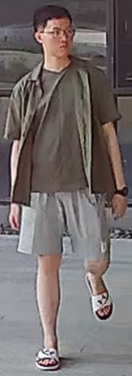
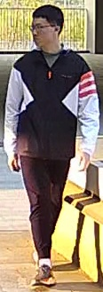
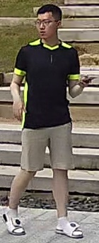
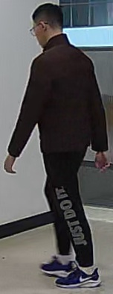


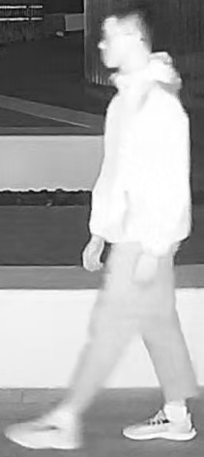
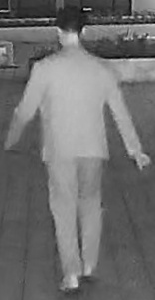
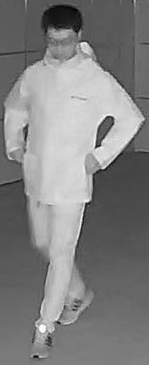
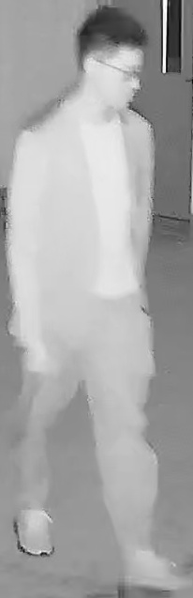
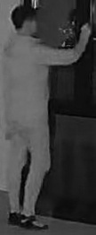
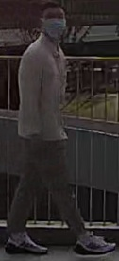
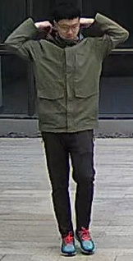
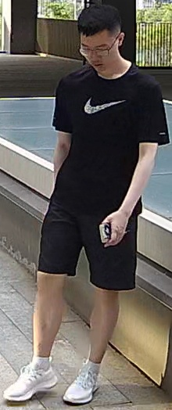
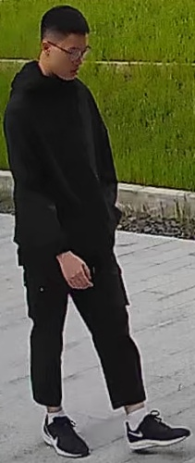
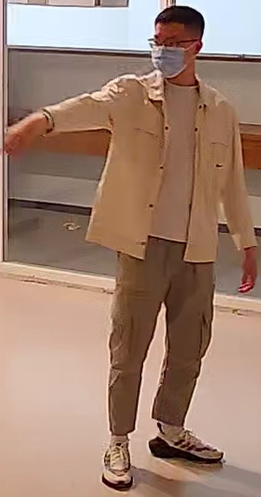




































AT-100K Average Intra-ID Diversity = 36.1
MSMT17 Average Intra-ID Diversity = 4.7
SYSU-MM01 Average Intra-ID Diversity = 4.6
LTCC Average Intra-ID Diversity = 7.3

Slide 17
AT-100K Intra-ID diversity = 36.1
MSMT17 Intra-ID diversity = 4.7
SYSU-MM01 Intra-ID diversity = 4.6
LTCC Intra-ID Diversity = 7.3

Slide 18
Intra-ID diversity
AT-100K: 36.1
MSMT17: 4.7
SYSU-MM01: 4.6
LTCC: 7.3

Slide 19
AT-100K
AT-100K
(a)
(b)
AT-100K
AT-100K
(c)
(d)

Slide 20
AT-100K
AT-100K
(a)
(b)
AT-100K
AT-100K
(c)
(d)

Slide 21
AT-100K
AT-100K
(a)
(b)
AT-100K
AT-100K
(c)
(d)

Slide 22
AT-135K
AT-135K
(a)
(b)
AT-135K
AT-135K
(c)
(d)

Slide 23
AT-USTC
AT-USTC
(a)
(b)
AT-USTC
AT-USTC
(c)
(d)

Slide 24








Task-Specific Head
Hierarchical Dynamic Weighting (HDW)
ID Loss
Position
Embedding
…
5
0
MoAE-FFN
Task-Specific
CLS Token
Transformer Layer
Norm
Expert 1
…
…
Gating
Expert 2
Expert n
Transformer Layer
…
…
Self-Attention
13
12
7
6
5
5
0
0
Linear Projection of Flattened Patches
Norm
Atom Experts
VM IM CM SC CC
…
Transformer Layer
Mixture-of-Atom-Experts (MoAE)

Slide 25
Task-Specific Head
Hierarchical Dynamic Weighting (HDW)
ID Loss
Gating
Position
Embedding
5
…
0
Expert 1
FFN
MoAE
Expert 2
Task-Specific
CLS Token
Transformer Layer
Select
…
…
Norm
Patch Token
Transformer Layer
Expert n
Expert 1
Expert 2
…
Expert n
13
12
…
6
…
Self-Attention
7
5
5
0
0
Linear Projection of Flattened Patches
Norm
Atom Experts
…
Mixture-of-Atom-Experts (MoAE)

Slide 26
Scenario-Specific Head
Hierarchical Dynamic Weighting (HDW)
ID Loss
Gating
Position
Embedding
5
…
0
expert 1
FFN
MoAE
…
Scenario-Specific
CLS Token
Transformer Layer
select
expert n
weighted
sum
…
…
Norm
expert 6n
Patch Token
Transformer Layer
Atoms
0
…
expert n
[ DT ]
[ NT ]
[ AD ]
[ ST ]
[ LT ]
DT-ST
expert 2
13
12
…
6
…
expert 1
7
5
5
0
0
Self-Attention
Linear Projection of Flattened Patches
Norm
1
expert n+1
DT-LT
…
…
…
Mixture-of-Atom-Experts (MoAE)

Slide 27
Scenario-Specific Head
Hierarchical Dynamic Weighting (HDW)
ID Loss
Gating
Position
Embedding
5
…
0
expert 1
FFN
MoAE
…
Scenario-Specific
CLS Token
Transformer Layer
select
expert n
weighted
sum
…
…
Norm
expert 6n
Patch Token
Transformer Layer
Atoms
expert n
[ DT ]
[ NT ]
[ AD ]
[ ST ]
[ LT ]
…
13
12
…
6
…
0
expert 2
7
5
5
0
0
Self-Attention
DT-ST
expert 1
Linear Projection of Flattened Patches
Norm
…
…
5
AD-LT
Mixture-of-Atom-Experts (MoAE)

Slide 28
Time Moment Atoms
[ DT ] Daytime
Scenario-Aware Identity Loss
Gating
[ NT ] Nighttime
Hierarchical Dynamic Weighting (HDW)
expert 1
[ AD ] All-day
…
…
Time Interval Atoms
Transformer Layer
FFN
MoAE
Select
expert n
Weighted
sum
[ ST ] Short-term
…
…
expert 6n
[ LT ] Long-term
Transformer Layer
Norm
expert n
[ DT ]
[ NT ]
[ AD ]
[ ST ]
[ LT ]
…
Scenario Head
…
…
13
0
expert 2
0
0
5
5
6
7
12
Position
Embedding
Multi-Scenario ReID (MS-ReID)
Self-Attention
DT-ST
expert 1
Linear Projection of Flattened Patches
…
Scenario
CLS Token
Norm
5
Patch Token
…
AD-LT
Mixture-of-Atom-Experts (MoAE)
Patch
Token
Scenario Head
Time Moment Atoms
[ DT ] Daytime
[ NT ] Nighttime
[ AD ] All-day
Scenario
CLS Token
Position
Embedding
Time Interval Atoms
[ ST ] Short-term
[ LT ] Long-term

Slide 29
Scenario-Aware Identity Loss
Patch
Token
Scenario Head
*
*
*
Gating
Weighted
sum
Task2
Task3
…
*
Scenario
CLS Token
Position
Embedding
*
Expert
*
Transformer Layer
FFN
MoAE
*
Select
…
*
Confidence
(Time Interval)
*
*
…
Norm
Transformer Layer
[ DT ]
*
DT-ST
Confidence
(Time Moment)
0
*
1
*
…
5
*
6
7
8
…
13
[ NT ]
…
…
Task1
Self-Attention
[ AD ]
*
Linear Projection
NT-ST
Norm
[ ST ]
…
…
Loss weight
…
*
*
[ LT ]
*
*
AD-LT
AT-USTC
Dataset
Attribute
layers
Experts
(FFN)
Hierarchical Dynamic Weighting (HDW)
Multi-Scenario ReID (MS-ReID)
Mixture-of-Attribute-
Experts (MoAE)

