Slide 1
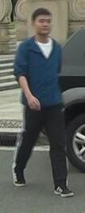


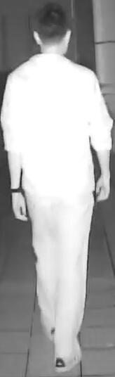



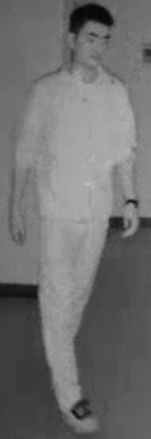
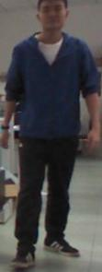




Graph Nodes
Graph Nodes
Do-expression
𝐗
𝐗
Direct
Connection
Indirect
Connection
$$Y_{X,𝓐}$$
$$Y_{X,\overline{𝓐}}$$
$$𝓐$$
$$\overline{𝓐}$$
Graph Structure
Prediction
Graph Structure
Prediction
(a)
(b)
(c)
(d)

Slide 2

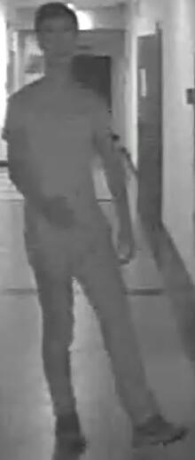



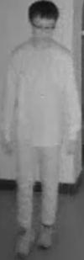
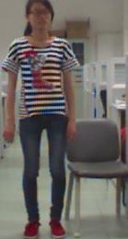










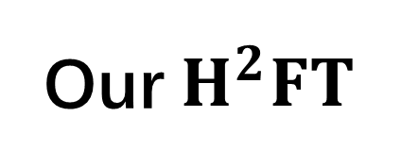
Heterogeneous Feature Transfer
Training samples
train-test gap
mimicking
Gallery samples
Single query sample
Homogeneous Feature Transfer
Other methods
Single query test
Our $H^{2}FT$

Slide 3






Graph Nodes
Do-expression
𝐗
𝐗
a
c
e
Visible Image
Direct
Connection
train-test gap
mimicking
Indirect
Connection
$$Y_{X,𝓐}$$
$$Y_{X,\overline{𝓐}}$$
$$𝓐$$
$$\overline{𝓐}$$
b
d
f
Graph Structure
Prediction
Graph Structure
Prediction
Infrared Image
(d)
Other methods training
Single query test
Our $H^{2}FT$ training
(c)

Slide 4
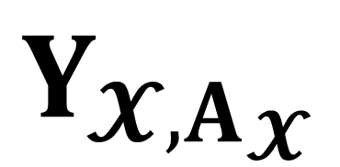

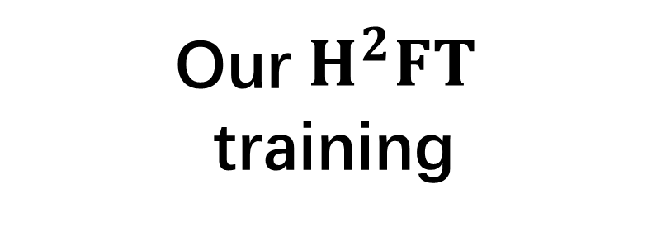
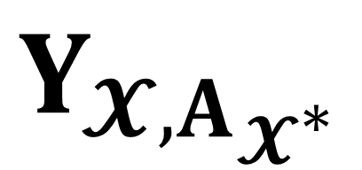





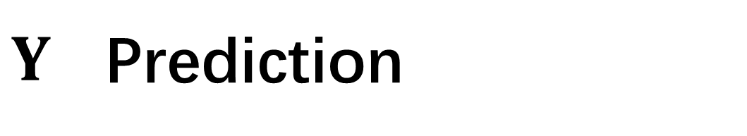

𝐗 Node Features
A Graph Affinity
$$A$$
$Y$ Prediction
Indirect
Connection
Visible Image
train-test gap
mimicking
𝐗
Direct
Connection
$$Y_{ }$$
$$A$$
$$𝓧^{∗}$$
$$A$$
𝓧
$$Y_{ }$$
$$Y_{𝓧,A_{𝓧}}$$
𝓧
$$Y_{ }$$
$$Y_{𝓧,A_{𝓧^{∗}}}$$
Infrared Image
Existing methods
training
Single query
test
Our $H^{2}FT$
training
Causal Graph

Slide 5
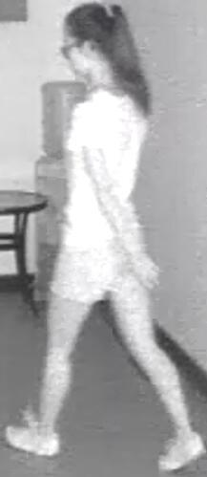
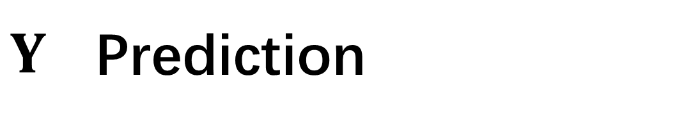

𝐗 Images Features
A Graph Affinity
Visible Image
$$A$$
$Y$ Prediction
train-test gap
mimicking
Indirect
Connection
𝐗
Direct
Connection
$$Y_{ }$$
Infrared Image
Existing methods
training
Single query
test
Our $H^{2}FT$
training
Causal Graph

Slide 6




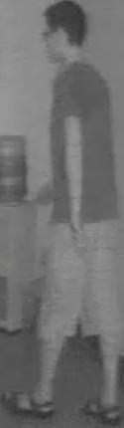
modality balance training
modality unbalance testing
Visible Images
Infrared Images

Slide 7
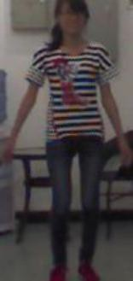

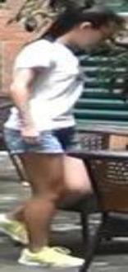


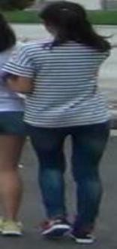
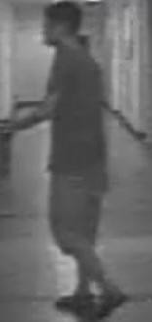




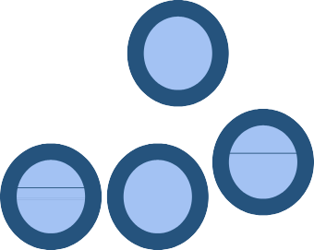

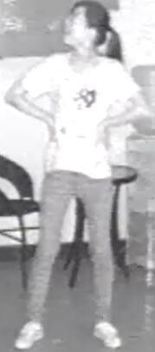
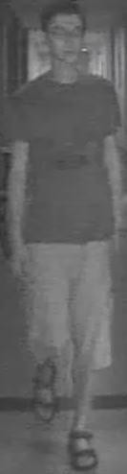
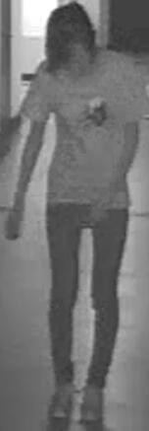
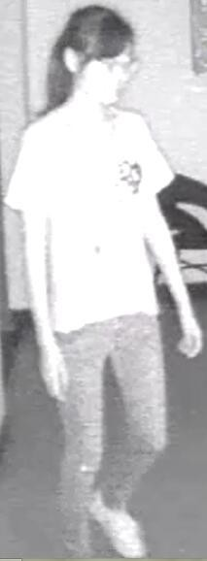
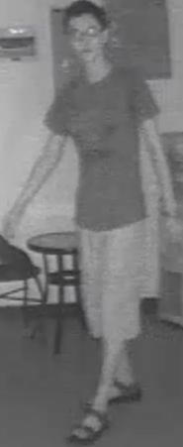
(a). Train-test modality balance gap.
(b). Structural Causal Model of VI-ReID graph models.
A
Affinity
X
Features
Y
Outputs
A
General representation of
Graph VI-ReID Model
X
$${\text{Y}}_{ }$$
Structural Causal Model
(c). Sub-optimal topology structure and causal inference solution.
A
$$X^{∗}$$
A
A
$$\text{Y}$$
X
$$\text{Y}$$
X
$$\text{Y}$$
Counterfactual
Bad A
Good A

Slide 8
(a). Train-test modality balance gap.
(b). Sub-optimal topology structure.
A
Affinity
Bad A
X
Features
Y
Outputs
A
Direct supervision
X
$${\text{Y}}_{ }$$
Structural Causal Model
A
$${ X}^{∗}$$
$${ A}^{∗}$$
pure effect
A
$$\text{Y}$$
X
$$\text{Y}$$
X
$${ Y}^{∗}$$
$\text{Y}$-$Y^{∗}$
Counterfactual
Good A
Direct supervision

Slide 10
Backbone Network

Slide 11





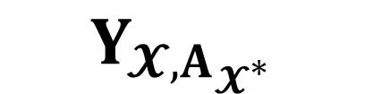












Heterogeneous Graph
$$𝓧^{∗}$$
$$Y_{𝓧,A_{𝓧}}$$
$$𝓧$$
CE Loss
Visible Images
Unbalanced Mimicking Scenario Training
CE Loss
DHCA Loss
CE Loss
HCA-kl Loss
$$A_{𝓧^{∗}}$$
$$Y_{TIE}$$
$$A_{𝓧}$$
$$Y_{𝓧,A_{𝓧}}$$
$$𝓧$$
$$Y_{𝓧,A_{𝓧^{∗}}}$$
Classifier
Classifier
Backbone Network
Features
Homogeneous Graph
$$𝓧$$
$$𝓧^{∗}$$
$$Y_{𝓧,A_{𝓧}}$$
CE Loss
$$A_{𝓧}$$
CE Loss
HCA-kl Loss
$$A_{𝓧^{∗}}$$
$$Y_{TIE}$$
CE Loss
DHCA Loss
$$Y_{𝓧,A_{𝓧}}$$
$$Y_{𝓧,A_{𝓧^{∗}}}$$
Infrared Images
$$𝓧$$
Classifier
Classifier
Backbone Feature Extractor
Homogeneous and Heterogeneous Feature Transfer
Counterfactual Relation Intervention

Slide 12
Visible
Images
Subgroup features
Heterogeneous Graph
Transferred Features
Loss
functions
Heterogeneous Graph (Counterfactual)
$$x_{q}$$
$$ℒ_{ce}^{g}$$
$$ℒ_{ce}^{b}$$
Gaussian
Distribution
Classifier
$$ℒ_{tie}$$
Classifier
$$ℒ_{me}^{g}$$
$$ℒ_{me}^{b}$$
$$X^{∗}$$
$$X_{G}$$
$$A_{X^{∗}} (het)$$
…
$$A_{het}$$
…
…
…
…
Backbone Network
…
$$Y_{TIE}$$
Infrared
Images
Classifier
Homogeneous Graph
Classifier
Homogeneous Graph (Counterfactual)
$$A_{X^{∗}} (hom)$$
Classifier
…
Classifier
…
$$A_{hom}$$
$$Y_{X,A_{X}}$$
$$Y_{X,A_{X^{∗}}}$$
Backbone Feature Extractor
Unbalanced Scenario
Simulation
Homogeneous and Heterogeneous
Feature Transfer
$$Counterfactual Relation Intervention$$

Slide 13
Visible
Images
Subgroup features
Heterogeneous Graph
Loss functions
Heterogeneous Graph (Counterfactual)
Subgroup features
$$x_{q}$$
$$ℒ_{ce}^{b}$$
$$ℒ_{me}^{b}$$
$$ℒ_{me}^{g}$$
$$ℒ_{ce}^{g}$$
$$ℒ_{tie}$$
Gaussian
Distribution
Backbone term
Graph term
CRI term
$$X^{∗}$$
$$X_{G}$$
Transferred
Features
$$A_{X^{∗}} (het)$$
…
$$A_{het}$$
$$Y_{TIE}$$
…
Backbone Network
Infrared
Images
…
Homogeneous Graph
Homogeneous Graph (Counterfactual)
$$Y_{X,A_{X}}$$
$$Y_{X,A_{X^{∗}}}$$
$$A_{X^{∗}} (hom)$$
Classifier
$$A_{hom}$$
Backbone Feature Extractor
Unbalanced Scenario
Simulation
Homogeneous and Heterogeneous
Feature Transfer
$$Counterfactual Relation Intervention$$

Slide 14





1.0
0.8
0.6
0.4
1.0
0.2
0.8
0.0
0.6
(a)
(b)
0.4
0.2

