Slide 1





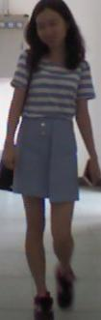

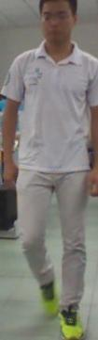
features
logits
GAP
Classifier
ID Loss
CACC_kl Loss
Images
Backbone Network
CACC_euc Loss
ID1 Clothes 1
features or logits
center
ID1 Clothes 2
aggregate
ID2 Clothes 3
center
LEARNING
center
push away
CACC Loss

Slide 2
features
CACC Loss
probabilities
person A
person A
bottleneck
classifier
…
…
global average
pooling
person B
person B
CACC Loss
Identity Loss
…
…
…
…
Images
Backbone Network
Cloth-Aware Center Cluster (CACC) loss
Features/probabilities
Euclidean distance/KL distance
person A
person A
…
…
aggregate
…
…
cloth-aware
clothes A1
clothes A2
CACC Loss training
person B
person B
…
…
push away
center
…
…
center
clothes B1
clothes B2
…
…

Slide 3
features
probabilities
person A
person A
bottleneck
classifier
…
…
global average
pooling
person B
person B
Identity Loss
…
…
…
…
Images
Backbone Network
CACC Loss
features or probabilities
Euclidean distance or KL distance
person A
person A
…
…
…
…
center
aggregate
cloth-aware
clothes A1
clothes A2
CACC Loss training
person B
person B
center
…
…
push away
…
…
center
clothes B1
clothes B2
center
…
…

Slide 4
Features
Probabilities
person A
person A
Bottleneck
Classifier
…
…
Global average
pooling
person B
person B
Identity Loss
…
…
…
…
Images
Backbone Network
CACC Loss
Features or Probabilities
Euclidean distance or KL distance
person A
person A
…
…
…
…
center
Aggregate
cloth-aware
clothes A1
clothes A2
CACC Loss training
person B
person B
center
…
…
Push away
…
…
center
clothes B1
clothes B2
center
…
…

Slide 5
Features
Probabilities
person A
person A
…
…
person B
Bottleneck
Classifier
person B
Identity Loss
GAP
…
…
Images
Backbone Network
…
…
CACC Loss
Features or Probabilities
Euclidean distance or KL distance
person A
person A
…
…
…
…
Center
Aggregate
Cloth-aware
clothes A1
clothes A2
CACC Loss training
person B
person B
center
…
…
Push away
…
…
Center
clothes B1
clothes B2
Center
…
…

Slide 6
Features
Probabilities
person A
person A
…
…
person B
Bottleneck
Classifier
person B
Identity Loss
GAP
…
…
Images
Backbone Network
…
…
CACC Loss
Features or Probabilities
Euclidean distance or KL distance
person A
person A
…
…
…
…
Center
Aggregate
clothes A1
clothes A2
person B
person B
center
CACC Loss training
Cloth-aware
…
…
Push away
…
…
Center
clothes B1
clothes B2
Center
…
…

Slide 7
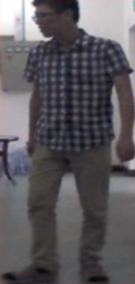
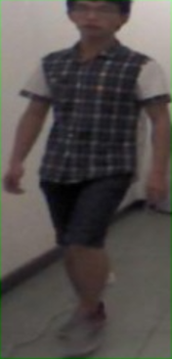
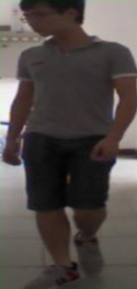
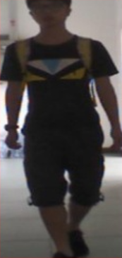
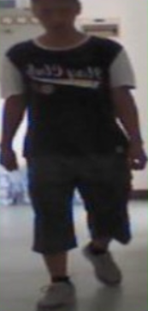
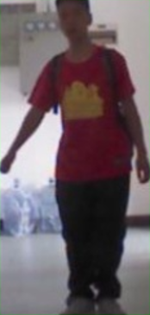
Clothes A
Clothes B
Clothes
Texture
Clothes C
Cloth-related
Feature Distribution
Cloth-unrelated
Feature Distribution
ID2
ID1
ID1
Clothes
Color
ID4
ID3
ID3
(a)
(b)

Slide 8
person A
person A
dissimilar
appearance
similar
clothes texture
cloth-aware
clothes 1
clothes 1
ID1
ID1
ID2
clothes 2
clothes 3
clothes 2
clothes 3
dissimilar
appearance
similar
clothes color
other losses
training
cross-clothing
discrepancy
our method
training
cloth-irrelevant
clothes 1
clothes 2
ID3
ID3
ID4
clothes 3
(a)
(b)

Slide 9
dissimilar
appearance
similar
clothes texture
Person A
Person A
Clothes 1
Clothes 1
Cloth-aware
ID1
ID1
ID2
Clothes 3
Clothes 3
Clothes 2
Clothes 2
dissimilar
appearance
similar
clothes color
Other losses
training
cross-clothing
discrepancy
Our method
training
cloth-irrelevant
Clothes 1
Clothes 2
ID3
ID3
ID4
Clothes 3
(a)
(b)

