Slide 1




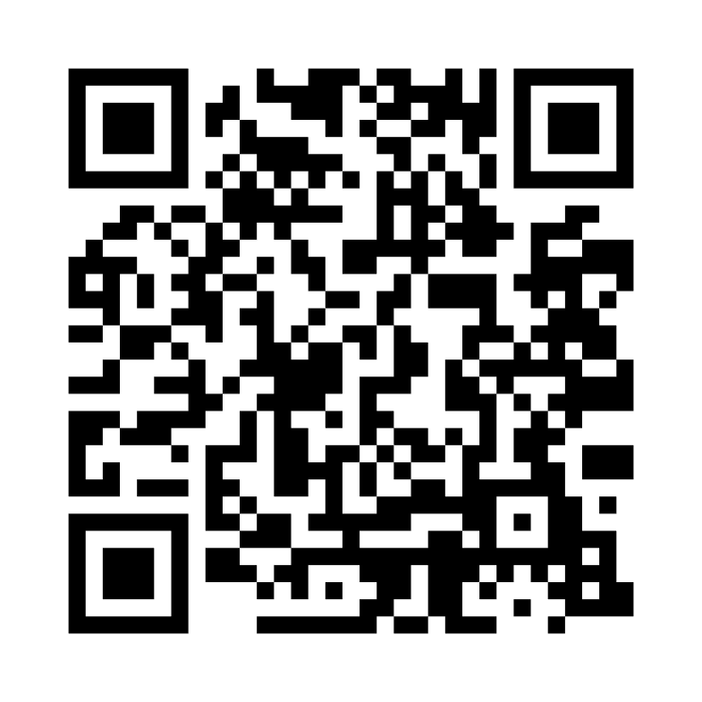
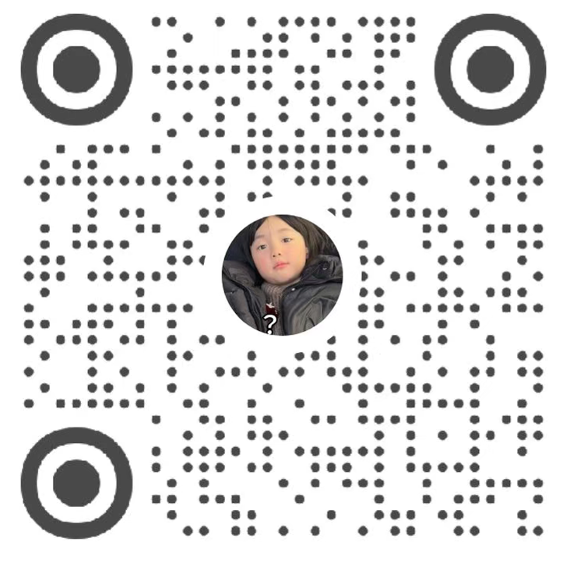
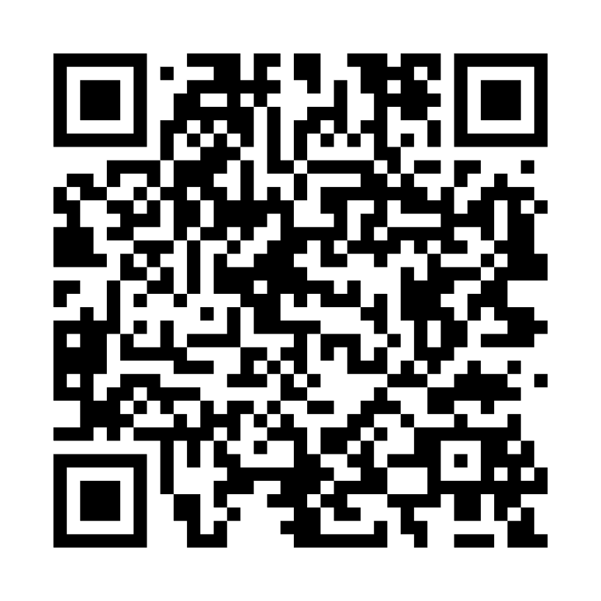
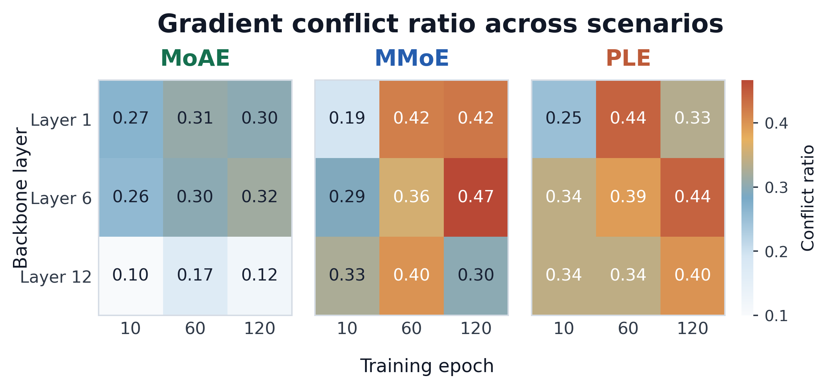
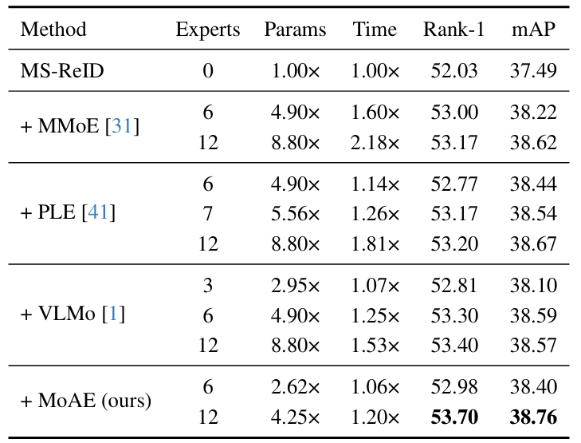

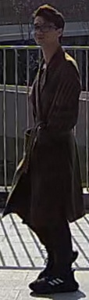

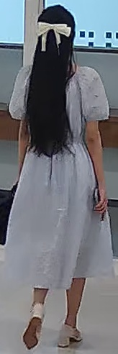
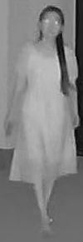
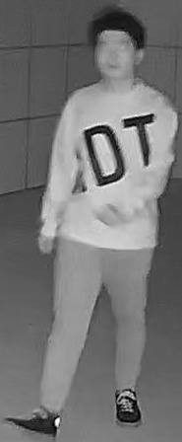
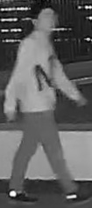


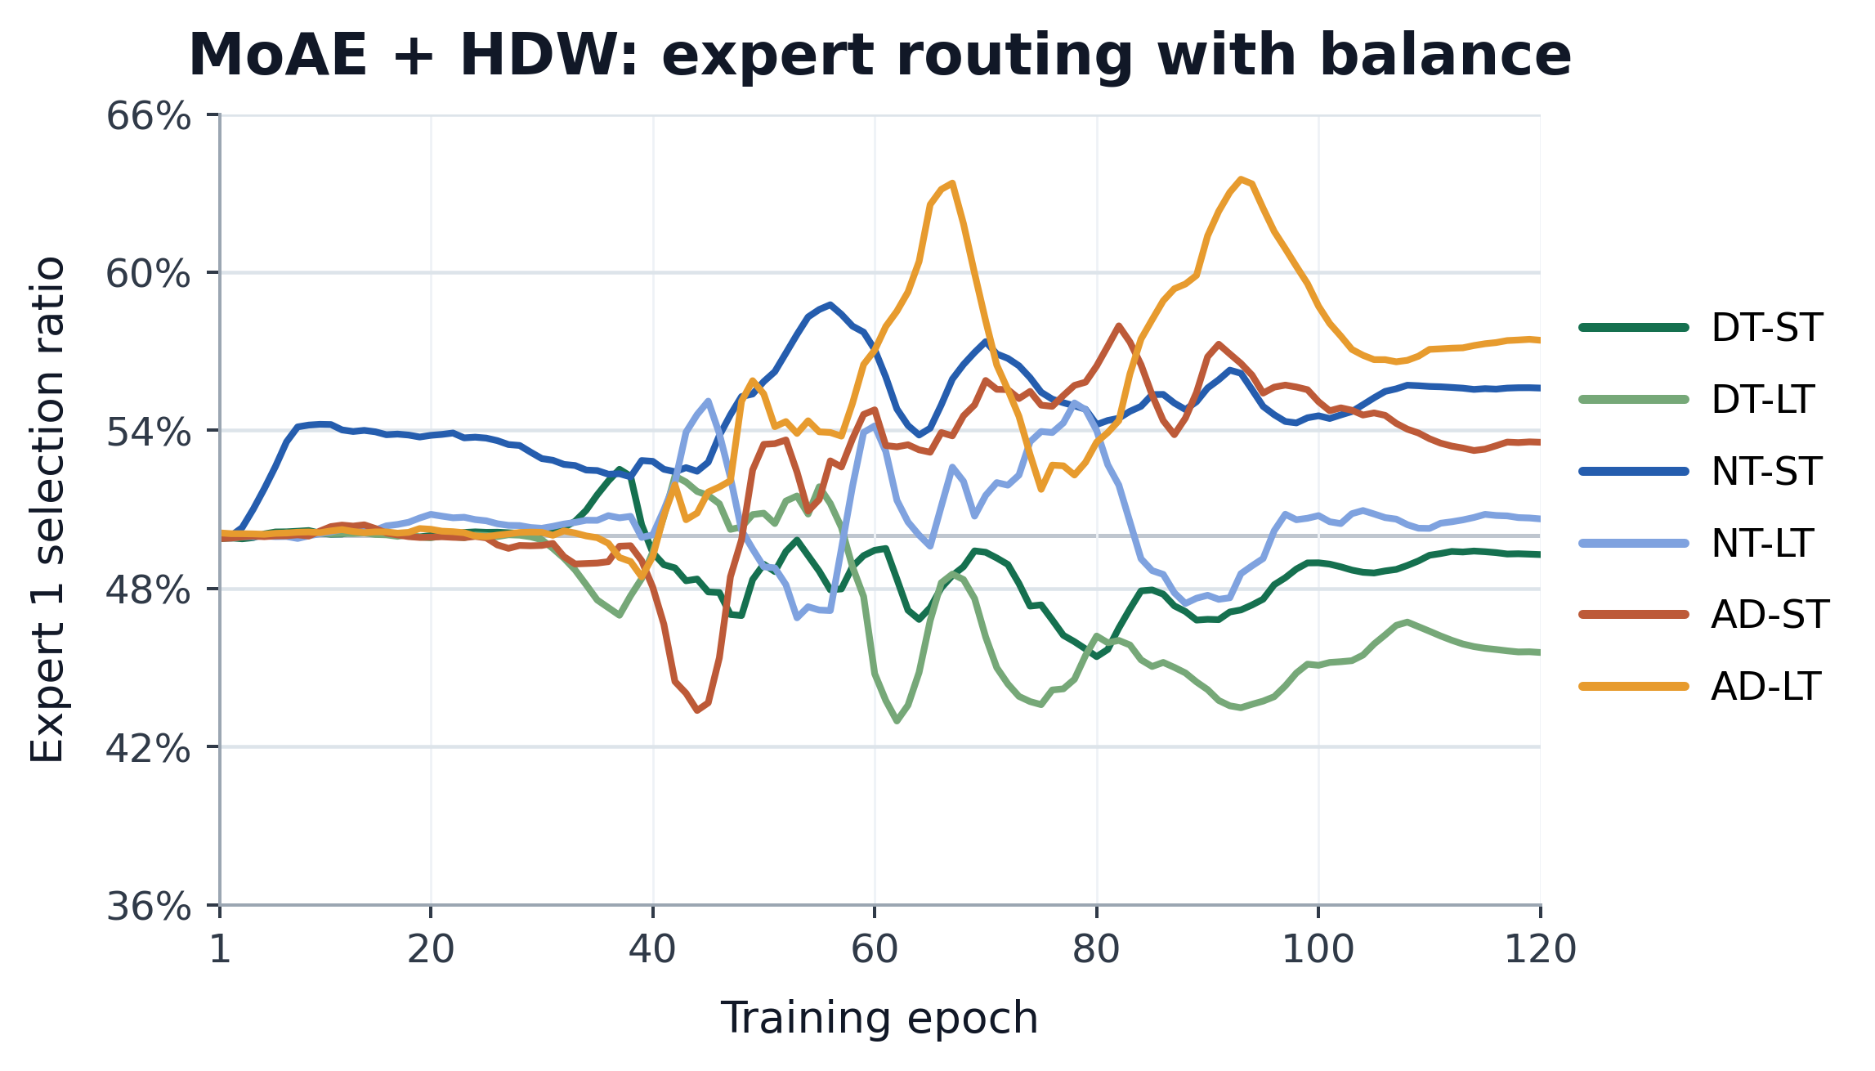
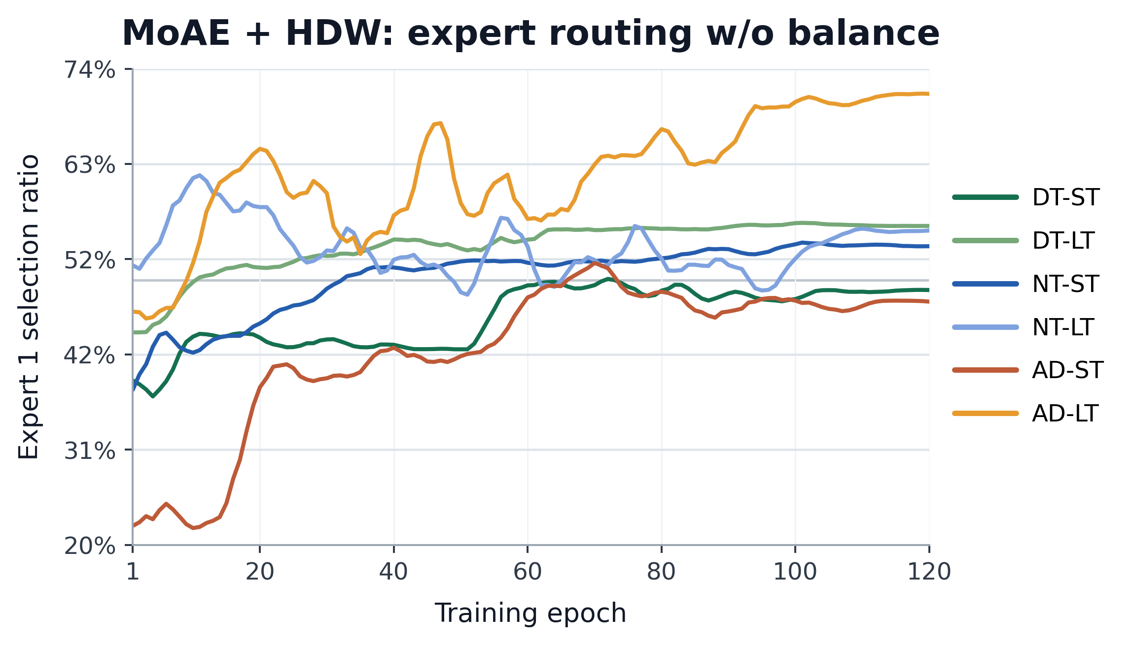




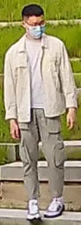
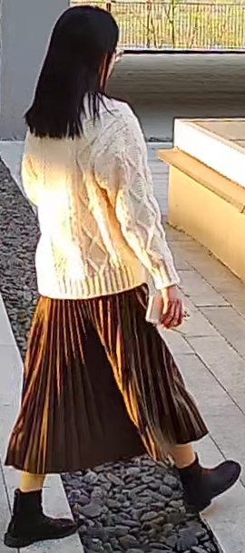
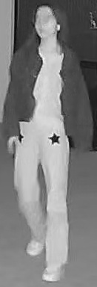
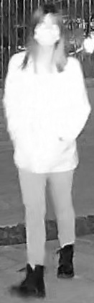
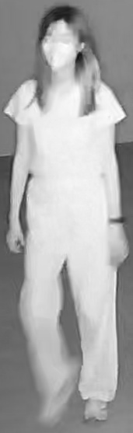



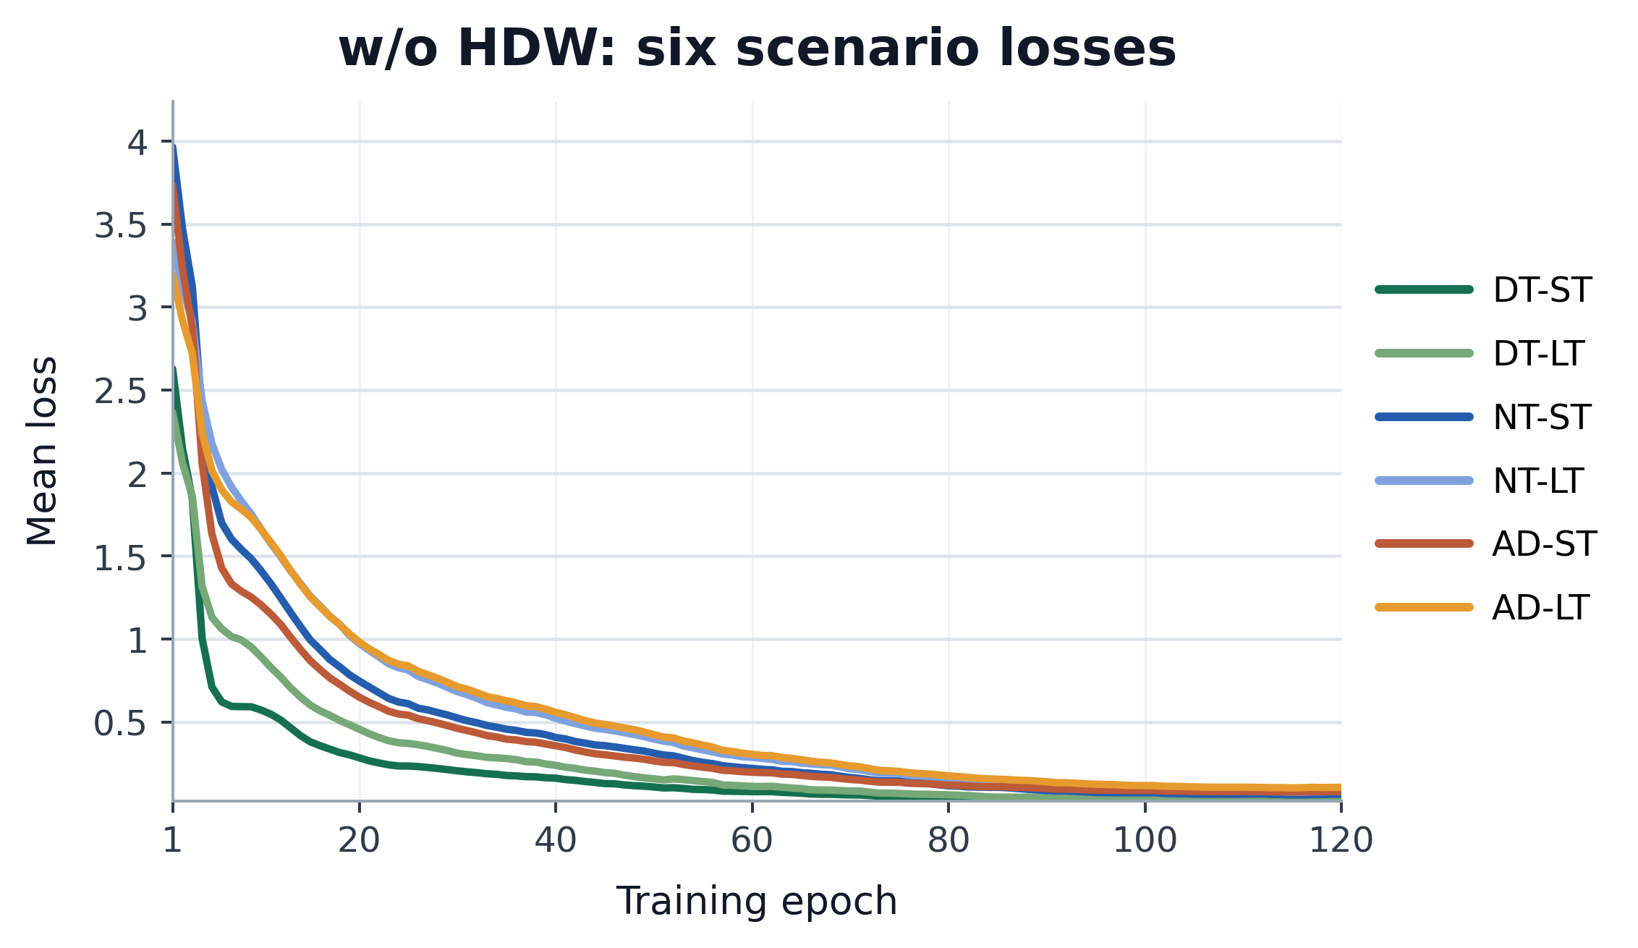
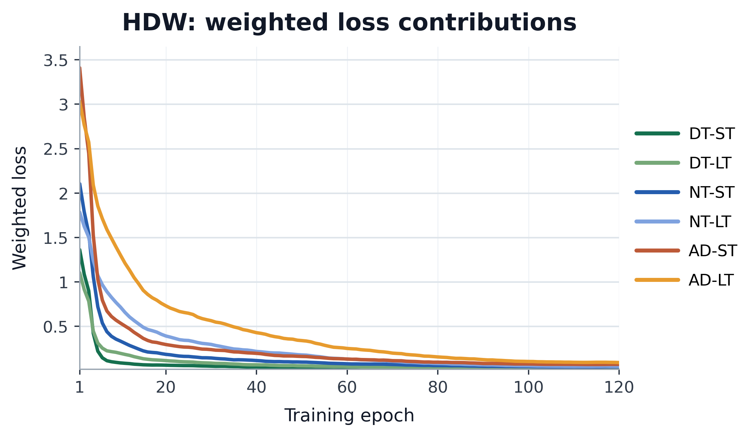


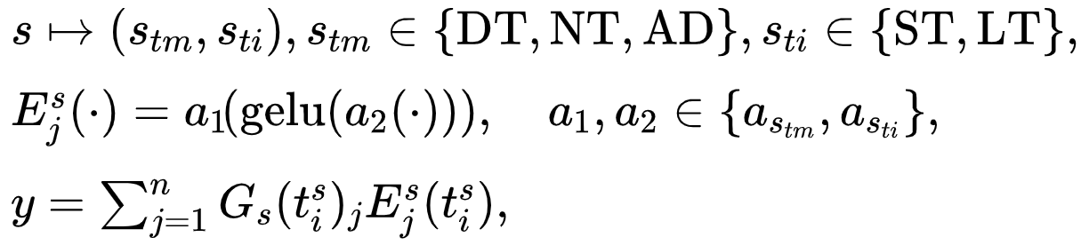

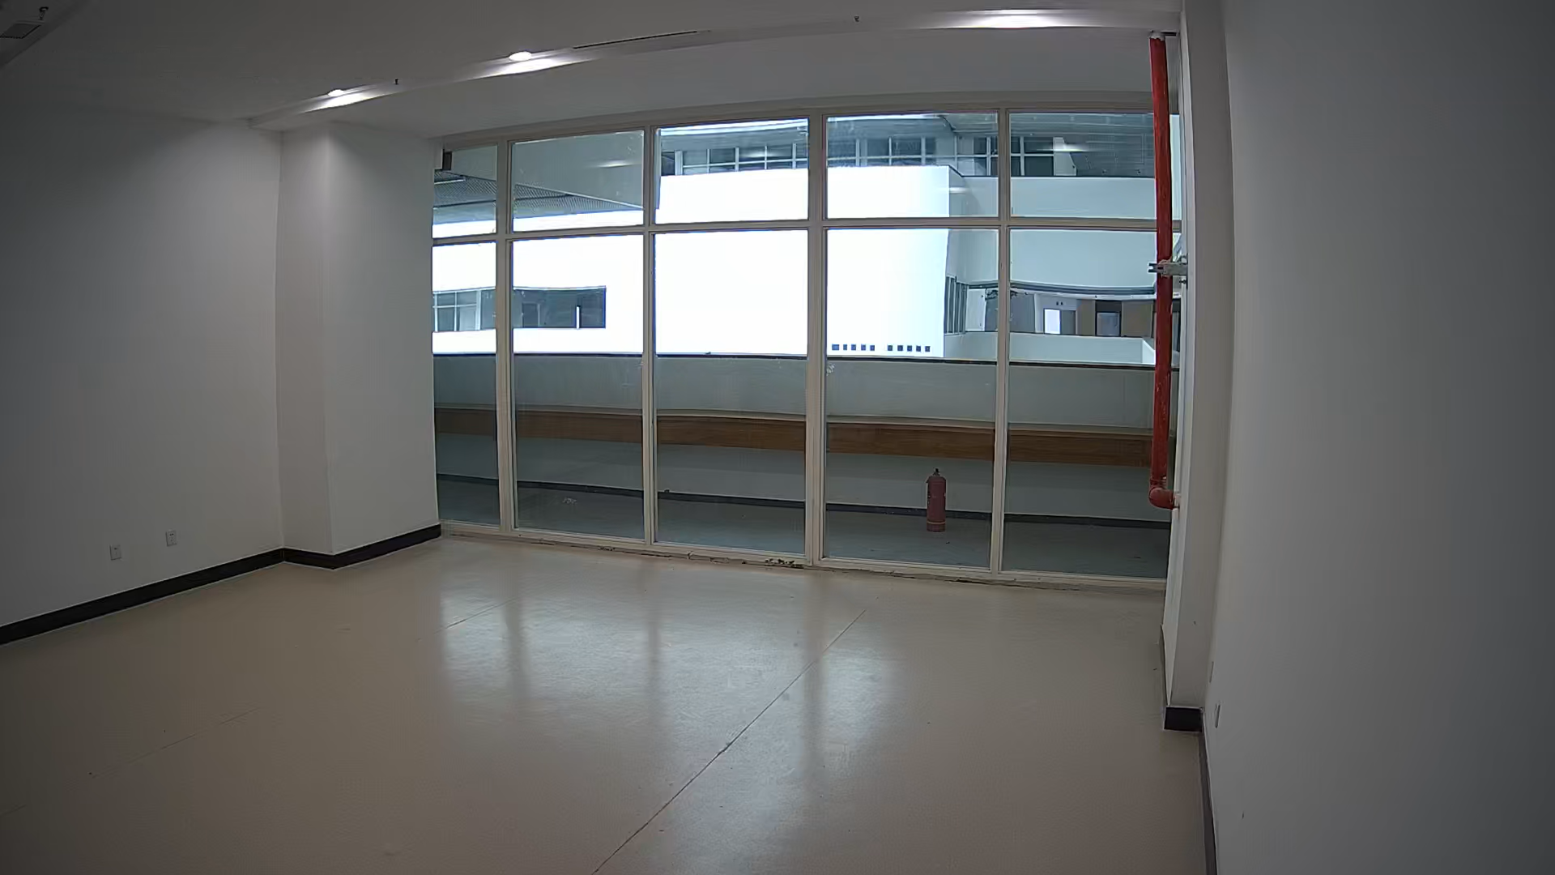
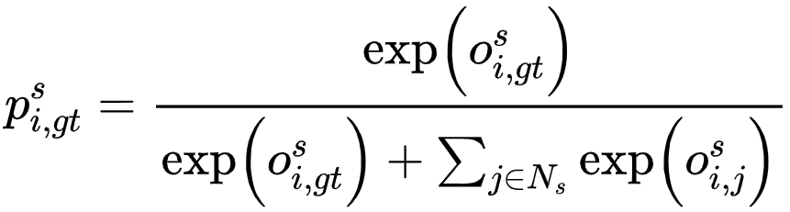
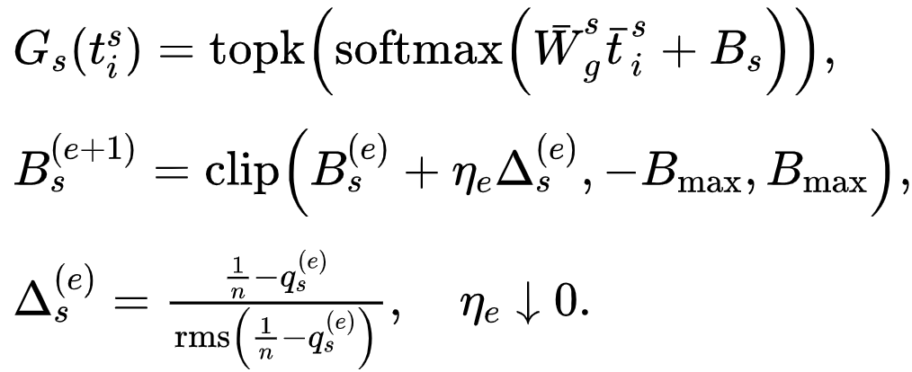
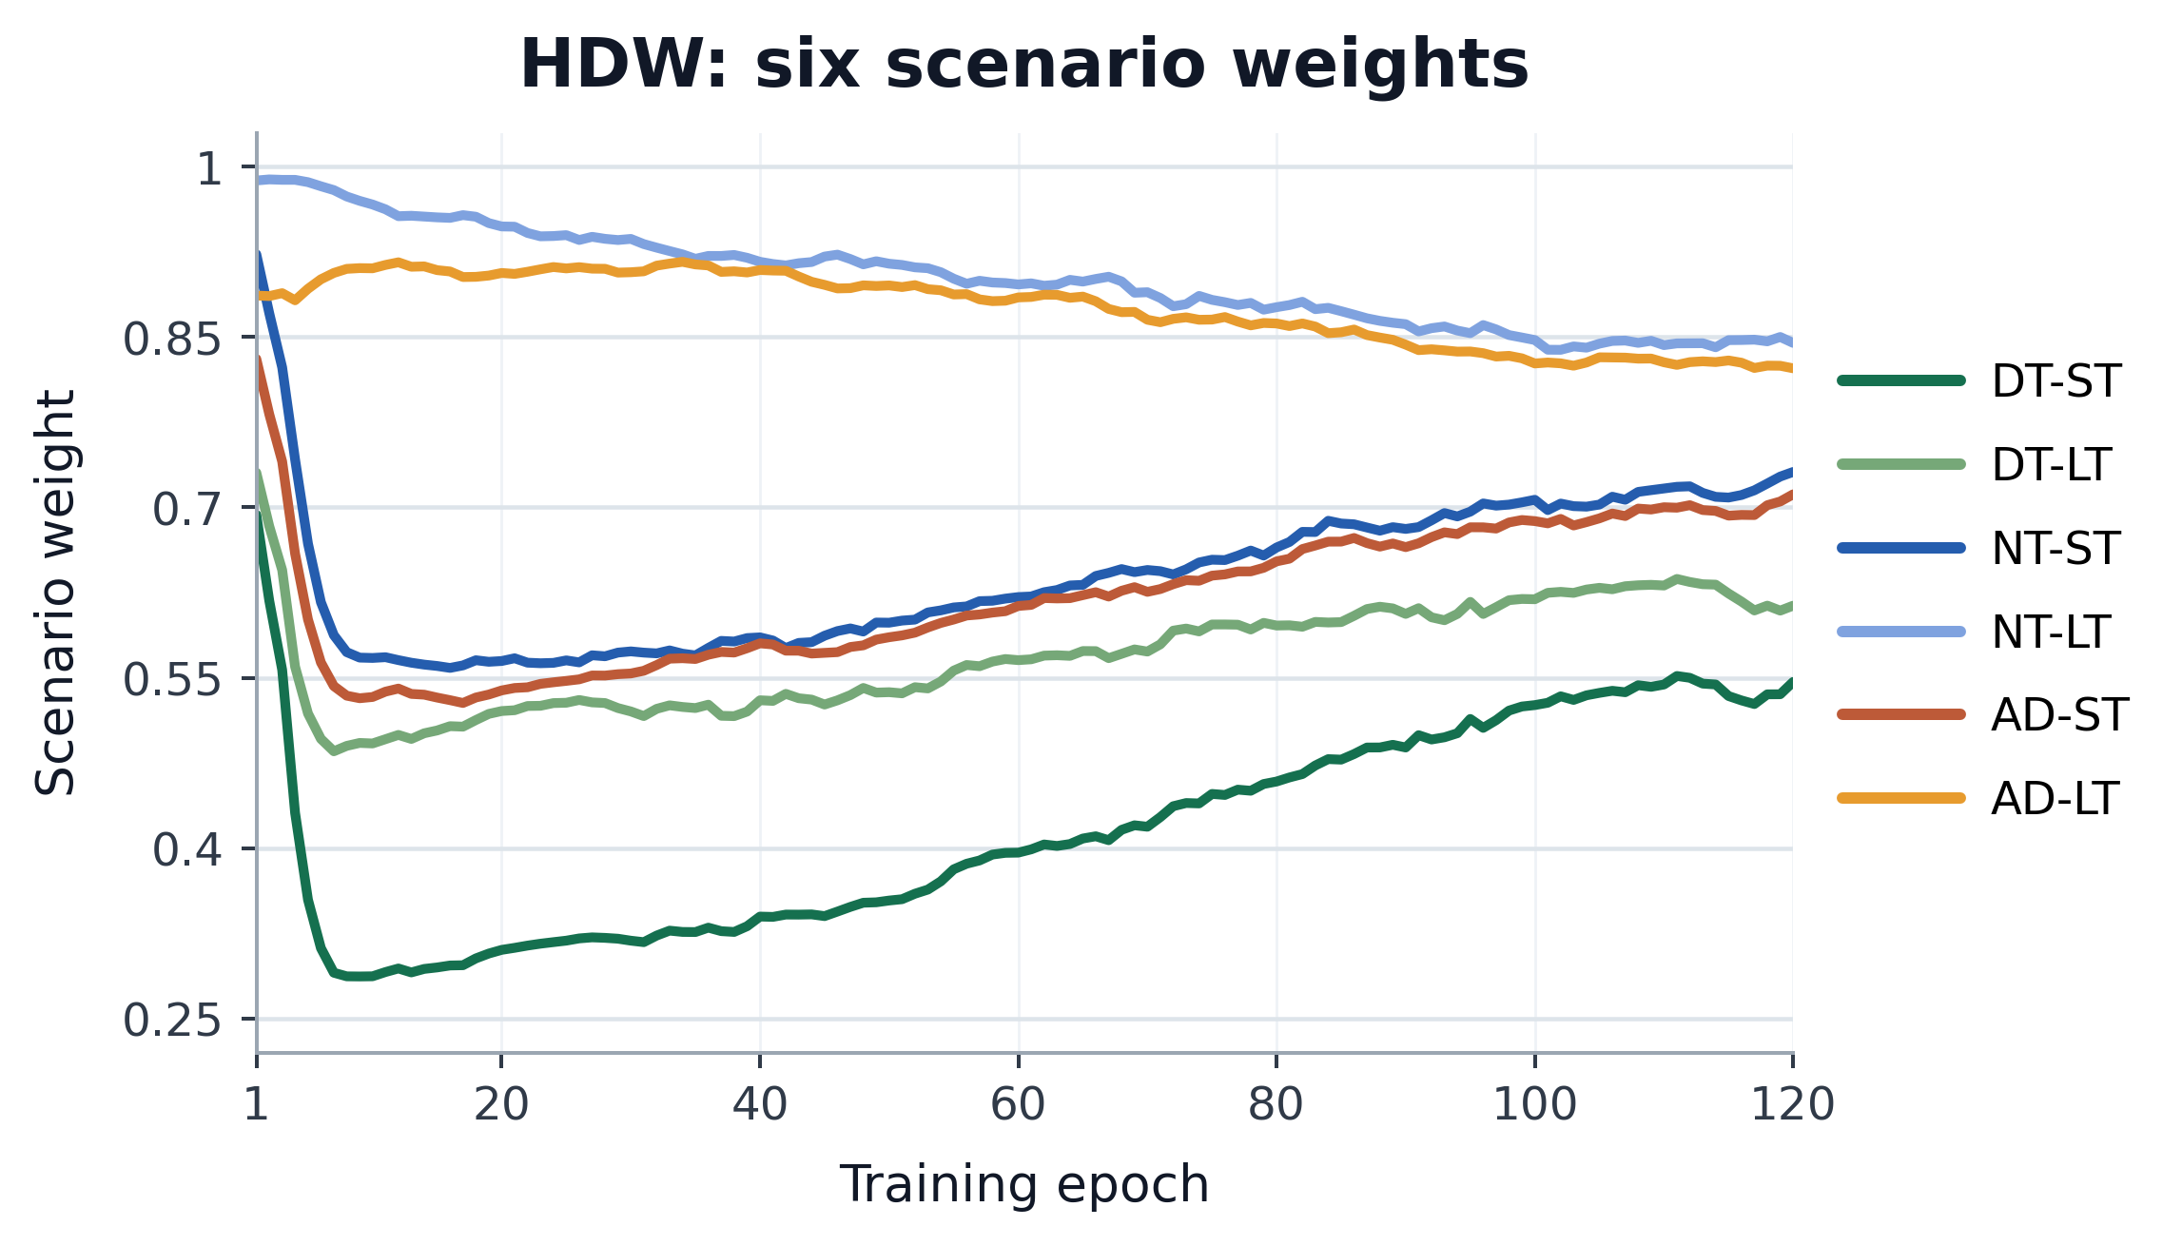
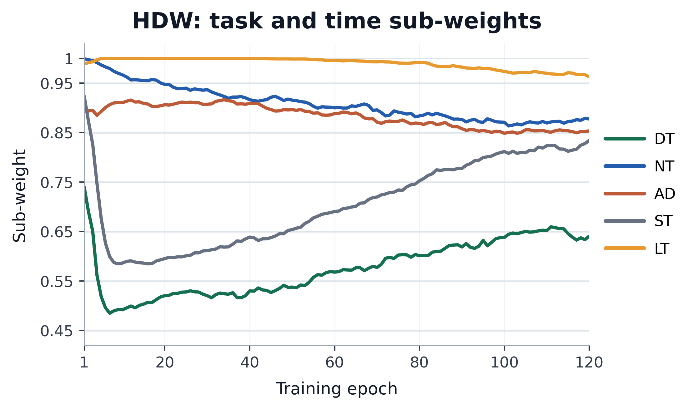
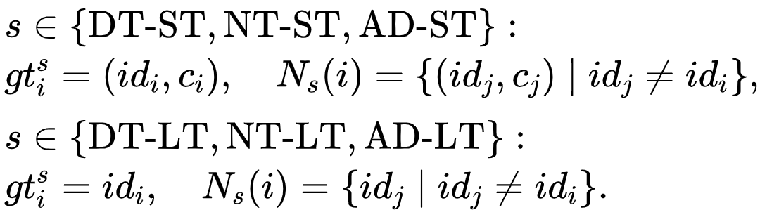

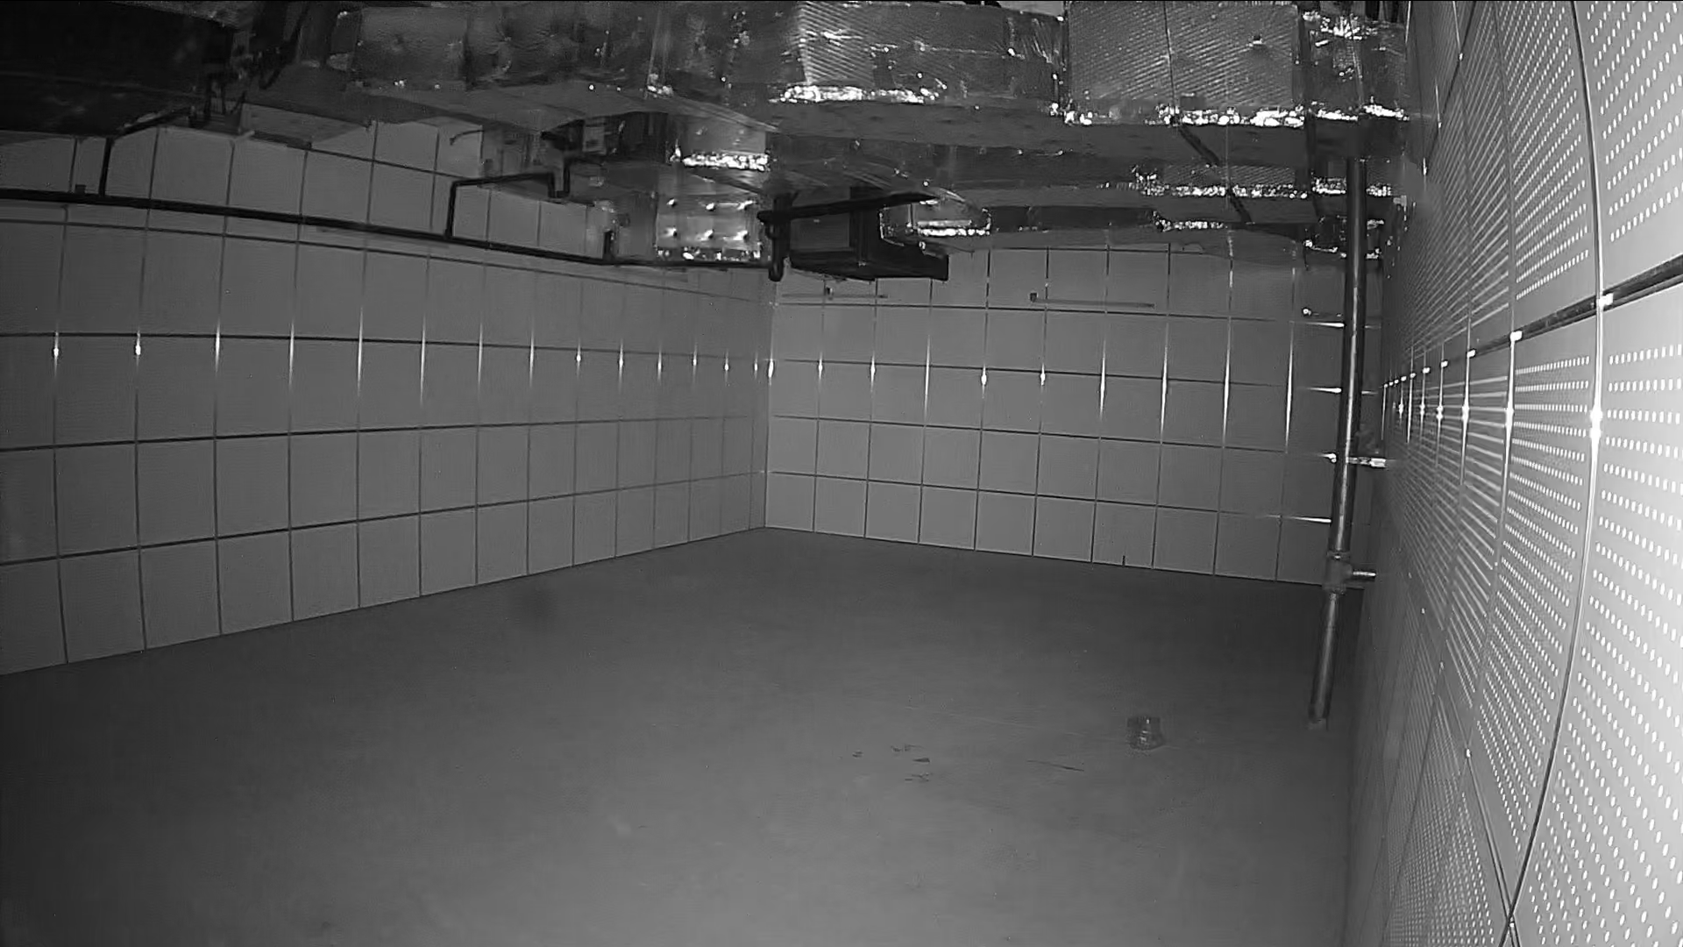
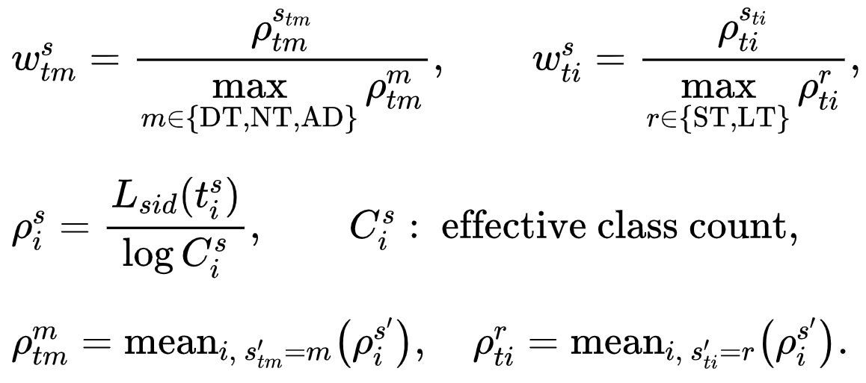
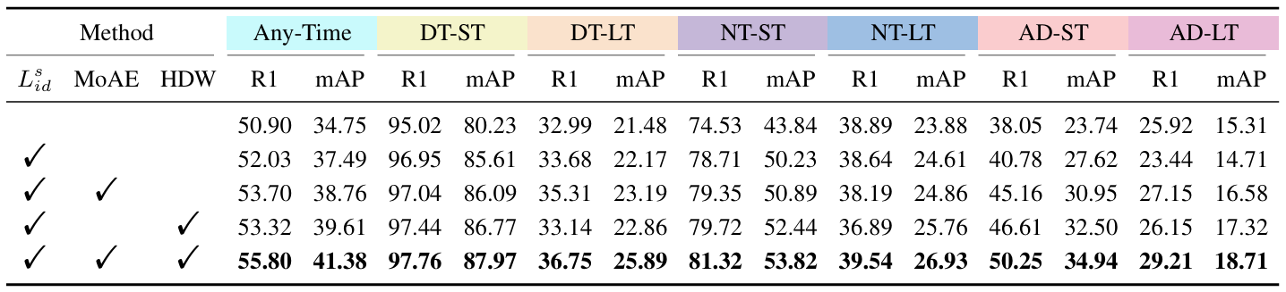
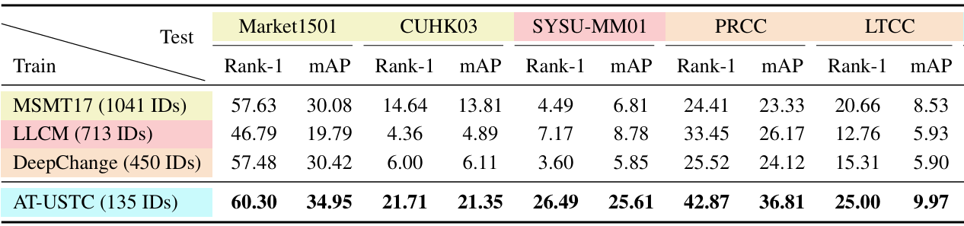
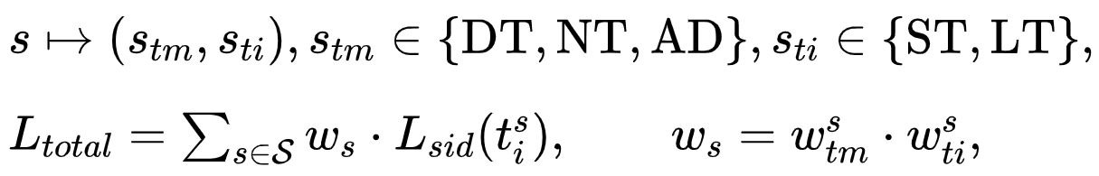
Towards Anytime Retrieval: A Benchmark for Anytime Person Re-Identification
项目地址
小红书
小
游
戏
ReID
MoE
MTL
Xulin Li Yan Lu Bin Liu Jiaze Li Qinhong Yang Tao Gong Qi Chu Mang Ye Nenghai Yu
邮箱： lxlkw@mail.ustc.edu.cn 主页：kw66.github.io
Anytime Person Retrieval
Multi-Task Method: Uni-AT
Experiment
Anytime
In real applications, person re-identification (ReID) expects to retrieve the target person at any time, including both daytime and nighttime, ranging from short-term to long-term.
We investigate a new task called Anytime Person Re-identification (AT-ReID), which aims to achieve effective retrieval in 6 scenarios based on variations in time.
Scenario-Aware Identity Loss
Patch
Token
Scenario Head
*
*
*
Gating
Weighted
sum
Task2
Task3
…
*
Scenario
CLS Token
Position
Embedding
*
Expert
*
Transformer Layer
FFN
MoAE
*
Select
…
*
Confidence
(Time Interval)
…
Norm
*
*
Daytime
All-day
Nighttime
RGB camera
RGB IR
IR camera
Transformer Layer
[ DT ]
*
Scenario : DT-ST
Scenario : AD-ST
Scenario : NT-ST
DT-ST
Short-
term
Confidence
(Time Moment)
0
*
1
*
…
5
*
6
7
8
…
13
Self-Attention
[ NT ]
…
…
Task1
Linear Projection
[ AD ]
*
NT-ST
Same clothes
Loss weight
Norm
[ ST ]
…
…
Scenario : DT-LT
Scenario : AD-LT
Scenario : NT-LT
…
*
*
*
[ LT ]
*
Long-
term
Hierarchical Dynamic Weighting (HDW)
AT-USTC
Dataset
Multi-Scenario ReID (MS-ReID)
Mixture-of-Attribute-
Experts (MoAE)
Attribute
layers
Experts
(FFN)
AD-LT
Clothes
changes
Challenge
Multi-Scenario ReID Framework
Extract different features for different scenarios separately to capture specific clues in each scenario.
Mixture-of-Attribute-Experts
MoE to alleviate interference between scenarios. We define the attribute layer as the basic cell shared among experts with similar scenario attributes. With this, the model can benefit from multiple inter-related scenarios.
Cross Modality
Clothes Changes
Multiple Scenarios
AT-USTC Benchmark
6 CLS Tokens
Shared Patch Tokens
Different scenarios have non-shared classifiers, distinct negative category sets, and different modality filtering mechanisms.
Shared Attribute Layers
270 IDs
710 Clothes
403K Images
7.9K×50s Videos
ID-clothing category
21 Months
29.1 Videos Per ID
Expert-Balance Routing
8 RGB Cameras
8 IR Cameras
5 Indoor
11 Outdoor
Hierarchical Dynamic Weighting
Balances the training for different tasks with a loss weighting scheme, which considers multiple relevant tasks when computing weights.
Hierarchical Weighting

