Slide 1
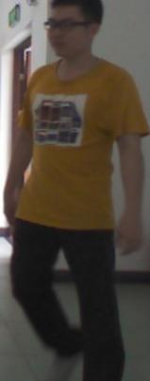
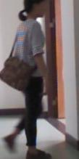
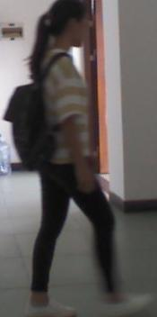
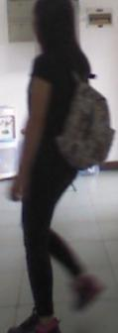
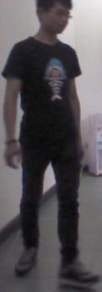
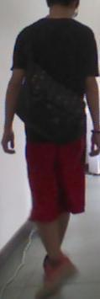
fx
Two-stream ConvBlock3
Two-stream ConvBlock5
SDM
Two-stream ConvBlock4
Share ConvBlock1
SDM
GAP
Share ConvBlock2
fc
先画主网络并预留几个模块位置

Slide 2
Feature Extraction
P(C)
SUM
Softmax
fc
…
FC
P(Y|do(X))
…
Confounder Dictionary
fx
C
…
FC
…
NWGM
Softmax
FC
Softmax
P(Y|X,C)
FC
P(Y|X)
改成更图形化而不是模块化的画法

Slide 3


Feature Extraction
P(C)
sum
Softmax
fc
fc
…
P(Y|do(X))
Confounder Dictionary
$${MLP}_{cls}$$
…
fx
fx
C
…
…
NWGM
$${MLP}_{feat}$$
fc
CLS
$$L_{POL}$$
fx
Uniform Manifold Embedding
$$L_{FOL}$$
二者结合，图形化+模块化

Slide 4









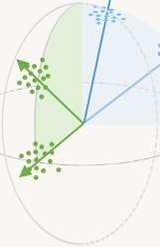
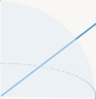



















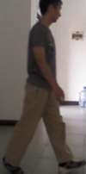
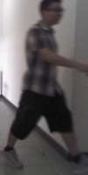
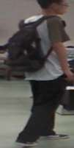
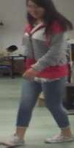
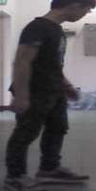
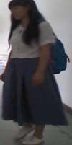
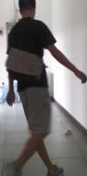
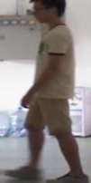
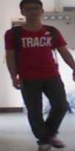
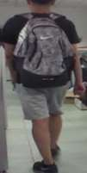
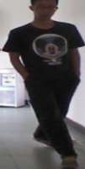
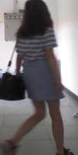
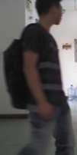
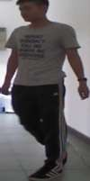
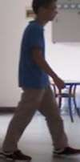
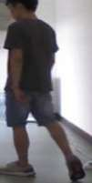
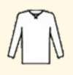

CIDNet
×2 layers
𝑓
category concatenate
img
^{ℒ}po
𝑥
i
^{𝑓}clt
^{ℒ}fo
C³I
^{𝑓}img
^{ℒ}int
CIDNet
training set
𝑷(𝑪)
…
𝑥_{i}
^{𝑓}clt
𝑃(𝑌|𝑑𝑜 𝑋 = 𝑥_{i} )
𝑓_{xi}
memory bank
…
…
Σ
𝒄_{j} clothing
𝑓_{cj}
MLP_{feat}(𝑓_{xi} , 𝑓_{cj} )
MLP_{cls}
推倒重来

Slide 5
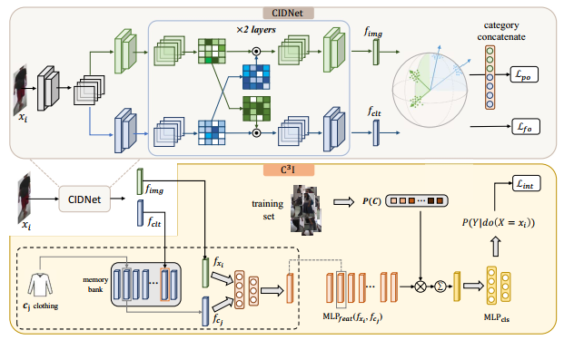










Clothes Classifier
$$f_{clt}$$
Loss
Loss
Loss
$$x_{i}$$
ID Classifier-Likelihood
$$P(Y|X=x_{i})$$
$$f_{img}$$
CIDNet
ID Classifier-Causal
$$P(Y|X=x_{i})$$
$$f_{img}$$
$$P(C|X)$$
$$x_{i}$$
…
$$f_{clt}$$
…
…
Memory Bank
Training Set
$$P(C)$$
ID Classifier-Causal
Σ
$$P(Y|do\left(X=x_{i}\right))$$
配上底框

Slide 6












$$P(Y|X=x_{i})$$
$$L_{a}$$
$$P(Y|X=x_{i})$$
$$f_{img}$$
$$f_{img}$$
ID Classifier-Likelihood
ID Classifier-Causal
Σ
C
$$P(C|X)$$
$$L_{fo}$$
$$L_{po}$$
$$L_{c}$$
…
…
…
$$x_{i}$$
Clothes Classifier
ID Classifier-Causal
$$P(C)$$
Training Set
Σ
Memory Bank
$$f_{clt}$$
$$P(Y|do\left(X=x_{i}\right))$$
CIDNet
$$C^{3}I$$
压缩一下不重要的部分
合成一个大框

Slide 7









Clothe&IDClassifier
Training Set
$$P(C)$$
$$f_{img}$$
$$L_{int}$$
$$P(Y|do\left(X\right))$$
Σ
$$P′ (Y|X)$$
$$L_{reg}$$
$$P(Y|X)$$
Causal Classifier
$$f_{img}$$
$$L_{fs}$$
$$L_{po}$$
Σ
$$x_{i}$$
$$P(C|X)$$
Memory Bank
…
$$f_{clt}$$
CIDNet
$$C^{3}I$$
一个大框的情况下
可以去背景框更清爽

Slide 8
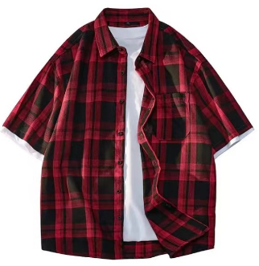
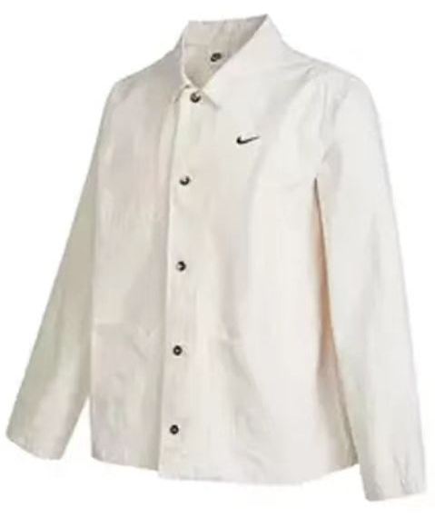
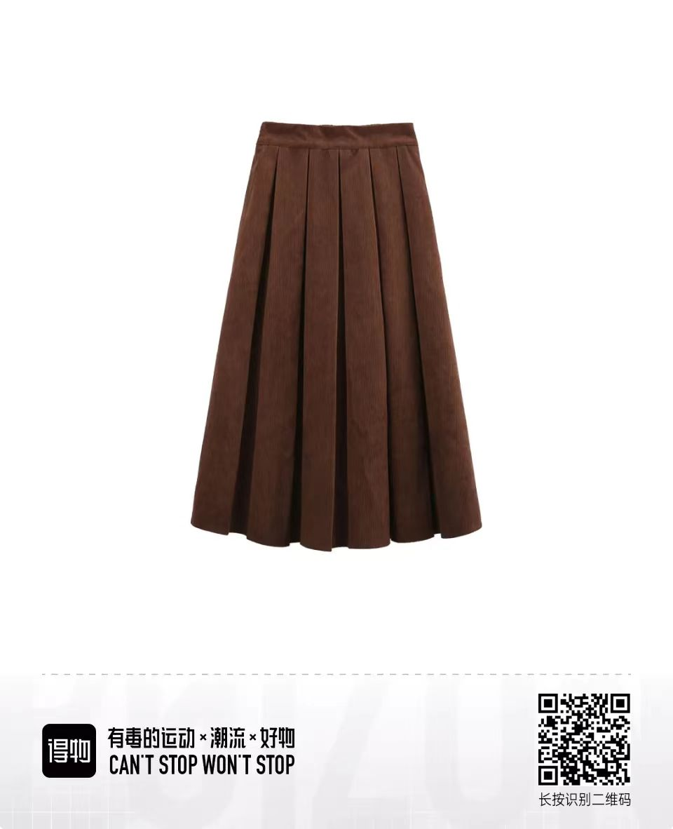
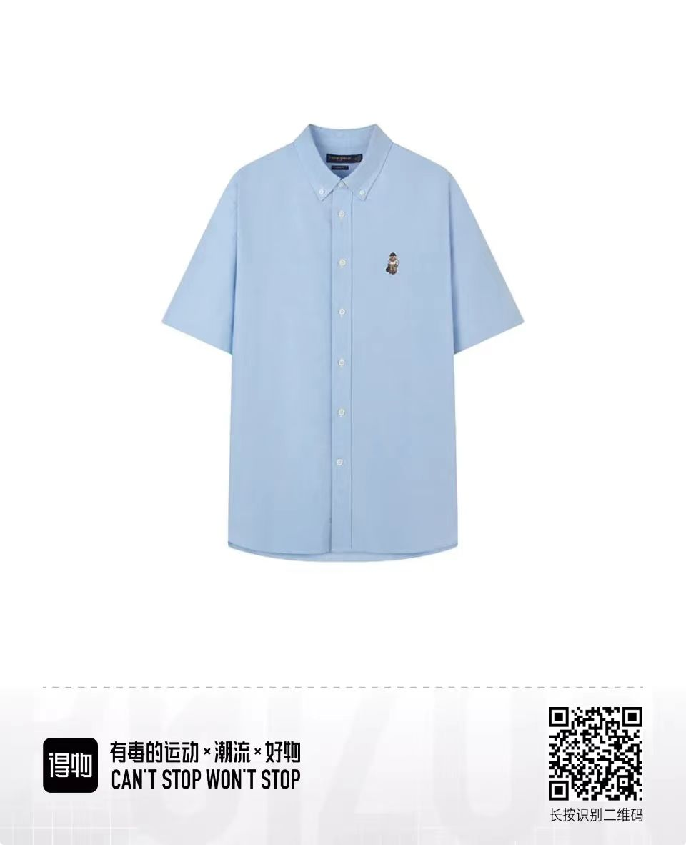






























(a) Framework of the CCIL
(b) Confounder Dictionary
Training
phase
$$F_{clt}$$
Confounder Dictionary
Inference
phase
$$c_{1}$$
$$c_{1}$$
$$c_{2}$$
$$c_{3}$$
…
$$c_{n}$$
$$f_{clt}$$
$$F_{clt}$$
Disentangle
Regularization
$$f_{img}$$
Two-stream Network
One-stream Network
…
$$f_{img}$$
$${Pool}^{c}$$
update
$$M_{clt}$$
$$x_{i}$$
Intervention Module
$$x_{i}$$
$$f_{clt}$$
$$F_{img}$$
$${Pool}^{s}$$
$${P(c}_{1})$$
$${P(c}_{2})$$
$${P(c}_{3})$$
$${P(c}_{n})$$
(c) Intervention Module
(d) Disentangle Regularization
element-wise product
element-wise add
ID-Clothe
Classifier
$$M_{c_{j}}$$
$$P(C)$$
Σ
weighted sum
Confounder Dictionary
$$f_{clt}$$
$$L_{po}$$
Σ
$$P(Y|do\left(X\right))$$
$$F_{img}$$
$$L_{fo}$$
Causal
Classifier
$$f_{img}$$
$$L_{kl}$$
$$f_{c_{j}}$$
之前有点乱，按照整体+3个模块改为4框

Slide 9

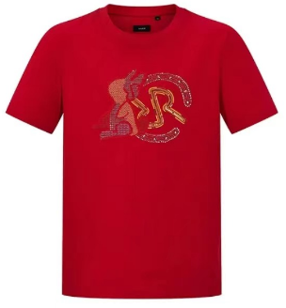























(a) Framework of the CCIL
(b) Confounder Dictionary
Confounder
Dictionary
Disentangle
Regularization
$$F_{clt}$$
$$F_{clt}$$
$$c_{1}$$
$$c_{2}$$
$$c_{3}$$
…
$$c_{n}$$
$$f_{clt}$$
$${P(c}_{1})$$
$${P(c}_{2})$$
$${P(c}_{3})$$
…
$${P(c}_{n})$$
Two-stream Network
Intervention
Module
$$x_{i}$$
$$L_{int}$$
$$L_{fo}$$
$$M_{clt}$$
…
$$F_{img}$$
ID
$$L_{po}$$
$$L_{kl}$$
update
$$f_{img}$$
Retrieval
$$f_{clt}$$
(c) Intervention Module
(d) Disentangle Regularization
$$φ(⋅)$$
$${P(c}_{1})\sim {P(c}_{n})$$
Causal
Classifier
$$L_{int}$$
$$M_{c_{1}}\sim M_{c_{n}}$$
ID-Clothe
Classifier
Σ
$$P(Y|do\left(X\right))$$
$$F_{img}$$
$$f_{clt}$$
$$ψ_{1}\left(⋅\right)$$
$$ψ_{2}\left(⋅\right)$$
element-wise product
$$L_{po}$$
element-wise add
$$L_{kl}$$
$$f_{img}$$
$$L_{fo}$$
$$f_{c_{1}}{\sim f}_{c_{n}}$$
Σ
weighted sum
4框布局不错，进一步调色

Slide 10
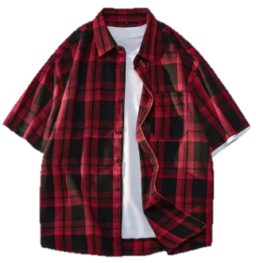
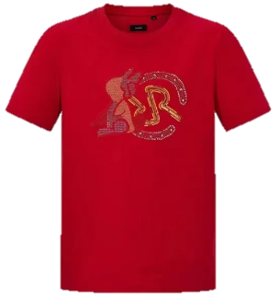
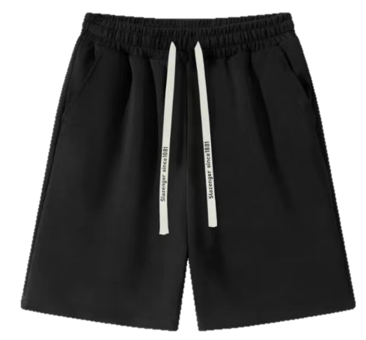

















(a) Framework of the CCIL
(b) Confounder Dictionary
Confounder
Dictionary
Disentangle
Regularization
$$c_{1}$$
$$c_{2}$$
$$c_{3}$$
…
$$c_{n}$$
$$F_{clt}$$
$${P(c}_{1})$$
$${P(c}_{2})$$
$${P(c}_{3})$$
…
$${P(c}_{n})$$
$$f_{clt}$$
Two-stream Network
Intervention
Module
$$c_{i}$$
…
$$x_{i}$$
$$L_{int}$$
$$M_{clt}$$
$$F_{img}$$
ID
update
…
$$L_{po}$$
$$L_{kl}$$
$$L_{fo}$$
$$F_{clt}$$
$$f_{img}$$
Inference
$$f_{clt}$$
(c) Intervention Module
(d) Disentangle Regularization
…
Feature center
$$φ(⋅)$$
$${P(c}_{1})\sim {P(c}_{n})$$
Causal
Classifier
$$L_{int}$$
Feature
$$M_{c_{1}}\sim M_{c_{n}}$$
…
ID-Clothe
Classifier
Σ
$$P(Y|do\left(X\right))$$
$$f_{clt}$$
$$F_{img}$$
element-wise product
$$L_{po}$$
$$L_{fo}$$
…
$$ψ_{1}\left(⋅\right)$$
$$ψ_{2}\left(⋅\right)$$
element-wise add
$$f_{c_{1}}{\sim f}_{c_{n}}$$
$$L_{kl}$$
$$f_{img}$$
Pull
close
Push
away
Σ
weighted sum
原来的色重了点，调轻快一点，并对齐框

Slide 11
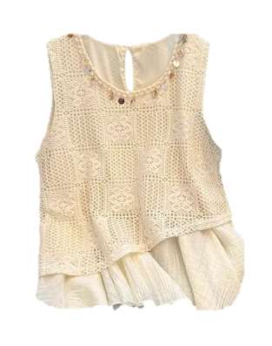
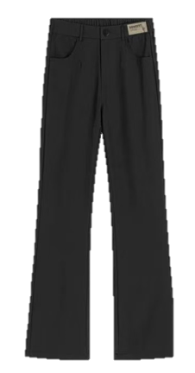
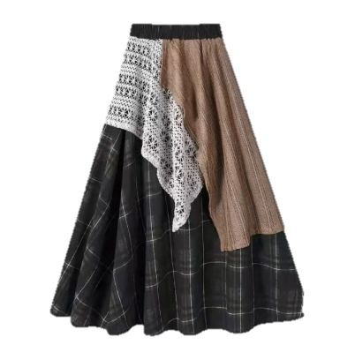






















(a) Framework of the CCIL
(b) Confounder Dictionary
Disentangle
Regularization
…
$$F_{clt}$$
$$L_{po}$$
$$L_{kl}$$
$$L_{fo}$$
$$M_{clt}$$
$$c_{1}$$
$$c_{2}$$
$$c_{n}$$
$$F_{clt}$$
$$f_{clt}$$
$${P(c}_{1})$$
$${P(c}_{2})$$
$${P(c}_{n})$$
Two-stream Network
$$f_{clt}$$
Confounder
Dictionary
…
$$c_{1}$$
$$c_{2}$$
$$c_{n}$$
$$μ_{clt}$$
$$1−M_{img}$$
Update
$$x_{i}$$
$$F_{img}$$
$$σ_{clt}^{2}$$
Intervention Module
$$M_{img}$$
…
$$f_{img}$$
$$L_{int}$$
Backdoor Adjustment
ID
Inference
$$F_{img}$$
$$f_{img}$$
(c) Intervention Module
(d) Disentangle Regularization
$$f_{c_{j1}}{\sim f}_{c_{jK}}$$
$$μ_{c_{j}}$$
$${P(c}_{j})$$
element-wise product
Feature center
Sampling
Softmax
element-wise add
Distance
Σ
weighted sum
Feature
$$N(μ_{c_{j}},σ_{c_{j}}^{2})$$
$${P(c}_{j1})\sim {P(c}_{jK})$$
ID-Clothe
Classifier
…
$${P(c}_{11})\sim {P(c}_{nK})$$
Causal
Classifier
$$L_{po}$$
$$f_{clt}$$
$$L_{int}$$
$$L_{fo}$$
$$f_{c_{11}}{\sim f}_{c_{nK}}$$
$$ψ_{1}\left(⋅\right)$$
$$ψ_{2}\left(⋅\right)$$
…
Σ
$$P(Y|do\left(X\right))$$
$$L_{kl}$$
$$f_{img}$$
$$f_{img}$$
Pull
close
Push
away
最后增加更多细节

Slide 12

先画两机器人
展示过去方法和我们的思路

Slide 13


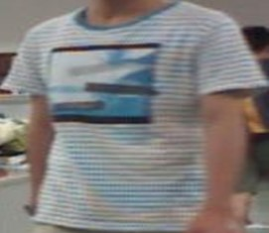
Likelihood-based method P(Y|X)
person A ✔
body shape / head
person A ✔
I know that clothing
Causality-based method P(Y|do(X))
person A ✔
body shape / head
X
person
I should not use this knowledge
Human or Neural network
算了，修改下机器人

Slide 14



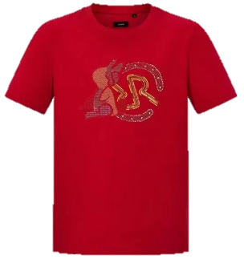
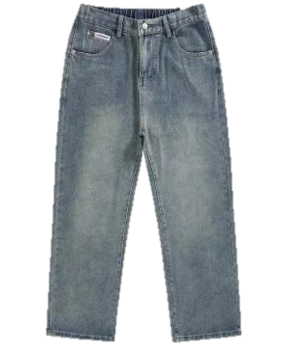
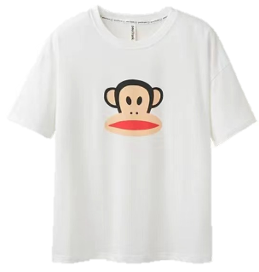
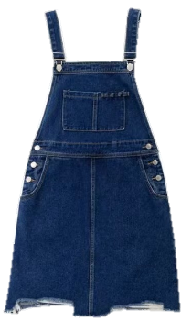
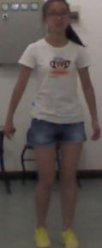
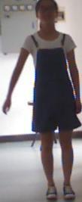
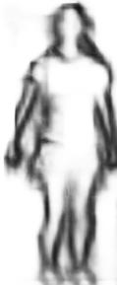
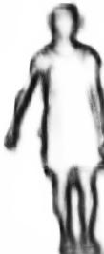
Spurious Correlation
Clothing Shortcut
Causal Relationship
ID 1
ID 2
ID 3
…
✔
×
×
ID 1
ID 1
✔
✔
✔
×
×
×
✔
×
P(Y|do(X))
×
✔
×
×
×
✔
…
…
deep models
(a) Training
？
×
Same ID
✔
(b) Testing with unseen IDs and clothing
之前的版本信息比较少
这个版本引入更多信息

Slide 15
Clothes Ownership
Clothing Shortcut
Feature Learning
ID 1
ID 2
ID 3
…
×
×
ID 1
✔
P(Y|do(X))
Clothes
Ownership
✔
×
×
×
✔
×
Causal Relationship
×
✔
×
×
×
✔
ID 1
…
…
(a) Training
Clothing Shortcut
Model Inference
Incorrect
Match
×
×
Clothes
Ownership
Clothes
Ownership
Causal Relationship
Correct
Match
(b) Testing with unseen IDs and clothing
进一步规整化排布，并加方框

Slide 16
Clothes Ownership
Clothing Shortcut
Feature Learning
ID 1
ID 2
ID 3
ID 1
✔
×
×
✔
P(Y|do(X))
Clothes
Ownership
✔
×
×
×
✔
×
Causal Relationship
×
✔
×
ID 1
×
×
✔
(a) Training
Clothing Shortcut
Model Inference
×
Incorrect
Match
×
Clothes
Ownership
Clothes
Ownership
Causal Relationship
Correct
Match
(b) Testing with unseen IDs and clothing
上色，并注意颜色对应

